Slide 1
Observing Critical Fluctuations in the Dynamics of
Heavy Ion Collisions
New proposal: HAD_03
Masakiyo Kitazawa
(Osaka U., Osaka / KEK)
with
Marlene Nahrgang
(SUBATECH, Nantes)
TYL/FJPPL, FKPPL workshop, Nara, May. 9, 2018

Slide 2



QCD Phase Diagram
T
Early Universe
Quark-Gluon Plasma
150MeV
ＱＣＤ Critical Point
Hadron Phase
(confined)
Color SC
Compact
Stars
~10¹⁵g/cm³
μ
Our Universe

Slide 3
Beam-Energy Scan Program in Heavy-Ion Collisions
T
high
Quark-Gluon Plasma
beam energy
150MeV
ＱＣＤ Critical Point
low
Hadron Phase
(confined)
Color SC
~10¹⁵g/cm³
μ
Our Universe

Slide 4
Beam-Energy Dependence

Slide 5
Beam-Energy Dependence
High energy
Low energy
Nuclear transparency
Baryon stopping
net-baryon #: small
net-baryon #: large

Slide 6
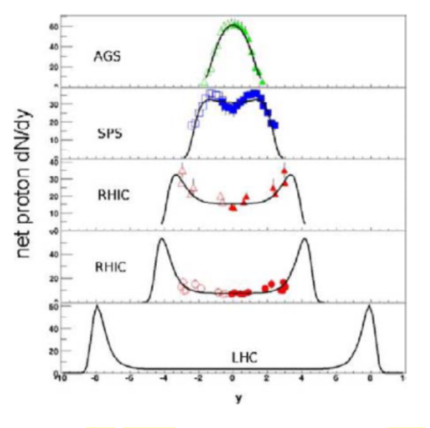





Baryon Stopping
rapidity dep. of net-proton #
stopping
Baryons stop at collision point
transparency
Baryons pass through
rapidity

Slide 7




AGS
-1996
SPS
1994-2000
RHIC
2000-
LHC
2010-
RHIC-BES
2010-
creation of quark-gluon plasma,
strongly-interacting QGP
BES-II
2019-
NICA
2020-?
~2010
History of HIC = increasing energy
FAIR
2023-?
2010~
Beam-energy scan
Low-energy exp.
Heavy-Ion Collisions
J-PARC-HI
2025~?
2-6.2 GeV

Slide 8
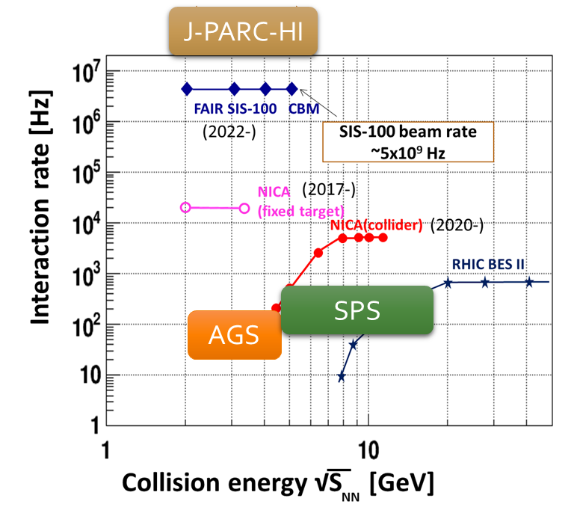
HI Acceleration @ J-PARC
J-PARC Heavy Ion
Spectrometer
New HI Injector
high intensity
RCS & Main Ring
stable
well established
Use of reliable / high-performance RCS & main ring
→Reduce cost and time

Slide 9
Searh for QCD Phase Structure with Fluctuation Observables
T
high
Quark-Gluon Plasma
beam energy
150MeV
ＱＣＤ Critical Point
low
Hadron Phase
(confined)
Color SC
~10¹⁵g/cm³
μ
Our Universe

Slide 10
Thermal Fluctuations
Observables are fluctuating even in an equilibrated medium.
P(N)
N
V
N
Phase transition → Large fluctuation
Non-Gaussian fluctuations: good observables of QCD-CP
Stephanov, PRL (2009); Asakawa, Ejiri, MK, PRL (2009)
Review: Asakawa, MK, PPNP90 (’16)

Slide 11


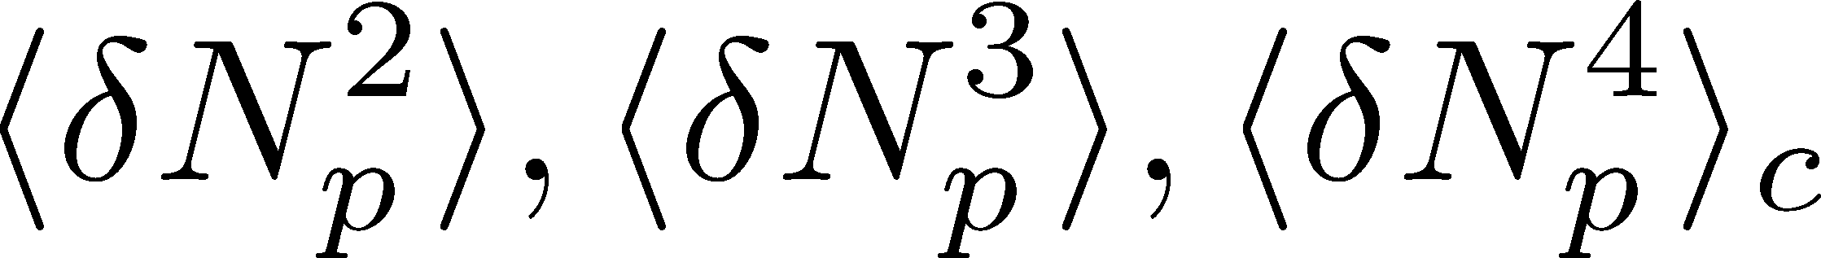
Event-by-Event Fluctuations
Review: Asakawa, MK, PPNP 90 (2016)
Fluctuations can be measured by e-by-e analysis in experiments.
STAR, PRL105 (2010)
Detector
Cumulants

Slide 12


Higher-Order Cumulants
STAR Collab.
2010~
Enhancement
Enhanement in non-Gaussian cumulants
has been observed!
Have we measured critical fluctuations?

Slide 13






Time Evolution of Fluctuations
Asakawa, Heinz, Muller (2000)
Jeon, Koch (2000)
Shuryak, Stephanov (2001)
Detector
t
Hadronic
Particle-number fluctuations
in a phase space continue to
change during the time
evolution.
QGP

Slide 14
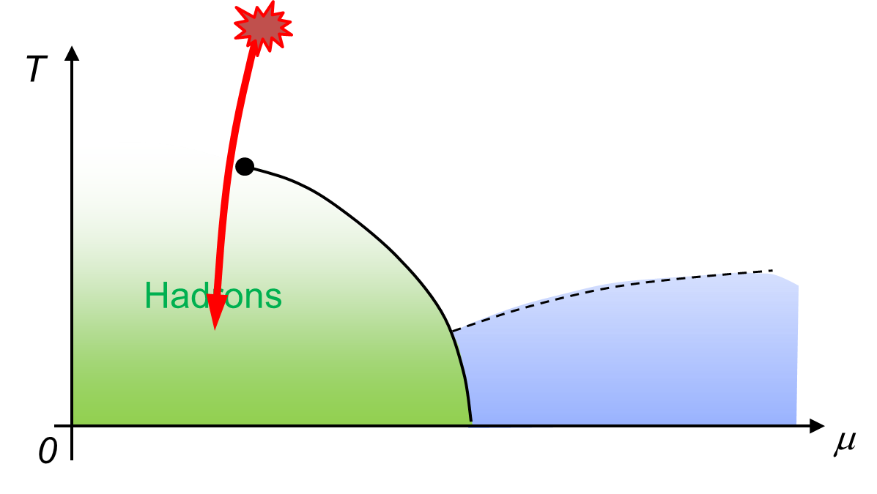
Effect of Dynamical Evolution
Growth
Growth of the critical fluctuation is limited by the critical slowing down.
Decay by diffusion
Fluctuations developed at CP are modified by the time evolution in later stage before observation.
So far, these problems have not been studied seriously…

Slide 15




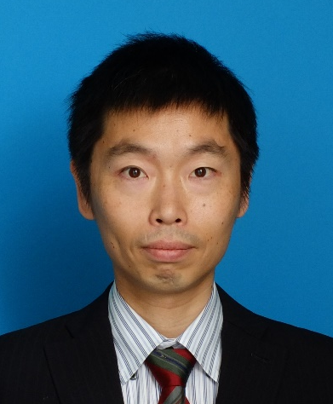
Two Groups Working Actively on Dynamics
Osaka
Nantes
Masakiyo Kitazawa
(Osaka University/KEK)
Marlene Nahrgang
(SUBATECH)
Diffusion in Brownian model
2014~
Thermal blurring effects
2016
Stochastic diffusion model
2017
Chiral fluid dynamics: model building
2011~
chiral fluid dynamics: applications
2014~
diffusion of non-Gaussianity
2018

Slide 16
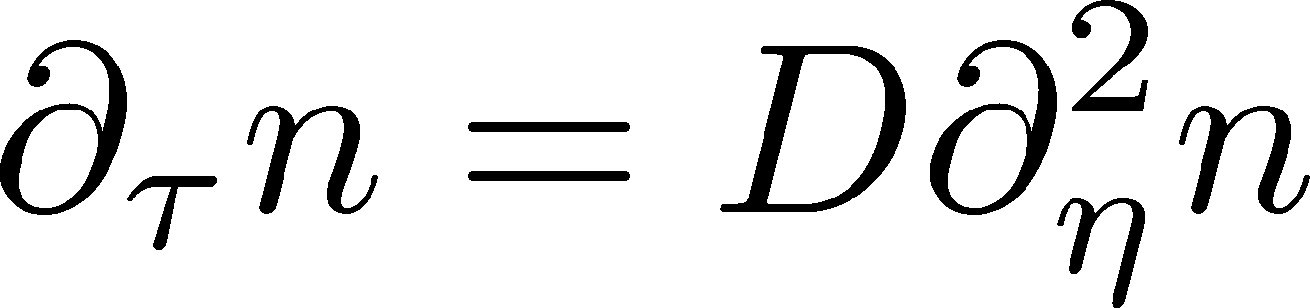

Stochastic Diffusion Equation
Sakaida, MK, et al.
PRD95, 064905 (2017)
Diffusion equation
Describe a relaxation of a conserved density n toward uniform state without fluctuation
Stochastic diffusion equation
Describe a relaxation toward fluctuating uniform state
Only Gaussian fluctuations
Review: Asakawa, MK, PPNP 90 (2016)

Slide 17
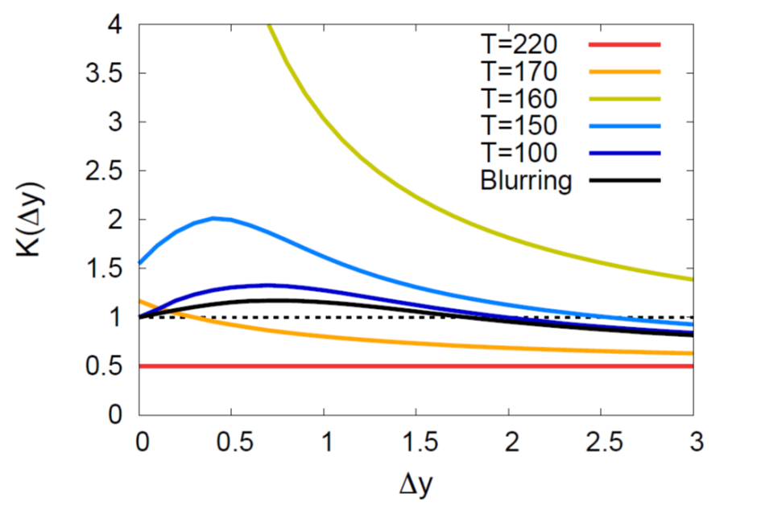

Evolution of Fluctuation
Sakaida, MK, et al.
PRD95, 064905 (2017)
Solve the time evolution analytically
for Gaussian fluctuations
Non-monotonic Δy dep.
as a signal of QCD-CP

Slide 18
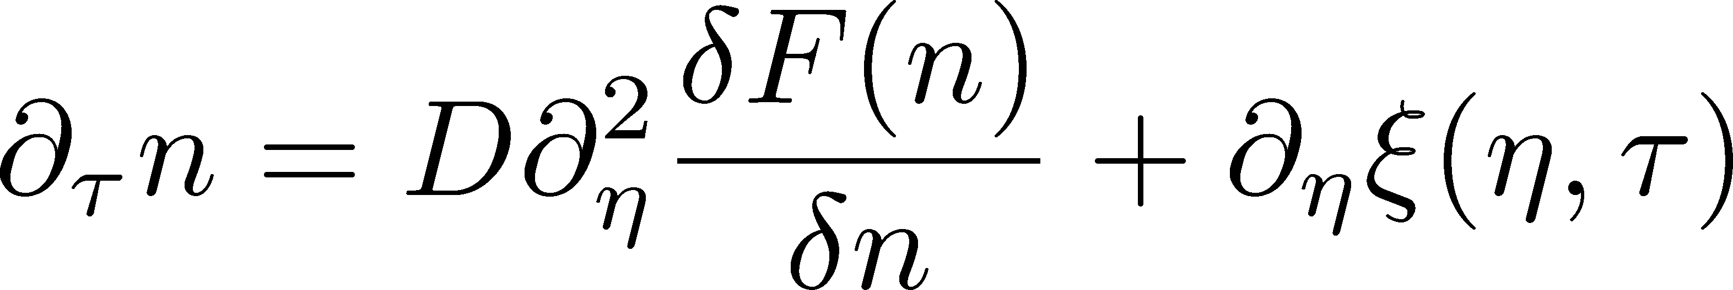
Extension to Non-Gaussianity
Nahrgang, Bluhm, et al.
arXiv:1804.05728
Include non-linear effects
Solve the time evolution stochastically including
non-Gaussian fluctuations

Slide 19
Many Things To Do
Gaussian
Analytic
Non-Gaussian
Stochasitc
Stochastic diffusion
model

Slide 20
Many Things To Do
Gaussian
Analytic
Non-Gaussian
Stochasitc
Stochastic diffusion
model
analytic result
for non-Gaussian
parameter
dependence
Comparison
Deeper understanding
on dynamics of fluctuations

Slide 21

Many Things To Do
Gaussian
Analytic
Non-Gaussian
Stochasitc
Stochastic diffusion
model
analytic result
for non-Gaussian
parameter
dependence
Comparison
Deeper understanding
on dynamics of fluctuations
Diffusion on
Brownian particle
model
Coupling to
chiral condensate
in chiral-fluid model

Slide 22

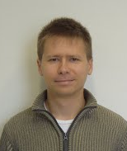
Many Things To Do
Gaussian
Analytic
Non-Gaussian
Stochasitc
Stochastic diffusion
model
analytic result
for non-Gaussian
parameter
dependence
Comparison
Deeper understanding
on dynamics of fluctuations
Diffusion on
Brownian particle
model
Coupling to
chiral condensate
in chiral-fluid model
Dynamical evolution in
realistic space-time evolution

Slide 23
Many Things To Do
Gaussian
Analytic
Non-Gaussian
Stochasitc
Stochastic diffusion
model
analytic result
for non-Gaussian
parameter
dependence
Comparison
Deeper understanding
on dynamics of fluctuations
Diffusion on
Brownian particle
model
Coupling to
chiral condensate
in chiral-fluid model
Dynamical evolution in
realistic space-time evolution
Realistic description of fluctuation dynamics
New methodology to search for phases of QCD

Slide 24

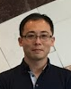
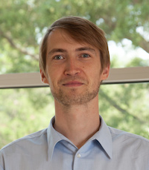
Summary
Beam-energy scan: world-wide exciting topics!
Fluctuations: important observables for the search for QCD phase structure
Proper description of dynamics of fluctuations is necessary, but has not been studied well.
Osaka-Nantes bilateral collaboration will play a crucial role in resolving these problems!!
Osaka Group
Nantes Group
Masakiyo
Kitazawa
Yukinao
Akamatsu
Marlene
Nahrgang
Iurii
Karpenko
Marcus
Bluhm
and young students…

