Slide 1
Stress Tensor Distribution around Flux Tube in SU(3) Yang-Mills Theory
XQCD2018, 23 May, 2018, Frankfurt, Germany
Masakiyo Kitazawa
for FlowQCD Collaboration
Yanagihara+ (FlowQCD Collab.)
arXiv:1803.01234

Slide 2


Force

Slide 3

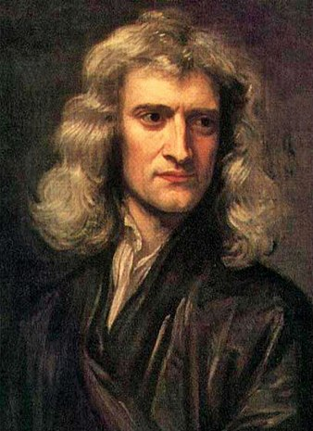

Force
Newton
Action-at-a-distance

Slide 4

Force
Faraday
Local interaction
“Action through medium”

Slide 5
Stress = Force per Unit Area

Slide 6


Stress = Force per Unit Area
Pressure
S

Slide 7
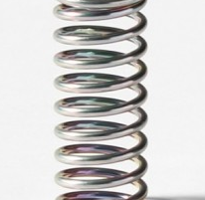



Stress = Force per Unit Area
Pressure
Generally, F and n are not parallel
v
fluid
S
F
S
elastic body
S
In thermal medium
Stress Tensor
Landau
Lifshitz

Slide 8




Maxwell Stress
(in Maxwell Theory)
E
pulling
Parallel to field: Pulling
Vertical to field: Pushing
pushing

Slide 9



Maxwell Stress
(in Maxwell Theory)
length:
pulling
pushing
Distortion of field, line of the force
Propagation of the force as local interaction
Absolute value of the force between sources

Slide 10
Maxwell Stress
(in Maxwell Theory)
length:
pulling
pushing
Distortion of field, line of the force
Propagation of the force as local interaction
Absolute value of the force between sources

Slide 11
Quark—Anti-quark system
Formation of the flux tube → confinement

Slide 12
Quark—Anti-quark system
Formation of the flux tube → confinement
Previous Studies on Flux Tube
Potential
Action density
Color-electric field
so many studies…
Cea+ (2012)
Cardoso+ (2013)

Slide 13
Spatial Distribution of Stress Tensor in the QQ System
Lattice simulation
SU(3) Yang-Mills
a=0.029 fm
R=0.69 fm
t/a²=2.0
length:
Clearly gauge invariant
Distortion of field, line of the force
Propagation of the force as local interaction
Absolute value of the force between sources

Slide 14
Comparison: SU(3) YM vs Maxwell
SU(3) Yang-Mills
(quantum)
Maxwell
(classical)
Propagation of the force is clearly different
in YM and Maxwell theories!

Slide 15
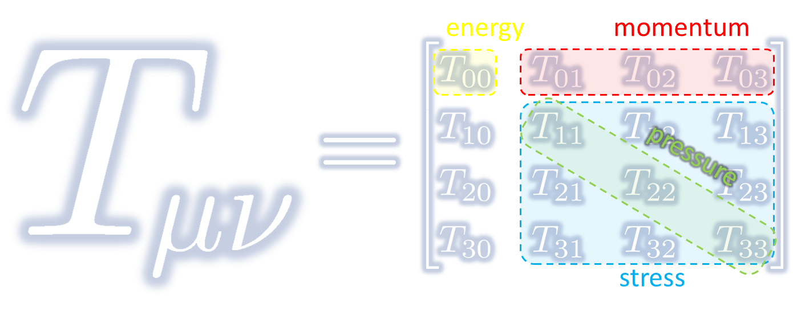
Energy-Momentum Tensor on the Lattice and Gradient Flow

Slide 16




: nontrivial observable
on the lattice
Definition of the operator is nontrivial
because of the explicit breaking of Lorentz symmetry
ex:
Its measurement is extremely noisy
due to high dimensionality and etc.

Slide 17




(Yang-Mills) Gradient Flow
Luscher 2010
Narayanan, Neuberger, 2006
Luscher, Weiss, 2011
t: “flow time”
dim:[length²]
leading
diffusion equation in 4-dim space
diffusion distance
“continuous” cooling/smearing

Slide 18




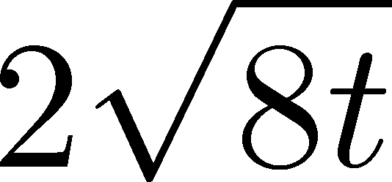
Small Flow-Time Expansion
Luescher, Weisz, 2011
Suzuki, 2013
an operator at t>0
remormalized operators
of original theory
original 4-dim theory
t→0 limit

Slide 19


Constructing EMT 1
gauge-invariant dimension 4 operators

Slide 20




Constructing EMT 2
Suzuki, 2013
Suzuki coeffs.
Remormalized EMT

Slide 21



Application to Thermodynamics
FlowQCD, PRD94, 114512 (2016)
Conventional
Integral Method
Our Approach
Gradient Flow Method
Thermodynamic relations
Take expectation values
Other progress: shifted boundary Giusti and Pepe (2014~)
Jarzynski’s equality Caselle+ (2018); Talk by Nada, Monday

Slide 22


Numerical Simulation
FlowQCD,
PRD94, 114512 (2016)
Expectation values of T_{μν}
SU(3) YM theory
Wilson gauge action
Parameters:
Scale from gradient flow
N_{t} = 12, 16, 20-24
aspect ratio 5.3<N_{s}/N_{t}<8
1500~2000 configurations
FlowQCD 1503.06516

Slide 23



t, a Dependence
clover+plaq
clover
: strong discretization effect
: over smeared
: Linear t dependence

Slide 24




Double Extrapolation t→0, a→0
Continuum extrapolation
strong
discretization
effect
Small t extrapolation

Slide 25
Double Extrapolation
Black line: continuum extrapolated

Slide 26

Double Extrapolation
Range2
Range1
Range3
Black line: continuum extrapolated
Fitting ranges:
  range-1:
  range-2:
  range-3:
Systematic error from the
choice of fitting range
≈ statistical error

Slide 27
Temperature Dependence
Excellent agreement with integral method
High accuracy only with ~2000 confs.
Error includes
statistical error
choice of t range for t→0 limit
uncertainty in aΛ_{MS}
total error <1.5% for T>1.1T_{c}
See also, talk by Nada, Monday

Slide 28
Full QCD Result
Taniguchi+ (WHOT-QCD),
PRD96, 014509 (2017)
no linear
window
Agreement with integral method except for N_{t}=4, 6
No stable extrapolation for N_{t}=4, 6
Suppression of statistical error
Physical mass: Kanaya+ (WHOT-QCD), 1710.10015

Slide 29





EMT Euclidean Correlator
FlowQCD, PR D96, 111502 (2017)
τ-independent plateau in all channels ➔ conservation law
Confirmation of linear-response relations
New analysis of specific heat

Slide 30
Analysis of Stress Tensor in QQ System

Slide 31








Preparing Static QQ
Wilson loop
APE smearing for spatial links
Multi-hit for temporal links
No gradient flow for W(R,T)
potential
at b=6.6
(a=0.038 fm)

Slide 32
Lattice Setup
SU(3) Yang-Mills (Quenched)
Wilson gauge action
Clover operator
APE smearing / multi-hit
fine lattices (a=0.029-0.06 fm)
continuum extrapolation
Simulation: bluegene/Q@KEK
R=0.92 fm
R=0.69 fm
R=0.46 fm

Slide 33



Ground State Saturation
mid point
β=6.819 (a=0.029 fm), R=0.46 fm
Appearance of plateau
for t/a²<4, T/a>15
Grand state saturation
under control

Slide 34
Ground State Saturation
t/a²=1.0
Wilson loop
t/a²=3.0
t/a²=4.0
β=6.819 (a=0.029 fm), R=0.46 fm
Appearance of plateau
for t/a²<4, T/a>15
Grand state saturation
under control

Slide 35
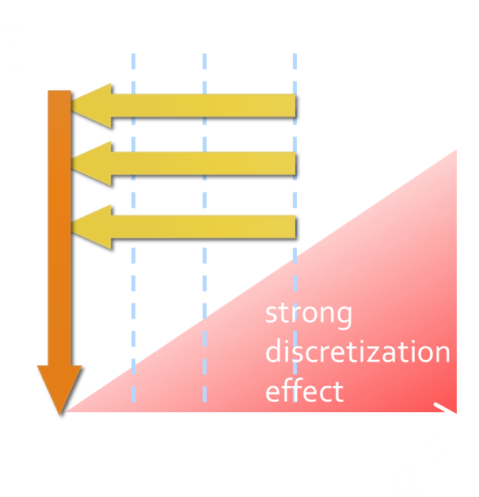
Continuum Extrapolation
continuum
limit
a→0 extrapolation with fixed t

Slide 36
t→0 Extrapolation
Range2
continuum
Range1
limit
Range3
a→0 extrapolation with fixed t
Then, t→0 with three ranges

Slide 37
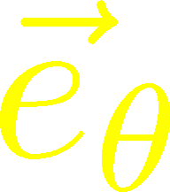
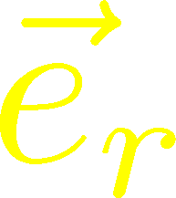
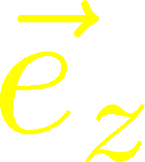


Symmetry on Mid-Plane
From rotational symm. & parity
EMT is diagonalized
in Cylindrical Coordinates
Degeneracy
in Maxwell theory

Slide 38


Mid-Plane
Separation
Continuum
Extrapolated!
Degeneracy:
Separation:
Nonzero trace anomaly

Slide 39
Mid-Plane
Separation
Continuum
Extrapolated!
Degeneracy:
Separation:
Nonzero trace anomaly

Slide 40


Force
Force from Potential
Force from Stress

Slide 41
Force
Force from Potential
Force from Stress

Slide 42
Force
Force from Potential
Force from Stress
Agreement!

Slide 43
Stress Tensor Distribution in Dual Abelian-Higgs Model
Yanagihara+, in prep.

Slide 44
Abelian-Higgs Model
Abelian-Higgs Model
flux-tube solution w/ monopoles Nielsen, Olesen (1973)
model for QCD vacuum (dual-Ginzburg-Landau)
describe symmetry breaking/restoration
nonzero trace anomaly

Slide 45






Abelian-Higgs Model
Abelian-Higgs Model
GL parameter:
Infinitely long tube
type-I :
type-II :
Bogomol’nyi bound :
degeneracy
Luscher, 1981
conservation law

Slide 46

Stress Tensor in AH Model
Bogomol’nyi bound :
de Vega, Schaposnik, PRD14, 1100 (1976).

Slide 47




Stress Tensor in AH Model
Type-I
Type-II
Gauge dominant
Higgs dominant
conservation law
No degeneracy bw T_{rr} & T_{θθ}

Slide 48

Comparison
Abelian-Higgs
Lattice
Type-I; infinitely long
→ Suggest type-I (if dual-SC picture is correct)?
→ Translationally-invariant flux tube is not formed.

Slide 49
Summary
First non-perturbative analysis of the stress tensor distribution in quark-anti-quark systems
New insights into the nature of the flux tube
“Action-at-a-distance” force is given by the sum of local interaction.
Non-trivial degeneracy in mid-plane
T_{rr}>0 → type-I vacuum? / T_{rr}~T_{θθ} → Is R still small?

Slide 50
Summary
First non-perturbative analysis of the stress tensor distribution in quark-anti-quark systems
New insights into the nature of the flux tube
“Action-at-a-distance” force is given by the sum of local interaction
Non-trivial degeneracy in mid-plane
T_{rr}>0 → type-I vacuum? / T_{rr}~T_{θθ} → Is R still small?
So many future studies
  Nonzero temperature / excited states
  EMT distribution inside hadrons
  Model study of the flux tube with finite length

