Slide 1
Exploring Non-Abelian
Gauge Theory with
Energy-Momentum Tensor
~ Stress, Thermodynamics and Correlations ~
XIII Quark Confinement and Hadron Spectroscopy, 4 Aug., 2018, Maynooth, Ireland
Masakiyo Kitazawa
for FlowQCD / WHOT-QCD Collaborations
FlowQCD: M. Asakawa, T. Hatsuda, T. Iritani, H. Suzuki, R. Yanagihara
PRD94,114512(2016); PRD96,111502(2017); arXiv:1803.05656
WHOT-QCD: S. Ejiri, K. Kanaya, H. Suzuki, Y. Taniguchi, T. Umeda, …
PRD96,014509(2017); arXiv:1710.10015; arXiv:1711.02262

Slide 2





Energy-Momentum Tensor
One of the most fundamental quantities in physics

Slide 3


Energy-Momentum Tensor
energy
momentum
pressure
stress
All components are important physical observables!

Slide 4




: nontrivial observable
on the lattice
Definition of the operator is nontrivial
because of the explicit breaking of Lorentz symmetry
ex:
Its measurement is extremely noisy
due to high dimensionality and etc.

Slide 5
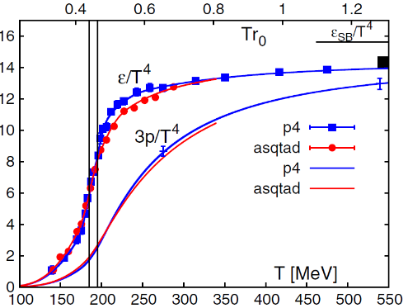
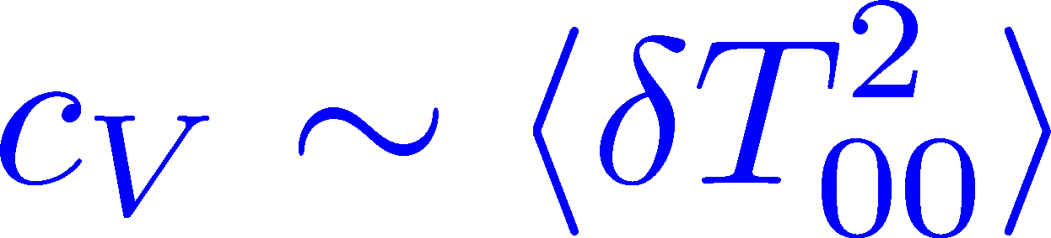
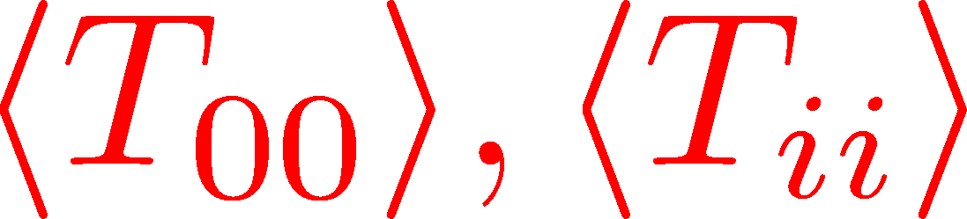
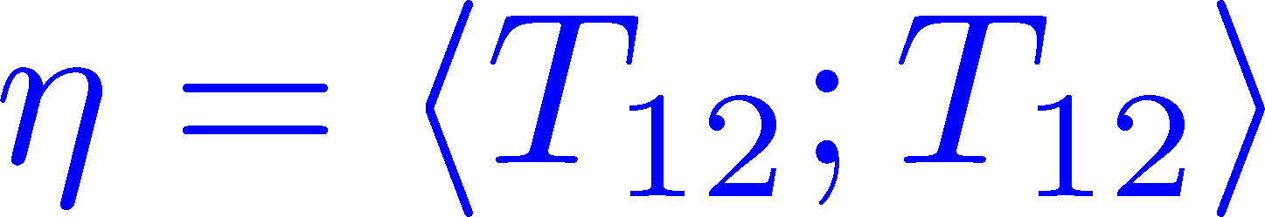

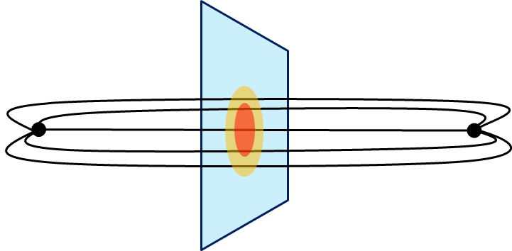
Thermodynamics
Fluctuations and
Correlations
direct measurement of
expectation values
viscosity, specific heat, ...
If we have
flux tube / hadrons
stress distribution
vacuum configuration
mixed state on 1st transition
Hadron Structure
Vacuum Structure

Slide 6

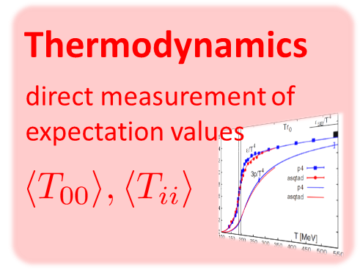
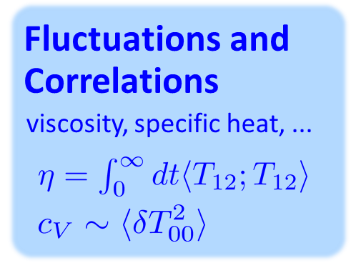
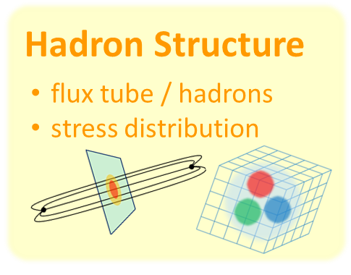
Contents
Constructing EMT on the lattice
Thermodynamics
EMT Correlation Function
ー
Stress distribution in qq system

Slide 7



EMT on the Lattice: Conventional
Lattice EMT Operator
Caracciolo+, 1990
Fit to thermodynamics: Z₃, Z₁
Shifted-boundary method: Z₆, Z₃
Giusti, Meyer, 2011; 2013;
Giusti, Pepe, 2014~; Borsanyi+, 2018
Multi-level algorithm
effective in reducing statistical error of correlator
Meyer, 2007;
Borsanyi, 2018;
Astrakhantsev+, 2018

Slide 8




Yang-Mills Gradient Flow
Luscher 2010
Narayanan, Neuberger, 2006
Luscher, Weiss, 2011
t: “flow time”
dim:[length²]
leading
diffusion equation in 4-dim space
diffusion distance
“continuous” cooling/smearing
No UV divergence at t>0

Slide 9
Yang-Mills Gradient Flow
Luscher 2010
Narayanan, Neuberger, 2006
Luscher, Weiss, 2011
t: “flow time”
dim:[length²]
leading
Applications
scale setting / topological charge / running coupling
noise reduction / defining operators / …

Slide 10





Small Flow-Time Expansion
Luescher, Weisz, 2011
Suzuki, 2013
an operator at t>0
remormalized operators
of original theory
original 4-dim theory
t→0 limit

Slide 11


Constructing EMT 1
Suzuki, 2013
Gauge-invariant dimension 4 operators

Slide 12




Constructing EMT 2
Suzuki, 2013
Suzuki coeffs.
Remormalized EMT

Slide 13



Gradient Flow Method
lattice regularized
gauge theory
Smeared world
by gradient flow
gradient flow
continuum theory
gradient flow
Measure on
the lattice
analytic relation
Take Extrapolation (t,a)→(0,0)
O(t) terms in SFTE
lattice discretization

Slide 14
Contents
Constructing EMT on the lattice
Thermodynamics
EMT Correlation Function
ー
Stress distribution in qq system

Slide 15



t, a Dependence
clover+plaq
clover
: strong discretization effect
: over smeared
: Linear t dependence

Slide 16




Double Extrapolation t→0, a→0
O(t) terms in SFTE
lattice discretization
Continuum extrapolation
strong
discretization
effect
Small t extrapolation

Slide 17
Double Extrapolation
Black line: continuum extrapolated

Slide 18

Double Extrapolation
Range2
Range1
Range3
Black line: continuum extrapolated
Fitting ranges:
  range-1:
  range-2:
  range-3:
Systematic error from the
choice of fitting range
≈ statistical error

Slide 19
Temperature Dependence
Excellent agreement with integral method
High accuracy only with ~2000 confs.
Error includes
statistical error
choice of t range for t→0 limit
uncertainty in aΛ_{MS}
total error <1.5% for T>1.1T_{c}

Slide 20



Thermodynamics on the Lattice recent progress in SU(3) YM
Integral method
  Most conventional / established
  Use themodynamic relations
  Boyd+ 1995; Borsanyi, 2012
Gradient-flow method
  Take expectation values of EMT
  FlowQCD, 2014, 2016
Moving-frame method
  Giusti, Pepe, 2014~
Non-equilibrium method
  Use Jarzynski’s equality Caselle+, 2016;2018
Differential method
  Shirogane+(WHOT-QCD), 2016~

Slide 21

SU(3) YM EoS: Comparison
Figure from
Caselle+,
1801.03110
Measurement of thermodynamics with various methods.
All results are in good agreement.
But, non-negligible discrepancy at T/Tc≈1-1.3?

Slide 22



Gradient Flow for Fermions
Luscher, 2013
Makino, Suzuki, 2014
Taniguchi+ (WHOT)
2016; 2017
Not “gradient” flow but a “diffusion” equation.
Divergence in field renormalization of fermions.
All observables are finite at t>0 once Z(t) is fixed.

Slide 23
2+1 QCD EoS from Gradient Flow
Taniguchi+ (WHOT-QCD), PRD96, 014509 (2017)
m_{PS}/m_{V} ≈0.63
no linear
window
no linear
window
Agreement with integral method except for N_{t}=4, 6
No stable extrapolation for N_{t}=4, 6
Statistical error is substantially suppressed!
Physical mass: Kanaya+ (WHOT-QCD), 1710.10015

Slide 24
Contents
Constructing EMT on the lattice
Thermodynamics
EMT Correlation Function
ー
Stress distribution in qq system

Slide 25




EMT Correlator: Motivation
Transport Coefficient
Karsch, Wyld, 1987
Nakamura, Sakai, 2005
Meyer; 2007, 2008
…
Borsanyi+, 2018
Astrakhantsev+, 2018
Kubo formula → viscosity
Energy/Momentum Conservation
: τ-independent constant
Fluctuation-Response Relations

Slide 26



EMT Euclidean Correlator
FlowQCD, PR D96, 111502 (2017)
τ-independent plateau in all channels ➔ conservation law
Confirmation of fluctuation-response relations
New method to measure c_{V}
Similar result for (41;41) channel: Borsanyi+, 2018
Perturbative analysis: Eller, Moore, 2018

Slide 27
Contents
Constructing EMT on the lattice
Thermodynamics
EMT Correlation Function
ー
Stress distribution in qq system

Slide 28
Stress = Force per Unit Area

Slide 29


Stress = Force per Unit Area
Pressure
S

Slide 30
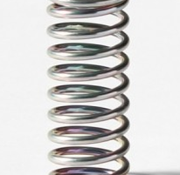



Stress = Force per Unit Area
Pressure
Generally, F and n are not parallel
v
fluid
S
F
S
elastic body
S
In thermal medium
Stress Tensor
Landau
Lifshitz

Slide 31


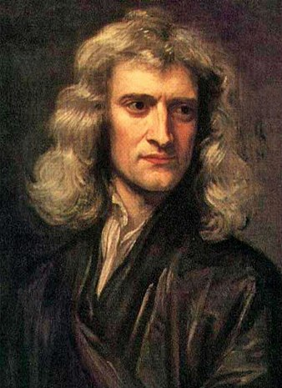


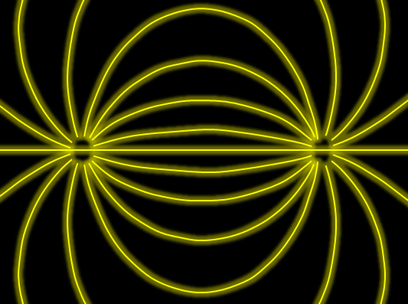

Force
Action-at-a-distance
Newton
1687
Local interaction
Faraday
1839

Slide 32




Maxwell Stress
(in Maxwell Theory)
Maxwell
E
pulling
Parallel to field: Pulling
Vertical to field: Pushing
pushing

Slide 33



Maxwell Stress
(in Maxwell Theory)
length:
pulling
pushing
Definite physical meaning
Distortion of field, line of the force
Propagation of the force as local interaction

Slide 34
Stress Tensor in QQ System
ー
Yanagihara+, 1803.05656
Lattice simulation
SU(3) Yang-Mills
a=0.029 fm
R=0.69 fm
t/a²=2.0
pulling
pushing
Definite physical meaning
Distortion of field, line of the force
Propagation of the force as local interaction
Manifestly gauge invariant

Slide 35

Lattice Setup
SU(3) Yang-Mills (Quenched)
Wilson gauge action
Clover operator
APE smearing / multi-hit
fine lattices (a=0.029-0.06 fm)
continuum extrapolation
Simulation: bluegene/Q@KEK
R=0.92 fm
R=0.69 fm
R=0.46 fm
Yanagihara+, 1803.05656

Slide 36






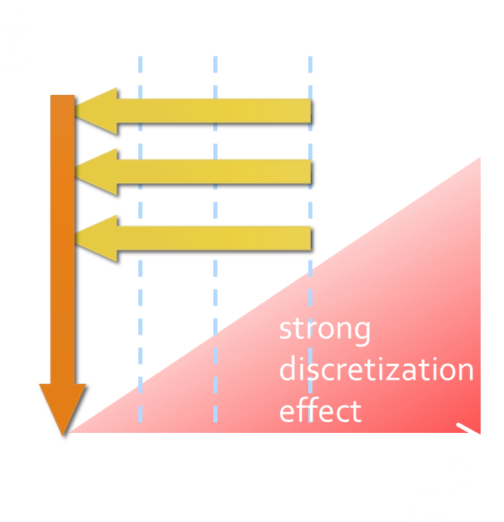
Continuum Extrapolation at mid-point
mid point
continuum
limit
a→0 extrapolation with fixed t

Slide 37
t→0 Extrapolation at mid-point
Range2
continuum
limit
Range1
Range3
a→0 extrapolation with fixed t
Then, t→0 with three ranges

Slide 38
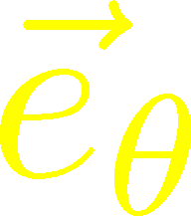
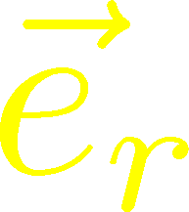
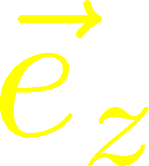


Stress Distribution on Mid-Plane
From rotational symm. & parity
EMT is diagonalized
in Cylindrical Coordinates
Degeneracy
in Maxwell theory

Slide 39


Mid-Plane
Separation
Continuum
Extrapolated!
In Maxwell theory
Degeneracy:
Separation:
Nonzero trace anomaly

Slide 40
Mid-Plane
Separation
Continuum
Extrapolated!
Degeneracy:
Separation:
Nonzero trace anomaly

Slide 41


Force
Force from Potential
Force from Stress

Slide 42
Force
Force from Potential
Force from Stress
Newton
1687
Faraday
1839

Slide 43
Force
Force from Potential
Force from Stress
Good Agreement!
Newton
1687
Faraday
1839

Slide 44






Abelian-Higgs Model
Yanagihara, Iritani, MK, in prep.
Abelian-Higgs Model
GL parameter:
Infinitely long tube
type-I :
type-II :
Bogomol’nyi bound :
degeneracy
Luscher, 1981
momentum conservation

Slide 45

Stress Tensor in AH Model infinitely-long flux tube
Bogomol’nyi bound :
de Vega, Schaposnik, PRD14, 1100 (1976).

Slide 46




Stress Tensor in AH Model infinitely-long flux tube
Type-I
Type-II
No degeneracy bw T_{rr} & T_{θθ}
T_{θθ} changes sign
conservation law

Slide 47

Stress Tensor in AH Model infinitely-long flux tube
Type-I
Lattice
Inconsistent with
lattice result
No degeneracy bw T_{rr} & T_{θθ}
T_{θθ} changes sign

Slide 48



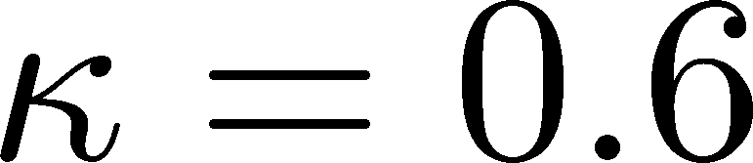
Flux Tube with Finite Length
Finite R, weak Type-I
Preliminary
Lattice
Finite-length effect of the flux tube is crucial!

Slide 49
Summary
The analysis of energy-momentum tensor on the lattice is now available, and various stuides are ongoing!
  gradient flow method
  determination of Z₆, Z₃, Z₁ / multilevel algorithm
Correlation
Functions
Stress
Thermodynamics

Slide 50
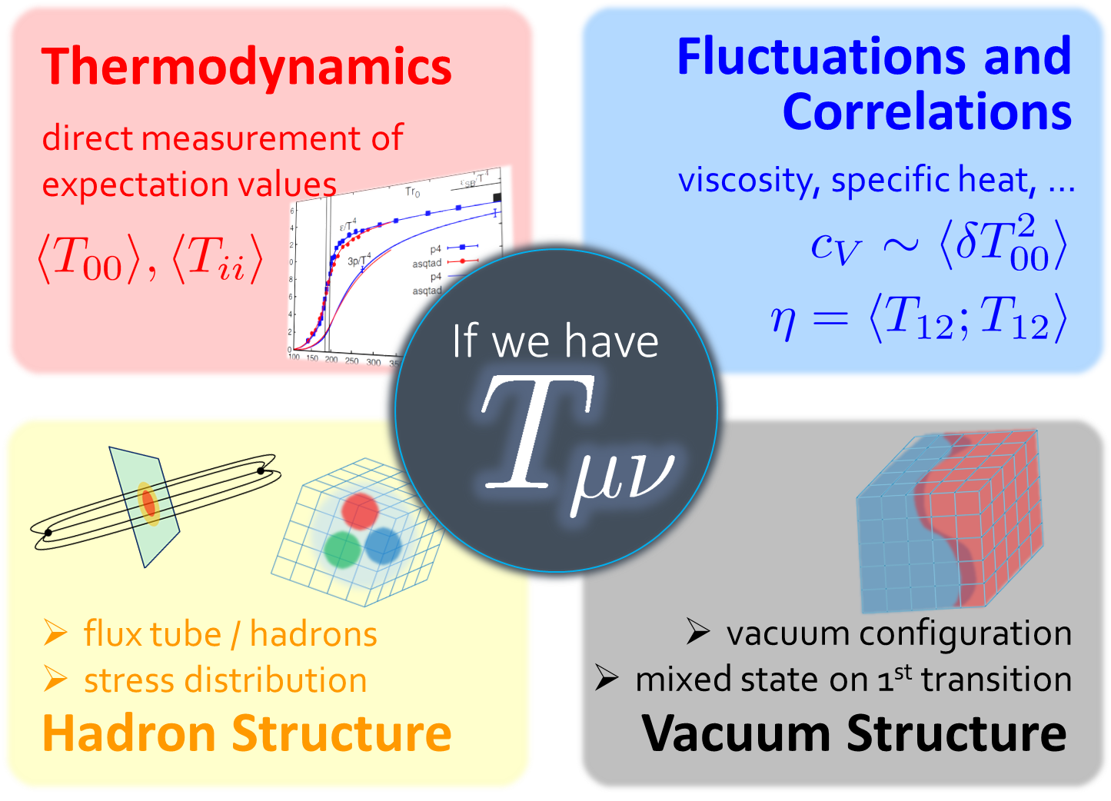
Summary
The analysis of energy-momentum tensor on the lattice is now available, and various stuides are ongoing!
  gradient flow method
  determination of Z₆, Z₃, Z₁ / multilevel algorithm
Correlation
Functions
Stress
Thermodynamics
So many future studies
  Flux tube at nonzero temperature
  EMT distribution inside hadrons
  viscosity / other operators / instantons / full QCD

Slide 51
backup

Slide 52

Numerical Simulation
FlowQCD,
PRD94, 114512 (2016)
Expectation values of T_{μν}
SU(3) YM theory
Wilson gauge action
Parameters:
Scale from gradient flow
N_{t} = 12, 16, 20-24
aspect ratio 5.3<N_{s}/N_{t}<8
1500~2000 configurations
FlowQCD, 1503.06516

Slide 53



Mid-Point Correlator
(44;11), (41;41) channels : confirmation of FRR
(44;44) channel: new measurement of c_{V}
2+1 QCD:
Taniguchi+ (WHOT-QCD),
1711.02262

Slide 54
Quark—Anti-quark system
Formation of the flux tube → confinement
Previous Studies on Flux Tube
Potential
Action density
Color-electric field
so many studies…
Cea+ (2012)
Cardoso+ (2013)

Slide 55
SU(3) YM vs Maxwell
SU(3) Yang-Mills
(quantum)
Maxwell
(classical)
Propagation of the force is clearly different
in YM and Maxwell theories!

Slide 56





Preparing Static QQ
Wilson loop
APE smearing for spatial links
Multi-hit for temporal links
No gradient flow for W(R,T)
potential
at b=6.6
(a=0.038 fm)

Slide 57
Ground State Saturation
mid point
β=6.819 (a=0.029 fm), R=0.46 fm
Appearance of plateau
for t/a²<4, T/a>15
Grand state saturation
under control

Slide 58
Ground State Saturation
t/a²=1.0
Wilson loop
t/a²=3.0
t/a²=4.0
β=6.819 (a=0.029 fm), R=0.46 fm
Appearance of plateau
for t/a²<4, T/a>15
Grand state saturation
under control

Slide 59
Abelian-Higgs Model
Abelian-Higgs Model
GL parameter:
Infinitely long tube
type-I :
type-II :
Bogomol’nyi bound :
degeneracy
Luscher, 1981
conservation law

