Slide 1
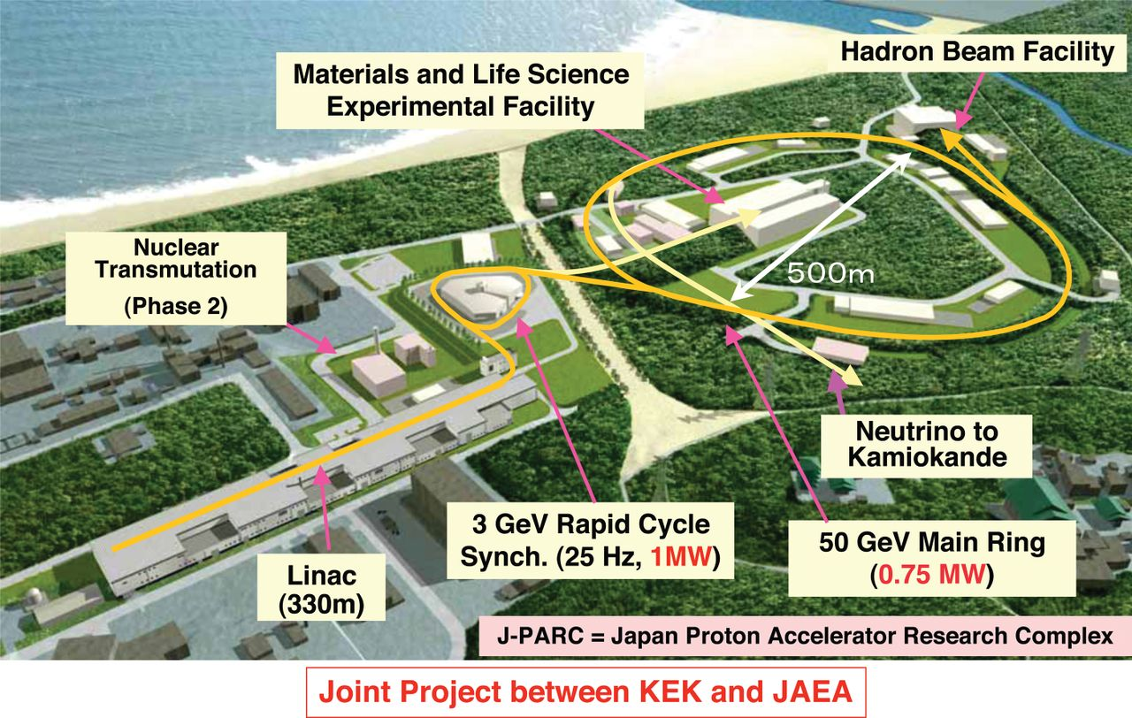
超高密度領域における
QCDの相構造と
その実験的探索
京都大学・原子核ハドロン研究室セミナー 2018年10月3日
北沢正清
(阪大理)
目次
J-PARC-HIとその物理の外観
ゆらぎを使って探るQCD相構造

Slide 2
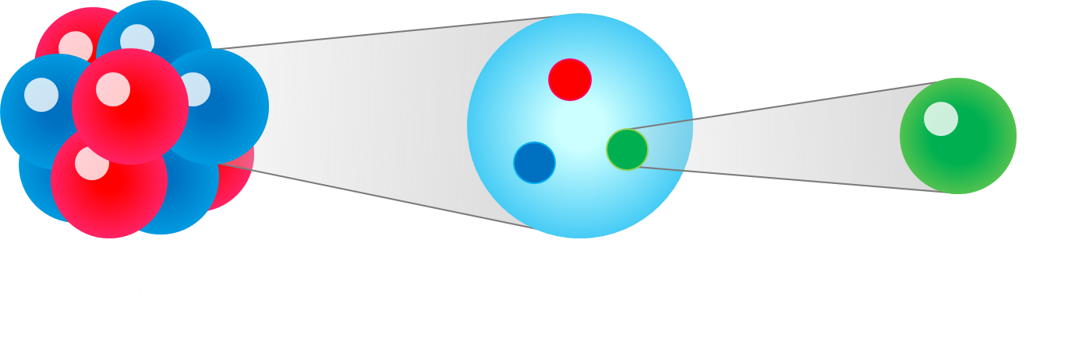
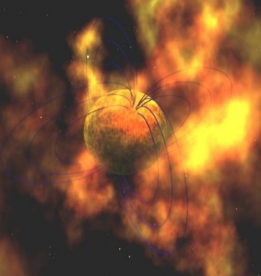

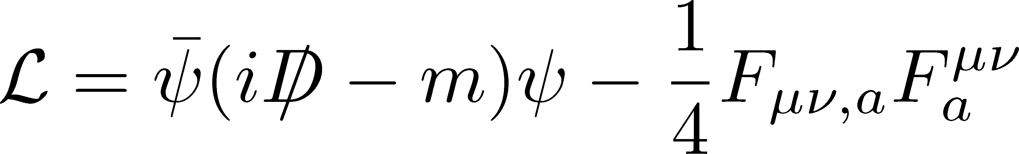
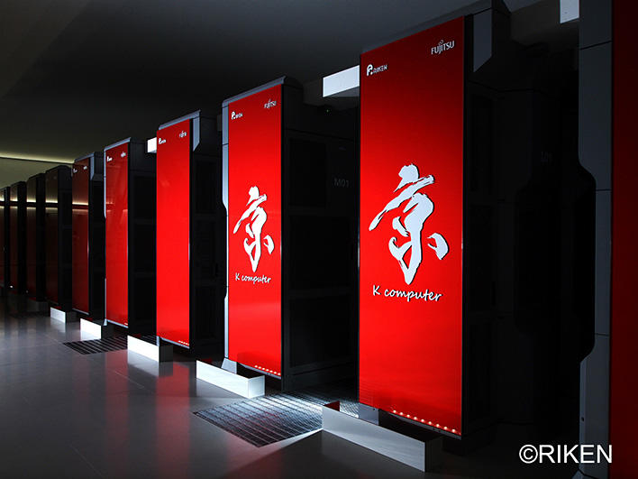
原子核物理の展開
研究対象
核構造・核反応
ハイパー核
ハドロン
QCDの相転移現象
媒質中のハドロン
歴史的発展
ストレンジ自由度の発見
多様なハドロンの発見
QCDの成立
中性子星・超新星爆発
格子QCDの発展

Slide 3
量子色力学
Quantum ChromoDynamics (QCD)
登場人物
クォーク
クォーク
クォーク：物質場、カラー電荷
グルオン：クォーク間の力を媒介
グルオン
1970年代、物質の基礎理論として確立
だが、難解すぎて誰にも解けない
グルオン
QCDの諸性質の理解には、実験的情報が不可欠

Slide 4
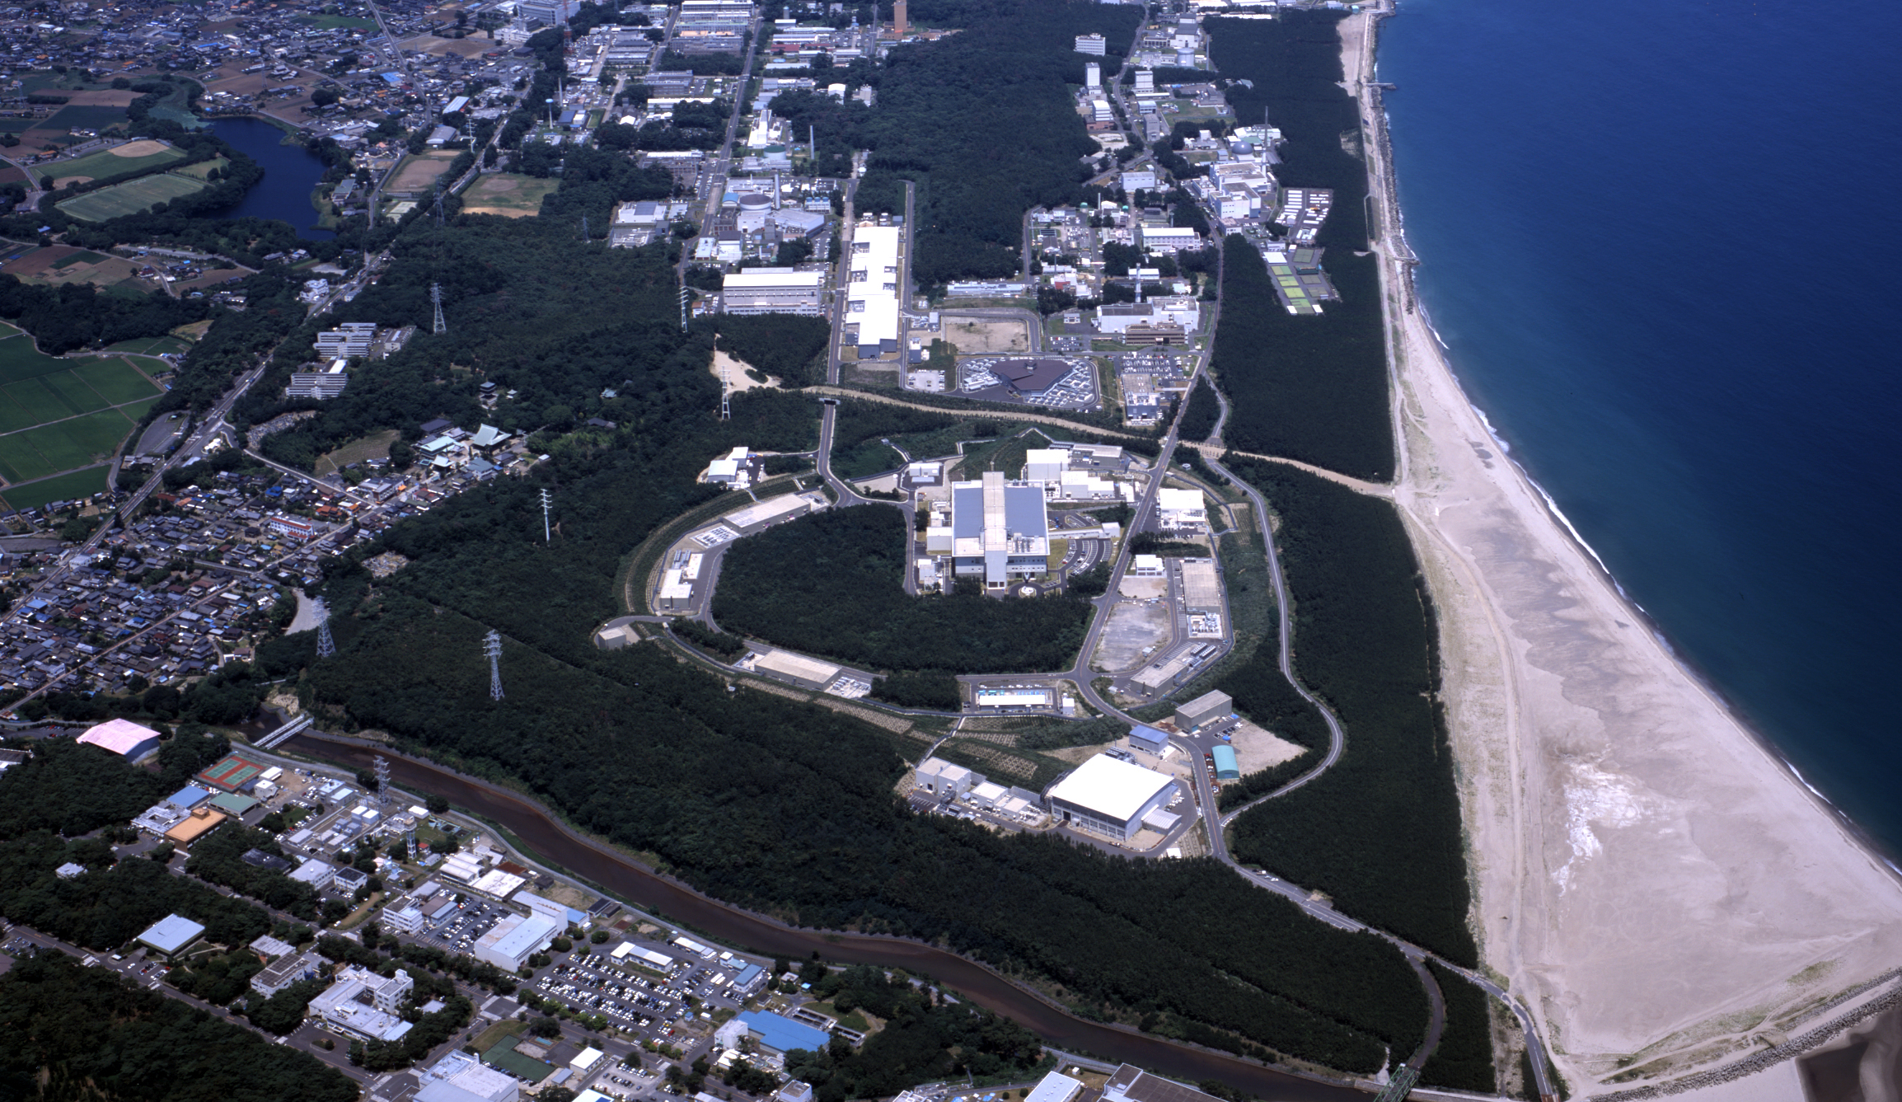
J-PARC-HI
J-PARC = Japan Proton Accelerator Research Complex
J-PARC-HI = J-PARC Heavy-Ion Program
Beam energy: ~20GeV/A (√s~6.2GeV)
High luminosity: collision rate ~10⁸Hz
Fixed target experiment
Launch: (hopefully) 2025~
White paper / Letter of Intent (2016)
  http://asrc.jaea.go.jp/soshiki/gr/hadron/jparc-hi/

Slide 5
HI Acceleration @ J-PARC
J-PARC Heavy Ion
Spectrometer
New HI Injector
high intensity
RCS & Main Ring
stable
well established
Use of reliable / high-performance RCS & main ring
→Reduce cost and time

Slide 6




AGS
-1996
SPS
1994-2000
RHIC
2000-
LHC
2010-
RHIC-BES
2010-
creation of quark-gluon plasma,
strongly-interacting QGP
FAIR
2022-?
NICA
2025-?
~2010
History of HIC = increasing energy
2010~
Beam-energy scan
Low-energy exp.
Heavy-Ion Collisions
J-PARC-HI
2025~?
2-6.2 GeV

Slide 7
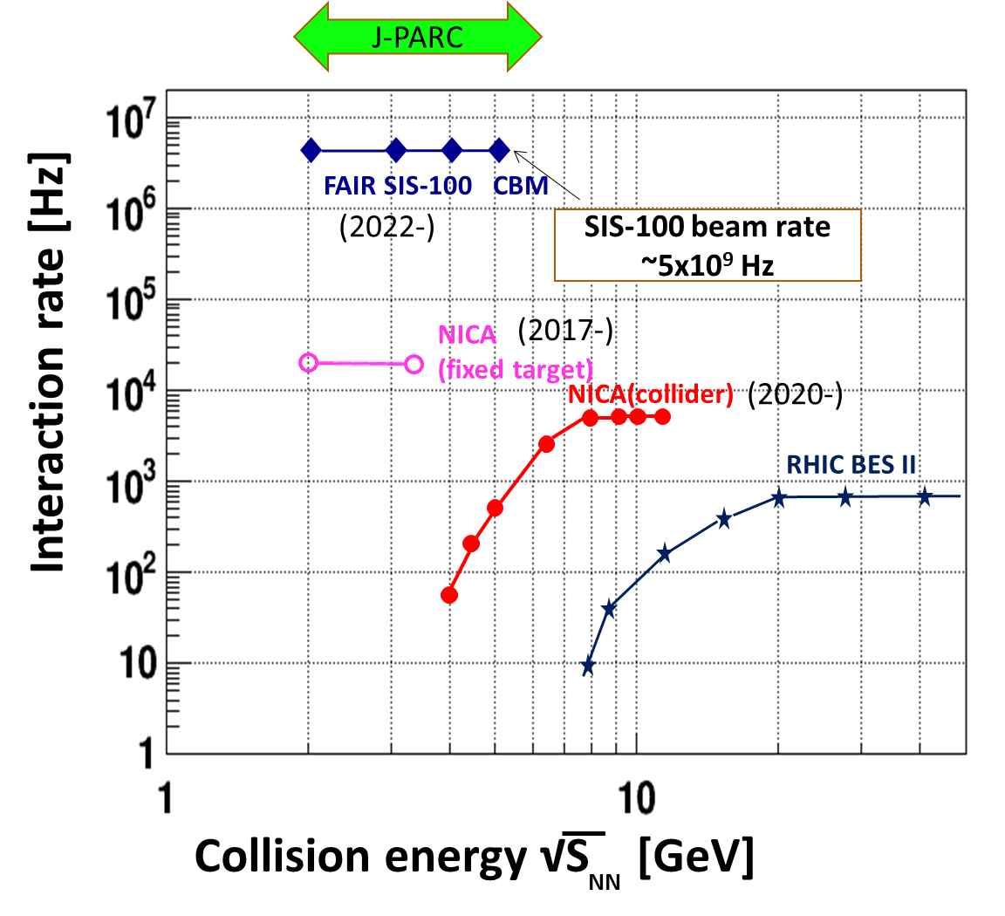
Collision Rate
J-PARC-HI
J-PARC-HI:
High-luminosity X Fixed target
→World highest rate～10⁸Hz
5-order higher than AGS,SPS
SPS
AGS
AGS, SPS
1 year
J-PARC-HI
5 min.
＝
High-statistical exp.
various event selections
higher order correlations
search of rare events

Slide 8
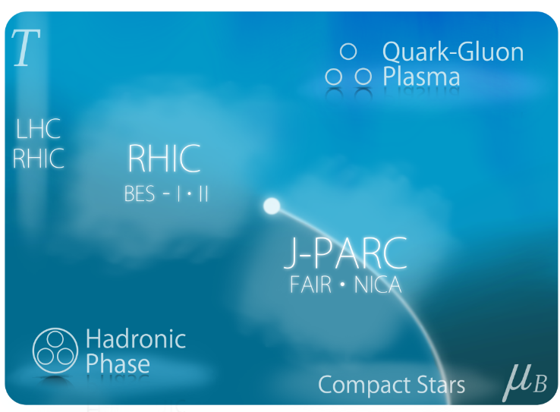
2 Main Goals of J-PARC-HI
Exploring Dense Medium
QCD phase diagram
1st order phase transition
equation of state
Rare-event Factory
hyper nuclei
exotic hadrons
hadron interaction

Slide 9




素粒子階層の相転移
温度
クォーク・グルオン・プラズマ
ハドロン相
(閉じこめ相)
密度
(バリオン化学
ポテンシャル)

Slide 10

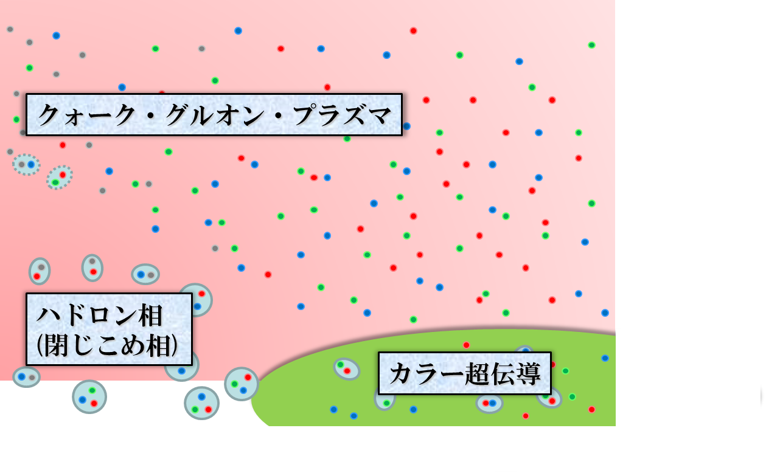

素粒子階層の相転移
温度
初期宇宙
クォーク・グルオン・プラズマ
ハドロン相
(閉じこめ相)
中性子星
密度
(バリオン化学
ポテンシャル)

Slide 11
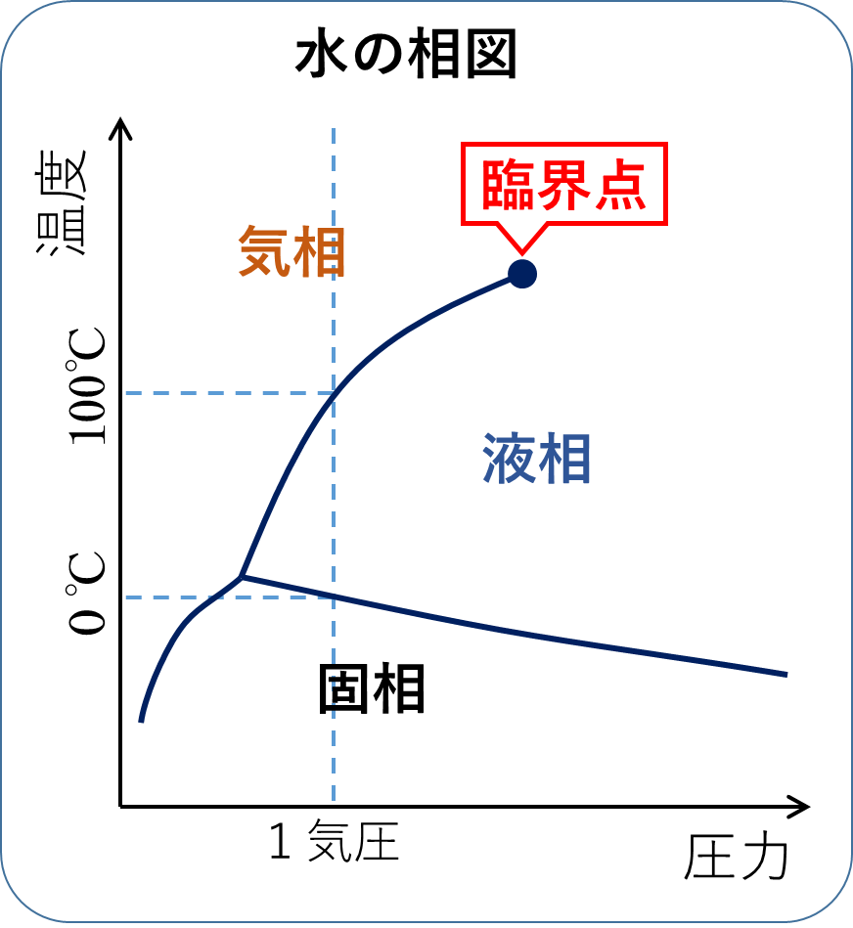
相転移の次数
温度
格子QCD第一原理計算
1.5超K
ＱＣＤ臨界点
第２臨界点
MK+ (2002)
ハドロン相
(閉じこめ相)
化学ポテンシャル
10¹⁵g/cm³

Slide 12

相対論的重イオン衝突実験
新粒子探索
陽子
陽子
初期宇宙の生成
６兆度を超える
高温物質
LHC – Large Hadron Collider

Slide 13
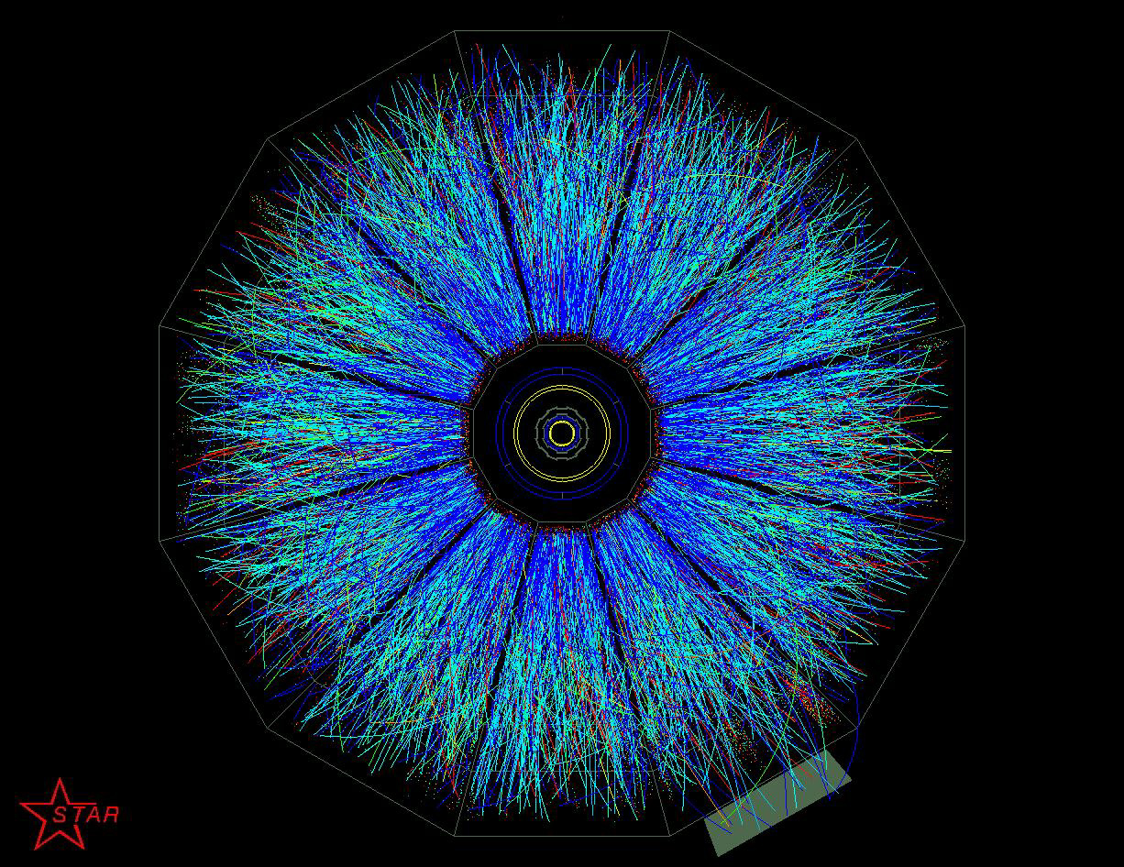

相対論的重イオン衝突実験
新粒子探索
小さなビッグバン
陽子
陽子
初期宇宙の生成
６兆度を超える
高温物質
LHC – Large Hadron Collider

Slide 14
ＱＧＰの生成と観測
生成されたＱＧＰは、大きさ約10⁻¹⁴m、
寿命は約10⁻²²秒
解放されたクォークとグルオンは、一瞬にしてハドロン内部に再び閉じ込められる。
ハドロン達は、
相互の散乱を経ながら検出器に到達する。

Slide 15
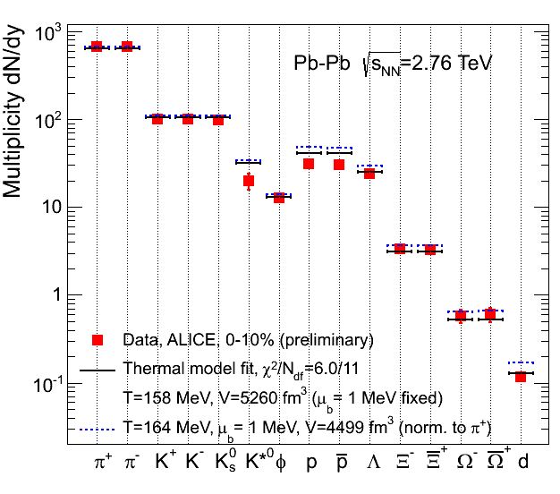

熱平衡化の証拠
各種ハドロンの粒子数は、
温度Ｔ、化学ポテンシャルμの
熱平衡値で再現可能
(化学)平衡状態の実現を示唆
実験的に決定したＴ, μは、
衝突エネルギーに応じて
相図上を移動する

Slide 16
Baryon Stopping

Slide 17
Baryon Stopping
High energy
Low energy
Nuclear transparency
Baryon stopping
net-baryon #: small
net-baryon #: large

Slide 18
Beam-Energy Scan
T, μ from particle yield
Translation to baryon density
J-PARC-HI
STAR,2012
J-PARC energy = highest baryon density

Slide 19



Maximum Density
Time evolution in T-ρ plane by JAM
A. Ohnishi, 2002
Maximum density 5~10ρ₀ @ J-PARC energy
Large event-by-event fluctuations?

Slide 20

ビームエネルギー走査
LHC
2010~
RHIC-BES
Phase I
2010~2014
Phase II
2019~
J-PARC
2025~ ??
LHC
温度
RHIC
ビームエネルギー走査
J-PARC-HI
化学ポテンシャル
ＱＣＤの相構造は、実験的に探索可能！

Slide 21
Theoretical Challenges
RHIC / LHC
creation of QGP
hydro. models
early thermalization
(boost invariance)
RHIC/LHC:
Thermalization
Hydrodynamics
Cascade

Slide 22
Theoretical Challenges
RHIC / LHC
Low-E Collisions
creation of QGP
hydro. models
early thermalization
(boost invariance)
Initial condition?
Thresholod of QGP formation
“Integrated” approach
  Hydro x Cascade
J-PARC:
Cascade
Hydrodynamics

Slide 23
流体・カスケード統合模型
Akamatsu, …, Nara, et al. PRC98 (2018)
流体とハドロンの同時時間発展
高密度のハドロン→流体化
冷却した流体→ハドロン化
流体化
流体
粒子化
統合
模型
カスケード
カスケード模型では記述不可能だったデータをよく再現

Slide 24
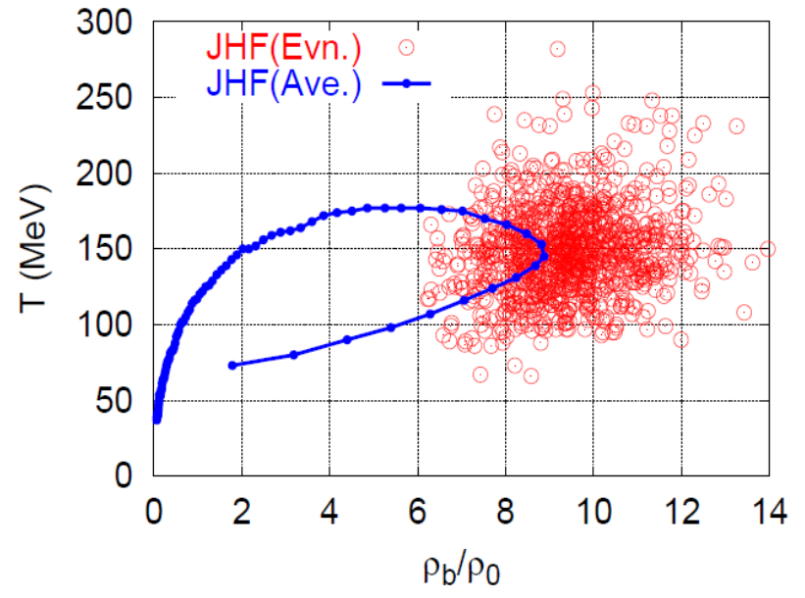
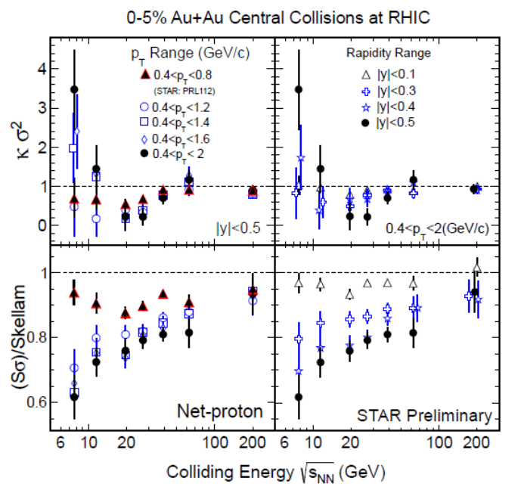
Various Observables
Flow
Dilepton / photon
Fluctuations, higher-order cumulants
Ξ, Ω, …
Sophisticated event selections
Various correlations
Can we select
these events??
MK, Sakaguchi, Sako,
Nara, Ohnishi, …

Slide 25

Radial Flow
②
①
物質の平均速度は、右上がり？右下がり？

Slide 26
高エネルギー
②

Slide 27
低エネルギー
②

Slide 28
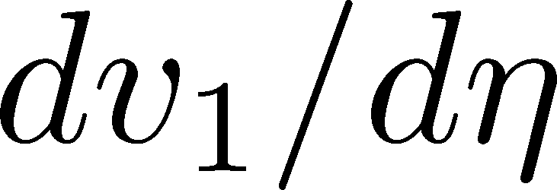
Directed Flow:
dv₁/dy: two sign change
No transport models can reproduce it quantitatively

Slide 29
dv₁/dy: Signal of 1st Phase Tr.?
Negative v₁
= signal of softening
≅1st order transition??
Nara+, 2017

Slide 30



Maximum Density Scan?
Large event-by-event fluctuations even with fixed centrality.
“Maximum density” dependence
may be studied experimentally.
average transverse energy
non-monotonic
behavior
as evidence of 1st. tr?
Baryon-rich events
Beam-energy scan
(no event selection)
faster
increase
Baryon-rich
events

Slide 31

Lepton & Photon:
Hierarchical Observation
gravitational wave
photons
Time scale: 10⁻¹s
di-lepton yield
EM probes
hadronic observables
time scale: 10⁻²²s

Slide 32
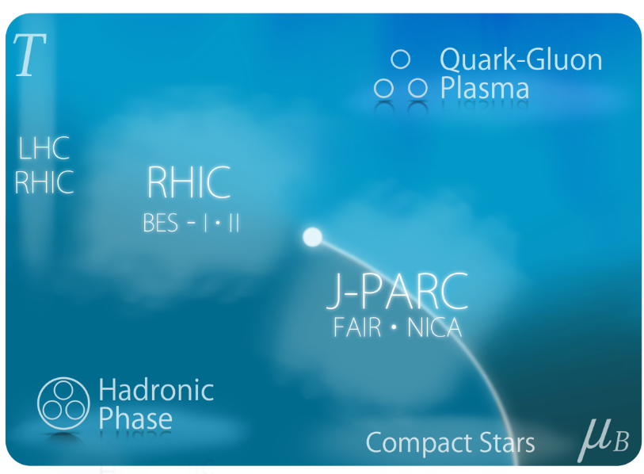
Fluctuations & QCD Critical Point
Is the signal of QCD-CP indicated in fluctuation observables??
Careful theor./exp. analyses are needed!
Non-eq. effects / rapidity dependences / experimental cuts / etc.
Asakawa, MK, Prog. Part. Nucl. Phys. (2016)

Slide 33
2 Main Goals of J-PARC-HI
Exploring Dense Medium
QCD phase diagram
1st order phase transition
equation of state
Rare-event Factory
hyper nuclei
exotic hadrons
hadron interaction

Slide 34
Search of Rare Events
Exotic
Hadrons
High density
High luminosity
High strange yield
Hypernuclei
Rare-event
Factory
Strangelets
hadron
Interaction
creation
properties
interaction

Slide 35
J-PARC-HI = Strangeness Factory
Particle yields having strangeness have maximum at J-PARC energy

Slide 36
Hyper-Nuclear Phyics @ J-PARC
Negatively-charged hypernuclei (Ξ⁻n, Ξ⁻nn, …)
Nuclear strangelets
n-rich / p-rich hypernuclei
Measurement of magnetic moments

Slide 37

Hadron-hadron Interaction
ΛΛ Correlation function
STAR,2015
Hadron interaction can be studied from correlation function.
emission source
func.
+
relative
wave func.
Morita, Furumoto, Ohnishi, 2015

Slide 38

ここまでのまとめ
J-PARC-HI = 地上で行うミニ中性子星合体
世界最強度ビームで探る宇宙最高密度
2つの重要課題
高密度物質探索
希少粒子生成工場

Slide 39
Non-Gaussian Fluctuations
in Relativistic Heavy-Ion Collisions
Asakawa, MK, Prog. Part. Nucl. Phys. (2016)

Slide 40
Thermal Fluctuations
Observables are fluctuating even in an equilibrated medium.
P(N)
N
V
N

Slide 41
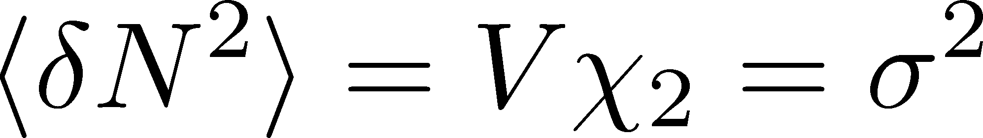
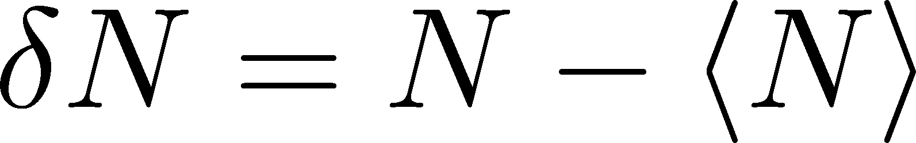
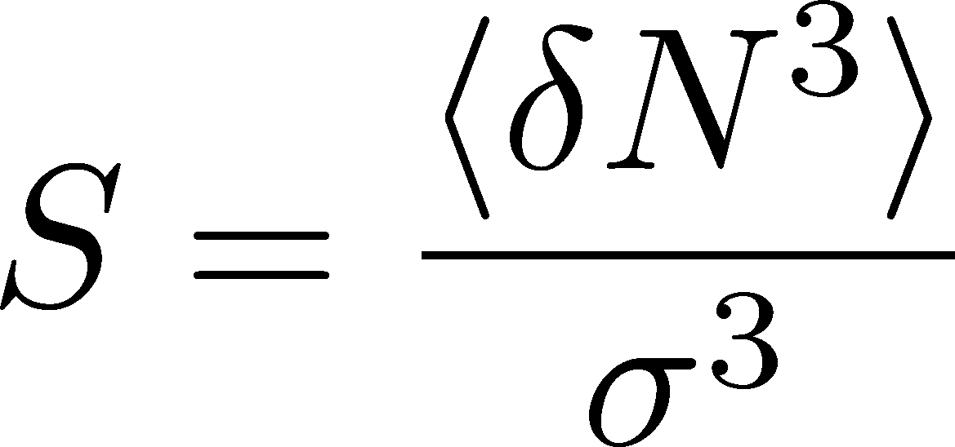
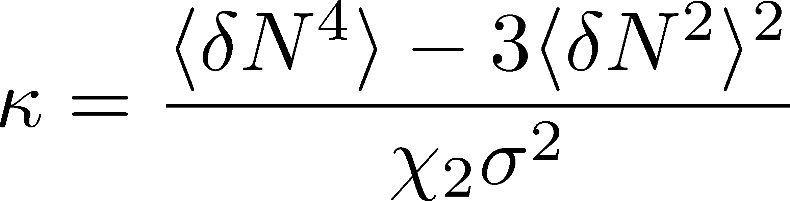
Thermal Fluctuations
Observables are fluctuating even in an equilibrated medium.
P(N)
N
V
N
Variance:
Non-Gaussianity
Skewness:
Kurtosis:

Slide 42
The noise is the signal.
R. Landauer
1998

Slide 43


A Coin Game
Bet 250 JPY
You get head coins of
A. 100 x 5 JPY
B. 50 x 10 JPY
Same expectation value.

Slide 44
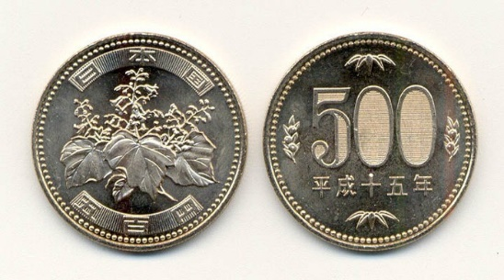
A Coin Game
Bet 250 JPY
You get head coins of
A. 100 x 5 JPY
B. 50 x 10 JPY
C. 1 x 500 JPY
Same expectation value.
But, different fluctuation

Slide 45

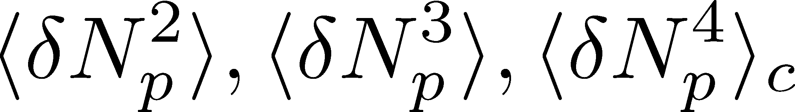
Event-by-Event Analysis @ HIC
Fluctuations can be measured by e-by-e analysis in experiments.
STAR, PRL105 (2010)
Detector

Slide 46
Event-by-Event Analysis @ HIC
Fluctuations can be measured by e-by-e analysis in experiments.
V
Detector

Slide 47


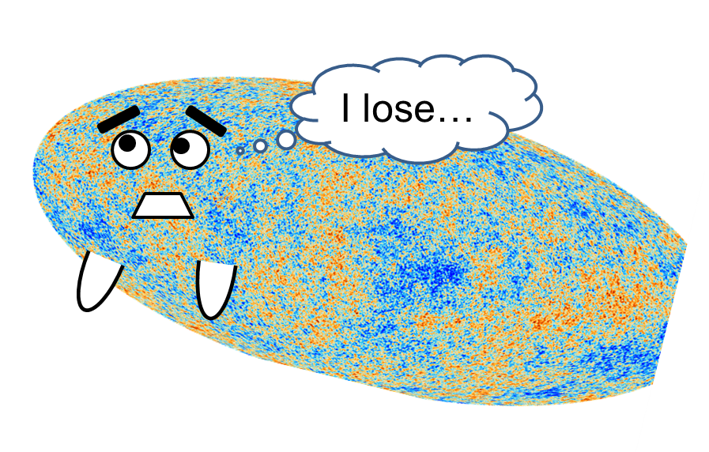
Non-Gaussianity in Exp.
X. Luo+, STAR Collab.
2010~
Non-zero non-Gaussian cumulants
have been established!

Slide 48
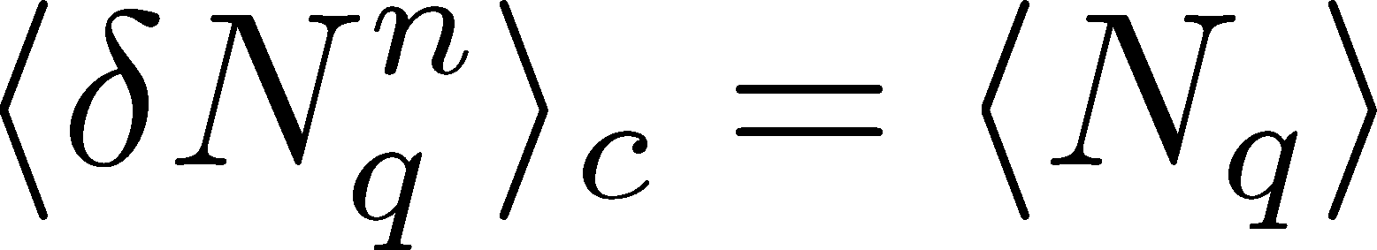
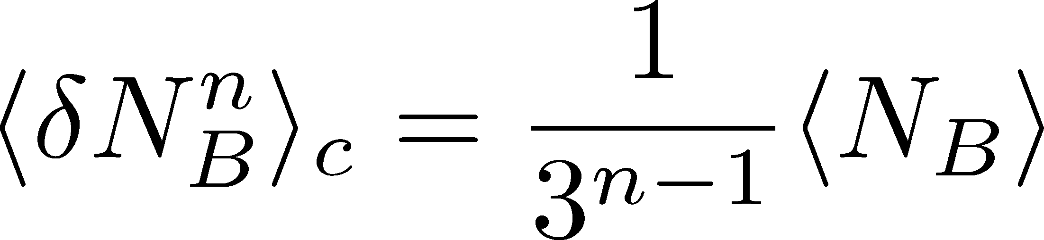
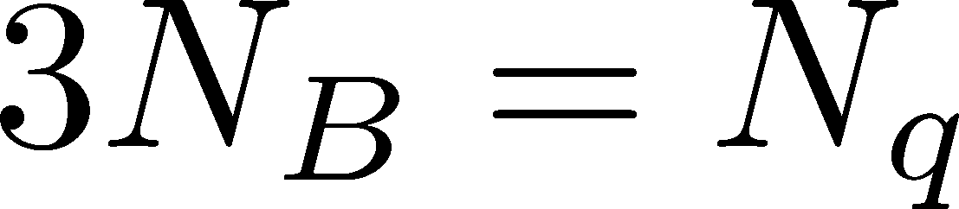
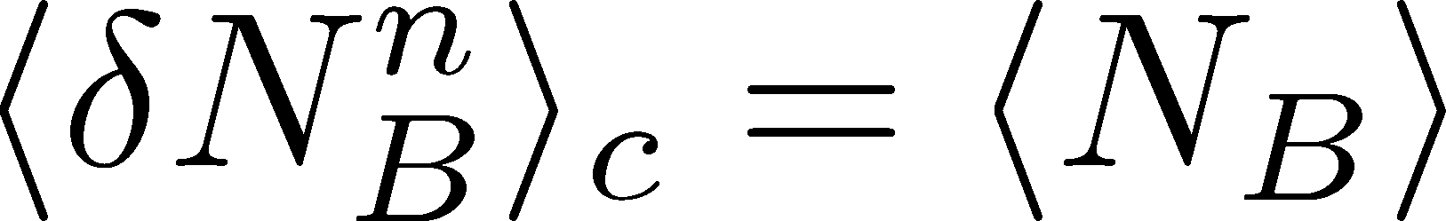
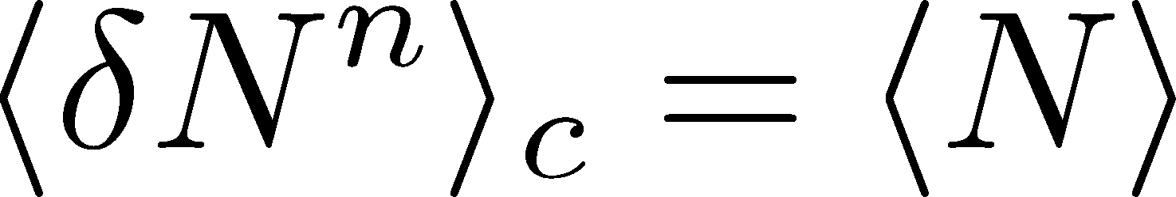
Fluctuations and Elemental Charge
Asakawa, Heinz, Muller, 2000
Jeon, Koch, 2000
Ejiri, Karsch, Redlich, 2005
Free Boltzmann → Poisson

Slide 49
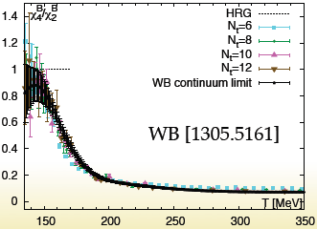
Fluctuations and Elemental Charge
Asakawa, Heinz, Muller, 2000
Jeon, Koch, 2000
Ejiri, Karsch, Redlich, 2005
Free Boltzmann → Poisson

Slide 50


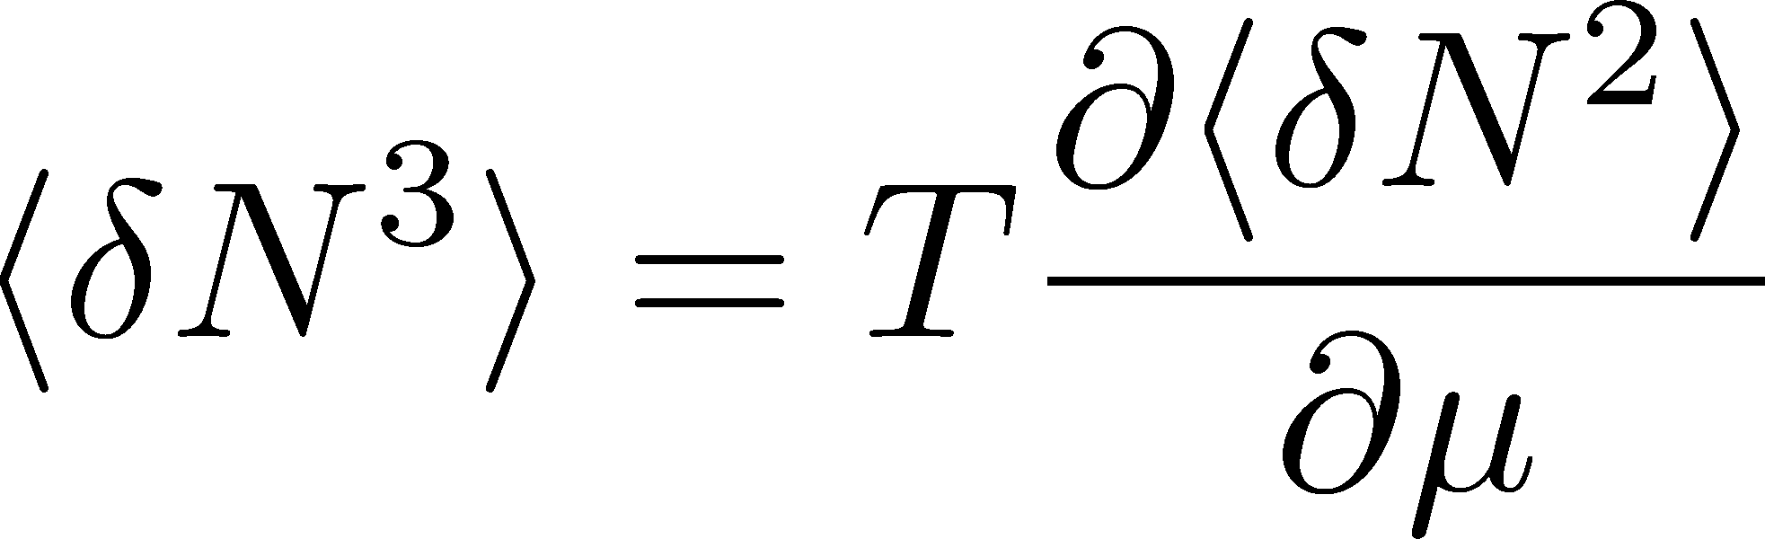

Fluctuation and QCD Critical Point
Fluctuations diverge at
the QCD critical point
Geometric interpretation to
signs of higher order cumulants
Asakawa, Ejiri, MK
2009
More severe divergence for higher-order cumulants
Stephanov, 2009

Slide 51

Impact of Negative Third Moments
Asakawa, Ejiri,
MK, 2009
Once negative <dN_{B}³> is established, it is evidences that
(1) χ_{B} has a peak structure in the QCD phase diagram.
(2) Hot matter beyond the peak is created in the collisions.
No dependence on any specific models.
Just the sign! No normalization (such as by N_{ch}).

Slide 52
How do Experimental Data Behave?
3rd-order:
suppression,
but no sign change
4th-order:
non-monotonic behavior
suppression
enhancement
More careful study is needed
suppression
Are fluctuations generated near the CP?
Detector’s efficiency effects

Slide 53





Diffusion of Fluctuations
Asakawa, Heinz, Muller, 2000
Jeon, Koch, 2000
Detector
Distributions in ΔY at the final state and early stage are different due to diffusion of individual particles.

Slide 54



Baryons in Hadronic Phase
time
chem. f.o.
hadronize
10~20fm
kinetic f.o.
Baryons behave like
Brownian pollens in water
mesons
baryons

Slide 55
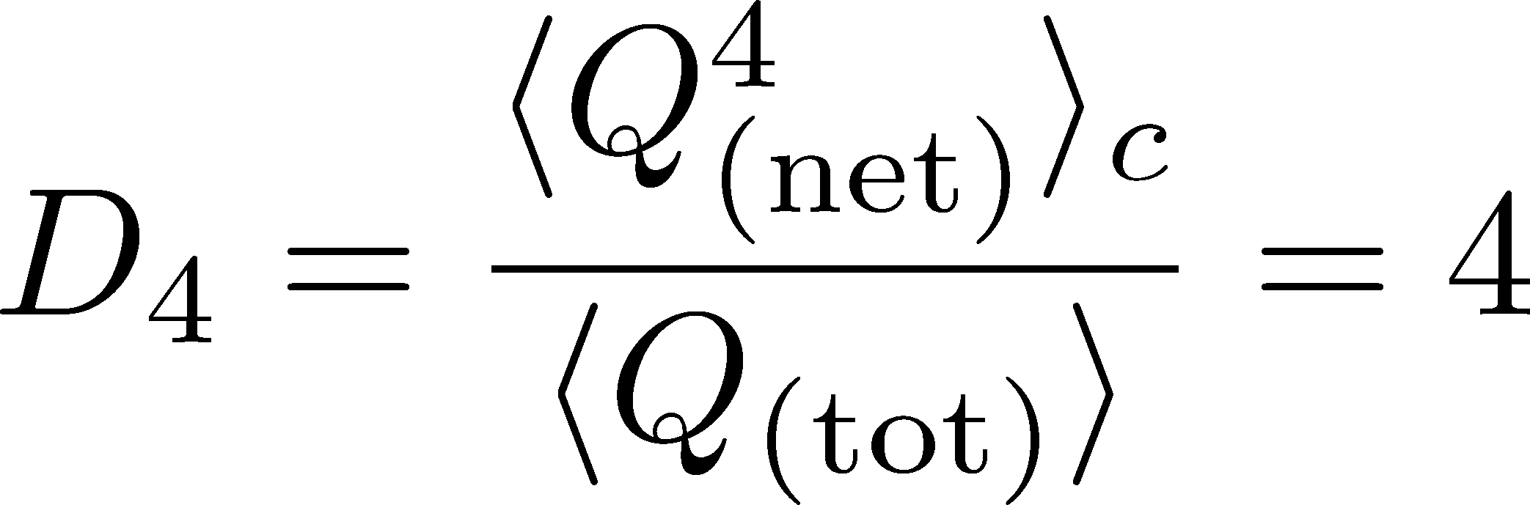




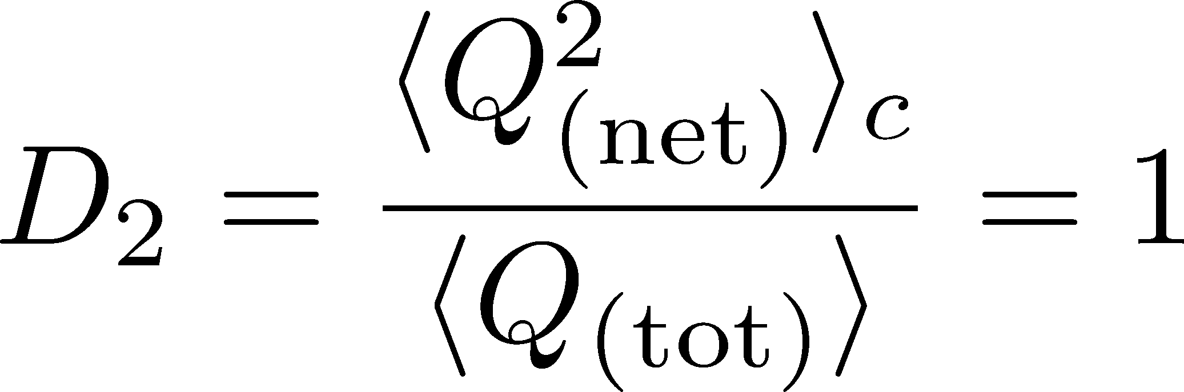

4th order : w/ Critical Fluctuation
MK+ (2014)
MK (2015)
Initial Condition
(rough estimate)
Higher order cumulants can behave non-monotonically.

Slide 56
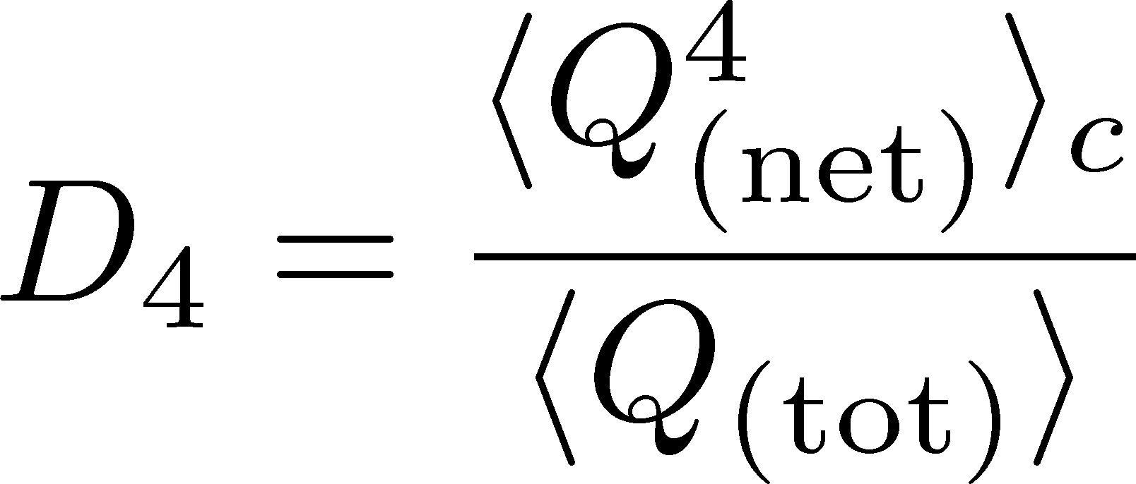


Rapidity Window Dep.
Initial Conditions
4th-order cumulant
MK+, 2014
MK, 2015
STAR Collab. (X. Luo, CPOD2014)
Different initial conditions give rise to different characteristic Δη dependence. → Study initial condition
Non-monotonic behaviors can appear in Δη dependence.
Finite volume effects: Sakaida+, PRC90 (2015)

Slide 57
Efficiency Correction
Experimental Detectors cannot
observe all particles
Efficiency ε
probability to observe a particle
Efficiency correction is indispensable in experimental analyses!

Slide 58





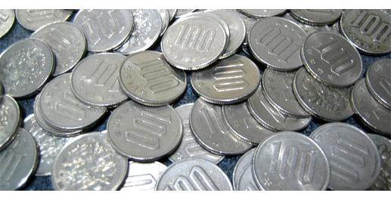
Slot Machine Analogy
= +
P (N)
N
P (N)
N

Slide 59
Slot Machine Analogy
Fixed # of coins
Constant probabilities
N
N
N
N

Slide 60
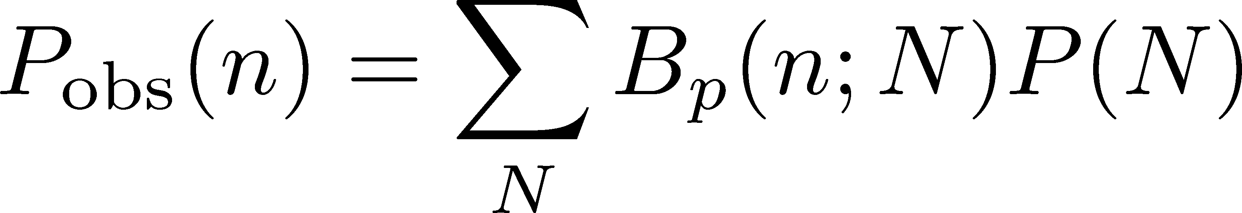
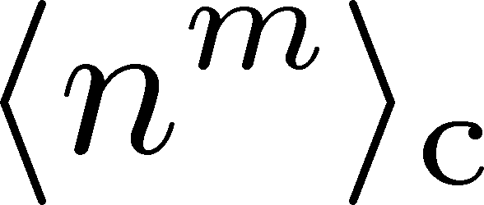
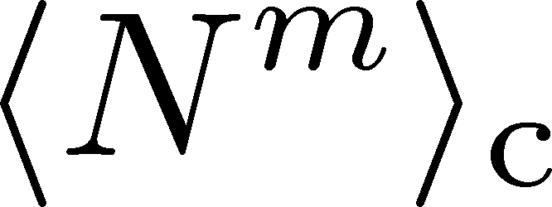
The Binomial Model
MK, Asakawa, 2012; 2012
Bzdak, Koch, 2012
When efficiency for individual particles are independent
dist. func. of
observed particle #
binmial
dist. func.
dist. func. of
original particle #
The cumulants connected with each other
Caveat: Effects of nonvanishing correlations: Holtzman+ 2016

Slide 61


Multi-efficiency Bin Problem
efficiency for proton ≠ anti-proton
efficiency has p_{T} dependence
STAR, net proton
TPC ε∼80%
TPC+TOF ε∼50%
Multi-variable efficiency correction
A method was proposed,
but too large numerical costs
Luo, 2014
Bzdak, Koch, 2015

Slide 62
Numerical cost: ~M^{n}
for n-th cumulant, M bins
Slide provided from T. Nonaka

Slide 63
Efficient Formulas for Efficiency Correction
Cumulant expansion method MK,2016
Number of terms is
drastically reduced!
Substantial reduction
of numerical cost

Slide 64
Efficient Formulas for Efficiency Correction
Cumulant expansion method MK,2016
Number of terms is
drastically reduced!
Substantial reduction
of numerical cost
Factorial cumulant method Nonaka, MK, Esumi, 2017
Systematic procedure
with the use of factorial
cumulants
Old
Numerical Cost
New

Slide 65
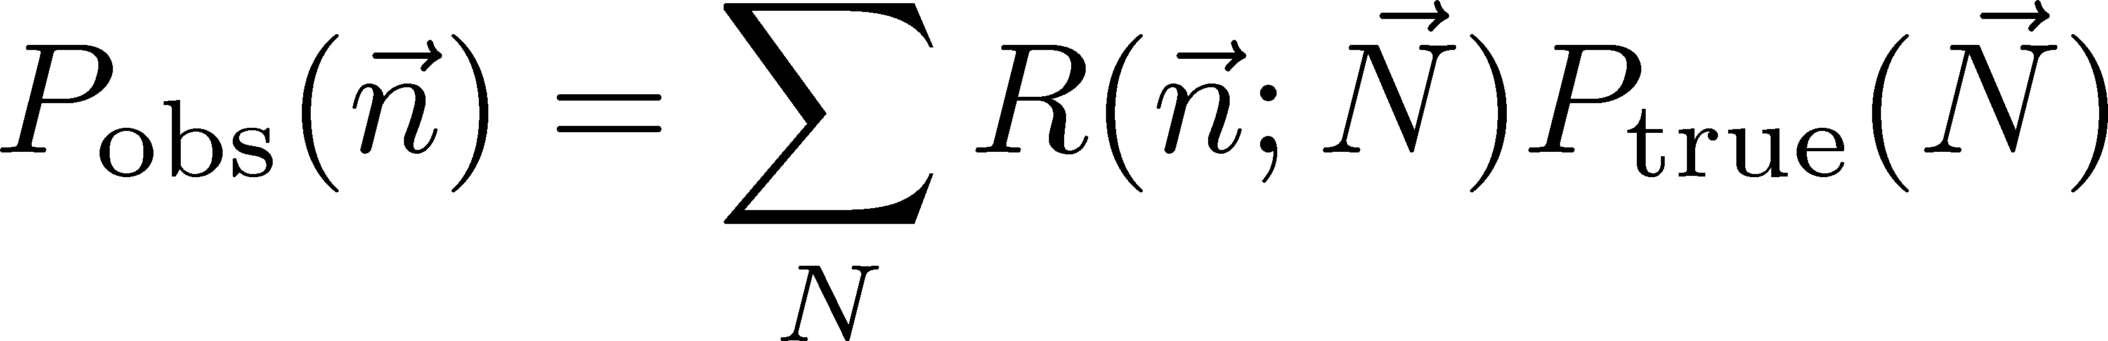
Violation of Binomial Model
Typical detectors have
clear deviation from the
binomial response.
Estimates of systematic
uncertainty arising from
this deviation are needed!
General procedure for efficiency correction Nonaka, MK, Esumi, 2018
Efficiency correction for any response matrix R(n,N)
We must understand the property of the detector

Slide 66
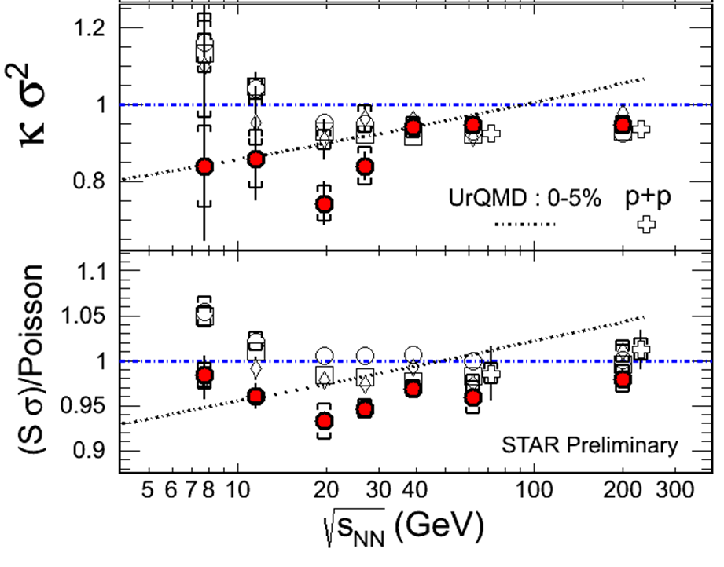
4th Order Cumulant: History
2013年
(PRL(2014))
2014年
(CPOD2014)
2015年
(QM2015)
2012年
(QM2012)

Slide 67
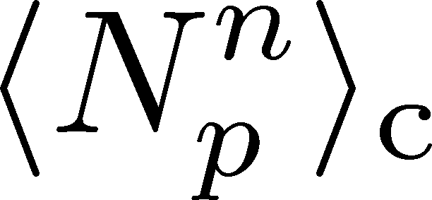
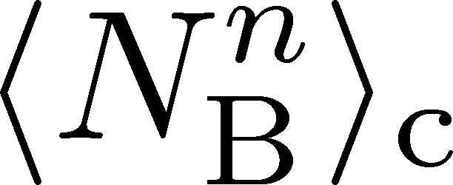
Proton v.s. Baryon Number Cumulants
MK, Asakawa, 2012; 2012
Experiments
proton number cumulants
Many theories
baryon number cumulants
measurement with
50% efficiency loss
The difference would be large.
Reconstruction of <N_{B}^{n}>_{c} is possible using the binomial model.
The use of binomial model is justified by “isospin randomization.”

Slide 68
Summary
非ガウスゆらぎは、QCD臨界点観測の有力な観測量である。
重イオン衝突実験では、非ガウスゆらぎの測定が実現している。
ゆらぎの解釈には、理論的にも、実験的にも更なる発展が必要だが、近年着実に発展している。

