Slide 1
Gradient Flow and
SU(3) Thermodynamics and some other topics
MIAPP, Interface of EFT and Lattice Gauge Theory, Munich, Oct. 30, 2018
Masakiyo Kitazawa
(Osaka University)
FlowQCD Collab.: Asakawa, Hatsuda, Iritani, Suzuki, Yanagihara
PRD94,114512(2016); PRD96,111502(2017); arXiv:1803.05656
WHOT-QCD Collab.: Ejiri, Kanaya, Suzuki, Taniguchi, Umeda, …
PRD96,014509(2017); arXiv:1710.10015; arXiv:1711.02262
Iritani, MK, Suzuki, Takaura, in preparation
MK, Mogliacci, Kolbe, Horowitz, in preparation

Slide 2




Energy-Momentum Tensor
energy
momentum
pressure
stress
All components are important physical observables!

Slide 3




: nontrivial observable
on the lattice
Definition of the operator is nontrivial
because of the explicit breaking of Lorentz symmetry
ex:
Its measurement is extremely noisy
due to high dimensionality and etc.

Slide 4
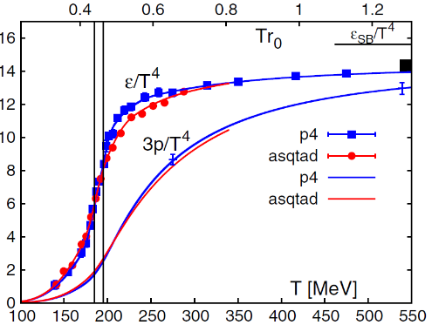
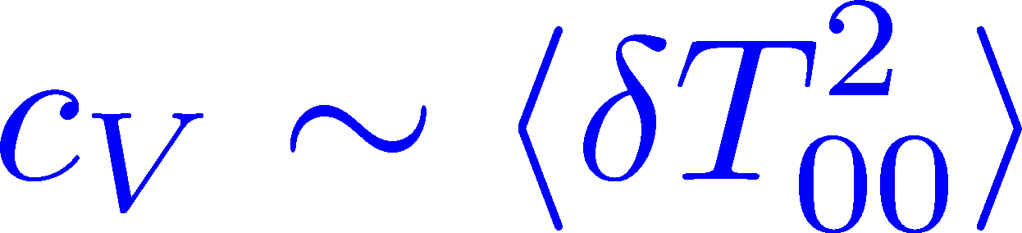
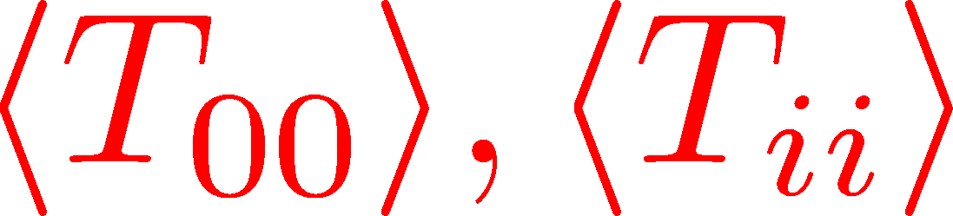
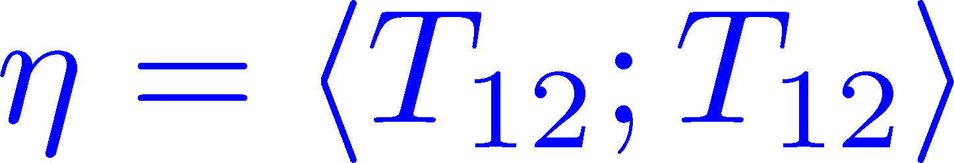

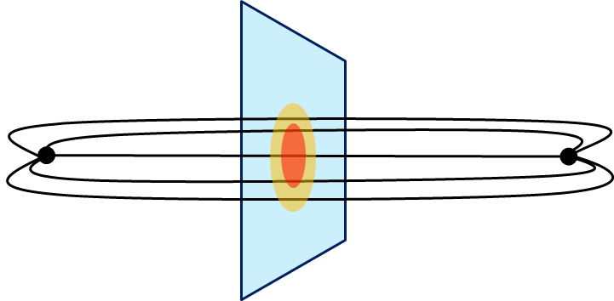
Thermodynamics
Fluctuations and
Correlations
direct measurement of
expectation values
viscosity, specific heat, ...
If we have
flux tube / hadrons
EM form factors
vacuum configuration
mixed state on 1st transition
Hadron Structure
Vacuum Structure

Slide 5
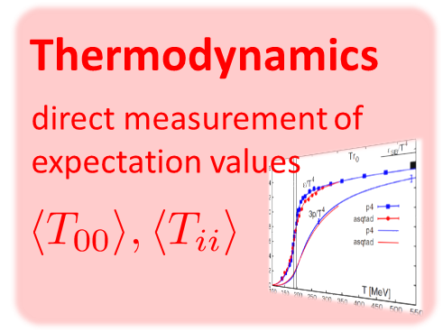
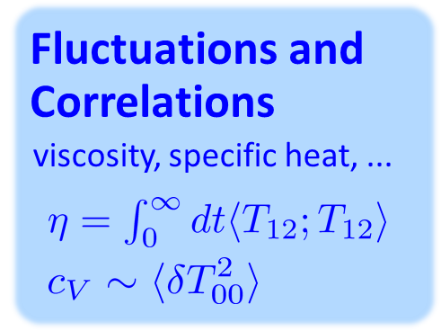
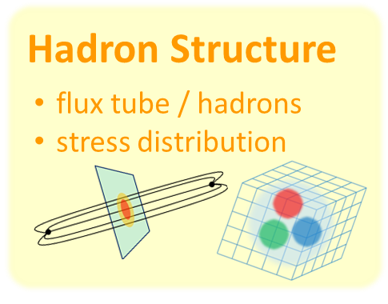
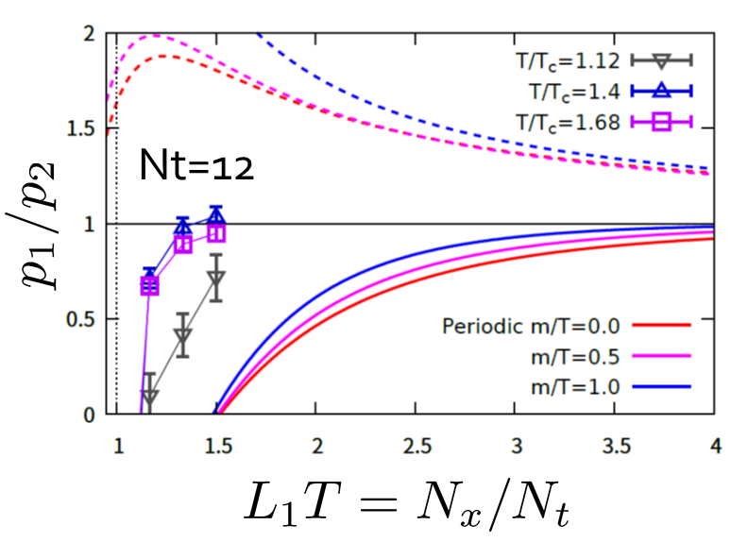
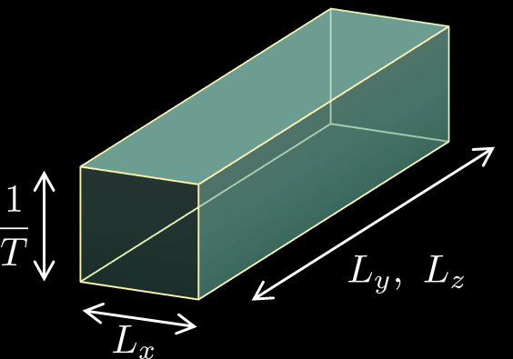
Main Results of This Talk
SU(3) YM
2+1 QCD
EMT correlator
—
finite anisotropic system
Line of Field b/w QQ

Slide 6

Contents
Constructing EMT on the lattice
with gradient flow
Thermodynamics
EMT Correlation Function
ー
Stress distribution in qq system

Slide 7




Yang-Mills Gradient Flow
Luscher 2010
Narayanan, Neuberger, 2006
Luscher, Weiss, 2011
t: “flow time”
dim:[length²]
leading
diffusion equation in 4-dim space
diffusion distance
“continuous” cooling/smearing
No UV divergence at t>0

Slide 8
Yang-Mills Gradient Flow
Luscher 2010
Narayanan, Neuberger, 2006
Luscher, Weiss, 2011
t: “flow time”
dim:[length²]
leading
Applications
scale setting / topological charge / running coupling
noise reduction / defining operators / …

Slide 9





Small Flow-Time Expansion
Luescher, Weisz, 2011
Suzuki, 2013
an operator at t>0
remormalized operators
of original theory
original 4-dim theory
t→0 limit

Slide 10


Constructing EMT 1
Suzuki, 2013
Gauge-invariant dimension 4 operators

Slide 11

Constructing EMT 2
Suzuki, 2013
vacuum subtr.
Remormalized EMT

Slide 12





Perturbative Coefficients
Suzuki, PTEP 2013, 083B03
Harlander+, 1808.09837
Iritani, MK, Suzuki, Takaura, in prep.
LO
1-loop
2-loop
3-loop
×
zero
Suzuki (2013)
Choice of the scale of g²
Previous:
Improved:
Harlander+ (2018)

Slide 13
Perturbative Coefficients
Suzuki, PTEP 2013, 083B03
Harlander+, 1808.09837
Iritani, MK, Suzuki, Takaura, in prep.
LO
1-loop
2-loop
3-loop
×
Iritani, MK, Suzuki,
Takaura, in prep.
zero
Suzuki (2013)
Harlander+(2018)
Choice of the scale of g²
Previous:
Improved:
Harlander+ (2018)

Slide 14
Contents
Constructing EMT on the lattice
Thermodynamics
EMT Correlation Function
ー
Stress distribution in qq system

Slide 15



Thermodynamics of SU(3) YM
Integral method
  Most conventional / established
  Use themodynamic relations
  Boyd+ 1995; Borsanyi, 2012
Gradient-flow method
  Take expectation values of EMT
  FlowQCD, 2014, 2016
Moving-frame method
  Giusti, Pepe, 2014~
Non-equilibrium method
  Use Jarzynski’s equality Caselle+, 2016;2018
Differential method
  Shirogane+(WHOT-QCD), 2016~

Slide 16



t, a Dependence
FlowQCD2016 (c1: 1-loop / c2: 2-loop)
clover+plaq
clover
: strong discretization
: over smeared
Stable t dependence

Slide 17




Double Extrapolation t→0, a→0
O(t) terms in SFTE
lattice discretization
Continuum extrapolation
strong
discretization
effect
Small t extrapolation

Slide 18
Double Extrapolation
Black line: continuum extrapolated

Slide 19

Double Extrapolation
Range2
Range1
Range3
Black line: continuum extrapolated
Fitting ranges:
  range-1:
  range-2:
  range-3:
Systematic error from the
choice of fitting range
≈ statistical error

Slide 20
Temperature Dependence
Excellent agreement with integral method
High accuracy only with ~2000 confs.
Error includes
statistical error
choice of t range for t→0 limit
uncertainty in aΛ_{MS}
total error <1.5% for T>1.1T_{c}

Slide 21
Higher Order Coefficient: ε+p
NLO (1-loop)
N²LO (2-loop)
Iritani, MK, Suzuki, Takaura, in prep.
t dependence becomes milder with higher order coeff.
1-loop → 2-loop : about 2% increase
Systematic analysis: μ₀ or μ_{d}, uncertainty of Λ, fit range
Extrapolation func: linear, higher order term in c₁ (~g⁶)

Slide 22
Higher Order Coefficient: ε-3p
N²LO (2-loop)
N³LO (3-loop)
Iritani, MK, Suzuki, Takaura, in prep.
No difference b/w 2- & 3-loops: 2-loop is already good!
Systematic analysis: μ₀ or μ_{d}, uncertainty of Λ, fit range
Extrapolation func: linear, higher order term in c₂ (~g⁸)

Slide 23
Effect of Higher-Order Coeffs.
Iritani, MK, Suzuki, Takaura, in prep.
Preliminary
Preliminary
□: 2-loop
△: Flow2016
Systematic error: μ₀ or μ_{d}, Λ, t→0 function, fit range
Effect of higher order c₁ & c₂
(pure gauge)
e-3p: negligible (<0.5%)
e+p: ~2% increase

Slide 24



Gradient Flow for Fermions
Luscher, 2013
Makino, Suzuki, 2014
Taniguchi+ (WHOT)
2016; 2017
Not “gradient” flow but a “diffusion” equation.
Divergence in field renormalization of fermions.
All observables are finite at t>0 once Z(t) is fixed.
Energy-momentum tensor from SFTE Makino, Suzuki, 2014

Slide 25


EMT in QCD

Slide 26
2+1 QCD EoS from Gradient Flow
Taniguchi+ (WHOT-QCD), PRD96, 014509 (2017)
m_{PS}/m_{V} ≈0.63
no linear
window
no linear
window
Agreement with integral method except for N_{t}=4, 6
N_{t}=4, 6: No stable extrapolation is possible
Statistical error is substantially suppressed!
Physical mass: Kanaya+ (WHOT-QCD), 1710.10015

Slide 27








Pressure anisotropy in finite system
NEW
Casimir effect
Finite system at nonzero T
MK, Mogliacci, Kolbe,
Horowitz, in preparation
attractive
pressure anisotropy

Slide 28








Two Special Cases with PBC
In conformal (Σ_{μ}T_{μμ}=0)

Slide 29
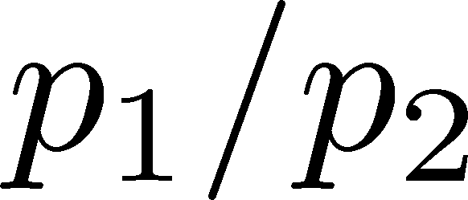
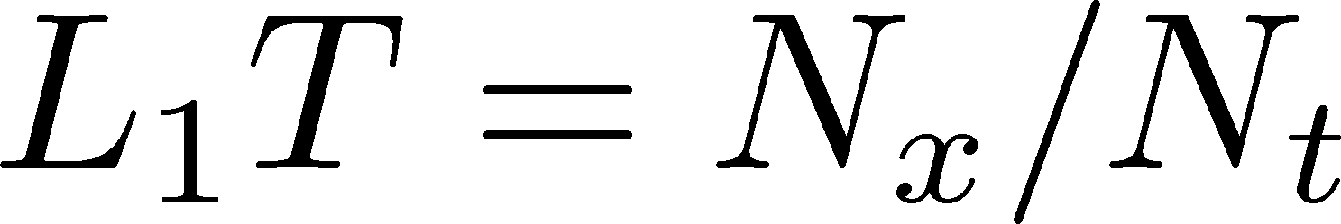
Pressure Anisotropy
MK, Mogliacci, Kolbe,
Horowitz, in prep.
Free scalar field
L₂=L₃=∞
Mogliacci+, 1807.07871

Slide 30
Pressure Anisotropy
MK, Mogliacci, Kolbe,
Horowitz, in prep.
Free scalar field
L₂=L₃=∞
Nt=12
Preliminary
Mogliacci+, 1807.07871
Lattice result
Periodic BC
N_{s}²xN_{x}xN_{t}=72²xN_{x}x12
N_{x}=12, 14, 16, 18
Only t→0 limit (fixed a)
Medium near T_{c} is remarkably insensitive to finite size!
How do we understand??

Slide 31
Contents
Constructing EMT on the lattice
Thermodynamics
EMT Correlation Function
ー
Stress distribution in qq system

Slide 32




EMT Correlator: Motivation
Transport Coefficient
Karsch, Wyld, 1987
Nakamura, Sakai, 2005
Meyer; 2007, 2008
…
Borsanyi+, 2018
Astrakhantsev+, 2018
Kubo formula → viscosity
Energy/Momentum Conservation
: τ-independent constant
Fluctuation-Response Relations

Slide 33



EMT Euclidean Correlator
FlowQCD, PR D96, 111502 (2017)
τ-independent plateau in all channels ➔ conservation law
Confirmation of fluctuation-response relations
New method to measure c_{V}
Similar result for (41;41) channel: Borsanyi+, 2018
Perturbative analysis: Eller, Moore, 2018

Slide 34



Fluctuation-Response Relations
Confirmation of FRR
New measurement of c_{V}
2+1 QCD:
Taniguchi+ (WHOT-QCD), 1711.02262

Slide 35
Contents
Constructing EMT on the lattice
Thermodynamics
EMT Correlation Function
ー
Stress distribution in qq system

Slide 36
Stress = Force per Unit Area

Slide 37


Stress = Force per Unit Area
Pressure
S

Slide 38
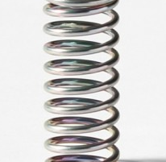



Stress = Force per Unit Area
Pressure
Generally, F and n are not parallel
v
fluid
S
F
S
elastic body
S
In thermal medium
Stress Tensor
Landau
Lifshitz

Slide 39


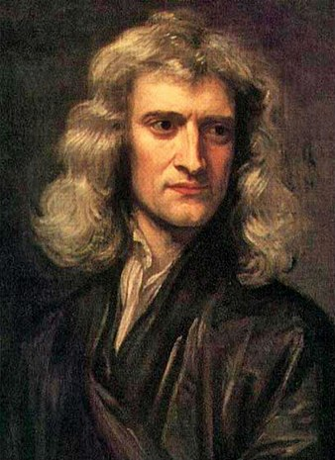


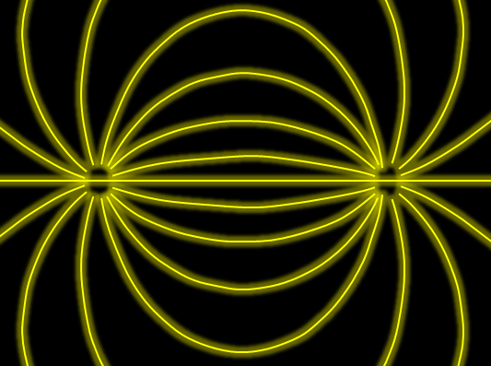

Force
Action-at-a-distance
Newton
1687
Local interaction
Faraday
1839

Slide 40




Maxwell Stress
(in Maxwell Theory)
Maxwell
E
pulling
Parallel to field: Pulling
Vertical to field: Pushing
pushing

Slide 41



Maxwell Stress
(in Maxwell Theory)
length:
pulling
pushing
Definite physical meaning
Distortion of field, line of the field
Propagation of the force as local interaction

Slide 42
Quark-Anti-quark system
Formation of the flux tube → confinement
Previous Studies on Flux Tube
Potential
Action density
Color-electric field
so many studies…
Cea+ (2012)
Cardoso+ (2013)

Slide 43
Stress Tensor in QQ System
ー
Yanagihara+, 1803.05656
PLB, in press
Lattice simulation
SU(3) Yang-Mills
a=0.029 fm
R=0.69 fm
t/a²=2.0
pulling
pushing
Definite physical meaning
Distortion of field, line of the field
Propagation of the force as local interaction
Manifestly gauge invariant

Slide 44
SU(3) YM vs Maxwell
SU(3) Yang-Mills
(quantum)
Maxwell
(classical)
Propagation of the force is clearly different
in YM and Maxwell theories!

Slide 45

Lattice Setup
SU(3) Yang-Mills (Quenched)
Wilson gauge action
Clover operator
APE smearing / multi-hit
fine lattices (a=0.029-0.06 fm)
continuum extrapolation
Simulation: bluegene/Q@KEK
R=0.92 fm
R=0.69 fm
R=0.46 fm
Yanagihara+, 1803.05656

Slide 46



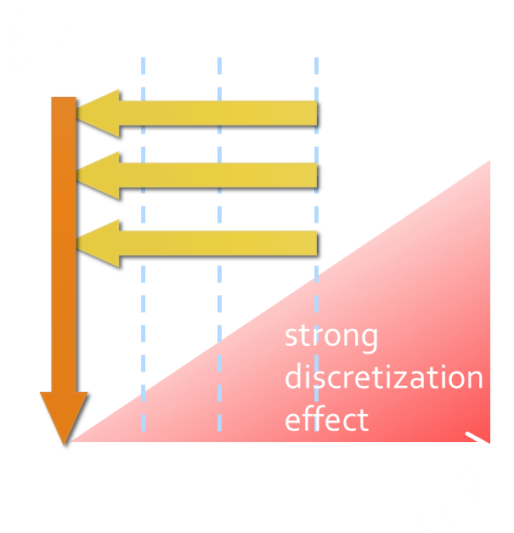
Continuum Extrapolation at mid-point
mid point
continuum
limit
a→0 extrapolation with fixed t

Slide 47
t→0 Extrapolation at mid-point
Range2
continuum
limit
Range1
Range3
a→0 extrapolation with fixed t
Then, t→0 with three ranges

Slide 48
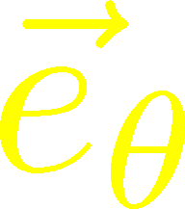
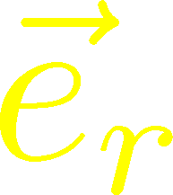
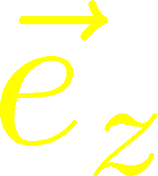



Stress Distribution on Mid-Plane
From rotational symm. & parity
EMT is diagonalized
in Cylindrical Coordinates
Degeneracy
in Maxwell theory

Slide 49


Mid-Plane
Separation
Continuum
Extrapolated!
In Maxwell theory
Degeneracy:
Separation:
Nonzero trace anomaly

Slide 50
Mid-Plane
Separation
Continuum
Extrapolated!
Degeneracy:
Separation:
Nonzero trace anomaly

Slide 51


Force
Force from Potential
Force from Stress

Slide 52
Force
Force from Potential
Force from Stress
Newton
1687
Faraday
1839

Slide 53
Force
Force from Potential
Force from Stress
Good Agreement!
Newton
1687
Faraday
1839

Slide 54






Abelian-Higgs Model
Yanagihara, Iritani, MK, in prep.
Abelian-Higgs Model
GL parameter:
Infinitely long tube
type-I :
type-II :
Bogomol’nyi bound :
degeneracy
Luscher, 1981
momentum conservation

Slide 55

Stress Tensor in AH Model infinitely-long flux tube
Bogomol’nyi bound :
de Vega, Schaposnik, PRD14, 1100 (1976).

Slide 56




Stress Tensor in AH Model infinitely-long flux tube
Type-I
Type-II
No degeneracy bw T_{rr} & T_{θθ}
T_{θθ} changes sign
conservation law

Slide 57

Stress Tensor in AH Model infinitely-long flux tube
Type-I
Lattice
Inconsistent with
lattice result
No degeneracy bw T_{rr} & T_{θθ}
T_{θθ} changes sign

Slide 58
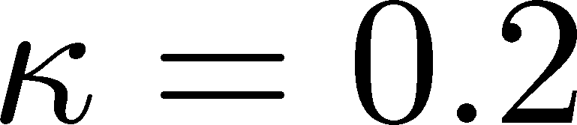
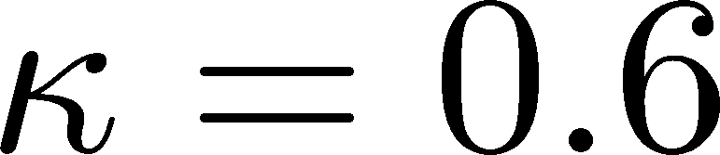




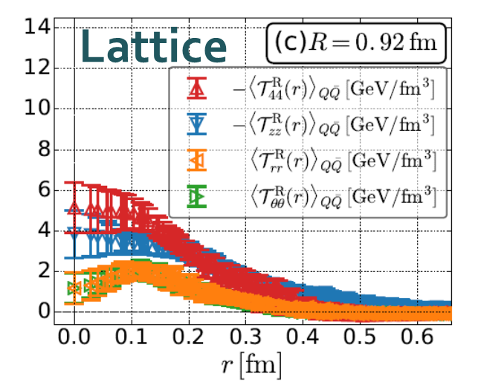
Flux Tube with Finite Length
R=0.92 fm
Left: T_{zz}(0), T_{rr}(0) reproduce lattice result
Right: A parameter satisfying T_{rr}≈T_{θθ}
No parameter can reproduce
lattice data at R=0.92fm.

Slide 59
Summary
The analysis of energy-momentum tensor on the lattice is now available, and various stuides are ongoing!
  gradient flow method
  higher-order perturbative coefficients
Pressure
Anisotropy
Correlation
Functions
Stress

Slide 60
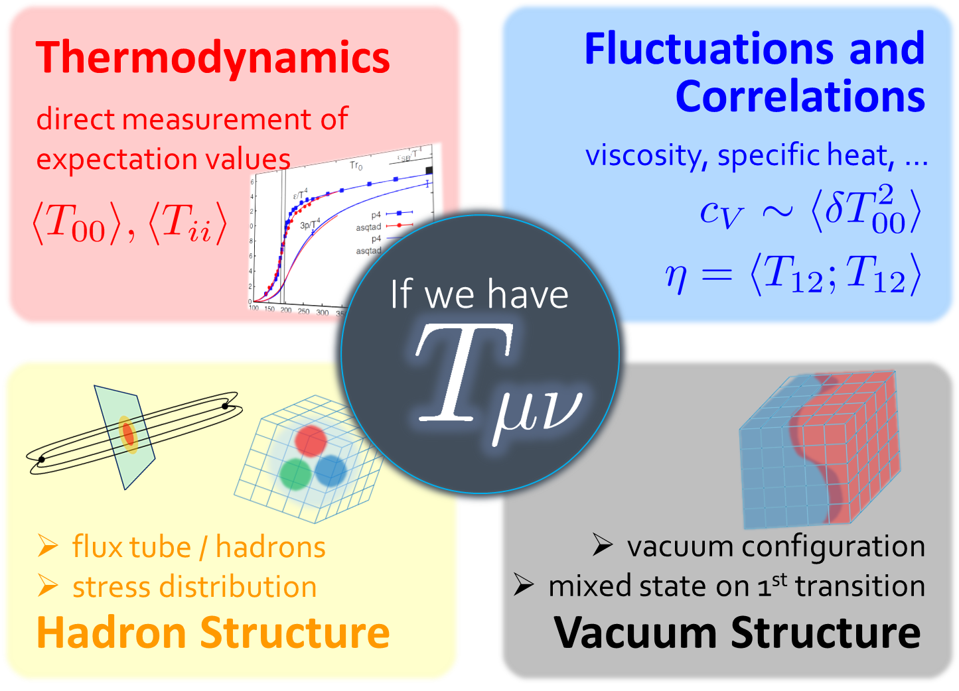
Summary
The analysis of energy-momentum tensor on the lattice is now available, and various stuides are ongoing!
  gradient flow method
  higher-order perturbative coefficients
Pressure
Anisotropy
Correlation
Functions
Stress
So many future studies
  Flux tube at nonzero temperature
  EMT distribution inside hadrons
  viscosity / other operators / instantons / full QCD

Slide 61
backup

Slide 62



EMT on the Lattice: Conventional
Lattice EMT Operator
Caracciolo+, 1990
Fit to thermodynamics: Z₃, Z₁
Shifted-boundary method: Z₆, Z₃
Giusti, Meyer, 2011; 2013;
Giusti, Pepe, 2014~; Borsanyi+, 2018
Multi-level algorithm
effective in reducing statistical error of correlator
Meyer, 2007;
Borsanyi, 2018;
Astrakhantsev+, 2018

Slide 63



Gradient Flow Method
lattice regularized
gauge theory
Smeared world
by gradient flow
gradient flow
continuum theory
gradient flow
Measure on
the lattice
analytic relation
Take Extrapolation (t,a)→(0,0)
O(t) terms in SFTE
lattice discretization

Slide 64

Numerical Simulation
FlowQCD,
PRD94, 114512 (2016)
Expectation values of T_{μν}
SU(3) YM theory
Wilson gauge action
Parameters:
Scale from gradient flow
N_{t} = 12, 16, 20-24
aspect ratio 5.3<N_{s}/N_{t}<8
1500~2000 configurations
FlowQCD, 1503.06516

Slide 65








Fermion Propagator
propagator of flow equation
Inverse propagator is needed
fermion field
t=0
gauge field

Slide 66
N_{f}=2+1 QCD Thermodynamics
Taniguchi+ (WHOT-QCD),
PRD96, 014509 (2017)
N_{f}=2+1 QCD, Iwasaki gauge + NP-clover
m_{PS}/m_{V} ≈0.63 / almost physical s quark mass
T=0: CP-PACS+JLQCD (ß=2.05, 28³x56, a≈0.07fm)
T>0: 32³xN_{t}, N_{t} = 4, 6, ... , 14, 16):
T≈174-697MeV
t→0 extrapolation only (No continuum limit)

Slide 67





Preparing Static QQ
Wilson loop
APE smearing for spatial links
Multi-hit for temporal links
No gradient flow for W(R,T)
potential
at b=6.6
(a=0.038 fm)

Slide 68
Ground State Saturation
mid point
β=6.819 (a=0.029 fm), R=0.46 fm
Appearance of plateau
for t/a²<4, T/a>15
Grand state saturation
under control

Slide 69
Ground State Saturation
t/a²=1.0
Wilson loop
t/a²=3.0
t/a²=4.0
β=6.819 (a=0.029 fm), R=0.46 fm
Appearance of plateau
for t/a²<4, T/a>15
Grand state saturation
under control

Slide 70
Abelian-Higgs Model
Abelian-Higgs Model
GL parameter:
Infinitely long tube
type-I :
type-II :
Bogomol’nyi bound :
degeneracy
Luscher, 1981
conservation law

