Slide 1
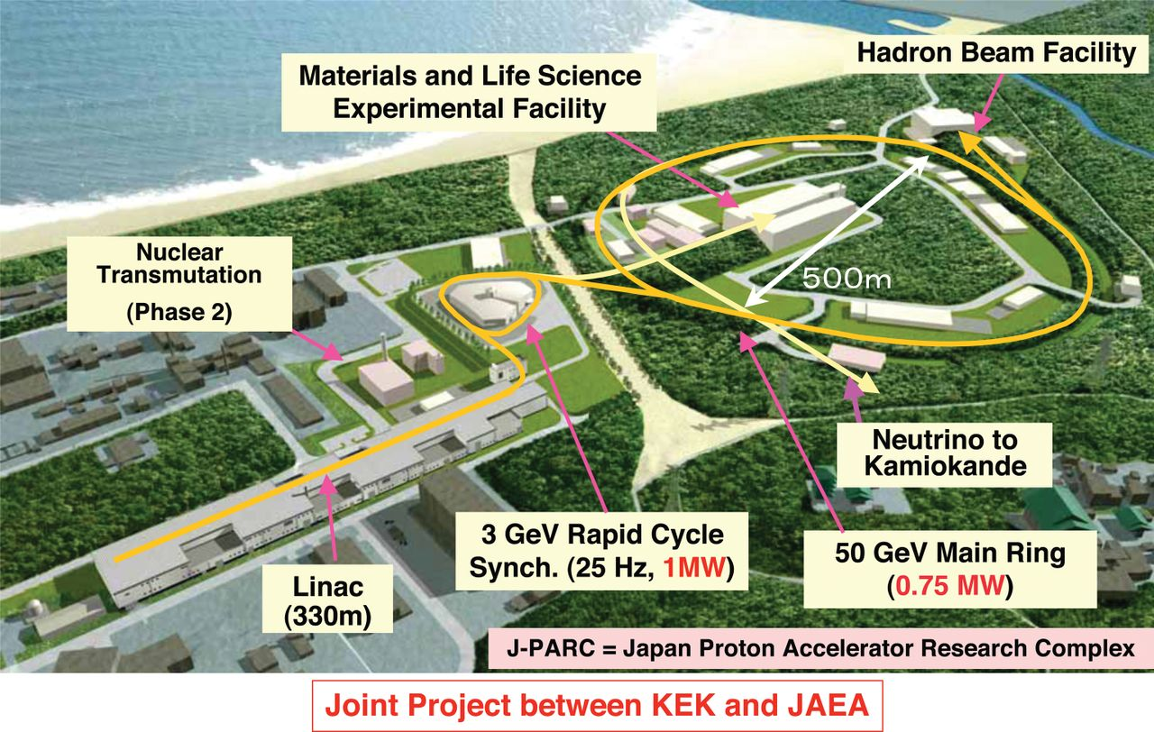
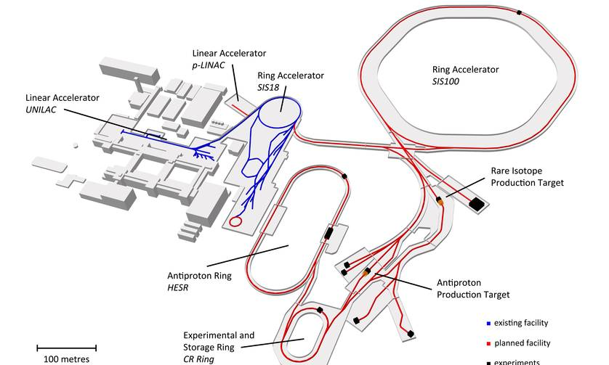
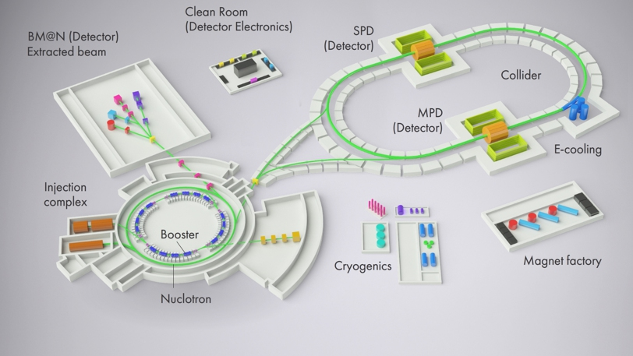
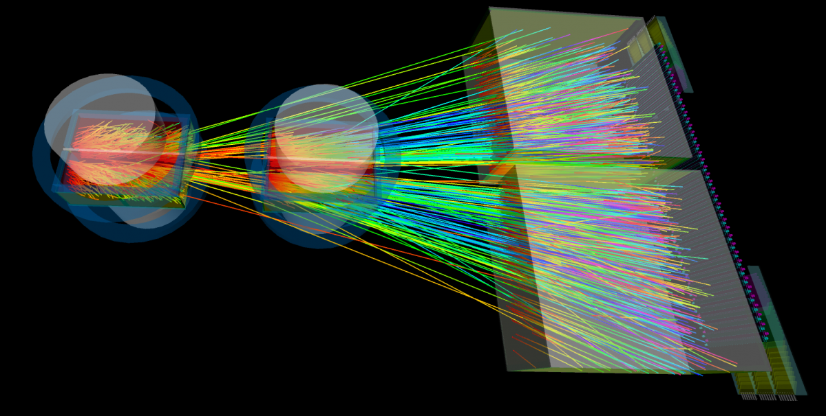
Exploring
Extremely Dense Medium in Heavy-Ion Collisions
Masakiyo Kitazawa
(Osaka U.)
NN2018, Omiya, Japan, 2018, Dec. 5

Slide 2

Relativistic Heavy-Ion Collisions
Physics
Hot & dense medium
Early Universe
Quark-gluon plasma
QCD phase structre
RHIC (2000~)
QGP Formation
Strongly coupled QGP
LHC (2010~)
Precision measurement
of the QGP
Picture of fireball by Soushi Nonaka

Slide 3




Brief History of Relativistic HIC
AGS
-1996
SPS
1994-2000
RHIC
2000-
LHC
2010-
~2010
High Energy Frontier
Picture of fireball by Soushi Nonaka

Slide 4
Brief History of Relativistic HIC
AGS
-1996
SPS
1994-2000
RHIC
2000-
LHC
2010-
RHIC-BES
2010-
~2010
High Energy Frontier
NICA
FXT: 2018-
2010~
Lower Energy
FAIR
2025-
Picture of fireball by Soushi Nonaka
J-PARC-HI
2025-?
Interaction rate
FAIR, J-PARC-HI: ~10⁷ Hz
AGS, SPS: ~10² Hz

Slide 5
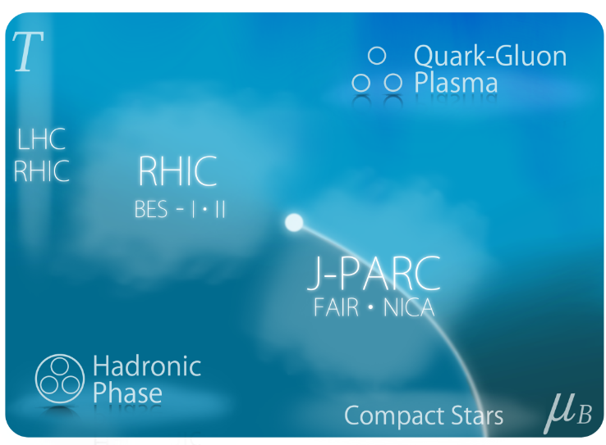
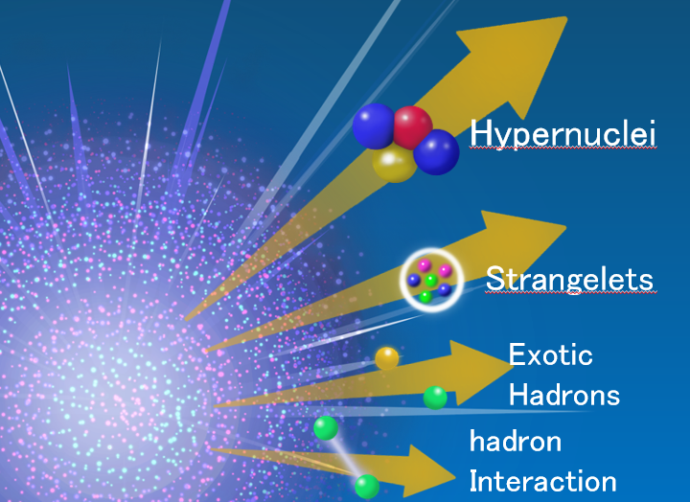
2 Main Goals
Exploring Dense Medium
QCD phase diagram
1st order phase transition
equation of state
Rare-event Factory
hyper nuclei
exotic hadrons
hadron interaction

Slide 6
2 Main Goals
Exploring Dense Medium
QCD phase diagram
1st order phase transition
equation of state
Rare-event Factory
hyper nuclei
exotic hadrons
hadron interaction

Slide 7

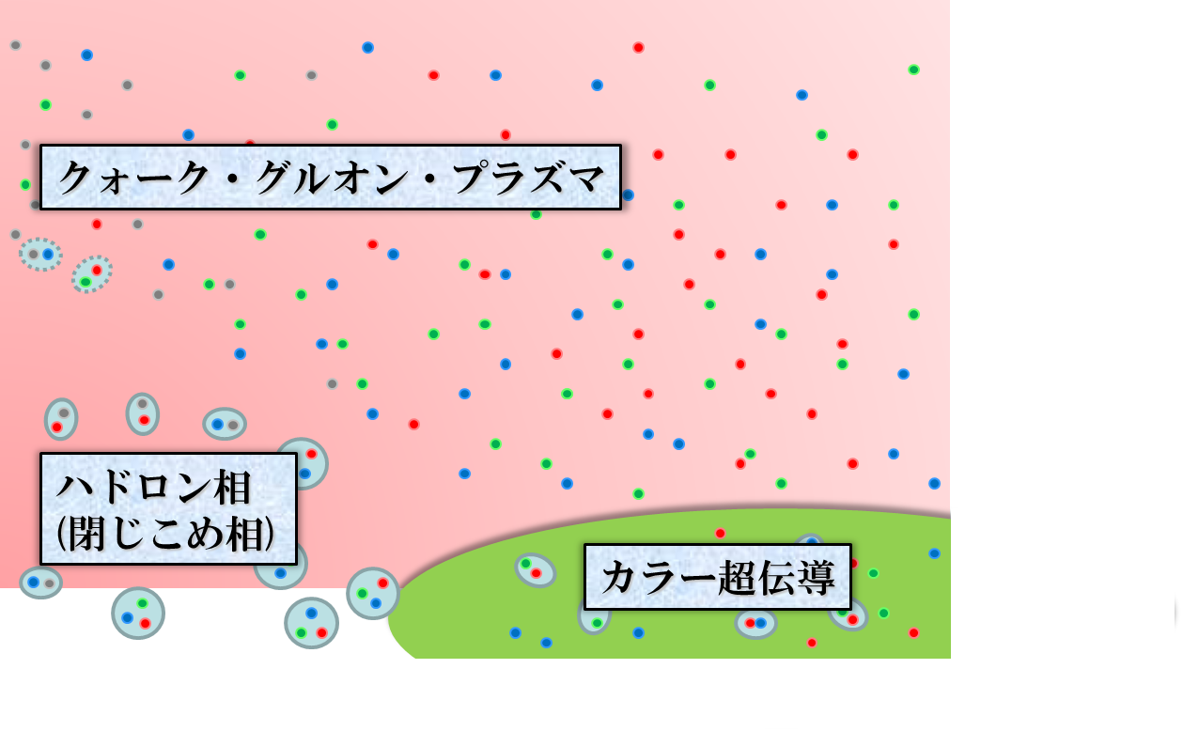





QCD Phase Diagram
Early Universe
Temperature
Quark-Gluon Plasma
ＱＣＤ Critical Point
Hadronic
Phase
Color SC
Baryon chemical
potential
Compact
Stars

Slide 8
Baryon Stopping

Slide 9
Baryon Stopping
High energy
Low energy
Nuclear transparency
Baryon stopping
net-baryon #: small
net-baryon #: large

Slide 10

Beam-Energy Scan
T, μ from particle yield
Translation to baryon density
STAR,2012
Highest baryon density

Slide 11



Maximum Density
Time evolution in T-ρ plane by JAM
A. Ohnishi, 2002
Maximum density 5~10ρ₀ @ E/A~20GeV
Large event-by-event fluctuations?

Slide 12

Beam-Energy Scan
Temperature
Beam-Energy Scan
Quark-Gluon Plasma
ＱＣＤ Critical Point
Hadronic
Phase
Color SC
Baryon chemical
potential

Slide 13



Event-by-Event Fluctuations
Review: Asakawa, MK, PPNP 90 (2016)
STAR, PRL105 (2010)
Detector
Cumulants

Slide 14


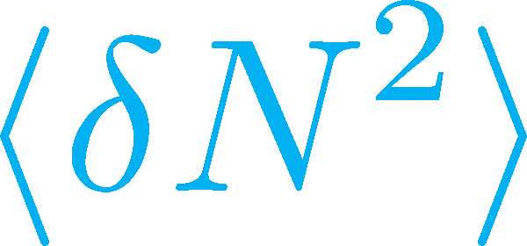

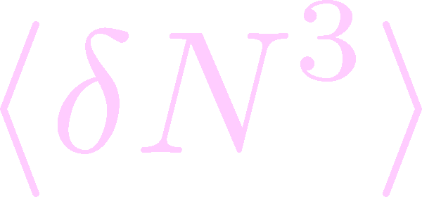

Non-Gaussian Cumulants
Gaussian fluctuations
diverge at the QCD-CP
Higher order cumulants change sign at the phase boundary
Asakawa, Ejiri, MK, 2009
Steeper divergence for higher-order cumulants
Stephanov, 2009

Slide 15


Experimental Results
Enhancement
STAR Collab.
2010~
Suppression
Enhancement & Suppression of non-Gaussian cumulants!
Have we observed
QCD critical point?

Slide 16





Rapidity Window Dependence
STAR Collab. 2015
Non-Gaussian Cumulants have been observed as a function of rapidity window Δy.
Some results have non-monotonic Δy dependence.

Slide 17
Diffusion of Non-Gaussian Fluc.
chem. f.o.
kinetic f.o.
hadronize
time
We want to see fluctuations around phase transition
But, fluctuations are modified
due to diffusion before observation

Slide 18







Rapidity Window dependence as a Result of Diffusion
MK+ (2014); MK (2015)
Parameters
(rough estimate)
Higher order cumulants can behave non-monotonically.
Δη dependence encodes history of time evolution.

Slide 19
Rapidity Window dependence as a Result of Diffusion
MK (2015)
Parameters
STAR 2015
(rough estimate)
Higher order cumulants can behave non-monotonically.
Δη dependence encodes history of time evolution.

Slide 20
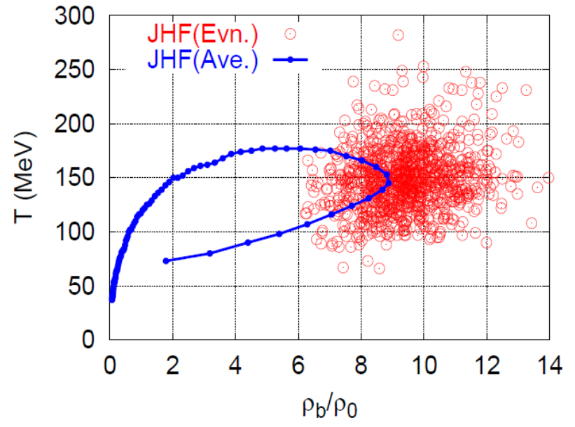
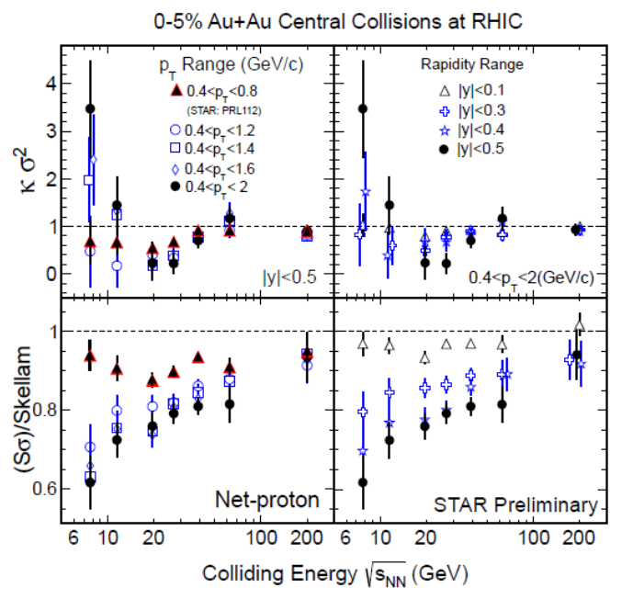
Various Observables
Flow
Dilepton / photon
Fluctuations, higher-order cumulants
Ξ, Ω, …
Sophisticated event selections
Various correlations
Can we select
these events??
MK, Sakaguchi, Sako,
Nara, Ohnishi, …

Slide 21
2 Main Goals
Exploring Dense Medium
QCD phase diagram
1st order phase transition
equation of state
Rare-event Factory
hyper nuclei
exotic hadrons
hadron interaction

Slide 22
Search for Rare Events
Exotic
Hadrons
High density
High luminosity
High strange yield
Hypernuclei
Strangelets
Rare-event
Factory
hadron
Interaction
creation
properties
interaction

Slide 23
Theoretical Challenges
RHIC / LHC
creation of QGP
hydro. models
early thermalization
(boost invariance)
RHIC/LHC:
Thermalization
Hydrodynamics
Cascade

Slide 24
Theoretical Challenges
RHIC / LHC
Lower-E Collisions
creation of QGP
hydro. models
early thermalization
(boost invariance)
Initial condition?
Thresholod of QGP formation
“Integrated” approach
  Hydro x Cascade
inter-
mediate
Hydrodynamics
Cascade

Slide 25
Hydro+JAM Integrated Model
Akamatsu, …, Nara, …, PRC98 (2018)
Murase, Tuesday F-2
Hydro+Hadron simultaneous
time evolution
Hydro
Dense hadrons →Hydronize
Cooled hydro →Hadronize
Hadrons
NEW
Integrated
hadron cascade
Particle ratios are well described in the new approach!

Slide 26
Summary
Exploring dense medium in relativistic heavy-ion collisions is one of the hottest topics in this field. Many new experiments will start in the near future!
Fluctuations are promising observables for the search for the phase structure of QCD.
Studies of hypernuclei and exotic hadrons are other important subjects in the future heavy-ion experiments.

Slide 27
J-PARC Heavy-Ion Program
H. Sako, this afternoon (E-3)
New HI Injector
high intensity
Beam energy: ~19GeV/A
Fixed target exp.
collision rate ~10⁸Hz
Launch: 2025~?
RCS & Main Ring
stable
well established
Utilize reliable / high-performance RCS & main ring
→Reduce cost and time
http://asrc.jaea.go.jp/soshiki/gr/hadron/jparc-hi/

Slide 28
backup

Slide 29
Hyper-Nuclear Phyics @ J-PARC
Negatively-charged hypernuclei (Ξ⁻n, Ξ⁻nn, …)
Nuclear strangelets
n-rich / p-rich hypernuclei
Measurement of magnetic moments

Slide 30

Hadron-hadron Interaction
ΛΛ Correlation function
STAR,2015
Hadron interaction can be studied from correlation function.
emission source
func.
+
relative
wave func.
Morita, Furumoto, Ohnishi, 2015

Slide 31


Radial Flow
①
②
①
②

Slide 32
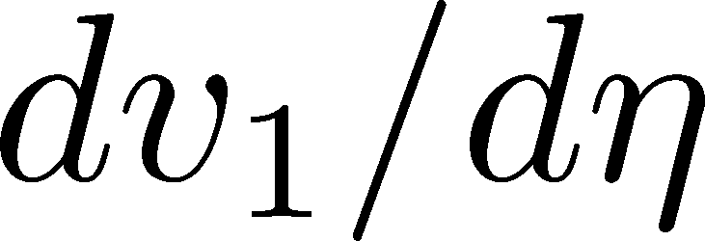
Directed Flow:
dv₁/dy: two sign change
No transport models can reproduce it quantitatively

Slide 33
dv₁/dy: Signal of 1st Phase Tr.?
Negative v₁
= signal of softening
≅1st order transition??
Nara+, 2017

Slide 34


Maximum Density Scan?
Large event-by-event fluctuations even with fixed centrality.
“Maximum density” dependence
may be studied experimentally.
average transverse energy
non-monotonic
behavior
as evidence of 1st. tr?
Baryon-rich events
Beam-energy scan
(no event selection)
faster
increase
Baryon-rich
events

Slide 35

Lepton & Photon:
Hierarchical Observation
gravitational wave
photons
Time scale: 10⁻¹s
di-lepton yield
EM probes
hadronic observables
time scale: 10⁻²²s

Slide 36
Strangeness Factory
Particle yields having strangeness have maximum at J-PARC energy

Slide 37














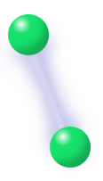
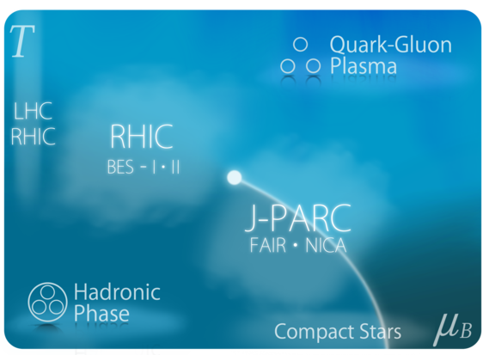

Hypernuclei
Strangelets
Exotic
Hadrons
hadron
Interaction

