Slide 1
Stress Tensor Distribution in Quark-Anti-Quark System
QCDと核子構造の進展2019、KEK、2019年3月1日
Masakiyo Kitazawa
(Osaka University)
FlowQCD Collab. (Yanagihara, Iritani, MK, Asakawa, Hatsuda
Phys. Lett. B789, 210 (2019)

Slide 2




Energy-Momentum Tensor
energy
momentum
pressure
stress
All components are important physical observables!

Slide 3




: nontrivial observable
on the lattice
Definition of the operator is nontrivial
because of the explicit breaking of Lorentz symmetry
ex:
Its measurement is extremely noisy
due to high dimensionality and etc.

Slide 4
Stress = Force per Unit Area

Slide 5


Stress = Force per Unit Area
Pressure
S

Slide 6
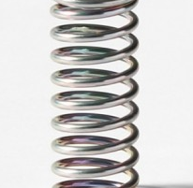



Stress = Force per Unit Area
Pressure
Generally, F and n are not parallel
v
fluid
S
F
S
elastic body
S
In thermal medium
Stress Tensor
Landau
Lifshitz

Slide 7


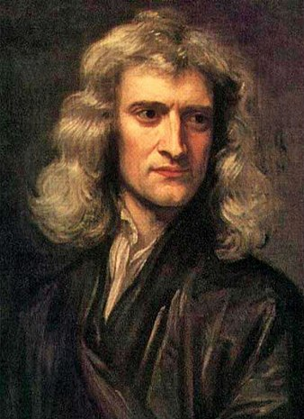


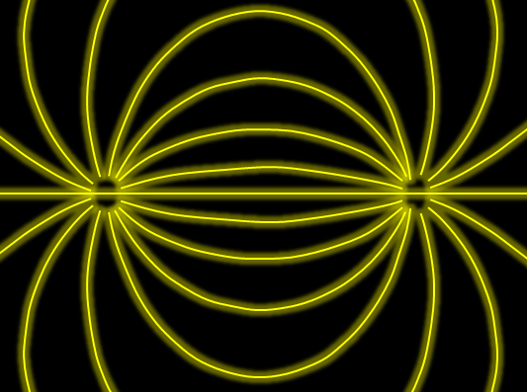

Force
Action-at-a-distance
Newton
1687
Local interaction
Faraday
1839

Slide 8




Maxwell Stress
(in Maxwell Theory)
Maxwell
E
pulling
Parallel to field: Pulling
Vertical to field: Pushing
pushing

Slide 9



Maxwell Stress
(in Maxwell Theory)
length:
pulling
pushing
Definite physical meaning
Distortion of field, line of the field
Propagation of the force as local interaction

Slide 10
Quark-Anti-quark system
Formation of the flux tube → confinement
Previous Studies on Flux Tube
Potential
Action density
Color-electric field
so many studies…
Cea+ (2012)
Cardoso+ (2013)

Slide 11
Stress Tensor in QQ System
ー
Yanagihara+, 1803.05656
PLB, in press
Lattice simulation
SU(3) Yang-Mills
a=0.029 fm
R=0.69 fm
t/a²=2.0
pulling
pushing
Definite physical meaning
Distortion of field, line of the field
Propagation of the force as local interaction
Manifestly gauge invariant

Slide 12
SU(3) YM vs Maxwell
SU(3) Yang-Mills
(quantum)
Maxwell
(classical)
Propagation of the force is clearly different
in YM and Maxwell theories!

Slide 13
Proton EMT Distribution
Pressure distribution in proton
is now accessible??
arXiv:1810.07589
Nature, 557, 396 (2018)
Kumano+,2018

Slide 14
EMT around A Quark in a deconfined phase
Q

Slide 15



EMT around A Quark in a deconfined phase
Yanagihara+, in prep.
Quenched QCD
48³x12 (T≈1.4T_{c})
fixed t , a
Preliminary
Energy density
Longitudinal pressure
Transverse pressure

Slide 16
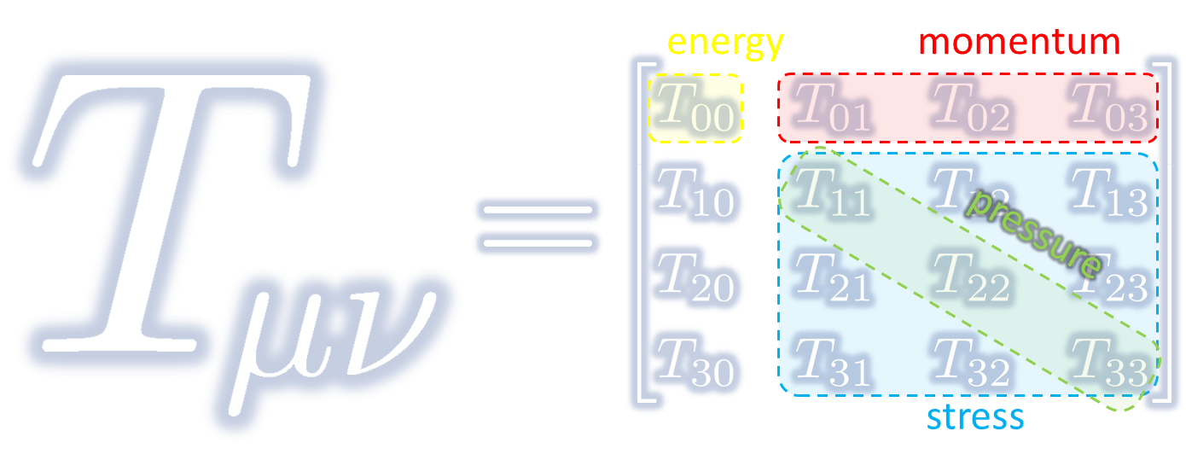
Energy-Momentum Tensor on the Lattice and Gradient Flow

Slide 17




Yang-Mills Gradient Flow
Luscher 2010
Narayanan, Neuberger, 2006
Luscher, Weiss, 2011
t: “flow time”
dim:[length²]
leading
diffusion equation in 4-dim space
diffusion distance
“continuous” cooling/smearing
No UV divergence at t>0

Slide 18
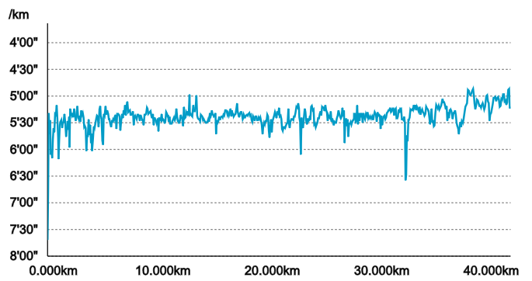
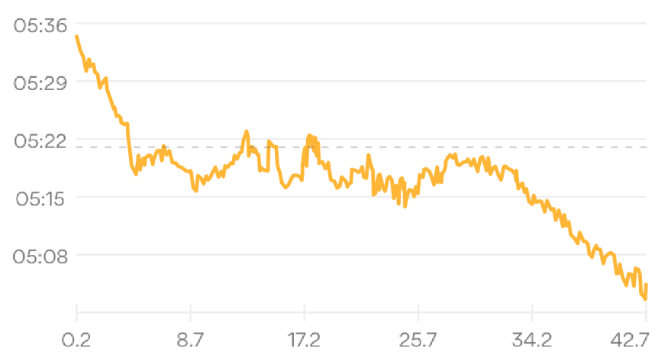


Gradient Flow = Smearing
Original Data
RunKeeper

Slide 19
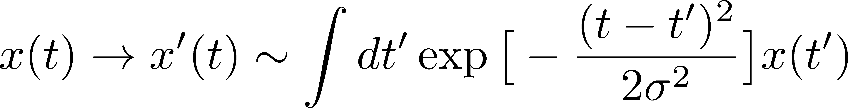
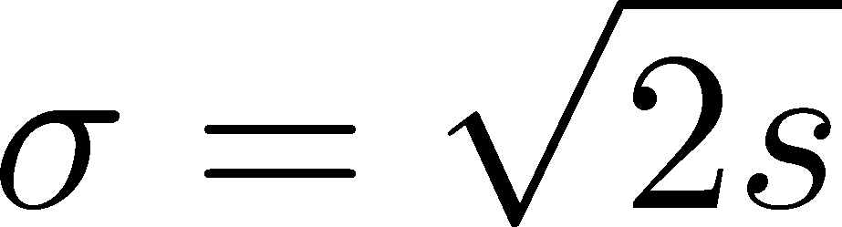
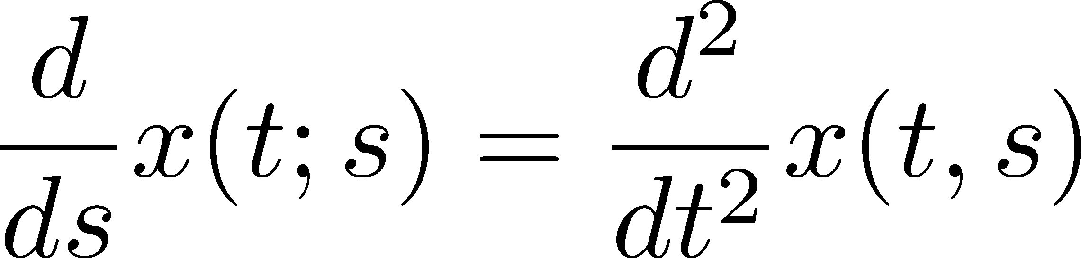
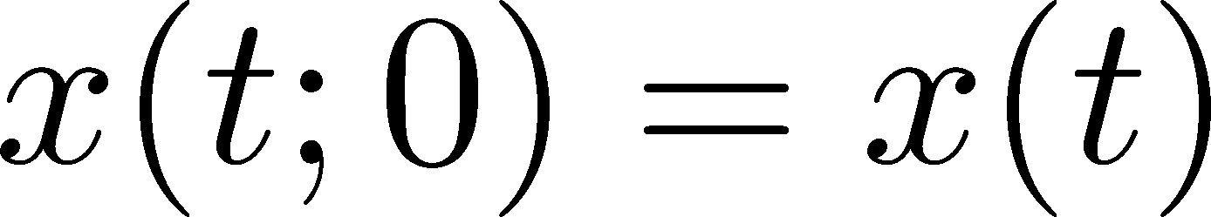

Gradient Flow = Smearing
Original Data
RunKeeper
Gaussian
①
②
Gradient Flow

Slide 20
Two Advantages of EMT Operator from Gradient Flow
The operator is uniquely determined
Statistics is substantially improved

Slide 21





Small Flow-Time Expansion
Luescher, Weisz, 2011
Suzuki, 2013
an operator at t>0
remormalized operators
of original theory
original 4-dim theory
t→0 limit

Slide 22


Constructing EMT 1
Suzuki, 2013
Gauge-invariant dimension 4 operators

Slide 23

Constructing EMT 2
Suzuki, 2013
vacuum subtr.
Remormalized EMT

Slide 24



Gradient Flow Method
lattice regularized
gauge theory
Smeared world
by gradient flow
gradient flow
continuum theory
gradient flow
Measure on
the lattice
analytic relation
Take Extrapolation (t,a)→(0,0)
O(t) terms in SFTE
lattice discretization

Slide 25





Perturbative Coefficients
Suzuki, PTEP 2013, 083B03
Harlander+, 1808.09837
Iritani, MK, Suzuki, Takaura, PTEP 2019
LO
1-loop
2-loop
3-loop
×
zero
Suzuki (2013)
Choice of the scale of g²
Previous:
Improved:
Harlander+ (2018)

Slide 26
Perturbative Coefficients
Suzuki, PTEP 2013, 083B03
Harlander+, 1808.09837
Iritani, MK, Suzuki, Takaura, PTEP 2019
LO
1-loop
2-loop
3-loop
×
Iritani, MK, Suzuki,
Takaura, 2019
zero
Suzuki (2013)
Harlander+(2018)
Choice of the scale of g²
Previous:
Improved:
Harlander+ (2018)

Slide 27



Thermodynamics of SU(3) YM
Integral method
  Most conventional / established
  Use themodynamic relations
  Boyd+ 1995; Borsanyi, 2012
Gradient-flow method
  Take expectation values of EMT
  FlowQCD, 2014, 2016
Moving-frame method
  Giusti, Pepe, 2014~
Non-equilibrium method
  Use Jarzynski’s equality Caselle+, 2016;2018
Differential method
  Shirogane+(WHOT-QCD), 2016~

Slide 28
Temperature Dependence
FlowQCD,2016
(1-loop)
Excellent agreement with integral method
High accuracy only with ~2000 confs.
Error includes
statistical error
choice of t range for t→0 limit
uncertainty in aΛ_{MS}
total error <1.5% for T>1.1T_{c}

Slide 29
Higher Order Coefficient: ε+p
NLO (1-loop)
N²LO (2-loop)
FlowQCD
2016
Iritani, MK, Suzuki, Takaura, 2019
t dependence becomes milder with higher order coeff.
1-loop → 2-loop : about 2% increase
Systematic analysis: μ₀ or μ_{d}, uncertainty of Λ, fit range
Extrapolation func: linear, higher order term in c₁ (~g⁶)

Slide 30




Double Extrapolation t→0, a→0
O(t) terms in SFTE
lattice discretization
Continuum extrapolation
strong
discretization
effect
Small t extrapolation

Slide 31
Higher Order Coefficient: ε+p
NLO (1-loop)
N²LO (2-loop)
Range2
Range1
Range3
Iritani, MK, Suzuki, Takaura, 2019
t dependence becomes milder with higher order coeff.
1-loop → 2-loop : about 2% increase
Systematic analysis: μ₀ or μ_{d}, uncertainty of Λ, fit range
Extrapolation func: linear, higher order term in c₁ (~g⁶)

Slide 32
Effect of Higher-Order Coeffs.
Iritani, MK, Suzuki, Takaura, 2019
□: 2-loop
△: Flow2016
Systematic error: μ₀ or μ_{d}, Λ, t→0 function, fit range
Effect of higher order c₁ & c₂
(pure gauge)
e-3p: negligible (<0.5%)
e+p: ~2% increase

Slide 33
2+1 QCD EoS from Gradient Flow
Taniguchi+ (WHOT-QCD), PRD96, 014509 (2017)
m_{PS}/m_{V} ≈0.63
no linear
window
no linear
window
Agreement with integral method except for N_{t}=4, 6
N_{t}=4, 6: No stable extrapolation is possible
Statistical error is substantially suppressed!
Physical mass: Kanaya+ (WHOT-QCD), 1710.10015

Slide 34
見小利則大事不成
小利を見ればすなわち大事成らず
Miss the wood for the trees
孔子
（論語、子路13）

Slide 35
Stress Tensor Distribution
around Flux Tube

Slide 36

Lattice Setup
SU(3) Yang-Mills (Quenched)
Wilson gauge action
Clover operator
APE smearing / multi-hit
fine lattices (a=0.029-0.06 fm)
continuum extrapolation
Simulation: bluegene/Q@KEK
R=0.92 fm
R=0.69 fm
R=0.46 fm
Yanagihara+, 1803.05656

Slide 37






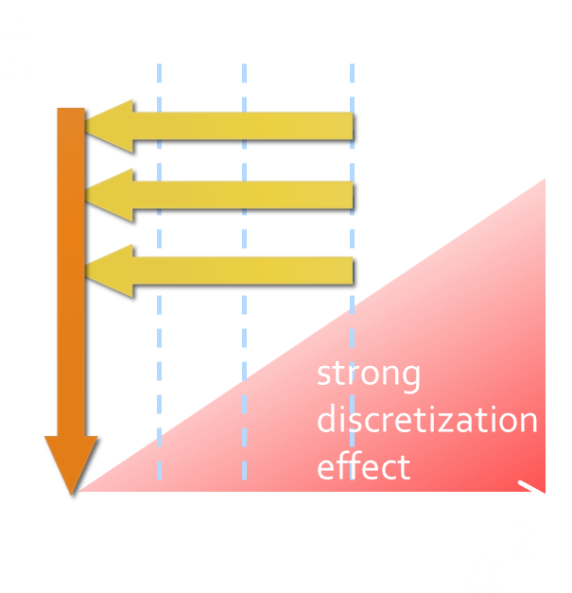
Continuum Extrapolation at mid-point
mid point
continuum
limit
a→0 extrapolation with fixed t

Slide 38
t→0 Extrapolation at mid-point
Range2
continuum
limit
Range1
Range3
a→0 extrapolation with fixed t
Then, t→0 with three ranges

Slide 39
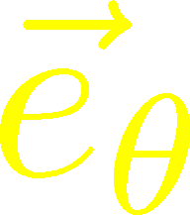
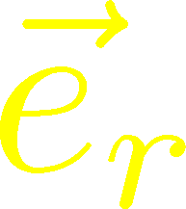
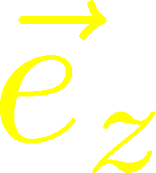



Stress Distribution on Mid-Plane
From rotational symm. & parity
EMT is diagonalized
in Cylindrical Coordinates
Degeneracy
in Maxwell theory

Slide 40


Mid-Plane
Separation
Continuum
Extrapolated!
In Maxwell theory
Degeneracy:
Separation:
Nonzero trace anomaly

Slide 41
Mid-Plane
Separation
Continuum
Extrapolated!
Degeneracy:
Separation:
Nonzero trace anomaly

Slide 42


Force
Force from Potential
Force from Stress

Slide 43
Force
Force from Potential
Force from Stress
Newton
1687
Faraday
1839

Slide 44
Force
Force from Potential
Force from Stress
Good Agreement!
Newton
1687
Faraday
1839

Slide 45
Dual Superconductor Picture
Nambu, 1970
Nielsen, Olesen, 1973
t ‘Hooft, 1981
…
QCD Vacuum
Superconductor
Anti-
Monopole
Quark
Anti-quark
Monopole
Flux Tube
Magnetic Vortex
Dual (E⇔B)

Slide 46






Abelian-Higgs Model
Yanagihara, Iritani, MK, in prep.
Abelian-Higgs Model
GL parameter:
Infinitely long tube
type-I :
type-II :
Bogomol’nyi bound :
degeneracy
Luscher, 1981
momentum conservation

Slide 47

Stress Tensor in AH Model infinitely-long flux tube
Bogomol’nyi bound :
de Vega, Schaposnik, PRD14, 1100 (1976).

Slide 48




Stress Tensor in AH Model infinitely-long flux tube
Type-I
Type-II
No degeneracy bw T_{rr} & T_{θθ}
T_{θθ} changes sign
conservation law

Slide 49

Stress Tensor in AH Model infinitely-long flux tube
Type-I
Lattice
Inconsistent with
lattice result
No degeneracy bw T_{rr} & T_{θθ}
T_{θθ} changes sign

Slide 50
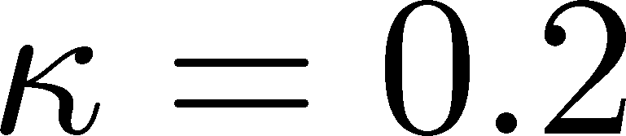
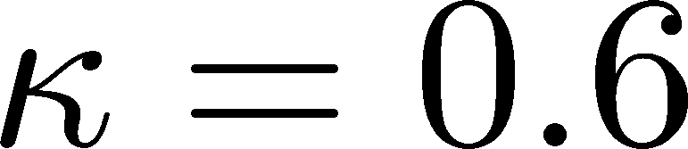




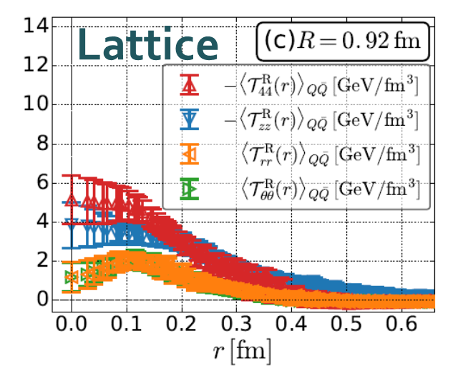
Flux Tube with Finite Length
R=0.92 fm
Left: T_{zz}(0), T_{rr}(0) reproduce lattice result
Right: A parameter satisfying T_{rr}≈T_{θθ}
No parameter can reproduce
lattice data at R=0.92fm.

Slide 51
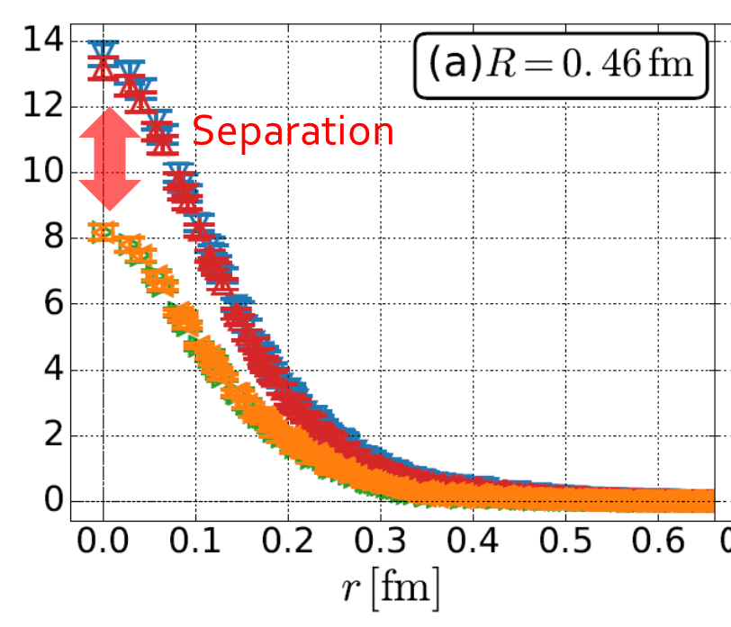
Summary
EMT (stress tensor) is a useful observable in understanding the flux tube.
Lattice data suggest that
  Degeneracy: T₄₄ ≈ T_{zz} , T_{rr} ≈ T_{θθ}
  Separation: T_{zz} ≠ T_{rr}
  Degeneracy of T_{rr} & T_{θθ} suggests that finite-length effect of the flux tube is not negligible.
Are there a priori reason for degeneragy of : T₄₄ & T_{rr} ?
Future
  Excited states / nonzero T / full QCD
  stress distribution inside hadrons
arXiv:1810.07589
Nature, 557, 396 (2018)

Slide 52





Pressure anisotropy in finite system
Casimir effect
Finite system at nonzero T
MK, Mogliacci, Kolbe,
Horowitz, in preparation
attractive
pressure anisotropy

Slide 53
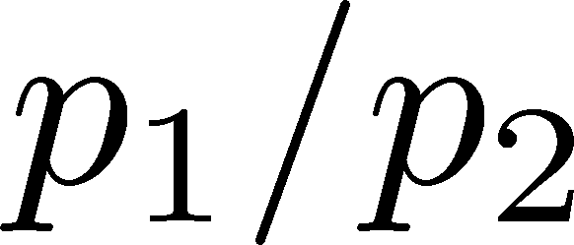
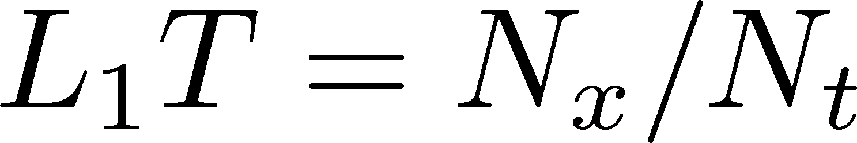



Pressure Anisotropy
MK, Mogliacci, Kolbe,
Horowitz, in prep.
Free scalar field
L₂=L₃=∞
Mogliacci+, 1807.07871

Slide 54
Pressure Anisotropy
MK, Mogliacci, Kolbe,
Horowitz, in prep.
Free scalar field
L₂=L₃=∞
Nt=12
Preliminary
Mogliacci+, 1807.07871
Lattice result
Periodic BC
N_{s}²xN_{x}xN_{t}=72²xN_{x}x12
N_{x}=12, 14, 16, 18
Only t→0 limit (fixed a)
Medium near T_{c} is remarkably insensitive to finite size!
How do we understand??

Slide 55
backup

Slide 56



EMT on the Lattice: Conventional
Lattice EMT Operator
Caracciolo+, 1990
Fit to thermodynamics: Z₃, Z₁
Shifted-boundary method: Z₆, Z₃
Giusti, Meyer, 2011; 2013;
Giusti, Pepe, 2014~; Borsanyi+, 2018
Multi-level algorithm
effective in reducing statistical error of correlator
Meyer, 2007;
Borsanyi, 2018;
Astrakhantsev+, 2018

Slide 57

Numerical Simulation
FlowQCD,
PRD94, 114512 (2016)
Expectation values of T_{μν}
SU(3) YM theory
Wilson gauge action
Parameters:
Scale from gradient flow
N_{t} = 12, 16, 20-24
aspect ratio 5.3<N_{s}/N_{t}<8
1500~2000 configurations
FlowQCD, 1503.06516

Slide 58








Fermion Propagator
propagator of flow equation
Inverse propagator is needed
fermion field
t=0
gauge field

Slide 59
N_{f}=2+1 QCD Thermodynamics
Taniguchi+ (WHOT-QCD),
PRD96, 014509 (2017)
N_{f}=2+1 QCD, Iwasaki gauge + NP-clover
m_{PS}/m_{V} ≈0.63 / almost physical s quark mass
T=0: CP-PACS+JLQCD (ß=2.05, 28³x56, a≈0.07fm)
T>0: 32³xN_{t}, N_{t} = 4, 6, ... , 14, 16):
T≈174-697MeV
t→0 extrapolation only (No continuum limit)

Slide 60
Ground State Saturation
mid point
β=6.819 (a=0.029 fm), R=0.46 fm
Appearance of plateau
for t/a²<4, T/a>15
Grand state saturation
under control

Slide 61



Ground State Saturation
t/a²=1.0
Wilson loop
t/a²=3.0
t/a²=4.0
β=6.819 (a=0.029 fm), R=0.46 fm
Appearance of plateau
for t/a²<4, T/a>15
Grand state saturation
under control

Slide 62


EMT in QCD

Slide 63
Higher Order Coefficient: ε-3p
N²LO (2-loop)
N³LO (3-loop)
Iritani, MK, Suzuki, Takaura, in prep.
No difference b/w 2- & 3-loops: 2-loop is already good!
Systematic analysis: μ₀ or μ_{d}, uncertainty of Λ, fit range
Extrapolation func: linear, higher order term in c₂ (~g⁸)

Slide 64



Gradient Flow for Fermions
Luscher, 2013
Makino, Suzuki, 2014
Taniguchi+ (WHOT)
2016; 2017
Not “gradient” flow but a “diffusion” equation.
Divergence in field renormalization of fermions.
All observables are finite at t>0 once Z(t) is fixed.
Energy-momentum tensor from SFTE Makino, Suzuki, 2014

Slide 65
Abelian-Higgs Model
Abelian-Higgs Model
GL parameter:
Infinitely long tube
type-I :
type-II :
Bogomol’nyi bound :
degeneracy
Luscher, 1981
conservation law

