Slide 1
高温物質中における
クォーク間相互作用の
微視的伝達機構の解明
OCTOPUS 平成30年度公募型利用制度 成果報告会、2019年3月5日
北沢正清
(阪大理)
FlowQCD Collab. (Yanagihara, Iritani, MK, Asakawa, Hatsuda
Phys. Lett. B789, 210 (2019)

Slide 2


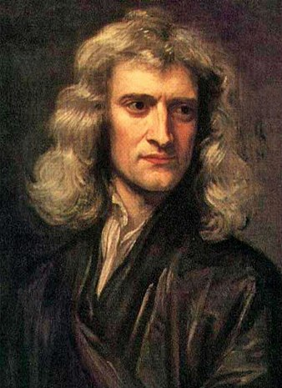


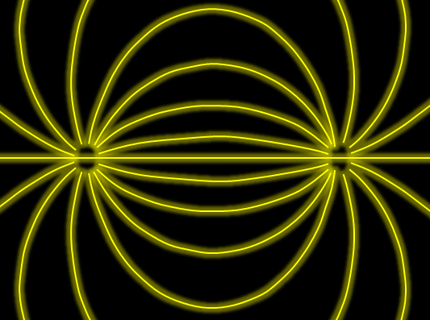

Force
Action-at-a-distance
Newton
1687
Local interaction
Faraday
1839

Slide 3
Stress = Force per Unit Area

Slide 4


Stress = Force per Unit Area
Pressure
S

Slide 5
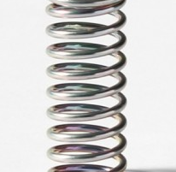



Stress = Force per Unit Area
Pressure
Generally, F and n are not parallel
v
fluid
S
F
S
elastic body
S
In thermal medium
Stress Tensor
Landau
Lifshitz

Slide 6




Maxwell Stress
(in Maxwell Theory)
Maxwell
E
pulling
Parallel to field: Pulling
Vertical to field: Pushing
pushing

Slide 7



Maxwell Stress
(in Maxwell Theory)
length:
pulling
pushing
Definite physical meaning
Distortion of field, line of the field
Propagation of the force as local interaction

Slide 8
Quark-Anti-quark system
Formation of the flux tube → confinement
Previous Studies on Flux Tube
Potential
Action density
Color-electric field
so many studies…
Cea+ (2012)
Cardoso+ (2013)

Slide 9
Stress Tensor in QQ System
ー
Yanagihara+, PLB (2019)
Lattice simulation
SU(3) Yang-Mills
a=0.029 fm
R=0.69 fm
t/a²=2.0
pulling
pushing
Definite physical meaning
Distortion of field, line of the field
Propagation of the force as local interaction
Manifestly gauge invariant

Slide 10
SU(3) YM vs Maxwell
SU(3) Yang-Mills
(quantum)
Maxwell
(classical)
Propagation of the force is clearly different
in YM and Maxwell theories!

Slide 11

Energy-Momentum Tensor
the most fundamental observable in physics
Einstein Equation

Slide 12




Energy-Momentum Tensor
the most fundamental observable in physics
Einstein Equation
All components are important physical observables!
energy
momentum
pressure
stress

Slide 13




: nontrivial observable
on the lattice
Definition of the operator is nontrivial
because of the explicit breaking of Lorentz symmetry
ex:
Its measurement is extremely noisy
due to high dimensionality and etc.

Slide 14
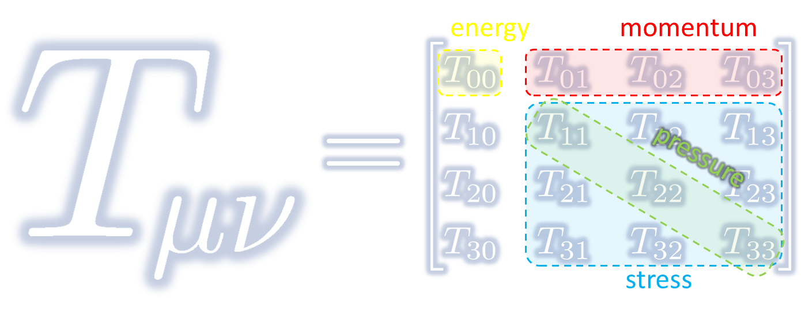
Energy-Momentum Tensor on the Lattice and Gradient Flow

Slide 15




Yang-Mills Gradient Flow
Luscher 2010
Narayanan, Neuberger, 2006
Luscher, Weiss, 2011
t: “flow time”
dim:[length²]
leading
diffusion equation in 4-dim space
diffusion distance
“continuous” cooling/smearing
No UV divergence at t>0

Slide 16
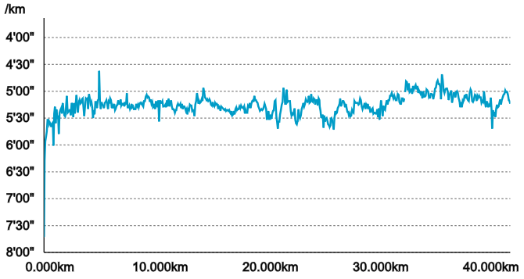
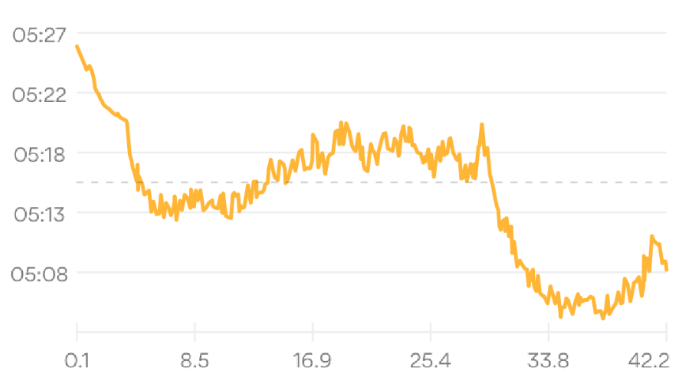


Gradient Flow = Smearing
Original Data
RunKeeper
第39回篠山ABCマラソン
2019年3月3日(日)
記録：3:42.45

Slide 17

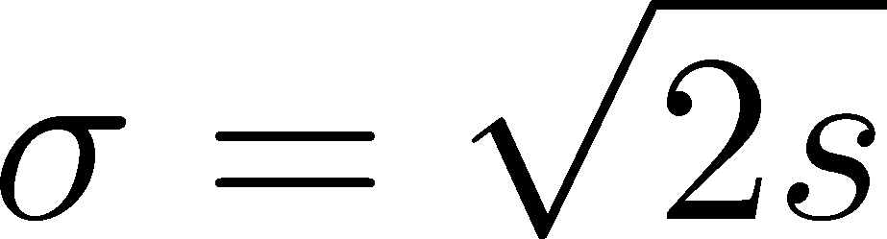



Gradient Flow = Smearing
Original Data
RunKeeper
Gaussian
①
②
Gradient Flow

Slide 18
Two Advantages of EMT Operator from Gradient Flow
The operator is uniquely determined
Statistics is substantially improved

Slide 19





Small Flow-Time Expansion
Luescher, Weisz, 2011
Suzuki, 2013
an operator at t>0
remormalized operators
of original theory
original 4-dim theory
t→0 limit

Slide 20


Constructing EMT 1
Suzuki, 2013
Gauge-invariant dimension 4 operators

Slide 21

Constructing EMT 2
Suzuki, 2013
vacuum subtr.
Remormalized EMT

Slide 22



Gradient Flow Method
lattice regularized
gauge theory
Smeared world
by gradient flow
gradient flow
continuum theory
gradient flow
Measure on
the lattice
analytic relation
Take Extrapolation (t,a)→(0,0)
O(t) terms in SFTE
lattice discretization

Slide 23



Thermodynamics of SU(3) YM
Integral method
  Most conventional / established
  Use themodynamic relations
  Boyd+ 1995; Borsanyi, 2012
Gradient-flow method
  Take expectation values of EMT
  FlowQCD, 2014, 2016
Moving-frame method
  Giusti, Pepe, 2014~
Non-equilibrium method
  Use Jarzynski’s equality Caselle+, 2016;2018
Differential method
  Shirogane+(WHOT-QCD), 2016~

Slide 24
Higher Order Coefficient: ε+p
NLO (1-loop)
N²LO (2-loop)
Range2
Range1
Range3
Iritani, MK, Suzuki, Takaura, 2019
t dependence becomes milder with higher order coeff.
1-loop → 2-loop : about 2% increase
Systematic analysis: μ₀ or μ_{d}, uncertainty of Λ, fit range
Extrapolation func: linear, higher order term in c₁ (~g⁶)

Slide 25
Effect of Higher-Order Coeffs.
Iritani, MK, Suzuki, Takaura, 2019
□: 2-loop
△: Flow2016
Systematic error: μ₀ or μ_{d}, Λ, t→0 function, fit range
Effect of higher order c₁ & c₂
(pure gauge)
e-3p: negligible (<0.5%)
e+p: ~2% increase

Slide 26
2+1 QCD EoS from Gradient Flow
Taniguchi+ (WHOT-QCD), PRD96, 014509 (2017)
m_{PS}/m_{V} ≈0.63
no linear
window
no linear
window
Agreement with integral method except for N_{t}=4, 6
N_{t}=4, 6: No stable extrapolation is possible
Statistical error is substantially suppressed!
Physical mass: Kanaya+ (WHOT-QCD), 1710.10015

Slide 27
Stress Tensor Distribution
around Flux Tube

Slide 28

Lattice Setup
SU(3) Yang-Mills (Quenched)
Wilson gauge action
Clover operator
APE smearing / multi-hit
fine lattices (a=0.029-0.06 fm)
continuum extrapolation
Simulation: bluegene/Q@KEK
R=0.92 fm
R=0.69 fm
R=0.46 fm
Yanagihara+, 1803.05656

Slide 29






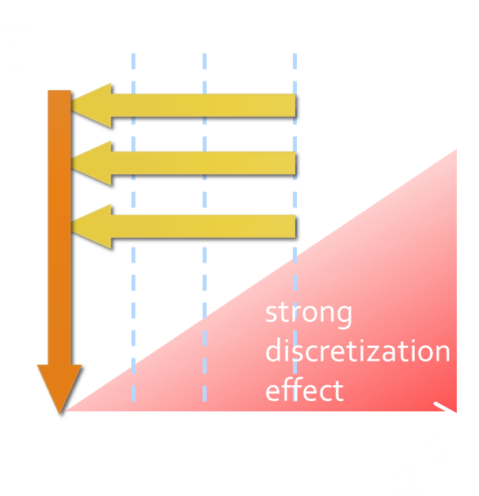
Continuum Extrapolation at mid-point
mid point
continuum
limit
a→0 extrapolation with fixed t

Slide 30
t→0 Extrapolation at mid-point
Range2
continuum
limit
Range1
Range3
a→0 extrapolation with fixed t
Then, t→0 with three ranges

Slide 31
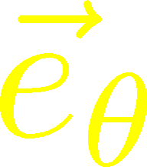

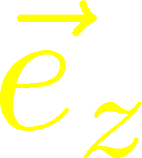



Stress Distribution on Mid-Plane
From rotational symm. & parity
EMT is diagonalized
in Cylindrical Coordinates
Degeneracy
in Maxwell theory

Slide 32


Mid-Plane
Separation
Continuum
Extrapolated!
In Maxwell theory
Degeneracy:
Separation:
Nonzero trace anomaly

Slide 33
Mid-Plane
Separation
Continuum
Extrapolated!
Degeneracy:
Separation:
Nonzero trace anomaly

Slide 34


Force
Force from Potential
Force from Stress

Slide 35
Force
Force from Potential
Force from Stress
Newton
1687
Faraday
1839

Slide 36
Force
Force from Potential
Force from Stress
Good Agreement!
Newton
1687
Faraday
1839

Slide 37
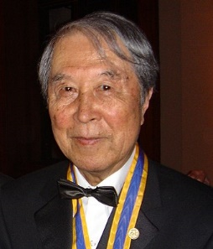
Dual Superconductor Picture
Nambu, 1970
Nielsen, Olesen, 1973
t ‘Hooft, 1981
…
QCD Vacuum
Superconductor
Anti-
Monopole
Quark
Anti-quark
Monopole
Flux Tube
Magnetic Vortex
Dual (E⇔B)

Slide 38






Abelian-Higgs Model
Yanagihara, Iritani, MK, in prep.
Abelian-Higgs Model
GL parameter:
Infinitely long tube
type-I :
type-II :
Bogomol’nyi bound :
degeneracy
Luscher, 1981
momentum conservation

Slide 39




Stress Tensor in AH Model infinitely-long flux tube
Type-I
Type-II
No degeneracy bw T_{rr} & T_{θθ}
T_{θθ} changes sign
conservation law

Slide 40

Stress Tensor in AH Model infinitely-long flux tube
Type-I
Lattice
Inconsistent with
lattice result
No degeneracy bw T_{rr} & T_{θθ}
T_{θθ} changes sign

Slide 41

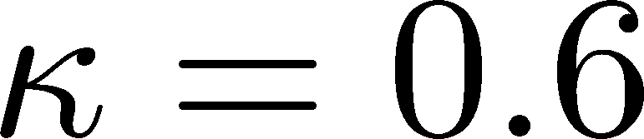




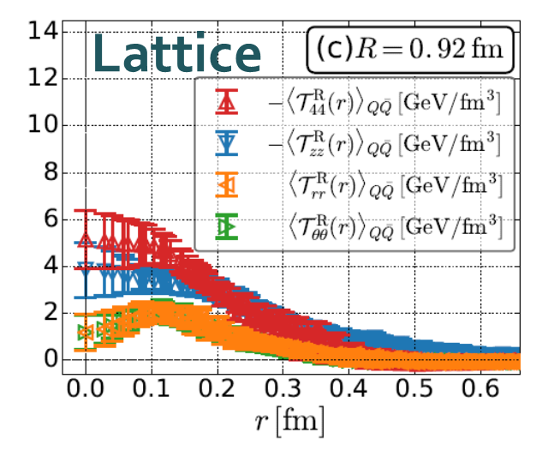
Flux Tube with Finite Length
R=0.92 fm
Left: T_{zz}(0), T_{rr}(0) reproduce lattice result
Right: A parameter satisfying T_{rr}≈T_{θθ}
No parameter can reproduce
lattice data at R=0.92fm.

Slide 42
本年度の成果
Quark Anti-Quark System
in the Early Universe

Slide 43

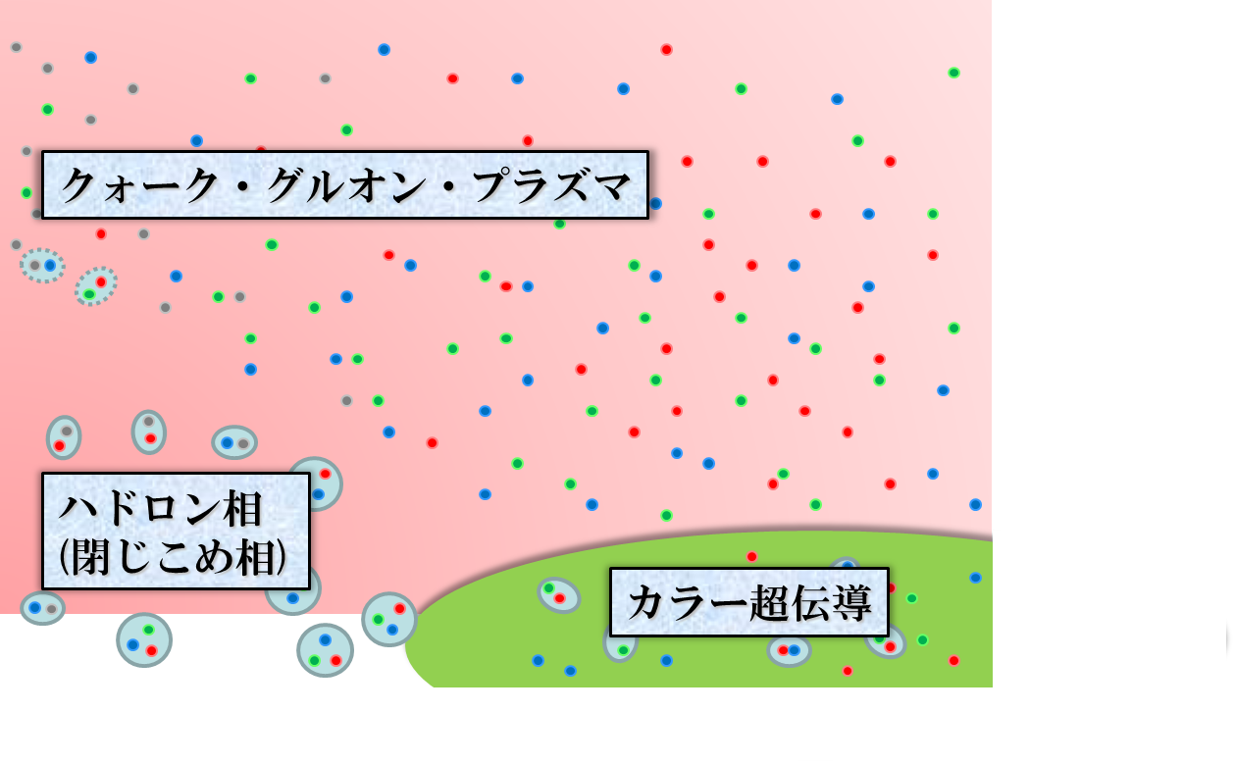





QCD Phase Diagram
Early Universe
Temperature
Quark-Gluon Plasma
ＱＣＤ Critical Point
Hadronic
Phase
Color SC
Baryon chemical
potential
Compact
Stars

Slide 44
SU(3) YM Thermodynamics
FlowQCD,2016
(1-loop)
1st order phase transition at Tc≈3x10¹² Kelvin
Sudden increase of energy density and pressure at Tc

Slide 45
Quark Anti-Quark Potential
vacuum
high temperature
Q-Qbar force is screened in the deconfined phase.

Slide 46
Temperature Dependence
Vacuum
(Current Universe)
High Temperature
(Early Universe)
?

Slide 47
Temperature Dependence
Vacuum
(Current Universe)
High Temperature
(Early Universe)
T=1.42Tc
Flux-tube structure disappears above Tc.

Slide 48
Stress Distribution on Mid-Plane
From rotational symm. & parity
EMT is diagonalized
in Cylindrical Coordinates
Degeneracy
in Maxwell theory

Slide 49
Mid-Plane
Vacuum
T=1.42Tc
Separation
Degeneracy:
Separation:
Too strong stress? Transverse stress is suppressed

Slide 50
Proton EMT Distribution
EMT distribution inside hadrons now accessible??
Pressure @ proton
EMT distribution @ pion
arXiv:1810.07589
Nature, 557, 396 (2018)
Kumano, Song, Teryaev
Phys. Rev. D 97, 014020 (2018)

Slide 51
EMT around A Quark in a deconfined phase
Q

Slide 52



EMT around A Quark in a deconfined phase
Yanagihara+, in prep.
Quenched QCD
48³x12 (T≈1.4T_{c})
fixed t , a
Preliminary
Energy density
Longitudinal pressure
Transverse pressure
not
reliable

Slide 53





Pressure anisotropy in finite system
Casimir effect
Finite system at nonzero T
MK, Mogliacci, Kolbe,
Horowitz, in preparation
attractive
pressure anisotropy

Slide 54
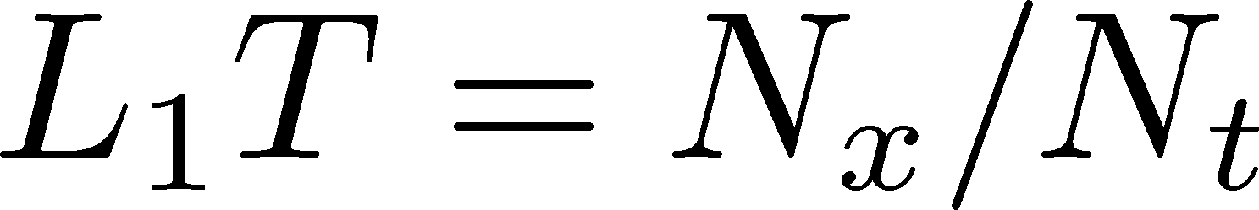
Pressure Anisotropy
MK, Mogliacci, Kolbe,
Horowitz, in prep.
Free scalar field
L₂=L₃=∞
Preliminary
Mogliacci+, 1807.07871
Lattice result
Periodic BC
Only t→0 limit
Medium near T_{c} is remarkably insensitive to finite size!
How do we understand??

Slide 55
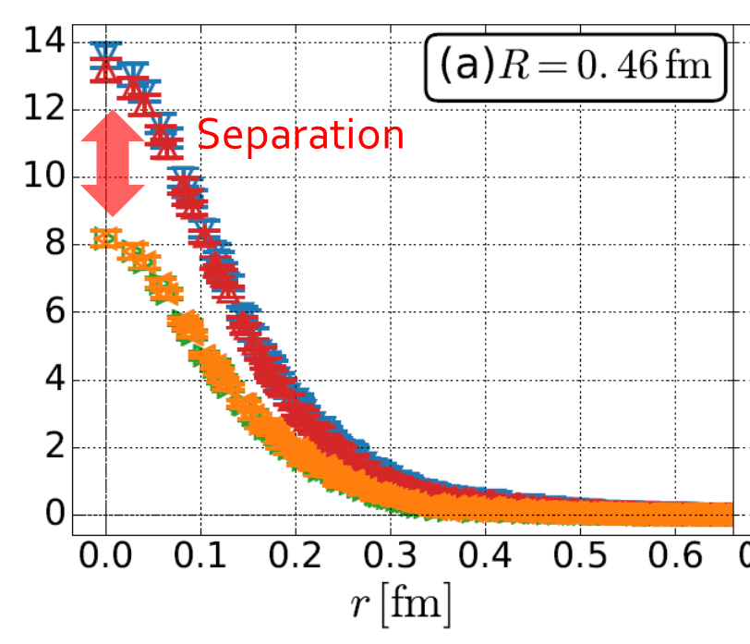
Summary
EMT (stress tensor) is a useful observable in understanding QCD and YM gauge theory.
EMT distribution in vacuum is now available:
  Degeneracy: T₄₄ ≈ T_{zz} , T_{rr} ≈ T_{θθ}
  Separation: T_{zz} ≠ T_{rr}
  EMT distribution at nonzero T is ongoing!
Future
  Continuum limit
  Temperature dependence
  Excited states / full QCD
  EMT distribution inside hadrons
arXiv:1810.07589
Nature, 557, 396 (2018)

Slide 56
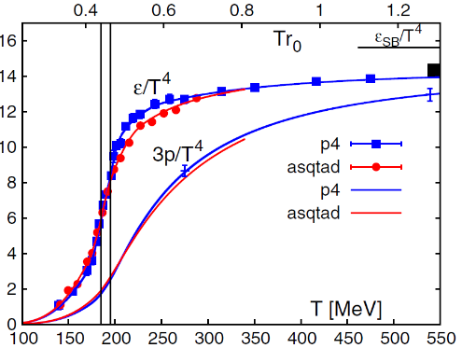
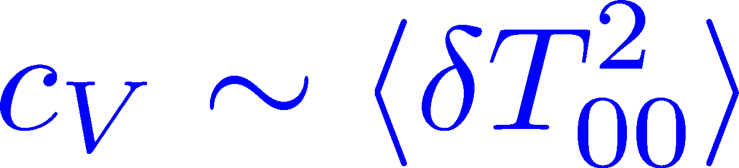

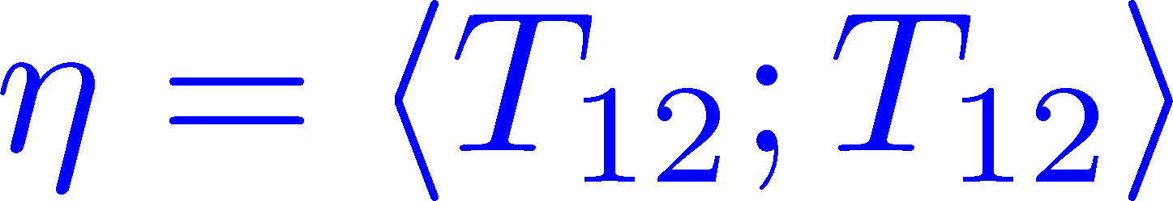

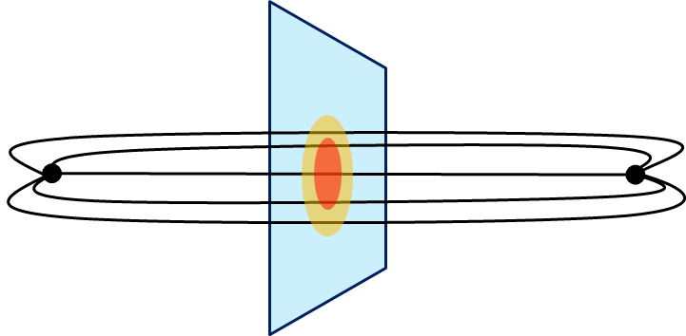
Thermodynamics
Fluctuations and
Correlations
direct measurement of
expectation values
viscosity, specific heat, ...
If we have
flux tube / hadrons
EM form factors
vacuum configuration
mixed state on 1st transition
Hadron Structure
Vacuum Structure

Slide 57
backup

Slide 58








Two Special Cases with PBC
In conformal (Σ_{μ}T_{μμ}=0)

Slide 59

Stress Tensor in AH Model infinitely-long flux tube
Bogomol’nyi bound :
de Vega, Schaposnik, PRD14, 1100 (1976).

Slide 60





Perturbative Coefficients
Suzuki, PTEP 2013, 083B03
Harlander+, 1808.09837
Iritani, MK, Suzuki, Takaura, PTEP 2019
LO
1-loop
2-loop
3-loop
×
zero
Suzuki (2013)
Choice of the scale of g²
Previous:
Improved:
Harlander+ (2018)

Slide 61
Perturbative Coefficients
Suzuki, PTEP 2013, 083B03
Harlander+, 1808.09837
Iritani, MK, Suzuki, Takaura, PTEP 2019
LO
1-loop
2-loop
3-loop
×
Iritani, MK, Suzuki,
Takaura, 2019
zero
Suzuki (2013)
Harlander+(2018)
Choice of the scale of g²
Previous:
Improved:
Harlander+ (2018)

Slide 62



EMT on the Lattice: Conventional
Lattice EMT Operator
Caracciolo+, 1990
Fit to thermodynamics: Z₃, Z₁
Shifted-boundary method: Z₆, Z₃
Giusti, Meyer, 2011; 2013;
Giusti, Pepe, 2014~; Borsanyi+, 2018
Multi-level algorithm
effective in reducing statistical error of correlator
Meyer, 2007;
Borsanyi, 2018;
Astrakhantsev+, 2018

Slide 63

Numerical Simulation
FlowQCD,
PRD94, 114512 (2016)
Expectation values of T_{μν}
SU(3) YM theory
Wilson gauge action
Parameters:
Scale from gradient flow
N_{t} = 12, 16, 20-24
aspect ratio 5.3<N_{s}/N_{t}<8
1500~2000 configurations
FlowQCD, 1503.06516

Slide 64









Fermion Propagator
propagator of flow equation
Inverse propagator is needed
fermion field
t=0
gauge field

Slide 65
N_{f}=2+1 QCD Thermodynamics
Taniguchi+ (WHOT-QCD),
PRD96, 014509 (2017)
N_{f}=2+1 QCD, Iwasaki gauge + NP-clover
m_{PS}/m_{V} ≈0.63 / almost physical s quark mass
T=0: CP-PACS+JLQCD (ß=2.05, 28³x56, a≈0.07fm)
T>0: 32³xN_{t}, N_{t} = 4, 6, ... , 14, 16):
T≈174-697MeV
t→0 extrapolation only (No continuum limit)

Slide 66
Ground State Saturation
mid point
β=6.819 (a=0.029 fm), R=0.46 fm
Appearance of plateau
for t/a²<4, T/a>15
Grand state saturation
under control

Slide 67



Ground State Saturation
t/a²=1.0
Wilson loop
t/a²=3.0
t/a²=4.0
β=6.819 (a=0.029 fm), R=0.46 fm
Appearance of plateau
for t/a²<4, T/a>15
Grand state saturation
under control

Slide 68
Temperature Dependence
FlowQCD,2016
(1-loop)
Excellent agreement with integral method
High accuracy only with ~2000 confs.
Error includes
statistical error
choice of t range for t→0 limit
uncertainty in aΛ_{MS}
total error <1.5% for T>1.1T_{c}

Slide 69
Higher Order Coefficient: ε+p
NLO (1-loop)
N²LO (2-loop)
FlowQCD
2016
Iritani, MK, Suzuki, Takaura, 2019
t dependence becomes milder with higher order coeff.
1-loop → 2-loop : about 2% increase
Systematic analysis: μ₀ or μ_{d}, uncertainty of Λ, fit range
Extrapolation func: linear, higher order term in c₁ (~g⁶)

Slide 70



Double Extrapolation t→0, a→0
O(t) terms in SFTE
lattice discretization
Continuum extrapolation
strong
discretization
effect
Small t extrapolation

Slide 71


EMT in QCD

Slide 72
Higher Order Coefficient: ε-3p
N²LO (2-loop)
N³LO (3-loop)
Iritani, MK, Suzuki, Takaura, in prep.
No difference b/w 2- & 3-loops: 2-loop is already good!
Systematic analysis: μ₀ or μ_{d}, uncertainty of Λ, fit range
Extrapolation func: linear, higher order term in c₂ (~g⁸)

Slide 73



Gradient Flow for Fermions
Luscher, 2013
Makino, Suzuki, 2014
Taniguchi+ (WHOT)
2016; 2017
Not “gradient” flow but a “diffusion” equation.
Divergence in field renormalization of fermions.
All observables are finite at t>0 once Z(t) is fixed.
Energy-momentum tensor from SFTE Makino, Suzuki, 2014

Slide 74
Abelian-Higgs Model
Abelian-Higgs Model
GL parameter:
Infinitely long tube
type-I :
type-II :
Bogomol’nyi bound :
degeneracy
Luscher, 1981
conservation law

