Slide 1
非等方な有限体積系に置かれた
SU(3)ゲージ理論の
圧力非等方性の測定
日本物理学会第74回年次大会＠九州大学伊都キャンパス、2019年3月15日
北沢正清
(阪大理)
with S. Mogliacci, I. Kolbe, W.A. Horowitz
MK, Mogliacci, Kolbe, Horowitz, to appear soon

Slide 2
Casimir Effect

Slide 3
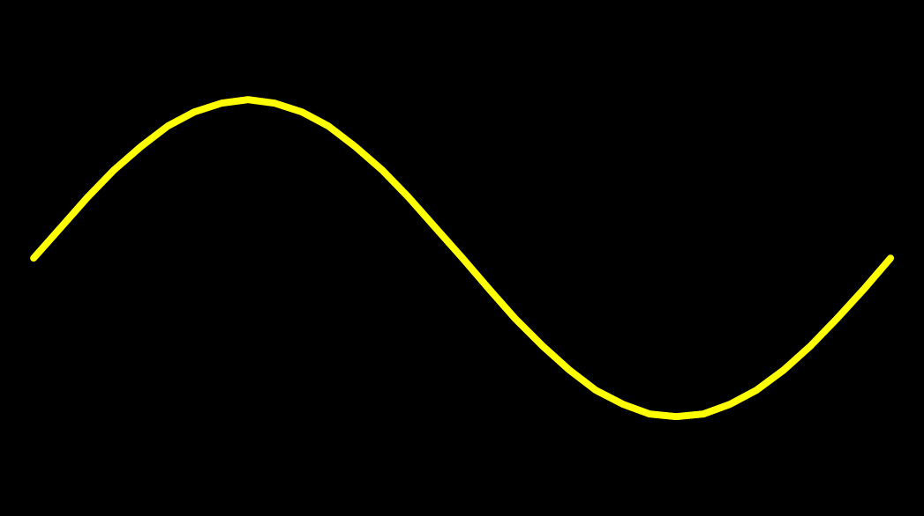
Casimir Effect
attractive force between two conductive plates

Slide 4





Casimir Effect
Brown, Maclay
1969

Slide 5



Casimir Effect
Brown, Maclay
1969

Slide 6

Casimir Effect
Brown, Maclay
1969
T

Slide 7

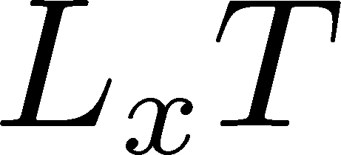

Pressure Anisotropy @ T≠0
MK, Mogliacci, Kolbe,
Horowitz, in prep.
Free scalar field
L₂=L₃=∞
Periodic BC
Mogliacci+, 1807.07871

Slide 8
Pressure Anisotropy @ T≠0
MK, Mogliacci, Kolbe,
Horowitz, in prep.
Free scalar field
L₂=L₃=∞
Periodic BC
Mogliacci+, 1807.07871
Lattice result
Periodic BC
Only t→0 limit
Error: stat.+sys.
Medium near T_{c} is remarkably insensitive to finite size!

Slide 9




Thermodynamics on the Lattice
Various Methods
Integral, differential, moving frame, non-equilibrium, …
rely on thermodynamic relations valid in V→∞
Not applicable to
anisotropic systems
We employ Gradient Flow Method
Components of EMT are directly accessible!

Slide 10




Yang-Mills Gradient Flow
Luscher 2010
Narayanan, Neuberger, 2006
Luscher, Weiss, 2011
t: “flow time”
dim:[length²]
leading
diffusion equation in 4-dim space
diffusion distance
“continuous” cooling/smearing
No UV divergence at t>0

Slide 11





Small Flow-Time Expansion
Luescher, Weisz, 2011
Suzuki, 2013
an operator at t>0
remormalized operators
of original theory
original 4-dim theory
t→0 limit

Slide 12


Constructing EMT
Suzuki, 2013
vacuum subtr.
Remormalized EMT
Perturbative coefficient:
Suzuki (2013); Makino, Suzuki (2014); Harlander+ (2018); Iritani, MK, Suzuki, Takaura (2019)

Slide 13





Perturbative Coefficients
Suzuki, PTEP 2013, 083B03
Harlander+, 1808.09837
Iritani, MK, Suzuki, Takaura, PTEP 2019
LO
1-loop
2-loop
3-loop
×
Iritani, MK, Suzuki,
Takaura, 2019
zero
Suzuki (2013)
Harlander+(2018)
Choice of the scale of g²
Previous:
Improved:
Harlander+ (2018)

Slide 14
Higher Order Coefficient: ε+p
NLO (1-loop)
N²LO (2-loop)
Range2
Range2
Range1
Range1
Range3
Range3
Iritani, MK, Suzuki, Takaura, PTEP 2019
t dependence becomes milder with higher order coeff.
Better t→0 extrapolation
Systematic error: μ₀ or μ_{d}, uncertaintyof Λ (±3%), fit range
Extrapolation func: linear, higher order term in c₁ (~g⁶)

Slide 15
Effect of Higher-Order Coeffs.
Iritani, MK, Suzuki, Takaura, 2019
□: 2-loop
△: Flow2016
Systematic error: μ₀ or μ_{d}, Λ, t→0 function, fit range
More stable extrapolation with higher order c₁ & c₂
(pure gauge)

Slide 16

Numerical Setup
SU(3) YM theory
Wilson gauge action
N_{t} = 16, 12
N_{z}/N_{t}=6
2000~4000 confs.
Even N_{x}
No Continuum extrap.
Same Spatial volume
12x72²x12 ~ 16x96²x16
18x72²x12 ~ 24x96²x16
Simulations on
OCTOPUS/Reedbush

Slide 17

Small-t Extrapolation
Filled: N_{t}=16 / Open: N_{t}=12
Small-t extrapolation
Solid: N_{t}=16, Range-1
Dotted: N_{t}=16, Range-2,3
Dashed: N_{t}=12, Range-1
Stable small-t extrapolation
No N_{t} dependence within statistics for L_{x}T=1, 1.5

Slide 18
Small-t Extrapolation
Filled: N_{t}=16 / Open: N_{t}=12
Small-t extrapolation
Solid: N_{t}=16, Range-1
Dotted: N_{t}=16, Range-2,3
Dashed: N_{t}=12, Range-1
Stable small-t extrapolation
No N_{t} dependence within statistics for L_{x}T=1, 1.5

Slide 19
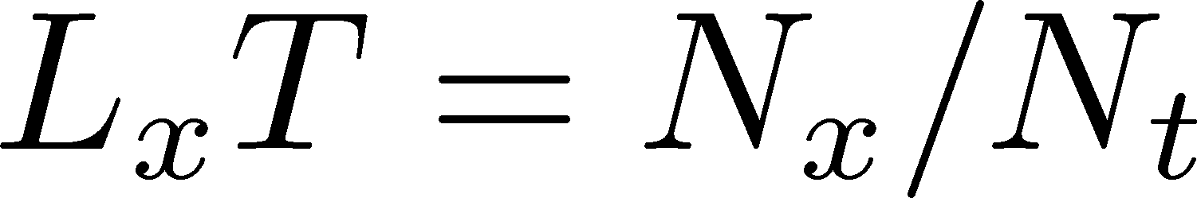
Pressure Anisotropy @ T≠0
MK, Mogliacci, Kolbe,
Horowitz, in prep.
Free scalar field
L₂=L₃=∞
Periodic BC
Mogliacci+, 1807.07871
Lattice result
Periodic BC
Only t→0 limit
Error: stat.+sys.
Medium near T_{c} is remarkably insensitive to finite size!

Slide 20
Pressure Anisotropy @ T≠0
MK, Mogliacci, Kolbe,
Horowitz, in prep.
Free scalar field
L₂=L₃=∞
Periodic BC
Mogliacci+, 1807.07871
Lattice result
Periodic BC
Only t→0 limit
Error: stat.+sys.
Medium near T_{c} is remarkably insensitive to finite size!

Slide 21
Higher T
High-T limit: massless free gluons
How does the anisotropy approach this limit?
Difficulties
Vacuum subtraction requires large-volume simulations.
Lattice spacing not available → c₁(t), c₂(t) are not determined.

Slide 22


Higher T
High-T limit: massless free gluons
How does the anisotropy approach this limit?
Difficulties
Vacuum subtraction requires large-volume simulations.
Lattice spacing not available → c₁(t), c₂(t) are not determined.
We study
No vacuum subtr. nor Suzuki coeffs. necessary!

Slide 23
T
massless free
T/T_{c}≅8.1 (β=8.0) / T/T_{c}≅25 (β=9.0)
Ratio approaches the asymptotic value.
But, large deviation exists even at T/T_{c}~25.

Slide 24
Summary
First numerical simulation of
anisotropic pressure in SU(3) YM
with periodic BC.
Medium at 1.4<T/T_{c}<2.1 is remarkably
insensitive to the existence of boundary.
Future
Anti-periodic / Dirichlet BCs
BC for two directions, magnetic field, below T_{c}, …
And, other many problems related to EMT!!

Slide 25
backup

Slide 26



Extrapolations t→0, a→0
O(t) terms in SFTE
lattice discretization
FlowQCD2016
This Study
①Continuum
②Small t extrapol.
strong
discretization
effect
strong
discretization
effect

Slide 27
energy densty / transverse P
Energy Density
Transverse Pressure P_{z}

Slide 28





Gradient Flow Method
lattice regularized
gauge theory
Smeared world
by gradient flow
gradient flow
continuum theory
gradient flow
Measure on
the lattice
analytic relation
Take Extrapolation (t,a)→(0,0)
O(t) terms in SFTE
lattice discretization

Slide 29







Two Special Cases with PBC
In conformal (Σ_{μ}T_{μμ}=0)

Slide 30



EMT on the Lattice: Conventional
Lattice EMT Operator
Caracciolo+, 1990
Fit to thermodynamics: Z₃, Z₁
Shifted-boundary method: Z₆, Z₃
Giusti, Meyer, 2011; 2013;
Giusti, Pepe, 2014~; Borsanyi+, 2018
Multi-level algorithm
effective in reducing statistical error of correlator
Meyer, 2007;
Borsanyi, 2018;
Astrakhantsev+, 2018

