Slide 1
Critical Fluctuations in HIC
~ Theory ~
FLUCTUAT NEC MERGITUR
Masakiyo Kitazawa
(Osaka U.)
RRTF “Dynamics of Critical Fluctuations: Theory – Phenomenology – HIC”
GSI, Darmstadt, 8/Apr./2019

Slide 2

FLUCTUAT
NEC
MERGITUR
Coat of arms of Paris
“[She] is tossed by the waves,
but does not sink”
from Wikipedia

Slide 3
Why Fluctuations?

Slide 4
Physicists can feel hot early Universe
13 800 000 000 years ago
in tiny fluctuations of
cosmic microwave

Slide 5
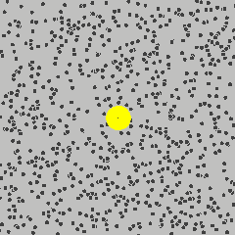
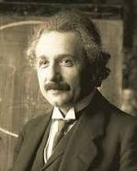
Physicists can feel the existence of microscopic
atoms behind random fluctuations
of Brownian pollens
A. Einstein
1905

Slide 6




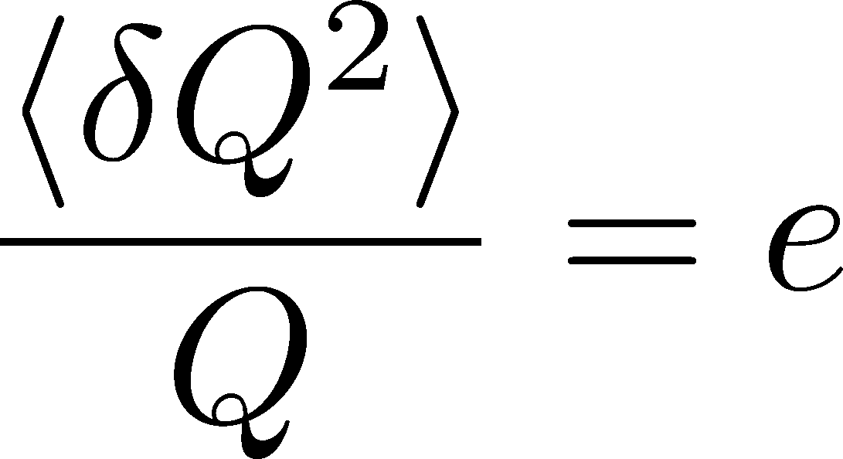
Shot Noise
e*
charge of quasi-particles
Total charge Q:

Slide 7
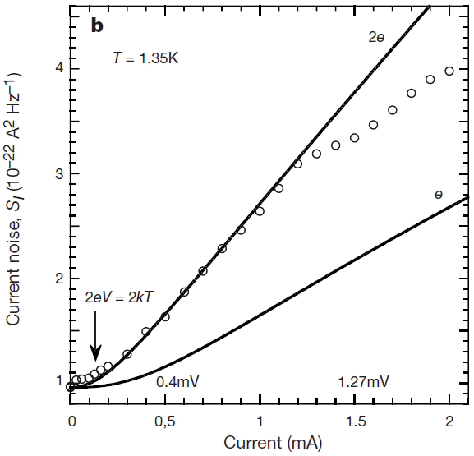


Shot Noise
e*
charge of quasi-particles
Superconductors
with Cooper Pairs
Fractional Quantum
Hall Systems
doubled!
Jehl+, Nature 405,50 (2000)
Saminadayar+, PRL79,2526 (1997)
Higher order cumulants:
3rd order: ex. Beenakker+, PRL90,176802(2003)
up to 5th order: Gustavsson+, Surf.Sci.Rep.64,191(2009)

Slide 8
The noise is the signal.
R. Landauer
1998

Slide 9

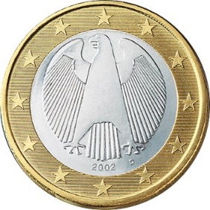
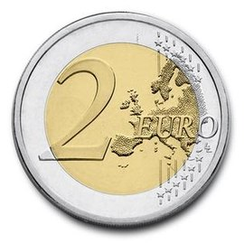

A Coin Game
Bet 25 Euro
You get head coins of
A. 50 x 1 Euro
B. 25 x 2 Euro
Same expectation value.

Slide 10
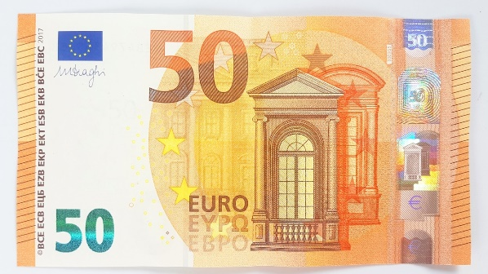
A Coin Game
Bet 25 Euro
You get head coins of
A. 50 x 1 Euro
B. 25 x 2 Euro
C. 1 x 50 Euro
Same expectation value.
But, different fluctuation.

Slide 11
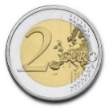

Fluctuations in HIC: 2nd Order
Search for QCD CP
Onset of QGP
Fluctuation
increases
Fluctuation
decreases
Asakawa, Heinz, Muller, 2000;
Jeon, Koch, 2000
Stephanov, Rajagopal, Shuryak, 1998; 1999

Slide 12
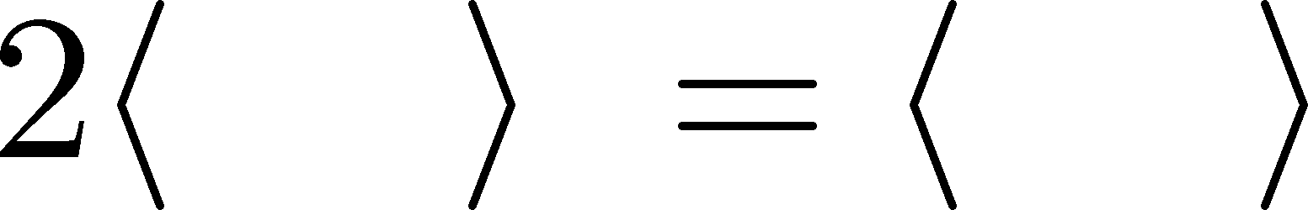

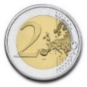
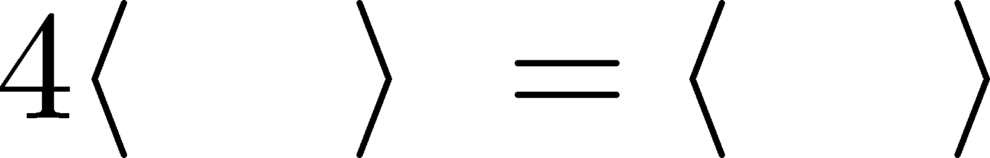
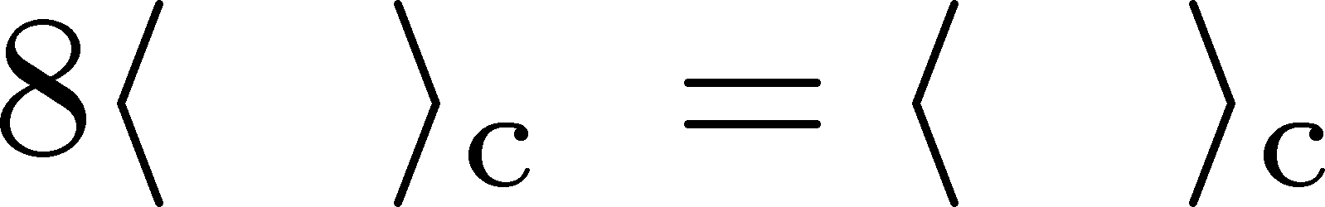
Higher-order Cumulants
A. 50 x 1 Euro
B. 25 x 2 Euro
δ€²
δ€²
δ€³
δ€³
€⁴
€⁴
Asakawa, MK,
PPNP 90, 299
(2016)

Slide 13
Non-Gaussian Fluctuations
Onset of QGP
Search for QCD CP
Fluctuation
decreases
Fluctuation
increases
Ejiri, Karsch, Redlich, 2006
Stephanov, 2009

Slide 14
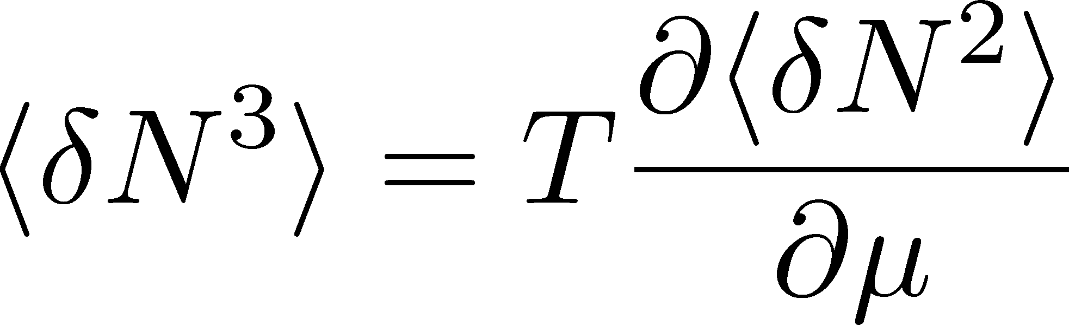

Sign of Higher-order Cumulants
Higher order cumulants can change sign near CP.
Asakawa, Ejiri, MK, 2009
Stephanov, 2011;
Friman, Karsch, Redlich, Skokov, 2011; …

Slide 15


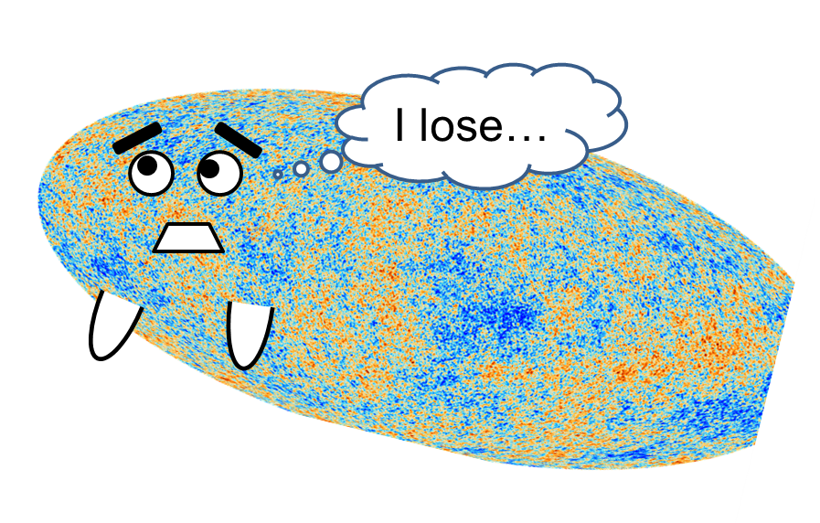
Higher-Order Cumulants
Enhancement
Non-zero non-Gaussian
cumulants have been
established!
STAR Collab.
2010~
This is a great achievement in physics!!

Slide 16
Theory/Lattice vs HIC
discussion so far
real experiments
Thermal System
Dynamical System
Initial fluctuation
Time evolution
Correct experimental measurement

Slide 17
Many Problems to be Considered
initial fluctuation: volume, collision dynamics
time evolution in fireballs
rapidity vs space-time rapidity
clustering / resonance decays
global charge conservation
effect of jets
classical vs quantum
evolution on dynamical models
discrete vs continuous: particlization
detector-response correction
acceptance cut such as p_{T}
…

Slide 18
Detector-Response
Correction

Slide 19
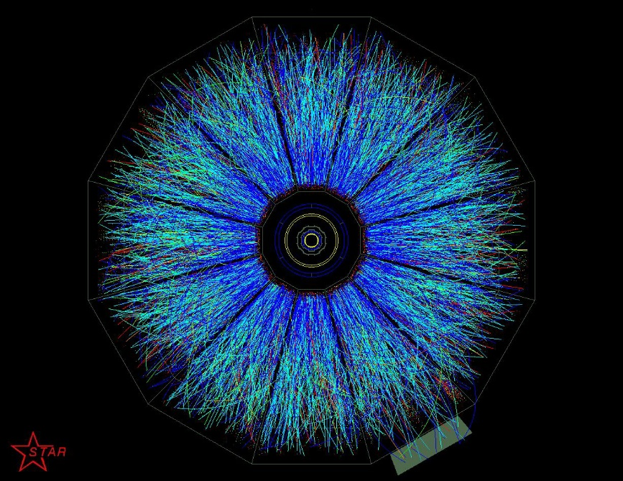
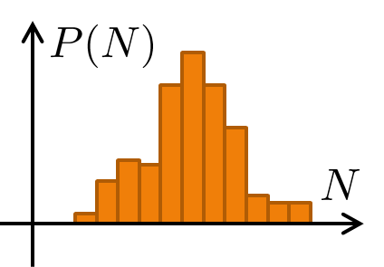
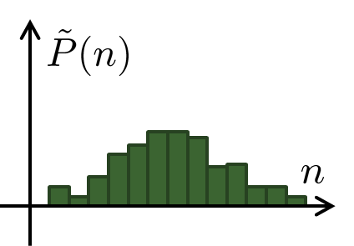
Detector-Response Correction
True distribution
Efficiency loss
Particle missID
Observed distr.
Correction assuming a binomial response
Bialas, Peschanski (1986);
MK, Asakawa (2012); Bzdak, Koch (2012); ….
But, the response of the detector is not binomial…

Slide 20
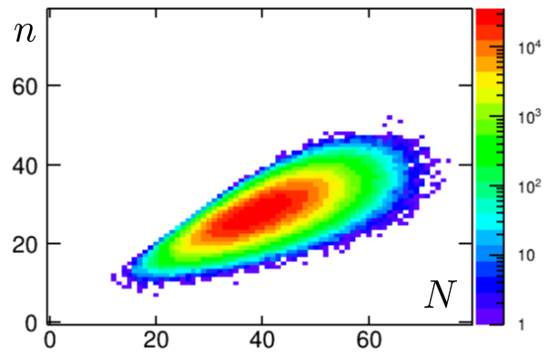
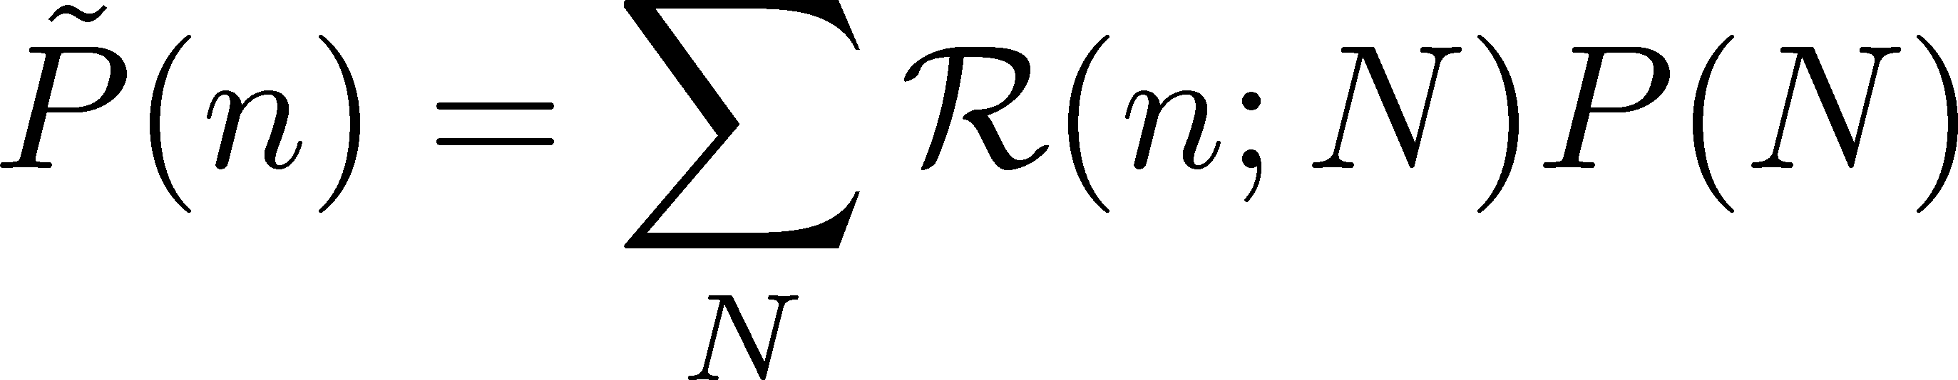
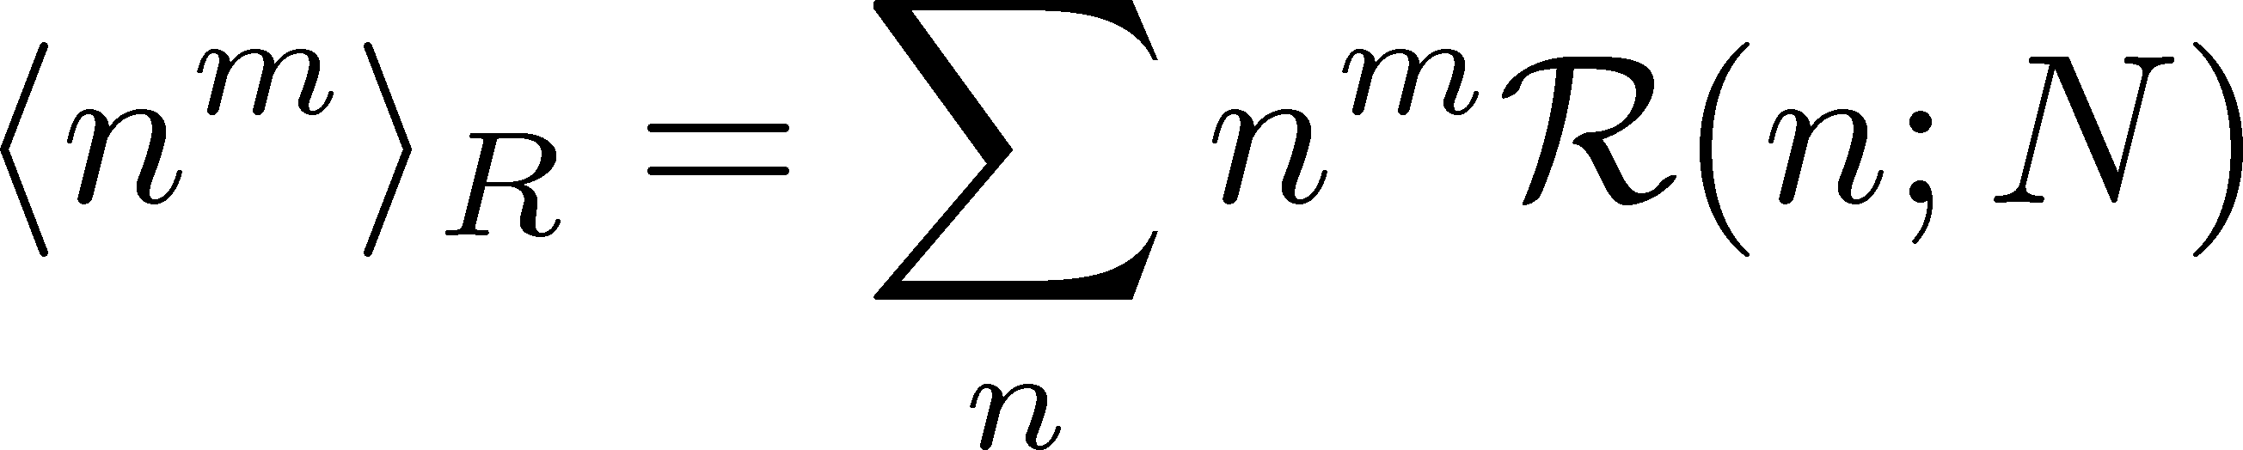
Non-Binomial Correction
Nonaka, MK, Esumi (2018)
Response matrix
Reconstruction for any R(n;N)
with moments of R(n;N)
Caveats:
Correction can be made. But,
Need accurate properties of the detector.
The higher order, the larger error.
Huge experimental statistics / numerical cost

Slide 21
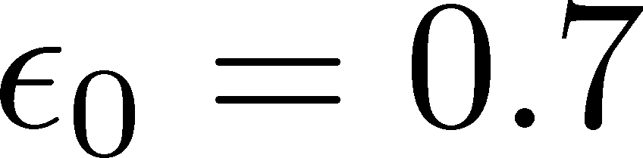
Result for Toy-Model
Binomial w/ multiplicity-dependent efficiency
Nonaka, MK,
Esumi (2018)
Holtzman, Bzdak,
Koch (16)
Reconstructed cumulants
Input P(N):
Poisson(λ=40)
Red:
true cumulant
True cumulants are
reproduced within
statistics!

Slide 22
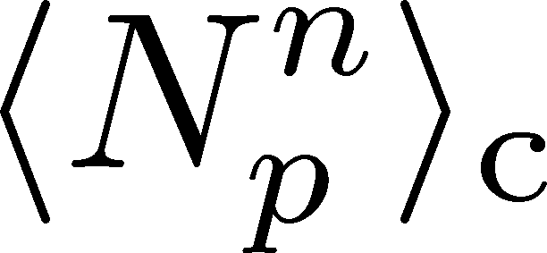
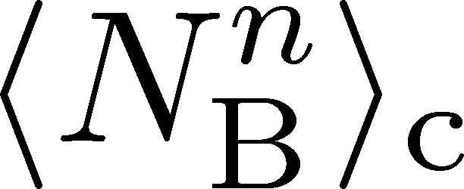
Proton vs Baryon Cumulants
MK, Asakawa, 2012; 2012
Experiments
proton number cumulants
Many theories
baryon number cumulants
measurement with
50% efficiency loss
Clear difference b/w these cumulants.
Isospin randomization justifies the reconstruction of <N_{B}^{n}>_{c} via the binomial model.
Similar problem on the momentum cut…

Slide 23
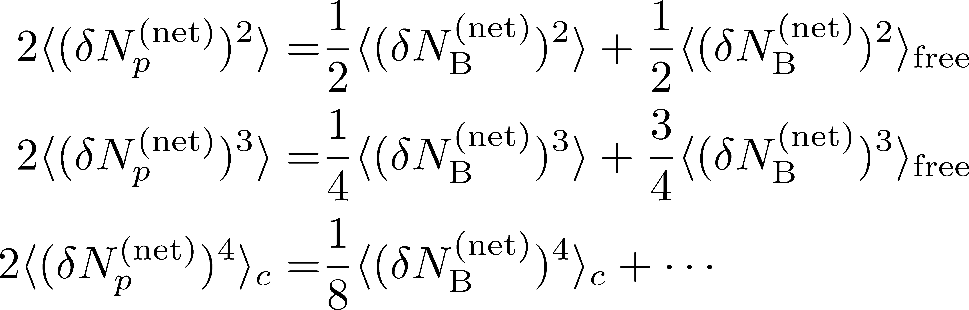
Fragile Higher Orders
Ex.: Relation b/w baryon & proton # cumulants
(with approximations)
MK, Asakawa, 2012
genuine info.
Poisson noise
Higher orders are more seriously affected by efficiency loss.

Slide 24
Evolution of Fluctuations

Slide 25

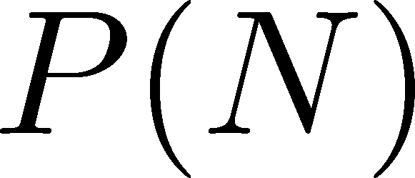




Time Evolution of Fluctuations
Detector
Hadronic
Distributions in ΔY and
Δy are different due to
“thermal blurring”.
Ohnishi, MK, Asakawa, PRC(2016)
QGP
Fluctuations in ΔY continue
to change until kinetic f.o.

Slide 26
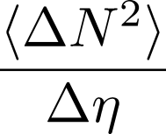
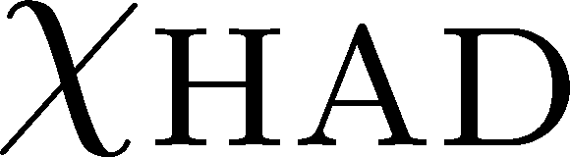
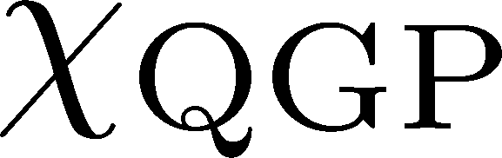


Rapidity-window Dependence
Asakawa, Heinz, Muller, 2000
Jeon, Koch, 2000; Shuryak, Stephanov, 2001
Quark-Gluon Plasma
Hadronization
Freezeout
The larger Δη, the slower diffusion.

Slide 27

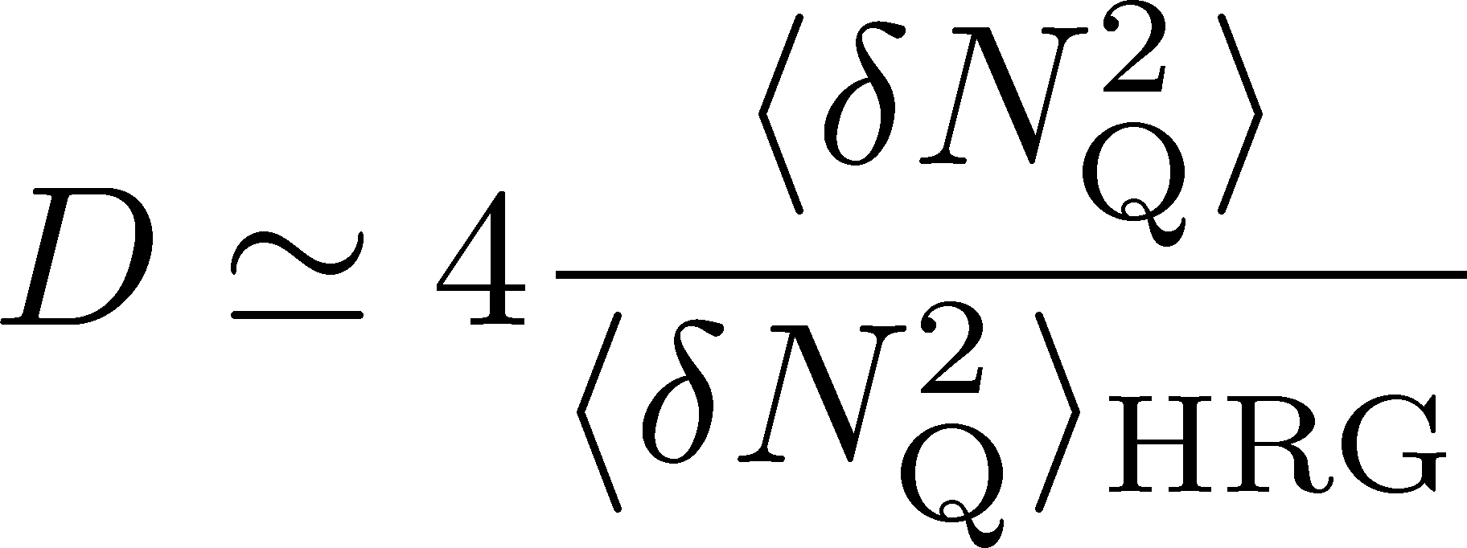
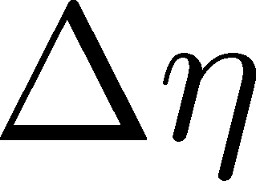
2nd Order @ ALICE
Net charge fluctuation
D-measure
ALICE, PRL2013

Slide 28
2nd Order @ ALICE
Net charge fluctuation
Net proton fluctuation
ALICE, PRL2013
Rustamov, 2017
Net-charge fluctuation has a suppression,
but net-proton fluctuation does not. Why??

Slide 29
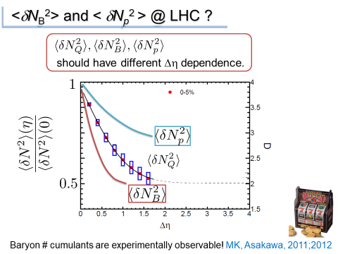
From My Old Prediction
GSI, Jan. 2013
Berkeley, Sep. 2014
FIAS, Jul. 2015
GSI, Jan. 2016
…
Baryon #
slower diffusion
more sensitive to phase transition
How to understand proton/charge fluctuations @ ALICE ??

Slide 30
Critical Fluctuation
①
Growth of critical fluctuation
Critical slowing down
T
①
②
Decay by diffusion
②
Hadrons
0
μ

Slide 31
Dynamical Evolution of Critical Fluctuations
Evolution of spatially uniform “σ” mode
Berdnikov, Rajagopal (2000)
Asakawa, Nonaka (2002)
Mukherjee+ (2015)
…
Evolution of conserved charge fluctuations
Conserved charges are directly observable.
Soft mode at QCD-CP is a conserved mode.

Slide 32

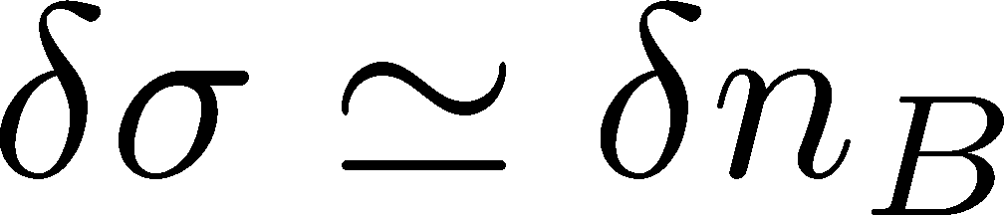
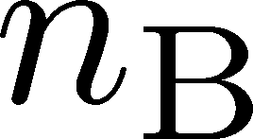
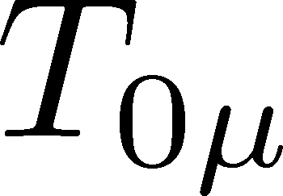
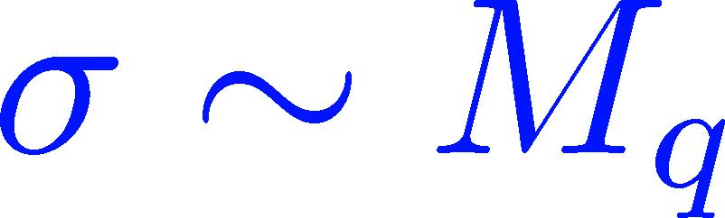
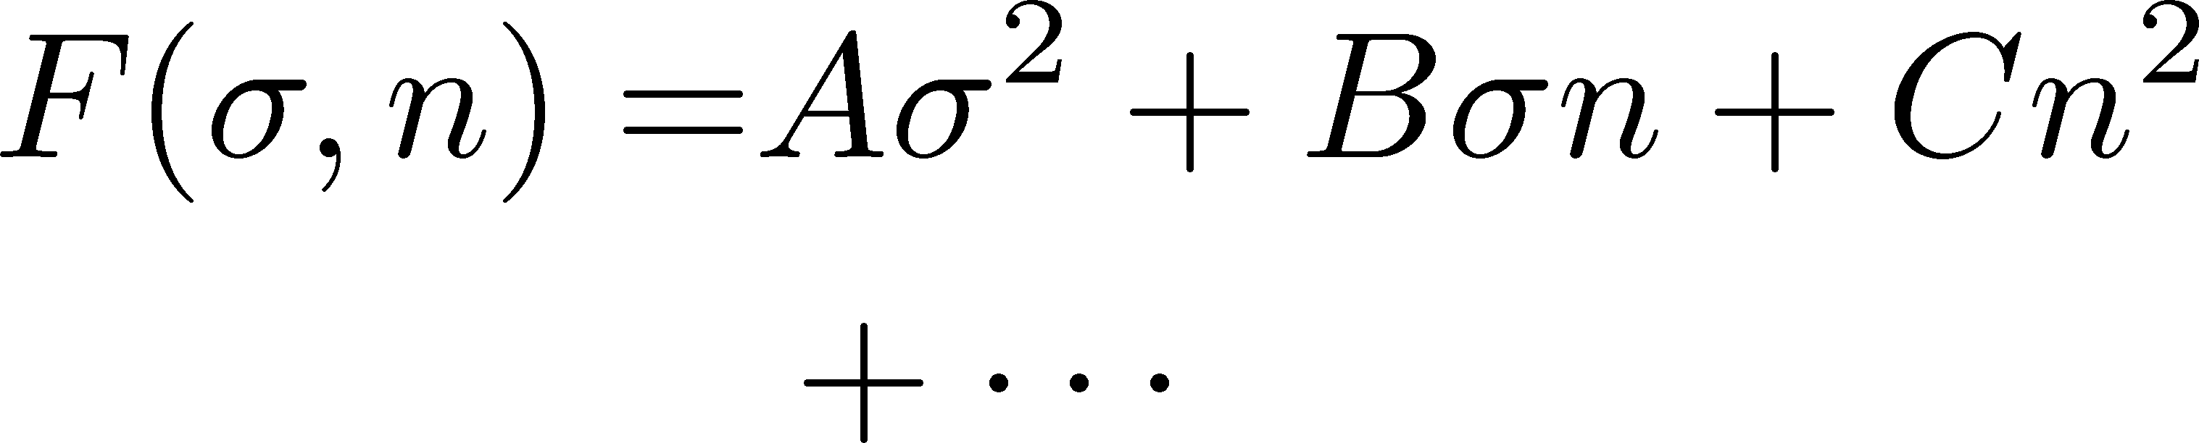


Soft Mode of QCD-CP = Conserved Mode
Fujii 2003; Fujii, Ohtani, 2004; Son, Stephanov, 2004
critical
soft mode
Fluctuations of σ and n_{B} are
coupled around the CP!
σ: fast damping

Slide 33
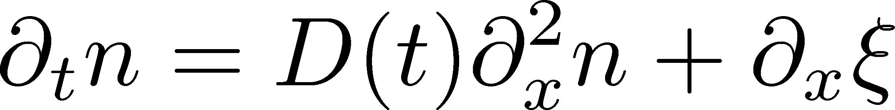
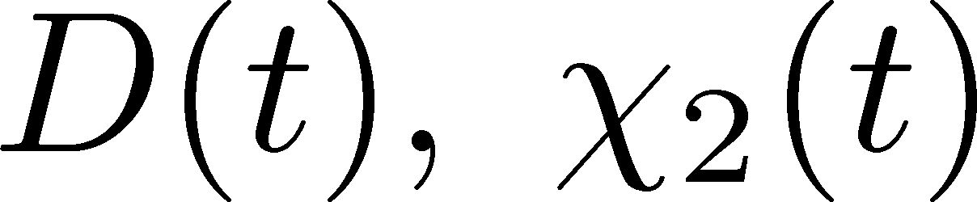
Analysis of 2nd-order Cumulant
Sakaida+ (2017)
Evolution of baryon number density
Stochastic Diffusion Equation
:parameters characterizing criticality
Analytic solution is obtained.
Study 2nd order cumulant & correlation function.
Our Main Conclusion
Non-monotonicity in
cumulants or correlation func.
=
Signal of
QCD-CP

Slide 34
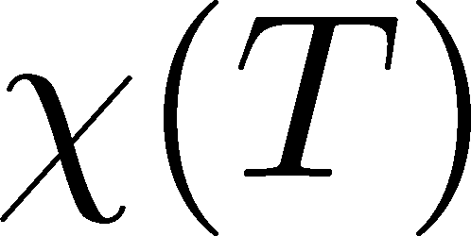
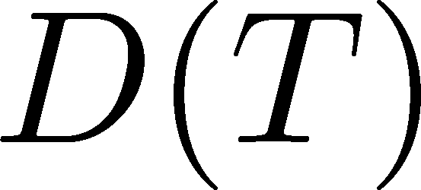
Parametrizing D(τ) and χ(τ)
Critical behavior
(critical point)
3D Ising (r,H)
model H
Berdnikov, Rajagopal (2000)
Stephanov (2011); Mukherjee+(2015)
Temperature dep.
critical
slowing
down
critical
enhancement

Slide 35
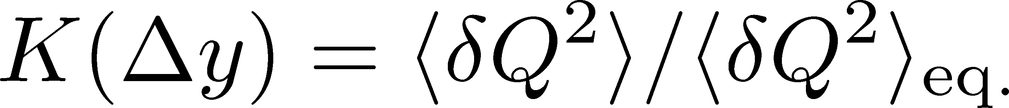
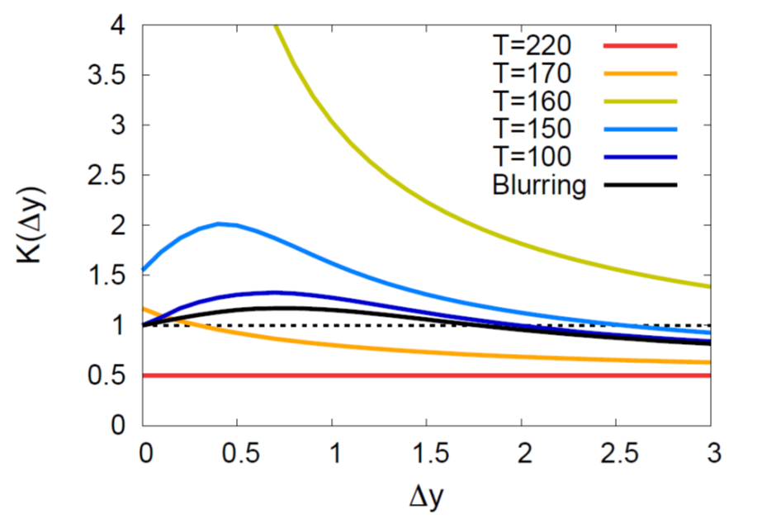
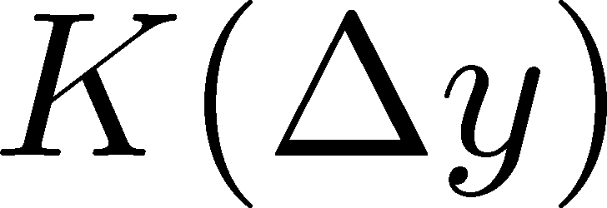
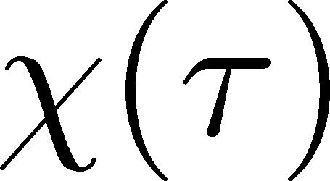
Critical Point / Cumulant
non-monotonic Δy dep.
Analytic
result
See also,
Wu, Song
arXiv: 1903.06075
non-monotonic
non-monotonic

Slide 36
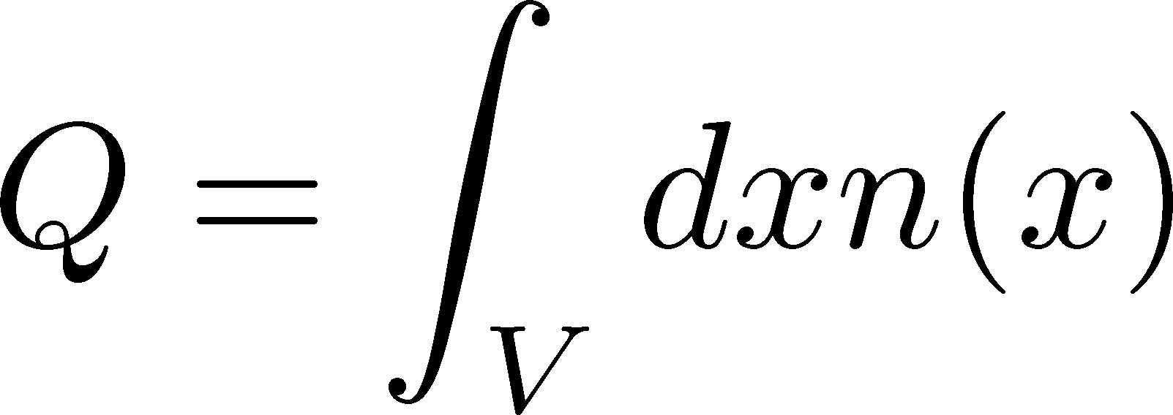
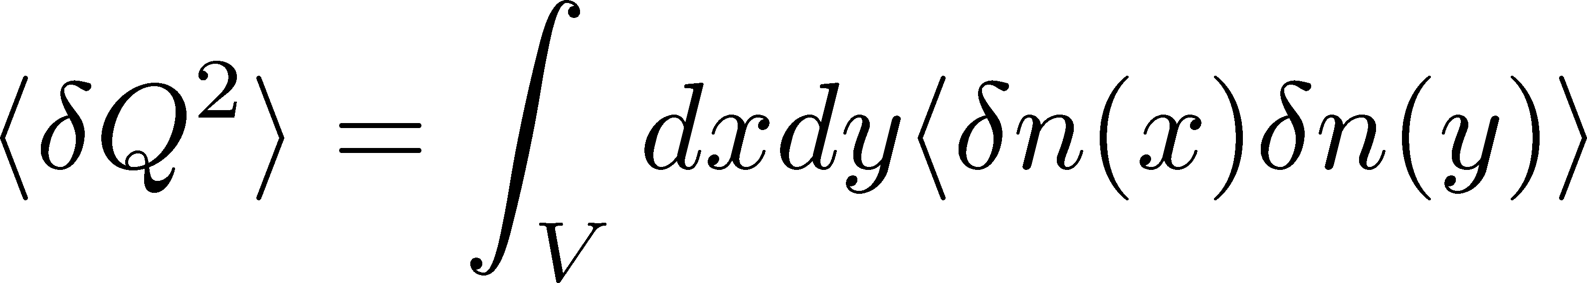
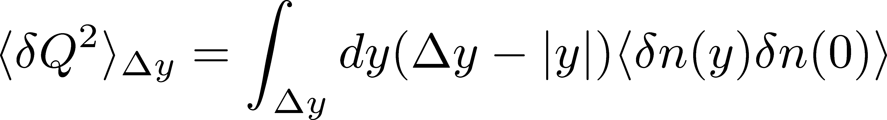
Cumulants and Correlation Function
total charge
charge density
2nd order cumulant
(fluctuation)
correlation function
1-to-1 correspondence
1-dim case

Slide 37
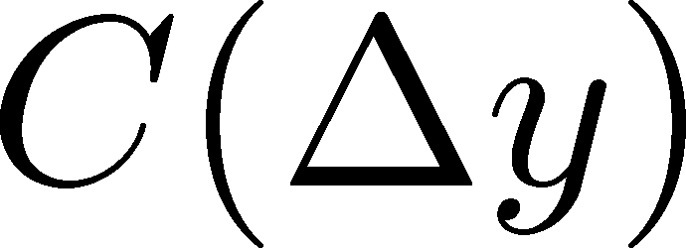
Criticap Point / Correlation Func.
non-monotonic Δy dep.
Analytic
result
See also,
Wu, Song
arXiv: 1903.06075
non-monotonic
non-monotonic

Slide 38
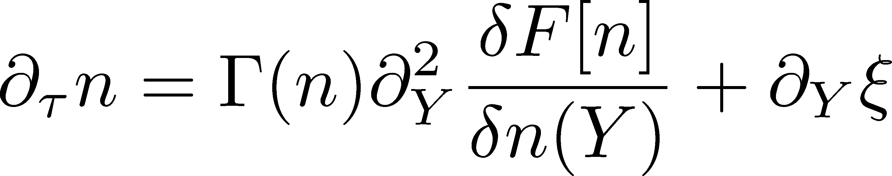
Describing Non-Gaussianity
Diffusion Eq. with Non-linear Terms
Nahrgang, Bluhm, Schaefer, Bass,
arxiv:1804.05728
Application to
1st order transition:
Nonaka, Akamatsu, Bluhm, MK, Nahrgang,
Wednesday
Proper description of higher order cumulants

Slide 39
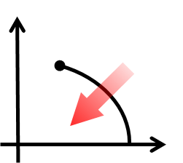
1st-Order Transition
T
μ
Domain formation
Non-uniform system
Finding a line: Easier than the search for a point.
Herold, Nahrgang, et al. (2011~); Steinheimer, Randrup (2012; 2013)

Slide 40
Dynamical Simulations
Hydro with unstable EoS
Steinheimer, Randrup, Koch, 2014
Chiral Fluid Dynamics
Herold, Nahrgang, Mishustin, Bleicher, 2014
Good observables to see domain formation: <ρ^{n}>/<ρ>, and ?

Slide 41
Many Problems to be Considered
initial fluctuation: volume, collision dynamics
time evolution in fireballs
rapidity vs space-time rapidity
clustering / resonance decays
global charge conservation
effect of jets
classical vs quantum
evolution on dynamical models
discrete vs continuous: particlization
detector-response correction
acceptance cut such as p_{T}
…

Slide 42
FLUCTUAT
NEC
MERGITUR
Coat of arms of Paris
“[She] is tossed by the waves,
but does not sink”
from Wikipedia
Let’s continue our voyage to QCD-CP!

Slide 43
In place of Summary
Let’s consider lower order cumulants more seriously before exploring higher orders.
Experimental analysis becomes more difficult and less reliable for higher orders.
Puzzle of Proton/charge fluctuations at ALICE.

