Slide 1
Critical Diffusion Dynamics
Masakiyo Kitazawa
(Osaka U.)
Rapid Reaction Task Force on
Dynamics of Critical Fluctuations: Theory – Phenomenology – HIC
GSI, Darmstadt, Germany, 11/Apr./2019

Slide 2






Time Evolution of Fluctuations
Detector
Hadronic
Distributions in ΔY and
Δy are different due to
“thermal blurring”.
Ohnishi, MK, Asakawa, PRC(2016)
QGP
Fluctuations in ΔY continue
to change until kinetic f.o.

Slide 3

Thermal Blurring
Asakawa, Heinz, Muller, 2000
Jeon, Koch, 2000
Koch,
0810.2520
Detector
Distributions in ΔY and
Δy are different due to
“thermal blurring”.

Slide 4
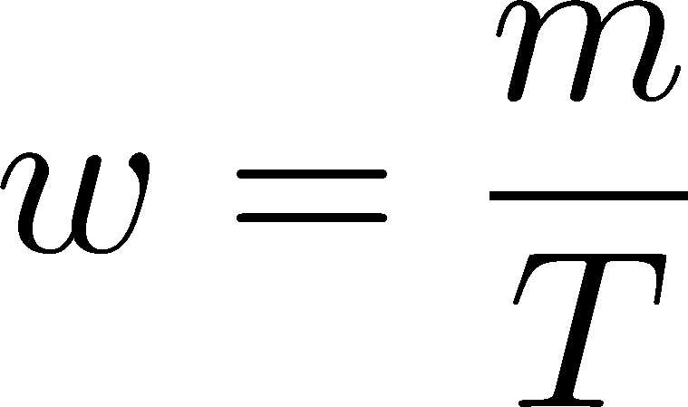



Thermal distribution in y space
Ohnishi, MK, Asakawa
PRC, 2016
nucleon
pions
nucleons
pion
Blast wave squeezes the
distribution in rapidity space
blast wave
flat freezeout surface

Slide 5
Thermal distribution in y space
Ohnishi, MK, Asakawa
PRC, 2016
pions
nucleons
half-width (Δy)
kurtosis
Rapidity distribution can be
well approximated by Gaussian.
blast wave
flat freezeout surface

Slide 6
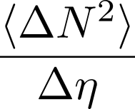

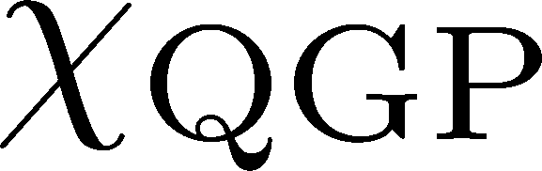


Rapidity-window Dependence
Asakawa, Heinz, Muller, 2000
Jeon, Koch, 2000; Shuryak, Stephanov, 2001
Quark-Gluon Plasma
Hadronization
Freezeout
The larger Δη, the slower diffusion.

Slide 7

Resonance Decay
Neutral Particles
Decay into charged particles

Slide 8
Resonance Decay
Neutral Particles
Decay into charged particles
The larger Δη, the slower diffusion.

Slide 9

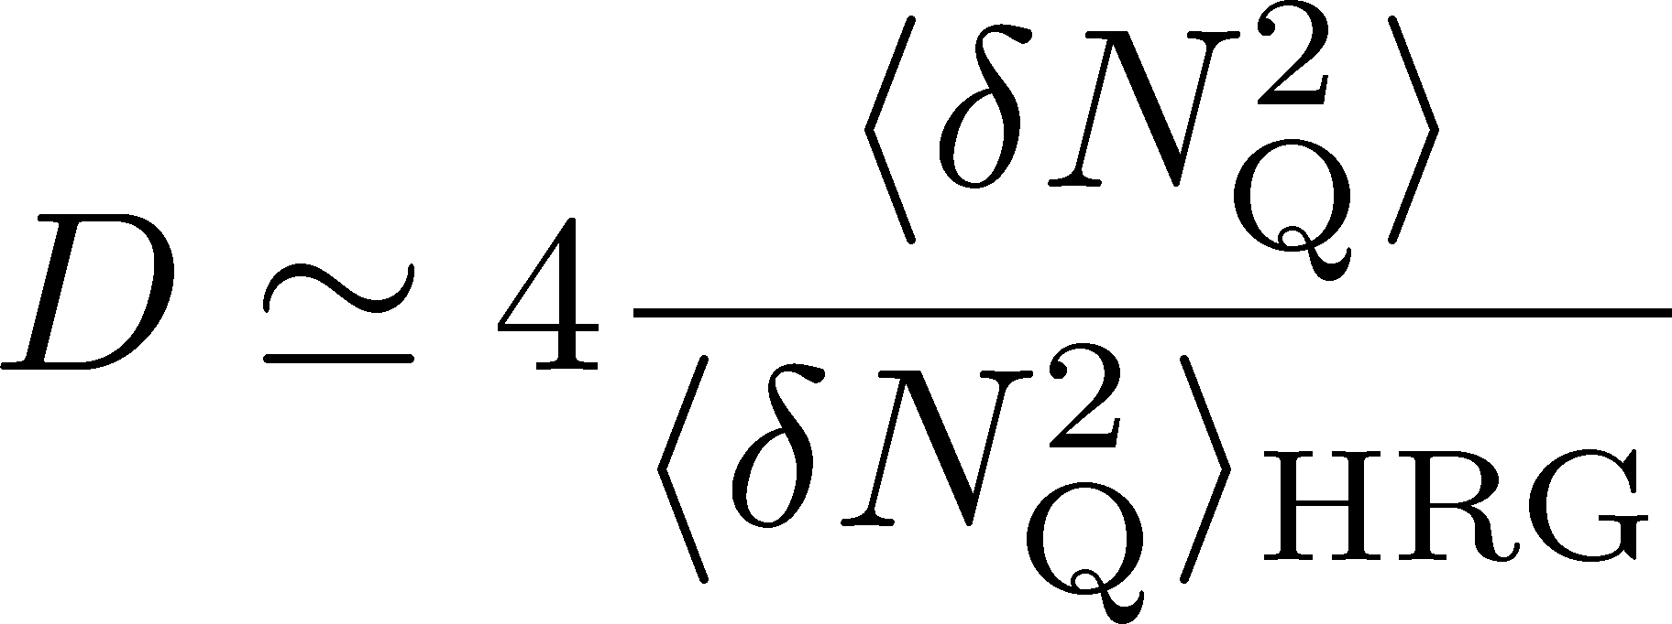

2nd Order @ ALICE
Net charge fluctuation
D-measure
ALICE, PRL2013

Slide 10
2nd Order @ ALICE
Net charge fluctuation
Net proton fluctuation
ALICE, PRL2013
Rustamov, 2017
Net-charge fluctuation has a suppression,
but net-proton fluctuation does not. Why??

Slide 11
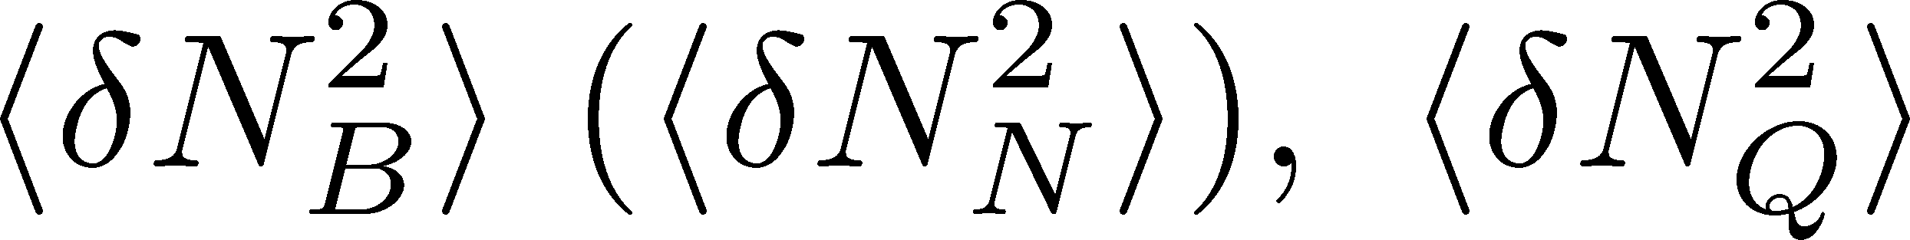
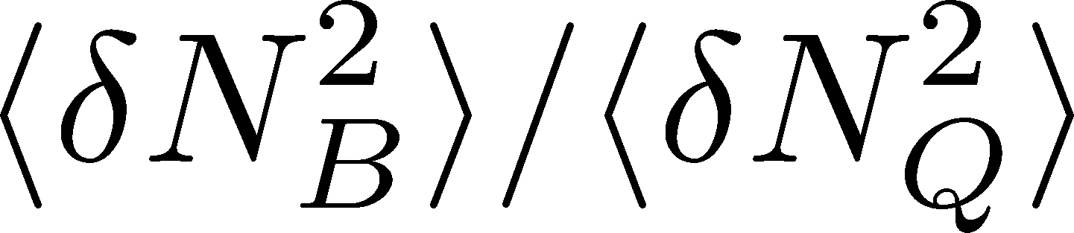
Suggestion
Net charge fluctuation
Construct
Then, take ratio
Compare it with lattice
ALICE, PRL2013
Net proton fluctuation
HotQCD preliminary
Special thanks to F. Karsch
linear T dependence near Tc !!
only 2nd order: reliable !!
Rustamov, 2017
First reliable comparison of LAT/HIC

Slide 12
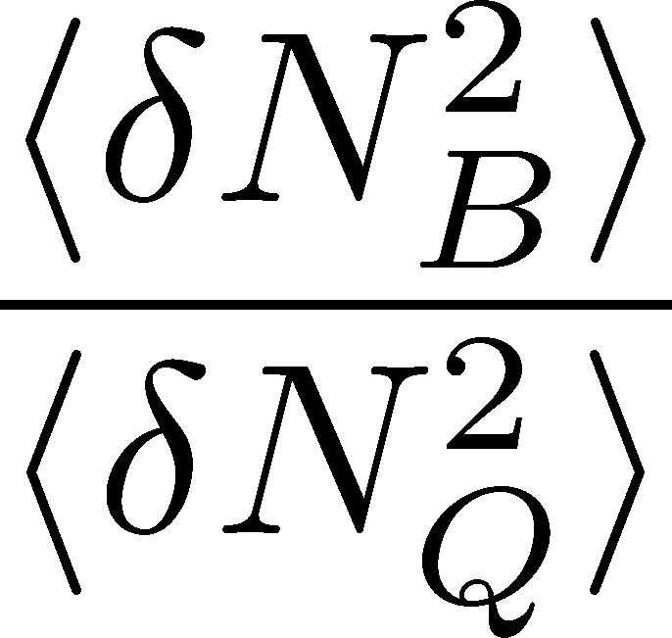
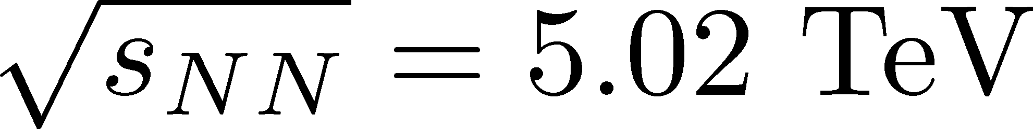
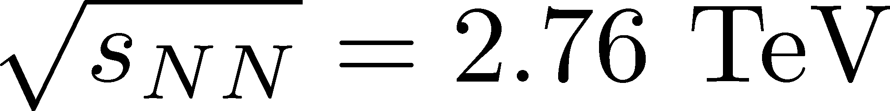
Prediction
LATTICE
ALICE
HotQCD preliminary
Special thanks to F. Karsch
before continuum limit
1.6
Δη dependence for tracing back the history!

Slide 13
Contents of
Critical Diffusion Dynamics
in Hadronic Stage
  MK, Ono, Asakawa, PLB (2014); MK(2015)
around the Critical Point
  Sakaida, Asakawa, Fujii, MK (2017)
at First Order Transition
  Nonaka, MK, Akamatsu, Bluhm, Nahrgang, in prep.

Slide 14



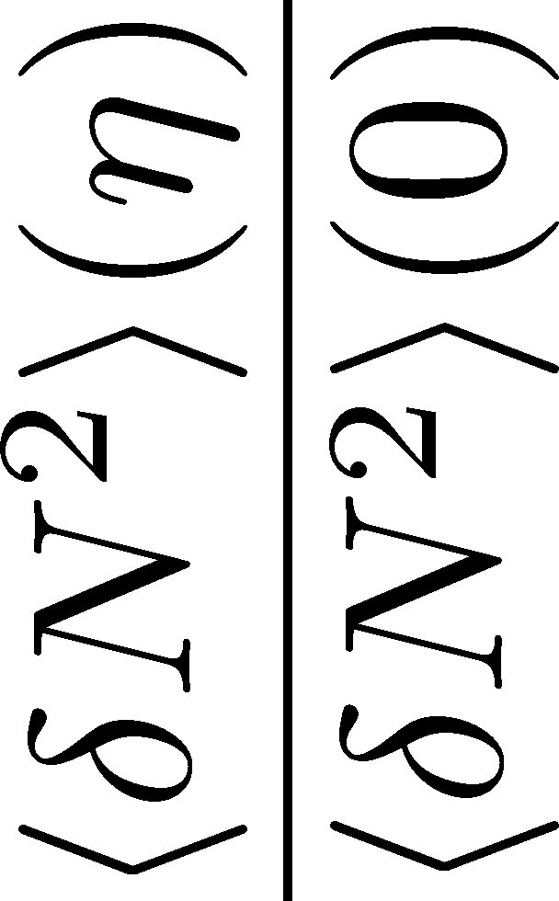
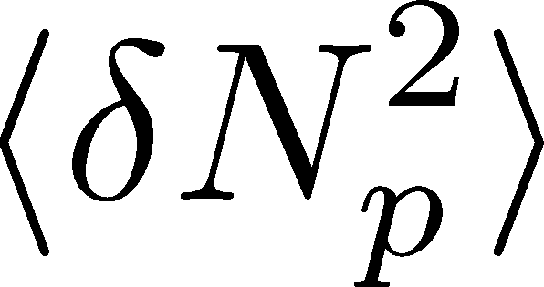
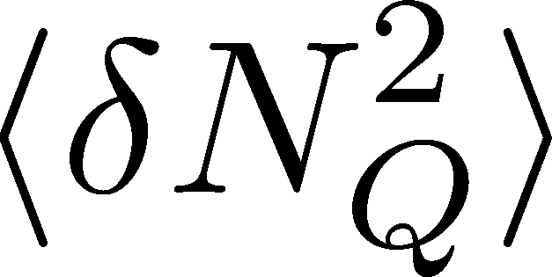



<δN_{B}²> and < δN_{p}² > @ LHC ?
MK, presentations
GSI, Jan. 2013
Berkeley, Sep. 2014
FIAS, Jul. 2015
GSI, Jan. 2016
…
should have different Δη dependence.
Baryon # cumulants are experimentally observable! MK, Asakawa, 2012

Slide 15
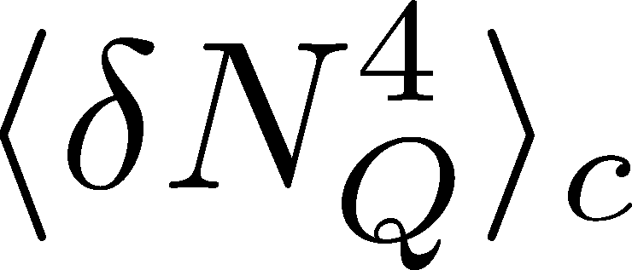

<δN_{Q}⁴> @ LHC ?
MK, presentations
GSI, Jan. 2013
Berkeley, Sep. 2014
FIAS, Jul. 2015
GSI, Jan. 2016
…
How does behave as a function of Δη?
suppression
or
enhancement

Slide 16


(Non-Interacting) Brownian Particle Model
Initial condition (uniform)
cumulants:
random
walk
diffusion master equation: MK+, PLB(2014)
probabilistic argument: Ohnishi+, PRC(2016)

Slide 17


(Non-Interacting) Brownian Particle Model
Initial condition (uniform)
cumulants:
diffusion
distance
random
walk
Study ΔY dependence
Poisson distribution
diffusion master equation: MK+, PLB(2014)
probabilistic argument: Ohnishi+, PRC(2016)

Slide 18



Baryons in Hadronic Phase
time
chem. f.o.
hadronize
10~20fm
kinetic f.o.
Baryons behave like
Brownian pollens in water
mesons
baryons

Slide 19
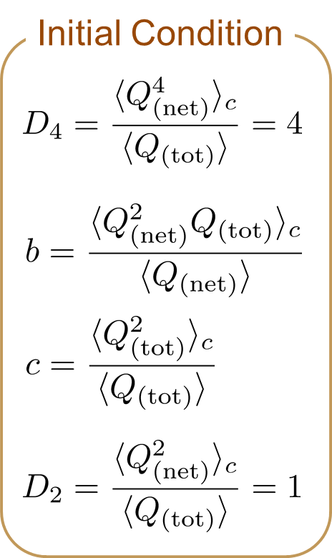

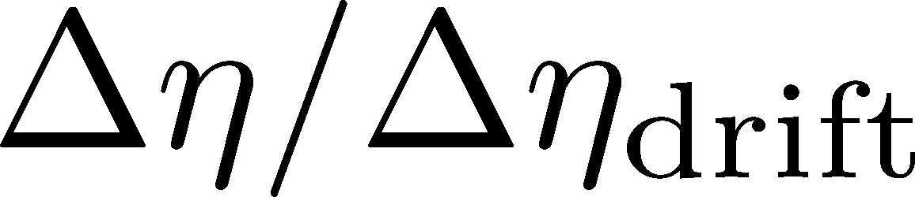
4th Order Cumulant
MK+ (2014)
MK (2015)
Before the diffusion

Slide 20

4th Order Cumulant
MK+ (2014)
MK (2015)
After the diffusion
(rough estimate)
Cumulant at small Δη is modified toward a Poisson value.
Non-monotonic behavior can appear.

Slide 21
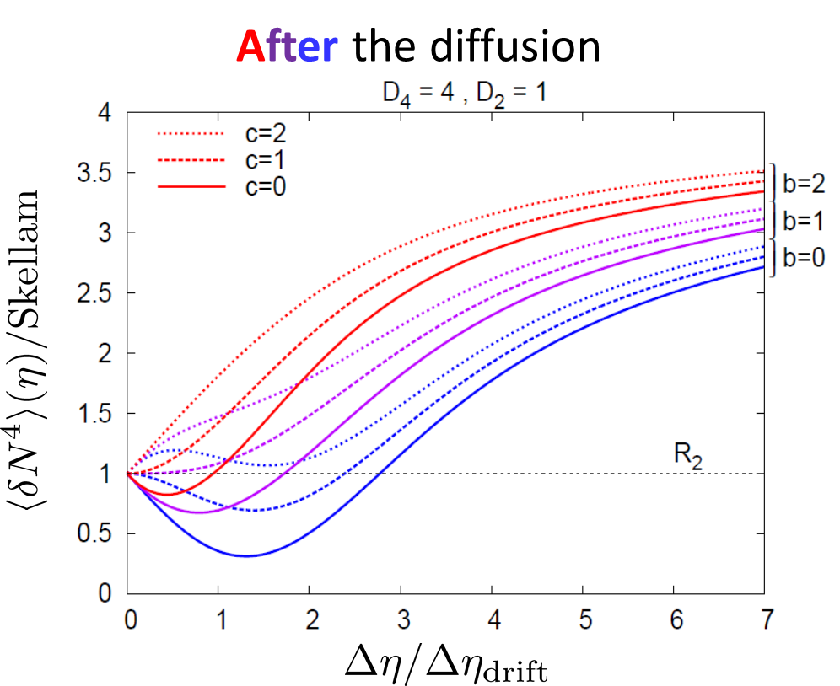
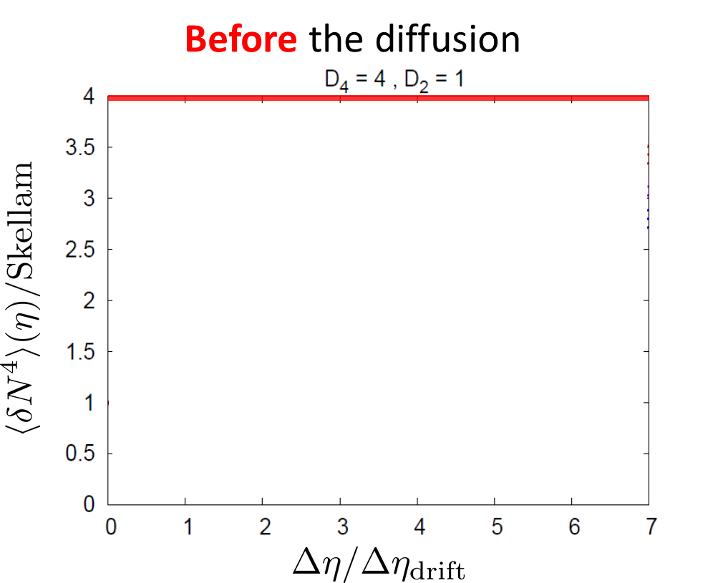
Time Evolution of Fluctuations
Detector
Hadronic
As a result of a simple random walk…
QGP

Slide 22
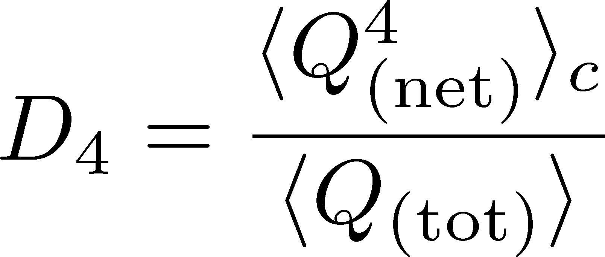




Rapidity Window Dep.
Initial Conditions
4th-order cumulant
MK+, 2014
MK, 2015
STAR Collab. (X. Luo, CPOD2014)
Is non-monotonic Δη dependence already observed?
Different initial conditions give rise to different characteristic Δη dependence. → Study initial condition
Finite volume effects: Sakaida+, PRC90 (2015)

Slide 23
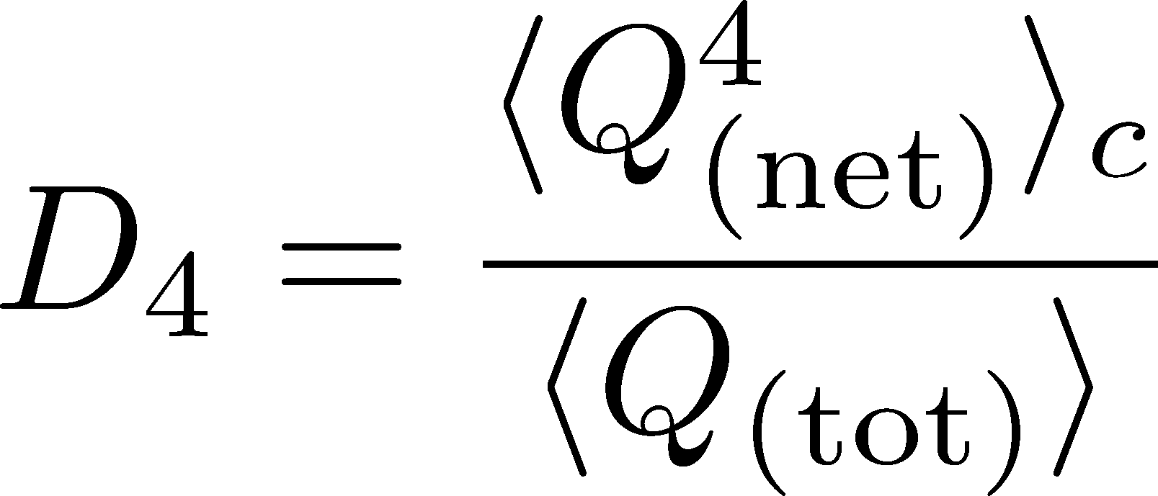
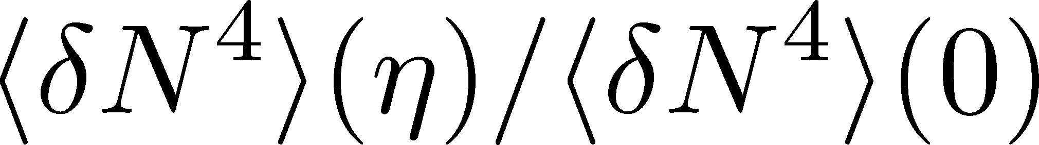
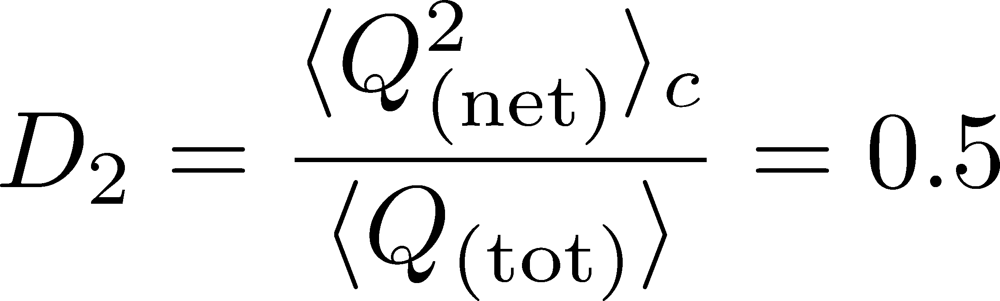
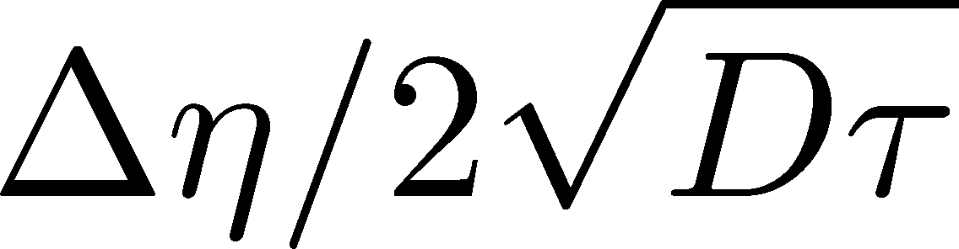
Δη Dependence: 4th order
MK, arXiv:1505.04349
Initial Condition
Charcteristic Δη dependences!
Cumulants with a Δη is not the initial value.

Slide 24
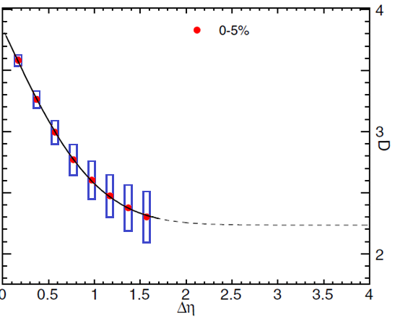
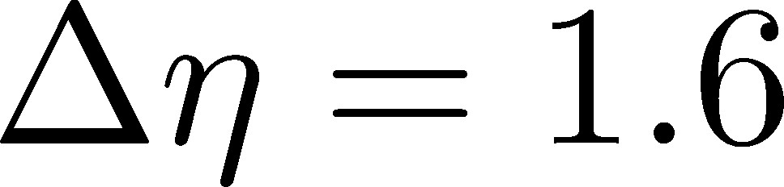
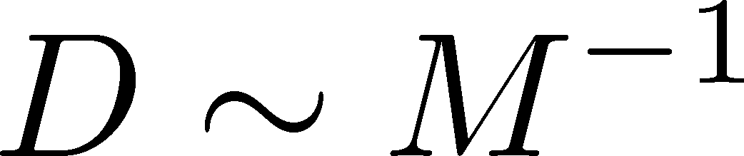
Δη Dependence: 4th order
MK, arXiv:1505.04349
Initial Condition
baryon #
at ALICE
at ALICE

Slide 25
Contents of
Critical Diffusion Dynamics
in Hadronic Stage
  MK, Ono, Asakawa, PLB (2014); MK(2015)
around the Critical Point
  Sakaida, Asakawa, Fujii, MK (2017)
at First Order Transition
  Nonaka, MK, Akamatsu, Bluhm, Nahrgang, in prep.

Slide 26
Critical Fluctuation
①
Growth of critical fluctuation
Critical slowing down
T
②
Decay by diffusion
①
③
At 1st order transition
domain formation
②
③
Hadrons
0
μ

Slide 27

Critical Fluctuation
①
Growth of critical fluctuation
Critical slowing down
T
②
Decay by diffusion
①
Kibble
-Zurek
③
At 1st order transition
domain formation
②
③
Hadrons
0
μ

Slide 28
Dynamical Evolution of Critical Fluctuations
Evolution of spatially uniform “σ” mode
Berdnikov, Rajagopal (2000)
Asakawa, Nonaka (2002)
Mukherjee+ (2015)
…
Model A
Model B
THIS STUDY
Evolution of conserved charge fluctuations
Sakaida+, PRC2017; Murata, MK, in prep.
Conserved charges are directly observable.
Soft mode at QCD-CP is a conserved mode.
See also, Kapusta, Torres-Rincon (2012); Herold, Nahrgang, … (2015); …

Slide 29

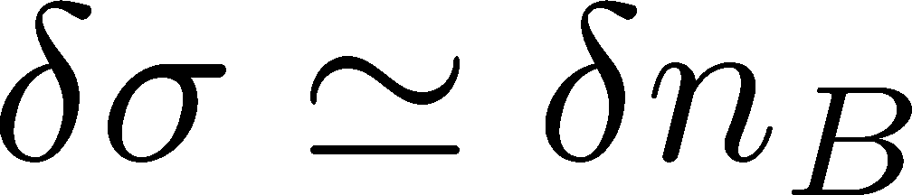

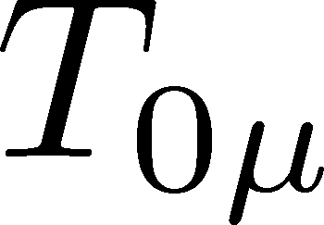
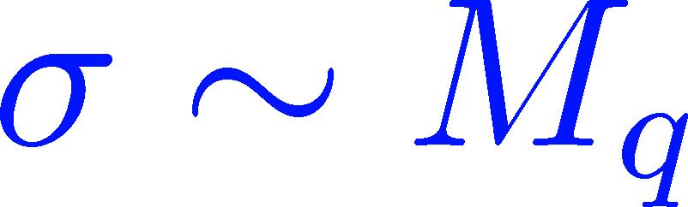
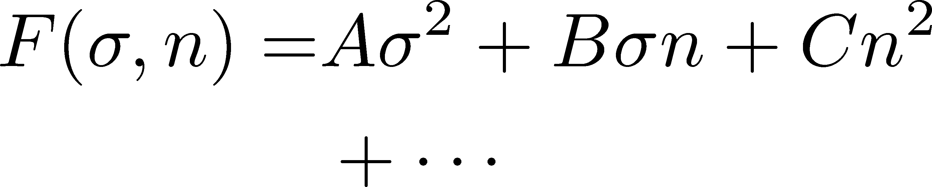


Soft Mode of QCD-CP = Conserved Mode
Fujii 2003; Fujii, Ohtani, 2004; Son, Stephanov, 2004
critical
soft mode
Fluctuations of σ and n_{B} are
coupled around the CP!
σ: fast damping

Slide 30
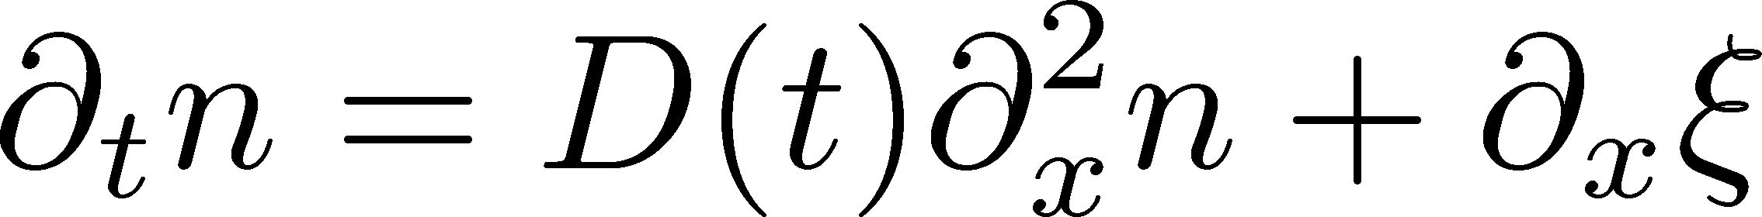

Analysis of 2nd-order Cumulant
Sakaida+ (2017)
Evolution of baryon number density
Stochastic Diffusion Equation
:parameters characterizing criticality
Analytic solution is obtained.
Study 2nd order cumulant & correlation function.
Our Main Conclusion
Non-monotonicity in
cumulants or correlation func.
=
Signal of
QCD-CP

Slide 31
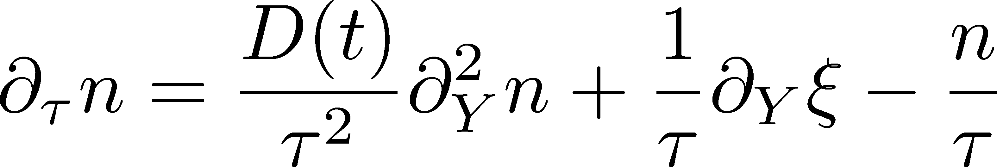
Bjorken Expansion
Cartesian coordinates
Hadronic
QGP
Milne coordinates
suppression
of diffusion
density
reduction

Slide 32
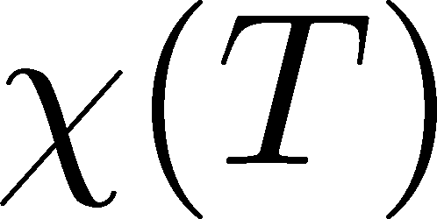
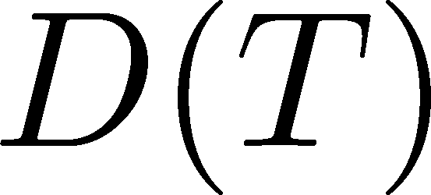
Parametrizing D(τ) and χ(τ)
Critical behavior
(critical point)
3D Ising (r,h)
model H
Berdnikov, Rajagopal (2000)
Stephanov (2011); Mukherjee+(2015)
Temperature dep.
critical
slowing
down
critical
enhancement

Slide 33
Assumptions
Evolution of baryon number density
Stochastic Diffusion Equation
:parameters characterizing criticality
Uniform / infinitely long system
Near equilibrium: δN_{μ} << N₀
Short correlation length
Slow diffusion

Slide 34
Resonance Decay
Neutral Particles
Decay into charged particles
The larger Δη, the slower diffusion.

Slide 35
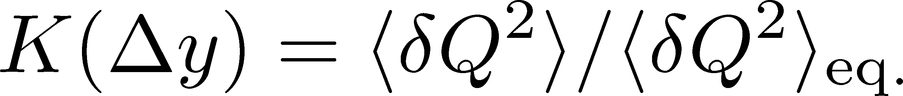
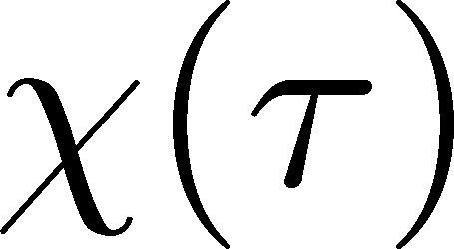
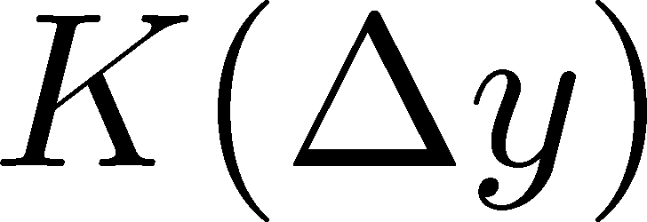
Crossover / Cumulant
ALICE
PRL 2013
monotonically decresing
Analytic
result
monotonically
increasing
monotonically
decreasing

Slide 36
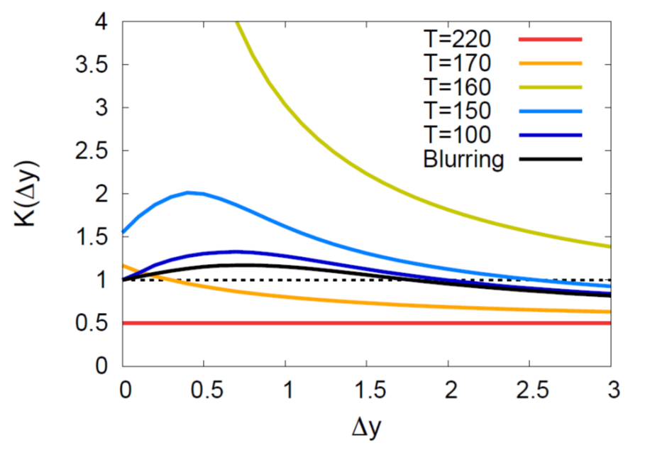
Critical Point / Cumulant
non-monotonic Δy dep.
Analytic
result
See also,
Wu, Song
arXiv: 1903.06075
non-monotonic
non-monotonic

Slide 37
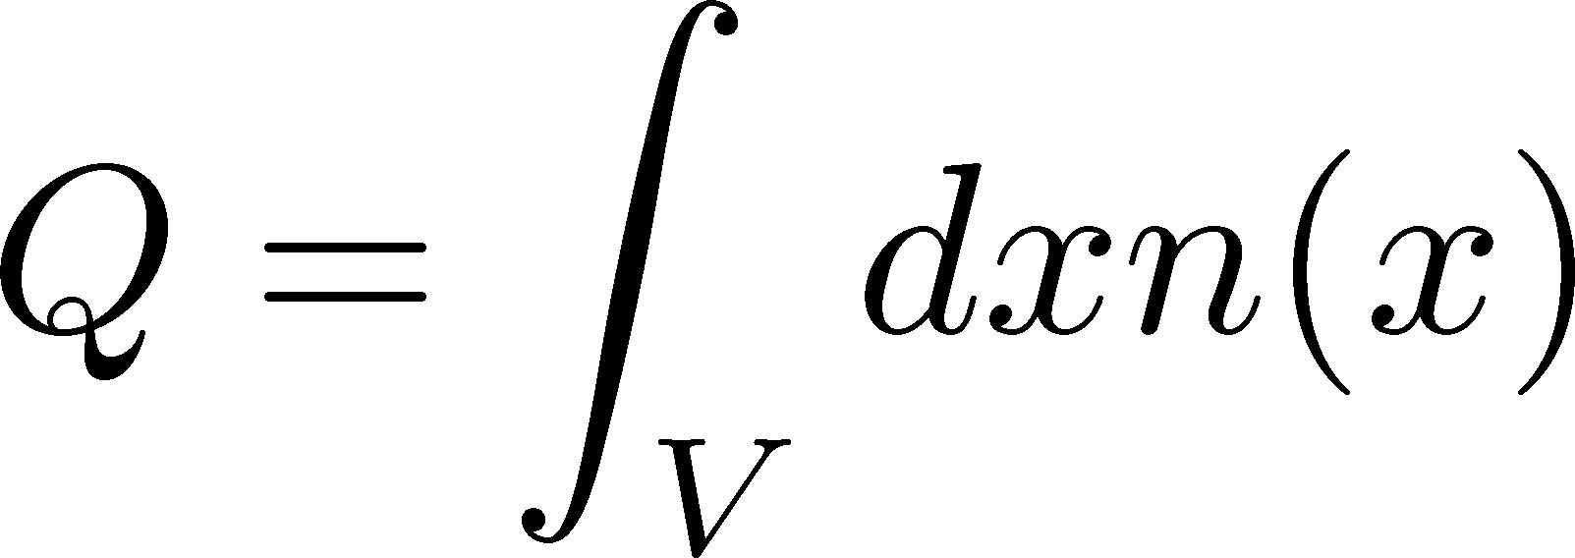
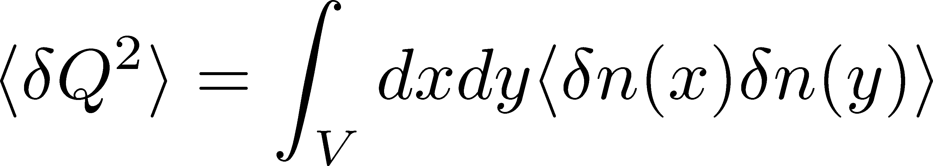
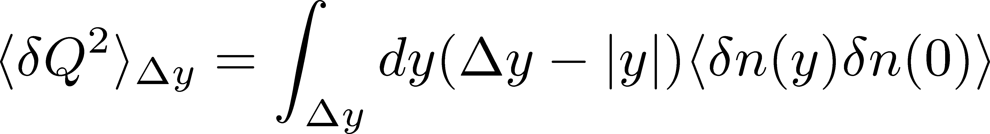
Cumulants and Correlation Function
total charge
charge density
2nd order cumulant
(fluctuation)
correlation function
1-to-1 correspondence
1-dim case

Slide 38
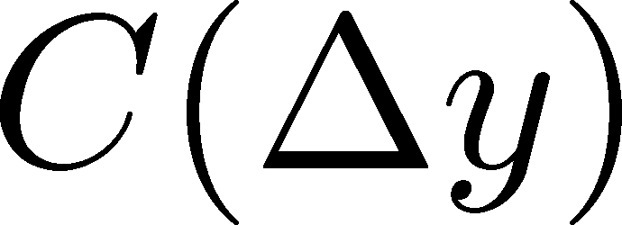
Criticap Point / Correlation Func.
non-monotonic Δy dep.
Analytic
result
See also,
Wu, Song
arXiv: 1903.06075
non-monotonic
non-monotonic

Slide 39


Away from the CP
(critical point)
Signal of the critical enhancement can be clearer on a path away from the CP.
Away from the CP → Weaker critical slowing down

Slide 40
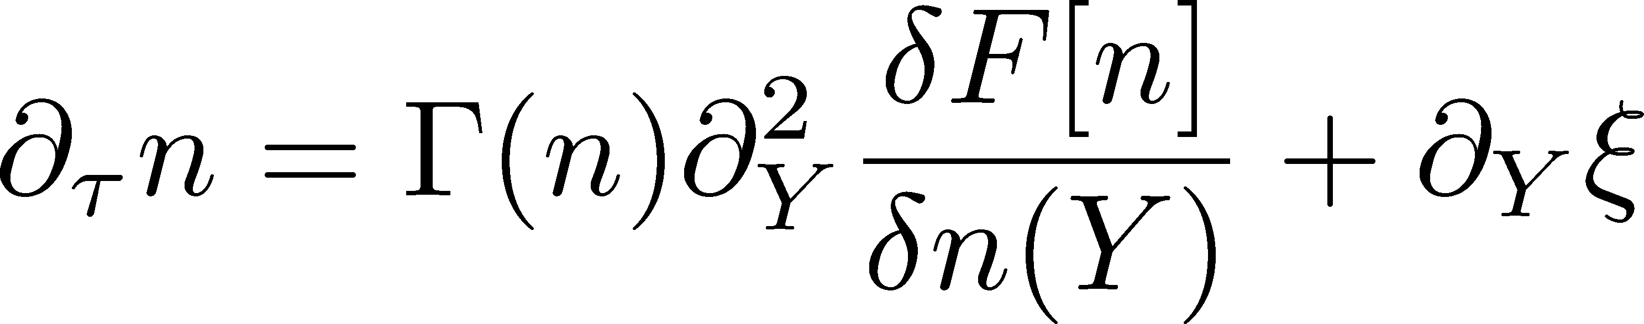
Describing Non-Gaussianity
Diffusion Eq. with Non-linear Terms
Nahrgang, Bluhm, Schaefer, Bass
arxiv:1804.05728
Application to
1st order transition:
Nonaka, Akamatsu, Bluhm, MK, Nahrgang,
Wednesday
Proper description of higher order cumulants

Slide 41
Contents of
Critical Diffusion Dynamics
in Hadronic Stage
  MK, Ono, Asakawa, PLB (2014); MK(2015)
around the Critical Point
  Sakaida, Asakawa, Fujii, MK (2017)
at First Order Transition
  Nonaka, MK, Akamatsu, Bluhm, Nahrgang, in prep.

Slide 42
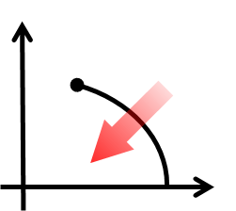
1st-Order Transition
T
μ
Domain formation
Non-uniform system
Herold, Nahrgang, et al. (2011~); Steinheimer, Randrup (2012; 2013)

Slide 43
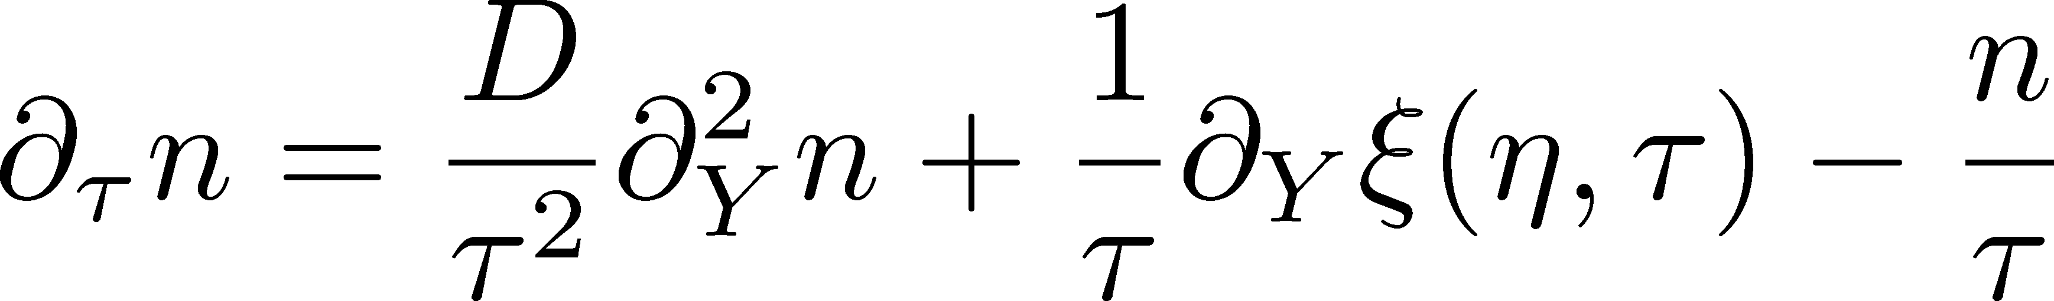
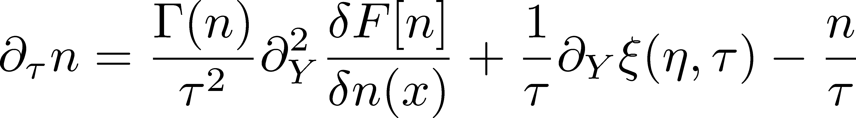
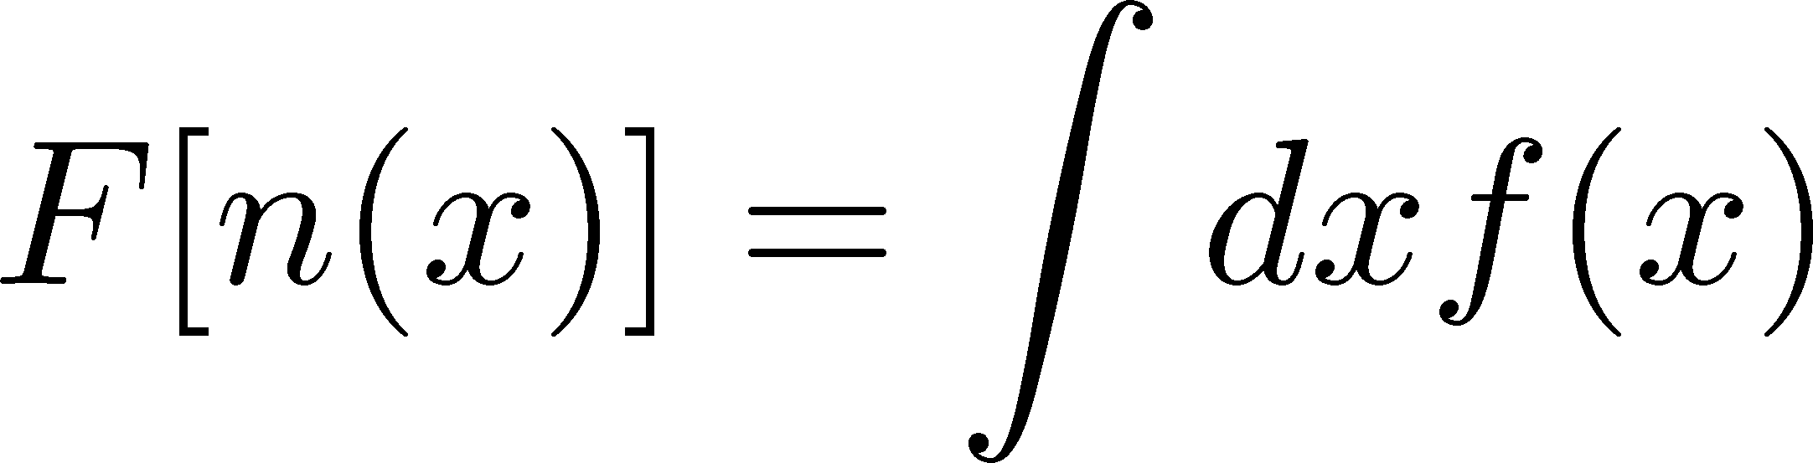
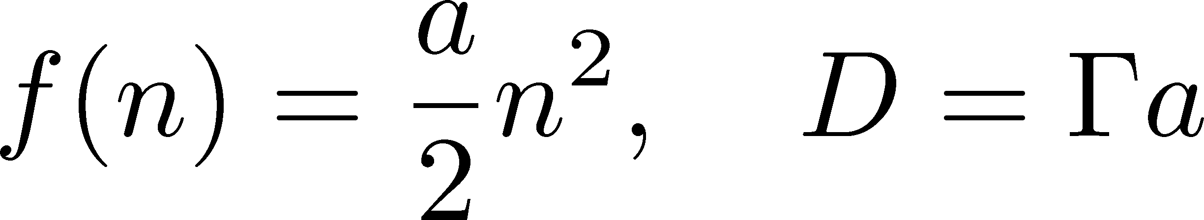
Including Non-Linearity
Nahrgang, Bluhm,
Schafer, Bass (2018)
Include non-linear effects
Diffusion equation:
solve numerically

Slide 44
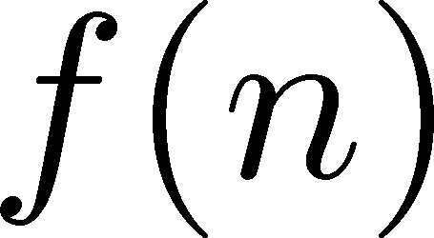

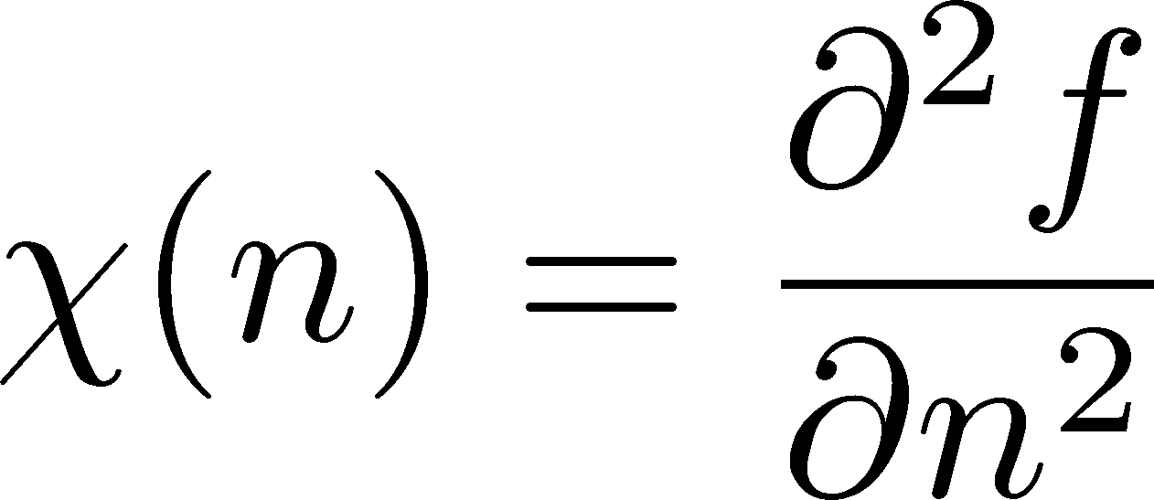
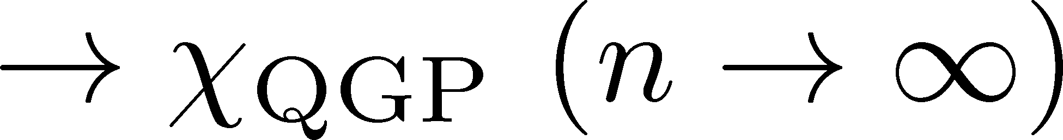

Free Energy
At 1st transition point
Large and small n
Poisson

Slide 45





Modeling 1st Transition
Γ: positive
adjust Γ and A to reproduce the behavior of D at small and large n

Slide 46
Configurations in Equilibrium
Domain formation
Surface: thickness √(2k/a), surface tension

Slide 47





Time Evolution
initial
Dynamical domain formation
Domains survive even after 1st transition
rapidity

Slide 48
Time Evolution
Weaker 1st transition can also lead to formation of domains.

Slide 49
Correlation Function
Correlation Function
τ= 2fm
τ= 5fm
τ=10fm
τ=20fm
Peak
structure
rapidity gap Δy
Domain leads to a peak structure in C(y).
The peak can survive even in the final state.

Slide 50
Summary
Fluctuations observed in HIC are not in equilibrium.
Plenty of information in rapidity window dependences of higher-order cumulants.
2nd-order cumulant (correlation function) already contains interesting information.
Future
  Evolution of higher-order cumulants around the critical point / 1st transition
  combination to momentum (model-H)
  more realistic model (dimension, Y dependence, …)

Slide 51
Prediction
LATTICE
ALICE
HotQCD preliminary
Special thanks to F. Karsch
before continuum limit
1.6
Δη dependence for tracing back the history!

