Slide 1
Theoretical Study of QGP and Phase Transition in RHIC
Masakiyo Kitazawa
(Osaka U.)
14th ANPhA Board meeting and Symposium in Korea
Seogwipo KAL Hotel, Korea, 27/June/2019

Slide 2
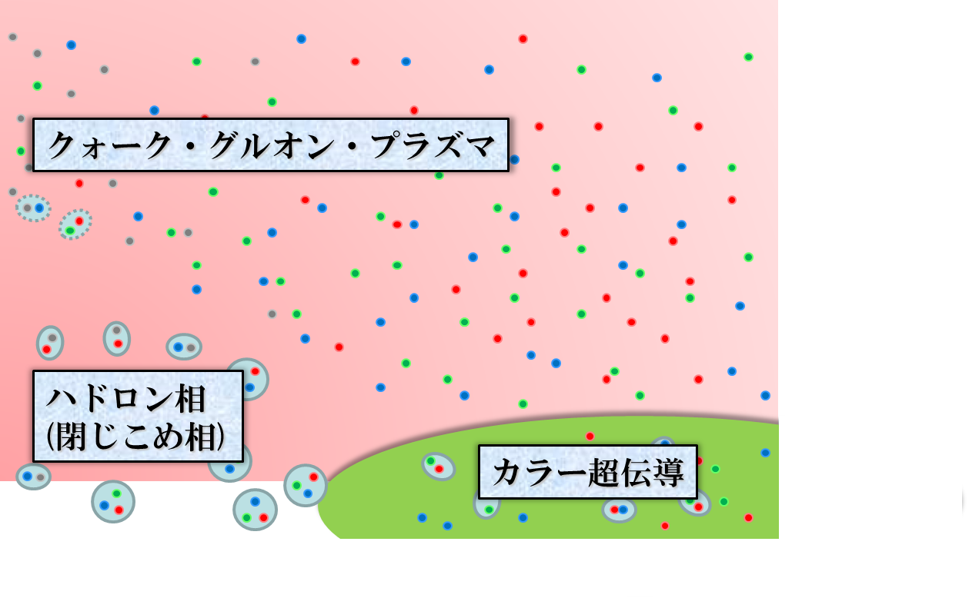




QCD Phase Diagram
Temperature
Quark-Gluon Plasma
ＱＣＤ Critical Point
Hadronic
Phase
Color SC
Baryon chemical
potential

Slide 3
QCD Phase Diagram
Temperature
Quark-Gluon Plasma
Lattice QCD
ＱＣＤ Critical Point
Hadronic
Phase
Color SC
Baryon chemical
potential

Slide 4


QCD Phase Diagram
Early Universe
Temperature
Quark-Gluon Plasma
ＱＣＤ Critical Point
Hadronic
Phase
Color SC
Baryon chemical
potential
Compact
Stars

Slide 5

Relativistic Heavy-Ion Collisions
Collide 2 heavy nuclei
Physics
Hot & dense medium
Early Universe
Quark-gluon plasma
QCD phase structre
RHIC (2000~)
QGP Formation
Strongly coupled QGP
LHC (2010~)
Precision measurement
of the QGP
Picture of fireball by Soushi Nonaka

Slide 6




Brief History of Relativistic HIC
AGS
-1996
SPS
1994-2000
RHIC
2000-
LHC
2010-
~2010
High Energy Frontier
Picture of fireball by Soushi Nonaka

Slide 7
Brief History of Relativistic HIC
AGS
-1996
SPS
1994-2000
RHIC
2000-
LHC
2010-
RHIC-BES
2010-
~2010
High Energy Frontier
NICA
FXT: 2018-
2010~
Lower Energy
FAIR
2025-
Picture of fireball by Soushi Nonaka
J-PARC-HI
2025-?
Interaction rate
FAIR, J-PARC-HI: ~10⁷ Hz
AGS, SPS: ~10² Hz

Slide 8
Beam-Energy Dependence

Slide 9
Beam-Energy Dependence
High energy
Low energy
Nuclear transparency
Baryon stopping
net-baryon #: small
net-baryon #: large

Slide 10



Maximum Density
Time evolution in T-ρ plane by JAM
A. Ohnishi, 2002
Maximum density 5~10ρ₀ @ E/A~20GeV
Large event-by-event fluctuations?

Slide 11

Beam-Energy Scan
Temperature
high
Quark-Gluon Plasma
beam energy
ＱＣＤ Critical Point
low
Hadronic
Phase
Color SC
Baryon chemical
potential

Slide 12
HI Acceleration @ J-PARC
J-PARC Heavy Ion
Spectrometer
New HI Injector
high intensity
RCS & Main Ring
stable
well established
Use of reliable / high-performance RCS & main ring
→Reduce cost and time

Slide 13
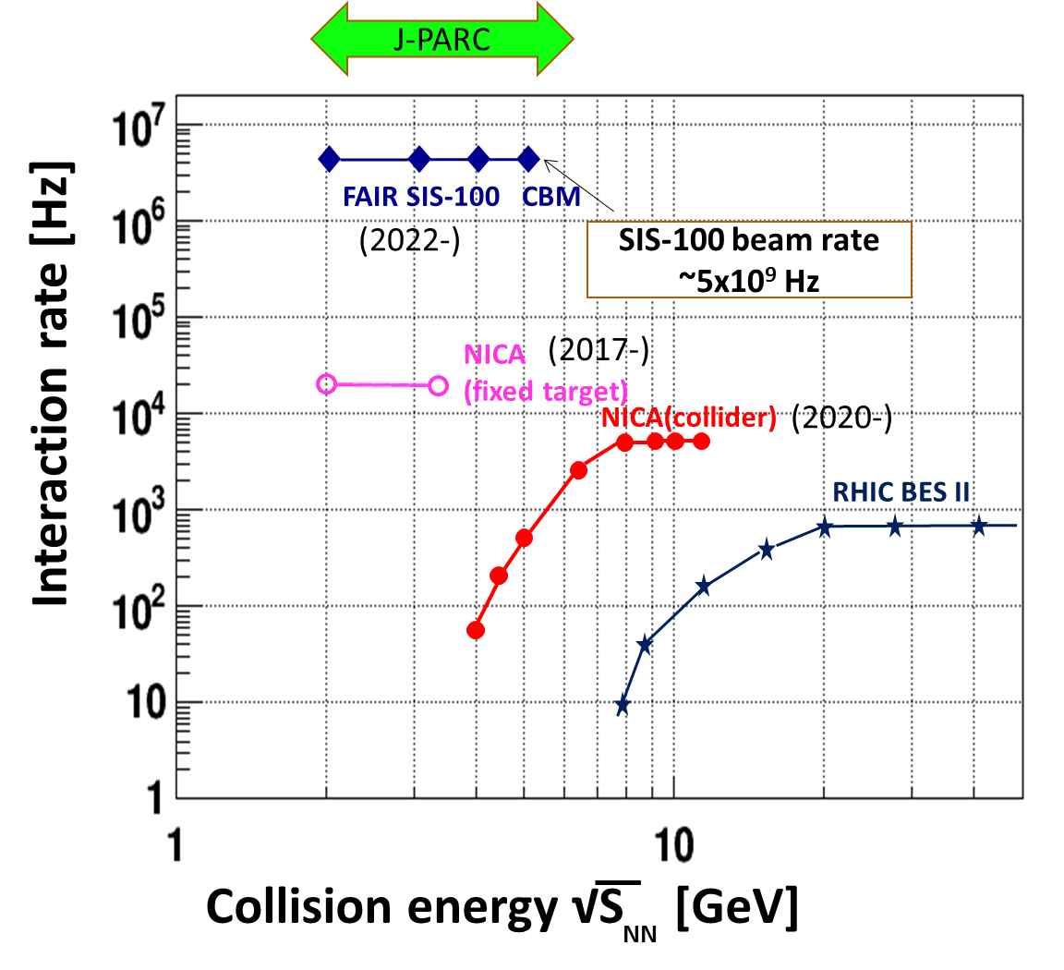
Collision Rate
J-PARC-HI
J-PARC-HI:
High-luminosity X Fixed target
→World highest rate～10⁸Hz
5-order higher than AGS,SPS
SPS
AGS
AGS, SPS
1 year
J-PARC-HI
5 min.
＝
High-statistical exp.
various event selections
higher order correlations
search of rare events

Slide 14
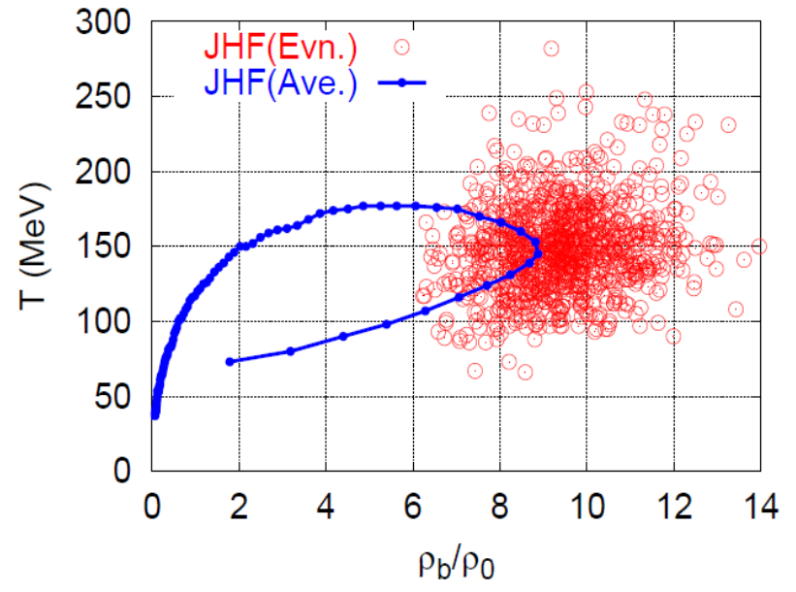
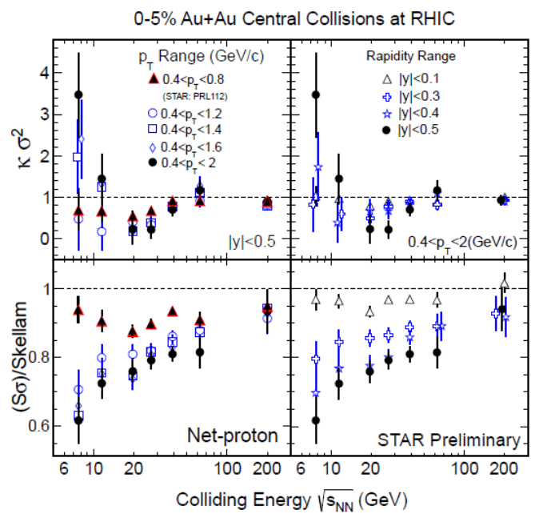
Various Observables
Flow
Dilepton / photon
Fluctuations, higher-order cumulants
Ξ, Ω, …
Sophisticated event selections
Various correlations

Slide 15



Event-by-Event Fluctuations
Review: Asakawa, MK, PPNP 90 (2016)
STAR, PRL105 (2010)
Detector
Cumulants

Slide 16




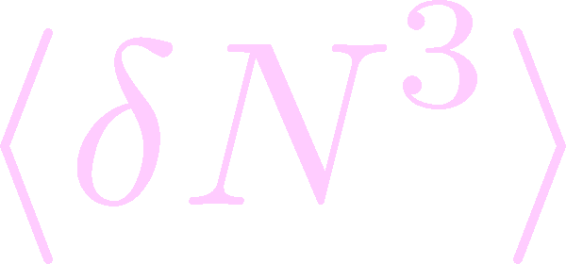

Non-Gaussian Cumulants
Gaussian fluctuations
diverge at the QCD-CP
Higher order cumulants change sign at the phase boundary
Asakawa, Ejiri, MK, 2009
Steeper divergence for higher-order cumulants
Stephanov, 2009

Slide 17


Experimental Results
Enhancement
STAR Collab.
2010~
Suppression
Enhancement & Suppression of non-Gaussian cumulants!
Have we observed
QCD critical point?

Slide 18





Rapidity Window Dependence
STAR Collab. 2015
Non-Gaussian Cumulants have been observed as a function of rapidity window Δy.
Some results have non-monotonic Δy dependence.

Slide 19
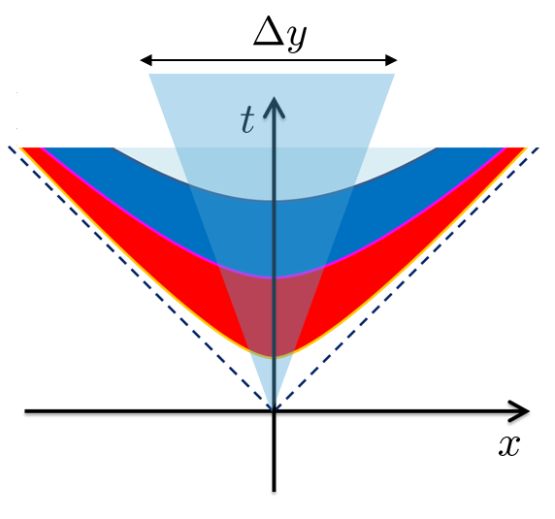


Diffusion of Fluctuations
MK, Ohno, Asakawa 2014
MK 2015
Distributions in Δy in the final state and early stage are different due to diffusion.

Slide 20







Rapidity Window dependence as a Result of Diffusion
MK+ (2014); MK (2015)
Parameters
(rough estimate)
Higher order cumulants can behave non-monotonically.
Δη dependence encodes history of time evolution.

Slide 21
Rapidity Window dependence as a Result of Diffusion
MK+ (2014); MK (2015)
Parameters
STAR 2015
(rough estimate)
Higher order cumulants can behave non-monotonically.
Δη dependence encodes history of time evolution.

Slide 22

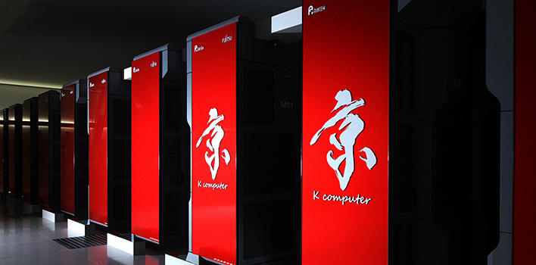
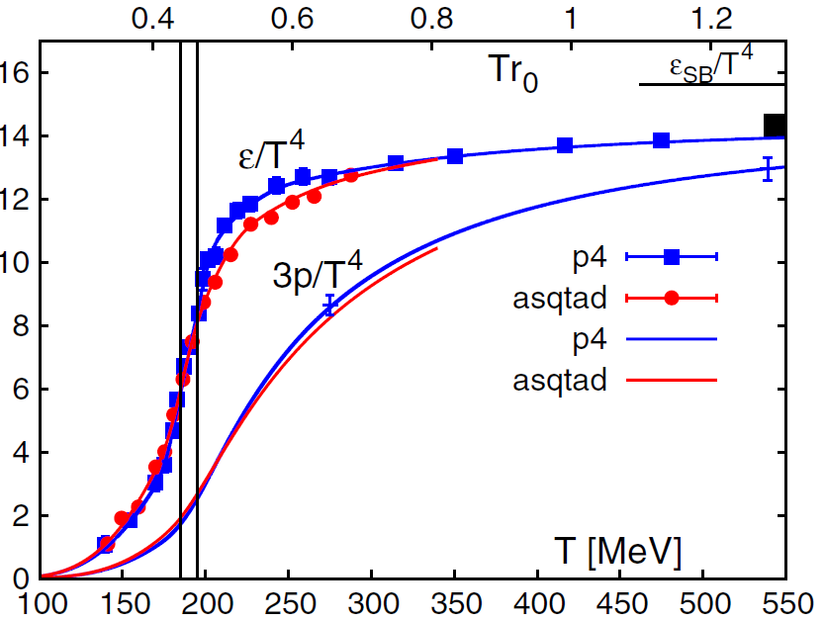
Numerical Experiments
Lattice QCD simulations on supercomputers
Example: Equation of State
Important inputs for understanding the experimental data in heavy-ion collisions

Slide 23
Confinement / Deconfinement
Single quarks have never been observed.
In QGP, liberated quarks are fundamental d.o.f.
We explore local propagation of the confinement force

Slide 24


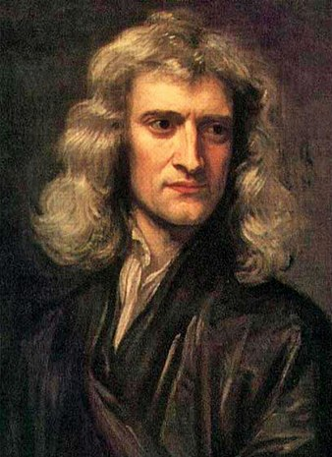




Force
Action-at-a-distance
Newton
1687
Local interaction
Faraday
1839

Slide 25


Stress = Force per Unit Area
Pressure
S

Slide 26
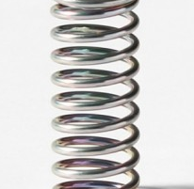



Stress = Force per Unit Area
Pressure
Generally, F and n are not parallel
v
fluid
S
F
S
elastic body
S
In thermal medium
Stress Tensor
Landau
Lifshitz

Slide 27




Maxwell Stress
(in Maxwell Theory)
Maxwell
E
pulling
Parallel to field: Pulling
Vertical to field: Pushing
pushing

Slide 28



Maxwell Stress
(in Maxwell Theory)
length:
pulling
pushing
Definite physical meaning
Distortion of field, line of the field
Propagation of the force as local interaction

Slide 29
Stress Tensor in QQ System
ー
Yanagihara+, PLB 2019
Lattice simulation
SU(3) Yang-Mills
a=0.029 fm
R=0.69 fm
t/a²=2.0
pulling
pushing
Definite physical meaning
Distortion of field, line of the field
Propagation of the force as local interaction
Manifestly gauge invariant

Slide 30


Force
Force from Potential
Force from Stress

Slide 31
Force
Force from Potential
Force from Stress
Newton
1687
Faraday
1839

Slide 32
Force
Force from Potential
Force from Stress
Good Agreement!
Newton
1687
Faraday
1839

Slide 33

Temperature Dependence
Yanagihara+, in prep.
Vacuum
(Current Universe)
QGP
(Early Universe)
?

Slide 34
Temperature Dependence
Yanagihara+, in prep.
Vacuum
(Current Universe)
QGP
(Early Universe)
Preliminary
(FlowQCD, in prep.)
T=1.44T_{c}
Singlet projection for T=1.44T_{c}
Flux-tube structure is screened above T_{c}.

Slide 35
Summary
Exploring dense medium in relativistic heavy-ion collisions is one of the hottest topics in this field. Many new experiments will start in the near future!
Fluctuations are promising observables for the search for the phase structure of QCD.
Lattice QCD numerical simulations are another important virtual experiments to explore the hot and dense medium.

