Slide 1
Stress-Energy-Momentum
Tensor on the Lattice
Seminar at SUBATECH, IMT Atlantique, Nantes, France, Sep./25/2019
Masakiyo Kitazawa
(Osaka U.)

Slide 2




Energy-Momentum Tensor
energy
momentum
pressure
stress
All components are important physical observables!

Slide 3




: nontrivial observable
on the lattice
Definition of the operator is nontrivial
because of the explicit breaking of Lorentz symmetry
ex:
Its measurement is extremely noisy
due to high dimensionality and etc.

Slide 4
Stress = Force per Unit Area

Slide 5


Stress = Force per Unit Area
Pressure
S

Slide 6
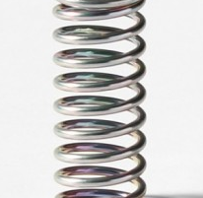



Stress = Force per Unit Area
Pressure
Generally, F and n are not parallel
v
fluid
S
F
S
elastic body
S
In thermal medium
Stress Tensor
Landau
Lifshitz

Slide 7


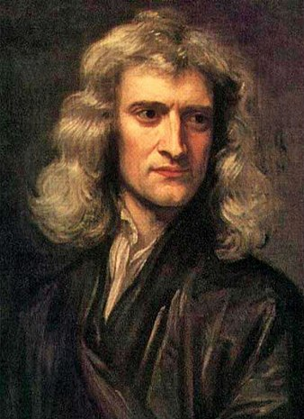


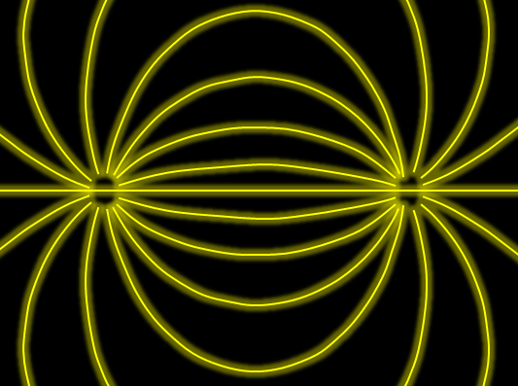

Force
Action-at-a-distance
Newton
1687
Local interaction
Faraday
1839

Slide 8




Maxwell Stress
(in Maxwell Theory)
Maxwell
E
pulling
Parallel to field: Pulling
Vertical to field: Pushing
pushing

Slide 9



Maxwell Stress
(in Maxwell Theory)
length:
pulling
pushing
Definite physical meaning
Distortion of field, line of the field
Propagation of the force as local interaction

Slide 10
Quark-Anti-quark system
Formation of the flux tube → confinement
Previous Studies on Flux Tube
Potential
Action density
Color-electric field
so many studies…
Cea+ (2012)
Cardoso+ (2013)

Slide 11
Stress Tensor in QQ System
ー
Yanagihara+, PLB, 2019
Lattice simulation
SU(3) Yang-Mills
a=0.029 fm
R=0.69 fm
t/a²=2.0
pulling
pushing
Definite physical meaning
Distortion of field, line of the field
Propagation of the force as local interaction
Manifestly gauge invariant

Slide 12
SU(3) YM vs Maxwell
SU(3) Yang-Mills
(quantum)
Maxwell
(classical)
Propagation of the force is clearly different
in YM and Maxwell theories!

Slide 13
Casimir Effect

Slide 14
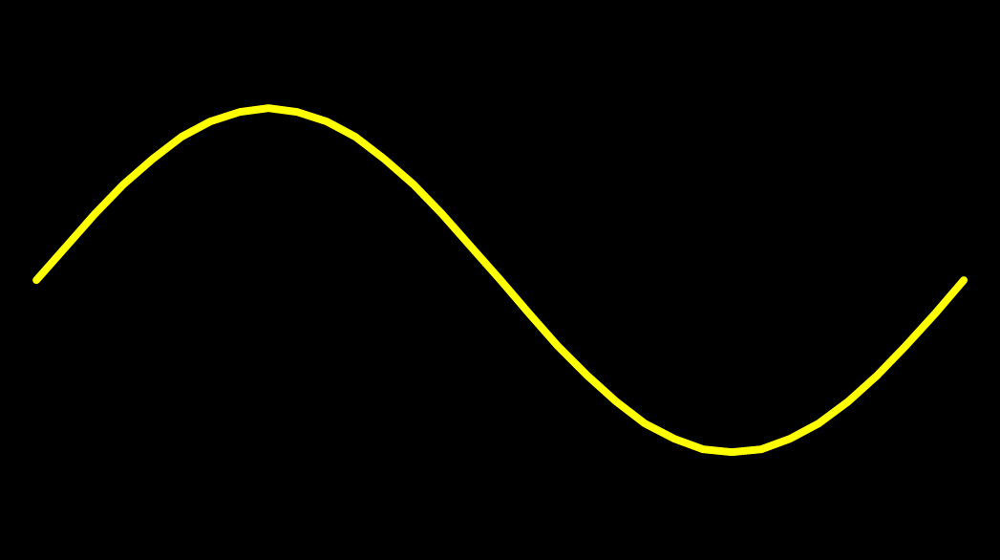
Casimir Effect
attractive force between two conductive plates

Slide 15





Casimir Effect
Brown, Maclay
1969

Slide 16



Casimir Effect
Brown, Maclay
1969

Slide 17

Casimir Effect
Brown, Maclay
1969
T

Slide 18

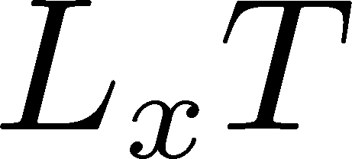

Pressure Anisotropy @ T≠0
MK, Mogliacci, Kolbe,
Horowitz, PRD, 2019
Free scalar field
L₂=L₃=∞
Periodic BC
Mogliacci+, 1807.07871

Slide 19
Pressure Anisotropy @ T≠0
MK, Mogliacci, Kolbe,
Horowitz, PRD, 2019
Free scalar field
L₂=L₃=∞
Periodic BC
Mogliacci+, 1807.07871
Lattice result
Periodic BC
Only t→0 limit
Error: stat.+sys.
Medium near T_{c} is remarkably insensitive to finite size!

Slide 20
Contents
1. Constructing EMT
2. Thermodynamics
FlowQCD, PRD90,011501 (2014); PRD94, 114512 (2016);
WHOT-QCD, PRD96, 014509 (2017); Iritani+, PTEP 2019, 023B02 (2019)
3. Flux Tube
FlowQCD, PLB789, 210 (2019); Yanagihara+, in prep.
4. Static Quark Systems at Nonzero T
FlowQCD, in prep.
5. Casimir Effect
MK, Mogliacci, Horowitz, Kolbe, PRD, 2019
6. Correlation Function
FlowQCD, PRD96, 111502 (2017)

Slide 21




Yang-Mills Gradient Flow
Luscher 2010
Narayanan, Neuberger, 2006
Luscher, Weiss, 2011
t: “flow time”
dim:[length²]
leading
diffusion equation in 4-dim space
diffusion distance
“continuous” cooling/smearing
No UV divergence at t>0

Slide 22





Small Flow-Time Expansion
Luescher, Weisz, 2011
Suzuki, 2013
an operator at t>0
remormalized operators
of original theory
original 4-dim theory
t→0 limit

Slide 23


Constructing EMT 1
Suzuki, 2013
Gauge-invariant dimension 4 operators

Slide 24

Constructing EMT
Suzuki, 2013
vacuum subtr.
Remormalized EMT
Perturbative coefficient:
Suzuki (2013); Makino, Suzuki (2014); Harlander+ (2018); Iritani, MK, Suzuki, Takaura (2019)

Slide 25





Perturbative Coefficients
Suzuki, PTEP 2013, 083B03
Harlander+, 1808.09837
Iritani, MK, Suzuki, Takaura, PTEP 2019
LO
1-loop
2-loop
3-loop
×
Iritani, MK, Suzuki,
Takaura, 2019
zero
Suzuki (2013)
Harlander+(2018)
Choice of the scale of g²
Previous:
Improved:
Harlander+ (2018)

Slide 26



Gradient Flow Method
lattice regularized
gauge theory
Smeared world
by gradient flow
gradient flow
continuum theory
gradient flow
Measure on
the lattice
analytic relation
Take Extrapolation (t,a)→(0,0)
O(t) terms in SFTE
lattice discretization

Slide 27
Contents
1. Constructing EMT
2. Thermodynamics
FlowQCD, PRD90,011501 (2014); PRD94, 114512 (2016);
WHOT-QCD, PRD96, 014509 (2017); Iritani+, PTEP 2019, 023B02 (2019)
3. Flux Tube
FlowQCD, PLB789, 210 (2019); Yanagihara+, in prep.
4. Static Quark Systems at Nonzero T
FlowQCD, in prep.
5. Casimir Effect
MK, Mogliacci, Horowitz, Kolbe, arXiv:1904.00241
6. Correlation Function
FlowQCD, PRD96, 111502 (2017)

Slide 28
Higher Order Coefficient: ε+p
NLO (1-loop)
N²LO (2-loop)
Iritani, MK, Suzuki, Takaura, PTEP 2019
t dependence becomes milder with higher order coeff.
Better t→0 extrapolation
Systematic error: μ₀ or μ_{d}, uncertaintyof Λ (±3%), fit range
Extrapolation func: linear, higher order term in c₁ (~g⁶)

Slide 29




Double Extrapolation t→0, a→0
O(t) terms in SFTE
lattice discretization
Continuum extrapolation
strong
discretization
effect
Small t extrapolation

Slide 30
Higher Order Coefficient: ε+p
NLO (1-loop)
N²LO (2-loop)
Range2
Range2
Range1
Range1
Range3
Range3
Iritani, MK, Suzuki, Takaura, PTEP 2019
t dependence becomes milder with higher order coeff.
Better t→0 extrapolation
Systematic error: μ₀ or μ_{d}, uncertaintyof Λ (±3%), fit range
Extrapolation func: linear, higher order term in c₁ (~g⁶)

Slide 31
Effect of Higher-Order Coeffs.
Iritani, MK, Suzuki, Takaura, 2019
□: 2-loop
△: Flow2016
Systematic error: μ₀ or μ_{d}, Λ, t→0 function, fit range
More stable extrapolation with higher order c₁ & c₂
(pure gauge)

Slide 32



Gradient Flow for Fermions
Luscher, 2013
Makino, Suzuki, 2014
Taniguchi+ (WHOT)
2016; 2017
Not “gradient” flow but a “diffusion” equation.
Divergence in field renormalization of fermions.
All observables are finite at t>0 once Z(t) is fixed.
Energy-momentum tensor from SFTE Makino, Suzuki, 2014

Slide 33


EMT in QCD

Slide 34
2+1 QCD EoS from Gradient Flow
Taniguchi+ (WHOT-QCD), PRD96, 014509 (2017)
m_{PS}/m_{V} ≈0.63
Not
reliable
Not
reliable
Agreement with integral method except for N_{t}=4, 6
N_{t}=4, 6: No stable extrapolation is possible
Statistical error is substantially suppressed!
Physical mass: Kanaya+ (WHOT-QCD), 1710.10015

Slide 35
Contents
1. Constructing EMT
2. Thermodynamics
FlowQCD, PRD90,011501 (2014); PRD94, 114512 (2016);
WHOT-QCD, PRD96, 014509 (2017); Iritani+, PTEP 2019, 023B02 (2019)
3. Flux Tube
FlowQCD, PLB789, 210 (2019); Yanagihara+, in prep.
4. Static Quark Systems at Nonzero T
FlowQCD, in prep.
5. Casimir Effect
MK, Mogliacci, Horowitz, Kolbe, arXiv:1904.00241
6. Correlation Function
FlowQCD, PRD96, 111502 (2017)

Slide 36
Quark-Anti-quark system
Formation of the flux tube → confinement
Previous Studies on Flux Tube
Potential
Action density
Color-electric field
so many studies…
Cea+ (2012)
Cardoso+ (2013)

Slide 37
Stress Tensor in QQ System
ー
Yanagihara+, 1803.05656
PLB, in press
Lattice simulation
SU(3) Yang-Mills
a=0.029 fm
R=0.69 fm
t/a²=2.0
pulling
pushing
Definite physical meaning
Distortion of field, line of the field
Propagation of the force as local interaction
Manifestly gauge invariant

Slide 38


Lattice Setup
Yanagihara+, PLB, 2019
SU(3) Yang-Mills (Quenched)
Wilson gauge action
Clover operator
APE smearing / multi-hit
fine lattices (a=0.029-0.06 fm)
continuum extrapolation
Simulation: bluegene/Q@KEK
R=0.92 fm
R=0.69 fm
R=0.46 fm

Slide 39



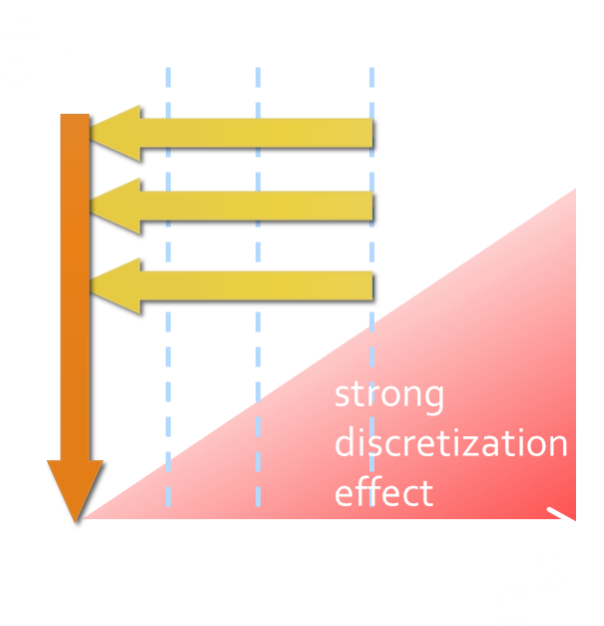
Continuum Extrapolation at mid-point
mid point
continuum
limit
a→0 extrapolation with fixed t

Slide 40
t→0 Extrapolation at mid-point
Range2
continuum
limit
Range1
Range3
a→0 extrapolation with fixed t
Then, t→0 with three ranges

Slide 41
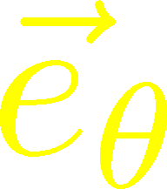
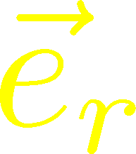
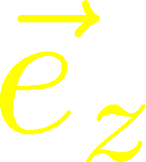



Stress Distribution on Mid-Plane
From rotational symm. & parity
EMT is diagonalized
in Cylindrical Coordinates
Degeneracy
in Maxwell theory

Slide 42


Mid-Plane
Separation
Continuum
Extrapolated!
In Maxwell theory
Degeneracy:
Separation:
Nonzero trace anomaly

Slide 43
Mid-Plane
Separation
Continuum
Extrapolated!
Degeneracy:
Separation:
Nonzero trace anomaly

Slide 44


Momentum Conservation
Yanagihara+, in prep.
In cylindrical coordinats,
For infinitely-long flux tube
Lattice
T_{rr} and T_{θθ} must separate!
Effect of boundaries is important
for the flux tube at R=0.92fm

Slide 45


Force
Force from Potential
Force from Stress

Slide 46
Force
Force from Potential
Force from Stress
Newton
1687
Faraday
1839

Slide 47
Force
Force from Potential
Force from Stress
Good Agreement!
Newton
1687
Faraday
1839

Slide 48
Dual Superconductor Picture
Nambu, 1970
Nielsen, Olesen, 1973
t ‘Hooft, 1981
…
QCD Vacuum
Superconductor
Anti-
Monopole
Quark
Anti-quark
Monopole
Flux Tube
Magnetic Vortex
Dual (E⇔B)

Slide 49






Abelian-Higgs Model
Yanagihara, MK, PTEP 2019
Abelian-Higgs Model
GL parameter:
Infinitely long tube
type-I :
type-II :
Bogomol’nyi bound :
degeneracy
Luscher, 1981
momentum conservation

Slide 50

Stress Tensor in AH Model infinitely-long flux tube
Bogomol’nyi bound :
de Vega, Schaposnik, PRD14, 1100 (1976).

Slide 51




Stress Tensor in AH Model infinitely-long flux tube
Type-I
Type-II
No degeneracy bw T_{rr} & T_{θθ}
T_{θθ} changes sign
conservation law

Slide 52

Stress Tensor in AH Model infinitely-long flux tube
Type-I
Lattice
Inconsistent with
lattice result
No degeneracy bw T_{rr} & T_{θθ}
T_{θθ} changes sign

Slide 53
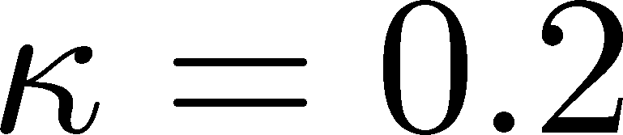
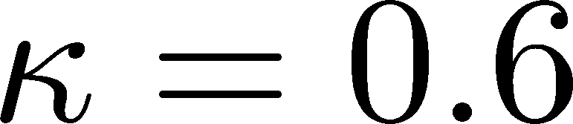




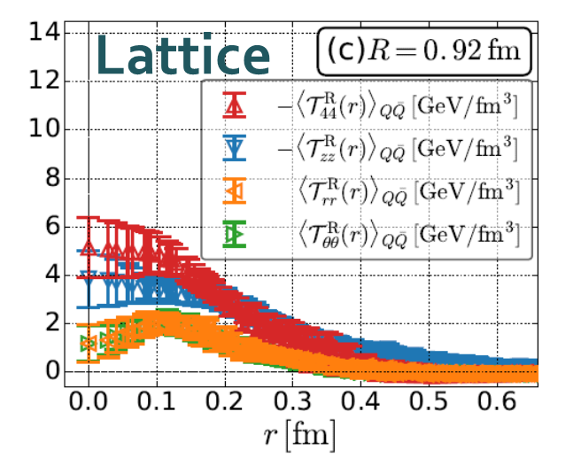
Flux Tube with Finite Length
R=0.92 fm
Left: T_{zz}(0), T_{rr}(0) reproduce lattice result
Right: A parameter satisfying T_{rr}≈T_{θθ}
No parameters to reproduce
lattice data at R=0.92fm.

Slide 54
Contents
1. Constructing EMT
2. Thermodynamics
FlowQCD, PRD90,011501 (2014); PRD94, 114512 (2016);
WHOT-QCD, PRD96, 014509 (2017); Iritani+, PTEP 2019, 023B02 (2019)
3. Flux Tube
FlowQCD, PLB789, 210 (2019); Yanagihara+, in prep.
4. Static Quark Systems at Nonzero T
FlowQCD, in prep.
5. Casimir Effect
MK, Mogliacci, Horowitz, Kolbe, arXiv:1904.00241
6. Correlation Function
FlowQCD, PRD96, 111502 (2017)

Slide 55
Screening of QQ Force above T_{c}
vacuum
high temperature
Q-Qbar force is screened in the deconfined phase.

Slide 56

Temperature Dependence
Vacuum
(Current Universe)
High Temperature
(Early Universe)
?

Slide 57
Temperature Dependence
Vacuum
(Current Universe)
High Temperature
(Early Universe)
Preliminary
(FlowQCD, in prep.)
T=1.44T_{c}
Singlet projection for T=1.44T_{c}
Flux-tube structure is screened above T_{c}.

Slide 58
Mid Plane
T=1.44Tc, R=0.46 fm
Vacuum, R=0.46 fm
Separation b/w T₄₄ & T_{zz}?

Slide 59
Stress Tensor around A Quark in a deconfined phase
Q

Slide 60
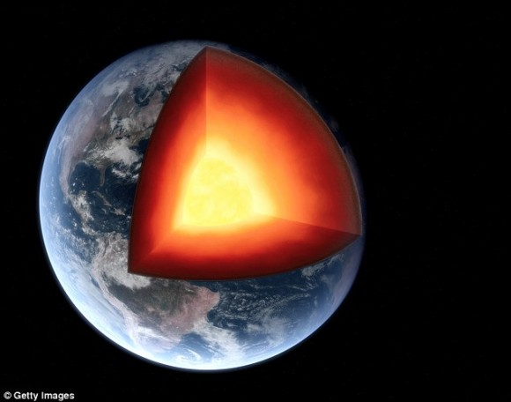
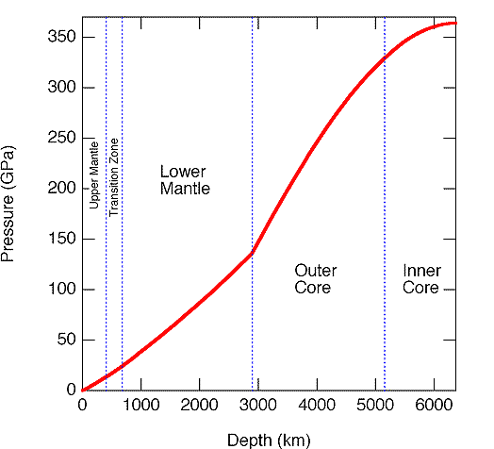
Pressure inside the Earth

Slide 61
Pressure inside Hadrons
EMT distribution inside hadrons now accessible??
Pressure @ proton
EMT distribution @ pion
arXiv:1810.07589
Nature, 557, 396 (2018)
Kumano, Song, Teryaev
Phys. Rev. D 97, 014020 (2018)

Slide 62




Stress Tensor around A Quark in a deconfined phase
Yanagihara+, in prep.
Quenched QCD
48³x12 (T≈1.4T_{c})
fixed t , a
Preliminary
Spherical Coordinates
Energy density
Longitudinal pressure
Transverse pressure
Screening mass
Strong coupling const.
Not reliable

Slide 63
Contents
1. Constructing EMT
2. Thermodynamics
FlowQCD, PRD90,011501 (2014); PRD94, 114512 (2016);
WHOT-QCD, PRD96, 014509 (2017); Iritani+, PTEP 2019, 023B02 (2019)
3. Flux Tube
FlowQCD, PLB789, 210 (2019); Yanagihara+, in prep.
4. Static Quark Systems at Nonzero T
FlowQCD, in prep.
5. Casimir Effect
MK, Mogliacci, Horowitz, Kolbe, arXiv:1904.00241
6. Correlation Function
FlowQCD, PRD96, 111502 (2017)

Slide 64
Casimir Effect
Brown, Maclay
1969
T

Slide 65
Pressure Anisotropy @ T≠0
MK, Mogliacci, Kolbe,
Horowitz, 1904.00241
Free scalar field
L₂=L₃=∞
Periodic BC
Mogliacci+, 1807.07871
Lattice result
Periodic BC
Only t→0 limit
Error: stat.+sys.
Medium near T_{c} is remarkably insensitive to finite size!

Slide 66




Thermodynamics on the Lattice
Various Methods
Integral, differential, moving frame, non-equilibrium, …
rely on thermodynamic relations valid in V→∞
Not applicable to
anisotropic systems
We employ Gradient Flow Method
Components of EMT are directly accessible!

Slide 67
Numerical Setup
SU(3) YM theory
Wilson gauge action
N_{t} = 16, 12
N_{z}/N_{t}=6
2000~4000 confs.
Even N_{x}
No Continuum extrap.
Same Spatial volume
12x72²x12 ~ 16x96²x16
18x72²x12 ~ 24x96²x16
Simulations on
OCTOPUS/Reedbush

Slide 68
Extrapolations t→0, a→0
O(t) terms in SFTE
lattice discretization
FlowQCD2016
This Study
①Continuum
②Small t extrapol.
strong
discretization
effect
strong
discretization
effect

Slide 69

Small-t Extrapolation
Filled: N_{t}=16 / Open: N_{t}=12
Small-t extrapolation
Solid: N_{t}=16, Range-1
Dotted: N_{t}=16, Range-2,3
Dashed: N_{t}=12, Range-1
Stable small-t extrapolation
No N_{t} dependence within statistics for L_{x}T=1, 1.5

Slide 70
Small-t Extrapolation
Filled: N_{t}=16 / Open: N_{t}=12
Small-t extrapolation
Solid: N_{t}=16, Range-1
Dotted: N_{t}=16, Range-2,3
Dashed: N_{t}=12, Range-1
Stable small-t extrapolation
No N_{t} dependence within statistics for L_{x}T=1, 1.5

Slide 71
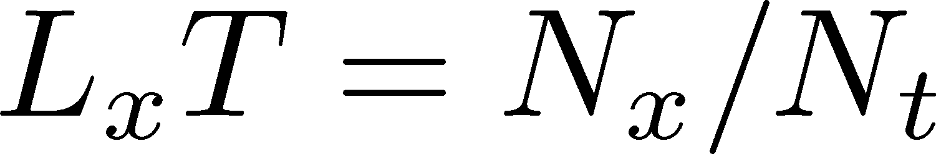
Pressure Anisotropy @ T≠0
MK, Mogliacci, Kolbe,
Horowitz, 1904.00241
Free scalar field
L₂=L₃=∞
Periodic BC
Mogliacci+, 1807.07871
Lattice result
Periodic BC
Only t→0 limit
Error: stat.+sys.
Medium near T_{c} is remarkably insensitive to finite size!

Slide 72
Pressure Anisotropy @ T≠0
MK, Mogliacci, Kolbe,
Horowitz, 1904.00241
Free scalar field
L₂=L₃=∞
Periodic BC
Mogliacci+, 1807.07871
Lattice result
Periodic BC
Only t→0 limit
Error: stat.+sys.
Medium near T_{c} is remarkably insensitive to finite size!

Slide 73
Energy densty / transverse P
Energy Density
Transverse Pressure P_{z}

Slide 74
Higher T
High-T limit: massless free gluons
How does the anisotropy approach this limit?
Difficulties
Vacuum subtraction requires large-volume simulations.
Lattice spacing not available → c₁(t), c₂(t) are not determined.

Slide 75


Higher T
High-T limit: massless free gluons
How does the anisotropy approach this limit?
Difficulties
Vacuum subtraction requires large-volume simulations.
Lattice spacing not available → c₁(t), c₂(t) are not determined.
We study
No vacuum subtr. nor Suzuki coeffs. necessary!

Slide 76
T
massless free
T/T_{c}≅8.1 (β=8.0) / T/T_{c}≅25 (β=9.0)
Ratio approaches the asymptotic value.
But, large deviation exists even at T/T_{c}~25.

Slide 77
Contents
1. Constructing EMT
2. Thermodynamics
FlowQCD, PRD90,011501 (2014); PRD94, 114512 (2016);
WHOT-QCD, PRD96, 014509 (2017); Iritani+, PTEP 2019, 023B02 (2019)
3. Flux Tube
FlowQCD, PLB789, 210 (2019); Yanagihara+, in prep.
4. Static Quark Systems at Nonzero T
FlowQCD, in prep.
5. Casimir Effect
MK, Mogliacci, Horowitz, Kolbe, arXiv:1904.00241
6. Correlation Function
FlowQCD, PRD96, 111502 (2017)

Slide 78




EMT Correlator: Motivation
Transport Coefficient
Karsch, Wyld, 1987
Nakamura, Sakai, 2005
Meyer; 2007, 2008
…
Borsanyi+, 2018
Astrakhantsev+, 2018
Kubo formula → viscosity
Energy/Momentum Conservation
: τ-independent constant
Fluctuation-Response Relations

Slide 79



EMT Euclidean Correlator
FlowQCD, PR D96, 111502 (2017)
τ-independent plateau in all channels ➔ conservation law
Confirmation of fluctuation-response relations
New method to measure c_{V}
Similar result for (41;41) channel: Borsanyi+, 2018
Perturbative analysis: Eller, Moore, 2018

Slide 80



Fluctuation-Response Relations
Confirmation of FRR
New measurement of c_{V}
2+1 QCD:
Taniguchi+ (WHOT-QCD), 1711.02262

Slide 81
Summary
Successful analysis of energy-momentum tensor on the lattice is now available, and various stuides are ongoing!
  gradient flow method
  higher-order perturbative coefficients
Pressure
Anisotropy
Correlation
Functions
Stress
So many future studies
  Flux tube at nonzero temperature
  EMT distribution inside hadrons
  viscosity / other operators / instantons / full QCD

Slide 82
backup

Slide 83







Two Special Cases with PBC
In conformal (Σ_{μ}T_{μμ}=0)

Slide 84



EMT on the Lattice: Conventional
Lattice EMT Operator
Caracciolo+, 1990
Fit to thermodynamics: Z₃, Z₁
Shifted-boundary method: Z₆, Z₃
Giusti, Meyer, 2011; 2013;
Giusti, Pepe, 2014~; Borsanyi+, 2018
Multi-level algorithm
effective in reducing statistical error of correlator
Meyer, 2007;
Borsanyi, 2018;
Astrakhantsev+, 2018

Slide 85








Fermion Propagator
propagator of flow equation
Inverse propagator is needed
fermion field
t=0
gauge field

Slide 86
N_{f}=2+1 QCD Thermodynamics
Taniguchi+ (WHOT-QCD),
PRD96, 014509 (2017)
N_{f}=2+1 QCD, Iwasaki gauge + NP-clover
m_{PS}/m_{V} ≈0.63 / almost physical s quark mass
T=0: CP-PACS+JLQCD (ß=2.05, 28³x56, a≈0.07fm)
T>0: 32³xN_{t}, N_{t} = 4, 6, ... , 14, 16):
T≈174-697MeV
t→0 extrapolation only (No continuum limit)

