Slide 1
Critical Fluctuation in a
Dynamically Expanding
Heavy-Ion Collisions
Marlene Nahrgang, Marcus Bluhm,
Masakiyo Kitazawa, Grégoire Pihan, Nathan Touroux
XXVIII International Conference on Ultrarelativistic Nucleus-Nucleus Collisions (QM2019)
Wanda Reign Hotel, Wuhan, China, 5/Nov./2019

Slide 2

Search for QCD Phase Structure
T
Possible existence of
1st order transition
QCD critical point
Quark-Gluon Plasma
150MeV
ＱＣＤ Critical Point
Hadron Phase
(confined)
Color SC
~10¹⁵g/cm³
μ

Slide 3
Search for QCD Phase Structure
T
Possible existence of
high
1st order transition
QCD critical point
Quark-Gluon Plasma
beam energy
150MeV
ＱＣＤ Critical Point
Beam-energy scan
low
RHIC-BES-I 2010～
RHIC-BES-II 2019～
Future: FAIR, NICA,
J-PARC-HI,
HADES, …
Hadron Phase
(confined)
Color SC
~10¹⁵g/cm³
μ

Slide 4


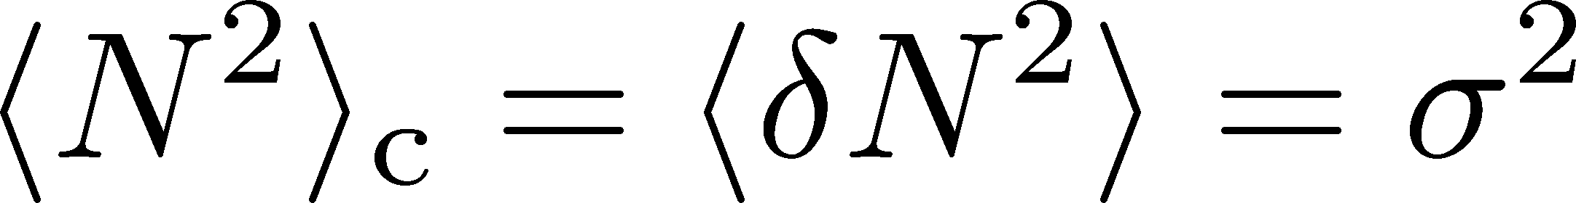
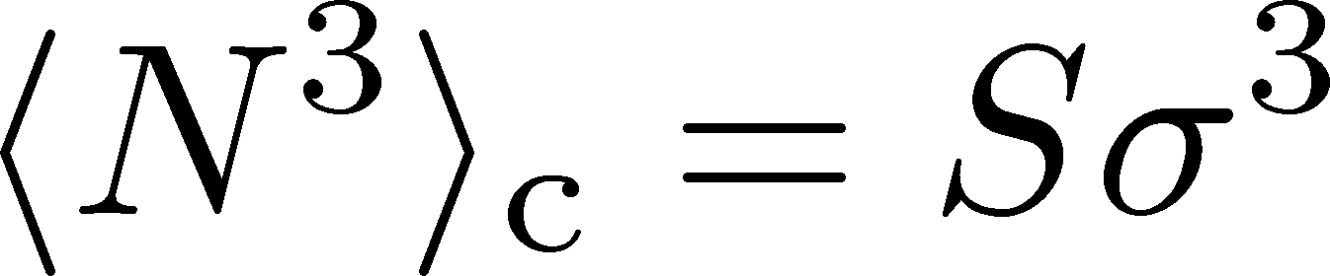
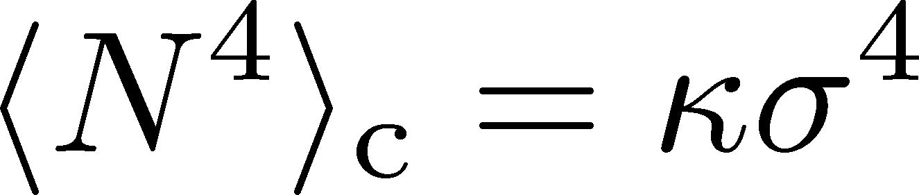
Event-by-Event Fluctuations
STAR, PRL105 (2010)
Cumulants
Detector
General Review:
Asakawa, MK, PPNP (2016)

Slide 5


Event-by-Event Fluctuations
Net-proton number cumulants
Enhancement
Non-zero non-Gaussian cumulants have been established experimentally!
Are they the signal of the QCD-CP?
Note: Baryon number cumulants are actually needed! MK, Asakawa, 2012;2012
Suppression
STAR 2010~

Slide 6






Time Evolution of Fluctuations
Detector
Hadronic
Distributions in ΔY and Δy are different due to “thermal blurring”.
Ohnishi, MK, Asakawa, PRC(2016)
QGP
Fluctuations in ΔY continue
to change until kinetic f.o.

Slide 7

Evolution of Conserved-Charge Fluct.
Equations describing the transport of n:
Density
enhancement

Slide 8
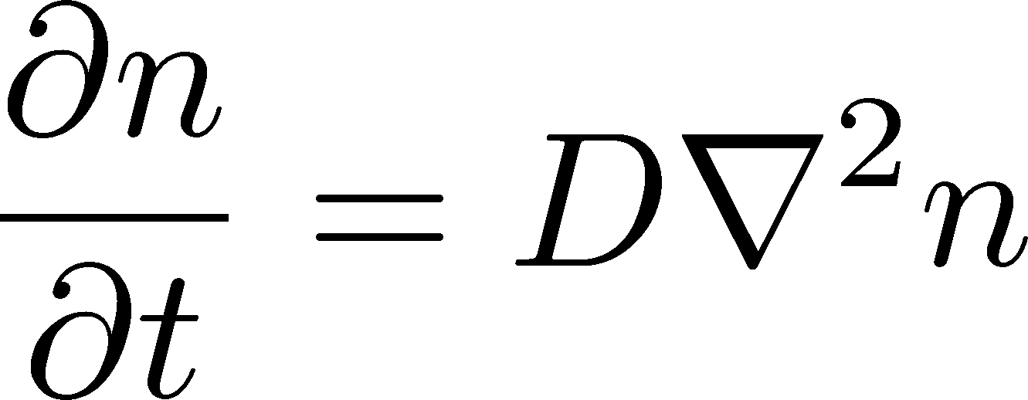
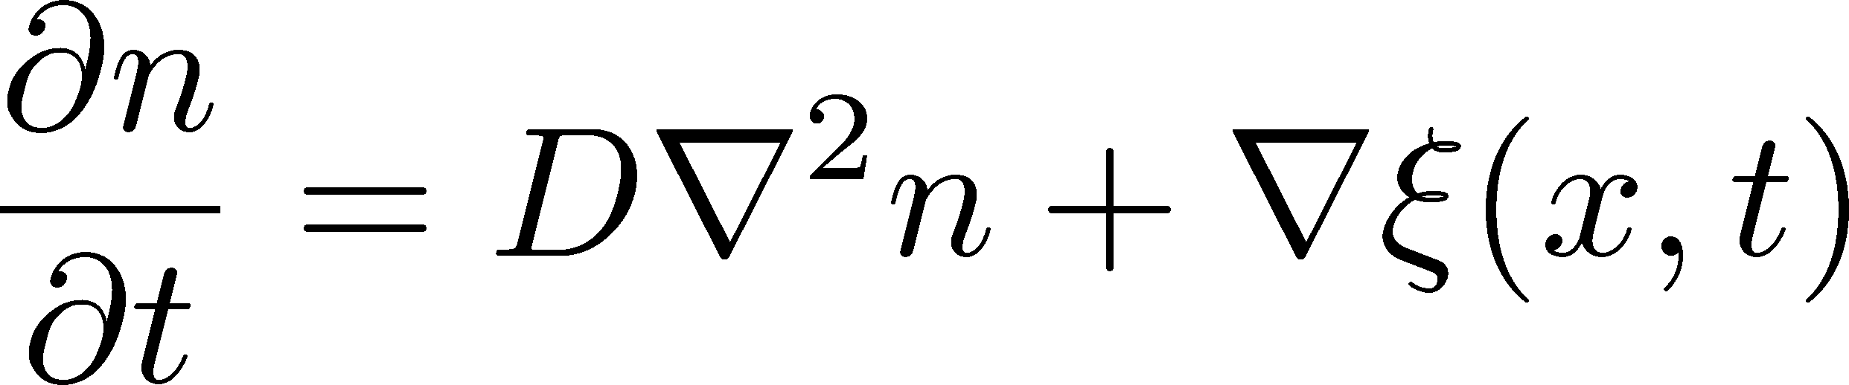
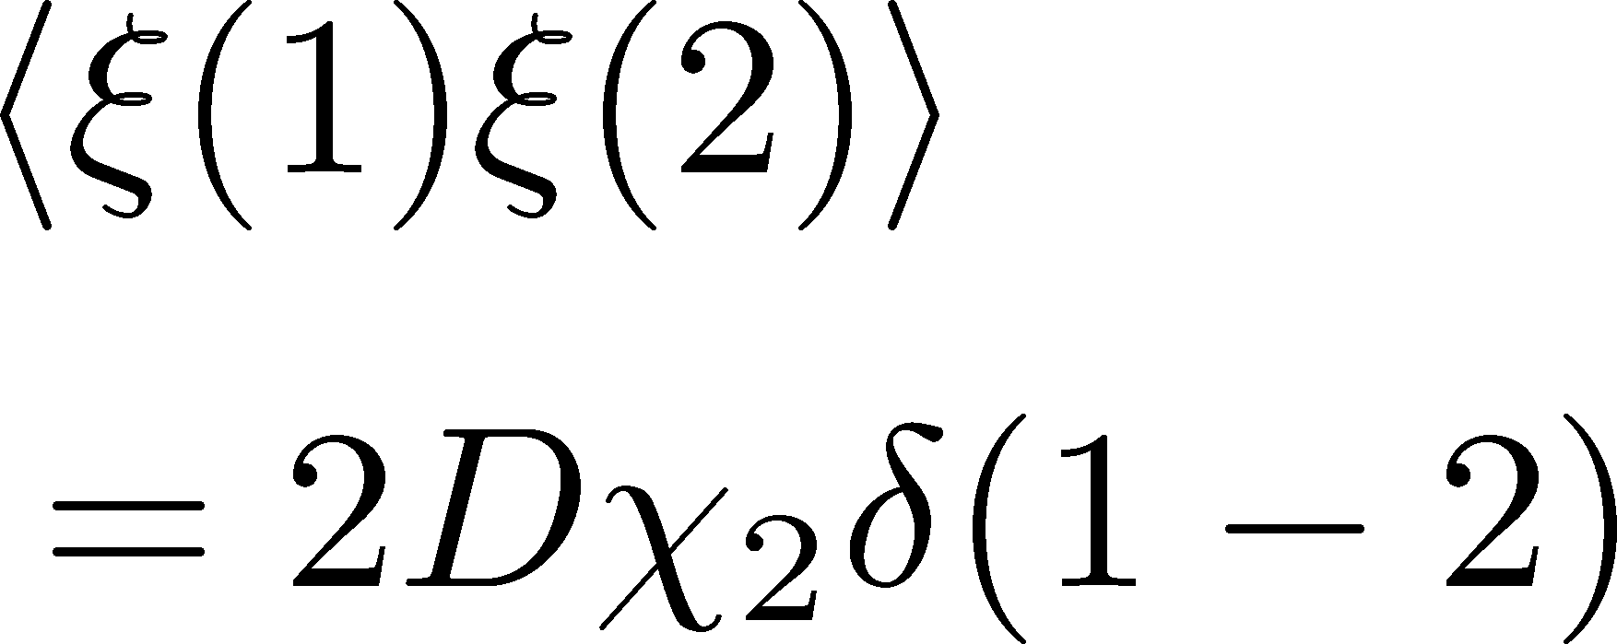
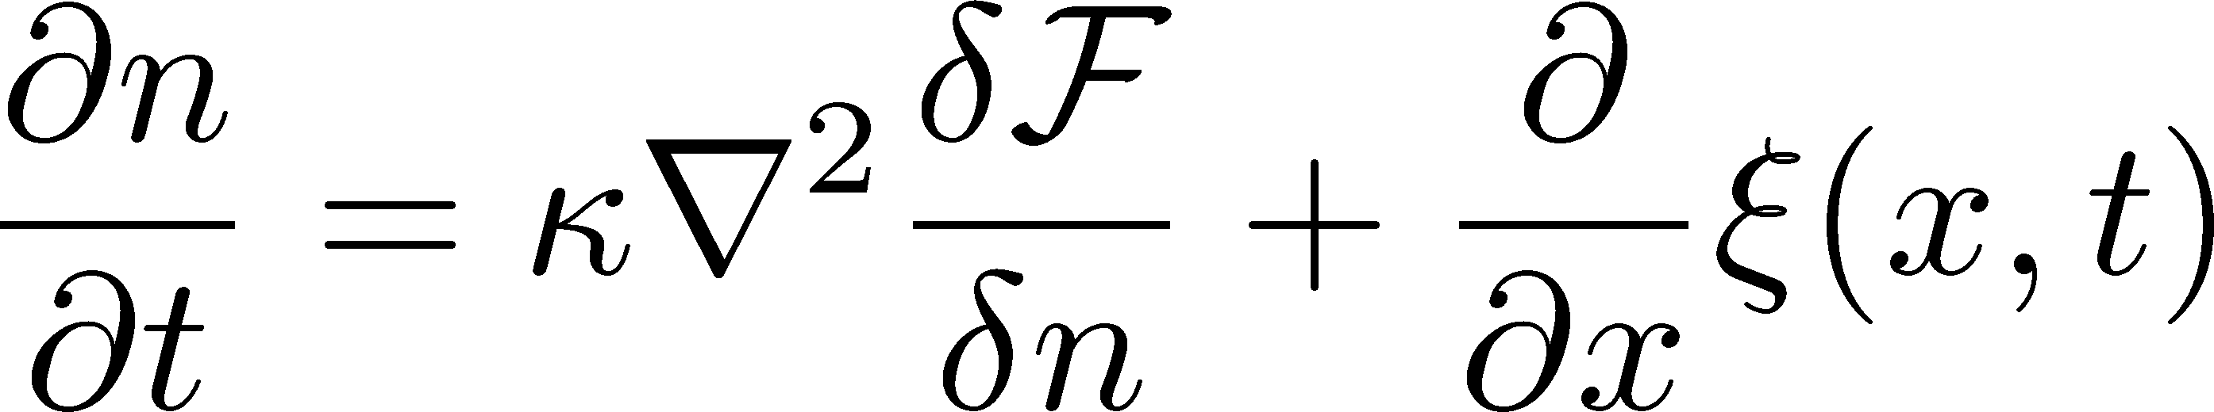
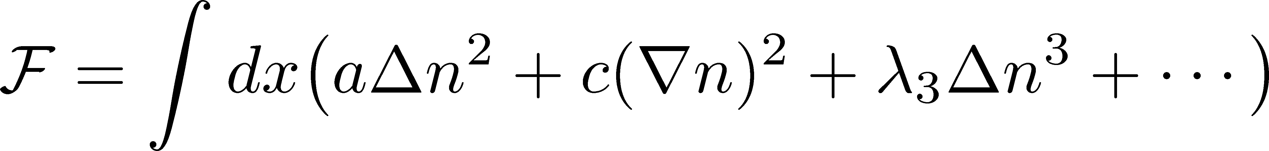
Evolution of Conserved-Charge Fluct.
Equations describing the transport of n:
Diffusion Equation
Stochastic Diffusion Equation (SDE)
SDE with non-linear terms
Density
enhancement

Slide 9

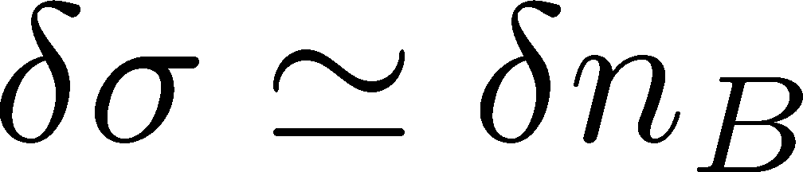

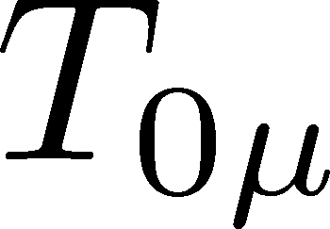
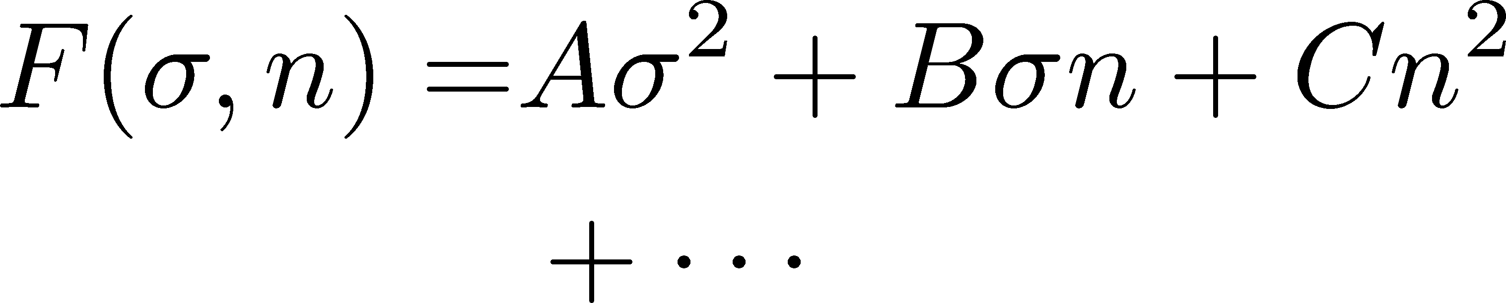



Soft Mode of QCD-CP
Fujii 2003; Fujii, Ohtani, 2004; Son, Stephanov, 2004
critical
soft mode
Fluctuations of σ and n_{B} are
coupled around the CP!
σ: fast damping
To a first approximation, SDE describes the soft mode of the CP.
Coupling to σ & T_{μν} has to be included for more accurate description.

Slide 10


Contents
CrossOver with SDE (Gaussian)
  2nd cumulant/correlation func.
  Sakaida, Asakawa, Fujii, MK, PRC95 (2017)
CrossOver with Non-Linear SDE
  higher-order cumulants
  Nahrgang, Bluhm, Schaefer, Bass PRD99 (2019);
  Pihan, Touroux, Nahrgang, Bluhm, Sami, MK, in prep.
1st-Order with Non-Linear SDE
  Nonaka, MK, et al., in prep.

Slide 11
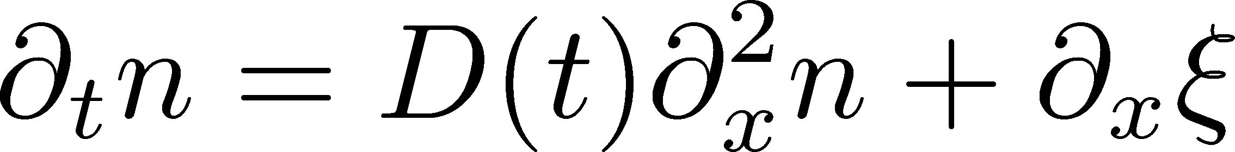

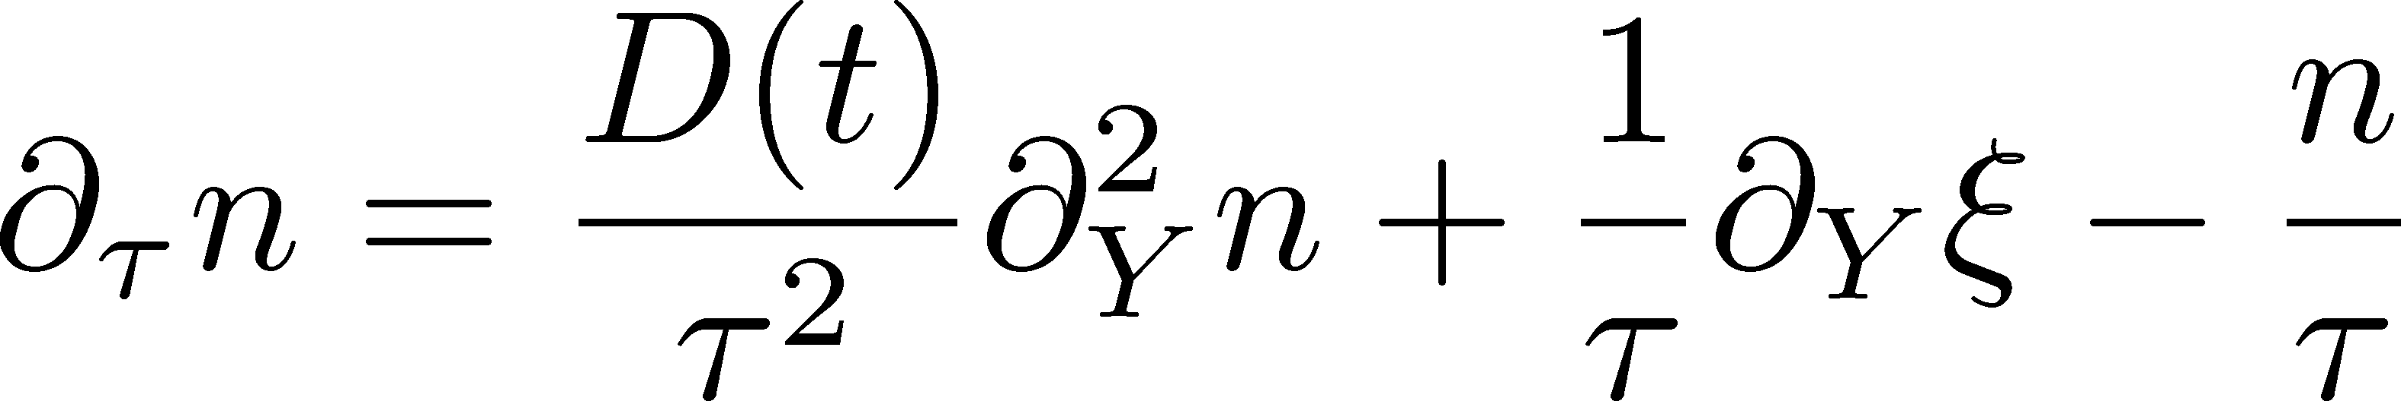
Stochastic Diffusion Equation (Gaussian)
Cartesian coordinates
:parameters characterizing
evolution of the medium
Milne coordinates
Analytic solution is obtained.
Study 2nd order cumulant & correlation function.
suppression
of diffusion
density
reduction

Slide 12

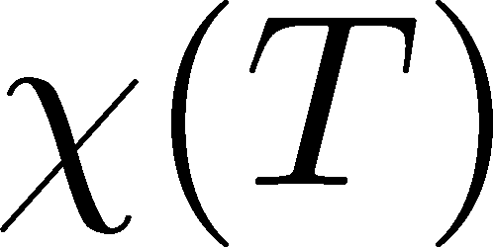
Evolution of Parameters
Critical behavior
Temperature dependence
3D Ising (r,H)
model H
critical
slowing
down
Berdnikov, Rajagopal (2000)
Stephanov (2011); Mukherjee+(2015)
(critical point)
critical
enhancement

Slide 13

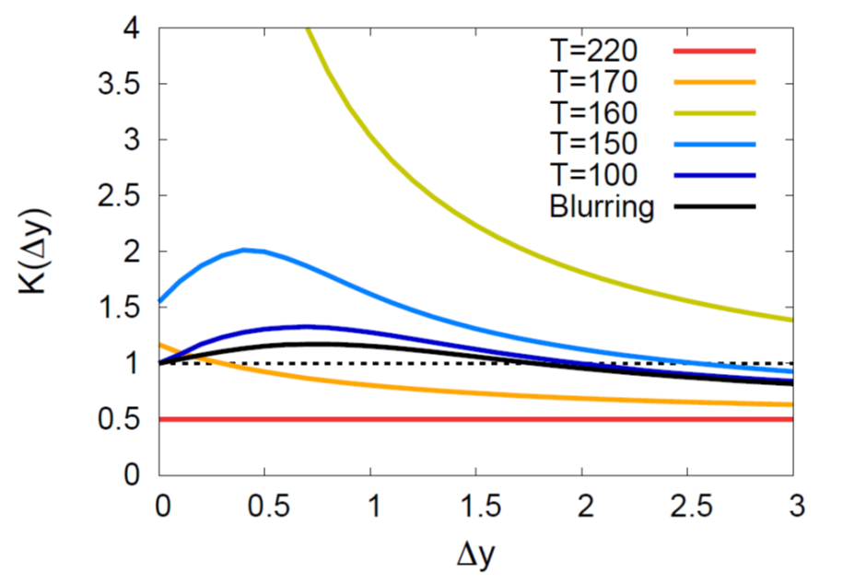
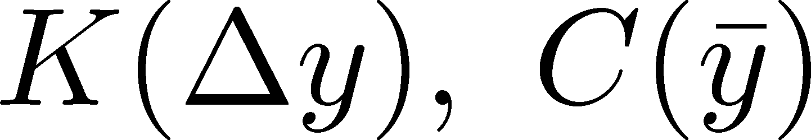
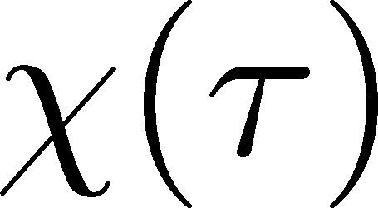
Time Evolution
Cumulant
Corr. Func.
See also,
Kapusta, Torres-Rincon,
PRC86 (2012);
Wu, Song,
Chin. Phys. C43 (2019)
Non-monotonic
rapidity dependence
Analytic
property
non-monotonic
non-monotonic

Slide 14
Contents
CrossOver with SDE (Gaussian)
  2nd cumulant/correlation func.
  Sakaida, Asakawa, Fujii, MK, PRC95 (2017)
CrossOver with Non-Linear SDE
  higher-order cumulants
  Nahrgang, Bluhm, Schaefer, Bass PRD99 (2019);
  Pihan, Touroux, Nahrgang, Bluhm, Sami, MK, in prep.
1st-Order with Non-Linear SDE
  Nonaka, MK, et al., in prep.

Slide 15
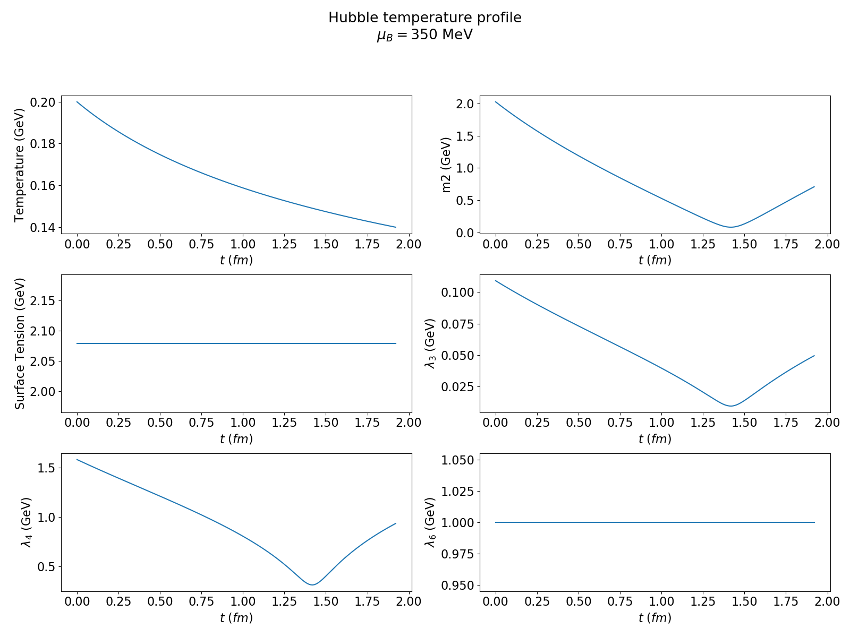
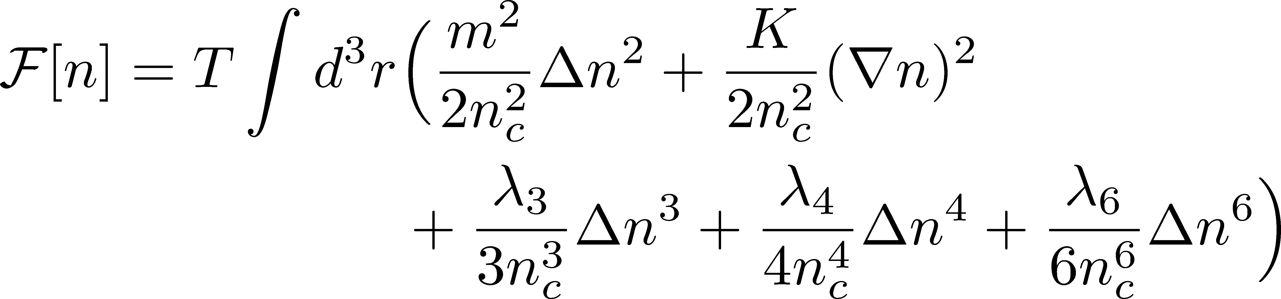
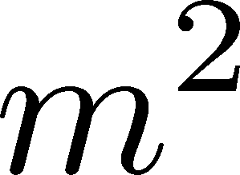
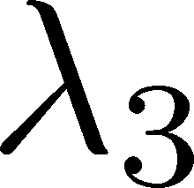
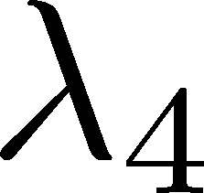

Introducing Non-Linear Terms
CP
Diffusive dynamics of higher order cumulants can be described.
No analytic solution. Need numerical analysis.
Parameters:
  ⬅Hubble expansion, Ising universality

Slide 16
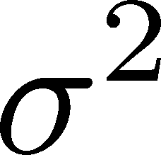


Cumulants in Equilibrium
Nahrgang, Bluhm, Schaefer, Bass PRD99 (2019)
2nd:
3rd:
4th:
Simulation with fixed T.
Spatial length L=20fm
Weaker criticality due to the finite volume effects
Shape of Sσ can be explained by the finite volume effects
M. Agah Nouhou+, arXiv:1906.02647; Bluhm, SQM2019

Slide 17
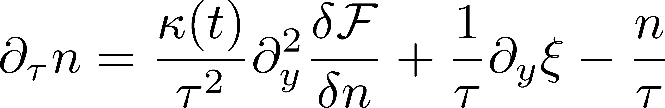
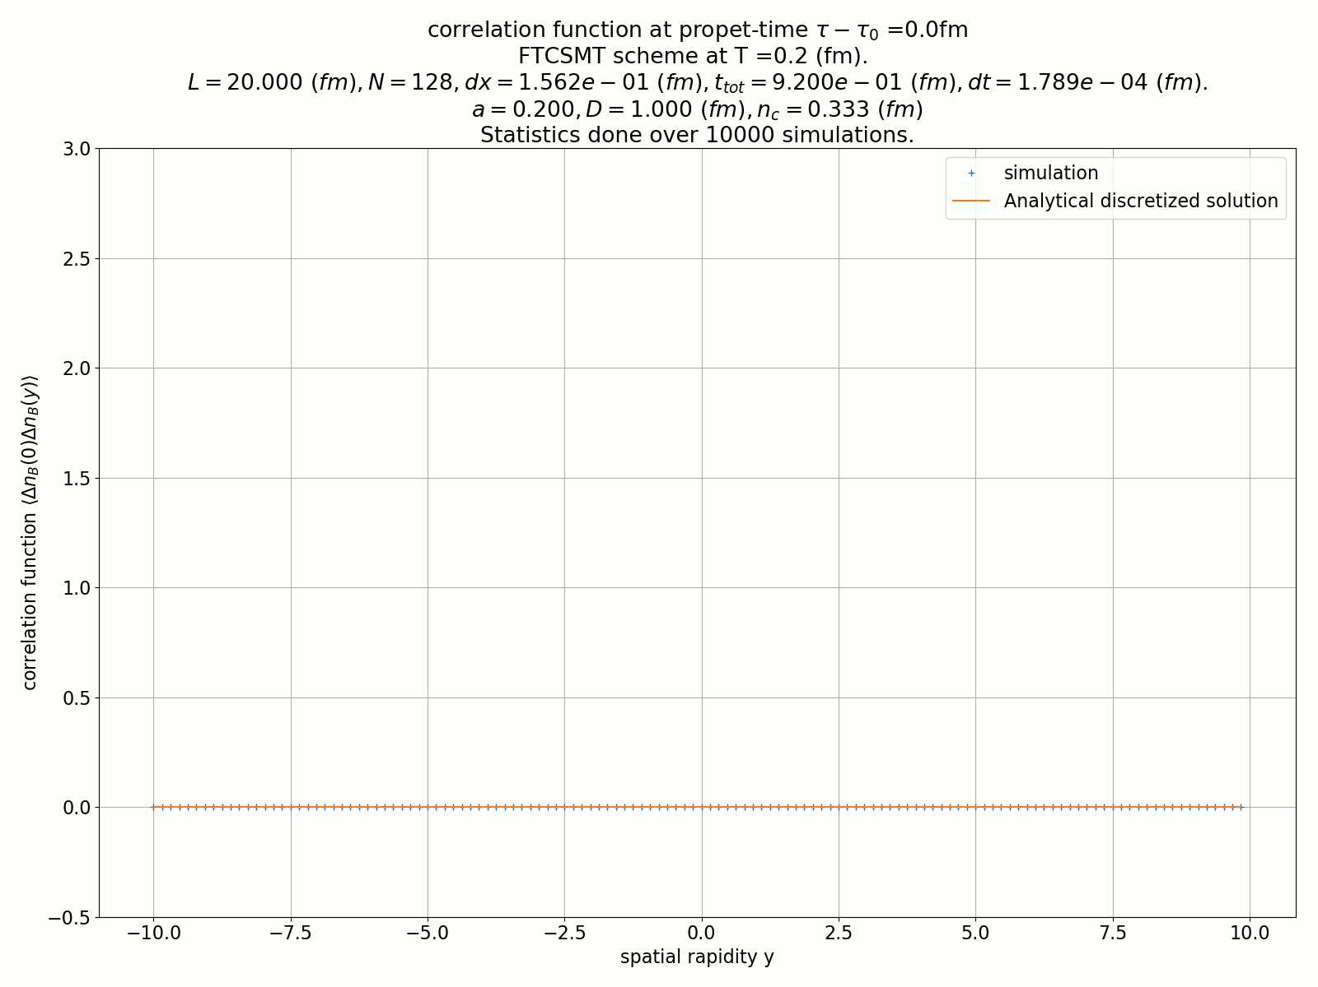

Evolution with Bjorken Expansion
  Pihan, Touroux, Nahrgang, Bluhm, Sami, MK, in prep.
Milne coordinates
Critical Point: T=150 MeV, μ=390 MeV
Initial temperature: T=200 MeV
μ=50, 200, 300, 350 MeV
Cumulants on a single cell
Compare results with & without NL terms
Evolution of C(y,τ)
(Gaussian)

Slide 18
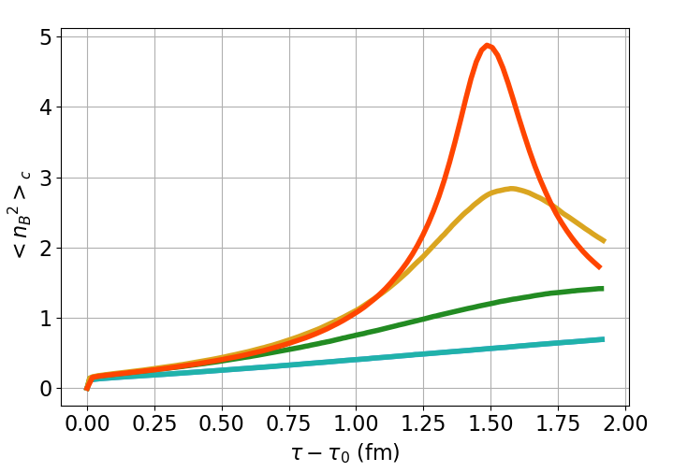
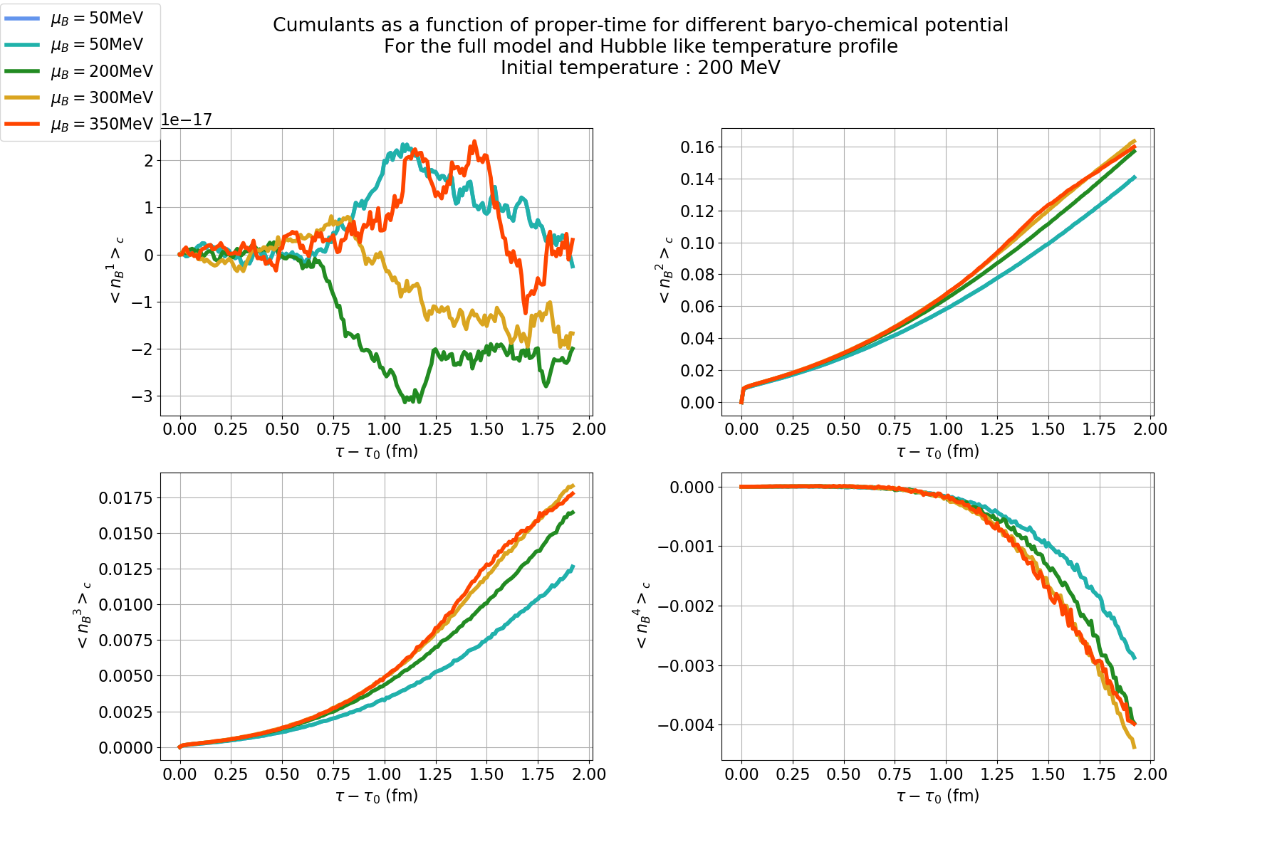
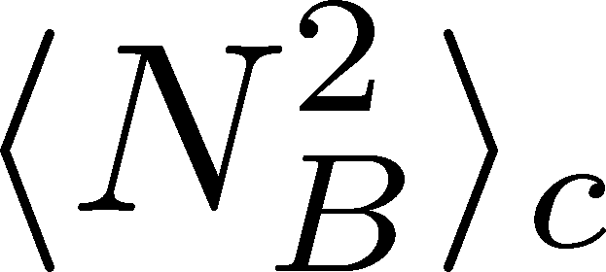
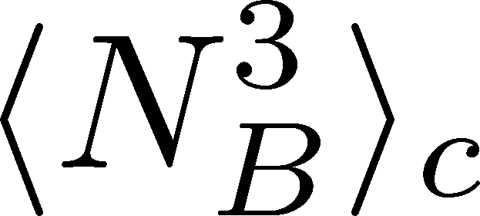
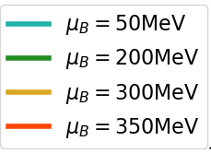
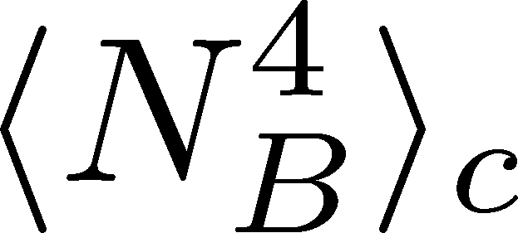
Numerical Result
  Pihan, Touroux, Nahrgang, Bluhm, Sami, MK, in prep.
Gaussian
(without nonlinear terms)
Full Non-linear model
CP
Preliminary
2nd cumulant in Gaussian model has a peak at the CP.
But, this behavior is washed out by the effect of the non-linear terms.
Need further investigation.

Slide 19
Contents
CrossOver with SDE (Gaussian)
  2nd cumulant/correlation func.
  Sakaida, Asakawa, Fujii, MK, PRC95 (2017)
CrossOver with Non-Linear SDE
  higher-order cumulants
  Nahrgang, Bluhm, Schaefer, Bass PRD99 (2019);
  Pihan, Touroux, Nahrgang, Bluhm, Sami, MK, in prep.
1st-Order with Non-Linear SDE
  Nonaka, MK, et al., in prep.

Slide 20
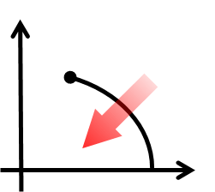
1st-Order Transition
T
μ
Domain formation
Non-uniform system
Herold, Nahrgang, et al. (2011~);
Steinheimer, Randrup (2012; 2013)

Slide 21
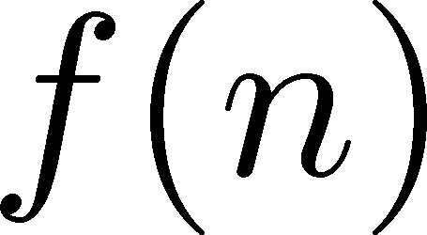
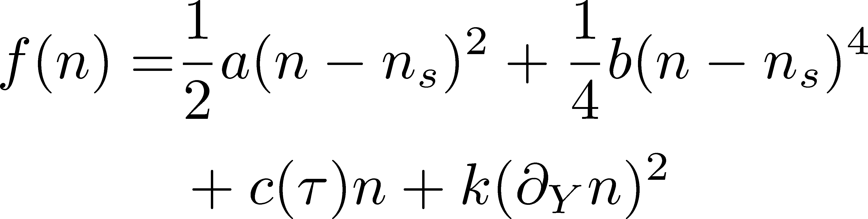


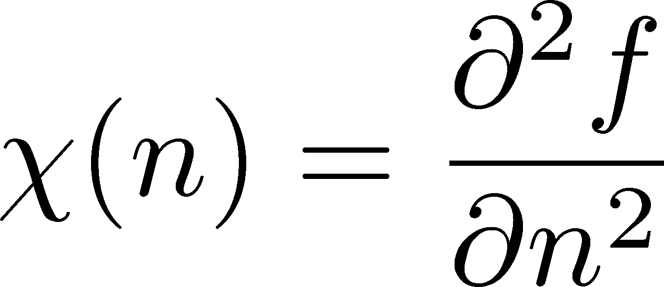

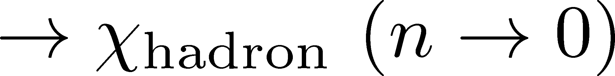
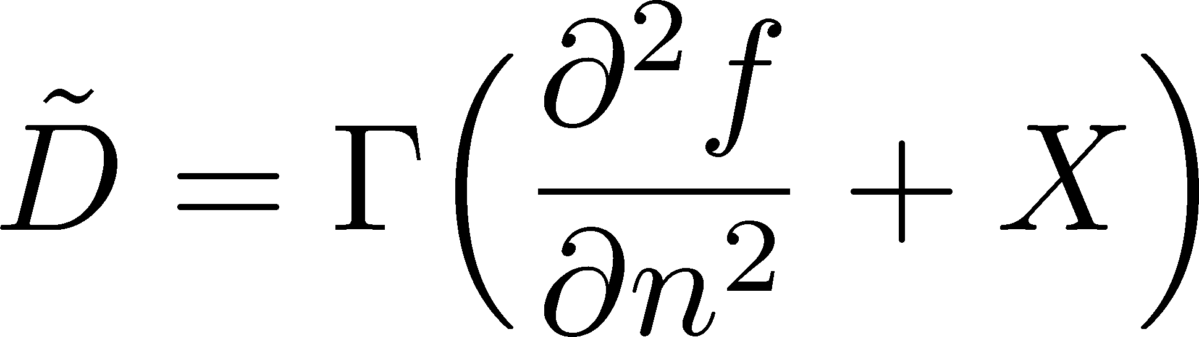
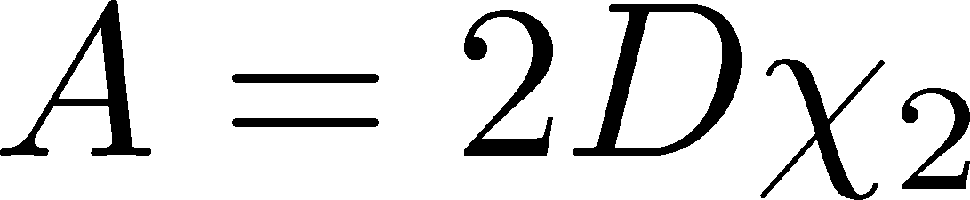
Free Energy
At 1st transition point
Large and small n
κ: positive
adjust κ and A to reproduce the behavior of D at small and large n
Poisson

Slide 22





Time Evolution
initial
Dynamical domain formation
Domains survive even after 1st transition
rapidity

Slide 23
Correlation Function
Correlation Function
τ= 2fm
τ= 5fm
τ=10fm
τ=20fm
Peak
structure
rapidity gap Δy
Domain leads to a peak structure in C(y).
The peak can survive even in the final state.

Slide 24
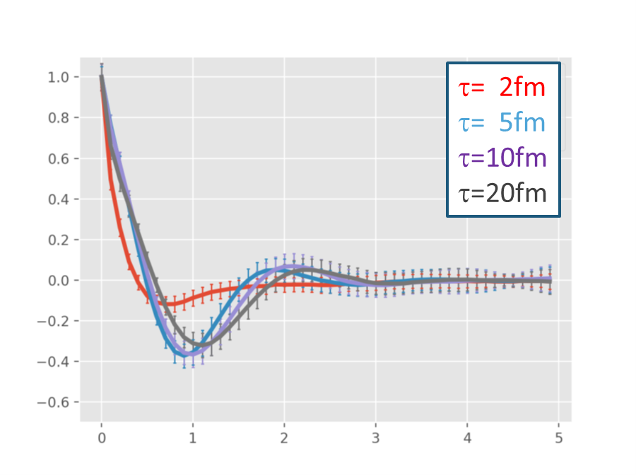
Summary
Diffusive dynamics is important in describing fluctuations in heavy-ion collisions.
We studied dynamical evolution near the QCD-CP and at the 1st transition in stochastic diffusion equation with and without non-linear terms.
Future: coupling with sigma & momentum / more realistic space-time evolution
Correlation function
Critical point/ crossover
1st order transition

