Slide 1
Topological Charge on the lattice studied by
Neural Network
Masakiyo Kitazawa, Takuya Matsumoto, Yasuhiro Kohno
(Osaka University)
MK, Kohno, Matsumoto, arXiv:1909.06238 [hep-lat]

Slide 2
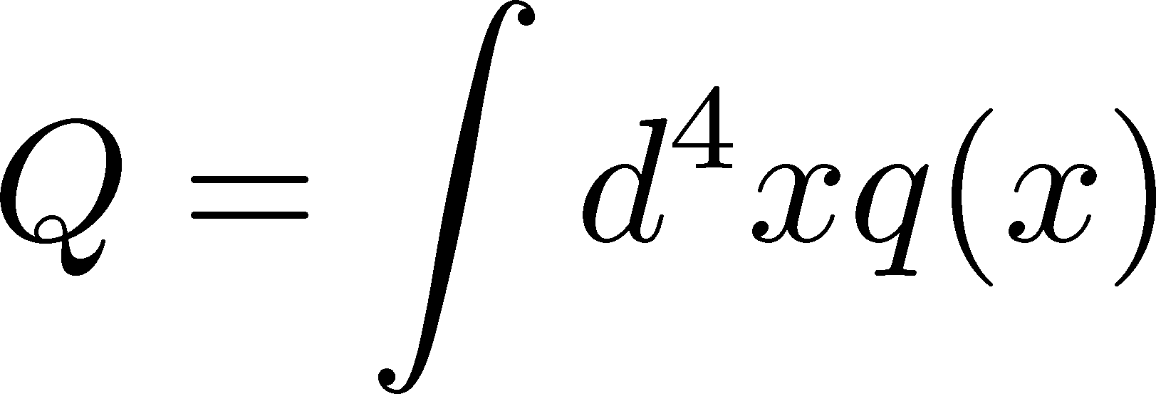
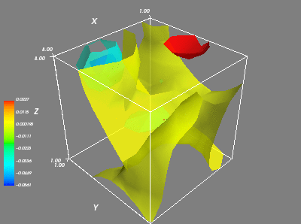
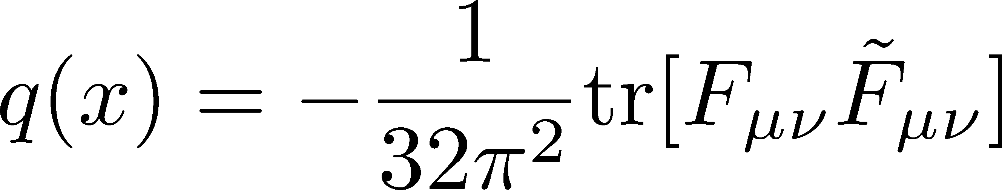
Topological Charge in YM Theory
q(x) in SU(3) YM,
β=5.8, 8⁴, t/a²=2.0
: integer
Interests / applications
Instantons
Axial U(1) anomaly
Axion cosmology
Topological freezing

Slide 3
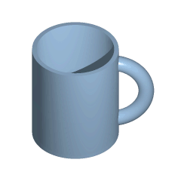
Topology
Topology
properties of an object that are preserved under continuous deformations
from Wikipedia

Slide 4

Topology
Topology
properties of an object that are preserved under continuous deformations
Example: 1-dim. space
from Wikipedia

Slide 5
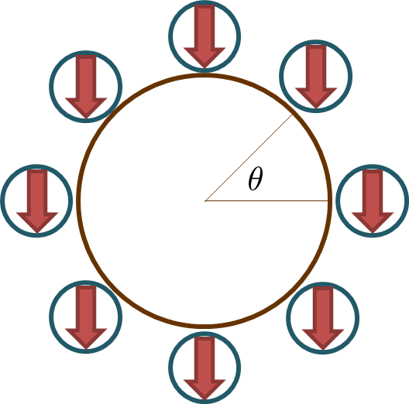
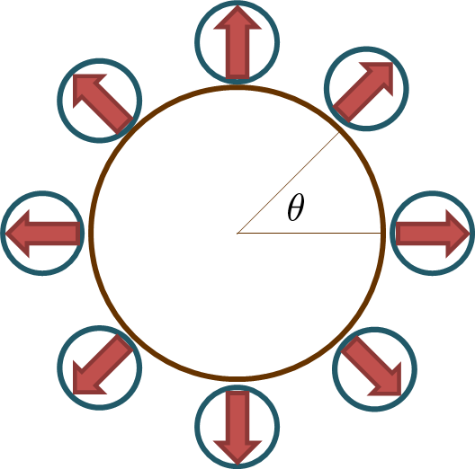
S₁ → S₁
winding number
n=0
winding number
n=1

Slide 6
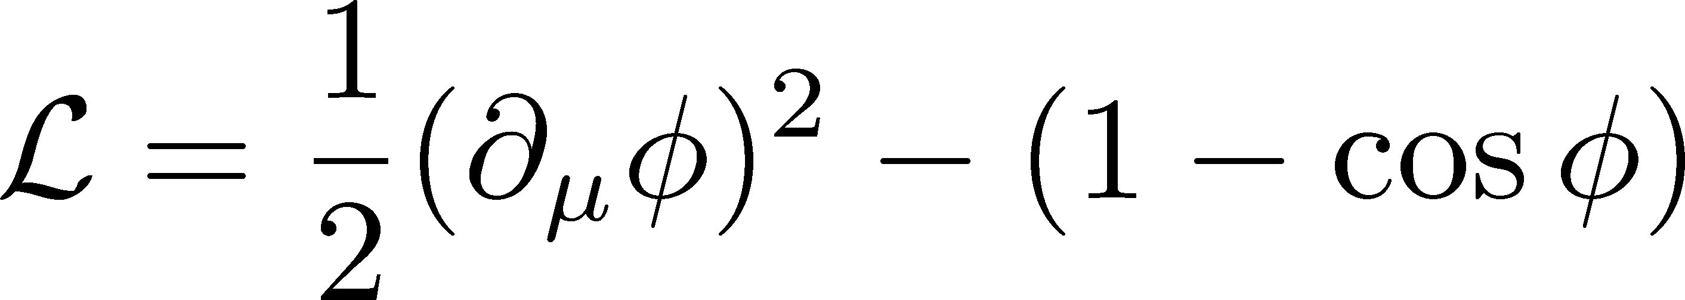
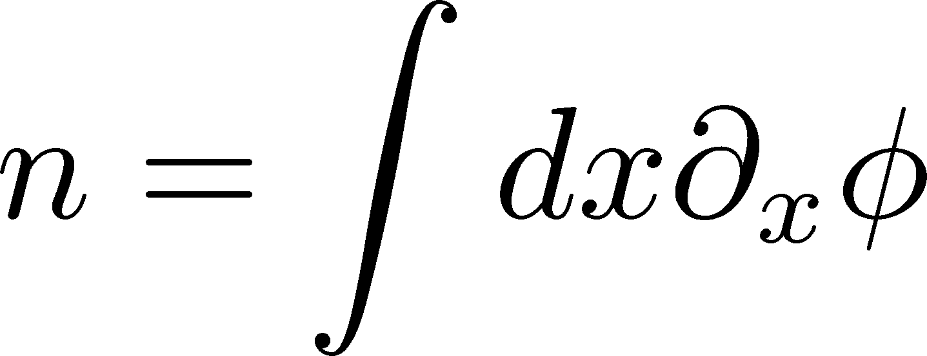
Sine-Gordon Model in 1+1D
“kink” solution
winding number n=1
nonzero energy
topologically stable
multi-“kink” solution is also possible.

Slide 7
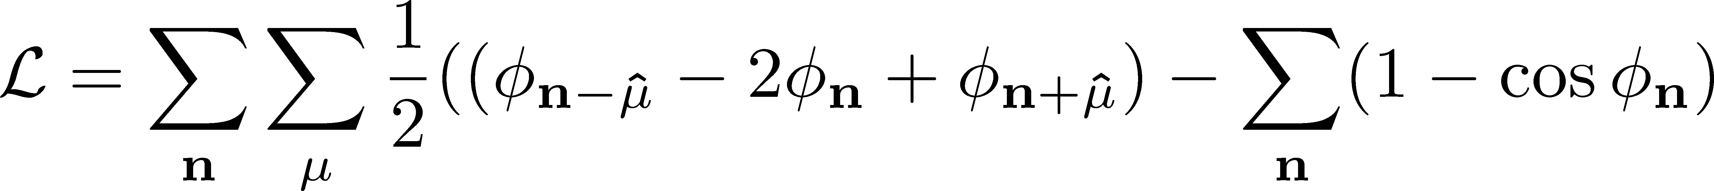
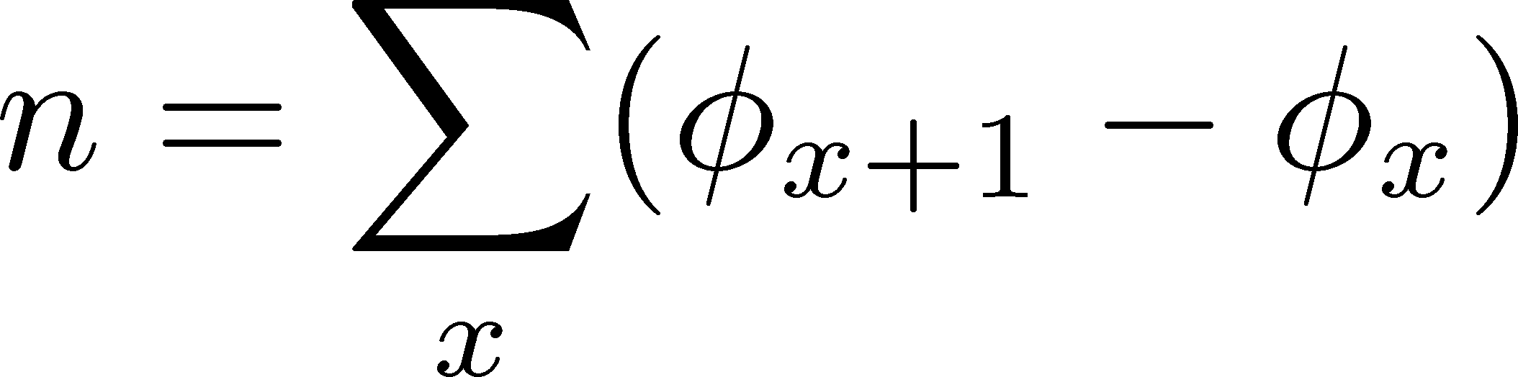
Lattice Theory & Topology
Different n are connected continuously.
“Topological sector” becomes obscure on the lattice.
Topological sectors recover in the continuum limit.

Slide 8
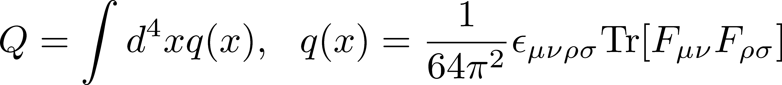
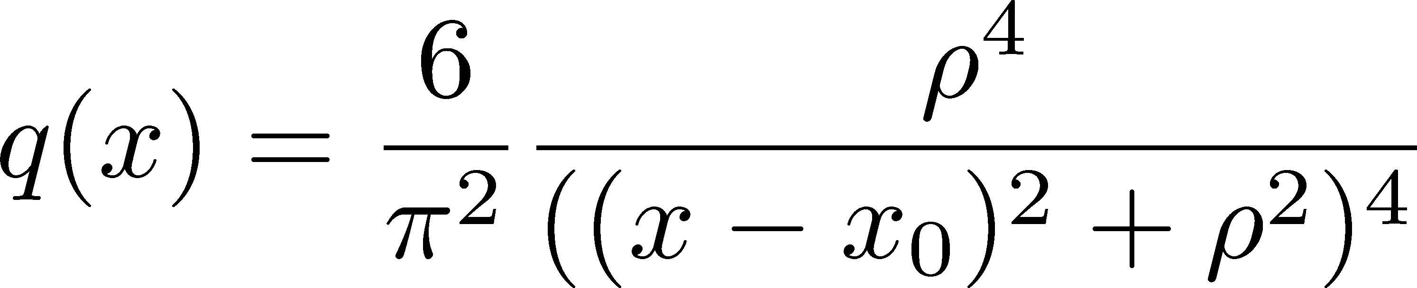
Topology in 4D YM Theory
SU(2) gauge field on |r|→∞ sphere in Euclid space
Mapping: S₃ (4D sphere)→S₃ (Gauge Tr. U(x))
S₃→S₃ has a non-trivial topology
topological charge
Instanton
classical solution of YM
winding number n=1
nonzero action

Slide 9
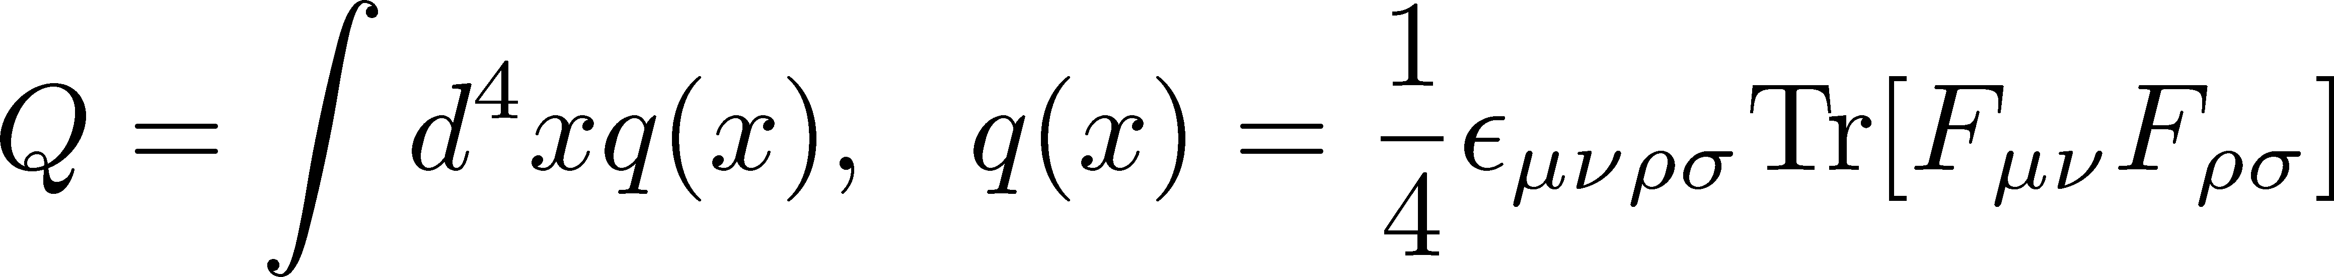
Topology on the Lattice
A naïve definition of Q
Q is not an integer, but distributes continuously.
Distinct topological sectors on sufficiently fine lattices
Luscher, 1981

Slide 10
Topology on the Lattice
Definitions of Q on the lattice:
  fermionic: Atiyah-Singer index theorem
  gluonic: q(x) after smoothing
    cooling, smearing
    gradient flow
Luscher, Weisz, 2011
Good agreement b/w various definitions
Faster algorithm is desirable!

Slide 11
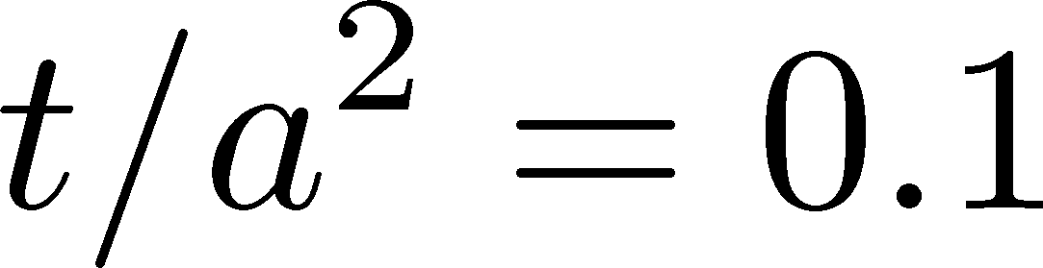
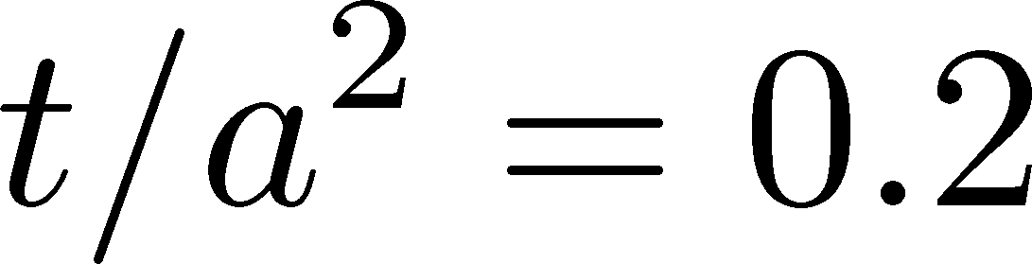
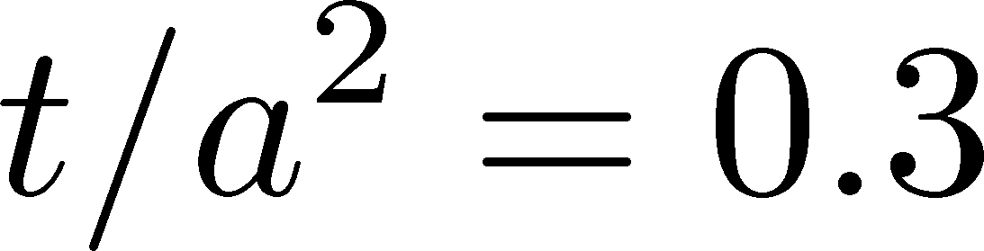
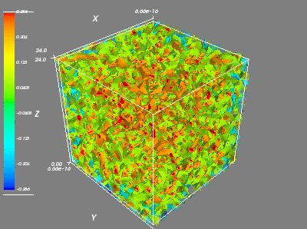
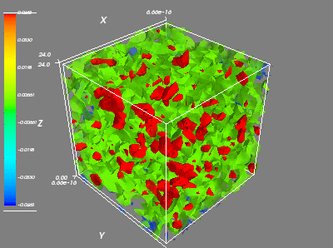
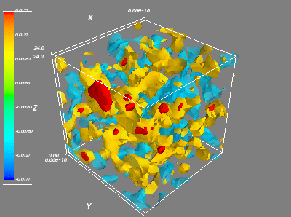
q(x) at Nonzero Flow Time
Field becomes smoother for larger t.

Slide 12
Topological Freezing
Lattice Monte-Carlo simulation → gauge update
Auto-correlation length of Q becomes longer as lattice spacing becomes finer.
M. Lüscher.(2014)

Slide 13
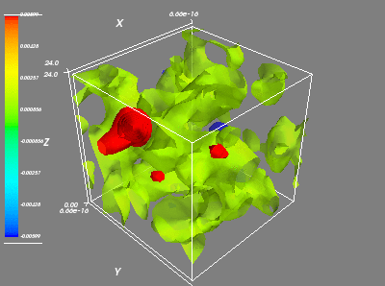
Neural Network
Input: q(x)
Output
Q
topological
charge
4-dimensional field
Capture “instanton”-like structure?
Acceleration of the analysis of Q?

Slide 14


Neural Network
slide by
T. Matsumoto
Approximate arbitrary functions
NN
$$\vec{x}$$
$$\vec{y}(x)$$
Supervised Learning:
Evaluate errors b/w outputs of NN and y(x)
Tune parameters in the NN to minimize the error
→ “Good” function y(x) is obtained.

Slide 15
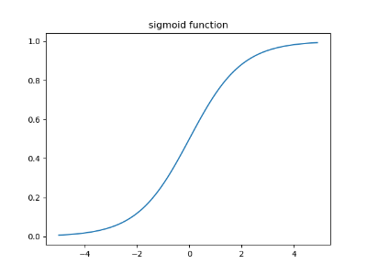
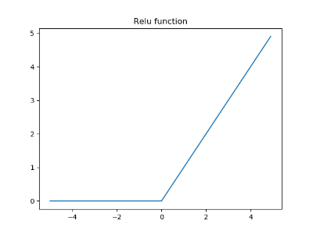































Mechanism
slide by
T. Matsumoto
Input layer
Hidden layers
Output layer
$$x_{1}$$
$$x_{1}^{\left(1\right)}$$
$$W_{1}$$
$$x_{1}^{\left(2\right)}$$
$$W_{2}$$
$$f\left(x_{1}^{\left(2\right)}\right)$$
$$x_{1}^{\left(3\right)}$$
$$y_{1}(\vec{x},W,\vec{b})$$
$$x_{2}$$
$$x_{2}^{\left(1\right)}$$
$$x_{2}^{\left(2\right)}$$
$$f\left(x_{2}^{\left(2\right)}\right)$$
$$x_{2}^{\left(3\right)}$$
$$y_{2}(\vec{x},W,\vec{b})$$
$$x_{3}$$
$$x_{3}^{\left(1\right)}$$
$$x_{3}^{\left(2\right)}$$
$$f\left(x_{3}^{\left(2\right)}\right)$$
$$x_{3}^{\left(3\right)}$$
$$y_{3}(\vec{x},W,\vec{b})$$
$$x_{4}$$
$$x_{4}^{\left(1\right)}$$
$$x_{4}^{\left(2\right)}$$
$$f\left(x_{4}^{\left(2\right)}\right)$$
適切な重みWとバイアスbがあれば、
任意の関数yを表現できる！
（NNの普遍性定理）
bias
$${\vec{b}}^{\left(1\right)}$$
$${\vec{b}}^{\left(2\right)}$$
$${\vec{x}}^{\left(2\right)}=W_{1}{\vec{x}}^{\left(1\right)}+{\vec{b}}^{\left(1\right)}$$
$$f\left(x\right)=\frac{1}{1+e^{−x}}$$
sigmoid
$$f\left(x\right)=\left\{\begin{aligned}x for x>0 \\ 0 for x≤0\end{aligned}\right.$$
ReLU
$${\vec{x}}^{\left(3\right)}=W_{2}f\left({\vec{x}}^{\left(2\right)}\right)+{\vec{b}}^{\left(2\right)}$$
$f(x)$：activation func.

Slide 16
Convolutional NN (CNN)
slide by
T. Matsumoto
Example: number 2
0 | 1 | 1 | 1 | 0 | 0
1 | 0 | 0 | 0 | 1 | 0
0 | 0 | 0 | 1 | 0 | 0
0 | 0 | 1 | 0 | 0 | 0
0 | 1 | 0 | 0 | 0 | 0
1 | 1 | 1 | 1 | 1 | 0
0 | 0 | 1
0 | 1 | 0
1 | 0 | 0
filter
CNNではフィルターのパラメータを更新していく
畳み込み層の出力
1 | 1 | 0 | 2
0 | 0 | 3 | 0
0 | 3 | 0 | 0
3 | 1 | 1 | 1
フィルターとどれだけ似ているかの度合いを抽出している

Slide 17
Neural Network
Input: q(x)
Output
Q
topological
charge
4-dimensional field
Capture “instanton”-like structure?
Acceleration of the analysis of Q?

Slide 18


Neural Network
Input: q(x)
Output
Q
topological
charge
4-dimensional field
Capture “instanton”-like structure?
Acceleration of the analysis of Q?

Slide 19
Neural Network
Input: q(x)
Output
Q
topological
charge
4-dimensional field
Why q(x) rather than link variables?
to reduce the input data
to skip teaching SU(N) and gauge invariance

Slide 20
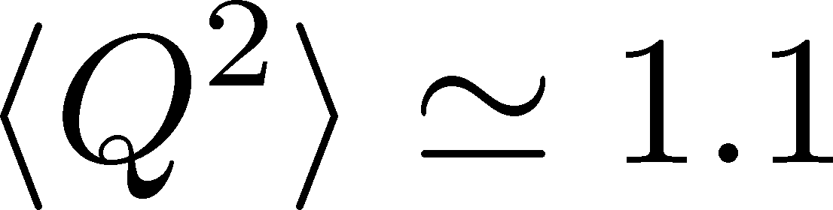
Lattice Setting
β | N⁴ | N_{conf}
6.2 | 16⁴ | 20,000
6.5 | 24⁴ | 20,000
SU(3) Yang-Mills
Wilson gauge action
2 lattice spacings with same physical volume
LT_{c}~0.63
Gradient flow for smoothing
Training: 10,000
20,000 confs. in total
Validation: 5,000
Test: 5,000
distribution of Q

Slide 21
Neural Network Setting
convolutional neural network by CHAINER framework
supervised learning
convolutional layer: 4-dim., periodic BC
regression analysis / round off to obtain integer
activation: logistic
answer of Q
  Q(t) @ t/a²=4.0
  round off

Slide 22
Trial 1: Topol. Charge Density
Input: q(x) in 4-dim space
Data reduction to 8⁴ (average pooling)
Q
Convolution
Output
Convolution
GAP
Full connect
Input
Full connect
Convolution
GAP=Global Average Pooling
Translational invariance is respected in this NN.

Slide 23
Trial 1: Topol. Charge Density
Input: q(x) in 4-dim space
Data reduction to 8⁴ (average pooling)
Q
Convolution
Output
Convolution
GAP
Full connect
Input
Full connect
Convolution
Result: best accuracy for β=6.2: 37.0%
Accuracy of each topological sector (%)
Q | -4 | -3 | -2 | -1 | 0 | 1 | 2 | 3 | 4 | total
t/a²=0 | 0 | 0 | 0 | 0 | 37.2 | 0 | 0 | 0 | 0 | 37.0

Slide 24
Trial 2: Topol. Density @ t>0
Input: q(x,t) in 4-dim space at nonzero flow time
Data reduction to 8⁴ (average pooling)
Q
Convolution
Output
Convolution
GAP
Full connect
Input
Full connect
Convolution
Accuracy of each topological sector (%)
Q | -4 | -3 | -2 | -1 | 0 | 1 | 2 | 3 | 4 | total
t/a²=0 | 0 | 0 | 0 | 0 | 37.2 | 0 | 0 | 0 | 0 | 37.0
t/a²=0.1 | 0 | 0 | 31.6 | 39.1 | 41.4 | 38.9 | 19.0 | 0 | 0 | 40.1
t/a²=0.2 | 0 | 40.0 | 46.4 | 53.8 | 55.9 | 52.3 | 48.1 | 50.0 | 0 | 55.2
t/a²=0.3 | 0 | 91.3 | 72.9 | 76.3 | 79.0 | 74.8 | 68.1 | 70.0 | 50.0 | 77.6

Slide 25
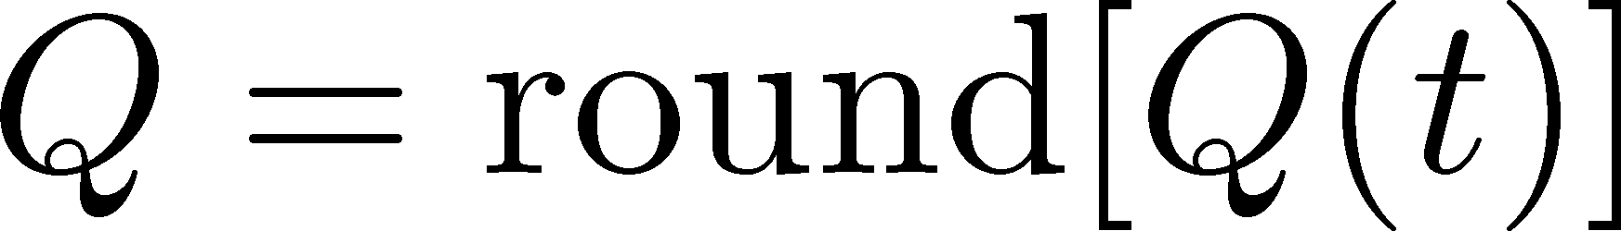
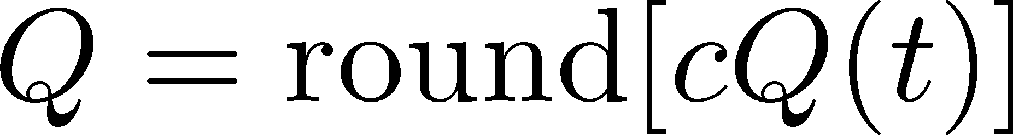
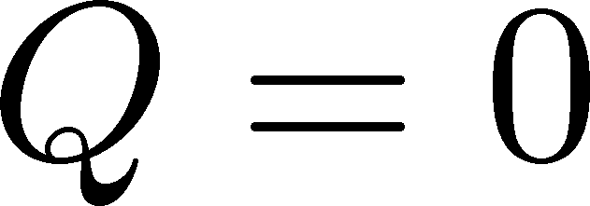
Benchmark
Distribution of Q(t)
Simple estimator from Q(t)
1) Naïve:
2) Improved:
3) zero:
c>1: optimization param.

Slide 26
Comparison: NN vs Benchmark
accuracy at β=6.2
 | ML (Trial 2) | naïve | improved
t/a²=0 | 37.0 | 27.3 | 27.3
t/a²=0.1 | 40.1 | 38.3 | 38.3
t/a²=0.2 | 55.2 | 54.0 | 54.6
t/a²=0.3 | 77.6 | 69.8 | 77.3
Machine learning cannot exceed the benchmark value.
NN would be trained to answer the “improved” value.
No useful local structures found by the NN.

Slide 27
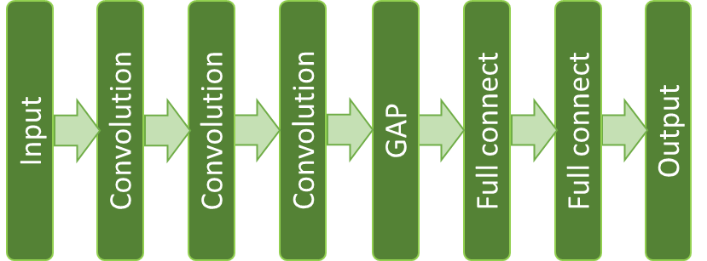
Trial 3: Multi-Channel Analysis
Input: q(x,t) in four-dimensional space at t/a²=0.1, 0.2, 0.3
Q

Slide 28
Trial 3: Multi-Channel Analysis
Input: q(x,t) in four-dimensional space at t/a²=0.1, 0.2, 0.3
Q
Result
machine learning
benchmark @ t/a²=0.3
β=6.2 | 93.8
β=6.5 | 94.1
77.3
71.3
non-trivial improvement from the benchmark!!

Slide 29
Is this a non-trivial result?
input
answer
We can estimate the answer from Q(t) by our eyes…

Slide 30
Trial 4: Feed Q(t) [0-dim]
Input: Q(t) at t/a²=0.1, 0.2, 0.3
Q(0.1)
Q
input
output
Output
Full connect (5)
Q(0.2)
Input (3)
Q(0.3)
Result
Q(t)
Trial 3 (4dim)
benchmark
β=6.2 | 94.1
β=6.5 | 95.7
93.8
94.1
77.3
71.3
Good accuracy can be obtained only from Q(t)

Slide 31
Using different flow times
t/a² | β=6.2 | β=6.5
0.3, 0.25, 0.2 | 95.9(2) | 99.0(2)
0.3, 0.2, 0.1 | 94.1(2) | 95.7(2)
0.25, 0.2, 0.15 | 93.9(3) | 95.0(2)
0.2, 0.15, 0.1 | 86.4(3) | 83.1(4)
0.2, 0.1, 0 | 74.1(5) | 68.2(4)
0.15, 0.1, 0.05 | 69.2(4) | 64.7(8)
0.1, 0.05, 0 | 53.8(5) | 49.9(3)
t/a²=0.3, 0.25, 0.2 gives the best accuracy.
Better accuracy on the finer lattice.
More than three input data do not improve accuracy.
error: variance in 10 independent trainings

Slide 32
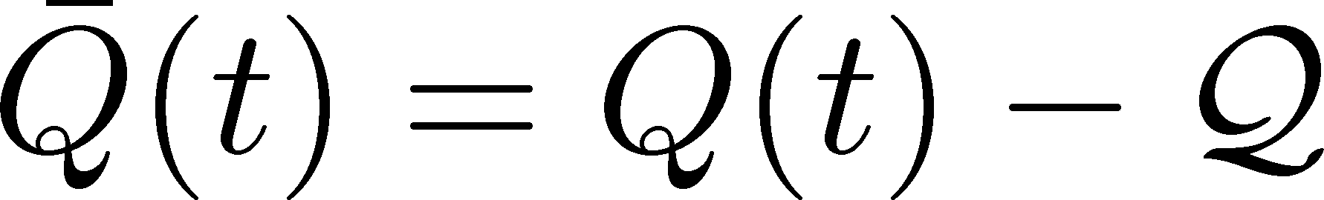
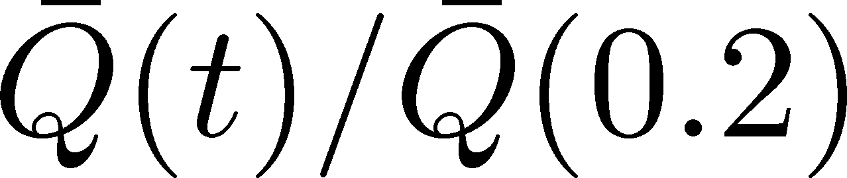
Trivial Check
beta=6.5
100 samples
99% accuracy is difficult to obtain by a simple prescription.

Slide 33
Reducing the Training Data
Smaller training data will reduce numerical cost for the training.
Training data | 10,000 | 5,000 | 1,000 | 500 | 100
β=6.2 | 95.9(2) | 95.9(2) | 95.9(2) | 95.5(3) | 90.3(7)
β=6.5 | 99.0(2) | 99.0(2) | 98.9(2) | 98.9(1) | 90.2(8)
1000 configurations are enough to train the NN successfully!
Numerical cost for the training is small.

Slide 34
Robustness
Analyze configurations with a different parameter set
analyzed data
 | β=6.2 | β=6.5
β=6.2 | 95.9(2) | 98.6(2)
β=6.5 | 95.6(2) | 99.0(2)
training
data
NNs trained for β=6.2 and 6.5 can be used for another parameter successfully.
Universal NN would be developed!
Note: same physical volume

Slide 35
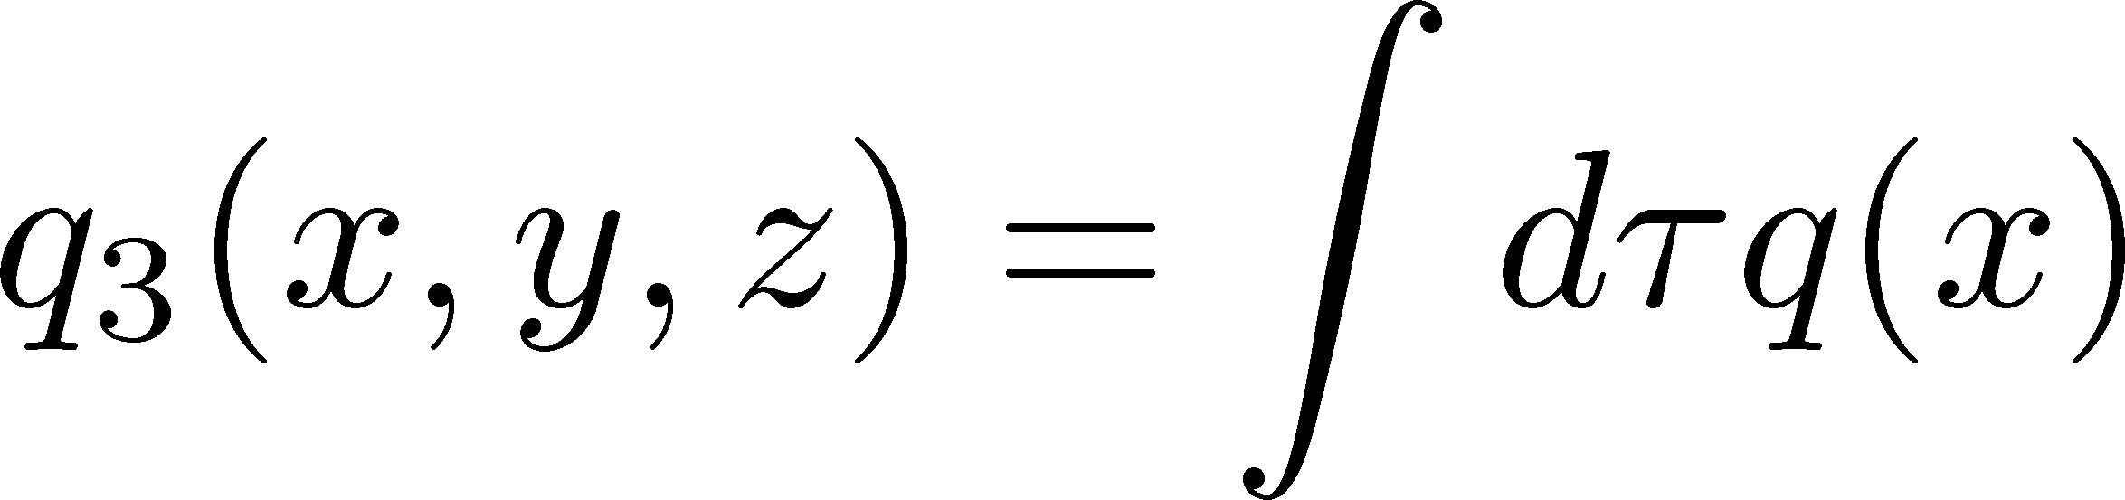
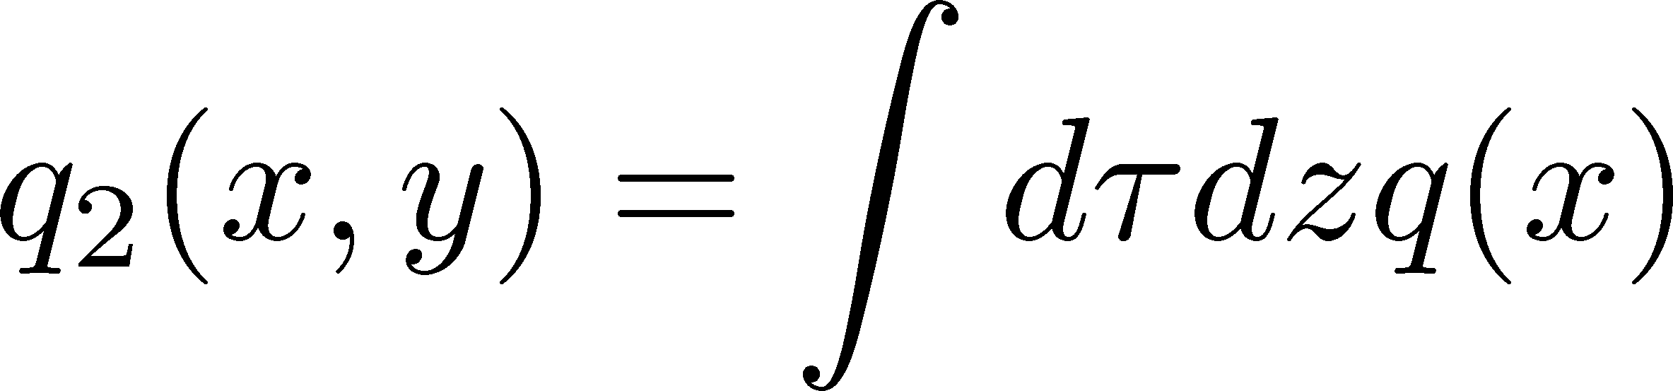
Trial 5: Dimensional Reduction
Optimal dimension between d=0 and 4?
d-dimensional CNN
Input: q_{d}(x) after dimensional reduction
3-channel analysis: t/a²=0.1, 0.2, 0.3
No d dependence
Failed in finding features in multi-dim. space.
No instanton-like local structure in QCD vacuum?

Slide 36
Summary and Outlook
Topological charge can be estimated with high accuracy from Q(t) at 0.2<t/a²<0.3 with the aid of the machine learning technique.
On the finer lattices, the better accuracy.
Applications: checking topological freezing, etc.
No local structures in multi-dim. space captured by NN
No “Instanton”-like structure? Or too noisy data?
Future Study
  Continuum limit / volume dependence
  High T configurations where DIGA is valid

Slide 37
backup

Slide 38
Topological Charge Density
No isolated instanton structure…

Slide 40
