Slide 1
SU(3)非可換ゲージ理論の
トポロジー分類への
機械学習の適用
北沢正清, 松本拓也, 河野泰宏
(大阪大学)
T. Matsumoto, M. Kitazawa, Y. Kohno, arXiv:1909.06238

Slide 2
理論物理学と機械学習
機械学習は理論物理学に応用可能か？
MLはblack box. 「理解」にはならない？
MLにできることは、より洗練した方法で実現可能？
100%の正答率は得られない。

Slide 3
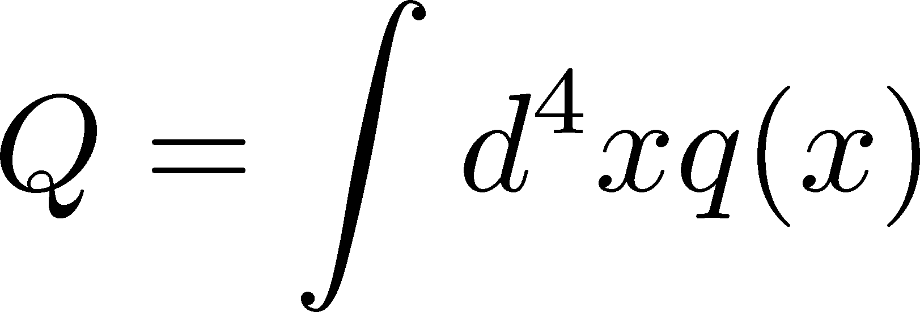
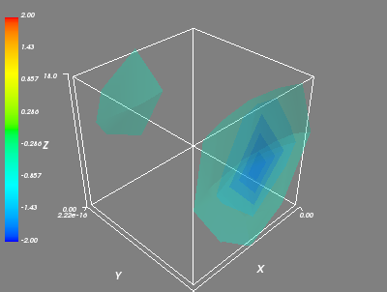
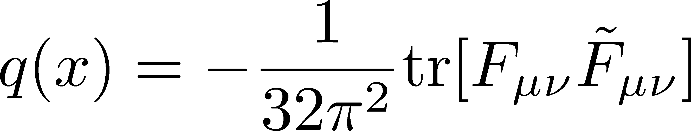
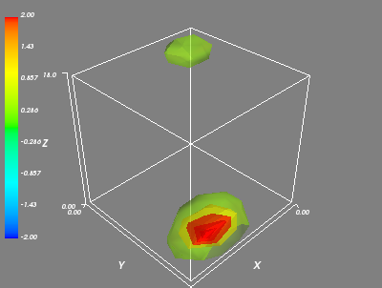
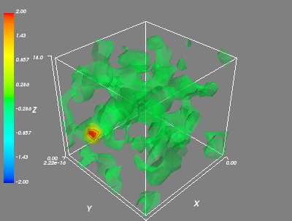
Topological Charge in YM Theory
q(x) in SU(3) YM
: integer
in continuum theory
Interests / applications
Instantons
Axial U(1) anomaly
Axion cosmology
Topological freezing

Slide 4
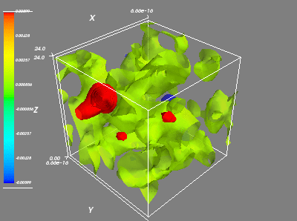
Machine Learning
Input: q(x)
Output
Q
topological
charge
4-dimensional field
Analysis of 4D data by 4D-CNN
Capture “instanton”-like structure?
Acceleration of the analysis of Q?

Slide 5
Gradient Flow and Topology
gradient flow ≃ Smoothing
flow time t = smearing radius

Slide 6
Trial 2: Topol. Density @ t>0
Input: q(x,t) in 4-dim space at nonzero flow time
Data reduction to 8⁴ (average pooling)
Q
GAP
Output
Convolution
Full connect
Input
Full connect
Convolution
Recalls of each topological sector (%)

Slide 7
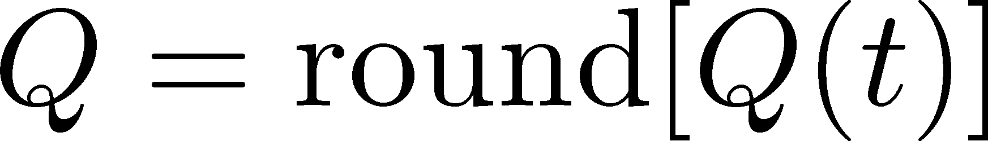
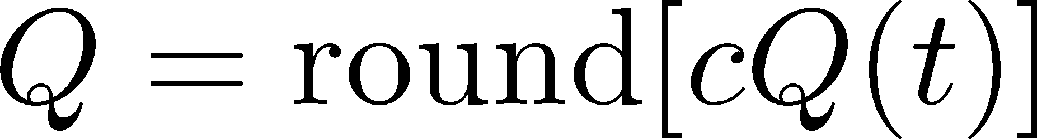
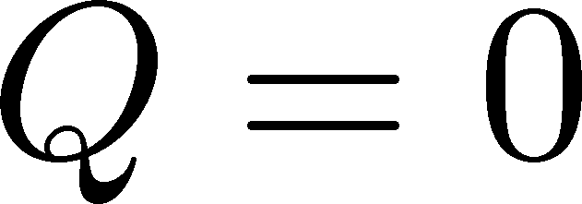
Benchmark
Distribution of Q(t)
Simple estimator from Q(t)
1) Naïve:
2) Improved:
3) zero:
c>1: optimization param.

Slide 8
Comparison: NN vs Benchmark
accuracy at β=6.2
 | ML (Trial 2) | naïve | improved
t/a²=0 | 37.0 | 27.3 | 27.3
t/a²=0.1 | 40.3 | 38.3 | 38.3
t/a²=0.2 | 53.7 | 54.0 | 54.6
t/a²=0.3 | 76.1 | 69.8 | 77.3
Machine learning cannot exceed the benchmark value.
NN would be trained to answer the “improved” value.
No useful local structures found by the NN.

Slide 9
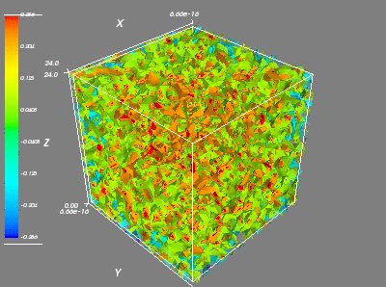
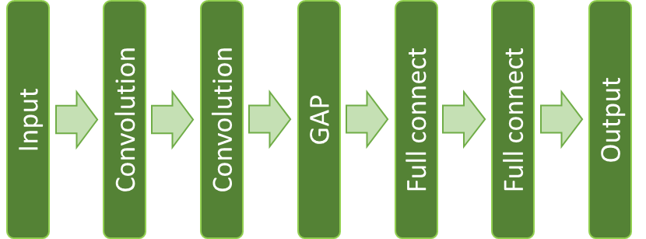
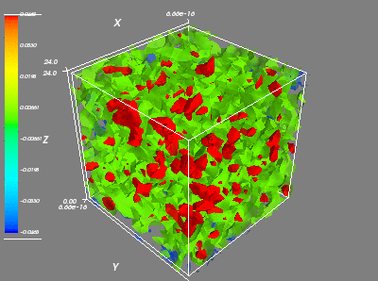
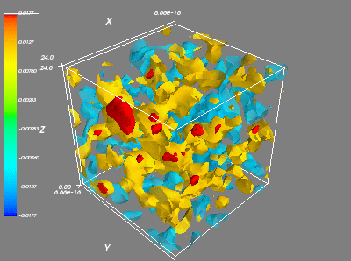
Trial 3: Multi-Channel Analysis
Input: q(x,t) in four-dimensional space at t/a²=0.1, 0.2, 0.3
Q
Result
machine learning
benchmark @ t/a²=0.3
β=6.2 | 93.8
β=6.5 | 94.1
77.3
71.3
non-trivial improvement from the benchmark!!

Slide 10
Is this a non-trivial result?
input
answer
We can estimate the answer from Q(t) by our eyes…

Slide 11
Trial 4: Feed Q(t) [0-dim]
Input: Q(t) at t/a²=0.1, 0.2, 0.3
Q(0.1)
Q
input
output
Output
Full connect (5)
Q(0.2)
Input (3)
Q(0.3)
Result
tuning
input t
Q(t)
Trial 3 (4dim)
benchmark
β=6.2 | 94.1
β=6.5 | 95.7
95.9
99.0
93.8
94.1
77.3
71.3
Good accuracy is obtained only from Q(t)

Slide 12
Reducing the Training Data
Smaller training data will reduce numerical cost for the training.
Training data | 10,000 | 5,000 | 1,000 | 500 | 100
β=6.2 | 95.9(2) | 95.9(2) | 95.9(2) | 95.5(3) | 90.3(7)
β=6.5 | 99.0(2) | 99.0(2) | 98.9(2) | 98.9(1) | 90.2(8)
1000 configurations are enough to train the NN successfully!
Numerical cost for the training is small.

Slide 13
Robustness Test
Analyze configurations with a different parameter set
analyzed data
 | β=6.2 | β=6.5
β=6.2 | 95.9(2) | 98.6(2)
β=6.5 | 95.6(2) | 99.0(2)
both | 95.8(1) | 98.9(2)
training
data
NNs trained for β=6.2 and 6.5 can be used for another parameter successfully.
Universal NN would be developed!
Note: same physical volume

Slide 14
Untrained Data
standard training
training w/o |Q|=4,5
CNN can make accurate predictions even for untrained values of Q.

Slide 15
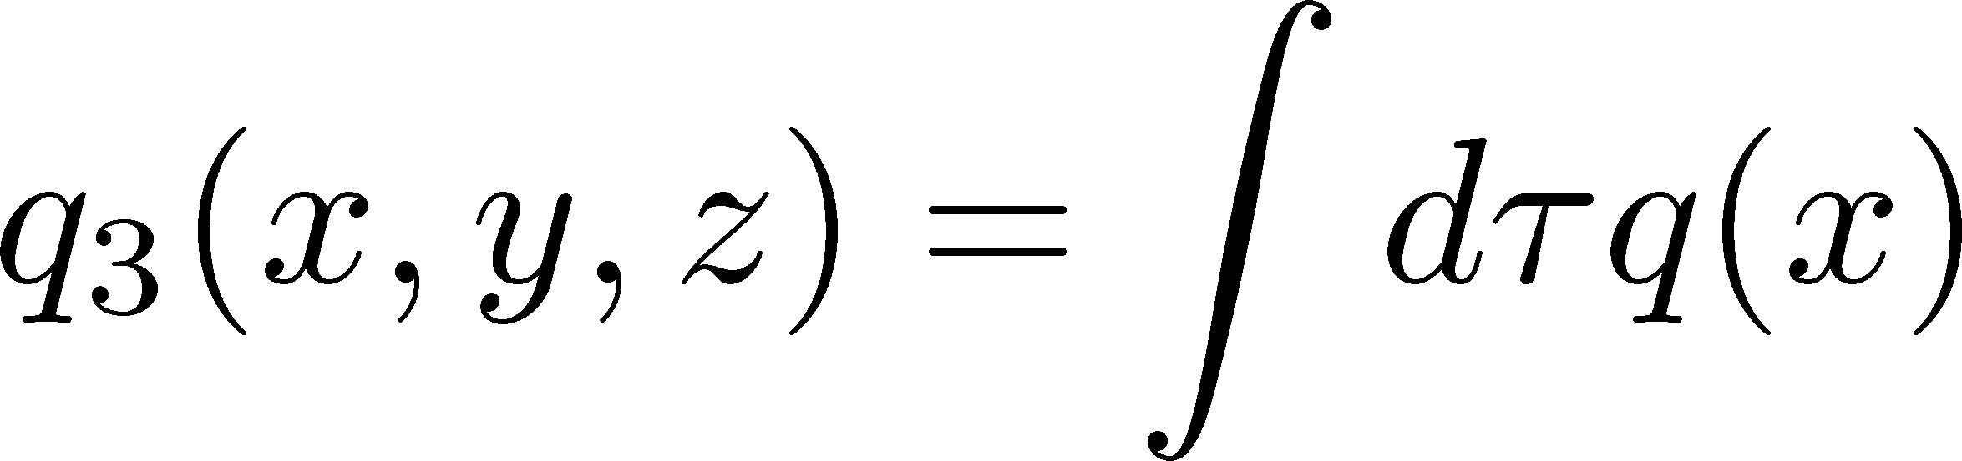
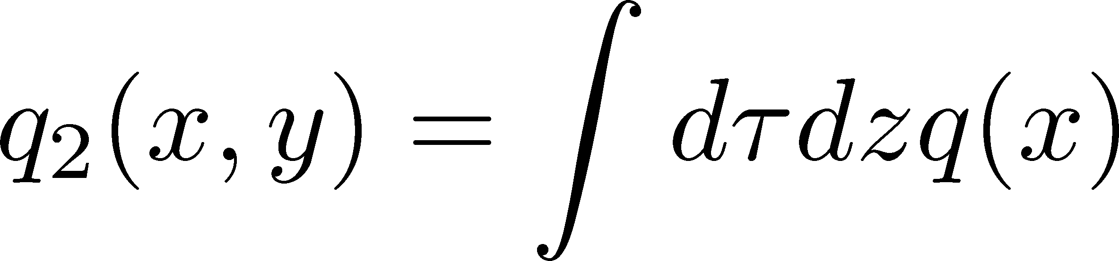
Trial 5: Dimensional Reduction
Optimal dimension between d=0 and 4?
d-dimensional CNN
Input: q_{d}(x) after dimensional reduction
3-channel analysis: t/a²=0.1, 0.2, 0.3
No d dependence
Failed in finding features in multi-dim. space.
No instanton-like local structure in QCD vacuum?

Slide 16


Summary and Outlook
4次元データのCNN解析は、配位の局所的構造を特徴抽出するには至っていないようである。
次元縮約も精度向上に寄与しない。
ゼロ次元FNN解析は、トポロジカル電荷推定の効率化に有効。Gradient flowはt/a²=0.3までで良い。
高い正答率／少ない学習データ／高い堅牢性／未知のデータへの適用
将来展望
  連続極限 / 体積依存性
  DIGAが適用可能な高温配位の解析
  論文の出版

Slide 17
backup

Slide 18
Neural Network Setting
convolutional neural network by CHAINER framework
supervised learning
convolutional layer: 4-dim., periodic BC
regression analysis / round off to obtain integer
activation: logistic
answer of Q
  Q(t) @ t/a²=4.0
  round off

Slide 19
Using different flow times
t/a² | β=6.2 | β=6.5
0.3, 0.25, 0.2 | 95.9(2) | 99.0(2)
0.3, 0.2, 0.1 | 95.5(2) | 95.7(2)
0.25, 0.2, 0.15 | 95.1(3) | 95.0(2)
0.2, 0.15, 0.1 | 86.9(3) | 83.1(4)
0.2, 0.1, 0 | 75.6(5) | 68.2(4)
0.15, 0.1, 0.05 | 71.8(4) | 65.2(4)
0.1, 0.05, 0 | 54.8(5) | 49.9(3)
t/a²=0.3, 0.25, 0.2 gives the best accuracy.
Better accuracy on the finer lattice.
More than three t values do not improve accuracy.
error: variance in 10 independent trainings

Slide 20
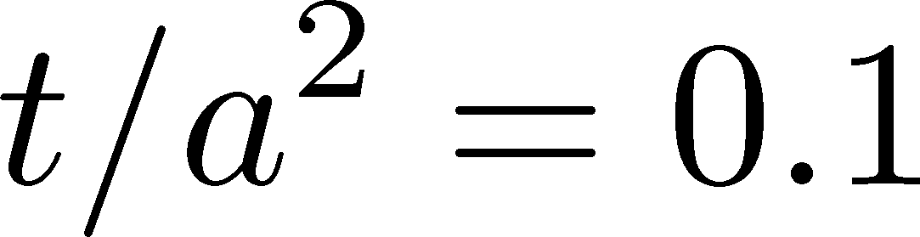
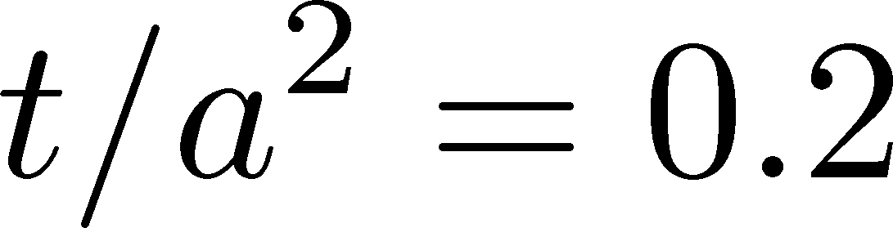
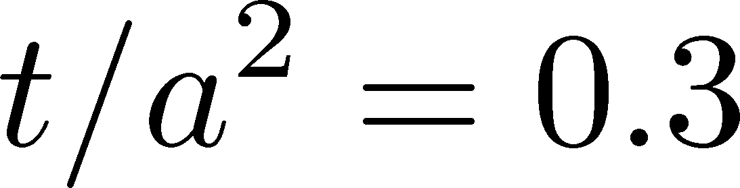
Topological Charge Density
No isolated instanton structure…

Slide 21
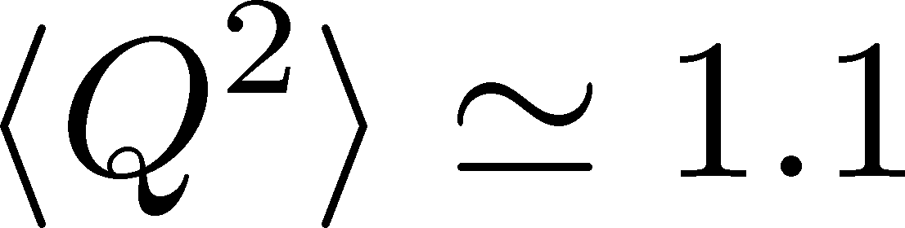
Lattice Setting
β | N⁴ | N_{conf}
6.2 | 16⁴ | 20,000
6.5 | 24⁴ | 20,000
SU(3) Yang-Mills
Wilson gauge action
2 lattice spacings with same physical volume
LT_{c}~0.63
Gradient flow for smoothing
Training: 10,000
20,000 confs. in total
Validation: 5,000
Test: 5,000
distribution of Q

Slide 22
Topology on the Lattice
Distinct topological sectors on sufficiently fine lattices
Luscher, 1981
Definitions of Q on the lattice:
  fermionic: Atiyah-Singer index theorem
  gluonic: q(x) after smoothing
    cooling, smearing
    gradient flow
Luscher, Weisz, 2011
Good agreement b/w various definitions
Faster algorithm is desirable!

Slide 23
Details of NN
Trial 1~3
Trial 4
Trial 5

