Slide 1
ヤンミルズ理論における
非等方有限系の非等方圧力
KEK理論センター研究会 「熱場の量子論とその応用」 2020/Aug./26
Masakiyo Kitazawa
(Osaka U.)
with S. Mogliacci, I. Kolbe, W.A. Horowitz
MK, Mogliacci, Kolbe, Horowitz, Phys.Rev.D 99 (2019) 094507
[arXiv:1904.00241[hep-lat]]

Slide 2
Casimir Effect

Slide 3
Casimir Effect
attractive force between two conductive plates

Slide 4
Casimir Effect
attractive force between two conductive plates

Slide 5
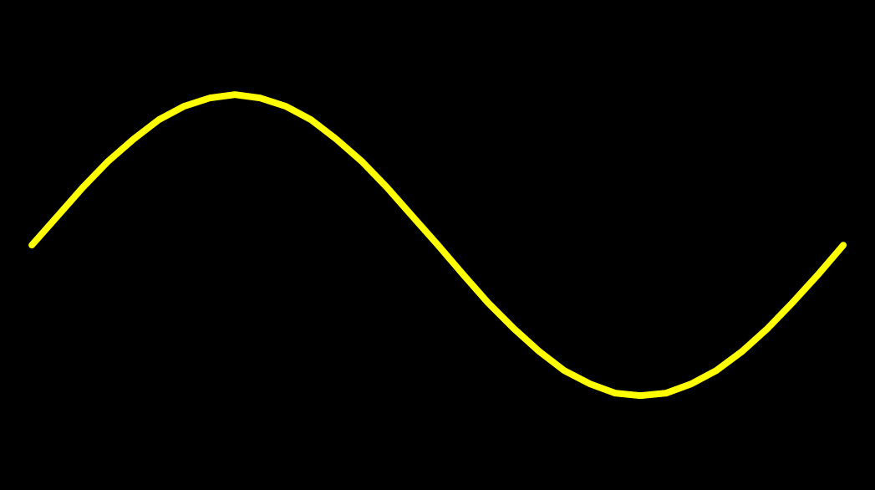
Casimir Effect
attractive force between two conductive plates

Slide 6





Casimir Effect
Brown, Maclay
1969

Slide 7

Casimir Effect
Brown, Maclay
1969

Slide 8


Casimir Effect
Brown, Maclay
1969

Slide 9

Casimir Effect
Brown, Maclay
1969
T

Slide 10

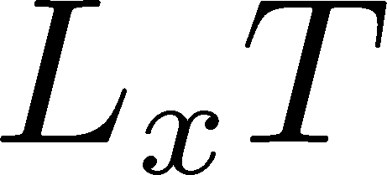

Pressure Anisotropy @ T≠0
MK, Mogliacci, Kolbe,
Horowitz, PRD(2019)
Free scalar field
L₂=L₃=∞
Periodic BC
Mogliacci+, 1807.07871

Slide 11
Pressure Anisotropy @ T≠0
MK, Mogliacci, Kolbe,
Horowitz, PRD(2019)
Free scalar field
L₂=L₃=∞
Periodic BC
Mogliacci+, 1807.07871
Lattice result
Periodic BC
Only t→0 limit
Error: stat.+sys.
Medium near T_{c} is remarkably insensitive to finite size!

Slide 12


Thermodynamics on the Lattice
Various Methods
Integral, differential, moving frame, non-equilibrium, …
rely on thermodynamic relations valid in V→∞
Not applicable to
anisotropic systems

Slide 13


Thermodynamics on the Lattice
Various Methods
Integral, differential, moving frame, non-equilibrium, …
rely on thermodynamic relations valid in V→∞
Not applicable to
anisotropic systems
We employ Gradient Flow Method
Components of EMT are directly accessible!

Slide 14




Yang-Mills Gradient Flow
Luscher 2010
Narayanan, Neuberger, 2006
Luscher, Weiss, 2011
t: “flow time”
dim:[length²]
leading
diffusion equation in 4-dim space
diffusion distance
“continuous” cooling/smearing
No UV divergence at t>0

Slide 15





Small Flow-Time Expansion
Luescher, Weisz, 2011
Suzuki, 2013
an operator at t>0
remormalized operators
of original theory
original 4-dim theory
t→0 limit

Slide 16


Constructing EMT
Suzuki, 2013
vacuum subtr.
Remormalized EMT
Perturbative coefficient:
Suzuki (2013); Makino, Suzuki (2014); Harlander+ (2018); Iritani, MK, Suzuki, Takaura (2019)

Slide 17





Perturbative Coefficients
Suzuki, PTEP 2013, 083B03
Harlander+, 1808.09837
Iritani, MK, Suzuki, Takaura, PTEP 2019
LO
1-loop
2-loop
3-loop
×
Iritani, MK, Suzuki,
Takaura, 2019
zero
Suzuki (2013)
Harlander+(2018)
Choice of the scale of g²
Previous:
Improved:
Harlander+ (2018)

Slide 18
t→0 Extrapolation: ε+p
N²LO (2-loop)
Range2
Range1
Range3
Iritani, MK, Suzuki, Takaura, PTEP 2019
Stable t→0 extrapolation with higher order coeff.
Systematic error: fit range, μ₀ or μ_{d}, uncertaintyof Λ (±3%)
Extrapolation func: linear, higher order term in c₁ (~g⁶)

Slide 19
Effect of Higher-Order Coeffs.
Iritani, MK, Suzuki, Takaura, 2019
□: 2-loop
△: Flow2016
Systematic error: μ₀ or μ_{d}, Λ, t→0 function, fit range
More stable extrapolation with higher order c₁ & c₂
(pure gauge)

Slide 20

Numerical Setup
SU(3) YM theory
Wilson gauge action
N_{t} = 16, 12
N_{z}/N_{t}=6
2000~4000 confs.
Even N_{x}
No Continuum extrap.
Same Spatial volume
12x72²x12 ~ 16x96²x16
18x72²x12 ~ 24x96²x16
Simulations on
OCTOPUS/Reedbush

Slide 21

Small-t Extrapolation
Filled: N_{t}=16 / Open: N_{t}=12
Small-t extrapolation
Solid: N_{t}=16, Range-1
Dotted: N_{t}=16, Range-2,3
Dashed: N_{t}=12, Range-1
Stable small-t extrapolation
No N_{t} dependence within statistics for L_{x}T=1, 1.5

Slide 22
Small-t Extrapolation
Filled: N_{t}=16 / Open: N_{t}=12
Small-t extrapolation
Solid: N_{t}=16, Range-1
Dotted: N_{t}=16, Range-2,3
Dashed: N_{t}=12, Range-1
Stable small-t extrapolation
No N_{t} dependence within statistics for L_{x}T=1, 1.5

Slide 23
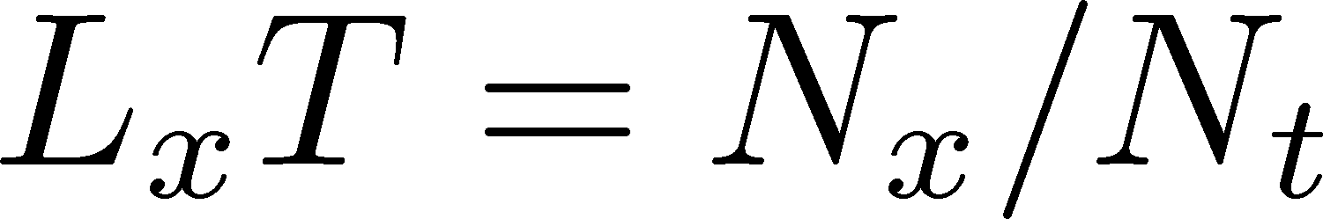
Pressure Anisotropy @ T≠0
MK, Mogliacci, Kolbe,
Horowitz, PRD(2019)
Free scalar field
L₂=L₃=∞
Periodic BC
Mogliacci+, 1807.07871
Lattice result
Periodic BC
Only t→0 limit
Error: stat.+sys.
Medium near T_{c} is remarkably insensitive to finite size!

Slide 24
Pressure Anisotropy @ T≠0
MK, Mogliacci, Kolbe,
Horowitz, PRD(2019)
Free scalar field
L₂=L₃=∞
Periodic BC
Mogliacci+, 1807.07871
Lattice result
Periodic BC
Only t→0 limit
Error: stat.+sys.
Medium near T_{c} is remarkably insensitive to finite size!

Slide 25
Higher T
High-T limit: massless free gluons
How does the anisotropy approach this limit?
Difficulties
Vacuum subtraction requires large-volume simulations.
Lattice spacing not available → c₁(t), c₂(t) are not determined.

Slide 26


Higher T
High-T limit: massless free gluons
How does the anisotropy approach this limit?
Difficulties
Vacuum subtraction requires large-volume simulations.
Lattice spacing not available → c₁(t), c₂(t) are not determined.
We study
No vacuum subtr. nor Suzuki coeffs. necessary!

Slide 27
T
massless free
T/T_{c}≅8.1 (β=8.0) / T/T_{c}≅25 (β=9.0)
Ratio approaches the asymptotic value.
But, large deviation exists even at T/T_{c}~25.

Slide 28
Summary
First numerical simulation of
anisotropic pressure in SU(3) YM
with periodic BC.
Medium at 1.4<T/T_{c}<2.1 is remarkably
insensitive to the existence of boundary.
Future
Anti-periodic / Dirichlet BCs
BC for two directions, magnetic field, below T_{c}, …
And, many other problems related to EMT!!

Slide 29
backup

Slide 30
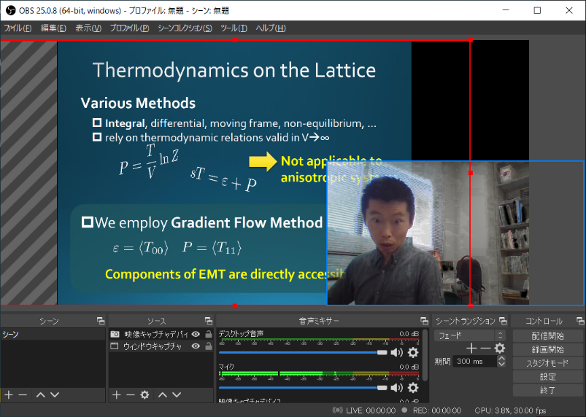
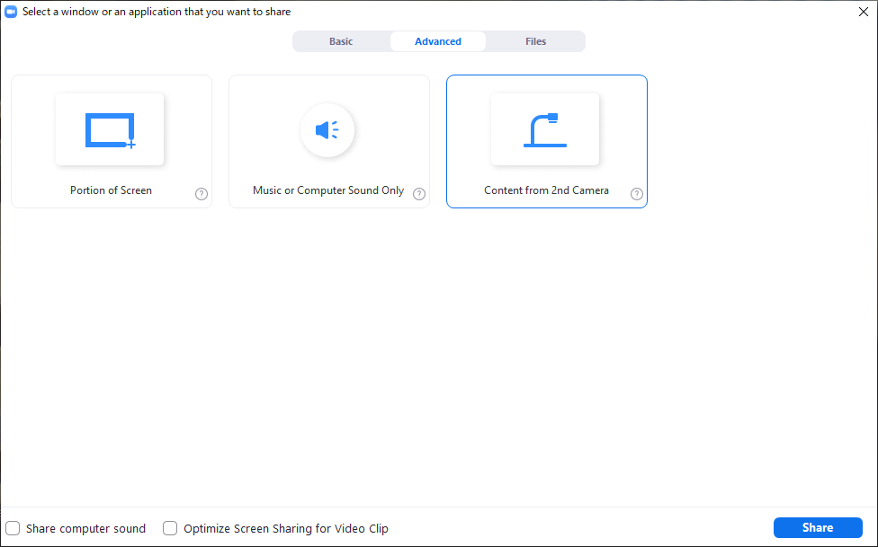
Tips for Presentation
Install
  OBS Studio https://obsproject.com/
  OBS VirtualCam https://github.com/CatxFish/obs-virtual-cam/
Setup
  tools – VirtualCam – Start
  Chroma key composition: Need a green sheet behind you!
Zoom: Share Screen – Advanced – Content from 2nd camera
Select Here!

Slide 31



Extrapolations t→0, a→0
O(t) terms in SFTE
lattice discretization
FlowQCD2016
This Study
①Continuum
②Small t extrapol.
strong
discretization
effect
strong
discretization
effect

Slide 32
energy densty / transverse P
Energy Density
Transverse Pressure P_{z}

Slide 33





Gradient Flow Method
lattice regularized
gauge theory
Smeared world
by gradient flow
gradient flow
continuum theory
gradient flow
Measure on
the lattice
analytic relation
Take Extrapolation (t,a)→(0,0)
O(t) terms in SFTE
lattice discretization

Slide 34







Two Special Cases with PBC
In conformal (Σ_{μ}T_{μμ}=0)

Slide 35



EMT on the Lattice: Conventional
Lattice EMT Operator
Caracciolo+, 1990
Fit to thermodynamics: Z₃, Z₁
Shifted-boundary method: Z₆, Z₃
Giusti, Meyer, 2011; 2013;
Giusti, Pepe, 2014~; Borsanyi+, 2018
Multi-level algorithm
effective in reducing statistical error of correlator
Meyer, 2007;
Borsanyi, 2018;
Astrakhantsev+, 2018

