Slide 1
Diffusion Dynamics of
Fluctuations of
Conserved Charges
Masakiyo Kitazawa
(Osaka U.)
RHIC-BES Theory and Experiment on-line seminar
on Sep. 8, 2020, online

Slide 2

Beam-Energy Scan Program in Heavy-Ion Collisions
T
STAR-BES
HADES
FAIR
NICA
J-PARC-HI
…
high
Quark-Gluon Plasma
beam energy
150MeV
ＱＣＤ Critical Point
low
Hadron Phase
(confined)
Color SC
~10¹⁵g/cm³
μ
Our Universe

Slide 3
Thermal Fluctuations
Observables are fluctuating even in an equilibrated medium.
P(N)
N
V
N
The noise is the signal.
R. Landauer
1998

Slide 4


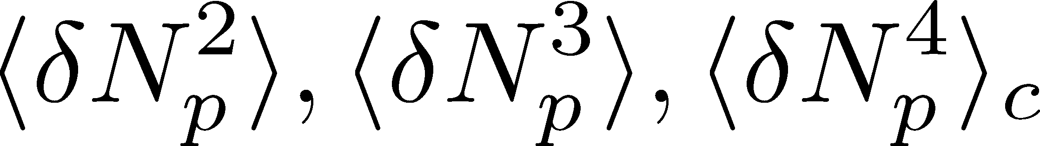
Event-by-Event Fluctuations
STAR, PRL105 (2010)
Detector
Form of distribution reflects microscopic properties
Cumulants:

Slide 5
Event-by-Event Fluctuations
V
Detector
Form of distribution reflects microscopic properties
Cumulants:

Slide 6
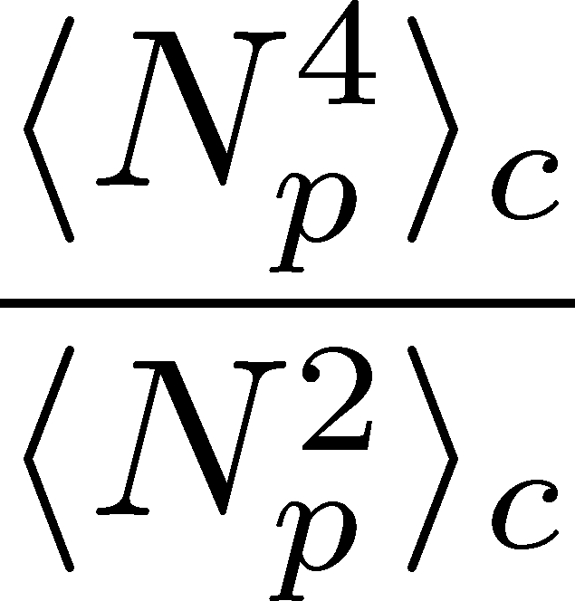

Higher Order Cumulants
STAR, 2015
STAR, 2020 (2001.02852)
Enhancement
Supression
Supression
Higher order cumulans have non-trivial enhancement and suppressions ➔ signal of the QCD critical point?

Slide 7
Why Fluctuations?

Slide 8

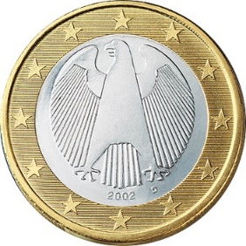
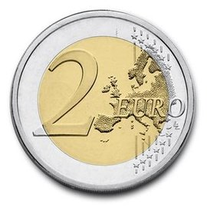

A Coin Game
Bet 25 Euro
You get head coins of
A. 50 x 1 Euro
B. 25 x 2 Euro
Same expectation value.

Slide 9
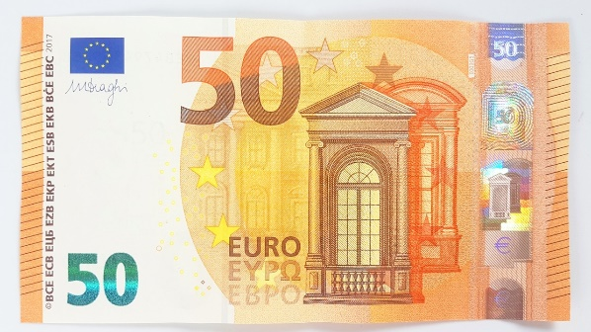
A Coin Game
Bet 25 Euro
You get head coins of
A. 50 x 1 Euro
B. 25 x 2 Euro
C. 1 x 50 Euro
Same expectation value.
But, different fluctuation.

Slide 10
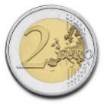

Fluctuations in HIC: 2nd Order
Search for QCD CP
Onset of QGP
Fluctuation
increases
Fluctuation
decreases
Asakawa, Heinz, Muller, 2000;
Jeon, Koch, 2000
Stephanov, Rajagopal, Shuryak, 1998; 1999

Slide 11



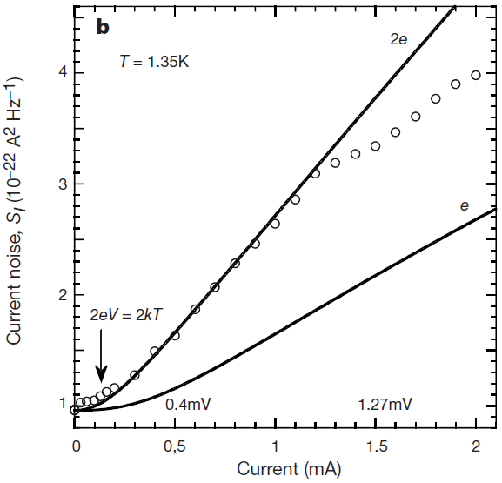


Shot Noise
e*
charge of quasi-particles
Superconductors
with Cooper Pairs
Fractional Quantum
Hall Systems
doubled!
Jehl+, Nature 405,50 (2000)
Saminadayar+, PRL79,2526 (1997)
Higher orders:
3rd: ex. Beenakker+, PRL90,176802(2003)
up to 5th: Gustavsson+, Surf.Sci.Rep.64,191(2009)

Slide 12
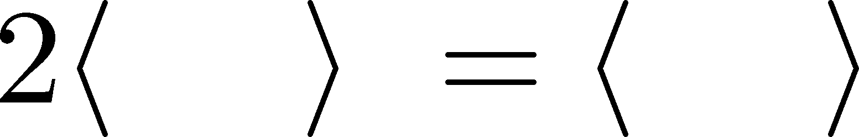
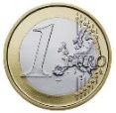
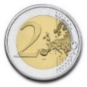
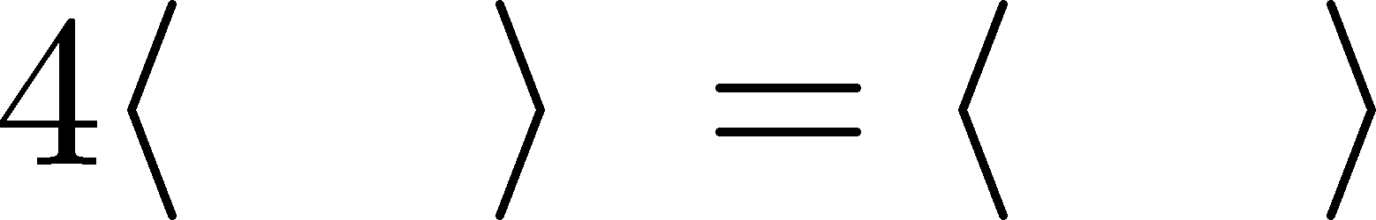
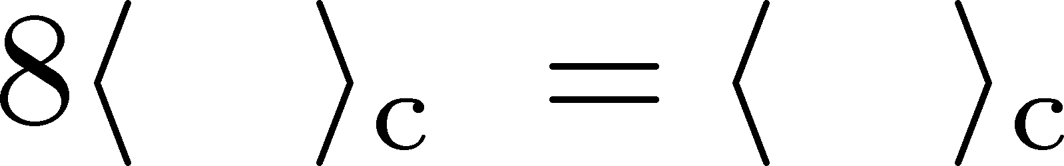
Higher-order Cumulants
A. 50 x 1 Euro
B. 25 x 2 Euro
δ€²
δ€²
δ€³
δ€³
Asakawa, MK,
PPNP 90, 299
(2016)
€⁴
€⁴

Slide 13
Non-Gaussian Fluctuations
Onset of QGP
Search for QCD CP
Fluctuation
decreases
Fluctuation
increases
Ejiri, Karsch, Redlich, 2006
Stephanov, 2009

Slide 14


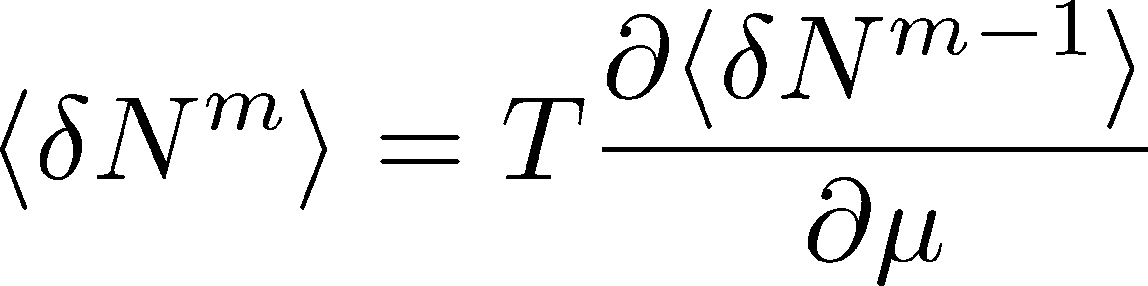
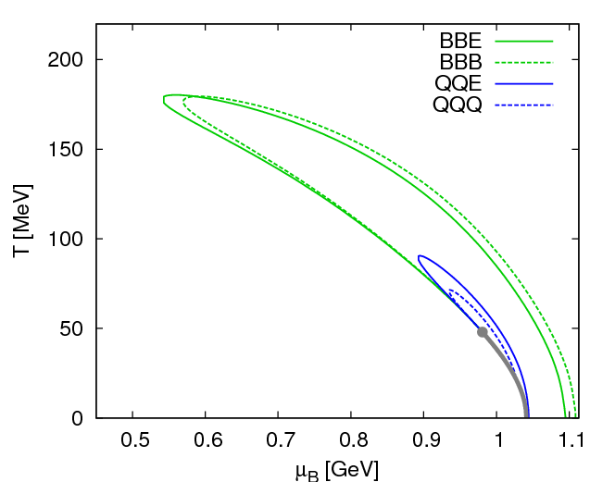
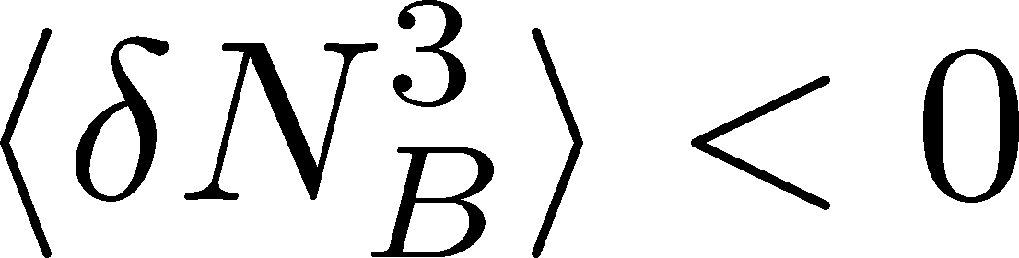

Sign of Higher-order Cumulants
Higher order cumulants can change sign near CP.
Asakawa, Ejiri, MK, 2009

Slide 15
Sign of Higher-order Cumulants
Higher order cumulants can change sign near CP.
Asakawa, Ejiri, MK, 2009
Stephanov, 2011;
Friman, Karsch, Redlich, Skokov, 2011; …

Slide 16
Various Issues
to compare exp. results with thermodynamics
Volume (initial) fluctuations
Dynamical evolution
Resonance decays
Measurement in momentum space
Difference b/w proton & baryon number flucts.
Efficiency/acceptance correction
…

Slide 17
Event-by-Event Fluctuations
V
Detector
When are observed fluctuations generated?
Observed fluc. ≠ fluc. at chemical freeze out
Asakawa, MK, Muller, PRC (2020)

Slide 18

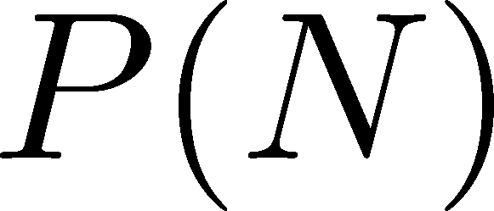




Time Evolution of Fluctuations
Detector
Hadronic
Distributions in ΔY and
Δy are different due to
“thermal blurring”.
Ohnishi, MK, Asakawa, PRC(2016)
QGP
Fluctuations in ΔY continue
to change until kinetic f.o.

Slide 19
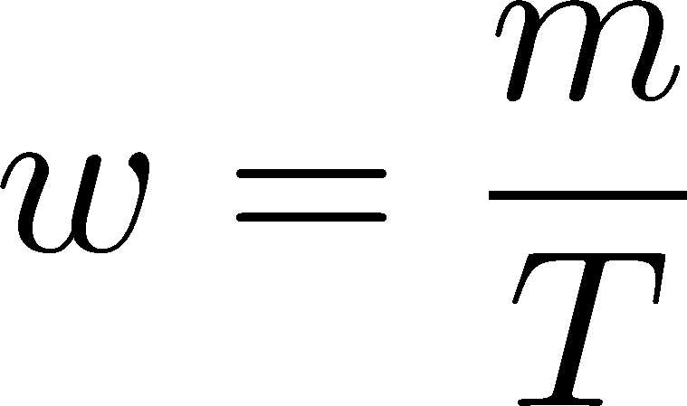



Thermal Distribution in y Space
nucleon
pions
nucleons
pion
assume Bjoroken picture
blast wave
flat freezeout surface
Blast wave squeezes the
distribution in rapidity space

Slide 20
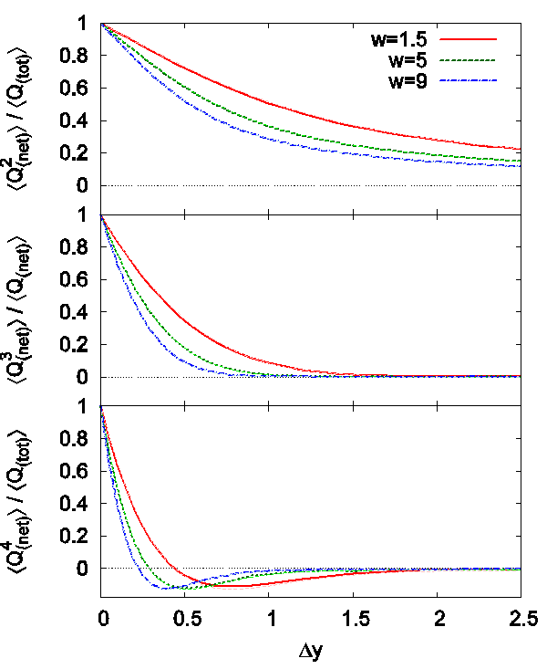
Δy Dependence
Ohnishi, MK, Asakawa, PRC (‘16)
Initial condition
(before blurring)
no e-v-e fluctuations
Cumulants after blurring
Cumulants after blurring
can take nonzero values
At Δy=1, the effect is
not well suppressed
pions
nucleons

Slide 21
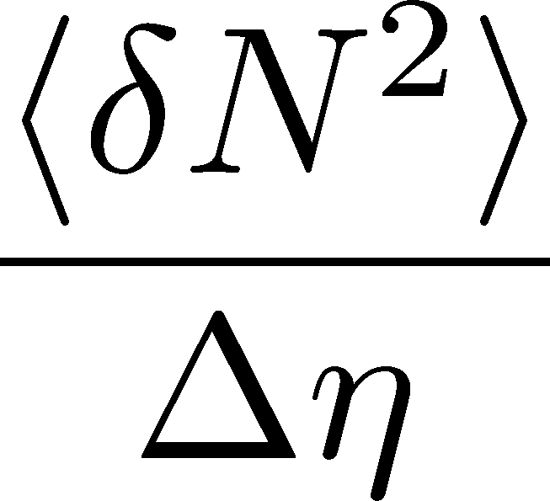
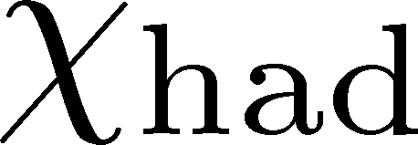
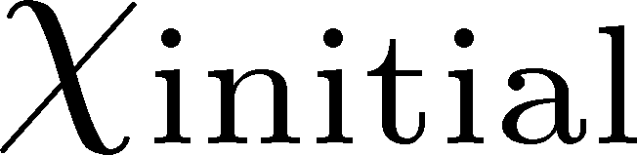
Time Evolution
Hadronization
Kinetic Freezeout
Variation of a conserved charge is achieved only through diffusion.
The larger Δη,
the slower diffusion
Same physics as balance func. / 2-particle correlation
Pratt, Steinhorst, 2008.08623

Slide 22

Low Energy Collisions
Large contribution of global charge conservation
Violation of Bjorken scaling
detector
Careful treatment is required to interpret fluctuations
at low beam energies!

Slide 23
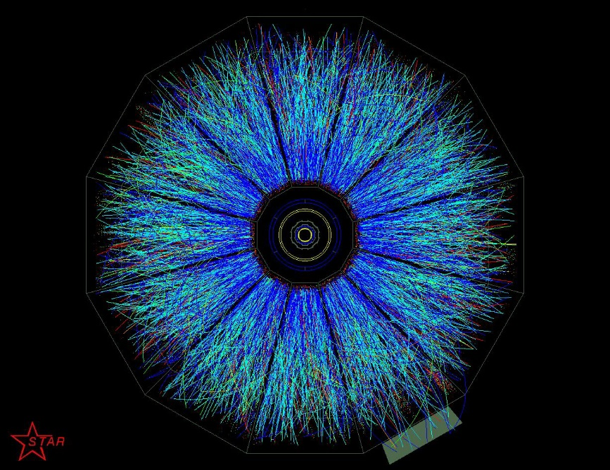
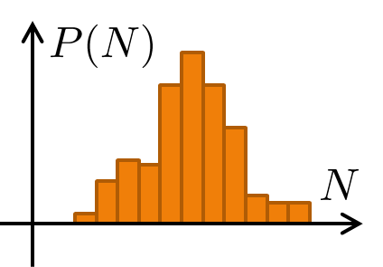
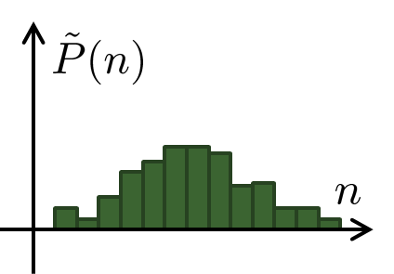
Detector-Response Correction
True distribution
Efficiency loss
Particle missID
Observed distr.
Correction assuming a binomial response
Bialas, Peschanski (1986);
MK, Asakawa (2012); Bzdak, Koch (2012); ….
Correction for general case
Nonaka, MK, Esumi (2018)

Slide 24
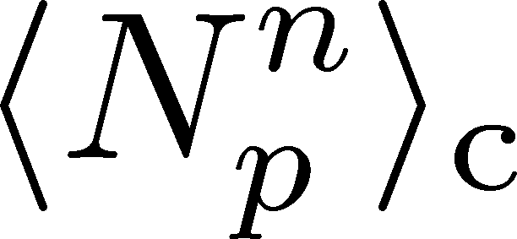
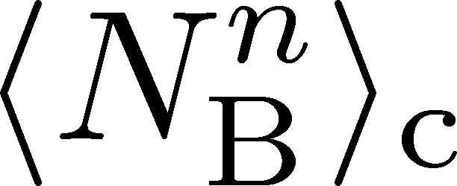
Proton vs Baryon Cumulants
MK, Asakawa, 2012; 2012
Experiments
proton number cumulants
Many theories
baryon number cumulants
measurement with
50% efficiency loss
Clear difference b/w proton and baryon # cumulants.
Isospin randomization justifies the reconstruction of <N_{B}^{n}>_{c} via the binomial model.
Similar problem on the momentum cut…

Slide 25
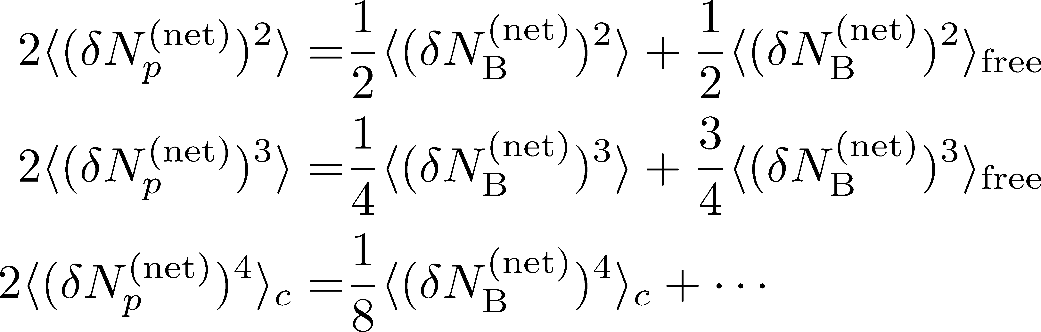
Fragile Higher Orders
Ex.: Relation b/w baryon & proton # cumulants
(with approximations)
MK, Asakawa, 2012
genuine info.
Poisson noise
Higher orders are more seriously affected by efficiency loss.
Reconstruction of true cumulants is more desirable.
Reliable analysis is more difficult for higher orders.

Slide 26
Pileup Correction
Nonaka, MK, Esumi, NIM, in press, 2006.15809
“Pileup events”
Collisions with small space-time interval identified as a single event.
true
pileup
Fluctuations are distorted by the pileup events.
Sonbun+ (’18); Garg, Mishra (’17)
This effect can be corrected by a systematic procedure.
Strong effects at the most central bin.

Slide 27
Fluctuations in
Dynamically Expanding
Systems
Thanks to:
A. Chatterjee, M. Bluhm, S. Esumi,
M. Nahrgang, T. Nonaka

Slide 28

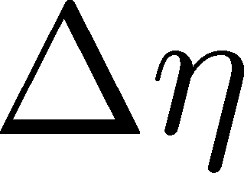
2nd Order @ ALICE
Net charge fluctuation
Net proton fluctuation
ALICE, PRL2013
Rustamov, 2017
Net-charge fluctuation has a suppression,
but net-proton fluctuation does not. Why??
Earlier fluctuations or resonance decays?

Slide 29
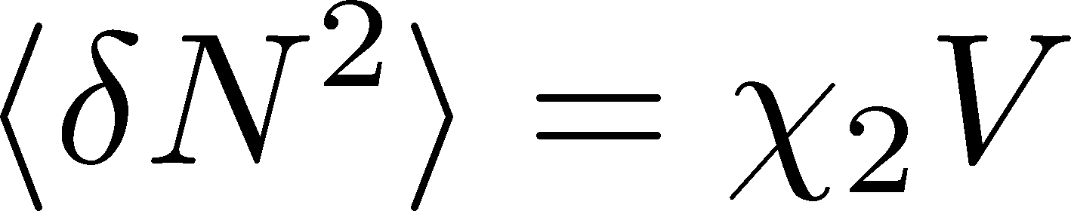
What is the VOLUME?
fluctuation
in volume V
susceptibility
(lattice observable)
χ₂→T³ in the high T limit
In HIC, V→0 as τ→small
How do these effects compete
in real evolution?
HotQCD, PRD86 (’12)

Slide 30

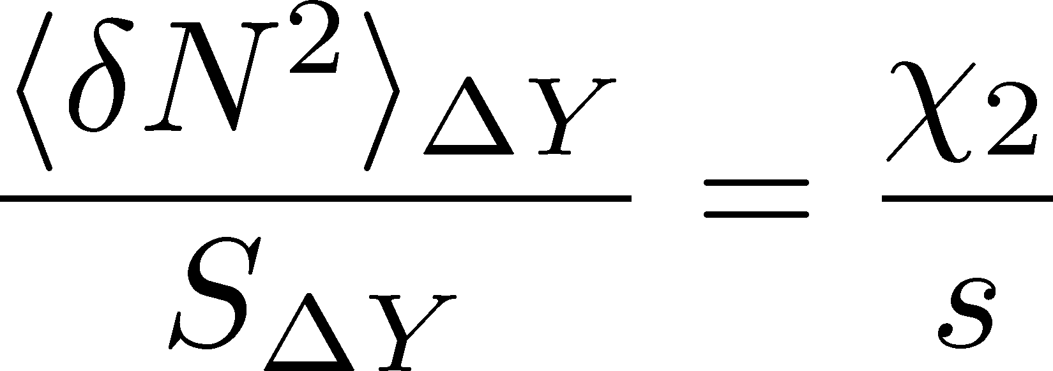
Revisiting AHM-JK’s Argument
Asakawa-Heinz-Müller/Jeon-Koch (’00)
System in a
space-time rapidity ΔY
Entropy S_{ΔY} is conserved
in perfect hydro. expansion
Hadronic
QGP
Described only by
thermodynamic quantities

Slide 31
χ₂/s
Data from HotQCD
PRD86,034509
PRD90,094503
Electric Charge
Baryon
Baryon: Almost T independent
Electric charge: suppression
Consistent with ALICE results

Slide 32
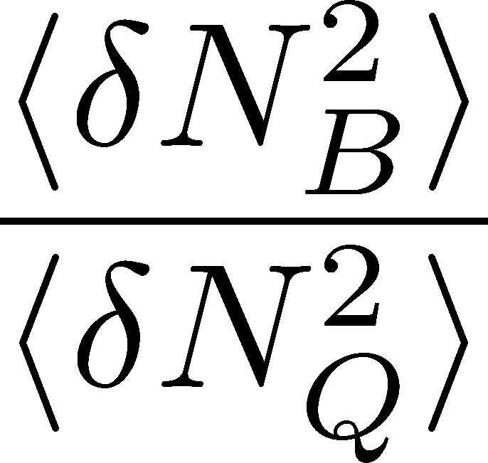
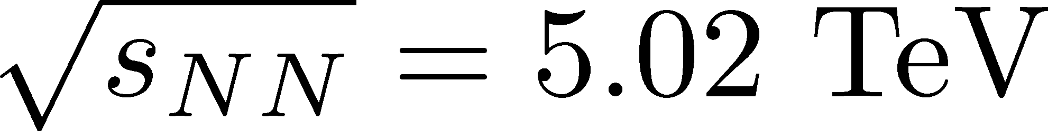

B & Q Cumulatns
Presentation by MK
RRTF, GSI, Apr. 2019
LATTICE
Experiment
Primordial
Fluctuation
HotQCD, PRD (’12)
Resonance
decays
1.6
Δη dependence for tracing back the history!

Slide 33
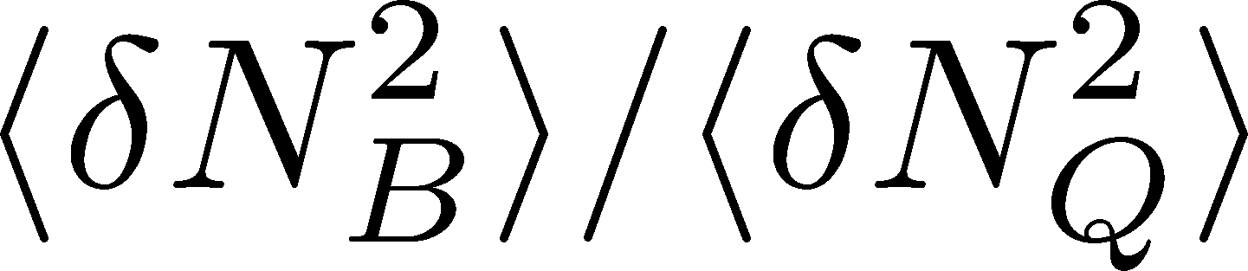
Exp. Result @ STAR
STAR, PRC100 (’19)
is directly calculable!
total particle numbers:
private comm. with A. Chatterjee
Remarks:
Reconstructed baryon # cumulants are used.
a non-trivial factor to convert η to y
p_{T} cut correction is imposed

Slide 34
p_{T} -Cut Correction
Experimental measurement:
0.4<p_{T}<2.0 [GeV/c]
In the blast wave model,
54% of charged pions
81% of protons
are observed @ √s_{NN}=200 GeV
We try acceptance correction via binomial response.

Slide 35
B/Q: Lattice vs Exp.
LATTICE
STAR, 200GeV
Extracted “temperature” doesn’t agree with thermal model.
Observed charge fluctuation would be dominated by the effects of resonance decays.
No direct evidence of primordial fluctuations at Δη =1.0.

Slide 36
Diffusion of
Higher-order Cumulants
in a simple diffusion model

Slide 37


Diffusion in Hadronic Stage
Initial condition (uniform)
cumulants:
random
walk
diffusion master equation: MK+, PLB(2014)
probabilistic argument: Ohnishi+, PRC(2016)

Slide 38


Diffusion in Hadronic Stage
Initial condition (uniform)
cumulants:
diffusion
distance
random
walk
Study ΔY dependence
Poisson distribution
diffusion master equation: MK+, PLB(2014)
probabilistic argument: Ohnishi+, PRC(2016)

Slide 39



Baryons in Hadronic Phase
time
chem. f.o.
hadronize
10~20fm
kinetic f.o.
Baryons behave like
Brownian pollens in water
mesons
baryons

Slide 40
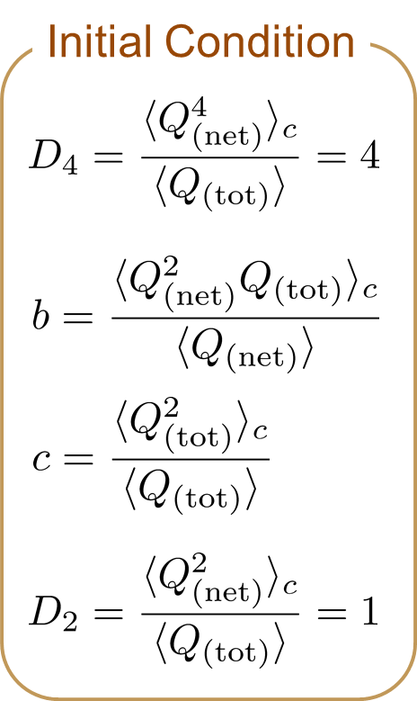

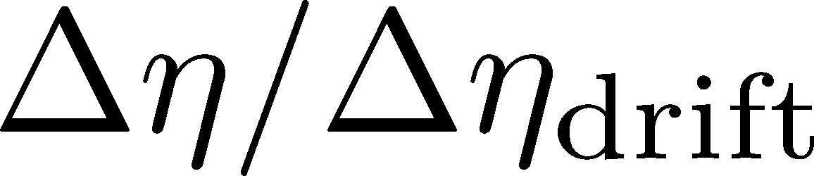
4th Order Cumulant
MK+ (2014)
MK (2015)
Before the diffusion

Slide 41

4th Order Cumulant
MK+ (2014)
MK (2015)
After the diffusion
(rough estimate)
Cumulant at small Δη is modified toward a Poisson value.
Non-monotonic behavior can appear.

Slide 42
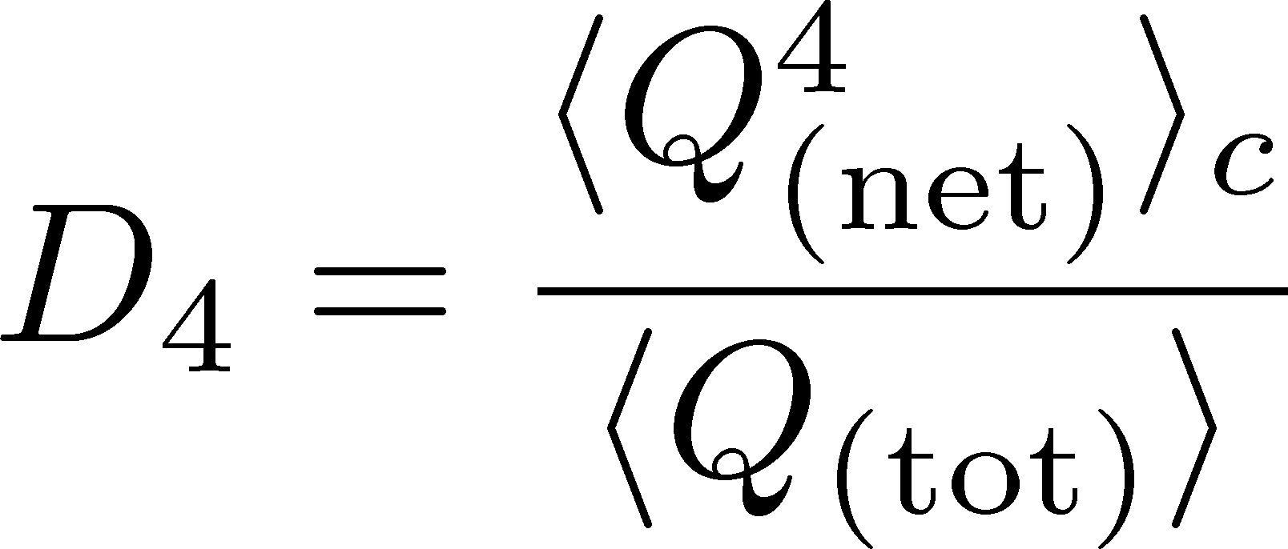




Rapidity Window Dep.
Initial Conditions
4th-order cumulant
MK+, 2014
MK, 2015
STAR Collab. (X. Luo, CPOD2014)
Is non-monotonic Δη dependence already observed?
Factorial cumulants will give us better understanding.
Ling, Stephanov, PRC (’16); MK, Luo, PRC(’17)
Finite volume effects: Sakaida+, PRC90 (2015)

Slide 43
Evolution of Cumulant near QCD-CP

Slide 44
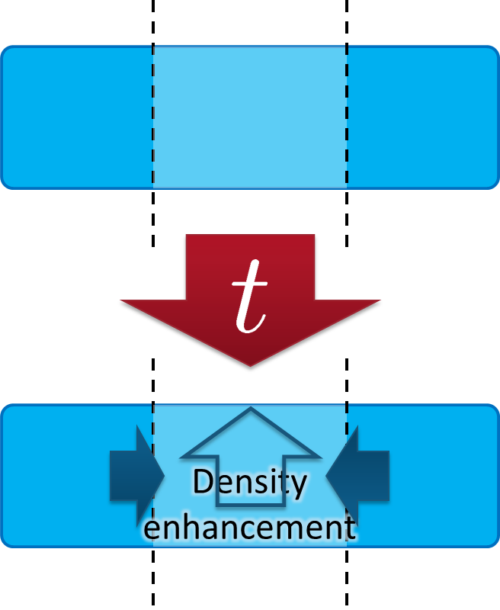
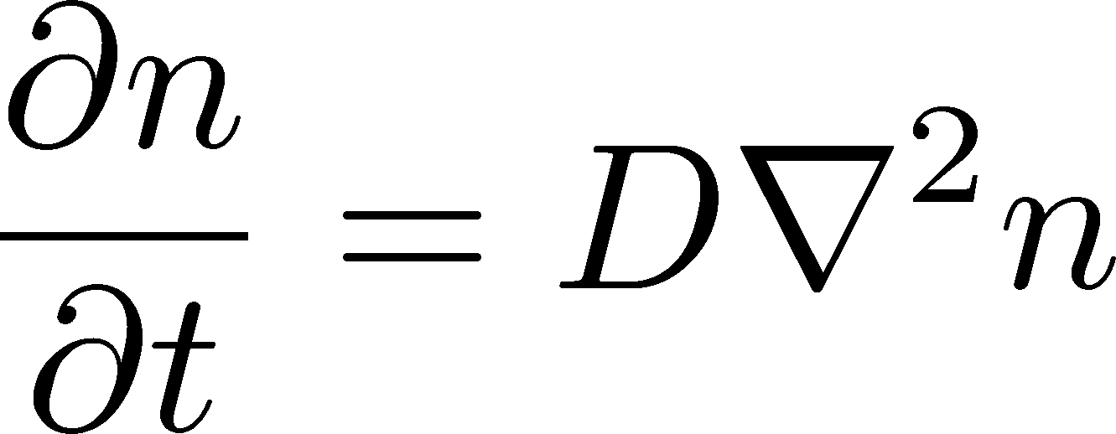
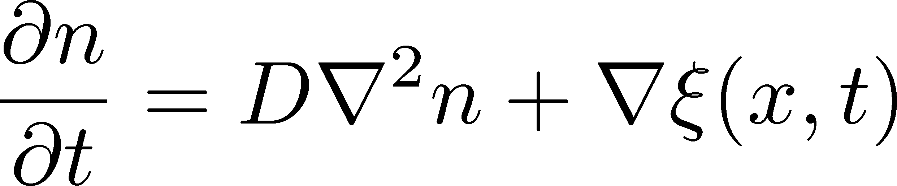
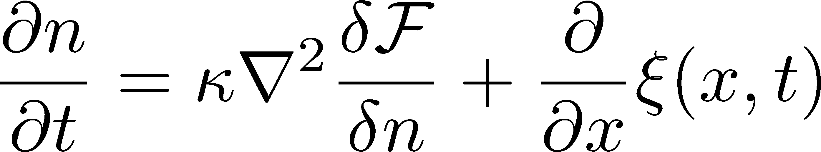
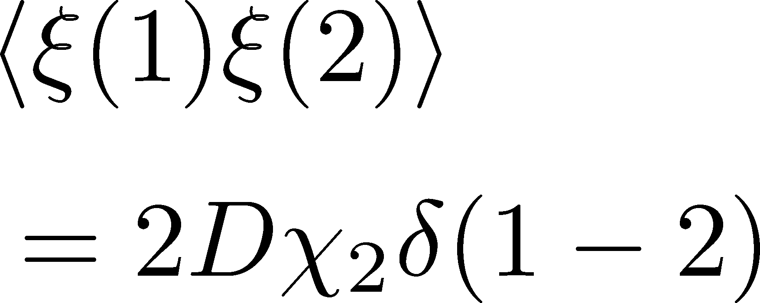
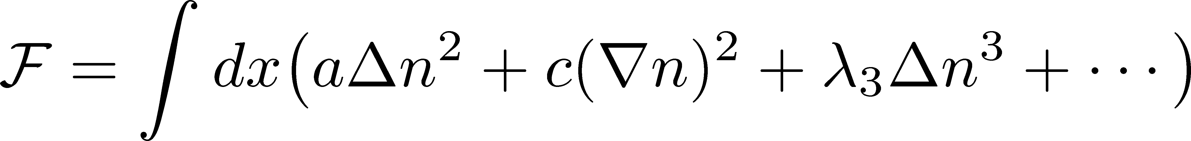
Evolution of Conserved-Charge
Fluctuations
Equations describing transport of n:
Diffusion Equation
Stochastic Diffusion Equation (SDE)
SDE with non-linear terms

Slide 45
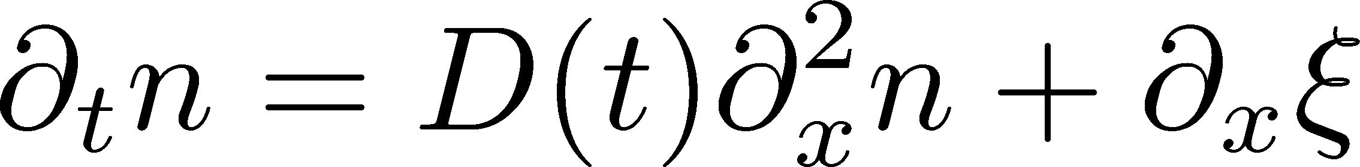
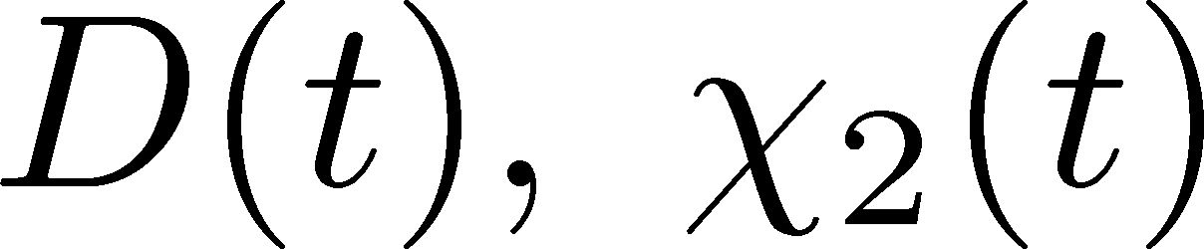
Analysis of 2nd-order Cumulant
Sakaida+ (2017)
Evolution of baryon number density
Stochastic Diffusion Equation
:parameters characterizing criticality
Analytic solution is obtained.
Study 2nd order cumulant & correlation function.

Slide 46
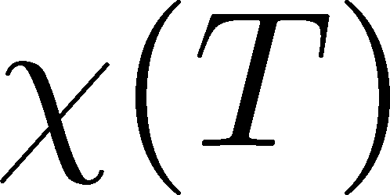
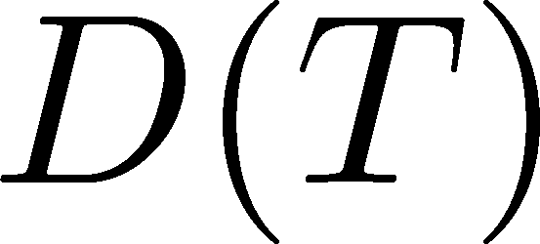
Parametrizing D(τ) and χ(τ)
Critical behavior
(critical point)
3D Ising (r,H)
model H
Berdnikov, Rajagopal (2000)
Stephanov (2011); Mukherjee+(2015)
Temperature dep.
critical
slowing
down
critical
enhancement

Slide 47
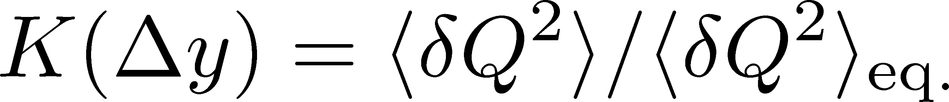
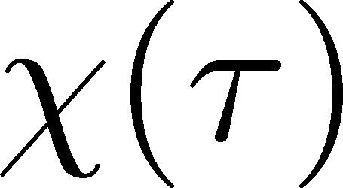
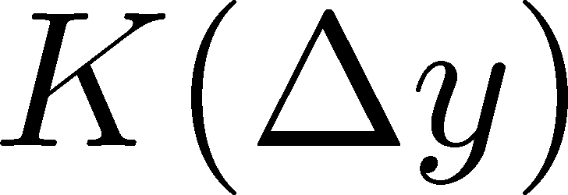
Crossover / Cumulant
monotonically decresing
Analytic
result
monotonically
increasing
monotonically
decreasing

Slide 48
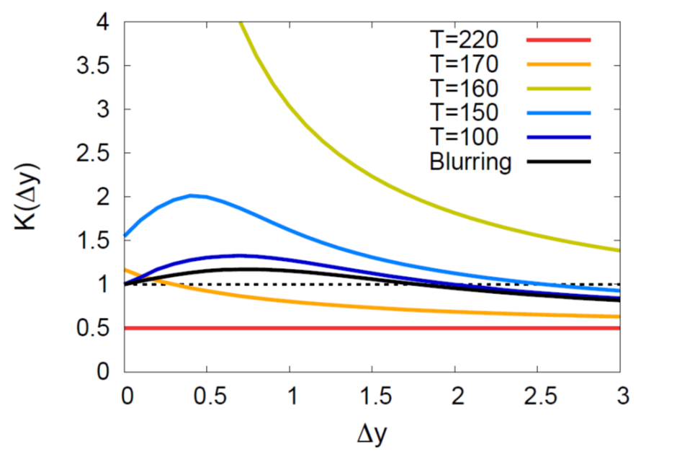
Critical Point / Cumulant
non-monotonic Δy dep.
Analytic
result
See also,
Wu, Song
Chin. Phys. C (’19)
non-monotonic
non-monotonic

Slide 49

Criticap Point / Correlation Func.
non-monotonic Δy dep.
Analytic
result
See also,
Wu, Song
Chin. Phys. C (’19)
non-monotonic
non-monotonic

Slide 50


Away from the CP
(critical point)
Signal of the critical enhancement can be clearer on a path away from the CP.
Away from the CP → Weaker critical slowing down

Slide 51
SDE with Non-Linear Terms
Non-linear terms are necessary to intoruduce non-Gaussian fluctuations in equilibrium.
No analytic solution
Careful numerical implementation is needed.
Nahrgang, Bluhm, Schaefr, Bass, PRD99 (’19)
Nahrgang, Bluhm, 2007.10371

Slide 52



SDE with Non-Linear Terms
Higher order cumulants
Pihan, Touroux, Nahrgang, Bluhm, Sami, MK, in prep.
Time evolution of 4th cumulant can be described.
1st order transition
Domain formation and peak structure in the correlation function are found.

Slide 53
Summary
Comprehensive understanding of various order cumulants are needed to understand .
2nd-order cumulants already contain important physics.
Fluctuations observed in HIC are not in equilibrium.
Plenty of information encoded in rapidity window dependences.
Future
  Wider rapidity coverage
  Evolution of fluctuations in realistic dynamical models

Slide 54



Resonance Decay
Neutral Particles
Decay into charged particles

Slide 55
Resonance Decay
Neutral Particles
Decay into charged particles
The larger Δη, the slower diffusion.

Slide 56






Slot Machine Analogy
= +
P (N)
N
P (N)
N

Slide 57
Extreme Examples
Fixed # of coins
Constant probabilities
N
N
N
N

Slide 58


Reconstructing Total Number
P (N )= P (N )B_{1/2}(N ;N )
:binomial distr. func.

Slide 59


Non-Binomial Correction
Response matrix
R(n;N)
Reconstruction for any R(n;N)
Nonaka, MK, Esumi (2018)
Example
multiplicity-dependent efficiency
True cumulants are
reproduced within
statistics!

Slide 60
want
quickly
then
not
achieve
欲 速 則 不 達
则
达
孔子
Confucius
Haste makes waste.

