Slide 1
Energy-Momentum Tensor on the Lattice
Extreme Nonequilibrium QCD, Online, 2020/Oct./8
Masakiyo Kitazawa
(Osaka U.)

Slide 2




Energy-Momentum Tensor
energy
momentum
pressure
stress
All components are important physical observables!

Slide 3




: nontrivial observable
on the lattice
Definition of the operator is nontrivial
because of the explicit breaking of translational invariance
ex:
Its measurement is extremely noisy
due to high dimensionality and etc.

Slide 4
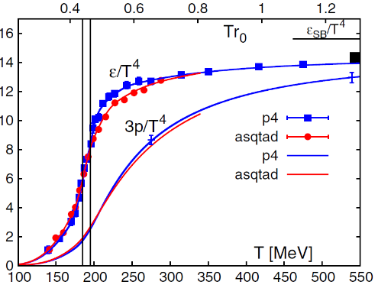
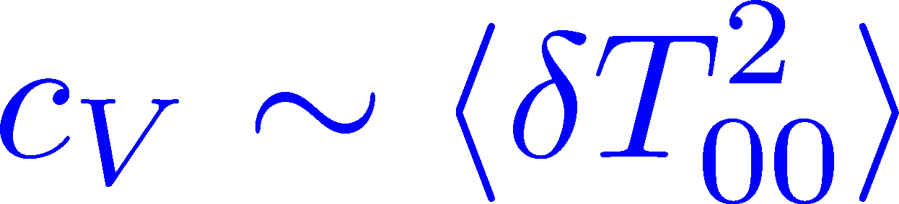
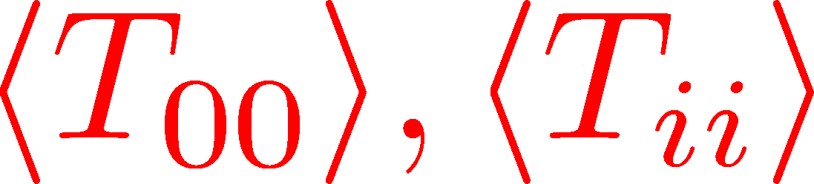
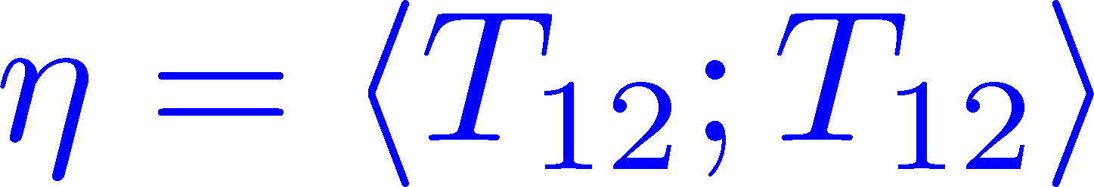

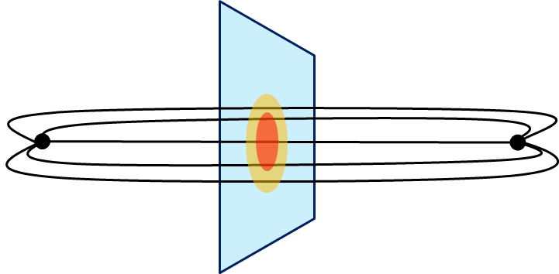
Thermodynamics
Fluctuations and
Correlations
direct measurement of
expectation values
viscosity, specific heat, ...
If we have
flux tube / hadrons
stress distribution
vacuum configuration
mixed state on 1st transition
Hadron Structure
Vacuum Structure

Slide 5

Contents
1. Constructing EMT through gradient flow
2. Thermodynamics
FlowQCD, PRD90,011501 (2014); PRD94, 114512 (2016)
WHOT-QCD, PRD96, 014509 (2017); PRD102, 014510 (2020)
Iritani+, PTEP 2019, 023B02 (2019)
3. Casimir Effect & Pressure Anisotropy
MK, Mogliacci, Horowitz, Kolbe, PRD99, 094507 (2019)
4. EMT Correlation Functions
FlowQCD, PRD96, 111502 (2017)
5. Flux Tube
FlowQCD, PLB789, 210 (2019); Yanagihara, MK, PTEP2019, 093B02 (2019)
6. Single-Quark System at T$≠$0
FlowQCD, in prep.

Slide 6




Yang-Mills Gradient Flow
Luscher 2010
Narayanan, Neuberger, 2006
Luscher, Weiss, 2011
t: “flow time”
dim:[length²]
leading
diffusion equation in 4-dim space
diffusion distance
“continuous” cooling/smearing
No UV divergence at t>0

Slide 7





Small Flow-Time Expansion
Luescher, Weisz, 2011
Suzuki, 2013
an operator at t>0
remormalized operators
of original theory
original 4-dim theory
t→0 limit

Slide 8


Constructing EMT 1
Suzuki, 2013
Gauge-invariant dimension 4 operators

Slide 9

Constructing EMT
Suzuki, 2013
vacuum subtr.
Remormalized EMT
“SFtX method” (Small Flow time eXpansion)

Slide 10





Perturbative Coefficients
Suzuki, PTEP 2013, 083B03
Harlander+, 1808.09837
Iritani, MK, Suzuki, Takaura, PTEP 2019
LO
1-loop
2-loop
3-loop
×
Iritani, MK, Suzuki,
Takaura, 2019
zero
Suzuki (2013)
Harlander+(2018)
Choice of the scale of g²
Previous:
Improved:
Harlander+ (2018)

Slide 11



SFtX Method
lattice regularized
gauge theory
Smeared world
by gradient flow
gradient flow
continuum theory
gradient flow
analytic relation
(perturbative)
Measure on
the lattice
Take Extrapolation (t,a)→(0,0)
O(t) terms in SFTE
lattice discretization

Slide 12



Gradient Flow for Fermions
Luscher, 2013
Makino, Suzuki, 2014
Taniguchi+ (WHOT)
2016~
Not “gradient” flow but a “diffusion”-type equation.
Divergence in field renormalization of fermions.
All observables are finite at t>0 once Z(t) is fixed.
Energy-momentum tensor from SFtX Makino, Suzuki, 2014

Slide 13


EMT in QCD
Makino, Suzuki (2014)
Harlander+ (2018)

Slide 14



EMT on the Lattice: Conventional
Lattice EMT Operator
Caracciolo+, 1990
Determination of Zs
Fit to thermodynamics: Z₃, Z₁
Shifted-boundary method: Z₆, Z₃
Full QCD with fermions
Giusti, Meyer, 2011; 2013;
Giusti, Pepe, 2014~; Borsanyi+, 2018
Brida, Giusti, Pepe, 2020

Slide 15
Contents
1. Constructing EMT through gradient flow
2. Thermodynamics
FlowQCD, PRD90,011501 (2014); PRD94, 114512 (2016)
WHOT-QCD, PRD96, 014509 (2017); PRD102, 014510 (2020)
Iritani+, PTEP 2019, 023B02 (2019)
3. Casimir Effect & Pressure Anisotropy
MK, Mogliacci, Horowitz, Kolbe, PRD99, 094507 (2019)
4. EMT Correlation Functions
FlowQCD, PRD96, 111502 (2017)
5. Flux Tube
FlowQCD, PLB789, 210 (2019); Yanagihara, MK, PTEP2019, 093B02 (2019)
6. Single-Quark System at T$≠$0
FlowQCD, in prep.

Slide 16


t Dependence
Iritani, MK, Suzuki, Takaura, PTEP 2019
Existence of “linear window” at intermediate t

Slide 17




Double Extrapolation t→0, a→0
O(t) terms in SFTE
lattice discretization
Continuum extrapolation
strong
discretization
effect
Small t extrapolation

Slide 18
Thermodynamics: ε+p & ε-3p
Range2
Range2
Range1
Range3
Range1
Range3
Iritani, MK, Suzuki, Takaura, PTEP 2019
Existence of “linear window” at intermediate t
Stable t→0 extrapolation
Systematic errors: fit range, uncertaintyof Λ (±3%), …

Slide 19
T Dependence: Comparison
Iritani, MK, Suzuki, Takaura, 2019
□: 3-loop
△: Flow2016
□: 2-loop
△: Flow2016
Systematic error: μ₀ or μ_{d}, Λ, t→0 function, fit range
Good agreement with other methods!
Smaller statistics thanks to smearing by the flow

Slide 20
2+1 QCD EoS from Gradient Flow
WHOT-QCD, PRD96 (2017); PRD102 (2020)
Agreement with integral method
Substantial suppression of statistical errors
m_{PS}/m_{V} ≈0.63
Physical mass: Kanaya+ (WHOT-QCD), 1910.13036

Slide 21
Contents
1. Constructing EMT through gradient flow
2. Thermodynamics
FlowQCD, PRD90,011501 (2014); PRD94, 114512 (2016)
WHOT-QCD, PRD96, 014509 (2017); PRD102, 014510 (2020)
Iritani+, PTEP 2019, 023B02 (2019)
3. Casimir Effect & Pressure Anisotropy
MK, Mogliacci, Horowitz, Kolbe, PRD99, 094507 (2019)
4. EMT Correlation Functions
FlowQCD, PRD96, 111502 (2017)
5. Flux Tube
FlowQCD, PLB789, 210 (2019); Yanagihara, MK, PTEP2019, 093B02 (2019)
6. Single-Quark System at T$≠$0
FlowQCD, in prep.

Slide 22
Casimir Effect

Slide 23
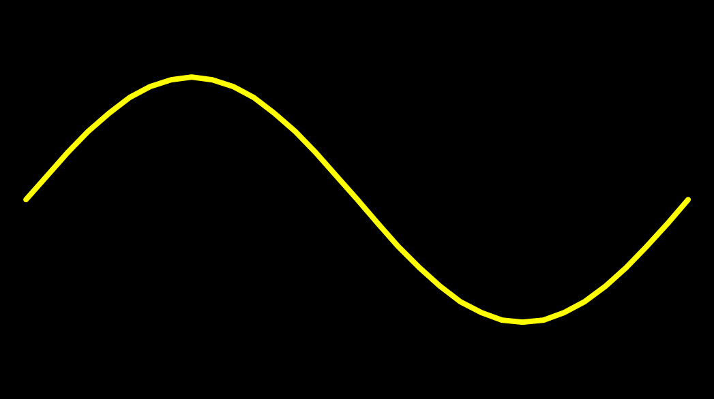
Casimir Effect
attractive force between two conductive plates

Slide 24





Casimir Effect
Brown, Maclay
1969

Slide 25



Casimir Effect
Brown, Maclay
1969

Slide 26

Casimir Effect
Brown, Maclay
1969
T

Slide 27

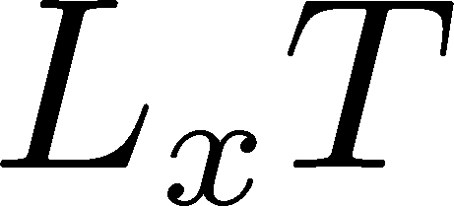

Pressure Anisotropy @ T≠0
MK, Mogliacci, Kolbe,
Horowitz, PRD(2019)
Free scalar field
L₂=L₃=∞
Periodic BC
Mogliacci+, 1807.07871

Slide 28
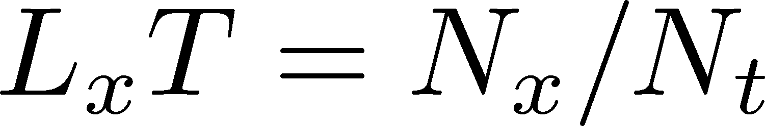
Pressure Anisotropy @ T≠0
MK, Mogliacci, Kolbe,
Horowitz, PRD (2019)
Free scalar field
L₂=L₃=∞
Periodic BC
Mogliacci+, 1807.07871
Lattice result
Periodic BC
Only t→0 limit
Error: stat.+sys.
Medium near T_{c} is remarkably insensitive to finite size!

Slide 29
Pressure Anisotropy @ T≠0
MK, Mogliacci, Kolbe,
Horowitz, PRD (2019)
Free scalar field
L₂=L₃=∞
Periodic BC
Mogliacci+, 1807.07871
Lattice result
Periodic BC
Only t→0 limit
Error: stat.+sys.
Medium near T_{c} is remarkably insensitive to finite size!

Slide 30
Energy densty / transverse P
Energy Density
Transverse Pressure P_{z}

Slide 31


Higher T
High-T limit: massless free gluons
How does the anisotropy approach this limit?
Difficulties
Vacuum subtraction requires large-volume simulations.
Lattice spacing not available → c₁(t), c₂(t) are not determined.
We study
No vacuum subtr. nor Suzuki coeffs. necessary!

Slide 32
T
massless free
T/T_{c}≅8.1 (β=8.0) / T/T_{c}≅25 (β=9.0)
Ratio slowly approaches the asymptotic value.
But, large deviation exists even at T/T_{c}~25.

Slide 33




Thermodynamics on the Lattice
Various Methods
Integral, differential, moving frame, non-equilibrium, …
rely on thermodynamic relations valid in V→∞
Not applicable to
anisotropic systems
We employ SFtX Method
Components of EMT are directly accessible!

Slide 34
Contents
1. Constructing EMT through gradient flow
2. Thermodynamics
FlowQCD, PRD90,011501 (2014); PRD94, 114512 (2016)
WHOT-QCD, PRD96, 014509 (2017); PRD102, 014510 (2020)
Iritani+, PTEP 2019, 023B02 (2019)
3. Casimir Effect & Pressure Anisotropy
MK, Mogliacci, Horowitz, Kolbe, PRD99, 094507 (2019)
4. EMT Correlation Functions
FlowQCD, PRD96, 111502 (2017)
5. Flux Tube
FlowQCD, PLB789, 210 (2019); Yanagihara, MK, PTEP2019, 093B02 (2019)
6. Single-Quark System at T$≠$0
FlowQCD, in prep.

Slide 35




EMT Correlator: Motivation
Viscosity
Karsch, Wyld, 1987
Nakamura, Sakai, 2005
Meyer, 2007; 2008
…
Borsanyi+, 2018
Astrakhantsev+, 2018
Kubo formula → viscosity
Energy/Momentum Conservation
: τ-independent constant
Fluctuation-Response Relations

Slide 36





EMT Euclidean Correlator
FlowQCD (2017)
See also: Eller, Moore (2018)
Suppression of errors at large τ
τ-independent plateau ⬅ energy conservation
small τ region: not reliable due to smearing

Slide 37


EMT Euclidean Correlator
FlowQCD, PR D96, 111502 (2017)
τ-independent plateau in all channels ➔ conservation law
Confirmation of fluctuation-response relations
New method to measure c_{V}
Similar result for (41;41) channel: Borsanyi+, 2018
Perturbative analysis: Eller, Moore, 2018

Slide 38


Fluctuation-Response Relations
Correlators at mid-point
Confirmation of FRR
2+1 QCD: WHOT-QCD, 1711.02262

Slide 39

Fluctuation-Response Relations
fluctuation of energy
~ specific heat
New measurement of c_{V}
[11] Borsanyi+ (2012)
[19] Gavai+ (2005)

Slide 40
Contents
1. Constructing EMT through gradient flow
2. Thermodynamics
FlowQCD, PRD90,011501 (2014); PRD94, 114512 (2016)
WHOT-QCD, PRD96, 014509 (2017); PRD102, 014510 (2020)
Iritani+, PTEP 2019, 023B02 (2019)
3. Casimir Effect & Pressure Anisotropy
MK, Mogliacci, Horowitz, Kolbe, PRD99, 094507 (2019)
4. EMT Correlation Functions
FlowQCD, PRD96, 111502 (2017)
5. Flux Tube
FlowQCD, PLB789, 210 (2019); Yanagihara, MK, PTEP2019, 093B02 (2019)
6. Single-Quark System at T$≠$0
FlowQCD, in prep.

Slide 41


Stress = Force per Unit Area
Pressure
S

Slide 42
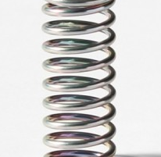



Stress = Force per Unit Area
Pressure
Generally, F and n are not parallel
v
fluid
S
F
S
elastic body
S
In thermal medium
Stress Tensor
Landau
Lifshitz

Slide 43


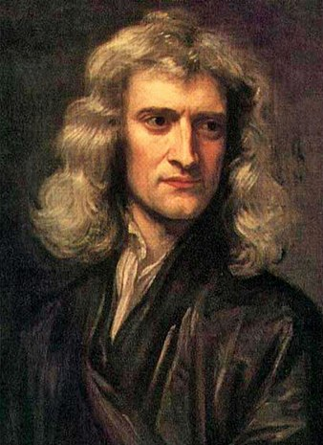


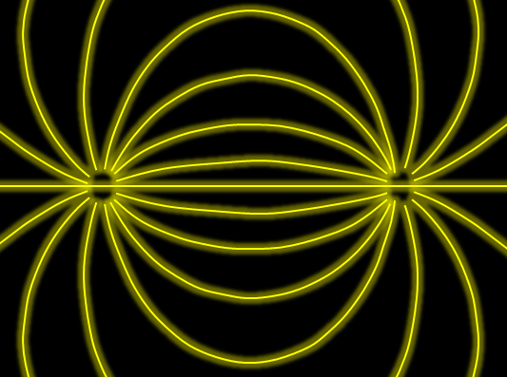

Force
Action-at-a-distance
Newton
1687
Local interaction
Faraday
1839

Slide 44




Maxwell Stress
(in Maxwell Theory)
Maxwell
E
pulling
Parallel to field: Pulling
Vertical to field: Pushing
pushing

Slide 45



Maxwell Stress
(in Maxwell Theory)
length:
pulling
pushing
Definite physical meaning
Distortion of field, line of the field
Propagation of the force as local interaction

Slide 46
Quark-Anti-quark System
Formation of the flux tube → confinement
Previous Studies on Flux Tube
Potential
Action density
Color-electric field
so many studies…
Cea+ (2012)
Cardoso+ (2013)

Slide 47
Stress Tensor in QQ System
ー
FlowQCD, PLB (2019)
Lattice simulation
SU(3) Yang-Mills
a=0.029 fm
R=0.69 fm
t/a²=2.0
pulling
pushing
Definite physical meaning
Distortion of field, line of the field
Propagation of the force as local interaction
Manifestly gauge invariant

Slide 48
SU(3) YM vs Maxwell
SU(3) Yang-Mills
(quantum)
Maxwell
(classical)
Propagation of the force is clearly different
in YM and Maxwell theories!

Slide 49


Lattice Setup
FlowQCD, PLB (2019)
SU(3) Yang-Mills (Quenched)
Wilson gauge action
Clover operator
EMT around Wilson Loop
APE smearing / multi-hit
fine lattices (a=0.029-0.06 fm)
continuum extrapolation
Simulation: bluegene/Q@KEK
R=0.92 fm
R=0.69 fm
R=0.46 fm

Slide 50
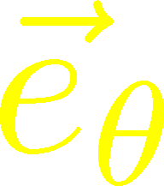
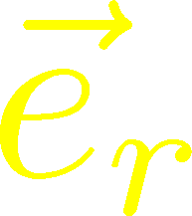
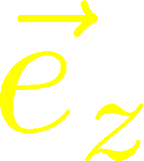






Stress Distribution on Mid-Plane
From rotational symm. & parity
EMT is diagonalized
in Cylindrical Coordinates
Degeneracy
in Maxwell theory

Slide 51


Mid-Plane
Separation
Continuum
Extrapolated!
In Maxwell theory
Degeneracy:
Separation:
Nonzero trace anomaly

Slide 52
Mid-Plane
Separation
Continuum
Extrapolated!
Degeneracy:
Separation:
Nonzero trace anomaly

Slide 53


Momentum Conservation
Yanagihara, MK, PTEP2019
In cylindrical coordinats,
For infinitely-long flux tube
Lattice
T_{rr} and T_{θθ}
degenerate!
T_{rr} and T_{θθ} must separate!
Effect of boundaries is important
for the flux tube at R=0.92fm

Slide 54


Force
Force from Potential
Force from Stress

Slide 55
Force
Force from Potential
Force from Stress
Newton
1687
Faraday
1839

Slide 56
Force
Force from Potential
Force from Stress
Good Agreement!
Newton
1687
Faraday
1839

Slide 57
Dual Superconductor Picture
Nambu, 1970
Nielsen, Olesen, 1973
t ‘Hooft, 1981
…
QCD Vacuum
Superconductor
Anti-
Monopole
Quark
Anti-quark
Monopole
Flux Tube
Magnetic Vortex
Dual (E⇔B)

Slide 58






Abelian-Higgs Model
Yanagihara, MK, 2019
Abelian-Higgs Model
GL parameter:
Infinitely long tube
type-I :
type-II :
Bogomol’nyi bound :
degeneracy
Luscher, 1981
momentum conservation

Slide 59

Stress Tensor in AH Model infinitely-long flux tube
Bogomol’nyi bound :
de Vega, Schaposnik, PRD14, 1100 (1976).

Slide 60




Stress Tensor in AH Model infinitely-long flux tube
Type-I
Type-II
No degeneracy bw T_{rr} & T_{θθ}
T_{θθ} changes sign
conservation law

Slide 61

Stress Tensor in AH Model infinitely-long flux tube
Type-I
Lattice
Inconsistent with
lattice result
No degeneracy bw T_{rr} & T_{θθ}
T_{θθ} changes sign

Slide 62
Flux Tube with Finite Length
Yanagihara, MK (2019)
AH model can reproduce lattice results qualitatively by tuning parameters.
But, quantitatively all parameters are rejected.

Slide 63
Contents
1. Constructing EMT through gradient flow
2. Thermodynamics
FlowQCD, PRD90,011501 (2014); PRD94, 114512 (2016)
WHOT-QCD, PRD96, 014509 (2017); PRD102, 014510 (2020)
Iritani+, PTEP 2019, 023B02 (2019)
3. Casimir Effect & Pressure Anisotropy
MK, Mogliacci, Horowitz, Kolbe, PRD99, 094507 (2019)
4. EMT Correlation Functions
FlowQCD, PRD96, 111502 (2017)
5. Flux Tube
FlowQCD, PLB789, 210 (2019); Yanagihara, MK, PTEP2019, 093B02 (2019)
6. Single-Quark System at T$≠$0
FlowQCD, in prep.

Slide 64
Stress Tensor around A Quark in a deconfined phase
Q

Slide 65
Pressure inside Hadrons
EMT distribution inside hadrons now accessible??
Pressure @ proton
EMT distribution @ pion
Nature, 557, 396 (2018)
Shanahan, Detmold (2019)
Kumano, Song, Teryaev (2018)

Slide 66

Lattice Setup
SU(3) Yang-Mills (Quenched)
Wilson gauge action
Clover operator
Analysis above Tc
Simulation on a Z₃ minimum
EMT around a Polyakov loop
continuum extrapolation
Ω: Polyakov loop

Slide 67


Spherical Coordinates
EMT is diagonalized
in Spherical Coordinates
Maxwell theory

Slide 68
Stress Tensor Around a Quark
T=1.44T_{c}
Suppression at large distance
Separation of different channels
pulling
pushing

Slide 69



r Dependence
Leading order perturbation
Higher order terms:
M. Berwein, in progress
T dependence is suppressed at $r<1/T$
Too noisy at large $r$ for extracting screening mass $m_{D}$

Slide 70




Channel Dependence
Separation b/w channels becomes clearer for smaller T

Slide 71




Running Coupling
Estimate of $α_{s}$
by the formula at the leading-order perturbation theory
channel dependent
Consistent with the estimate from $Q\overline{Q}$ potential
Kaczmarek, Karsch, Zantow, PRD70 (2004)

Slide 72
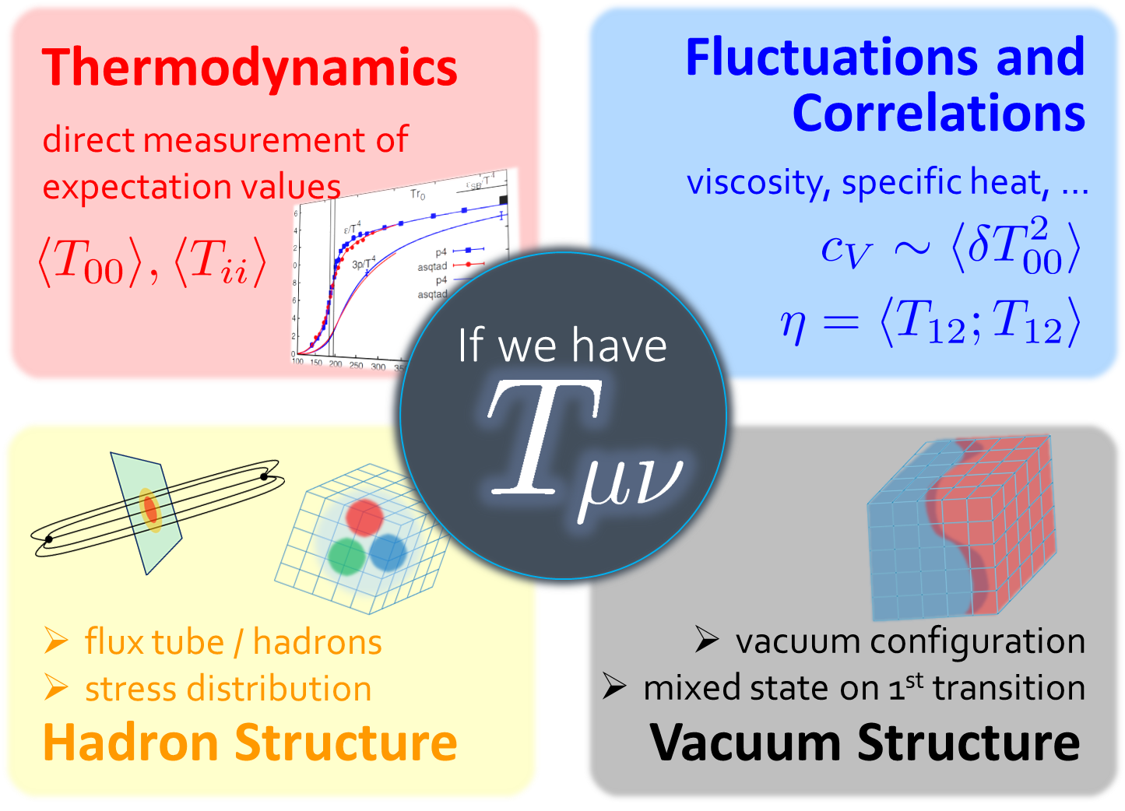
Summary
Successful analysis of energy-momentum tensor on the lattice is now available, and various stuides are ongoing!
  SFtX (gradient flow) method
  significant error suppression
Pressure
Anisotropy
Correlation
Functions
Stress
So many future studies
  Flux tube at nonzero temperature
  EMT distribution inside hadrons
  viscosity / other operators / topology / QCD

Slide 73
backup

Slide 74
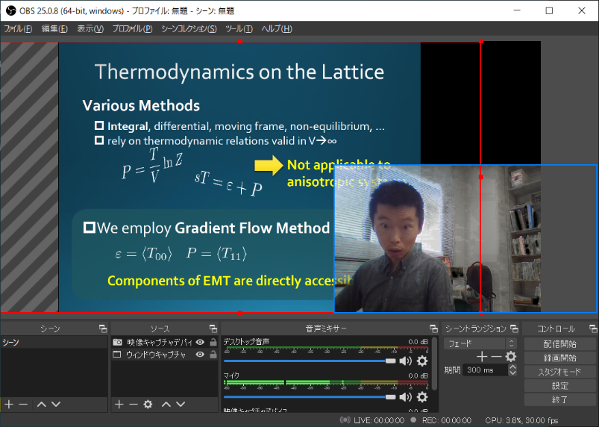
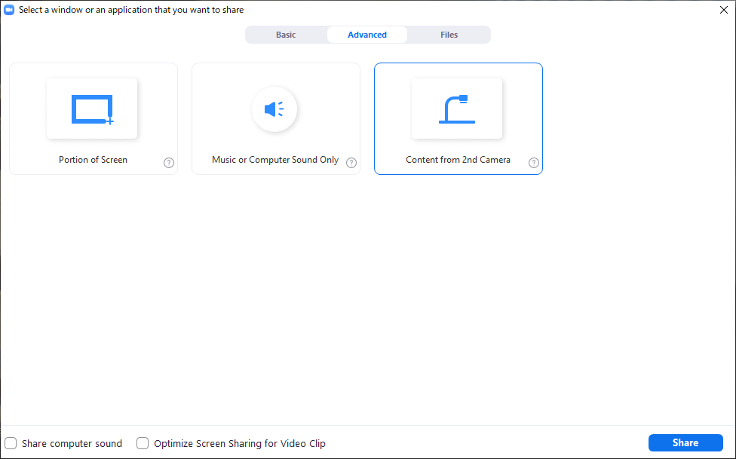
Tips for Presentation
Install
  OBS Studio https://obsproject.com/
  OBS VirtualCam https://github.com/CatxFish/obs-virtual-cam/
Setup
  tools – VirtualCam – Start
  Chroma key composition: Need a green sheet behind you!
Zoom: Share Screen – Advanced – Content from 2nd camera
Select Here!

Slide 75







Two Special Cases with PBC
In conformal (Σ_{μ}T_{μμ}=0)

Slide 76








Fermion Propagator
propagator of flow equation
Inverse propagator is needed
fermion field
t=0
gauge field

Slide 77
N_{f}=2+1 QCD Thermodynamics
Taniguchi+ (WHOT-QCD),
PRD96, 014509 (2017)
N_{f}=2+1 QCD, Iwasaki gauge + NP-clover
m_{PS}/m_{V} ≈0.63 / almost physical s quark mass
T=0: CP-PACS+JLQCD (ß=2.05, 28³x56, a≈0.07fm)
T>0: 32³xN_{t}, N_{t} = 4, 6, ... , 14, 16):
T≈174-697MeV
t→0 extrapolation only (No continuum limit)

Slide 78
Numerical Setup
SU(3) YM theory
Wilson gauge action
N_{t} = 16, 12
N_{z}/N_{t}=6
2000~4000 confs.
Even N_{x}
No Continuum extrap.
Same Spatial volume
12x72²x12 ~ 16x96²x16
18x72²x12 ~ 24x96²x16
Simulations on
OCTOPUS/Reedbush

Slide 79
Extrapolations t→0, a→0
O(t) terms in SFTE
lattice discretization
FlowQCD2016
This Study
①Continuum
②Small t extrapol.
strong
discretization
effect
strong
discretization
effect

Slide 80

Small-t Extrapolation
Filled: N_{t}=16 / Open: N_{t}=12
Small-t extrapolation
Solid: N_{t}=16, Range-1
Dotted: N_{t}=16, Range-2,3
Dashed: N_{t}=12, Range-1
Stable small-t extrapolation
No N_{t} dependence within statistics for L_{x}T=1, 1.5

Slide 81
Small-t Extrapolation
Filled: N_{t}=16 / Open: N_{t}=12
Small-t extrapolation
Solid: N_{t}=16, Range-1
Dotted: N_{t}=16, Range-2,3
Dashed: N_{t}=12, Range-1
Stable small-t extrapolation
No N_{t} dependence within statistics for L_{x}T=1, 1.5

Slide 82
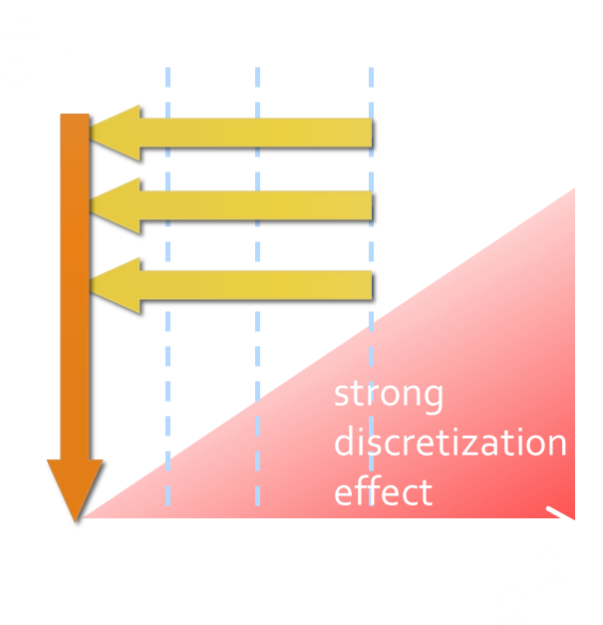
Continuum Extrapolation at mid-point
mid point
continuum
limit
a→0 extrapolation with fixed t

Slide 83
t→0 Extrapolation at mid-point
Range2
continuum
limit
Range1
Range3
a→0 extrapolation with fixed t
Then, t→0 with three ranges

