Slide 1
Search for Phase Structure of QCD in Relativistic
Heavy-Ion Collisions
Masakiyo Kitazawa
北澤 正清
(Osaka U.)
Exchange program between SJTU and OU
Mini Workshop: Prospect on particle and nuclear physics, and related subjects

Slide 2


Introducing Myself…
Research Interest
  QCD in medium
  Relativistic heavy-ion collisions
    Non-Gaussian fluctuations
  Lattice numerical simulations
    Gradient flow, energy-momentum tensor
  Machine learning / Hadron structure
  Marathon
Past Affiliations
  Tsukuba, Kyoto (Japan)
  Frankfurt U. (Germany)
  Brookhaven National Lab. (USA)
Today’s topics

Slide 3
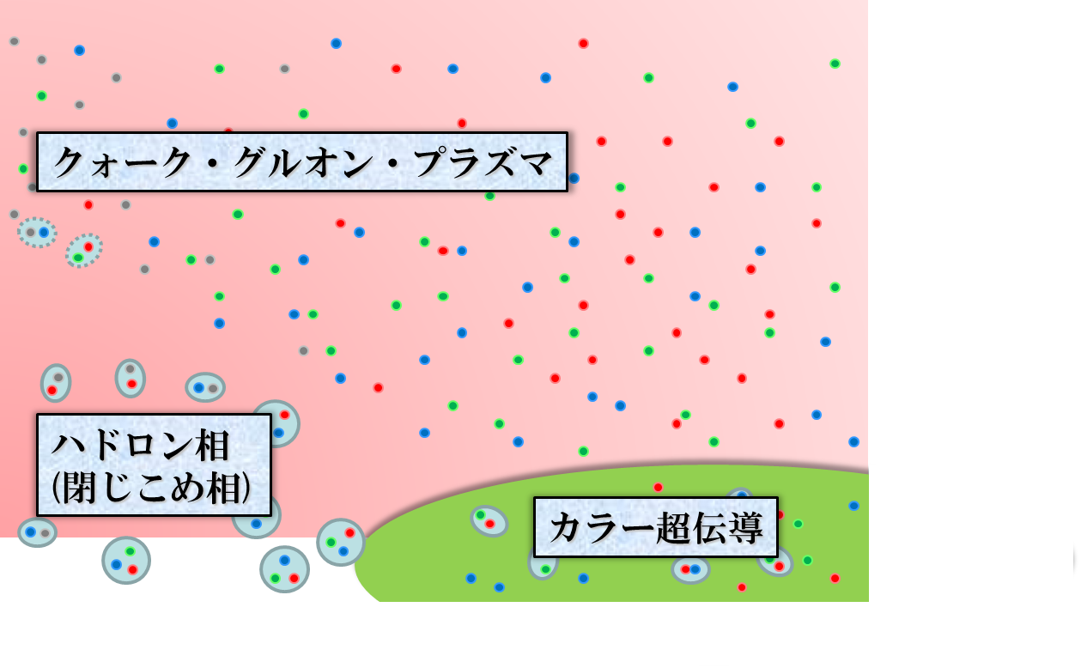




QCD Phase Diagram
Temperature
Quark-Gluon Plasma (QGP)
ＱＣＤ Critical Point
Hadronic
Phase
Color SC
Baryon chemical
potential

Slide 4
QCD Phase Diagram
Temperature
Quark-Gluon Plasma (QGP)
Lattice QCD
ＱＣＤ Critical Point
Hadronic
Phase
Color SC
Baryon chemical
potential

Slide 5


QCD Phase Diagram
Early Universe
Temperature
Quark-Gluon Plasma (QGP)
ＱＣＤ Critical Point
Hadronic
Phase
Color SC
Baryon chemical
potential
Compact
Stars

Slide 6
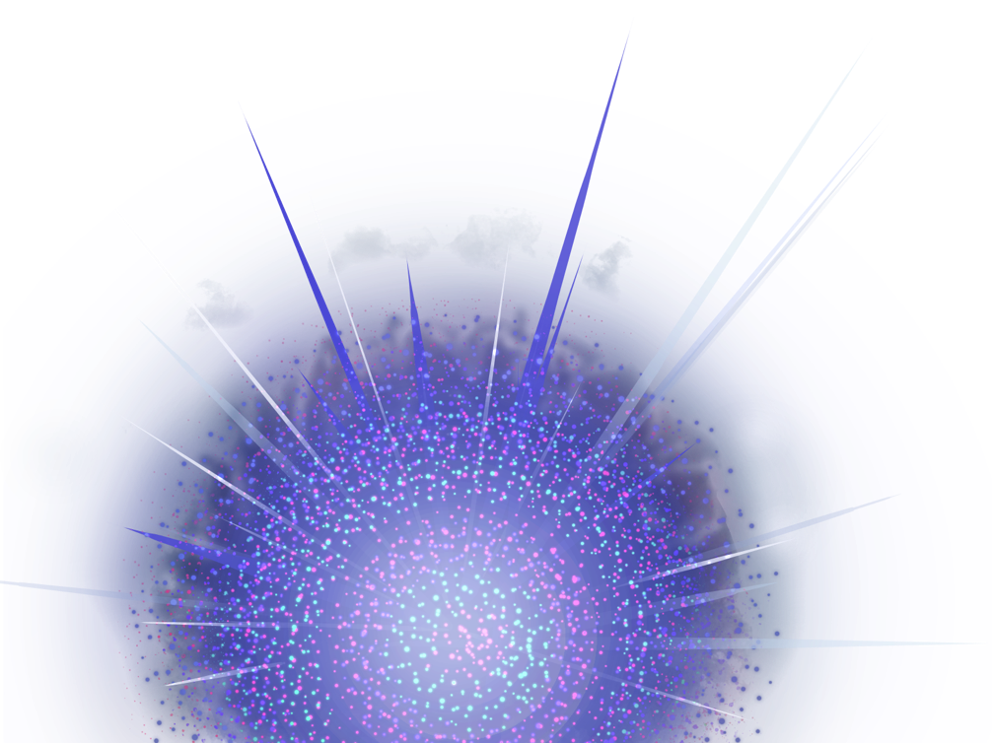
Relativistic Heavy-Ion Collisions
Collide 2 heavy nuclei
Physics
Hot & dense medium
Early Universe
Quark-gluon plasma
QCD phase structre
RHIC (2000~)
QGP Formation
Strongly coupled QGP
LHC (2010~)
Precision measurement
of the QGP
Picture of fireball by Soushi Nonaka

Slide 7




Brief History of Relativistic HIC
AGS
-1996
SPS
1994-2000
RHIC
2000-
LHC
2010-
~2010
High Energy Frontier
Picture of fireball by Soushi Nonaka

Slide 8
Brief History of Relativistic HIC
AGS
-1996
SPS
1994-2000
RHIC
2000-
LHC
2010-
RHIC-BES
2010-
~2010
High Energy Frontier
NICA
FXT: 2019-
2010~
Lower Energy
FAIR
2025-
Picture of fireball by Soushi Nonaka
J-PARC-HI
2025-?
Interaction rate
FAIR, J-PARC-HI: ~10⁷ Hz
AGS, SPS: ~10² Hz

Slide 9
Beam-Energy Dependence

Slide 10
Beam-Energy Dependence
High energy
Low energy
Nuclear transparency
Baryon stopping
net-baryon #: small
net-baryon #: large

Slide 11


Beam-Energy Scan
LHC
temperature
RHIC
beam energy scan
future facilities
ex. J-PARC @ Tokai
Picture of fireball by Soushi Nonaka
baryon chemical potential

Slide 12
Beam-Energy Scan
RHIC-BES
Phase I
2010~2015
Phase II
2019~2021
GSI-FAIR
2025~?
J-PARC-HI
2025~??
LHC
temperature
RHIC
beam energy scan
future facilities
ex. J-PARC @ Tokai
Picture of fireball by Soushi Nonaka
baryon chemical potential

Slide 13



Maximum Density
Time evolution in T-ρ plane by JAM
A. Ohnishi, 2002
Maximum density 5~10ρ₀ @ E/A~20GeV
Large event-by-event fluctuations?

Slide 14
HI Acceleration @ J-PARC
J-PARC Heavy Ion
Spectrometer
New HI Injector
high intensity
RCS & Main Ring
stable
well established
Use of reliable / high-performance RCS & main ring
→Reduce cost and time

Slide 15
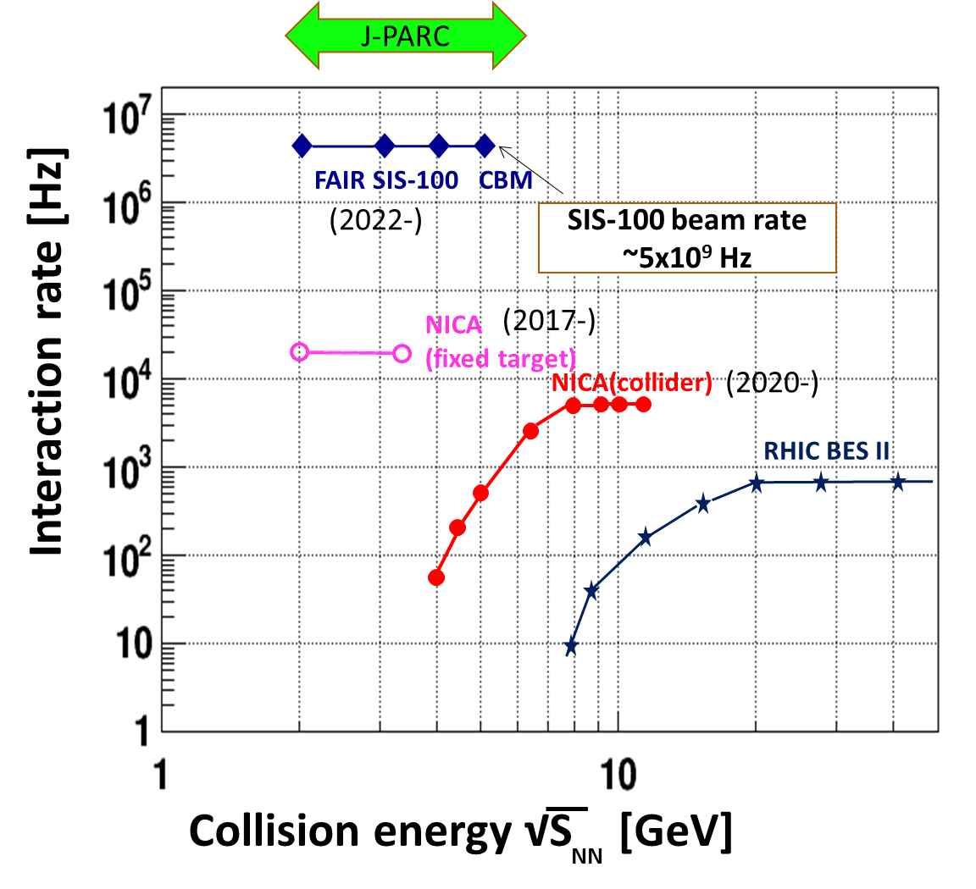
Collision Rate
J-PARC-HI
J-PARC-HI:
High-luminosity X Fixed target
→World highest rate～10⁸Hz
5-order higher than AGS,SPS
SPS
AGS
AGS, SPS
1 year
J-PARC-HI
5 min.
＝
High-statistical exp.
various event selections
higher order correlations
search of rare events

Slide 16
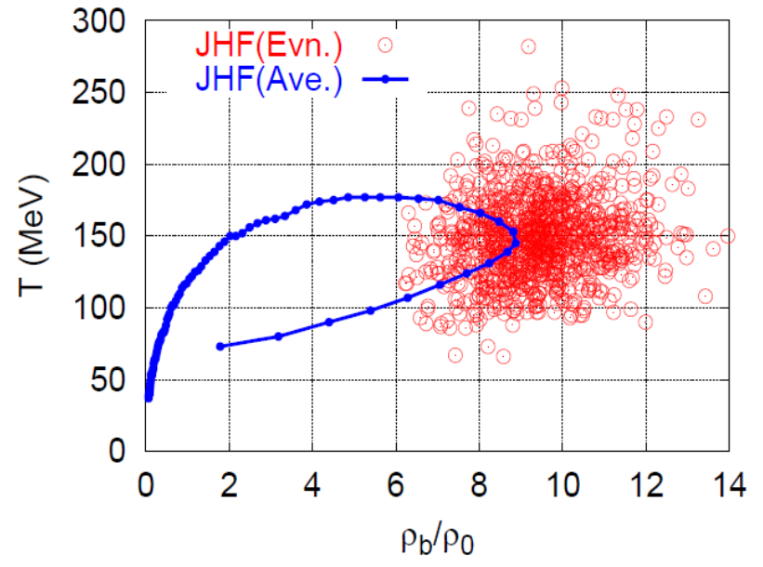
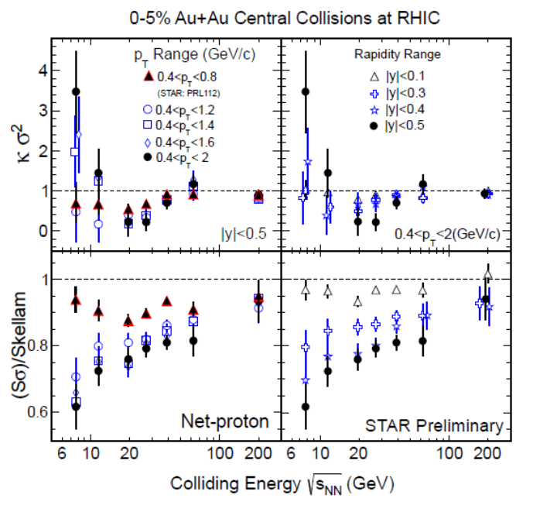
Various Observables
Flow
Dilepton / photon
Fluctuations, higher-order cumulants
Ξ, Ω, …
Sophisticated event selections
Various correlations

Slide 17



Event-by-Event Fluctuations
Review: Asakawa, MK, PPNP 90 (2016)
STAR, PRL105 (2010)
Detector
Cumulants

Slide 18


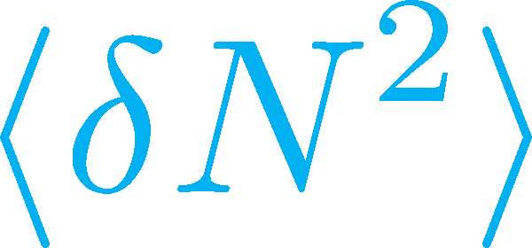

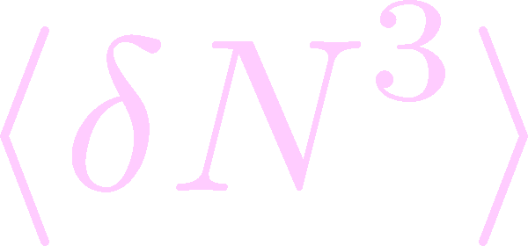

Non-Gaussian Cumulants
Gaussian fluctuations
diverge at the QCD-CP
Higher order cumulants change sign at the phase boundary
Asakawa, Ejiri, MK, 2009
Steeper divergence for higher-order cumulants
Stephanov, 2009

Slide 19


Experimental Results
Enhancement
STAR Collab.
2010~
Suppression
Enhancement & Suppression of non-Gaussian cumulants!
Have we observed
QCD critical point?

Slide 20





Rapidity Window Dependence
STAR Collab. 2015
Non-Gaussian Cumulants have been observed as a function of rapidity window Δy.
Some results have non-monotonic Δy dependence.

Slide 21
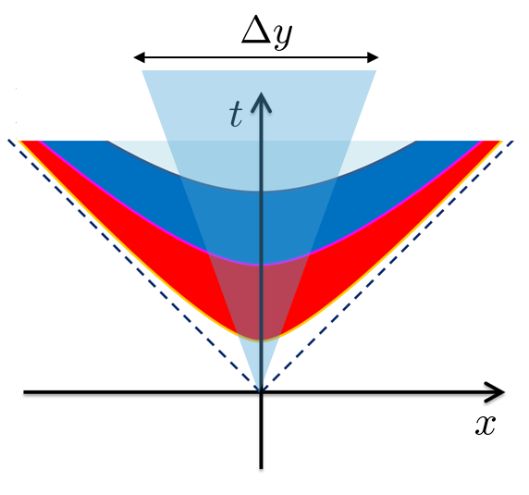


Diffusion of Fluctuations
MK, Ohno, Asakawa 2014
MK 2015
Distributions in Δy in the final state and early stage are different due to diffusion.

Slide 22







Rapidity Window dependence as a Result of Diffusion
MK+ (2014); MK (2015)
Parameters
(rough estimate)
Higher order cumulants can behave non-monotonically.
Δη dependence encodes history of time evolution.

Slide 23
Rapidity Window dependence as a Result of Diffusion
MK+ (2014); MK (2015)
Parameters
STAR 2015
(rough estimate)
Higher order cumulants can behave non-monotonically.
Δη dependence encodes history of time evolution.

Slide 24
Summary
Exploring dense medium in relativistic heavy-ion collisions is one of the hottest topics in this field. Many new experiments will start in the near future!
Fluctuations are promising observables for the search for the phase structure of QCD. Non-Gaussian fluctuations attract much attention, and active experimental and theoretical studies are ongoing.

