Slide 1
Single-static-quark system above T_{c} investigated by
Energy-momentum tensor in SU(3) Yang-Mills theory
38th International Symposium on Lattice Field Theory, Jul. 27, 2021
Masakiyo Kitazawa
(Osaka U.)
with R. Yanagihara, M. Asakawa, T. Hatsuda
FlowQCD Collaboration
Phys. Rev. D102, 114522 (2020)

Slide 2
Static Charge
Fundamental tool to study field theories

Slide 3


Static Charge
Fundamental tool to study field theories
This study
QQ
Single Q
Flux tube formation
Heavy-light meson @ T<T_{c}
Debye screening @ T>T_{c}

Slide 4
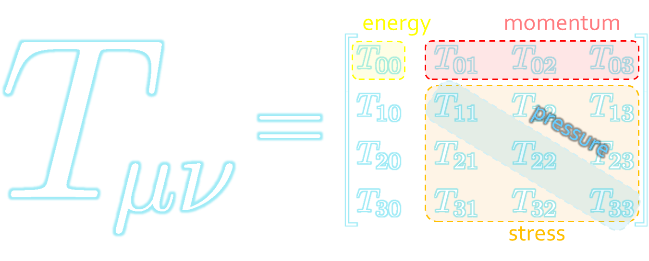
Energy-Momentum Tensor
The most fundamental quantity in physics.
All components are important quantities.
EMT in Static Q systems
Combine 2 fundamental tools!

Slide 5




Maxwell Stress
(in Maxwell Theory)
Maxwell
E
pulling
Parallel to field: Pulling
Vertical to field: Pushing
pushing

Slide 6



Maxwell Stress
(in Maxwell Theory)
length:
pulling
pushing
Definite physical meaning
Distortion of field, line of the field
Propagation of the force as local interaction

Slide 7
Stress Tensor in QQ System
ー
FlowQCD, PLB (2019)
Lattice simulation
SU(3) Yang-Mills
a=0.029 fm
R=0.69 fm
t/a²=2.0
pulling
pushing
Definite physical meaning
Distortion of field, line of field
Propagation of the force as local interaction
Manifestly gauge invariant

Slide 8
EMT in Abelian-Higgs Model
Yanagihara, MK (2019)
Lattice
AH model
EMT has 4 components / conservation law
Insight into detailed property of the system

Slide 9
EMT Distribution Inside Hadrons
Proton
Pion
Nature 557, 396 (2018)
Kumano+, PRD97, 014020 (2018)
Lattice:
Shanahan, Detmold PRL (2019)
Static-Q system below $T_{c}$ = Heavy-light meson
Gravitational structure / dissociation

Slide 10

Lattice Setup
FlowQCD, PRD (2020)
SU(3) Yang-Mills (Quenched)
Wilson gauge action
Clover operator
EMT around a Polyakov loop
Noise reduction by multi-hit
Gauge invariant
T/Tc=1.2, 1.44, 2.0, 2.6
continuum extrapolation
5 lattice spacings for each T

Slide 11


EMT Around a Static Q
Ω: Polyakov loop
EMT-Polyakov loop correlation
Gauge invariant
Z3 symmetry has to be broken
EMT by SFtX method

Slide 12




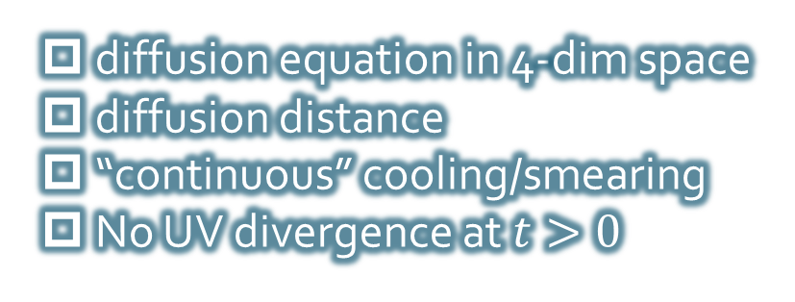
Yang-Mills Gradient Flow
Luscher 2010
Narayanan, Neuberger, 2006
Luscher, Weiss, 2011
t: “flow time”
dim:[length²]
leading
diffusion equation in 4-dim space
diffusion distance
“continuous” cooling/smearing
No UV divergence at $t>0$

Slide 13





Small Flow-time Expansion
“SFtX method”
Remormalized EMT
Operators at $t>0$
original 4-dim theory
t→0 limit
Luescher, Weisz, 2011
Suzuki, 2013

Slide 14

Thermodynamics:
Iritani, MK, Suzuki, Takaura, 2019
□: SFtX
□: SFtX
Agreement with other methods within 1% level!
Suppression of errors thanks to smearing nature

Slide 15


2+1 QCD EoS from Gradient Flow
WHOT-QCD, PRD96 (2017); PRD102 (2020)
Agreement with integral method
Substantial suppression of statistical errors
m_{PS}/m_{V} ≈0.63
Physical mass: Kanaya+ (WHOT-QCD), 1910.13036

Slide 16





Double Extrapolation
$$t→0, a→0$$
O(t) terms in SFTE
lattice discretization
Continuum extrapolation
strong
discretization
effect
Small t extrapolation

Slide 17
Double Extrapolation
$$t→0, a→0$$
O(t) terms in SFTE
lattice discretization
Continuum extrapolation
strong
discretization
effect
Small t extrapolation

Slide 18






Spherical Coordinates
EMT is diagonalized
in Spherical Coordinates
Maxwell theory

Slide 19

Stress Tensor Around a Quark
T=1.44T_{c}
Suppression at large distance
Separation of different channels
$|T_{44}|>{|T}_{rr}| \sim |T_{θθ}|$
pulling
pushing

Slide 20

Stress Tensor Around a Quark
T=1.44T_{c}
Suppression at large distance
Separation of different channels
$|T_{44}|>|T_{rr}| \sim |T_{θθ}|$
Clearer separation for lower $T$
pulling
pushing

Slide 21




Perturbative Analysis
M. Berwein, private comm.
Perturbation
Lattice
$|T_{44}|>|T_{rr}|$ is reproduced by perturbation.
Hierarchy of $T_{rr} , T_{θθ}$ does not match?
Perturbation:
Combination of
NLO pert. + NLO EQCD

Slide 22





$r$ Dependence
Increase
suppress
Increase at short $r$ / suppression at larger $r$
$T$ dependence is suppressed at $r<1/T$
Too noisy at large $r$ for extracting screening mass $m_{D}$

Slide 23




Running Coupling
Estimate of $α_{s}$
at the leading-order perturbation theory
channel dependent
All results are approximately consistent with the estimate from $Q\overline{Q}$ potential
Kaczmarek, Karsch, Zantow, 2004

Slide 24
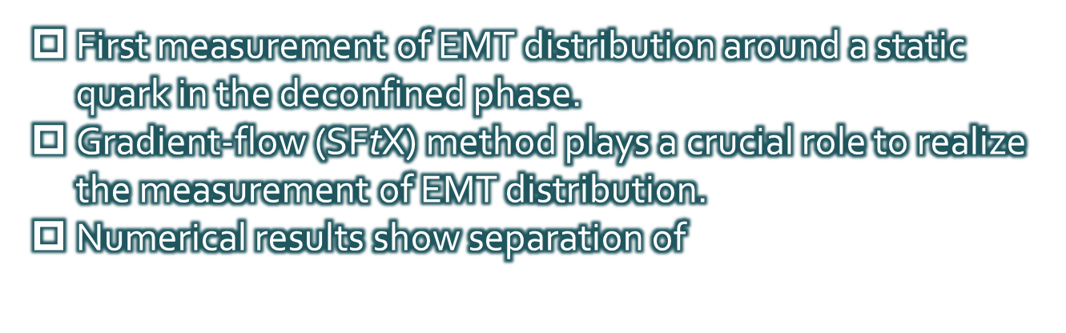
Summary
First measurement of EMT distribution around a static quark in the deconfined phase.
Gradient-flow (SFtX) method plays a crucial role to realize the measurement of EMT distribution.
Numerical results show separation of $T_{44} ,T_{rr} , T_{θθ}$. Qualitative agreement with the perturbative calculation.
Many future studies
  Single Q in full QCD @ T<T_{c} = heavy-light meson
  QQQ, QQ, etc. / T dependence
  EMT distribution inside hadrons

Slide 25
backup

Slide 26





Perturbative Coefficients
Suzuki, PTEP 2013, 083B03
Harlander+, 1808.09837
Iritani, MK, Suzuki, Takaura, PTEP 2019
LO
1-loop
2-loop
3-loop
×
Iritani, MK, Suzuki,
Takaura, 2019
zero
Suzuki (2013)
Harlander+(2018)
Choice of the scale of g²
Previous:
Improved:
Harlander+ (2018)

Slide 27
Double Extrapolation t→0, a→0
O(t) terms in SFTE
lattice discretization
Continuum extrapolation
strong
discretization
effect
Small t extrapolation

Slide 28
SU(3) YM vs Maxwell
SU(3) Yang-Mills
(quantum)
Maxwell
(classical)
Propagation of the force is clearly different
in YM and Maxwell theories!

Slide 29


Momentum Conservation
Yanagihara, MK, PTEP2019
In cylindrical coordinats,
For infinitely-long flux tube
Lattice
T_{rr} and T_{θθ}
degenerate!
T_{rr} and T_{θθ} must separate!
T_{θθ} must change sign!
Effect of boundaries is important
for the flux tube at R=0.92fm

Slide 30



EMT on the Lattice: Conventional
Lattice EMT Operator
Caracciolo+, 1990
Determination of Zs are necessary.
Non-pert. Determination of Zs
Shifted-boundary method
Full QCD with fermions
Giusti, Pepe, 2014~; Borsanyi+, 2018
Brida, Giusti, Pepe, 2020

Slide 31
Static Charge
Fundamental tool to study field theories
This study
QQ
Single Q
Flux tube formation
Heavy-light meson @ T<T_{c}
Debye screening @ T>T_{c}
FlowQCD, PLB 789, 210 (2019)
FlowQCD, PRD 102, 114522 (2020)

