Slide 1
Critical Points in Strongly-Interacting Media
Masakiyo Kitazawa
(Osaka U.)
Tsukuba Global Science Week (TGSW), 2021/9/11, online (Tsukuba)

Slide 2






Critical Points
Water
Ising Model
gas
Critical
Point
Temperature
1st tr.
liquid
Critical
Point
1st tr.
solid
pressure
These CPs belong to the same universality class ($Z_{2}$).
Common critical exponents.
ex.

Slide 3

Quantum ChromoDynamics
Building blocks of matter
nucleus
nucleon
quark

Slide 4

Quantum ChromoDynamics
Building blocks of matter
nucleus
nucleon
quark
Quantum chromodynamics (QCD)
=Fundamental theory of strong interaction
gluons
quarks
gluons

Slide 5
Quark-Gluon Plasma (QGP)
vacuum
baryon
meson

Slide 6
Quark-Gluon Plasma (QGP)
temperature
vacuum
baryon
meson

Slide 7


Quark-Gluon Plasma (QGP)
temperature
vacuum
baryon
meson
quark-gluon plasma
Early Universe

Slide 8




QCD Phase Diagram
Temperature
Quark-Gluon Plasma
Critical
Point
Hadron
Phase
1st tr.
Color SC
Chemical Potential

Slide 9
QCD Phase Diagram
Temperature
Quark-Gluon Plasma
Critical
Point
Another CP?
MK+ (2002)
Hadron
Phase
1st tr.
Color SC
Chemical Potential

Slide 10


QCD Phase Diagram
Early
Universe
Temperature
Quark-Gluon Plasma
Critical
Point
Another CP?
MK+ (2002)
Hadron
Phase
1st tr.
Color SC
Compact
Stars
Chemical Potential

Slide 11





Varying Quark Masses
Columbia plot
Example
= order of phase tr. at $μ_{q}=0$
Phase diagram in heavy-quark region
1st tr.
Critical
Point
Various orders of phase transition with variation of $m_{q}$.

Slide 12
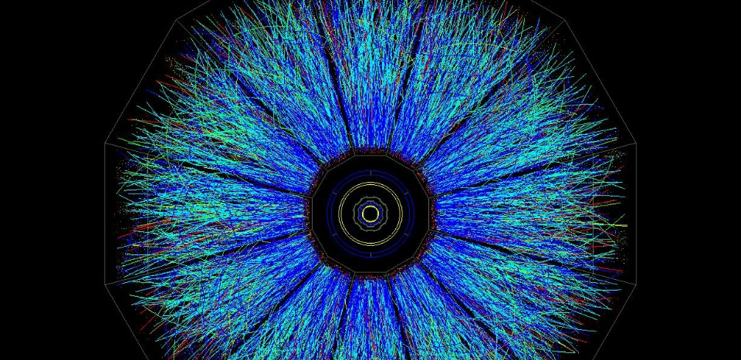
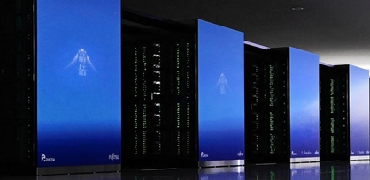
Two Experimental Tools
Real Experiment
Virtual Experiment
Relativistic Heavy-Ion Collisions
Lattice QCD
Numerical Simulations
Colliding two heavy nuclei in accelerators
RHIC (USA), LHC (EU), etc.
First-principle simulations
on supercomputers

Slide 13

Lattice QCD Numerical Simulations
Hadron Spectroscopy
PACS-CS,
PRD79 (’09)
Thermodynamics
Unique tool to perform
quantitative analyses of
non-perturbative QCD aspects

Slide 14


Relativistic Heavy-Ion Collisions
LHC – Large Hadron Collider

Slide 15
Relativistic Heavy-Ion Collisions
Proton-proton
Heavy Ion Collisions
proton
proton
Elementary processes
new particle search
properties of particles
Thermal Medium
hot & dense medium
phase transitions
LHC – Large Hadron Collider

Slide 16

Beam-Energy Scan
LHC
temperature
RHIC
beam energy scan
future facilities
ex. J-PARC @ Tokai
baryon chemical potential

Slide 17
Beam-Energy Scan
RHIC-BES
Phase I
2010~2015
Phase II
2019~2021
GSI-FAIR
2026~?
J-PARC-HI
2028~??
LHC
temperature
RHIC
beam energy scan
future facilities
ex. J-PARC @ Tokai
baryon chemical potential

Slide 18
Beam-Energy Scan
RHIC-BES
Phase I
2010~2015
Phase II
2019~2021
GSI-FAIR
2026~?
J-PARC-HI
2028~??
LHC
temperature
RHIC
beam energy scan
Lattice QCD
future facilities
ex. J-PARC @ Tokai
baryon chemical potential

Slide 19
Two Experimental Tools
Real Exp.
Relativistic
Heavy-Ion Collisions
Virtual Exp.
Lattice QCD
Numerical
Simulations
Real experiments
Various density
Dynamical evolution
Final-state observables only
Virtual, but unphysical params
Small baryon density only
Ideal thermal system
Limited observables
Complementary use of both exps. is important!

Slide 20



Fluctuations
Observables in equilibrium are fluctuating!
variance
V

Slide 21




Cumulants
Binder Cumulant
Cumulants
skewness
kurtosis
average
variance
NOTE
Gauss distribution:
Poisson distribution:
Review: Asakawa, MK, PPNP 90 (2016)

Slide 22



Cumulants around Critical Point
Ising Model
$P(M)$: probability distr.
$V(M)$: effective potential
$M$ : order parameter
1st tr.
Sign of ${\left\langle N^{3}\right\rangle }_{c}$ is flipped at the CP.

Slide 23



Cumulants around Critical Point
Ising Model
$P(M)$: probability distr.
$V(M)$: effective potential
$M$ : order parameter
1st tr.
Sign of ${\left\langle N^{3}\right\rangle }_{c}$ is flipped at the CP.

Slide 24


Cumulants around Critical Point
Ising Model
$P(M)$: probability distr.
$V(M)$: effective potential
$M$ : order parameter
${\left\langle N^{4}\right\rangle }_{c}$ changes discontinuously at the CP.

Slide 25
Experimental Search for QCD Critical Point
Reviews:
Asakawa, MK, PPNP (’16)
Bluhm, MK+, NPA 1003 (’20)
MK, Esumi, Nonaka, JPS journal, 2021/8

Slide 26
Beam-Energy Scan
LHC
temperature
RHIC
beam energy scan
future facilities
ex. J-PARC @ Tokai
baryon chemical potential

Slide 27



Event-by-event Fluctuations
Review: Asakawa, MK, PPNP 90 (2016)
STAR, PRL105 (2010)
Detector
Cumulants

Slide 28
Cumulants around Critical Point
Ising Model
$P(M)$: probability distr.
$V(M)$: effective potential
$M$ : order parameter
1st tr.
Sign of ${\left\langle N^{3}\right\rangle }_{c}$ is flipped at the CP.

Slide 29



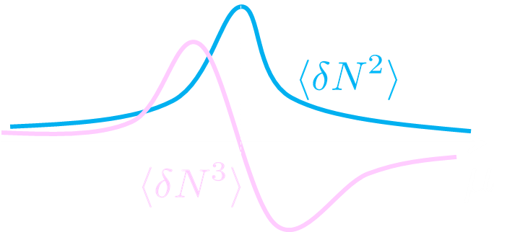


Sign Change of Cumulant
Asakawa, Ejiri, MK, PRL ’09
Geometric interpretation on the signs
Fluctuations ${\left\langle N_{B}^{2}\right\rangle }_{c}$ diverge at the QCD-CP.
Themodynamic Relation
Sign of ${\left\langle N_{B}^{3}\right\rangle }_{c}$ can distinguish near and away sides!

Slide 30

Impact of Negative Cumulants
Asakawa, Ejiri, MK, PRL ’09
Once negative ${\left\langle N_{B}^{3}\right\rangle }_{c}$ is established, it is evidences that
(1) χ_{B} has a peak structure in the QCD phase diagram.
(2) Hot matter beyond the peak is created in the collisions.
No dependence on any specific models.
Just the sign! No normalization (such as by N_{ch}).

Slide 31


Proton Number Cumulants
suppression?
non-monotonic
STAR, 2001.06419
Nonzero and non-Poissonian cumulants are experimentally established.

Slide 32
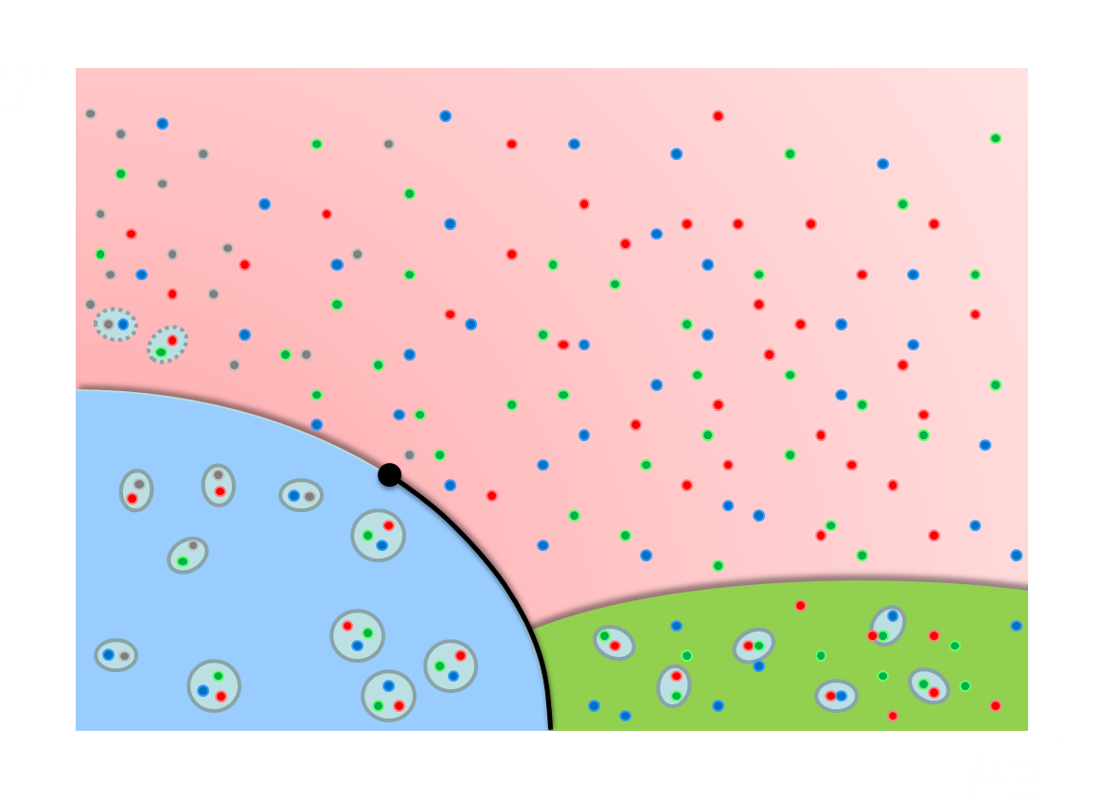
Time Evolution of Cumulants
initial
fluctuations
Critical slowing down around CP
diffusion of fluctuations
Proper understanding of the time evolution of fluctuations is indispensable.

Slide 33




Rapidity Window Dependence in Diffusion Models
Higher order cumulants
2nd order cumulant near CP
in diffusion master equation
in stochastic diffusion equation
MK+ (2014); MK (2015)
sakaida, Asakawa, Fujii, MK, 2018
Non-monotonic $Δy$ dependence can emerge reflecting the dynamical evolution.

Slide 34
Issues with Experimental Analysis
Detector-response correction
MK, Asakawa, 2012
MK, 2016
MK, Luo, 2017
Nonaka, MK, Esumi, 2017
Nonaka, MK, Esumi, 2018
Pileup correction
true
Nonaka, MK, Esumi, 2020
pileup
Closer look at Exp. data
Nonaka, MK, Esumi, in prep.

Slide 35
Lattice Simulation of
CP in Heavy-Quark Region
Kiyohara, MK, Ejiri, Kanaya, arXiv:2108.00118
See also
WHOT-QCD Collab.
PTEP 2021 (2021) 013B08; Phys.Rev.D 101 (2020) 05450

Slide 36

Varying Quark Masses
Columbia plot
Example
= order of phase tr. at $μ=0$
Phase diagram in heavy-quark region
1st tr.
Critical
Point
Various orders of phase transition with variation of $m_{q}$.

Slide 37
Cumulants around Critical Point
Ising Model
$P(M)$: probability distr.
$V(M)$: effective potential
$M$ : order parameter
${\left\langle N^{4}\right\rangle }_{c}$ changes discontinuously at the CP.

Slide 38





Finite-Volume Effects
Binder Cumulant
Ising Model
$$V=∞$$
Sudden change of $B_{4}$ at the CP is smeared by finite $V$ effect.
$B_{4}$ obtained for various $V$ has crossing at $t=0$.
At the crossing point, $B_{4}=1.604$ in $Z_{2}$ universality class.

Slide 39

Finite-Volume Effects
Binder Cumulant
Ising Model
$$V=∞$$
smaller $V$
Sudden change of $B_{4}$ at the CP is smeared by finite $V$ effect.
$B_{4}$ obtained for various $V$ has crossing at $t=0$.
At the crossing point, $B_{4}=1.604$ in $Z_{2}$ universality class.

Slide 40



Binder-Cumulant Analysis
Light-quark region
Heavy-quark region
Kuramashi, Nakamura, Ohno, Takeda, ’20
Cuteri , Philipsen , Schön, Sciarra, ’21
$$N_{t}=12, LT<2.7$$
$$N_{t}=10, LT≤6$$
Statistically-significant deviation of the crossing point from the 3d-Ising value.
Too large finite-V effects?

Slide 41
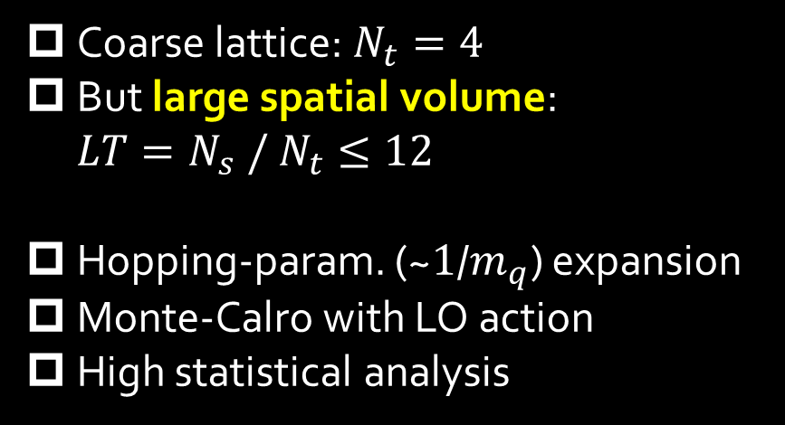
Numerical Simulation
Coarse lattice: $N_{t}=4$
But large spatial volume: $LT=N_{s} / N_{t}≤12$
Hopping-param. (~$1$/$m_{q}$) expansion
Monte-Calro with LO action
High statistical analysis
Simulation params.

Slide 42




Binder-Cumulant Analysis
Z2
$$LT≥9$$
$$LT≥8$$
$B_{4}$ and $ν$ are consistent with Z2 universality class only when $LT≥9$ data are used for the analysis.

Slide 43
Further Check of Finite-V Scaling
Effective potential at the CP
Scaling of order parameter
Z2 scaling is well established

Slide 44
Summary
Critical points appear many places in QCD at nonzero temperature.
Two experimental tools for the search for the CPs:
  Relativistic heavy-ion collisions
  Lattice QCD numerical simulations
Various studies are ongoing using both real and virtual experiments.

