Slide 1
From Lattice to Observables
Masakiyo Kitazawa
(Osaka U.)
The 8th Asian Triangle Heavy-Ion Conference (ATHIC2021), 2021/11/5, Inha U., Incheon (S. Korea)

Slide 2





QCD Phase Diagram
Temperature
Quark-Gluon Plasma
QCD Critical Point
1st tr.
Hadron Phase
Color SC
Baryon
Chemical Potential

Slide 3


QCD Phase Diagram
Early
Universe
Temperature
Quark-Gluon Plasma
QCD Critical Point
1st tr.
Hadron Phase
Color SC
Compact
Stars
Another CP?
MK+ (2002); …
Baryon
Chemical Potential

Slide 4
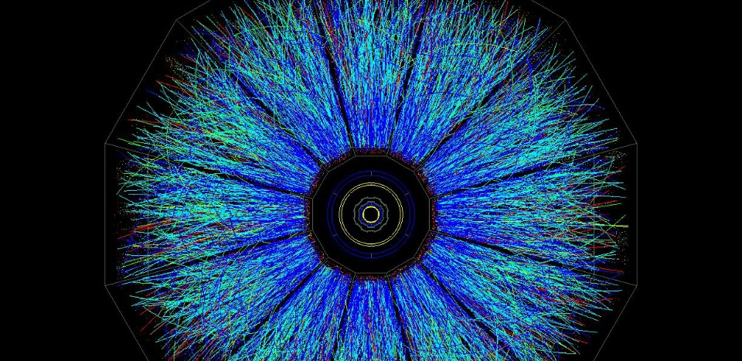
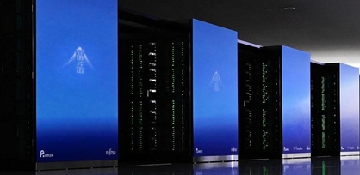
Two “Experimental” Tools to explore hot & dense medium
Relativistic
Heavy-Ion Collisions
Lattice QCD
Numerical Simulations
Real Experiment
Virtual Experiment

Slide 5


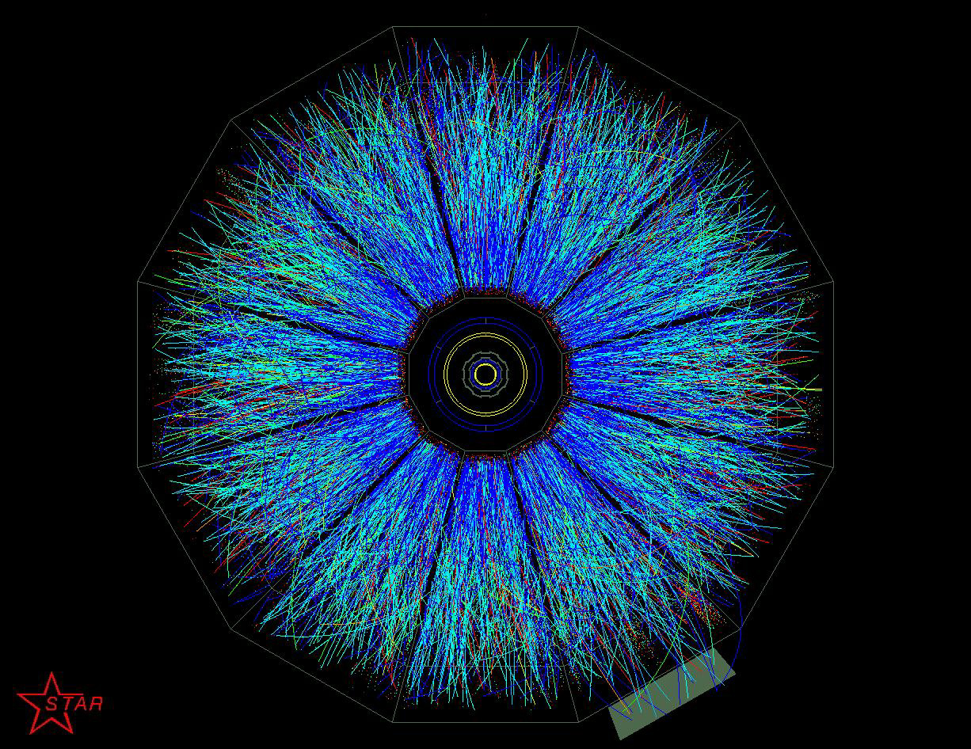

Relativistic Heavy-Ion Collisions
LHC – Large Hadron Collider

Slide 6

Beam-Energy Scan
LHC
temperature
RHIC
beam energy scan
future facilities
ex. J-PARC @ Tokai
baryon chemical potential

Slide 7
Beam-Energy Scan
RHIC-BES
Phase I
2010~2015
Phase II
2019~2021
GSI-FAIR,
NICA-MPD
2026~?
J-PARC-HI
2028~??
LHC
temperature
RHIC
beam energy scan
future facilities
ex. J-PARC @ Tokai
baryon chemical potential

Slide 8

Lattice QCD Numerical Simulations
Hadron Spectroscopy
PACS-CS,
PRD79 (’09)
Thermodynamics
Unique tool to perform
quantitative analyses of
non-perturbative QCD aspects

Slide 9
Beam-Energy Scan
RHIC-BES
Phase I
2010~2015
Phase II
2019~2021
GSI-FAIR,
NICA-MPD
2026~?
J-PARC-HI
2028~??
LHC
temperature
RHIC
beam energy scan
Lattice QCD
future facilities
ex. J-PARC @ Tokai
baryon chemical potential

Slide 10

Usage of Lattice for HIC
(Pseudo) critical temperature $T_{c}$
Equations of state
Fluctuations of conserved charges
Dissociation of quarkonia
Transport coefficients

Slide 11
HIC vs Lattice: Pros & Cons
Real Exp.
Relativistic
Heavy-Ion Collisions
Virtual Exp.
Lattice QCD
Numerical
Simulations
Real experiments
Zero~high baryon density
Dynamical evolution
Final-state observables only
Virtual, but unphysical params
Small baryon density only
Ideal thermal system
Limited observables
Complementary use of both exps. is important!

Slide 12
Three Applications
1. Fluctuations of Conserved Charges
2. Finite-volume Effects
in anisotropic systems
3. Finite-size Scaling around QCD-CP

Slide 13


Event-by-event Fluctuations
STAR, PRL105 (2010)
Detector
Cumulants

Slide 14




Cumulants
Cumulants
skewness
kurtosis
average
variance
NOTE
Gauss distribution:
Poisson distribution:
Review: Asakawa, MK, PPNP 90 (2016)

Slide 15


Proton Number Cumulants
suppression?
non-monotonic
STAR, PRC 2020 [2001.06419]
Nonzero and non-Poissonian cumulants are experimentally established.

Slide 16




Cumulants of Conserved Charges
= Lattice observable
$T$ dependence @ $μ=0$
Nonzero density
Lattice observable:
HotQCD, Phys. Rev. D 101, 074502 (2020)

Slide 17
Issues to be Resolved
Experiments measure proton number cumulants, while lattice calculates baryon’s.
Experiments measure the final state of the dynamical evolution, while lattice calculations are performed for equilibrium states with fixed temperature.
And, other issues:
  Volume fluctuation
  Efficiency correction / imperfect acceptance
  Measurement in momentum space
  Resonance decays
  Jets
  …
See, Asakawa, MK, Mueller, PRC 101 (2020)

Slide 18



Proton vs Baryon Cumulants
MK, Asakawa, 2012; 2012
${\left\langle N_{p}^{m}\right\rangle }_{c}≠{\left\langle N_{B}^{m}\right\rangle }_{c}$
${\left\langle N_{B}^{m}\right\rangle }_{c}$can be obtained from the distribution of $N_{p}$ thanks to the isospin randomization.
Information of baryon # cumulants are more suppressed in higher order proton # cumulants!

Slide 19
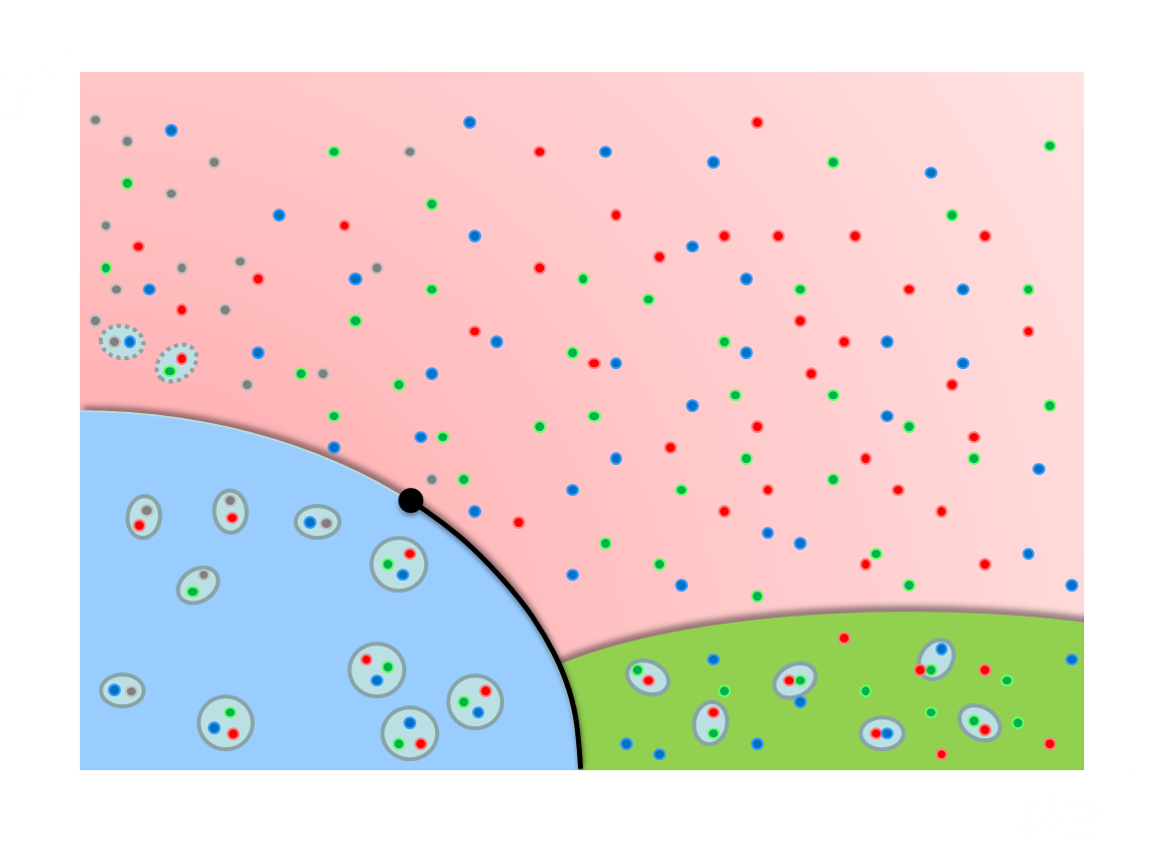
Time Evolution of Cumulants
diffusion of
fluctuations
Critical slowing down around CP
diffusion of fluctuations
Proper understanding of the time evolution of fluctuations is indispensable.

Slide 20

Diffusion of Fluctuations
Pre-Equilibrium
rapidity
QGP
Fluctuations are continue to change even after the chemical FO.
Measurement in momentum space gives rise to further “blurring” effect.
Hadronization
Freezeout
Ohnishi, MK, Asakawa, PRC 2016
detector

Slide 21

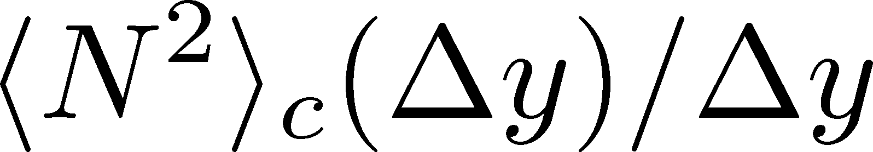


Rapidity Window Dependence in Diffusion Models
Higher order cumulants
2nd order cumulant near CP
in diffusion master equation
in stochastic diffusion equation
MK+, PLB (2014); MK, NPA (2015)
sakaida, Asakawa, Fujii, MK, (2018)
Non-monotonic $Δy$ dependence can emerge reflecting the dynamical evolution.

Slide 22
Three Applications
1. Fluctuations of Conserved Charges
2. Finite-volume Effects
in anisotropic systems
3. Finite-size Scaling around QCD-CP

Slide 23

Casimir Effect
attractive force between two conductive plates

Slide 24





Casimir Effect
Brown, Maclay
1969

Slide 25




Thermodynamics on the Lattice
Various Methods
Integral, differential, moving frame, non-equilibrium, …
rely on thermodynamic relations valid in V→∞
Not applicable to
anisotropic systems
We employ SFtX Method
Components of EMT are directly accessible!
SFtX = Small Flow time eXpansion

Slide 26



Casimir Effect
Brown, Maclay
1969

Slide 27

Casimir Effect
Brown, Maclay
1969
T

Slide 28

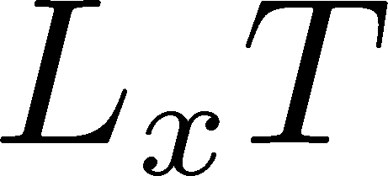

Pressure Anisotropy @ T≠0
MK, Mogliacci, Kolbe,
Horowitz, PRD (2019)
Free scalar field
L₂=L₃=∞
Periodic BC
Mogliacci+, 1807.07871

Slide 29
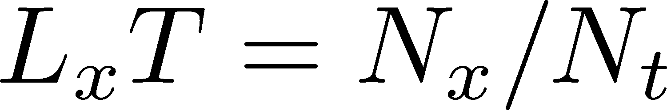
Pressure Anisotropy @ T≠0
MK, Mogliacci, Kolbe,
Horowitz, PRD (2019)
Free scalar field
L₂=L₃=∞
Periodic BC
Mogliacci+, 1807.07871
Lattice result
Periodic BC
Only t→0 limit
Error: stat.+sys.
Medium near T_{c} is remarkably insensitive to finite size!

Slide 30
Pressure Anisotropy @ T≠0
MK, Mogliacci, Kolbe,
Horowitz, PRD (2019)
Free scalar field
L₂=L₃=∞
Periodic BC
Mogliacci+, 1807.07871
Lattice result
Periodic BC
Only t→0 limit
Error: stat.+sys.
Medium near T_{c} is remarkably insensitive to finite size!

Slide 31
Three Applications
1. Fluctuations of Conserved Charges
2. Finite-volume Effects
in anisotropic systems
3. Finite-size Scaling around QCD-CP

Slide 32








Varying Quark Masses
Columbia plot
Phase Diagram
= order of phase tr. at $μ=0$
on the $T−m_{q}$ plane
Critical
Point
1st tr.
1st tr.
Various orders of phase transition with variation of $m_{q}$.

Slide 33






Cumulants around Critical Point
Ising Model
Gauss distribution
Two delta functions
Kurtosis ${\left\langle M^{4}\right\rangle }_{c}/{\left\langle M^{2}\right\rangle }_{c}$ changes discontinuously at the CP.

Slide 34





Finite-Size Effects
Binder Cumulant
Ising Model
$$V=∞$$
Sudden change of $B_{4}$ at the CP is smeared by finite-size effect.
$B_{4}$ obtained for various size have crossing at $t=0$.
At the crossing point, $B_{4}=1.604$ in $Z_{2}$ universality class.

Slide 35


Finite-Volume Effects
Binder Cumulant
Ising Model
$$V=∞$$
smaller $V$
Sudden change of $B_{4}$ at the CP is smeared by finite $V$ effect.
$B_{4}$ obtained for various $V$ has crossing at $t=0$.
At the crossing point, $B_{4}=1.604$ in $Z_{2}$ universality class.

Slide 36



Binder-Cumulant Analysis
Light-quark region
Heavy-quark region
Kuramashi, Nakamura, Ohno, Takeda, ’20
Cuteri , Philipsen , Schön, Sciarra, ’21
$$N_{t}=12, LT<2.7$$
$$N_{t}=10, LT≤6$$
Statistically-significant deviation of the crossing point from the 3d-Ising value.
Too large finite-S effects?

Slide 37
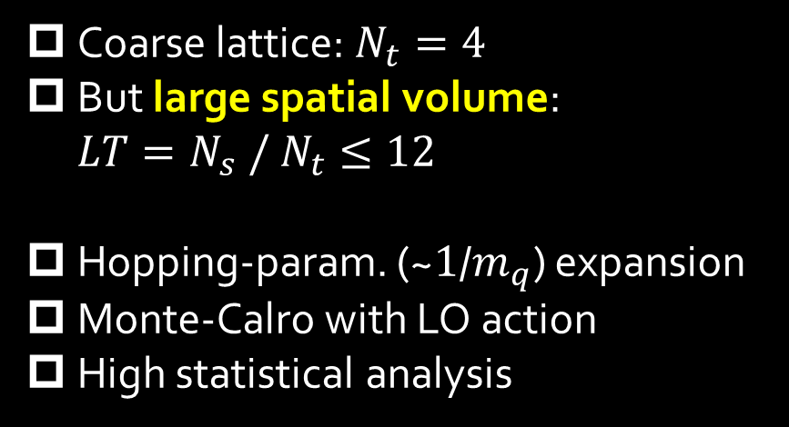
Numerical Simulation
Coarse lattice: $N_{t}=4$
But large spatial volume: $LT=N_{s} / N_{t}≤12$
Hopping-param. (~$1$/$m_{q}$) expansion
Monte-Calro with LO action
High statistical analysis
Simulation params.
Kiyohara, MK, Ejiri, Kanaya
2108.00118, PRD, in press

Slide 38




Binder-Cumulant Analysis
Z2
$$LT≥9$$
$$LT≥8$$
$B_{4}$ and $ν$ are consistent with Z2 universality class only when $LT≥9$ data are used for the analysis.
Kiyohara, MK, Ejiri, Kanaya, 2108.00118

Slide 39
Further Check of Z₂ Scaling
Effective potential at the CP
Scaling of order parameter
Z2 scaling is well established
Kiyohara, MK, Ejiri, Kanaya, 2108.00118

Slide 40
HIC vs Lattice: Pros & Cons
Real Exp.
Relativistic
Heavy-Ion Collisions
Virtual Exp.
Lattice QCD
Numerical
Simulations
Real experiments
Zero~high baryon density
Dynamical evolution
Final-state observables only
Virtual, but unphysical params
Small baryon density only
Ideal thermal system
Limited observables
Complementary use of both exps. is important!

Slide 41
Final Remarks
Relativistic HIC and lattice simulations are useful “experimental” tools for exploring hot and dense medium.
Both experiments have pros and cons. Their complementary use is important.
Further exchanges of ideas between lattice and experimental communities will be especially effective for the search for the QCD phase structure!

Slide 42




Critical Points
Water
Ising Model
gas
Critical
Point
Temperature
1st tr.
liquid
Critical
Point
1st tr.
solid
pressure
These CPs belong to the same universality class ($Z_{2}$).
Common critical exponents.
ex.

Slide 43

T
massless free
T/T_{c}≅8.1 (β=8.0) / T/T_{c}≅25 (β=9.0)
Ratio slowly approaches the asymptotic value.
But, large deviation still exists even at T/T_{c}~25.

