Slide 1
Gravitational Form Factors from Lattice QCD
GPD and Related Topics at J-PARC, 2022/12/22, KEK (online)
Masakiyo Kitazawa
(Osaka U.)
Thanks to:
H. Ito, R. Yanagihara &
FlowQCD/WHOT-QCD Collaborations

Slide 2




Energy-Momentum Tensor
energy
momentum
pressure
stress
All components are important physical observables!

Slide 3

Gravitational Form Factors
Pressure distribution inside proton
(partially) accessible with hard exclusive processes
Mechanical structure of hadrons
D-term: the last global unknown
Mass decomposition
Polyakov(2003); Kumano, Song, Teryaev (2018); Ji (1995); Locre (2018); Hatta, Rajan, Tanaka (2018);
Burkert+, Nature 557, 396 (2018)

Slide 4





GFF from Lattice
Mass decomposition
Nucleon $σ$ term, $⟨x_{q}⟩, ⟨x_{g}⟩$, …
Trace anomaly: difficult to measure
cf: Alexandrou+ (2020); (2020)
Mechanical structure
Distribution of EMT
Momentum space → Coordinate
cf: Shanahan, Detmold (2019)

Slide 5
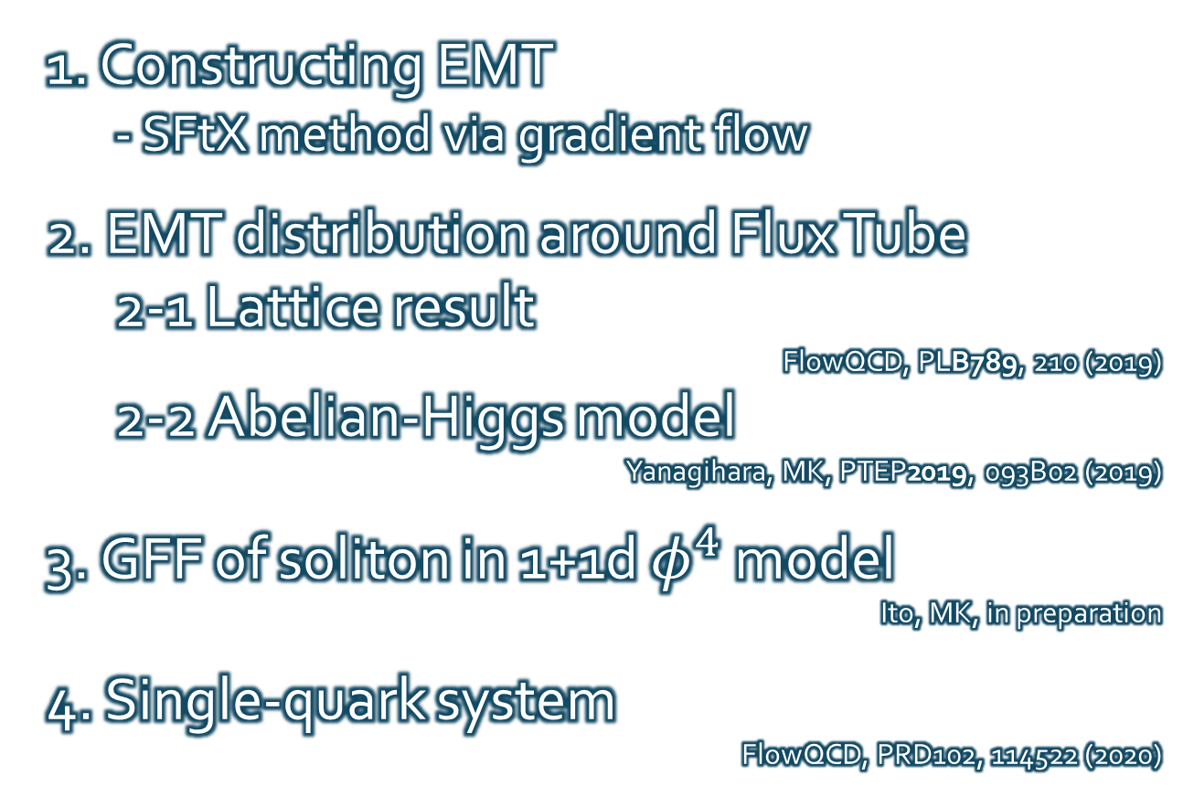
Contents
1. Constructing EMT
  - SFtX method via gradient flow
2. EMT distribution around Flux Tube
  2-1 Lattice result
FlowQCD, PLB789, 210 (2019)
  2-2 Abelian-Higgs model
Yanagihara, MK, PTEP2019, 093B02 (2019)
3. GFF of soliton in 1+1d $φ^{4}$ model
Ito, MK, in preparation
4. Single-quark system
FlowQCD, PRD102, 114522 (2020)

Slide 6




: nontrivial observable
on the lattice
Definition of the operator is nontrivial
because of the explicit breaking of translational invariance
ex:
Its measurement is extremely noisy
due to high dimensionality and etc.

Slide 7





Yang-Mills Gradient Flow
Luscher 2010
Narayanan, Neuberger, 2006
Luscher, Weiss, 2011
t: “flow time”
dim:[length²]
leading
diffusion equation in 4-dim space
diffusion distance
“continuous” cooling/smearing
No UV divergence at$t>0$

Slide 8



Gradient Flow for Fermions
Luscher, 2013
Makino, Suzuki, 2014
Taniguchi+ (WHOT)
2016~
Not “gradient” flow but a “diffusion”-type equation.
Divergence in field renormalization of fermions.
All observables are finite at t>0 once Z(t) is fixed.
Energy-momentum tensor from SFtX Makino, Suzuki, 2014

Slide 9





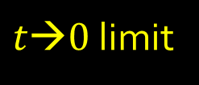

Small Flow-Time Expansion
Luescher, Weisz, 2011
Suzuki, 2013
an operator at $t>0$
remormalized operators
of original theory
original 4-dim theory
$t→0$limit

Slide 10


Constructing EMT 1
Suzuki, 2013
Gauge-invariant dimension 4 operators

Slide 11

Constructing EMT 2
Suzuki, 2013
vacuum subtr.
Remormalized EMT
“SFtX method” (Small Flow time eXpansion)

Slide 12


EMT in QCD
Makino, Suzuki (2014)
Harlander+ (2018)

Slide 13






Perturbative Coefficients
Suzuki, PTEP 2013, 083B03
Harlander+, 1808.09837
Iritani, MK, Suzuki, Takaura, PTEP 2019
LO
1-loop
2-loop
3-loop
×
Iritani, MK, Suzuki,
Takaura, 2019
zero
Suzuki (2013)
Harlander+(2018)
Choice of the scale of $g2$
Previous:
Improved:
Harlander+ (2018)

Slide 14


t Dependence: SU(3) YM
Iritani, MK, Suzuki, Takaura, PTEP 2019
Existence of “linear window” at intermediate t

Slide 15




Double Extrapolation
Method A:
Consistency check
latent heat & pressure gap
Shirogane+, 2021
(WHOT-QCD)
discretization
Method B:
B
Method A
Consistent result for two methods
discretization

Slide 16
t Dependence: SU(3) YM
Range2
Range2
Range1
Range3
Range1
Range3
Iritani, MK, Suzuki, Takaura, PTEP 2019
Suzuki, Takaura 2021
Existence of “linear window” at intermediate t
Stable t→0 extrapolation
Systematic errors: fit range, uncertaintyof Λ (±3%), …

Slide 17
T Dependence: Comparison
Iritani, MK, Suzuki, Takaura, 2019
□: 3-loop
△: Flow2016
□: 2-loop
△: Flow2016
Systematic error: μ₀ or μ_{d}, Λ, t→0 function, fit range
Good agreement with other methods!
Smaller statistics thanks to smearing by the flow

Slide 18
2+1 QCD EoS from SFtX Method
WHOT-QCD, PRD96 (2017); PRD102 (2020)
Agreement with integral method
Substantial suppression of statistical errors
m_{PS}/m_{V} ≈0.63
Physical mass: Kanaya+ (WHOT-QCD), 1910.13036

Slide 19
Contents
1. Constructing EMT
  - SFtX method via gradient flow
2. EMT distribution around Flux Tube
  2-1 Lattice result
FlowQCD, PLB789, 210 (2019)
  2-2 Abelian-Higgs model
Yanagihara, MK, PTEP2019, 093B02 (2019)
3. GFF of soliton in 1+1d $φ^{4}$ model
Ito, MK, in preparation
4. Single-quark system
FlowQCD, PRD102, 114522 (2020)

Slide 20


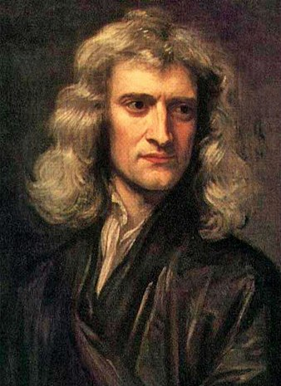


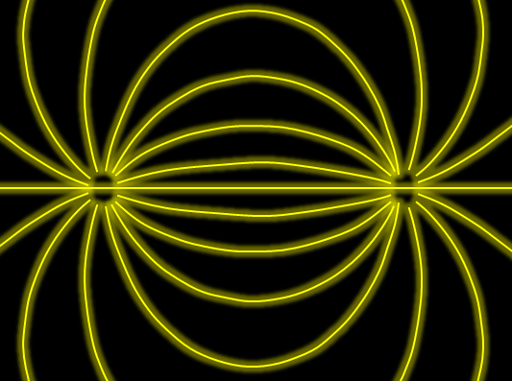

Force
Action-at-a-distance
Newton
1687
Local interaction
Faraday
1839

Slide 21




Maxwell Stress
(in Maxwell Theory)
Maxwell
E
pulling
Parallel to field: Pulling
Vertical to field: Pushing
pushing

Slide 22



Maxwell Stress
(in Maxwell Theory)
length:
pulling
pushing
Definite physical meaning
Distortion of field, line of the field
Propagation of the force as local interaction

Slide 23
Quark-Anti-quark System
Formation of the flux tube → confinement
Previous Studies on Flux Tube
Potential
Action density
Color-electric field
so many studies…
Cea+ (2012)
Cardoso+ (2013)

Slide 24
Stress Tensor in QQ System
ー
FlowQCD, PLB (2019)
Lattice simulation
SU(3) Yang-Mills
a=0.029 fm
R=0.69 fm
t/a²=2.0
pulling
pushing
Definite physical meaning
Distortion of field, line of the field
Propagation of the force as local interaction
Manifestly gauge invariant

Slide 25
SU(3) YM vs Maxwell
SU(3) Yang-Mills
(quantum)
Maxwell
(classical)
Propagation of the force is clearly different
in YM and Maxwell theories!

Slide 26


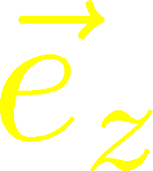






Stress Distribution on Mid-Plane
From rotational symm. & parity
EMT is diagonalized
in Cylindrical Coordinates
Degeneracy
in Maxwell theory

Slide 27


Mid-Plane
Separation
Continuum
Extrapolated!
In Maxwell theory
Degeneracy:
Separation:
Nonzero trace anomaly

Slide 28
Mid-Plane
Separation
Continuum
Extrapolated!
Degeneracy:
Separation:
Nonzero trace anomaly

Slide 29


Momentum Conservation
Yanagihara, MK, PTEP2019
In cylindrical coordinats,
For infinitely-long flux tube
Lattice
T_{rr} and T_{θθ}
degenerate!
T_{rr} and T_{θθ} must separate!
Effect of boundaries is not
negligible at R=0.92fm

Slide 30


Force
Force from Potential
Force from Stress

Slide 31
Force
Force from Potential
Force from Stress
Newton
1687
Faraday
1839

Slide 32
Force
Force from Potential
Force from Stress
Good Agreement!
Newton
1687
Faraday
1839

Slide 33
Contents
1. Constructing EMT
  - SFtX method via gradient flow
2. EMT distribution around Flux Tube
  2-1 Lattice result
FlowQCD, PLB789, 210 (2019)
  2-2 Abelian-Higgs model
Yanagihara, MK, PTEP2019, 093B02 (2019)
3. GFF of soliton in 1+1d $φ^{4}$ model
Ito, MK, in preparation
4. Single-quark system
FlowQCD, PRD102, 114522 (2020)

Slide 34
Dual Superconductor Picture
Nambu, 1970
Nielsen, Olesen, 1973
t ‘Hooft, 1981
…
QCD Vacuum
Superconductor
Anti-
Monopole
Quark
Anti-quark
Monopole
Flux Tube
Magnetic Vortex
Dual (E⇔B)

Slide 35






Abelian-Higgs Model
Yanagihara, MK, 2019
Abelian-Higgs Model
GL parameter:
Infinitely long tube
type-I :
type-II :
Bogomol’nyi bound :
degeneracy
Luscher, 1981
momentum conservation

Slide 36



Stress Tensor in AH Model infinitely-long flux tube
Type-I
Lattice
Inconsistent with
lattice result
No degeneracy bw T_{rr} & T_{θθ}
T_{θθ} changes sign

Slide 37
Flux Tube with Finite Length
Yanagihara, MK (2019)
AH model can reproduce lattice results qualitatively by tuning parameters.
But, quantitatively all parameters are rejected.

Slide 38
Contents
1. Constructing EMT
  - SFtX method via gradient flow
2. EMT distribution around Flux Tube
  2-1 Lattice result
FlowQCD, PLB789, 210 (2019)
  2-2 Abelian-Higgs model
Yanagihara, MK, PTEP2019, 093B02 (2019)
3. GFF of soliton in 1+1d $φ^{4}$ model
Ito, MK, in preparation
4. Single-quark system
FlowQCD, PRD102, 114522 (2020)

Slide 39








Soliton in 1+1d
$φ^{4}$ Theory
Soliton (kink)
EMT around a soliton (classical)
How is the EMT distribution modified by the quantum effect?
cf) energy density: Goldhaber+ (2003)

Slide 40









Quantum Correction
Fluctuations around $φ_{cl}(x)$
Eigenmodes:
:continuum
Total Energy:
Dashen, Hasslacher, Neveu (1974)

Slide 41


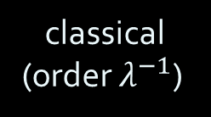

Quantum Correction to Total Energy
Dashen, Hasslacher, Neveu (1974)
Gervais, Gevicki, Sakita (1975)
…
Rebhan, Nieuwenhuizen (1997)
Shifman, Vainshtein, Voloshin (1999)
Goldhaber, Litvinsev, Nieuwenhuizen (2003)
…
Vacuum subtraction
finite box with length $L$
fixed mode number
$L→∞$ at the end
Renormalization
mass renorm. only $m^{2}→m^{2}+δm^{2}$
Final
result:
classical
(order $λ^{−1}$)
quantum
(1-loop)

Slide 42





Collective Coordinate Method
Gervais, Jevicki, Sakita (1975)
Goldstone and Jackiw (1975)
Tomboulis (1975)
Christ, Lee (1975)
Eliminate translational zero mode
in favor of the collective coordinate $\hat{X}$
Elimination of the zero mode
Obvious translational symmetry
Lorentz symmetry
Matrix element
EMT Conservation
For static systems

Slide 43
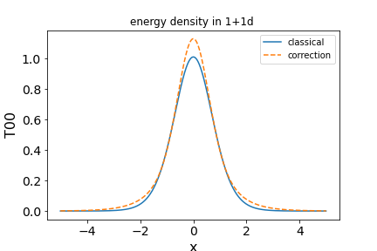





EMT Distr. at 1-loop Order
Finite EMT Correction
Ito, MK, in prep.
EMT conservation
(analytic)
$$λ=1$$
Subtlety: appearance of spatially uniform component
L: length of box
(anti-pBC)

Slide 44
Contents
1. Constructing EMT
  - SFtX method via gradient flow
2. EMT distribution around Flux Tube
  2-1 Lattice result
FlowQCD, PLB789, 210 (2019)
  2-2 Abelian-Higgs model
Yanagihara, MK, PTEP2019, 093B02 (2019)
3. GFF of soliton in 1+1d $φ^{4}$ model
Ito, MK, in preparation
4. Single-quark system
FlowQCD, PRD102, 114522 (2020)

Slide 45
Stress Tensor around a Quark
Q

Slide 46


Stress Tensor around a Quark
Deconfined phase
This study
screening property
running coupling
Vacuum
heavy-light meson
Q
$T\sim T_{c}$
dissociation of heavy-light meson

Slide 47
Pressure inside Hadrons
EMT distribution inside hadrons now accessible??
Pressure @ proton
EMT distribution @ pion
Nature, 557, 396 (2018)
Shanahan, Detmold (2019)
Kumano, Song, Teryaev (2018)

Slide 48


EMT Around a Static Q
Ω: Polyakov loop
EMT-Polyakov loop correlation
Gauge invariant
Z3 symmetry has to be broken
EMT by SFtX method

Slide 49


Lattice Setup
SU(3) Yang-Mills (Quenched)
Wilson gauge action
Clover operator
Analysis above Tc
Simulation on a Z₃ minimum
EMT around a Polyakov loop
continuum extrapolation
Ω: Polyakov loop

Slide 50


Spherical Coordinates
EMT is diagonalized
in Spherical Coordinates
Maxwell theory

Slide 51

Stress Tensor Around a Quark
T=1.44T_{c}
Suppression at large distance
Separation of different channels
$|T_{44}|>{|T}_{rr}| \sim |T_{θθ}|$
pulling
pushing

Slide 52

Stress Tensor Around a Quark
T=1.44T_{c}
Suppression at large distance
Separation of different channels
$|T_{44}|>|T_{rr}| \sim |T_{θθ}|$
Clearer separation for lower $T$
pulling
pushing

Slide 53




Perturbative Analysis
M. Berwein, private comm.
Perturbation
Lattice
$|T_{44}|>|T_{rr}|$ is reproduced by perturbation.
Hierarchy of $T_{rr} , T_{θθ}$ does not match?
Perturbation:
Combination of
NLO pert. + NLO EQCD

Slide 54





$r$ Dependence
Increase
suppress
Increase at short $r$ / suppression at larger $r$
$T$ dependence is suppressed at $r<1/T$
Too noisy at large $r$ for extracting screening mass $m_{D}$

Slide 55




Running Coupling
Estimate of $α_{s}$
at the leading-order perturbation theory
channel dependent
All results are approximately consistent with the estimate from $Q\overline{Q}$ potential
Kaczmarek, Karsch, Zantow, 2004

Slide 56
Summary
EMT is an important observable for investigating local systems in QFT. Experimental measurement of GFF of hadrons are ongoing.
SFtX (small flow-time expansion) method based on the gradient flow provides us with powerful method to carry out the measurement of EMT on the lattice.
  Flux tube
  single-Q system
Corresponding model analyses of EMT are also interesting.
Numerical analysis of the single-quark system will give us insights into heavy-light mesons.

Slide 57
backup

Slide 58


Double Extrapolation t→0, a→0
O(t) terms in SFTE
lattice discretization
Continuum extrapolation
strong
discretization
effect
Small t extrapolation

Slide 59



EMT on the Lattice: Conventional
Lattice EMT Operator
Caracciolo+, 1990
Determination of Zs
Fit to thermodynamics: Z₃, Z₁
Shifted-boundary method: Z₆, Z₃
Full QCD with fermions
Giusti, Meyer, 2011; 2013;
Giusti, Pepe, 2014~; Borsanyi+, 2018
Brida, Giusti, Pepe, 2020

Slide 60



SFtX Method
lattice regularized
gauge theory
Smeared world
by gradient flow
gradient flow
continuum theory
gradient flow
analytic relation
(perturbative)
Measure on
the lattice
Take Extrapolation (t,a)→(0,0)
O(t) terms in SFTE
lattice discretization

Slide 61








Fermion Propagator
propagator of flow equation
Inverse propagator is needed
fermion field
t=0
gauge field

Slide 62
N_{f}=2+1 QCD Thermodynamics
Taniguchi+ (WHOT-QCD),
PRD96, 014509 (2017)
N_{f}=2+1 QCD, Iwasaki gauge + NP-clover
m_{PS}/m_{V} ≈0.63 / almost physical s quark mass
T=0: CP-PACS+JLQCD (ß=2.05, 28³x56, a≈0.07fm)
T>0: 32³xN_{t}, N_{t} = 4, 6, ... , 14, 16):
T≈174-697MeV
t→0 extrapolation only (No continuum limit)

Slide 63
Numerical Setup
SU(3) YM theory
Wilson gauge action
N_{t} = 16, 12
N_{z}/N_{t}=6
2000~4000 confs.
Even N_{x}
No Continuum extrap.
Same Spatial volume
12x72²x12 ~ 16x96²x16
18x72²x12 ~ 24x96²x16
Simulations on
OCTOPUS/Reedbush

Slide 64
Extrapolations t→0, a→0
O(t) terms in SFTE
lattice discretization
FlowQCD2016
This Study
①Continuum
②Small t extrapol.
strong
discretization
effect
strong
discretization
effect

Slide 65

Lattice Setup
FlowQCD, PLB (2019)
SU(3) Yang-Mills (Quenched)
Wilson gauge action
Clover operator
EMT around Wilson Loop
APE smearing / multi-hit
fine lattices (a=0.029-0.06 fm)
continuum extrapolation
Simulation: bluegene/Q@KEK
R=0.92 fm
R=0.69 fm
R=0.46 fm

Slide 66


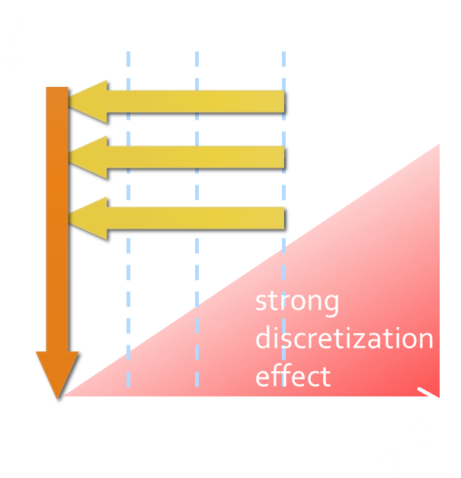
Continuum Extrapolation at mid-point
mid point
continuum
limit
a→0 extrapolation with fixed t

Slide 67
t→0 Extrapolation at mid-point
Range2
continuum
limit
Range1
Range3
a→0 extrapolation with fixed t
Then, t→0 with three ranges

Slide 68

Double Extrapolation
$$t→0, a→0$$
O(t) terms in SFTE
lattice discretization
Continuum extrapolation
strong
discretization
effect
Small t extrapolation

Slide 69


Stress = Force per Unit Area
Pressure
S

Slide 70
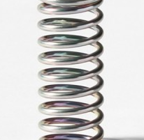



Stress = Force per Unit Area
Pressure
Generally, F and n are not parallel
v
fluid
S
F
S
elastic body
S
In thermal medium
Stress Tensor
Landau
Lifshitz

Slide 71

Stress Tensor in AH Model infinitely-long flux tube
Bogomol’nyi bound :
de Vega, Schaposnik, PRD14, 1100 (1976).

Slide 72


Stress Tensor in AH Model infinitely-long flux tube
Type-I
Type-II
No degeneracy bw T_{rr} & T_{θθ}
T_{θθ} changes sign
conservation law

