Slide 1
Distribution of
Energy-Momentum Tensor in Static-Quark Systems
Effective Field Theory Seminar, TUM, München (Online), 2022/Jan./26
Masakiyo Kitazawa
(Osaka U.)
FlowQCD, PLB 789, 210 (2019)
Yanagihara, MK, PTEP2019, 093B02 (2019)
FlowQCD, PRD 102, 114522 (2020)

Slide 2
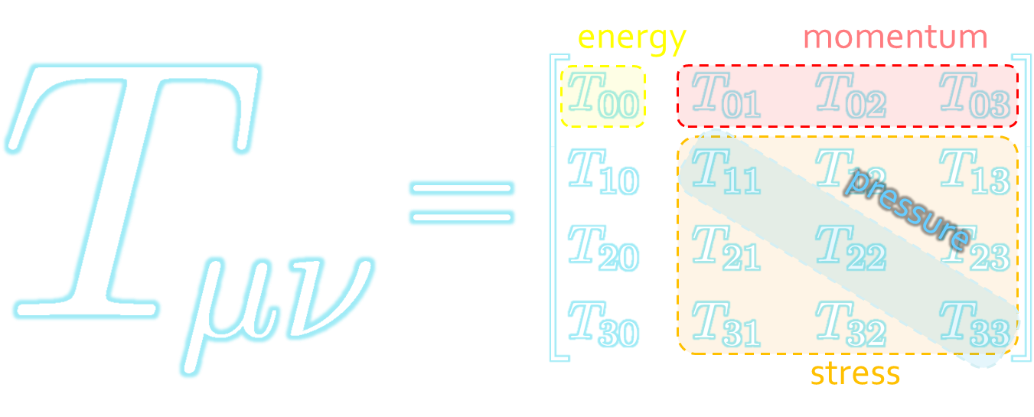
Energy-Momentum Tensor
The most fundamental quantity in physics.
All components are important quantities.
How does EMT behave inside hadrons?
Burkert+, Nature (2018)
Pressure inside a proton
Nature, 557, 396 (2018)

Slide 3
Static-Quark Systems
Fundamental probe to study field theories
Numerical simulations on the lattice is straightforward!
QQ
Single Q
Flux tube formation
Heavy-light meson @ T<T_{c}
Debye screening @ T>T_{c}
EMT in Static Q systems
Combine 2 fundamental tools!

Slide 4
Static-Quark Systems
Fundamental probe to study field theories
Numerical simulations on the lattice is straightforward!
QQ
Single Q
Flux tube formation
Heavy-light meson @ T<T_{c}
Debye screening @ T>T_{c}
FlowQCD, PLB 789, 210 (2019)
FlowQCD, PRD 102, 114522 (2020)

Slide 5




: nontrivial observable
on the lattice
Definition of the operator is nontrivial
because of the explicit breaking of translational invariance
ex:
Its measurement is noisy
due to high dimensionality and etc.

Slide 6
SFtX Method and Gradient Flow
SFtX = Small Flow-time eXpansion

Slide 7





Yang-Mills Gradient Flow
Luscher 2010
Narayanan, Neuberger, 2006
Luscher, Weiss, 2011
t: “flow time”
dim:[length²]
leading
diffusion equation in 4-dim space
diffusion distance
“continuous” cooling/smearing
No UV divergence at $t>0$

Slide 8





Small Flow-Time Expansion
Luescher, Weisz, 2011
Suzuki, 2013
an operator at t>0
remormalized operators
of original theory
original 4-dim theory
t→0 limit

Slide 9


Constructing EMT 1
Suzuki, 2013
Gauge-invariant dimension 4 operators

Slide 10

Constructing EMT
Suzuki, 2013
vacuum subtr.
Remormalized EMT
“SFtX method” (Small Flow time eXpansion)

Slide 11





Perturbative Coefficients
Suzuki, PTEP 2013, 083B03
Harlander+, 1808.09837
Iritani, MK, Suzuki, Takaura, PTEP 2019
LO
1-loop
2-loop
3-loop
×
Iritani, MK, Suzuki,
Takaura, 2019
zero
Suzuki (2013)
Harlander+(2018)
Choice of the scale of g²
Previous:
Improved:
Harlander+ (2018)

Slide 12


t Dependence
Iritani, MK, Suzuki, Takaura, PTEP 2019
Existence of “linear window” at intermediate t

Slide 13




Double Extrapolation t→0, a→0
O(t) terms in SFTE
lattice discretization
Continuum extrapolation
strong
discretization
effect
Small t extrapolation

Slide 14
Thermodynamics: ε+p & ε-3p
Range2
Range2
Range1
Range3
Range1
Range3
Iritani, MK, Suzuki, Takaura, PTEP 2019
Existence of “linear window” at intermediate t
Stable t→0 extrapolation
Systematic errors: fit range, uncertaintyof Λ (±3%), …

Slide 15

Thermodynamics:
Iritani, MK, Suzuki, Takaura, 2019
□: SFtX
□: SFtX
Agreement with other methods within 1% level!
Smaller statistics thanks to smearing by the flow

Slide 16


Alternative Extrapolation
Method A:
Consistency check
latent heat & pressure gap
Shirogane+, 2021
(WHOT-QCD)
discretization
Method B:
B
Method A
Consistent result for two methods
discretization

Slide 17



Gradient Flow for Fermions
Luscher, 2013
Makino, Suzuki, 2014
Taniguchi+ (WHOT)
2016~
Not “gradient” flow but a “diffusion”-type equation.
Divergence in field renormalization of fermions.
All observables are finite at t>0 once Z(t) is fixed.
Energy-momentum tensor from SFtX Makino, Suzuki, 2014

Slide 18


EMT in QCD
Makino, Suzuki (2014)
Harlander+ (2018)

Slide 19








Fermion Propagator
propagator of flow equation
Inverse propagator is needed
fermion field
t=0
gauge field

Slide 20
2+1 QCD EoS from Gradient Flow
WHOT-QCD, PRD96 (2017); PRD102 (2020)
Agreement with integral method
Substantial suppression of statistical errors
m_{PS}/m_{V} ≈0.63
Physical mass: Kanaya+ (WHOT-QCD), 1910.13036

Slide 21
Flux-Tube Formation in QQ System
FlowQCD, PLB 789, 210 (2019)
Yanagihara, MK, PTEP2019, 093B02 (2019)

Slide 22
Stress = Force per Unit Area

Slide 23


Stress = Force per Unit Area
Pressure
S

Slide 24
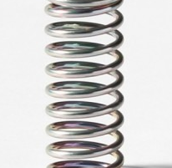



Stress = Force per Unit Area
Pressure
Generally, F and n are not parallel
v
fluid
S
F
S
elastic body
S
In thermal medium
Stress Tensor
Landau
Lifshitz

Slide 25




Maxwell Stress
(in Maxwell Theory)
Maxwell
E
pulling
Parallel to field: Pulling
Vertical to field: Pushing
pushing

Slide 26



Maxwell Stress
(in Maxwell Theory)
length:
pulling
pushing
Definite physical meaning
Distortion of field, line of the field
Propagation of the force as local interaction

Slide 27
Quark-Anti-quark System
Formation of the flux tube → confinement
Previous Studies on Flux Tube
Potential
Action density
Color-electric field
so many studies…
Cea+ (2012)
Cardoso+ (2013)

Slide 28


Lattice Setup
FlowQCD, PLB (2019)
SU(3) Yang-Mills (Quenched)
Wilson gauge action
Clover operator
EMT around Wilson Loop
APE smearing / multi-hit
fine lattices (a=0.029-0.06 fm)
continuum extrapolation
Simulation: bluegene/Q@KEK
R=0.92 fm
R=0.69 fm
R=0.46 fm

Slide 29
Stress Tensor in QQ System
ー
FlowQCD, PLB (2019)
Lattice simulation
SU(3) Yang-Mills
a=0.029 fm
R=0.69 fm
t/a²=2.0
pulling
pushing
Definite physical meaning
Distortion of field, line of field
Propagation of the force as local interaction
Manifestly gauge invariant

Slide 30
SU(3) YM vs Maxwell
SU(3) Yang-Mills
(quantum)
Maxwell
(classical)
Propagation of the force is clearly different
in YM and Maxwell theories!

Slide 31
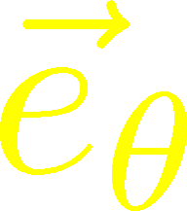
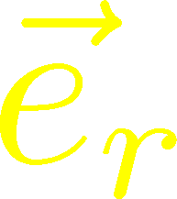
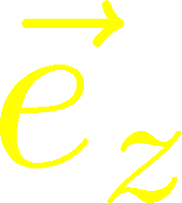






Stress Distribution on Mid-Plane
From rotational symm. & parity
EMT is diagonalized
in Cylindrical Coordinates
Degeneracy
in Maxwell theory

Slide 32


Mid-Plane
Separation
Continuum
Extrapolated!
In Maxwell theory
Degeneracy:
Separation:
Nonzero trace anomaly

Slide 33
Mid-Plane
Separation
Continuum
Extrapolated!
Degeneracy:
Separation:
Nonzero trace anomaly

Slide 34


Force
Force from Potential
Force from Stress

Slide 35
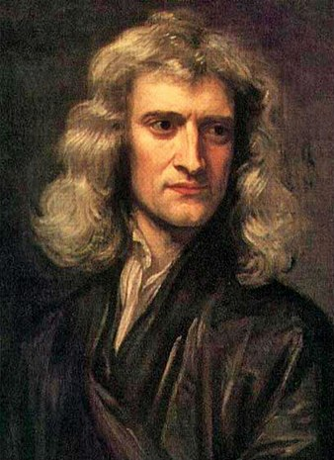

Force
Force from Potential
Force from Stress
Newton
1687
Faraday
1839

Slide 36
Force
Force from Potential
Force from Stress
Good Agreement!
Newton
1687
Faraday
1839

Slide 37


Momentum Conservation
Yanagihara, MK, PTEP2019
In cylindrical coordinats,
For infinitely-long flux tube
Lattice
T_{rr} and T_{θθ}
degenerate!
T_{rr} and T_{θθ} must separate!
T_{θθ} must change sign!
Effect of boundaries is important
for the flux tube at R=0.92fm

Slide 38
Dual Superconductor Picture
Nambu, 1970
Nielsen, Olesen, 1973
t ‘Hooft, 1981
…
QCD Vacuum
Superconductor
Anti-
Monopole
Quark
Anti-quark
Monopole
Flux Tube
Magnetic Vortex
Dual (E⇔B)

Slide 39






Abelian-Higgs Model
Yanagihara, MK, 2019
Abelian-Higgs Model
GL parameter:
Infinitely long tube
type-I :
type-II :
Bogomol’nyi bound :
degeneracy
Luscher, 1981
momentum conservation

Slide 40




Stress Tensor in AH Model infinitely-long flux tube
Type-I
Type-II
No degeneracy bw T_{rr} & T_{θθ}
T_{θθ} changes sign
conservation law

Slide 41

Stress Tensor in AH Model infinitely-long flux tube
Type-I
Lattice
Inconsistent with
lattice result
No degeneracy bw T_{rr} & T_{θθ}
T_{θθ} changes sign

Slide 42
Flux Tube with Finite Length
Yanagihara, MK (2019)
AH model can reproduce lattice results qualitatively by tuning parameters.
But, quantitatively all parameters are rejected.

Slide 43


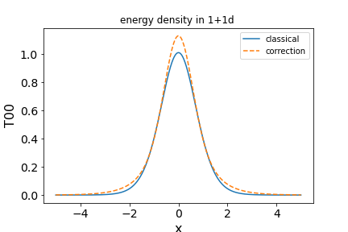



EMT Distr. in Simple Systems
Ito, MK, in prep.
$φ^{4}$ Theory in 1+1d
Soliton (kink)
Quantum effect on EMT at 1-loop order
Confirmation of EMT conservation

Slide 44
Single Q System in the Deconfined Phase
FlowQCD, PRD 102, 114522 (2020)

Slide 45

Flux Tube at Nonzero T
Vacuum
$$T=1.42T_{c}$$
Preliminary
(FlowQCD, in prep.)
Dissociation of the flux tube at T>T_{c}.

Slide 46


Motivations
$T<T_{c}$: Heavy-light meson
EMT distribution in the meson
$T>T_{c}$: Single charge
Screening
Running coupling
$T≈T_{c}$
Confinement transition
Q
This study:
$T>T_{c}$ in pure YM

Slide 47

Lattice Setup
SU(3) Yang-Mills (Quenched)
Wilson gauge action
Clover operator
Analysis above Tc
Simulation on a Z₃ minimum
EMT around a Polyakov loop
continuum extrapolation
Ω: Polyakov loop
FlowQCD, PRD 102, 114522 (2020)

Slide 48


Spherical Coordinates
EMT is diagonalized
in Spherical Coordinates
Maxwell theory

Slide 49

Stress Tensor Around a Quark
T=1.44T_{c}
Suppression at large distance
Separation of different channels
$|T_{44}|>{|T}_{rr}| \sim |T_{θθ}|$
pulling
pushing

Slide 50

Stress Tensor Around a Quark
T=1.44T_{c}
Suppression at large distance
Separation of different channels
$|T_{44}|>|T_{rr}| \sim |T_{θθ}|$
Clearer separation for lower $T$
pulling
pushing

Slide 51
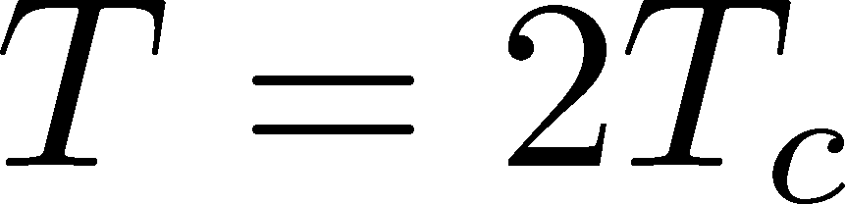



Perturbative Analysis
M. Berwein, private comm.
Perturbation
Lattice
$|T_{44}|>|T_{rr}|$ is reproduced by perturbation.
Hierarchy of $T_{rr} , T_{θθ}$ does not match?
Perturbation:
Combination of
NLO pert. + NLO EQCD

Slide 52




$r$ Dependence
Increase
Leading order perturbation
supress
Higher order terms:
M. Berwein, in progress
Increase at short $r$ / suppression at larger $r$
$T$ dependence is suppressed at $r<1/T$
Too noisy at large $r$ for extracting screening mass $m_{D}$

Slide 53



Channel Dependence
Separation b/w channels becomes clearer for smaller T
FlowQCD, PRD 102, 114522 (2020)

Slide 54




Running Coupling
Estimate of $α_{s}$
by the formula at the leading-order perturbation theory
channel dependent
Consistent with the estimate from $Q\overline{Q}$ potential
Kaczmarek, Karsch, Zantow, 2004

Slide 55
Summary
Static charges are fundamental but convenient tools for studying YM gauge theories.
Now, lattice simulations of EMT in static-quark systems are available thanks to SFtX (gradient flow) method.
So many future studies
  Single Q in full QCD @ T<T_{c} = heavy-light meson
  QQQ, QQ, etc. / T dependence
  Hadrons

Slide 56
backup

Slide 57
N_{f}=2+1 QCD Thermodynamics
Taniguchi+ (WHOT-QCD),
PRD96, 014509 (2017)
N_{f}=2+1 QCD, Iwasaki gauge + NP-clover
m_{PS}/m_{V} ≈0.63 / almost physical s quark mass
T=0: CP-PACS+JLQCD (ß=2.05, 28³x56, a≈0.07fm)
T>0: 32³xN_{t}, N_{t} = 4, 6, ... , 14, 16):
T≈174-697MeV
t→0 extrapolation only (No continuum limit)

Slide 58



EMT on the Lattice: Conventional
Lattice EMT Operator
Caracciolo+, 1990
Determination of Zs are necessary.
Non-pert. Determination of Zs
Shifted-boundary method
Full QCD with fermions
Giusti, Pepe, 2014~; Borsanyi+, 2018
Brida, Giusti, Pepe, 2020

Slide 59




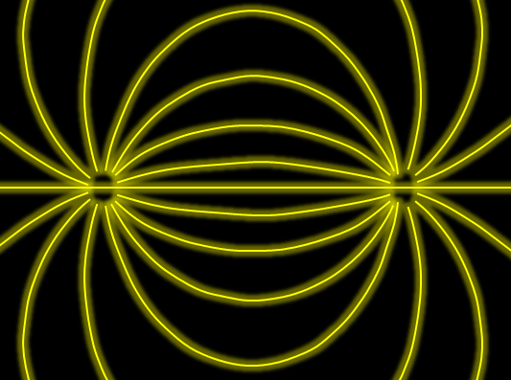
Force
Action-at-a-distance
Newton
1687
Local interaction
Faraday
1839

