Slide 1
Search for Phase Transitions in Dense QCD in Heavy-Ion Collisions
QCD Theory Seminars, 2022/Feb./14, online
Masakiyo Kiazawa (Osaka University)
Nishimura, MK, Kunihiro, arXiv:2201.01963

Slide 2



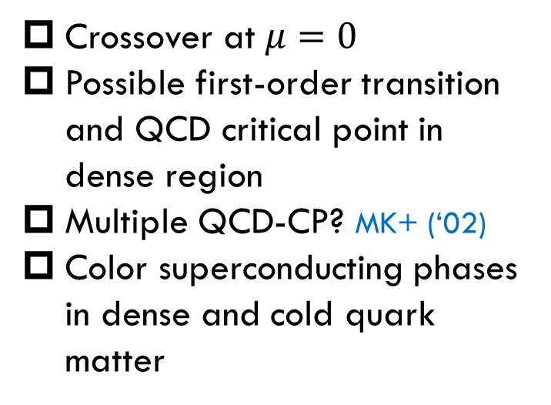
QCD Phase Diagram
Early Universe
T
Crossover at $μ=0$
Possible first-order transition and QCD critical point in dense region
Multiple QCD-CP? MK+ (‘02)
Color superconducting phases in dense and cold quark matter
Quark-Gluon Plasma
150MeV
ＱＣＤ Critical Point
Hadron Phase
(confined)
Color SC
Compact
Stars
~10¹⁵g/cm³
μ

Slide 3


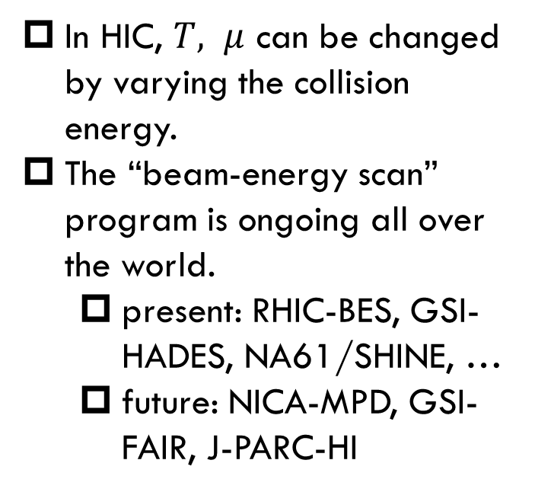
Beam-Energy Scan in Heavy-Ion Collisions
T
In HIC, $T, μ$ can be changed by varying the collision energy.
The “beam-energy scan” program is ongoing all over the world.
  present: RHIC-BES, GSI-HADES, NA61/SHINE, …
  future: NICA-MPD, GSI-FAIR, J-PARC-HI
varying $√s_{NN}$
150MeV
~10¹⁵g/cm³
μ

Slide 4
Contents
1. Search for QCD Critical Point
using fluctuation observables
2. Search for CSC Phase Transition
using dilepton production rates
Nishimura, MK, Kunihiro, arXiv:2201.01963

Slide 5
Thermal Fluctuations
Observables are fluctuating even in an equilibrated medium.
P(N)
N
V
N
Phase transition → Large fluctuation
Non-Gaussian fluctuations: good observables of QCD-CP
Stephanov, PRL (2009); Asakawa, Ejiri, MK, PRL (2009)

Slide 6


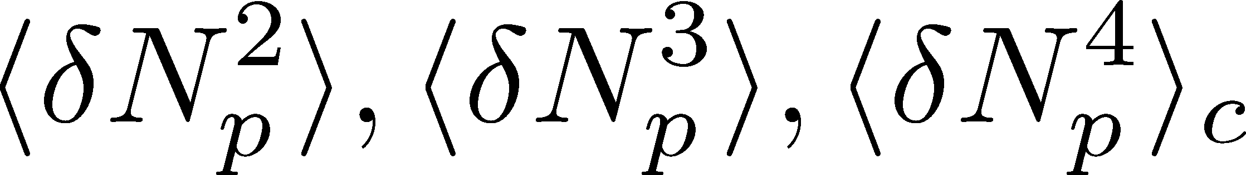
Event-by-Event Fluctuations in HIC
Review: Asakawa, MK, PPNP 90 (2016)
Fluctuations can be measured by e-by-e analysis in experiments.
STAR, PRL105 (2010)
Detector
Cumulants

Slide 7


Cumulants near QCD-CP
Divergence at the CP
more singular behavior for higher order cumulants
Stephanov (’09)

Slide 8
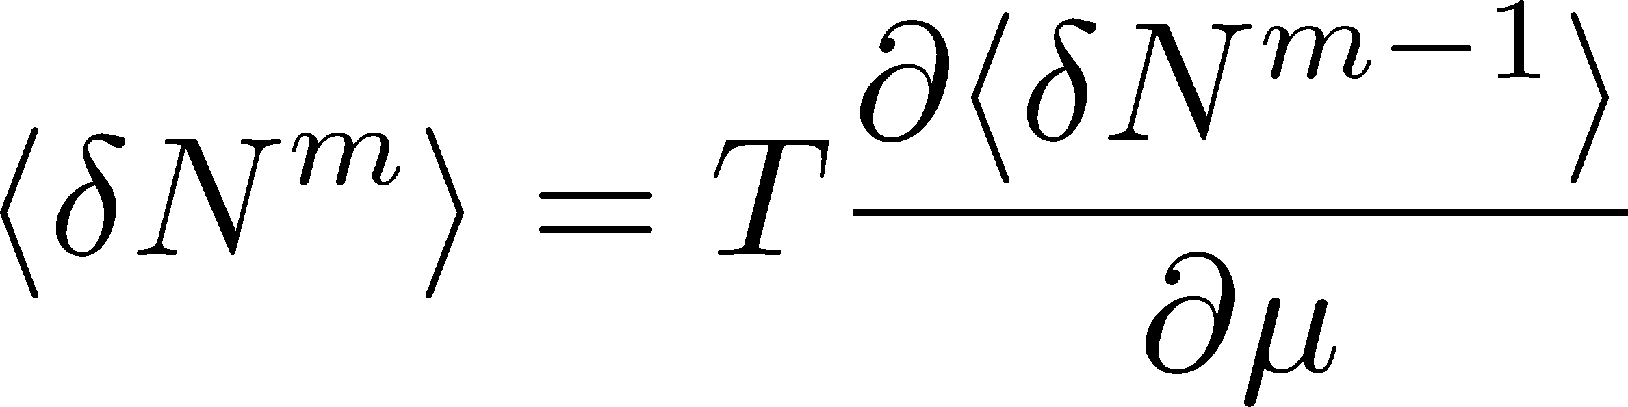
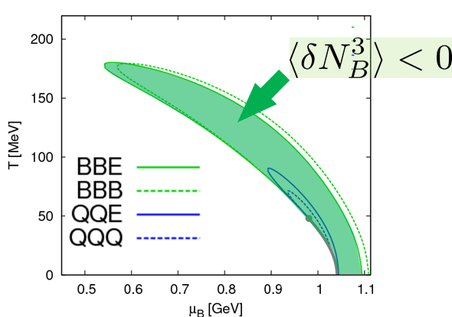

Cumulants near QCD-CP
Divergence at the CP
more singular behavior for higher order cumulants
Stephanov (’09)
Sign change
Asakawa, Ejiri, MK, 2009
Stephanov, 2011;
Friman, Karsch, Redlich, Skokov, 2011; …

Slide 9
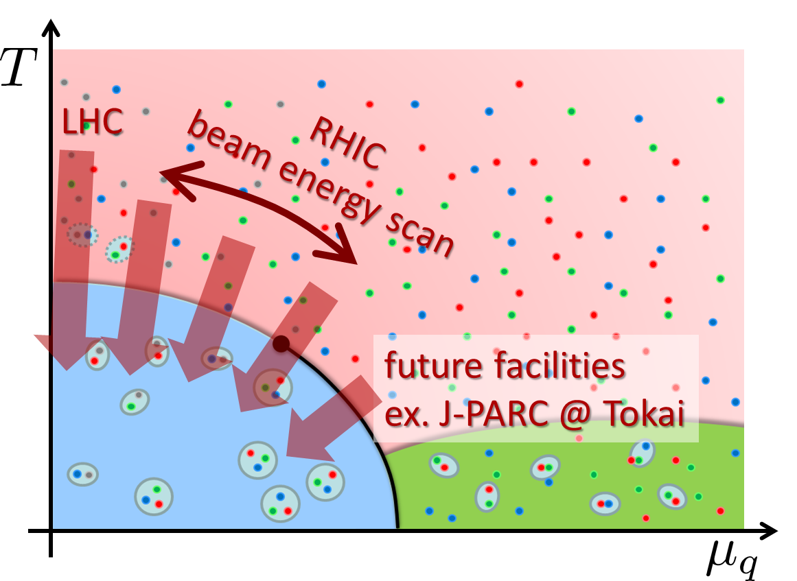
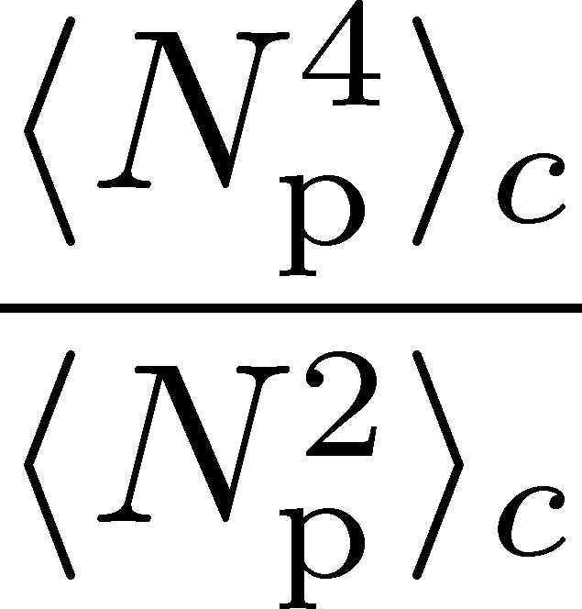
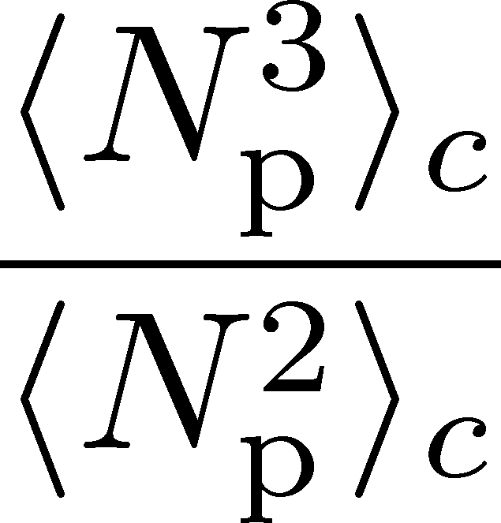
Experimental Results
STAR Collab. (’20)
Various Issues to be Resolved
Volume (initial) fluctuations
Difference b/w proton & baryon number
Efficiency/acceptance correction
Measurement in momentum space
Dynamical evolution
Resonance decays
…

Slide 10
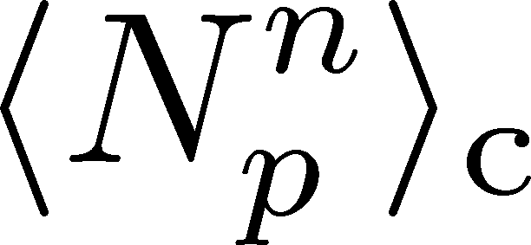
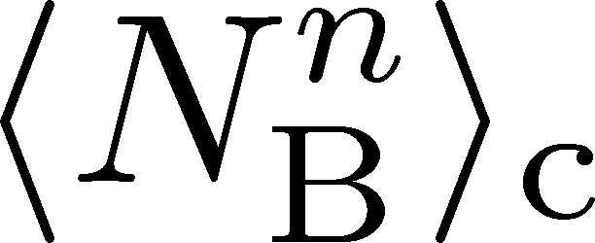
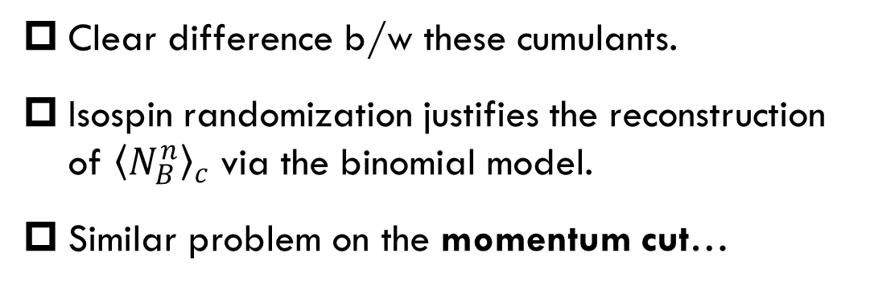
Proton vs Baryon Number Cumulants
MK, Asakawa, 2012; 2012
Experiments
proton number cumulants
Many theories
baryon number cumulants
Only 54% of charged particles are observed in the momentum bin
measurement with
50% efficiency loss
Clear difference b/w these cumulants.
Isospin randomization justifies the reconstruction of ${\left\langle N_{B}^{n}\right\rangle }_{c}$ via the binomial model.
Similar problem on the momentum cut…

Slide 11







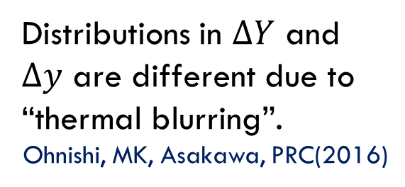
Time Evolution of Fluctuations
Detector
Distributions in $ΔY$ and
$Δy$ are different due to
“thermal blurring”.
Ohnishi, MK, Asakawa, PRC(2016)
Hadronic
QGP
Fluctuations in $ΔY$ continue
to change until kinetic f.o.

Slide 12


Evolution in Brownian Particle Model
Initial condition (uniform)
cumulants:
random
walk
diffusion master equation: MK+, PLB(’14)
probabilistic argument: Ohnishi+, PRC(’16)

Slide 13


Evolution in Brownian Particle Model
Initial condition (uniform)
cumulants:
diffusion
distance
random
walk
Study ΔY dependence
Poisson distribution
diffusion master equation: MK+, PLB(’14)
probabilistic argument: Ohnishi+, PRC(’16)

Slide 14
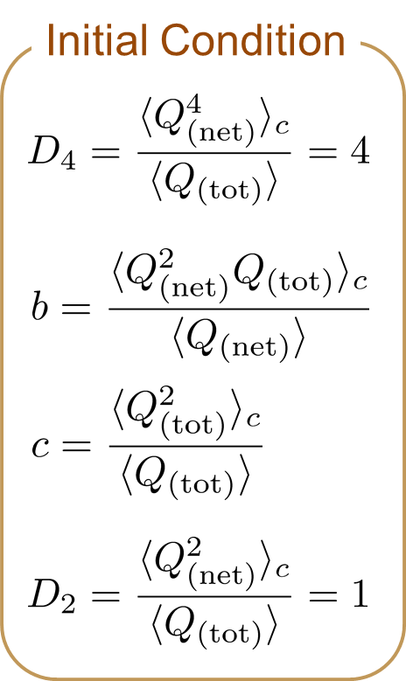


4th Order Cumulant
Before the diffusion
MK+ (2014)
MK (2015)

Slide 15

4th Order Cumulant
After the diffusion
MK+ (2014)
MK (2015)
(rough estimate)
Cumulant at small Δη is modified toward a Poisson value.
Non-monotonic behavior can appear.

Slide 16

Rapidity-Window Dependence
4th-order cumulant
STAR Collab. (X. Luo, CPOD2014)
Is non-monotonic Δη dependence already observed?
Different initial conditions give rise to different characteristic Δη dependence. → Study initial condition
MK+, 2014
MK, 2015
Finite volume effects: Sakaida+, PRC90 (2015)

Slide 17

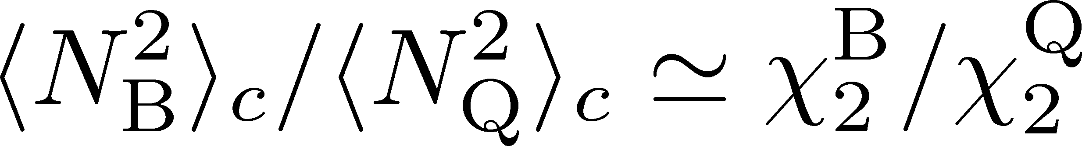
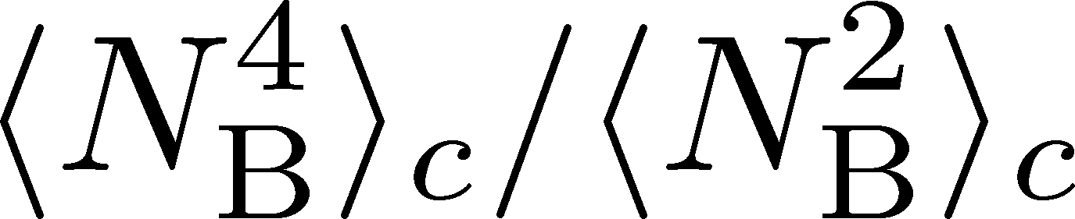
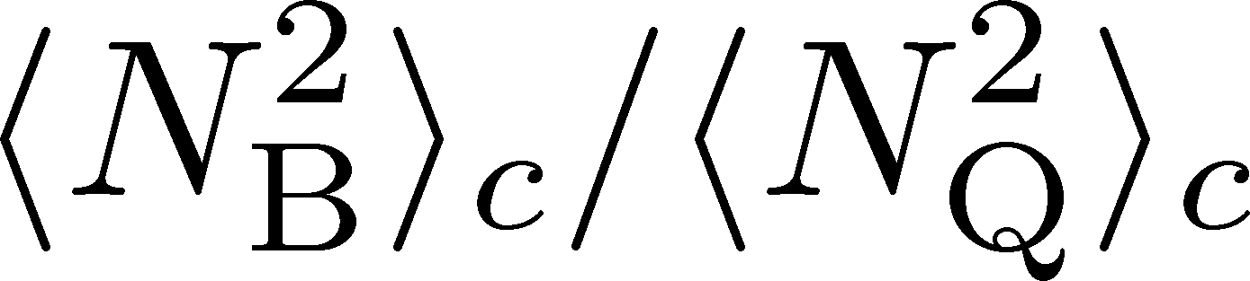
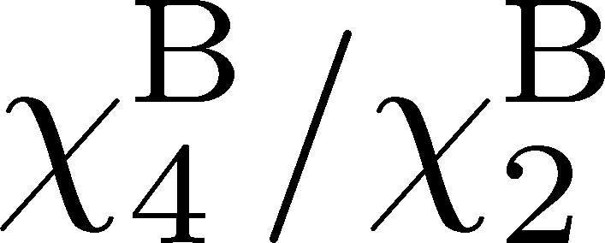
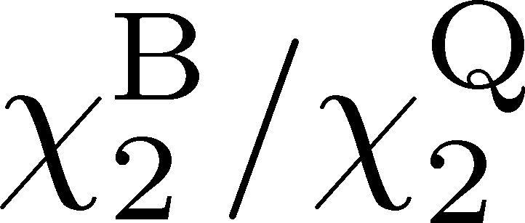
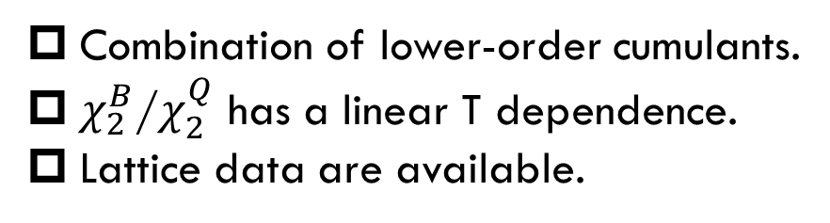
MK, Esumi, Nonaka, in prep.
Combination of lower-order cumulants.
$χ_{2}^{B}$/$χ_{2}^{Q}$ has a linear T dependence.
Lattice data are available.
HOT-QCD 2017
HotQCD,
2107.10011

Slide 18
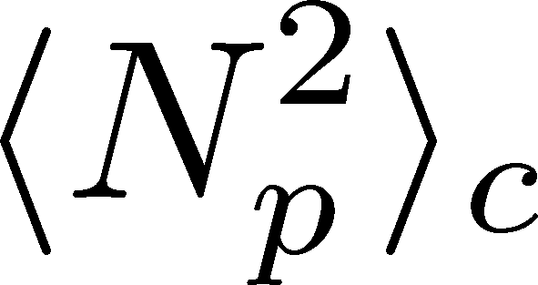
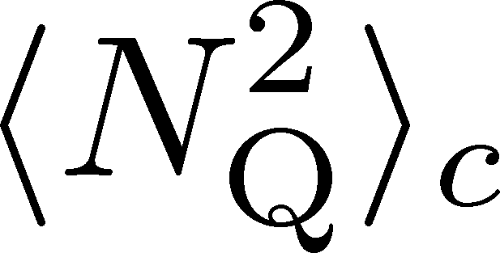
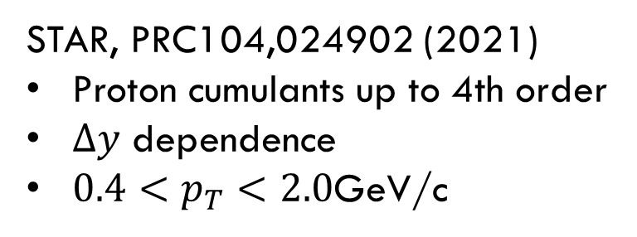
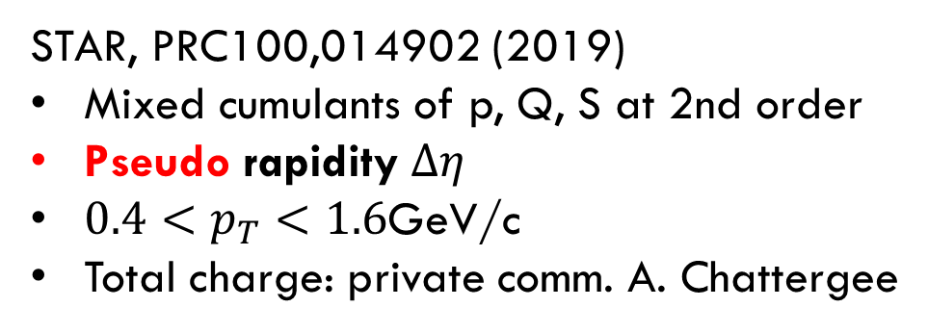
Experimental Data
STAR, PRC104,024902 (2021)
Proton cumulants up to 4th order
$Δy$ dependence
$0.4<p_{T}<2.0$GeV/c
STAR, PRC100,014902 (2019)
Mixed cumulants of p, Q, S at 2nd order
Pseudo rapidity $Δη$
$0.4<p_{T}<1.6$GeV/c
Total charge: private comm. A. Chattergee
p_{T} correction with binomial model

Slide 19
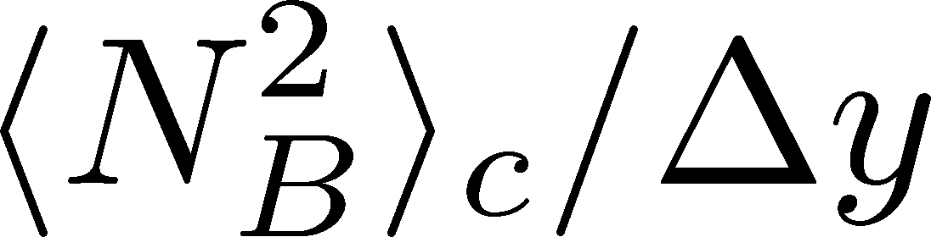
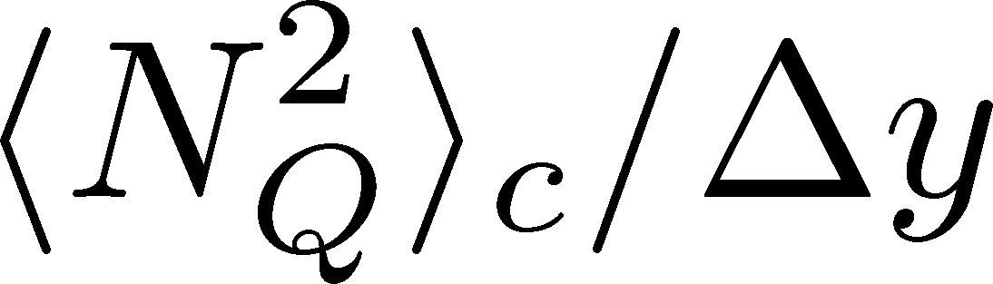
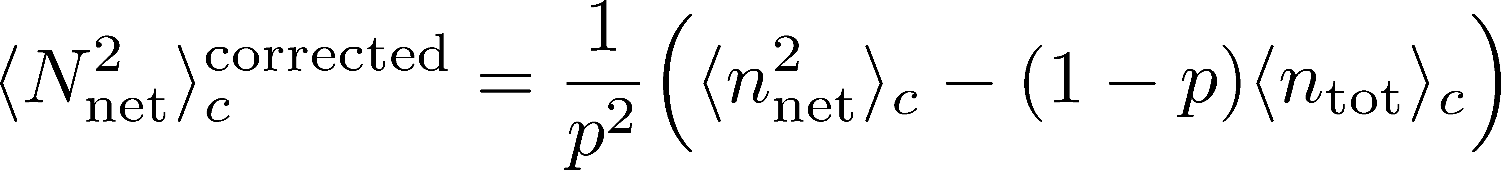
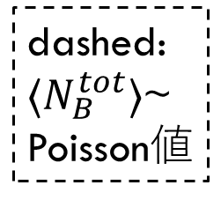
Baryon Number Cumulants w/ Acceptance Correction
dashed:
$⟨N_{B}^{tot}⟩$~
Poisson値
p_{T} corrected
suppression
p_{T} corrected
enhancement
N_{p}×2
p_{T} uncorrected
N_{p}→N_{B}
p_{T} correction with binomial model

Slide 20
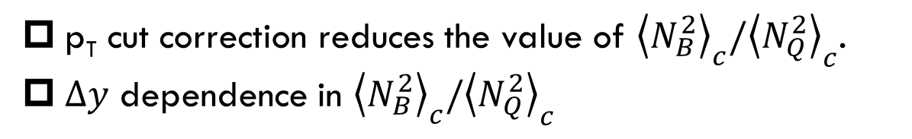
p_{T} uncorrected
p_{T} corrected
dashed:
Poisson
p_{T} cut correction reduces the value of ${\left\langle N_{B}^{2}\right\rangle }_{c}/{\left\langle N_{Q}^{2}\right\rangle }_{c}$.
$Δy$ dependence in ${\left\langle N_{B}^{2}\right\rangle }_{c}/{\left\langle N_{Q}^{2}\right\rangle }_{c}$
Dynamical effect

Slide 21

HIC vs LAT
STAR @ $\sqrt{s_{NN}}=200$GeV
Lattice QCD＋HRG
T=135~140MeV if exp. measures thermal fluctuations.
Lower than chemical freezeout T
Exp. results are not those produced at chemical freezeout!

Slide 22
Anomalous Dilepton Production
as a Precursor of CSC
Nishimura, MK, Kunihiro, arXiv:2201.01963

Slide 23
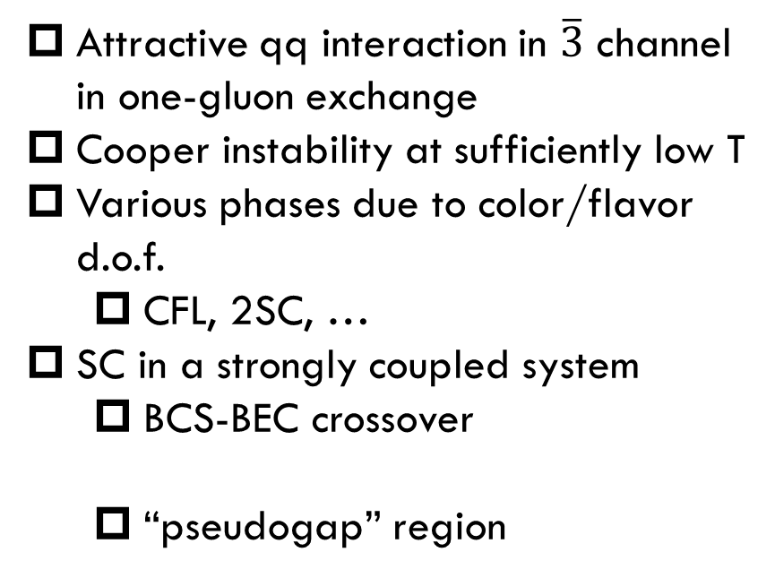

Color SuperConductiviting Phases (CSC)
T
Attractive qq interaction in $\overline{3}$ channel in one-gluon exchange
Cooper instability at sufficiently low T
Various phases due to color/flavor d.o.f.
  CFL, 2SC, …
SC in a strongly coupled system
  BCS-BEC crossover
  “pseudogap” region
varying $√s_{NN}$
150MeV
Abuki, Hatsuda, Itakura (’02)
MK, Rischeke, Shovkovy (’08)
Color SC
MK, Koide, Kunihiro, Nemoto (’03)
~10¹⁵g/cm³
μ

Slide 24
Observing CSC in HIC
Difficulties
  CSC would not be created if Tc is not high enough.
  Even if created, its lifetime would be short.
  Since CSC is created in the early stage, its signal would be blurred during the evolution in later stage.
Ohnishi, 2002
Strategy in the present study:
  Focus on precursory phenomena of CSC
  Use dilepton production as an observable

Slide 25
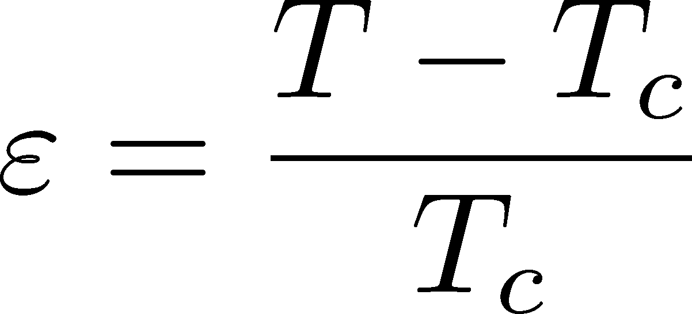


Precursor of CSC
Anomalous behavior of observables near but above Tc of SC
electric conductivity
magnetic susceptibility
pseudogap
Electric conductivity
Skopal, Tinkham(‘75)
Enhanced pair fluctuations is one of the origins of precursory phenomena.
More significant phenomena in strongly-coupled systems.
T>Tc
Landau’s free energy
T<Tc

Slide 26
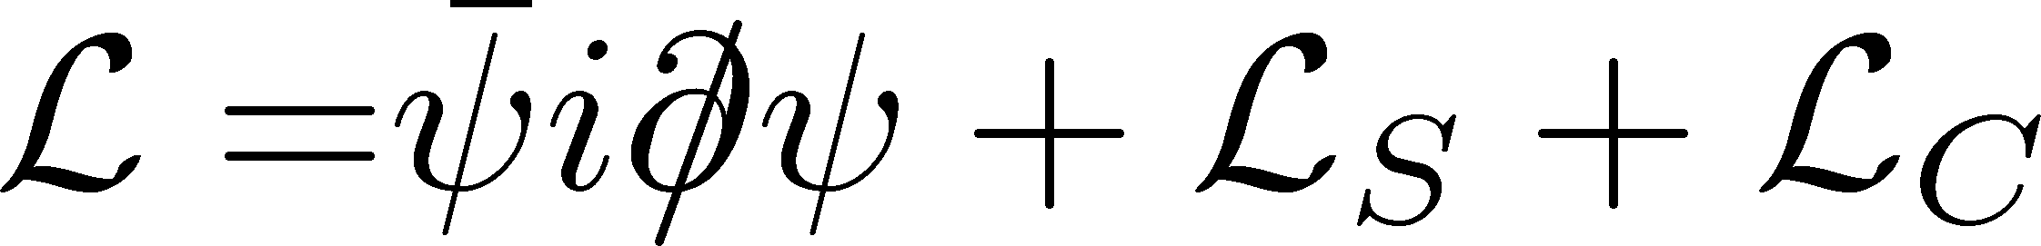
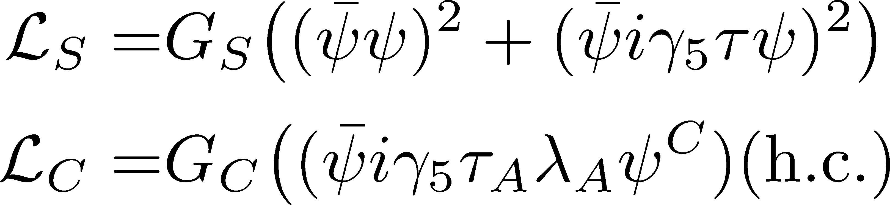
Model
NJL model (2-flavor)
Phase Diagram in MFA
diquark interaction
Parameters
Order of phase transition
  2nd in the MFA
  can be 1st due to gauge fluctuation
Matsuura+(’04), Giannakis+(’04)
Noronha+(’06), Fejos, Yamamoto(’19)

Slide 27
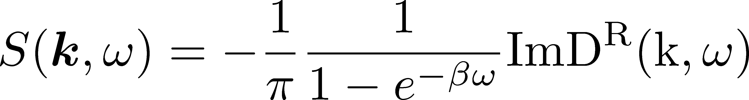

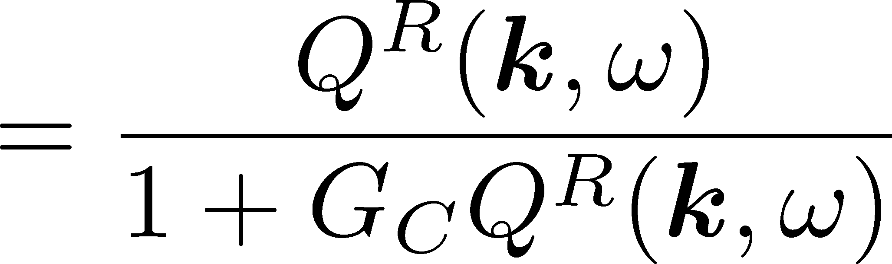
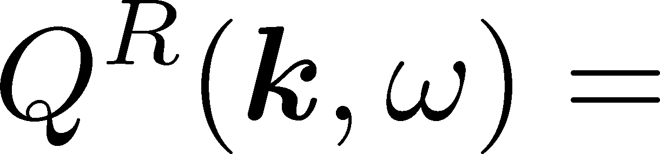



Di-quark Fluctuations
Diquark Propagator
Dynamical Structure Factor
Random Phase Approximaion
$$=$$
$$+$$
$$+ ∙∙∙$$
Diquark field becomes massless at T=Tc
Soft mode of CSC transition
Strength in the space-like region
MK, Koide, Kunihiro, Nemoto, ’01,’05

Slide 28

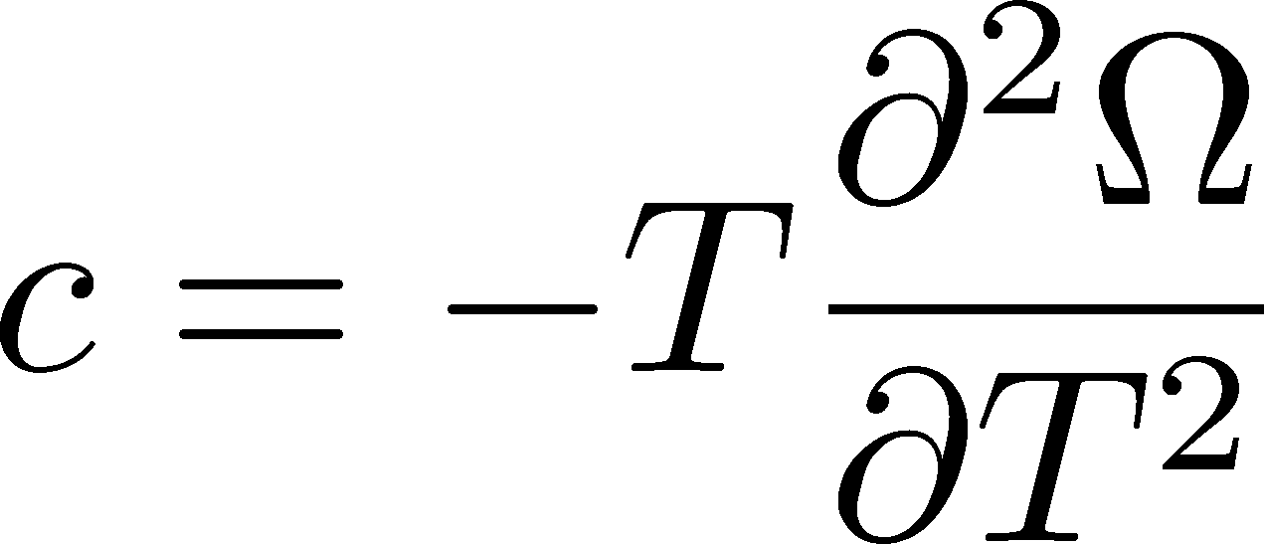
Effects on Observables
MK, Koide, Kunihiro, Nemoto, ’03, ‘05
Thermodynamic Potential
Pseudogap
Specific heat
density of states
Depression
in DoS above Tc

Slide 29

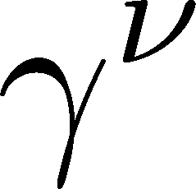
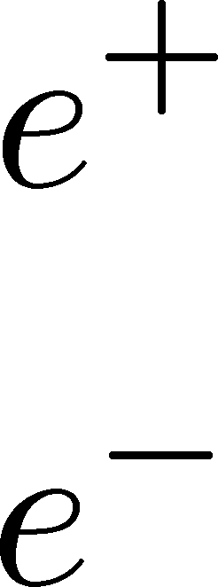
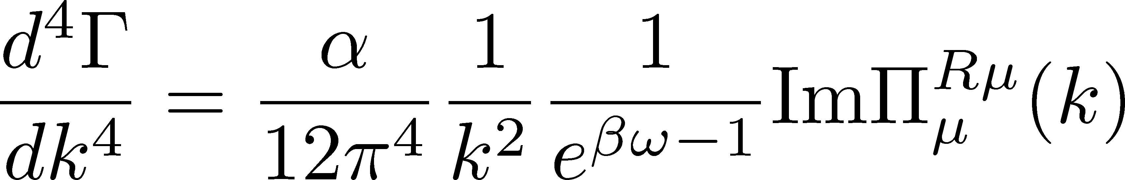
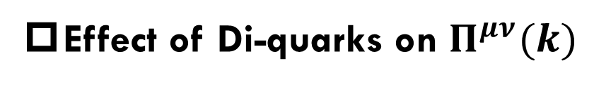
Photon Self-Energy: Precursor of CSC
Dilepton Production Rate
Effect of Di-quarks on $Π^{μν}(k)$
Aslamasov-Larkin term
Maki-Thompson term
DPR from CFL phase
Jaikumar, Rapp, Zahed (’02)
Well-known diagrams in metallic SC
for describing paraconductivity

Slide 30

Gauge-Invariant Construction of $Π_{μν}(k)$
Insert two photon vertices in thermodynamic potential
Aslamasov-Larkin (AL)
Maki-Thompson (MT)
Density of States (DoS)
WT identity $k_{μ}Π^{μν}\left(k\right)=0$ is satisfied with AL, MT and DoS terms.

Slide 31
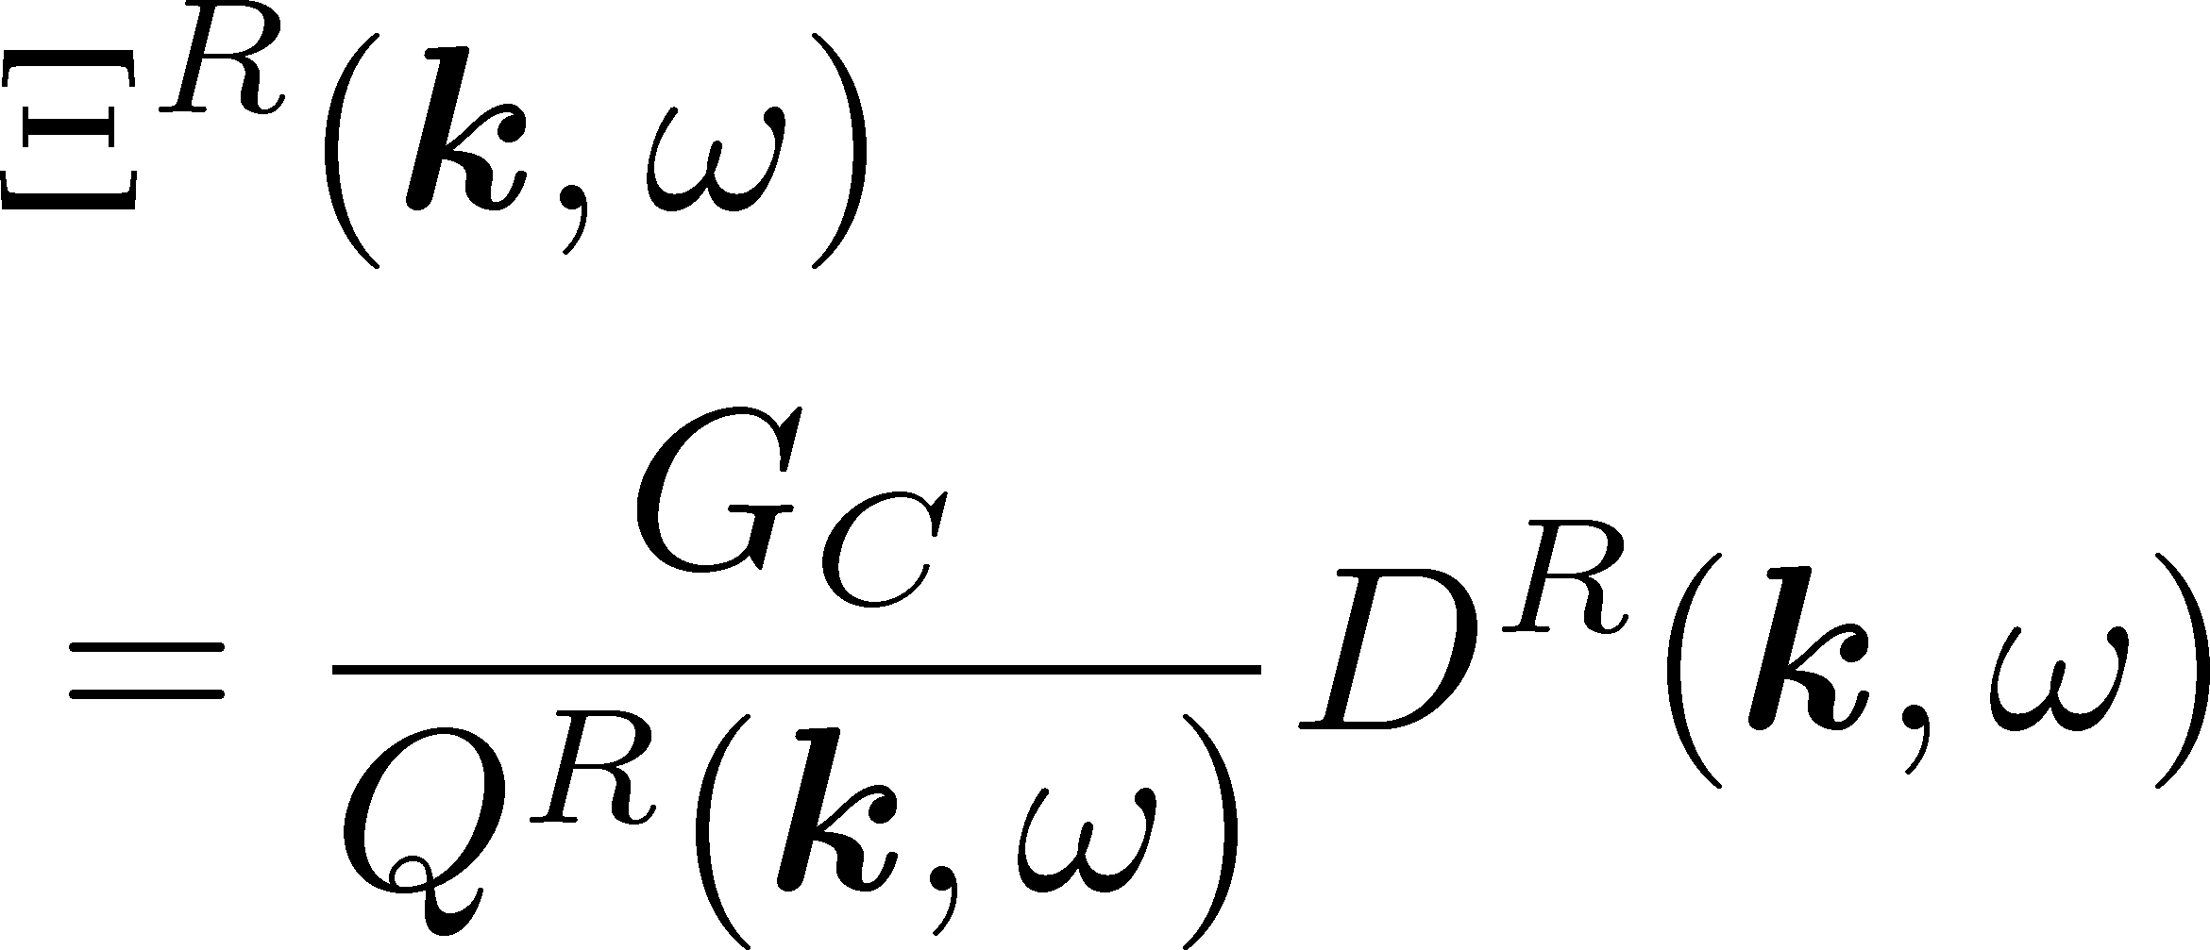
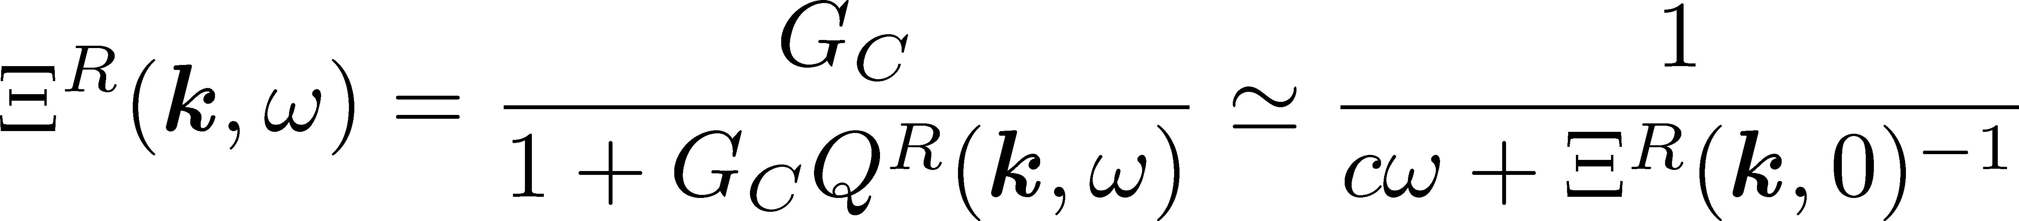
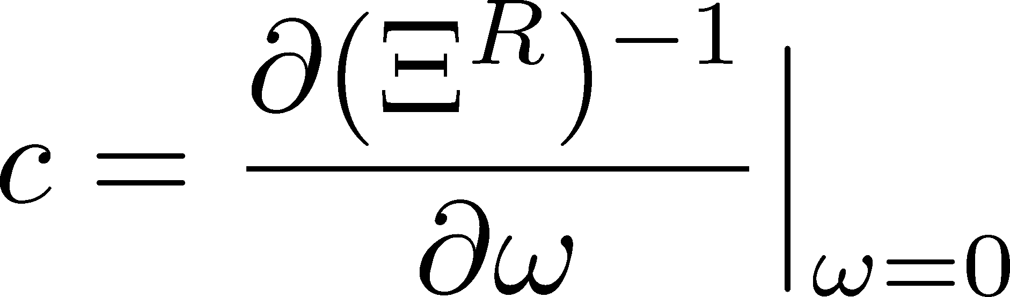
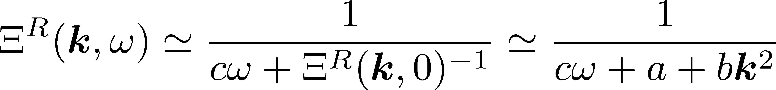
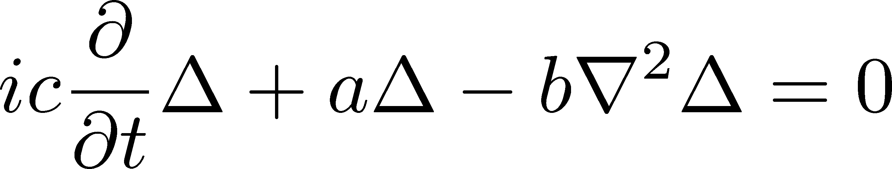
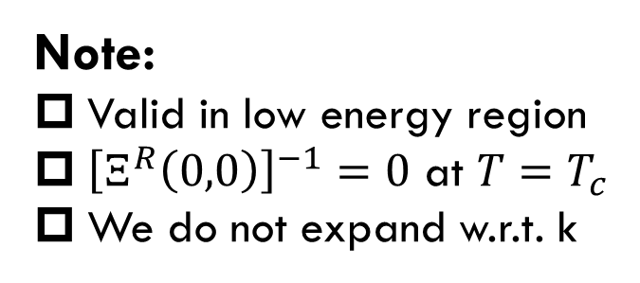
Time-Dependent Ginzburg-Landau Approximation
TDGL approximation for T-matrix
Note:
Valid in low energy region
${\left[Ξ^{R}\left(0,0\right)\right]}^{−1}=0$ at $T=T_{c}$
We do not expand w.r.t. k
TDGL equation:

Slide 32
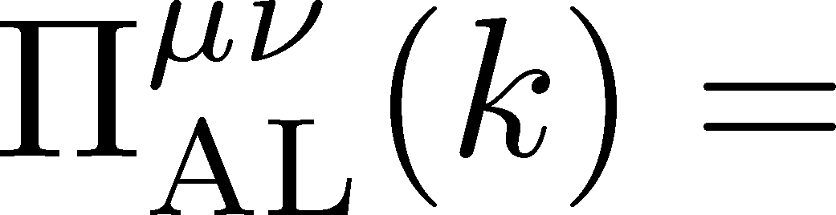

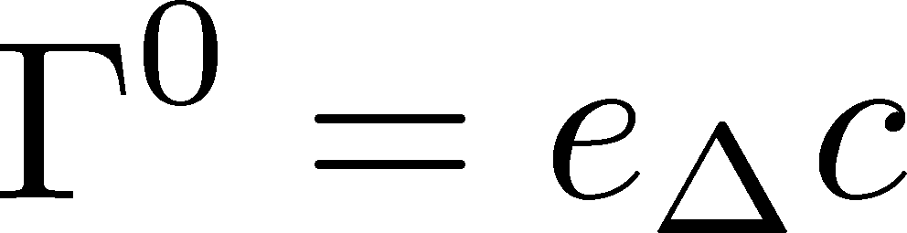
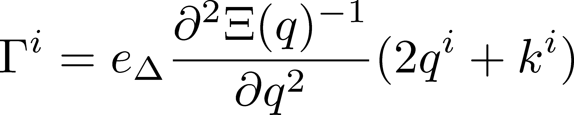
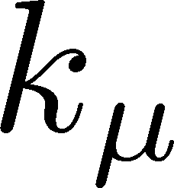







Vertices
Vertices must be determined to be consistent with the TDGL approx.
WT identity for AL vertex
At the lowest order in k
$$=$$
$$−$$
$e_{Δ}$: electric charge of diquarks
MT+DoS
Similar formula for MT+DoS vertex
$$=$$
$$−$$

Slide 33




Photon Self-Energy
Temporal Component
$Π^{00}(k)$ is obtained from spatial components.
Cancellation of MT+DoS
Calculation of AL term is sufficient to obtain Im$Π^{μν}(k)$

Slide 34


Production Rate at $k=0$
Red: fluctuation contribution
Blue: free quarks
$G_{C}=0.7G_{s}$, $T_{c}≃45$ MeV
enhancement
Di-quark fluctuations give rise to large enhancement in the low energy region $ω<200$ MeV and $T<1.5T_{c}$.
Anomalous enhancement is not sensitive to $T$.

Slide 35

Energy-Momentum Dependence
Red: fluctuation contribution
Blue: free quarks
$G_{C}=0.7G_{s}$, $T_{c}≃45$ MeV
Enhancement due to diquark fluctuations is more suppressed for larger k.

Slide 36


Production Mechanism of Virtual Photons
Production mechanism
scattering of diquarks
diquarks: space-like region
Production in the time-like region is possible.
C.f.) Scattering of free quarks produces virtual photons only in the space-like region.

Slide 37

Invariant-Mass Spectrum
Fixed $G_{C}$
Fixed Temperature
Strong enhancement at low invariant mass, though the range of M is narrower than the previous results.
Observable in the HIC?

Slide 38
Summary
The dilepton production rate is calculated incorporating the effects of diquark fluctuations enhanced near Tc of the 2SC.
  AL, MT and DoS terms for the photon self-energy.
  TDGL approximation for diquark propagator and vertices.
Dilepton production rate is enhanced significantly near but above Tc at low invariant-mass region.
Signal of the onset of the CSC phase transition?
Future
Comparison with bremsstrahlung in QGP, hadronic effects, Dalitz decays, etc.
Quantitative estimate on dynamical models
Electric conductivity

Slide 39
$μ$ Dependence
The enhancement from di-quark fluctuations is more pronounced at the higher density region.

