Slide 1
Exploring Phases of Dense QCD in Heavy-Ion Collisions
Masakiyo Kitazawa
(Osaka U.)
Reimei Workshop "Hadrons in dense matter at J-PARC“
KEK, Tokai, 2022/Feb./23

Slide 2
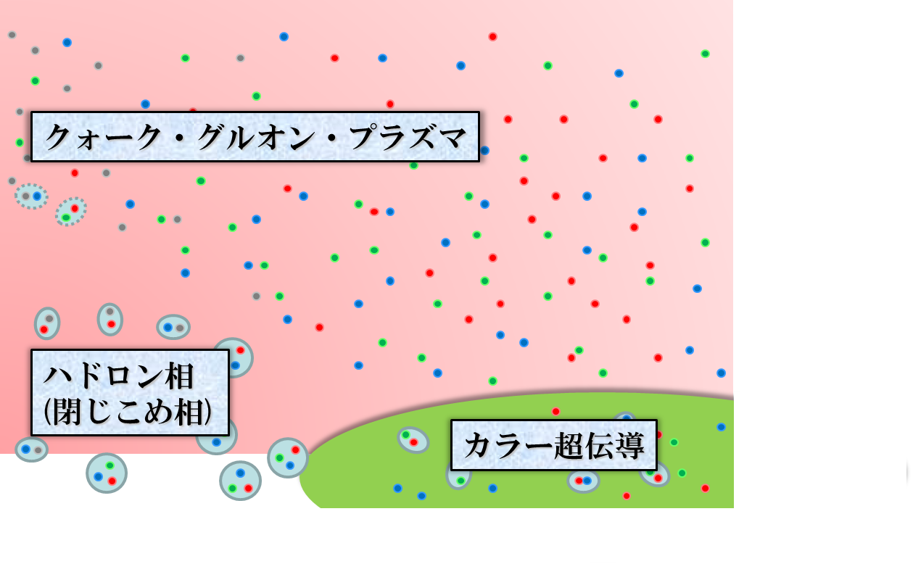




QCD Phase Diagram
Temperature
Quark-Gluon Plasma
ＱＣＤ Critical Point
Hadronic
Phase
Color SC
another CP?
MK+(’02)
Baryon chemical
potential

Slide 3


QCD Phase Diagram
Early Universe
Temperature
Quark-Gluon Plasma
Lattice QCD
ＱＣＤ Critical Point
Hadronic
Phase
Color SC
Baryon chemical
potential
Neutron
Stars

Slide 4
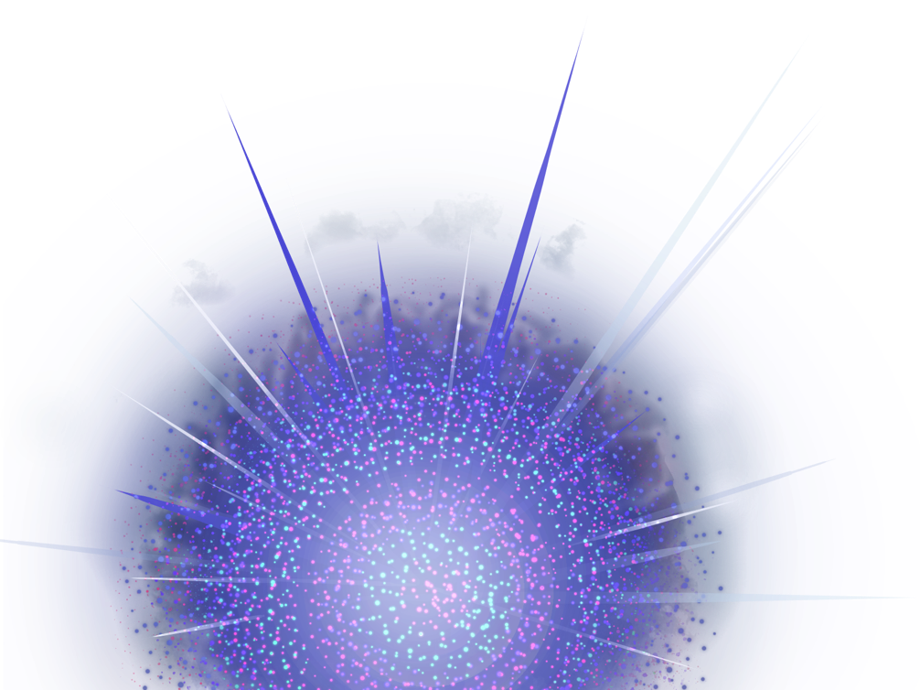
Relativistic Heavy-Ion Collisions
Collide 2 heavy nuclei
Physics
Hot & dense medium
Early Universe
Quark-gluon plasma
QCD phase structre
RHIC (2000~)
QGP Formation
Strongly coupled QGP
LHC (2010~)
Precision measurement
of the QGP

Slide 5




Brief History of Relativistic HIC
AGS
-1996
SPS
1994-2000
RHIC
2000-
LHC
2010-
~2010
High Energy Frontier

Slide 6
Brief History of Relativistic HIC
AGS
-1996
SPS
1994-2000
RHIC
2000-
LHC
2010-
RHIC-BES
2010-
~2010
High Energy Frontier
NICA
2010~
Lower Energy
FAIR
Interaction rate
FAIR, J-PARC-HI: ~10⁷ Hz
AGS, SPS: ~10² Hz
J-PARC-HI

Slide 7
Beam-Energy Dependence

Slide 8
Beam-Energy Dependence
High energy
Low energy
Nuclear transparency
Baryon stopping
net-baryon #: small
net-baryon #: large

Slide 9



Maximum Density
Time evolution in T-ρ plane by JAM
A. Ohnishi, 2002
Maximum density 5~10ρ₀ @ E/A~20GeV
Large event-by-event fluctuations?

Slide 10
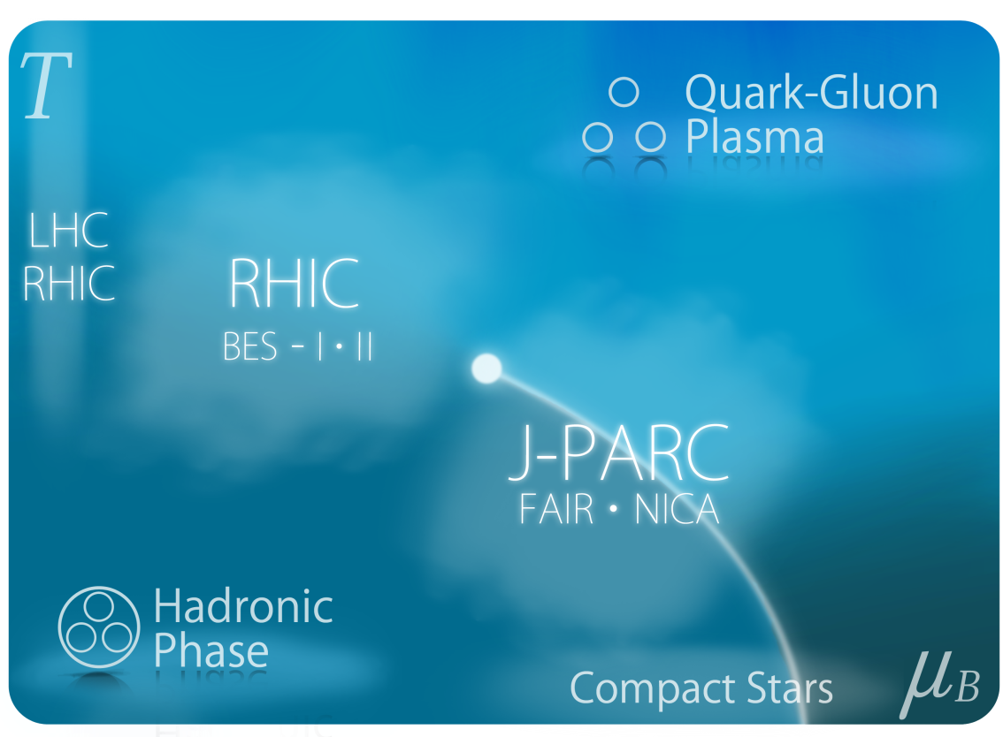
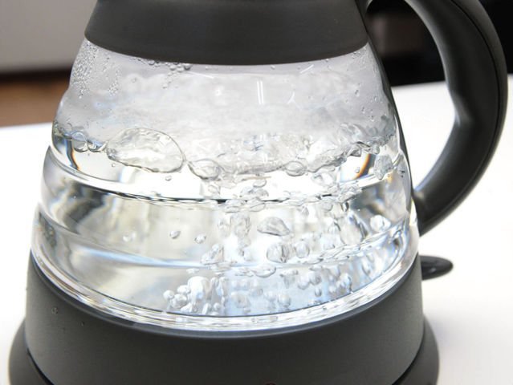
First-order Transition at Highest Density in the Universe
QGP formation in HIC
Lattice QCD
QCD-CP
crossover
first-order transition
liquid-gas tr.
of nuclear matter
Chiral
Transition
boiling water
1g/cm³
10¹⁴g/cm³
10¹⁵g/cm³

Slide 11
Collapse of Vacuum
Our vacuum is filled with the quark condensate.
quark
anti-quark

Slide 12
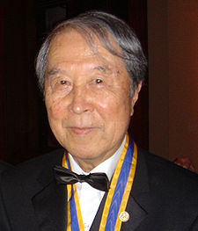
Collapse of Vacuum
Our vacuum is filled with the quark condensate.
quark
anti-quark
Spontaneous breaking of chiral symmetry (Nambu)

Slide 13
Collapse of Vacuum
Matter modifies the vacuum.
Restoration of chiral symmetry

Slide 14
Collision Rate
J-PARC-HI
J-PARC-HI:
High-luminosity x Fixed target
→World highest rate～10⁸Hz
5-order higher than AGS,SPS
SPS
AGS
AGS, SPS
1 year
J-PARC-HI
5 min.
＝
High-statistical exp.
various event selections
higher order correlations
search for rare events
Galatyuk, NPA982,163 (2019)

Slide 15
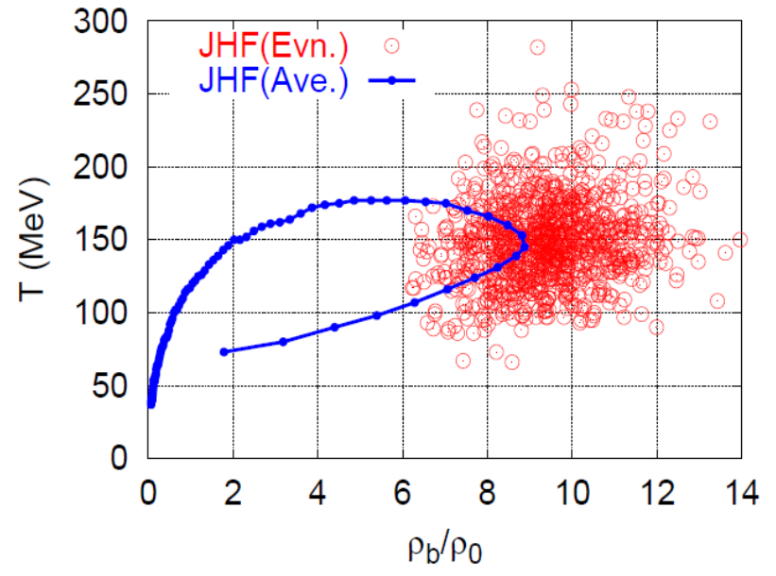
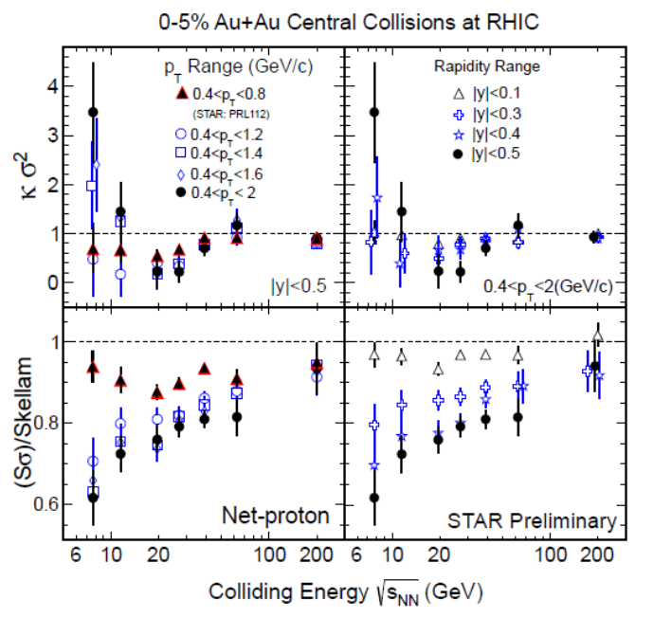
Various Observables
Flow
Dilepton / photon
Fluctuations, higher-order cumulants
Ξ, Ω, …
Sophisticated event selections
Various correlations

Slide 16
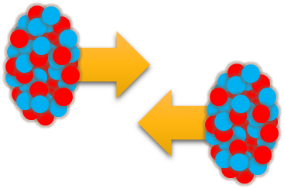

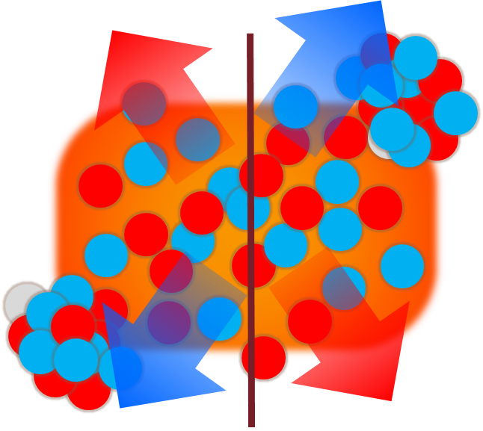
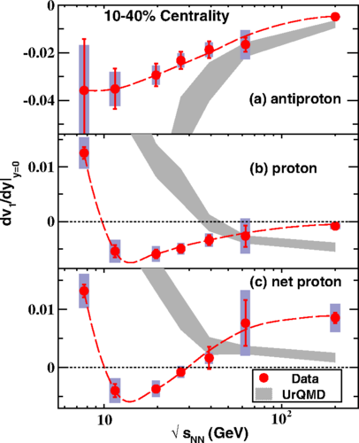



Directed Flow
Reproduction of $√s_{NN}$ dependence
STAR, PRL(’14)
Nara, Ohnishi, PRC (’22)

Slide 17




Event Selection
Large fluctuations
in highest density
“Density scan” by
event selection?
non-monotonic
behavior
as evidence of 1st. tr?
baryon rich events
mean $E_{T}$
beam-energy scan
Baryon-rich
events

Slide 18



Event-by-Event Fluctuations
Review: Asakawa, MK, PPNP 90 (2016)
STAR, PRL105 (2010)
Detector
Cumulants

Slide 19


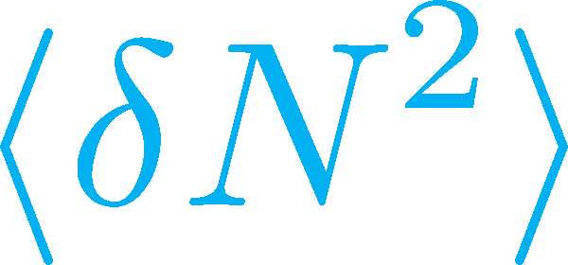

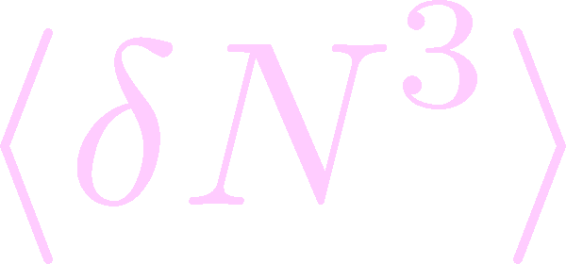
Non-Gaussian Cumulants
Gaussian fluctuations
diverge at the QCD-CP
Higher order cumulants change sign at the phase boundary
Asakawa, Ejiri, MK, 2009
Steeper divergence for higher-order cumulants
Stephanov, 2009

Slide 20




Experimental Results
Enhancement
STAR Collab.
2010~
Suppression
Enhancement & Suppression of non-Gaussian cumulants!
Have we observed
QCD critical point?

Slide 21





Rapidity Window Dependence
STAR Collab. 2015
Non-Gaussian Cumulants have been observed as a function of rapidity window Δy.
Some results have non-monotonic Δy dependence.

Slide 22
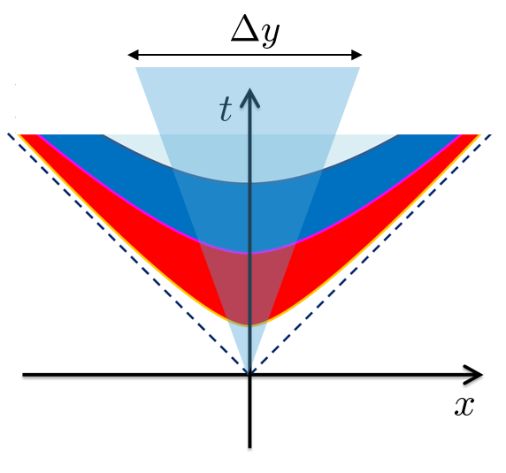


Diffusion of Fluctuations
MK, Ohno, Asakawa 2014
MK 2015
Distributions in Δy in the final state and early stage are different due to diffusion.

Slide 23







Rapidity Window dependence as a Result of Diffusion
MK+ (2014); MK (2015)
Parameters
(rough estimate)
Higher order cumulants can behave non-monotonically.
Δη dependence encodes history of time evolution.

Slide 24
Rapidity Window dependence as a Result of Diffusion
MK+ (2014); MK (2015)
Parameters
STAR 2015
(rough estimate)
Higher order cumulants can behave non-monotonically.
Δη dependence encodes history of time evolution.

Slide 25
Search for CSC Phase Transition
using dilepton production rates
Nishimura, MK, Kunihiro, arXiv:2201.01963

Slide 26
Color Superconductivity
Temperature
Quark-Gluon Plasma
ＱＣＤ Critical Point
Measurement of
CSC in HIC?
Hadronic
Phase
Color SC
Baryon chemical
potential

Slide 27
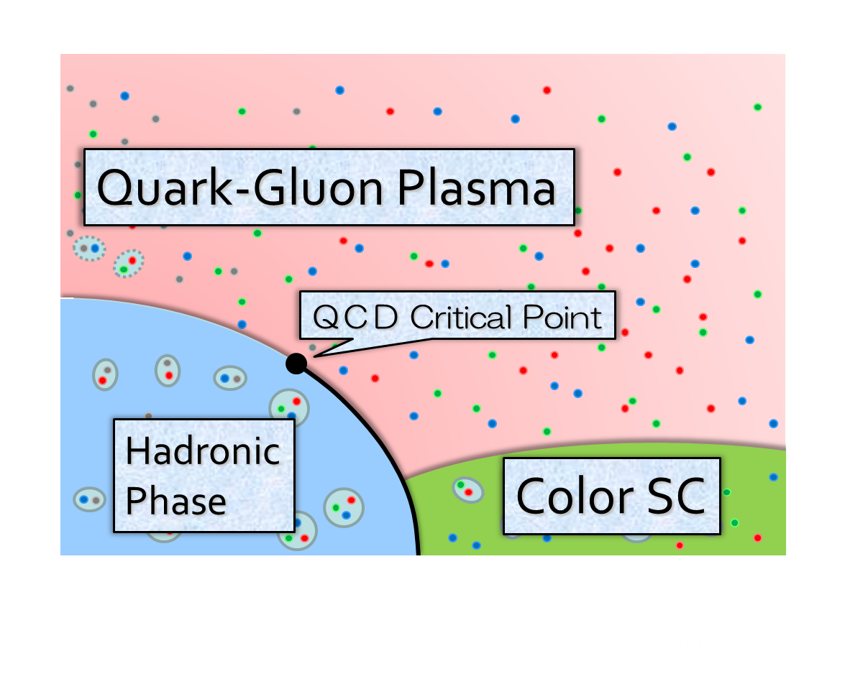
Observing CSC in HIC?
Difficulties
1)
2)
Creation of CSC itself would be impossible.
CSC would be realized only in the early stage.
Solution
1)
2)
Focus on precursor of CSC
Use dilepton production
precursor
Nishimura, MK, Kunihiro, 2201.01963

Slide 28

Multi-Messenger Observation
gravitational waves
electromagnetic waves
time scale：10⁻¹s
leptons,
photons
hadronic observables
time scale：10⁻²²s

Slide 29



Precursory Phenomena
= anomalous behavior of observables near but above T_{c}
Electric conductivity in metals
Landau’s Free Energy
Skopal,
Tinkham
1975
T>T_{c}
fluctuation
T<T_{c}
Precursor of CSC
Density of States
Specific Heat
Pseudogap = Depression in the density of states
Specific heat
etc.
MK, Koide, Kunihiro, Nemoto, ’03, ’05

Slide 30



Model
NJL model
(massless 2-flavor)
diquark interaction
Phase Diagram in MFA
$G_{C}$: free parameter
Order of CSC phase transition
Matsuura+(’04), Giannakis+(’04)
Noronha+(’06), Fejos, Yamamoto(’19)

Slide 31





Diquark Mode
Dynamical Structure
Factor
Diquark Propagator (T-matrix)
in random-phase approximaion
$$+$$
$$+ ∙∙∙$$
Massless at T=T_{c} as a soft mode of CSC transition
Strength in the space-like region
MK, Koide, Kunihiro, Nemoto, ’01,’05

Slide 32






Photon Self-Energy
Dilepton Production Rate
Terms included in $Π^{μν}$
Aslamasov-Larkin
Maki-Thompson, Density of states
= diquark propagator
common in metallic superconductors (conductivity)
time-dependent GL approx. for diquark field
gauge-invariant construction
Nishimura, MK, Kunihiro, 2201.01963

Slide 33



Dilepton Production Rates
Red: fluctuation contribution
Blue: free quarks
Nishimura, MK, Kunihiro,
2201.01963
Diquark fluctuations give rise to anomalous enhancement in the low energy-momentum region for $T<1.5T_{c}$.

Slide 34


Invariant-Mass Spectrum
Fixed Temperature
This point
enhancement at low M
Strong enhancement at low invariant mass, though the range of $M$ is narrower than the previous results.
Observable in the HIC?
Nishimura, MK, Kunihiro, 2201.01963

Slide 35
Summary
Exploring dense medium in relativistic heavy-ion collisions is a hot topic in this field. The beam-energy scan is ongoing, and many new experiments will start in near future!
Among them, search for
  the QCD critical point using fluctuation observables
  the color superconductivity using dileptons
are especially interesting and important subjects.
Heavy-ion collisions at J-PARC will play important roles in pursuing these subjects.

Slide 36


Beam-Energy Scan
Temperature
high
Quark-Gluon Plasma
beam energy
ＱＣＤ Critical Point
low
Hadronic
Phase
Color SC
Baryon chemical
potential

Slide 37
HI Acceleration @ J-PARC
J-PARC Heavy Ion
Spectrometer
New HI Injector
high intensity
RCS & Main Ring
stable
well established
Use of reliable / high-performance RCS & main ring
→Reduce cost and time

