Slide 1
Baryon/Charge Cumulant Ratio at Second Order
Quark Matter 2022, Krakow, Poland (hybrid), Apr. 6, 2022
Masakiyo Kitazawa (Osaka U.)
MK, S. Esumi, T. Nonaka, arXiv:2204.#####
MK, EMMI-RRTF, Apr. 2019, GSI; On-line seminar series on RHIC-BES, Sep. 2020

Slide 2

Beam-Energy Scan
T
Quark-Gluon Plasma
150MeV
ＱＣＤ Critical Point
Hadron Phase
(confined)
Color SC
~10¹⁵g/cm³
μ

Slide 3
Beam-Energy Scan
T
Experiments
RHIC-BES
HADES
NA61/SHINE
FAIR
NICA
J-PARC-HI
…
LHC
Quark-Gluon Plasma
Beam Energy Scan
150MeV
ＱＣＤ Critical Point
Future facilities
FAIR, J-PARC
Hadron Phase
(confined)
Color SC
~10¹⁵g/cm³
μ

Slide 4
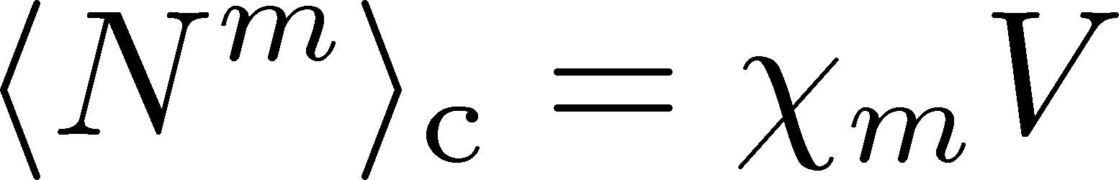
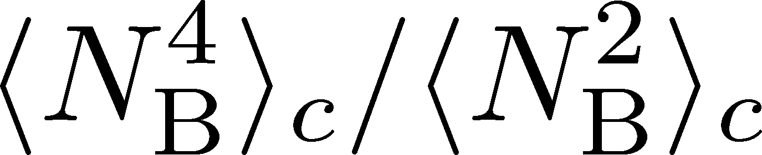


Fluctuations, Cumulants of Conserved Charges
Divergence and sign change at the QCD-CP. Stephanov,’09; Asakawa, Ejiri, MK,’09
Volume dependence is canceled out in ratio. Ejiri, Karsch, Redlich,’05
Direct comparison with lattice QCD simulations.
Slower diffusion.
HOT-QCD 2017
Asakawa, Ejiri, MK (2009)
Stephanov (2011)

Slide 5
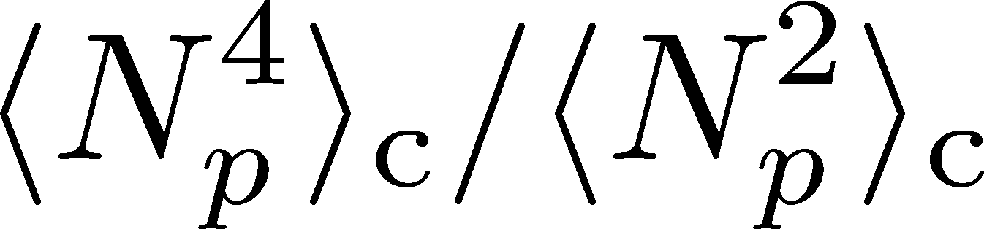
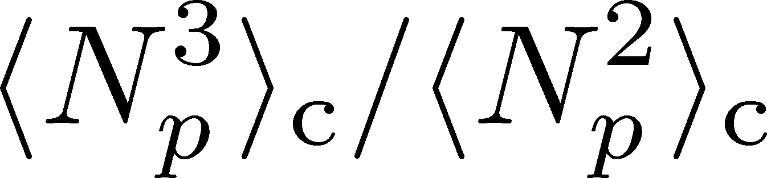
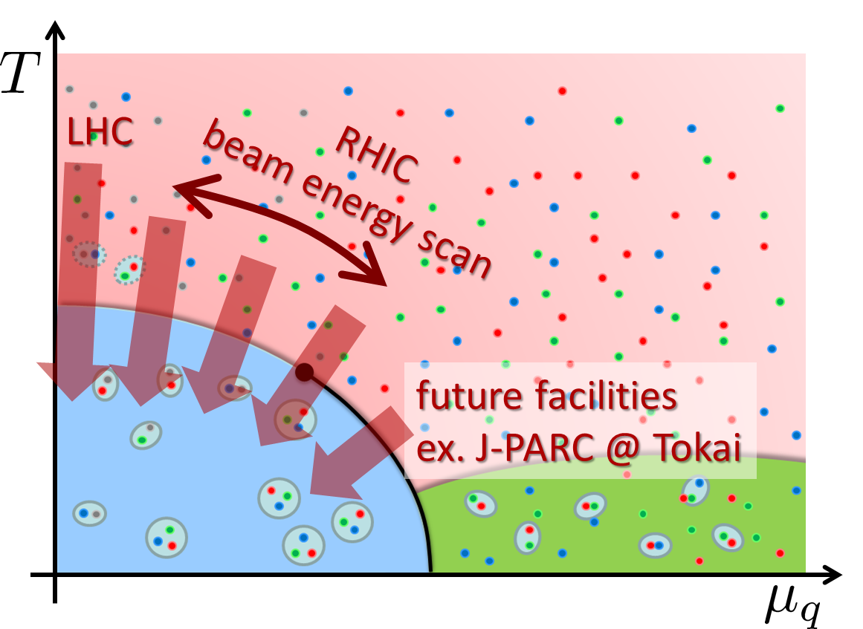
Experimental Results
Net-proton number cumulants
STAR, 2020 (2001.02852)
Non-Poisson and non-monotonic behaviors in the ratio of higher order cumulants.
When are these fluctuations generated?

Slide 6
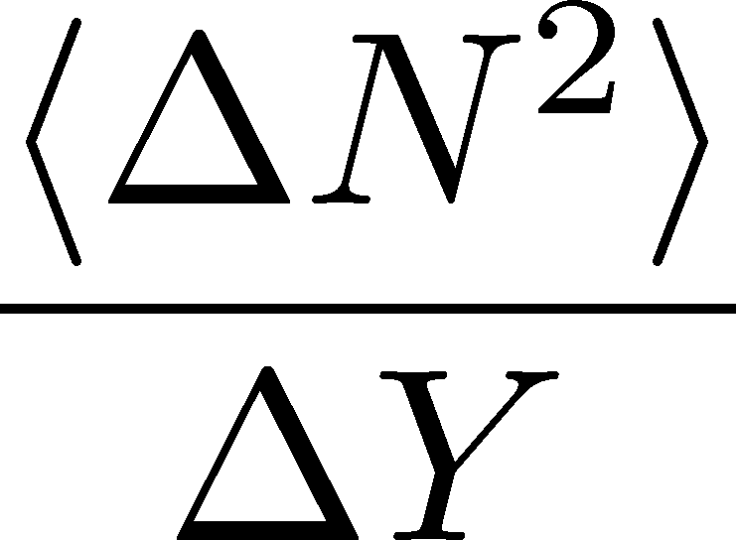



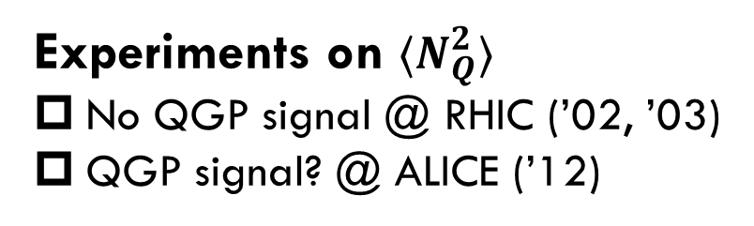
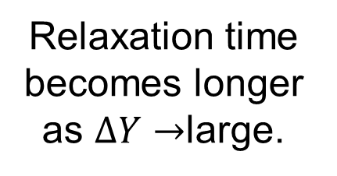
Evolution of Conserved-charge Fluctuations
Quark-Gluon Plasma
Fluctuations of CC are modified by the diffusion.
Hadronization
Relaxation time becomes longer as $ΔY→$large.
Freezeout
Experiments on $⟨N_{Q}^{2}⟩$
No QGP signal @ RHIC (’02, ’03)
QGP signal? @ ALICE (’12)
Asakawa, Heinz, Muller, 2000
Jeon, Koch, 2000; Shuryak, Stephanov, 2001

Slide 7

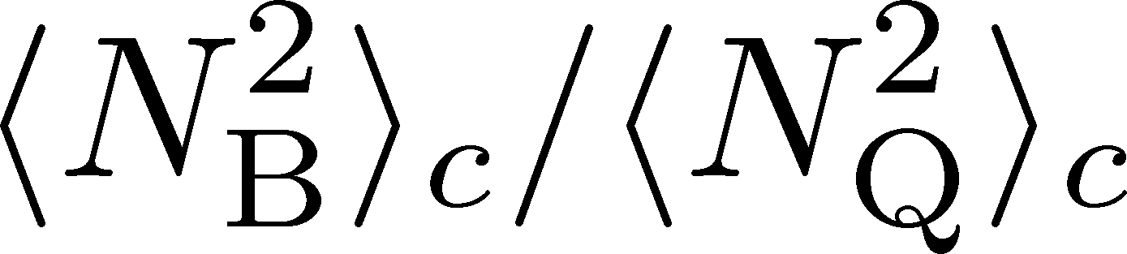
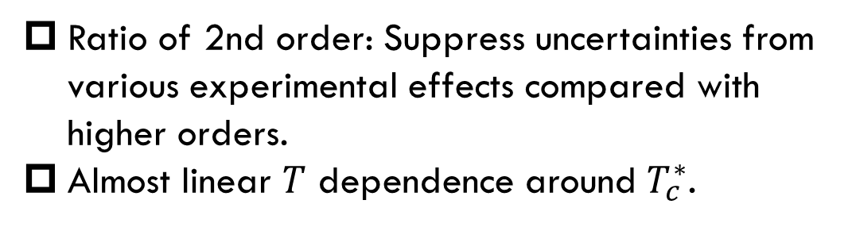
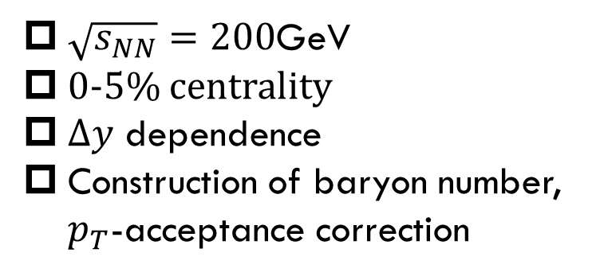
The purpose of this study:
$\sqrt{s_{NN}}=200$GeV
0-5% centrality
$Δy$ dependence
Construction of baryon number, $p_{T}$-acceptance correction
Ratio of 2nd order: Suppress uncertainties from various experimental effects compared with higher orders.
Almost linear $T$ dependence around $T_{c}^{∗}$.
Data from
HotQCD,
PRD104 (’21)
HOT-QCD 2017

Slide 8
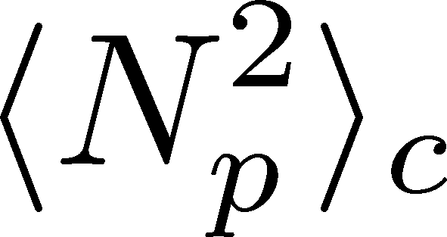
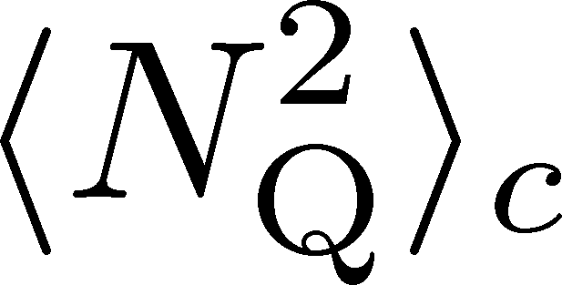
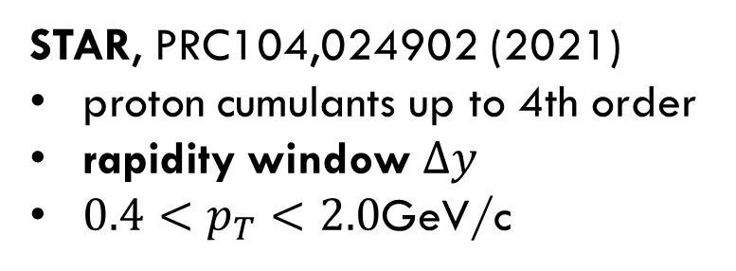
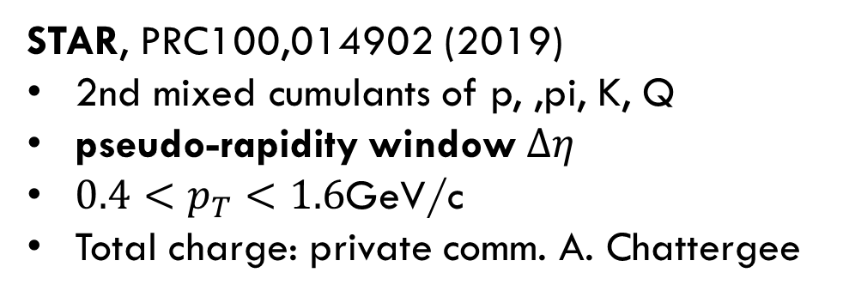
Experimental Data
$\sqrt{s_{NN}}=200$GeV
0-5% centrality
$Δy$ dependence
Construction of baryon number, $p_{T}$-acceptance correction
STAR, PRC104,024902 (2021)
proton cumulants up to 4th order
rapidity window $Δy$
$0.4<p_{T}<2.0$GeV/c
STAR, PRC100,014902 (2019)
2nd mixed cumulants of p, ,pi, K, Q
pseudo-rapidity window $Δη$
$0.4<p_{T}<1.6$GeV/c
Total charge: private comm. A. Chattergee
proton → baryon cumulants MK, Asakawa,’12;’12
Rapidity is better than pseudo-rapidity
Wider acceptance is more desirable.
Ohnishi, MK, Asakawa, ’16

Slide 9
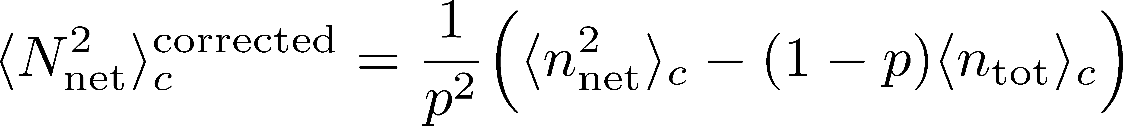
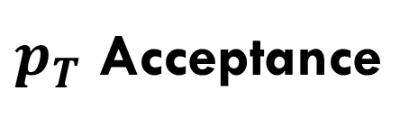


$pT$-Acceptance Correction
$p_{T}$ Acceptance
0.4<p_{T}<1.6 [GeV/c]
0.4<p_{T}<2.0 [GeV/c]
PRC100,014902(’19)
PRC104,024902(’21)
Particles in $p_{T}$ space
Electric charge: 49%
Protons: 82%
blast wave model @ √s_{NN}=200 GeV
Modification by $p_{T}$-cut should be corrected.
This study: Binomial distribution model.
MK, Asakawa, ’12, ’12

Slide 10
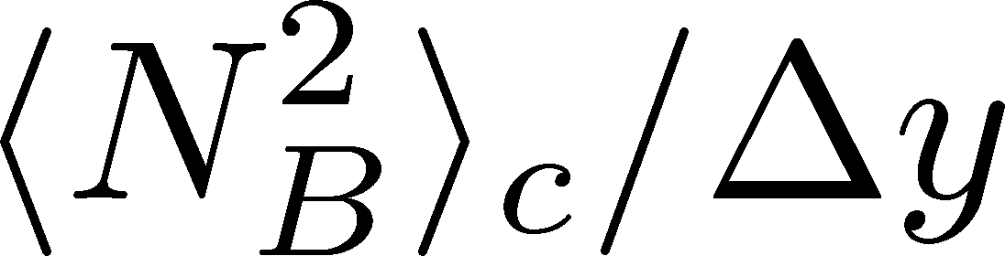
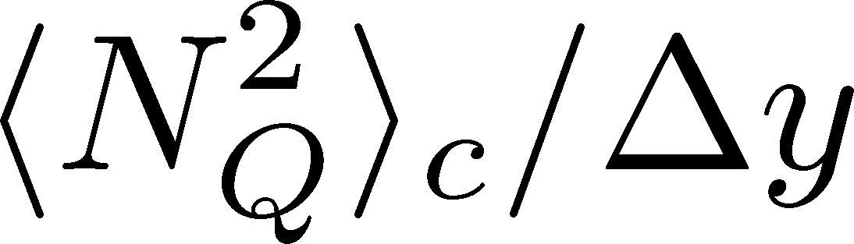

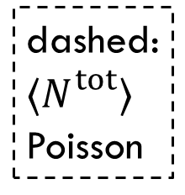
Cumulants: Proton→Baryon & Acceptance Correction
Data from STAR, ’19, ’21
corrected
dashed:
$⟨N_{}^{tot}⟩$
Poisson
suppress
corrected
uncorrected
uncorrected
$${\left\langle N_{p}^{2}\right\rangle }_{c}$$
Deviation from Poissonian is clarified by the acceptance correction.
MK, Asakawa, ’12, ’12

Slide 11


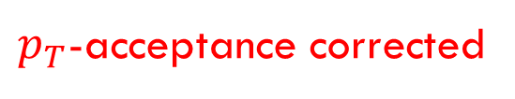
$p_{T}$-acceptance uncorrected
$p_{T}$-acceptance corrected
dashed:
Poisson
${\left\langle N_{B}^{2}\right\rangle }_{c}/{\left\langle N_{Q}^{2}\right\rangle }_{c}$ becomes smaller due to the $p_{T}$-acceptance correction.
Clear $Δy$ dependence
non-thermal effects behind fluctuations

Slide 12
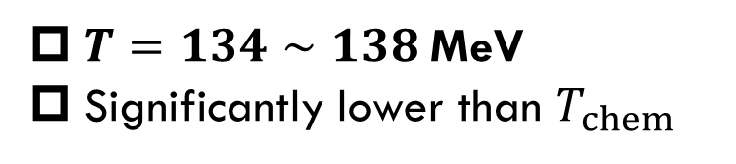
HIC vs HRG&LAT
From data @ STAR
HRG+Lattice
Data from
HotQCD, PRD104 (’21)
$T=134∼138$MeV
Significantly lower than $T_{chem}$
HRG: QMHRG2020
Bollweg+, PRD104, 7 (’21)
Volume dep. corrected
plot by MK

Slide 13
HIC vs HRG&LAT
From data @ STAR
HRG+Lattice
Data from
HotQCD, PRD104 (’21)
$T=134∼138$MeV
Significantly lower than $T_{chem}$
HRG: QMHRG2020
Bollweg+, PRD104, 7 (’21)
Volume dep. corrected
plot by MK

Slide 14
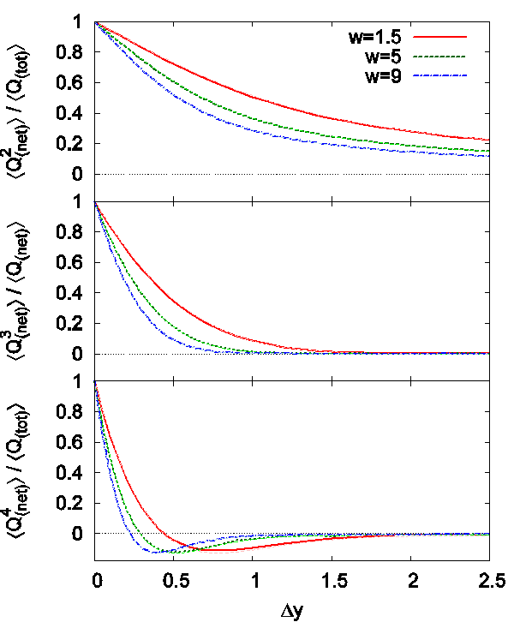

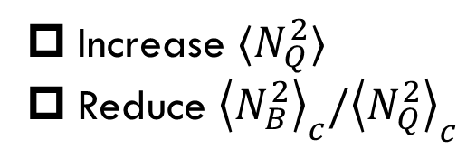

Effect of Diffusion and Rapidity Conversion
Ohnishi, MK, Asakawa, PRC (‘16)
Blurring due to diffusion & rapidity conversion ($Y→y$)
Stronger modification in Q than B
Resonance Decays
About 30% charged particles come from RD
Enhancement of charged particles
Increase $⟨N_{Q}^{2}⟩$
Reduce ${\left\langle N_{B}^{2}\right\rangle }_{c}/{\left\langle N_{Q}^{2}\right\rangle }_{c}$
These effects will be more important for higher order cumulants!

Slide 15
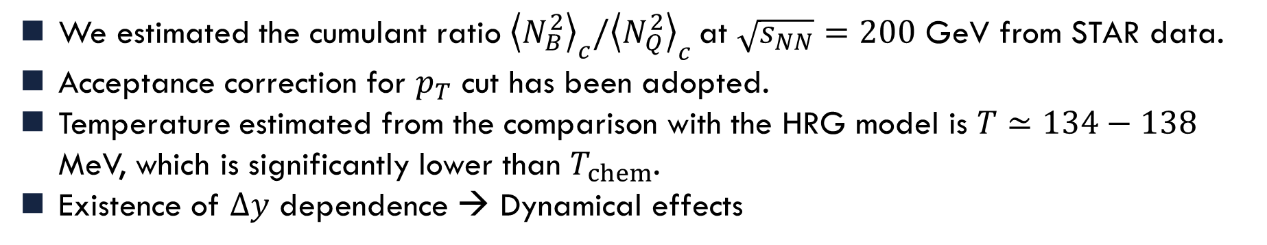
Summary
We estimated the cumulant ratio ${\left\langle N_{B}^{2}\right\rangle }_{c}/{\left\langle N_{Q}^{2}\right\rangle }_{c}$at $\sqrt{s_{NN}}=200$ GeV from STAR data.
Acceptance correction for $p_{T}$ cut has been adopted.
Temperature estimated from the comparison with the HRG model is $T≃134−138$ MeV, which is significantly lower than $T_{chem}$.
Existence of $Δy$ dependence → Dynamical effects

Slide 16
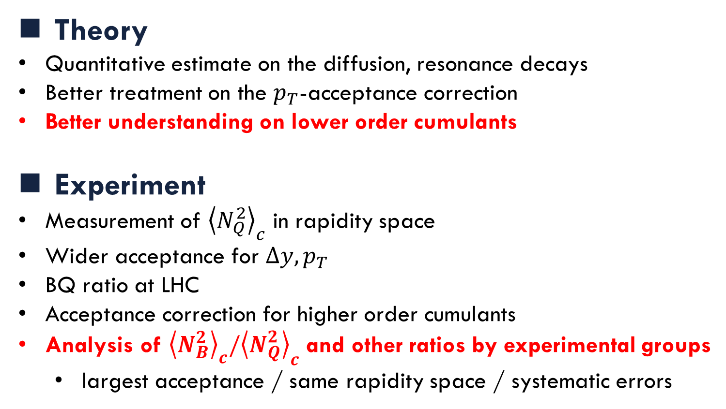
Future Work
Theory
Quantitative estimate on the diffusion, resonance decays
Better treatment on the $p_{T}$-acceptance correction
Better understanding on lower order cumulants
Experiment
Measurement of ${\left\langle N_{Q}^{2}\right\rangle }_{c}$ in rapidity space
Wider acceptance for $Δy, p_{T}$
BQ ratio at LHC
Acceptance correction for higher order cumulants
Analysis of ${\left\langle N_{B}^{2}\right\rangle }_{c}/{\left\langle N_{Q}^{2}\right\rangle }_{c}$ and other ratios by experimental groups
  largest acceptance / same rapidity space / systematic errors

Slide 17

Resonance Decays
Neutral Particles
Decay into charged particles

Slide 18
Resonance Decays
Neutral Particles
Decay into charged particles

Slide 19

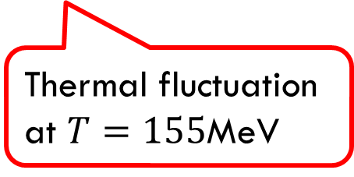
Expectations
Experimental data
Lattice QCD＋HRG
Data from
HotQCD, PRD104 (’21)
Thermal fluctuation at $T=155$MeV
HRG: QMHG2020
Bollweg+, PRD104, 7 (’21)
plot by MK

Slide 20
Expectations
Experimental data
Lattice QCD＋HRG
Fluctuations
in the early stage
Data from
HotQCD, PRD104 (’21)
Thermal fluctuation at $T=155$MeV
diffusion,
resonance decays
HRG: QMHG2020
Bollweg+, PRD104, 7 (’21)
plot by MK

Slide 21
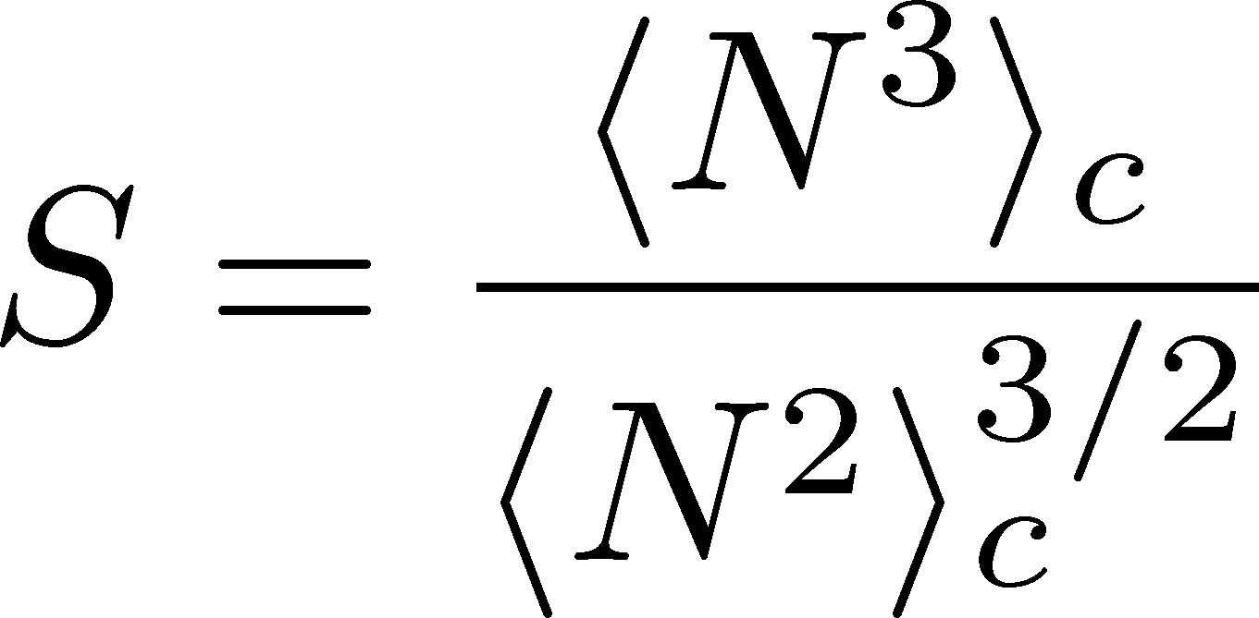
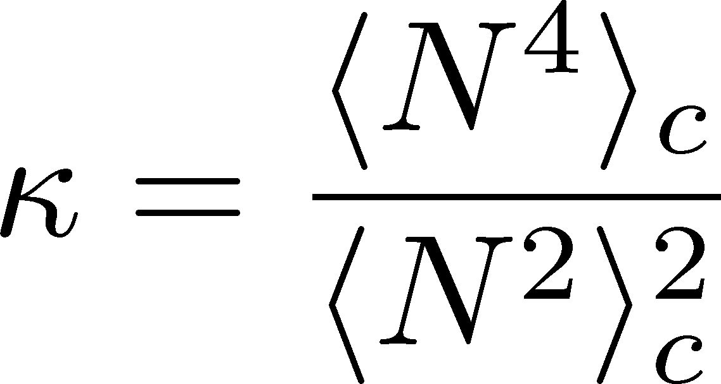
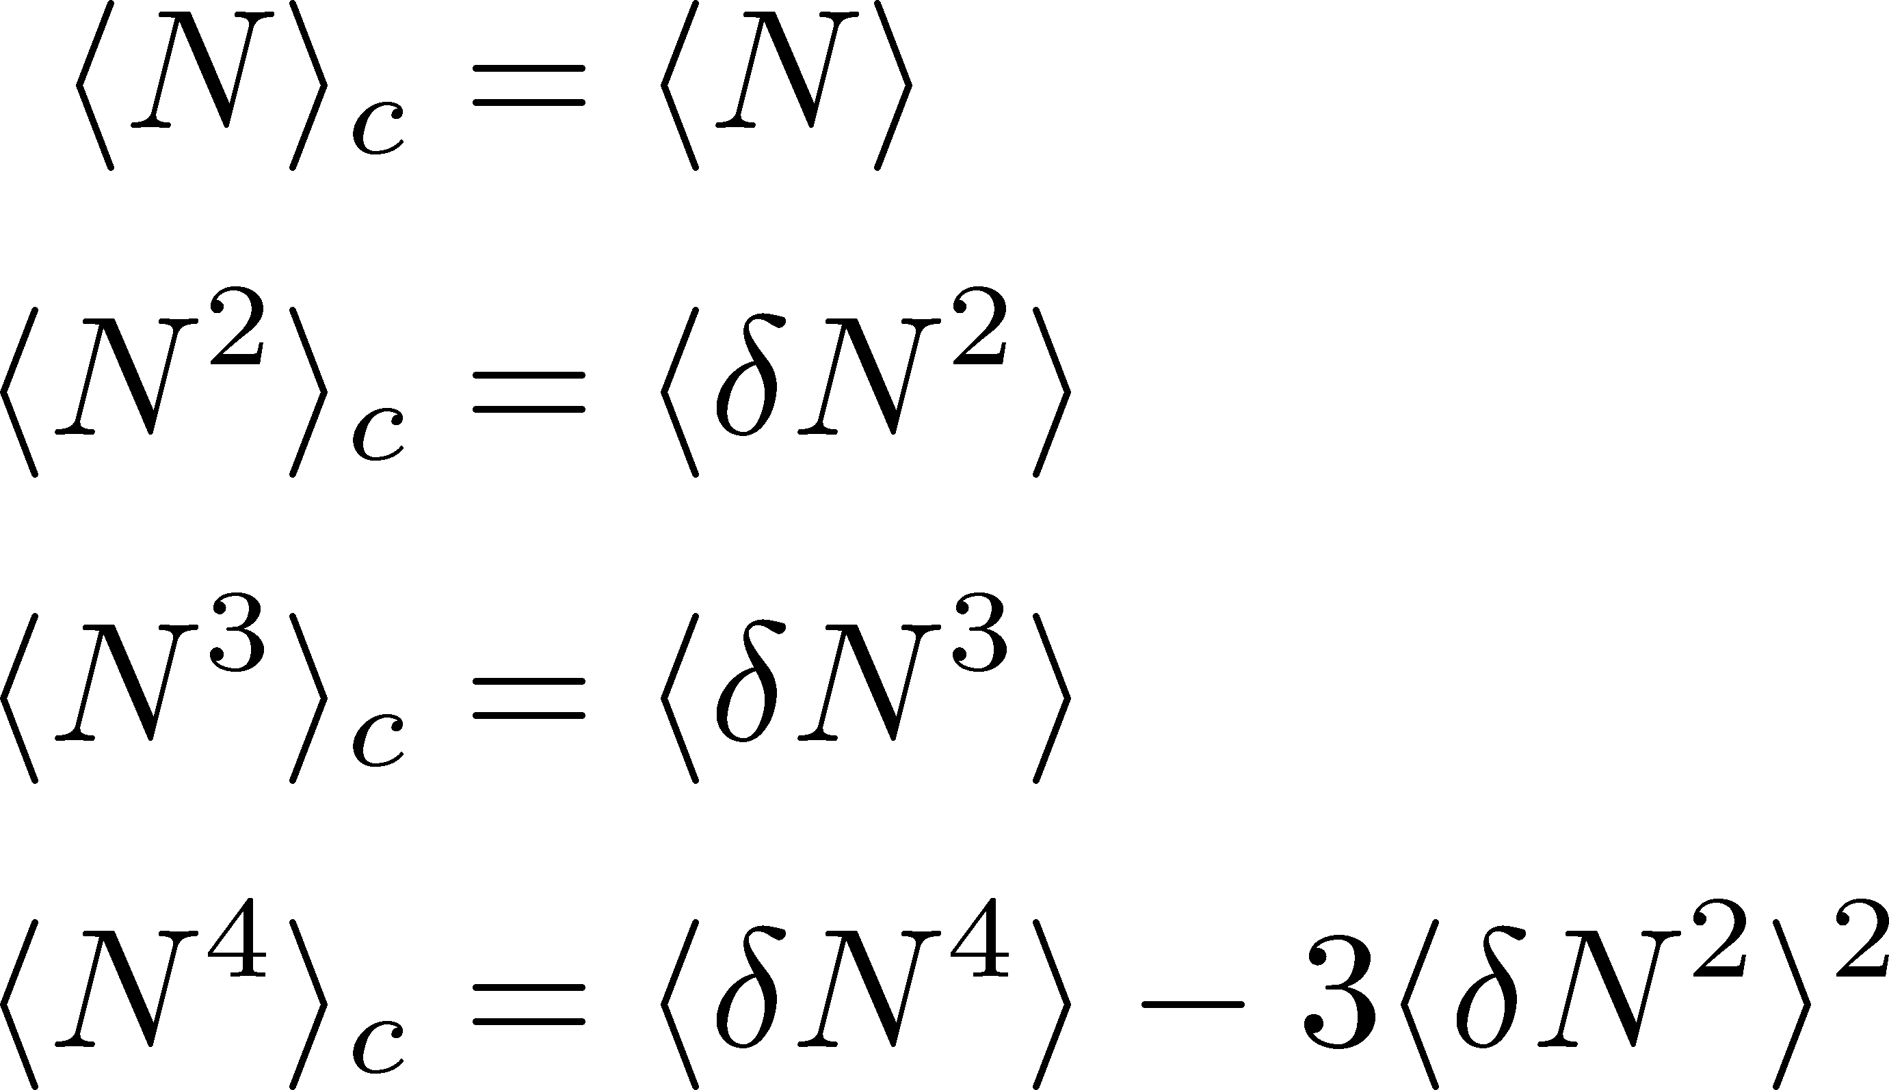

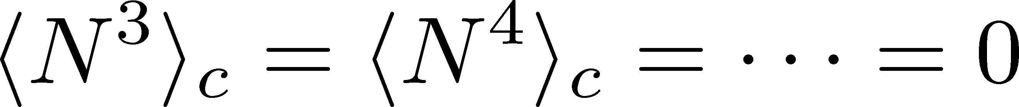
Cumulants
Skewness
Kurtosis
Cumulants
mean
variance
Important Properties
Extensive variables:
For Gauss distribution,
For Poisson distribution,
Review: Asakawa, MK, PPNP 90 (2016)

