Slide 1
Flux-tube Structure via
Energy-Momentum Tensor
Gauge Topology, Flux Tubes and Holographic Models, ECT*, May 24, 2022
Masakiyo Kitazawa
(Osaka U.)
FlowQCD, PLB 789, 210 (2019)
Yanagihara, MK, PTEP2019, 093B02 (2019)
FlowQCD, PRD 102, 114522 (2020)
Ito, MK, in prep.

Slide 2
Flux Tube
Quark confinement
Non-pert. dynamics
Linear potential
String theory
2

Slide 3
Flux Tube
Quark confinement
Non-pert. dynamics
Linear potential
String theory
Many Studies on Flux Tube
Potential
Color-electric field
Action density
so many studies…
Cea+ (2012)
Cardoso+ (2013)
3

Slide 4
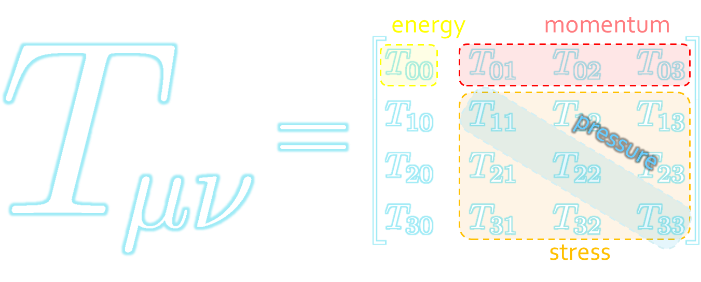
Energy-Momentum Tensor
The most fundamental quantity in physics
Gauge invariant observable
All components have important physical meaning.
stress tensor = mechanical distortion in static systems

Slide 5




Maxwell Stress
(in Maxwell Theory)
Maxwell
E
pulling
Parallel to field: Pulling
Vertical to field: Pushing
pushing

Slide 6



Maxwell Stress
(in Maxwell Theory)
length:
pulling
pushing
Definite physical meaning
Distortion of field, line of the field
Propagation of the force as local interaction

Slide 7
Stress Tensor in QQ System
ー
FlowQCD, PLB (2019)
Lattice simulation
SU(3) Yang-Mills
a=0.029 fm
R=0.69 fm
t/a²=2.0
pulling
pushing
Definite physical meaning
Distortion of field, line of field
Propagation of the force as local interaction
Manifestly gauge invariant

Slide 8
SU(3) YM vs Maxwell
SU(3) Yang-Mills
(quantum)
Maxwell
(classical)
Propagation of the force is clearly different
in YM and Maxwell theories!

Slide 9
Flux-Tube Structure
FlowQCD, PLB 789, 210 (2019)

Slide 10




: nontrivial observable
on the lattice
Definition of the operator is nontrivial
because of the explicit breaking of translational invariance
ex:
Its measurement is noisy
due to high dimensionality and etc.

Slide 11





Yang-Mills Gradient Flow
Luscher 2010
Narayanan, Neuberger, 2006
Luscher, Weiss, 2011
t: “flow time”
dim:[length²]
leading
diffusion equation in 4-dim space
diffusion distance
“continuous” cooling/smearing
No UV divergence at $t>0$

Slide 12





Small Flow-Time Expansion
Luescher, Weisz, 2011
Suzuki, 2013
an operator at t>0
remormalized operators
of original theory
original 4-dim theory
t→0 limit

Slide 13


Constructing EMT
Suzuki, 2013
vacuum subtr.
Remormalized EMT
“SFtX method” (Small Flow time eXpansion)

Slide 14

Thermodynamics:
Iritani, MK, Suzuki, Takaura, 2019
□: SFtX
□: SFtX
Agreement with other methods within 1% level!
Smaller statistics thanks to smearing by the flow

Slide 15


2+1 QCD EoS from Gradient Flow
WHOT-QCD, PRD96 (2017); PRD102 (2020)
Agreement with integral method
Substantial suppression of statistical errors
m_{PS}/m_{V} ≈0.63
Physical mass: Kanaya+ (WHOT-QCD), 1910.13036

Slide 16


Lattice Setup
FlowQCD, PLB (2019)
SU(3) Yang-Mills (Quenched)
Wilson gauge action
Clover operator
EMT around Wilson Loop
APE smearing / multi-hit
fine lattices (a=0.029-0.06 fm)
continuum extrapolation
Simulation: bluegene/Q@KEK
R=0.92 fm
R=0.69 fm
R=0.46 fm

Slide 17
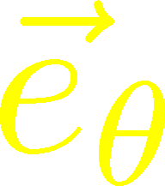

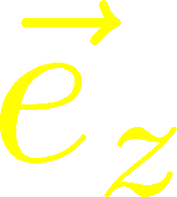






Stress Distribution on Mid-Plane
From rotational symm. & parity
EMT is diagonalized
in Cylindrical Coordinates
Degeneracy
in Maxwell theory

Slide 18


Mid-Plane
Separation
Continuum
Extrapolated!
In Maxwell theory
Degeneracy:
Separation:
Nonzero trace anomaly

Slide 19
Mid-Plane
Separation
Continuum
Extrapolated!
Degeneracy:
Separation:
Nonzero trace anomaly

Slide 20


Force
Force from Potential
Force from Stress

Slide 21
Force
Force from Potential
Force from Stress
Good Agreement!

Slide 22
EM Conservation,
Dual Superconductor
Picture
Yanagihara, MK, PTEP2019, 093B02 (2019)

Slide 23
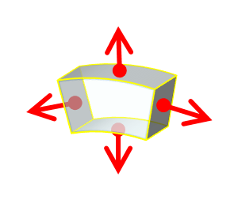



Momentum Conservation
Yanagihara, MK, PTEP2019
In cylindrical coordinats,
For infinitely-long tube
T_{rr} and T_{θθ} must separate!
T_{θθ} must change sign!

Slide 24
Momentum Conservation
Yanagihara, MK, PTEP2019
Lattice
Infinitely-long system
T_{rr} and T_{θθ}
degenerate!
T_{rr} and T_{θθ} must separate
T_{θθ} must change sign
Effect of boundaries is important
for the flux tube at R=0.92fm

Slide 25
Dual Superconductor Picture
Nambu, 1970
Nielsen, Olesen, 1973
t ‘Hooft, 1981
…
QCD Vacuum
Superconductor
Anti-
Monopole
Quark
Anti-quark
Monopole
Flux Tube
Magnetic Vortex
Dual (E⇔B)

Slide 26






Abelian-Higgs Model
Yanagihara, MK, 2019
Abelian-Higgs Model
GL parameter:
Infinitely long tube
type-I :
type-II :
Bogomol’nyi bound :
degeneracy
Luscher, 1981
momentum conservation

Slide 27




Stress Tensor in AH Model infinitely-long flux tube
Type-I
Type-II
No degeneracy bw T_{rr} & T_{θθ}
T_{θθ} changes sign
conservation law

Slide 28

Stress Tensor in AH Model infinitely-long flux tube
Type-I
Lattice
Inconsistent with
lattice result
No degeneracy bw T_{rr} & T_{θθ}
T_{θθ} changes sign

Slide 29

Flux Tube with Finite Length
Yanagihara, MK (2019)
Comparison: $T_{00}\left(0\right), T_{rr}(0)$
AH model can reproduce lattice results qualitatively by tuning parameters.
But, quantitatively all parameters are rejected.

Slide 30

Quantum Effects?
Classical vortex is unstable against quantum fluctuations
Quantum effects give rise to
  Luscher term in potential Luscher (1981)
  Fattening of the tube Luscher, Munster, Weisz (1981)
How do these effects modify EMT distribution?

Slide 31


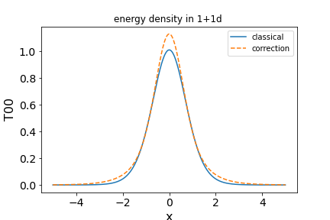



EMT Distr. in Simple Systems
Talk by H. Ito
Wednesday
$φ^{4}$ Theory in 1+1d
Soliton (kink)
Quantum effect on EMT at 1-loop order
Confirmation of EMT conservation

Slide 32
Flux Tube @ Nonzero T,
Single Q System
FlowQCD, PRD 102, 114522 (2020)

Slide 33


Motivations
$T<T_{c}$: Heavy-light meson
EMT distribution in the meson
$T>T_{c}$: Single charge
Screening
Running coupling
$T≈T_{c}$
Confinement transition
Q
This study:
$T>T_{c}$ in pure YM

Slide 34

Lattice Setup
SU(3) Yang-Mills (Quenched)
Wilson gauge action
Clover operator
Analysis above Tc
Simulation on a Z₃ minimum
EMT around a Polyakov loop
continuum extrapolation
Ω: Polyakov loop
FlowQCD, PRD 102, 114522 (2020)

Slide 35


Spherical Coordinates
EMT is diagonalized
in Spherical Coordinates
Maxwell theory

Slide 36
Stress Tensor Around a Quark
T=1.44T_{c}
Suppression at large distance
Separation of different channels
pulling
pushing

Slide 37




$r$ Dependence
Increase
Leading order perturbation
supress
Higher order terms:
M. Berwein, in progress
Increase at short $r$ / suppression at larger $r$
$T$ dependence is suppressed at $r<1/T$
Too noisy at large $r$ for extracting screening mass $m_{D}$

Slide 38



Channel Dependence
Separation b/w channels becomes clearer for smaller T
FlowQCD, PRD 102, 114522 (2020)

Slide 39




Running Coupling
Estimate of $α_{s}$
by the formula at the leading-order perturbation theory
channel dependent
Consistent with the estimate from $Q\overline{Q}$ potential
Kaczmarek, Karsch, Zantow, 2004

Slide 40
Summary
Now, lattice simulation of EMT around the flux tube is available thanks to SFtX (gradient flow) method.
EMT distribution of the flux tube tells us many interesting features of this system.
Future studies
  Theoretical understanding of the lattice results
  QQQ, QQ, etc. / T dependence / hadrons

Slide 41
backup

Slide 42









Fermion Propagator
propagator of flow equation
Inverse propagator is needed
fermion field
t=0
gauge field

Slide 43
N_{f}=2+1 QCD Thermodynamics
Taniguchi+ (WHOT-QCD),
PRD96, 014509 (2017)
N_{f}=2+1 QCD, Iwasaki gauge + NP-clover
m_{PS}/m_{V} ≈0.63 / almost physical s quark mass
T=0: CP-PACS+JLQCD (ß=2.05, 28³x56, a≈0.07fm)
T>0: 32³xN_{t}, N_{t} = 4, 6, ... , 14, 16):
T≈174-697MeV
t→0 extrapolation only (No continuum limit)

Slide 44





Perturbative Coefficients
Suzuki, PTEP 2013, 083B03
Harlander+, 1808.09837
Iritani, MK, Suzuki, Takaura, PTEP 2019
LO
1-loop
2-loop
3-loop
×
Iritani, MK, Suzuki,
Takaura, 2019
zero
Suzuki (2013)
Harlander+(2018)
Choice of the scale of g²
Previous:
Improved:
Harlander+ (2018)

Slide 45
t Dependence
Iritani, MK, Suzuki, Takaura, PTEP 2019
Existence of “linear window” at intermediate t

Slide 46



Double Extrapolation t→0, a→0
O(t) terms in SFTE
lattice discretization
Continuum extrapolation
strong
discretization
effect
Small t extrapolation

Slide 47
Thermodynamics: ε+p & ε-3p
Range2
Range2
Range1
Range3
Range1
Range3
Iritani, MK, Suzuki, Takaura, PTEP 2019
Existence of “linear window” at intermediate t
Stable t→0 extrapolation
Systematic errors: fit range, uncertaintyof Λ (±3%), …

Slide 48



EMT on the Lattice: Conventional
Lattice EMT Operator
Caracciolo+, 1990
Determination of Zs are necessary.
Non-pert. Determination of Zs
Shifted-boundary method
Full QCD with fermions
Giusti, Pepe, 2014~; Borsanyi+, 2018
Brida, Giusti, Pepe, 2020

