Slide 1
From Lattice to Observables:
Real & Virtual Experiments for Exploring Hot and Dense QCD
Masakiyo Kitazawa
(Osaka U.)
Strangeness in Quark Matter (SQM2022), 2022/6/13, Busan, Korea

Slide 2
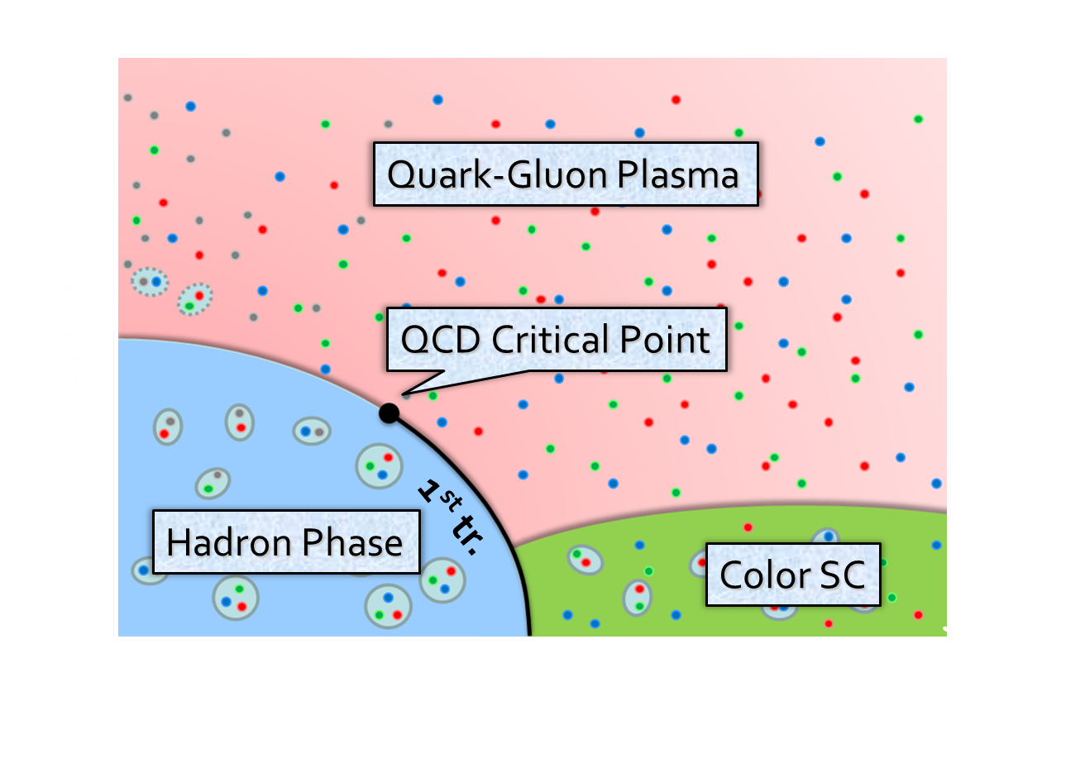
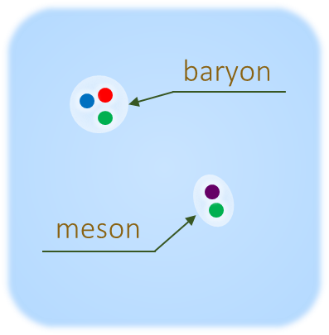



Hot & Dense QCD: Motivations
Quark-Gluon Plasma
QCD Phase Diagram
high T
Non-perturbative aspects of QCD
Early universe, neutron stars, …

Slide 3
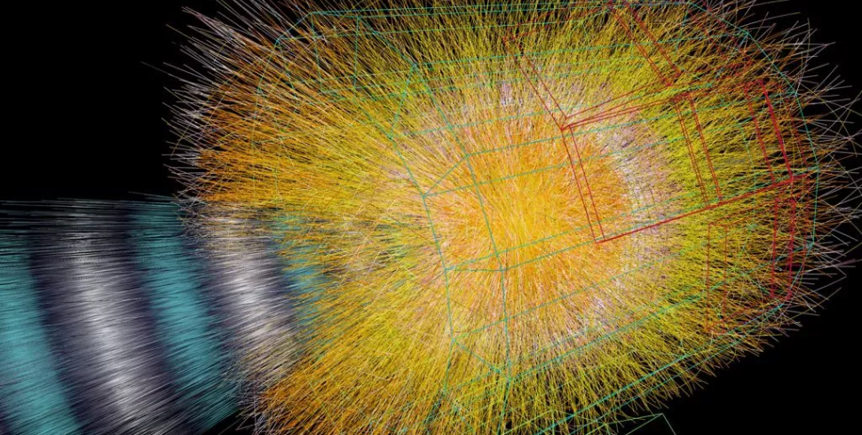
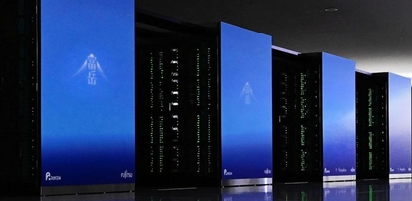
Two “Experimental” Tools to explore hot & dense medium
Relativistic
Heavy-Ion Collisions
Lattice QCD
Numerical Simulations
Real Experiment
“HIC”
Virtual Experiment
“LAT”
Their complementary use is essential!

Slide 4
HIC vs LAT: Pros & Cons
HIC
Real
Dynamical
LAT
Virtual
Thermal
necessary
in physics
simulating
unphysical
world
need
space-time
models
ideal environment;
unable to simulate
real-time evolution
input
motivate

Slide 5
HIC vs LAT: Pros & Cons
HIC
Real
Dynamical
LAT
Virtual
Thermal
necessary
in physics
simulating
unphysical
world
need
space-time
models
ideal environment;
unable to simulate
real-time evolution
input
motivate
finite density
Accessible
beam-energy
scan
Difficult
due to
sign problem

Slide 6
Equation of State
Crossover transition
Low T: hadron resonance gas (HRG) model
High T: gas of quarks & gluons
Input for hydrodynamic models
Budapest-Wuppertal ’14, HotQCD ’14
(plot by MK)
Hydro. models need transport coefficients.
Its reliable measurement in LAT is still a challenge.

Slide 7
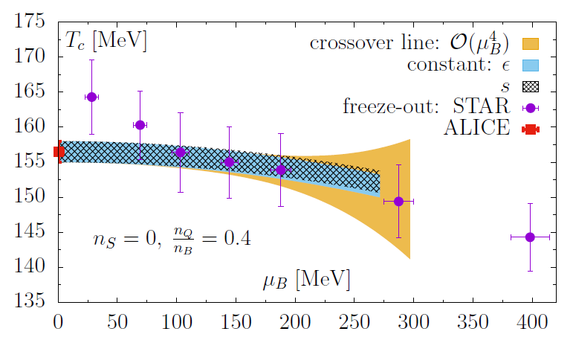




(Pseudo) Critical Temperature
HotQCD, PLB795, 15 (2019)
LAT: $T_{c}^{∗}=156.5(1.5)$ MeV
HIC: thermal model (chemical f.o.)
$T_{c}^{∗}≃T_{chem}$ → Consistent picture of hadronization
Taylor expansion method for nonzero $μ_{B}$

Slide 8
Non-Gaussian Fluctuations /
Higher Order Cumulants

Slide 9




Cumulants
Cumulants
skewness
kurtosis
average
variance
NOTE
Gauss distribution:
Poisson distribution:
Review: Asakawa, MK, PPNP 90 (2016) Sec. 2

Slide 10



Thermal Fluctuations
Observables in equilibrium are fluctuating!
variance
V
Enhancement & sign change of higher order cumulants will be used for the signal of the QCD critical point.
Stephanov, ’09; Asakawa, Ejiri, MK, ’09

Slide 11




Cumulants of Conserved Charges
=Observable on the Lattice
Fluctuation-Response Relations
Thermal
Fluctuation
Susceptibility
Volume dependence canceled out in ratios
Ejiri, Karsch, Redlich, ’05
useful for comparison
w/ HIC
under magnetic field:
Ding+, 2104.06843
HotQCD, PRD101 (2020)

Slide 12


Proton Number Cumulants in HIC
suppression?
non-monotonic
STAR, PRC 2020 [2001.06419]
Nonzero and non-Poissonian cumulants are experimentally established.

Slide 13
Issues to be Resolved
Experiments measure proton number cumulants, while lattice calculates baryon’s.
Experiments measure the final state of the dynamical evolution, while the lattice measures an equilibrium state.
And, other issues:
  Volume fluctuation
  Efficiency correction / imperfect acceptance
  Measurement in momentum space
  Resonance decays, Jets, …
More problematic for higher order cumulants!
See, Asakawa, MK, Mueller, PRC 101 (2020)

Slide 14



Proton vs Baryon Cumulants
MK, Asakawa, 2012; 2012
${\left\langle N_{p}^{m}\right\rangle }_{c}≠{\left\langle N_{B}^{m}\right\rangle }_{c}$
${\left\langle N_{B}^{m}\right\rangle }_{c}$can be obtained from the distribution of $N_{p}$ thanks to the isospin randomization.
Information of baryon # cumulants are more suppressed in higher order proton # cumulants!

Slide 15



MK, Esumi, Nonaka, 2205.10030
Motivations:
Ratio of 2nd orders: suppress uncertainties
Almost linear $T$ dep. around $T_{c}^{∗}$
Analysis:
$\sqrt{s_{NN}}=200$GeV, 0-5%
$Δy$ dependence
Construction of baryon #, $p_{T}$-acceptance correction
Data from HotQCD,
PRD104 (’21)
Data from STAR,
PRC104,024902 (2021)
PRC100,014902 (2019)

Slide 16



$p_{T}$-Acceptance Correction
$p_{T}$ Acceptance
0.4<p_{T}<1.6 [GeV/c]
0.4<p_{T}<2.0 [GeV/c]
PRC100,014902(’19)
PRC104,024902(’21)
Particles in $p_{T}$ acceptance
Electric charge: 49%
Protons: 82%
blast wave model @ √s_{NN}=200 GeV
correction assuming binomial distr. model (independent particle emission)
MK, Asakawa, ’12; ’12
Correction in theoretical models: Alba, Bellwied, ’15, …

Slide 17


Baryon & Acceptance Corrections
corrected
suppress
corrected
uncorrected
uncorrected
MK, Esumi, Nonaka,
2205.10030
Deviation from Poisson distribution is more amplified by the correction.

Slide 18


HIC v.s. LAT / HRG
Data from HotQCD,
PRD104 (’21)
MK, Esumi, Nonaka, 2205.10030
Rapidity window dependence of ${\left\langle N_{B}^{2}\right\rangle }_{c}/{\left\langle N_{Q}^{2}\right\rangle }_{c}$
Naïve comparison gives $T=134∼138$MeV
Non-thermal behavior
Significantly lower than $T_{chem}$

Slide 19
HIC v.s. LAT / HRG
Data from HotQCD,
PRD104 (’21)
MK, Esumi, Nonaka, 2205.10030
Rapidity window dependence of ${\left\langle N_{B}^{2}\right\rangle }_{c}/{\left\langle N_{Q}^{2}\right\rangle }_{c}$
Naïve comparison gives $T=134∼138$MeV
Non-thermal behavior
Significantly lower than $T_{chem}$

Slide 20

Diffusion of Fluctuations
Pre-Equilibrium
rapidity
QGP
Fluctuations continue to change even after the chemical FO.
Measurement in momentum space gives rise to further “blurring” effect.
Hadronization
Freezeout
Ohnishi, MK, Asakawa, PRC 2016
detector

Slide 21
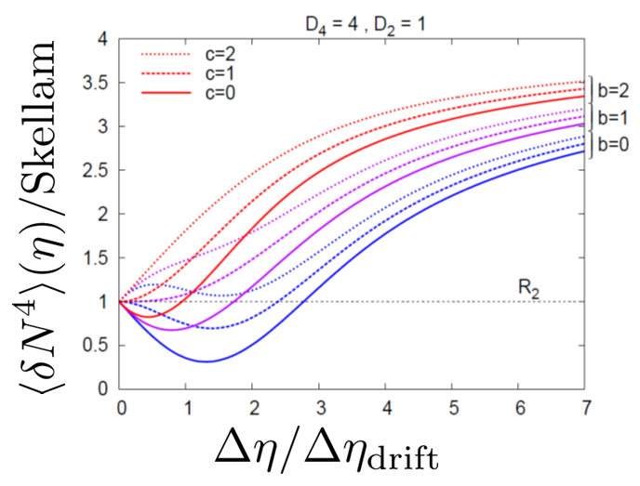
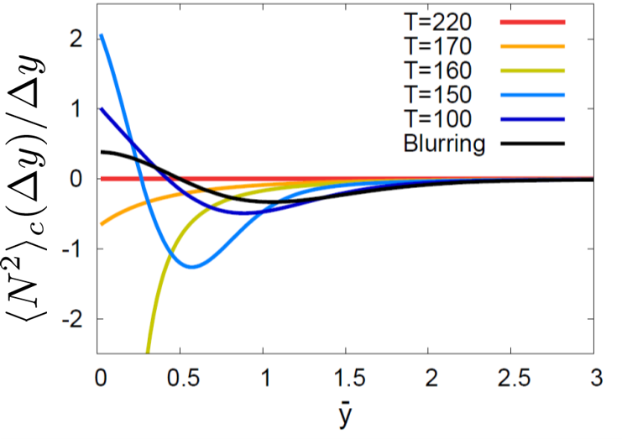

Rapidity Window Dependence in Diffusion Models
Higher order cumulants
Evolution near CP
in diffusion master equation
in stochastic diffusion equation
MK+, PLB (’14); MK, NPA (’15)
Sakaida+ (’18)
Pihan+, 2205.12834
Non-monotonic $Δy$ dependence can emerge reflecting the dynamical history.

Slide 22
QCD Phase Structure at Unphysical Quark Masses

Slide 23

Columbia Plot
= order of phase tr. at $μ=0$
massless
2-flavor
pure gauge
s quark mass
massless
3-flavor
u,d (degenerate) quark mass
Various orders of phase transition with variation of $m_{q}$.

Slide 24

Phase Transition in Chiral Limit
HotQCD, PRL123 (’19)
Figure from F. Karsch (GSI, ’19)
For massless 2-flavor: $T_{c}={132}_{−6}^{+3}$

Slide 25








Varying Quark Masses
Columbia plot
Phase Diagram
= order of phase tr. at $μ=0$
on the $T−m_{q}$ plane
Critical
Point
1st tr.
1st tr.

Slide 26






Cumulants around Critical Point
Ising Model
Gauss distribution
Two delta functions
Kurtosis ${\left\langle M^{4}\right\rangle }_{c}/{\left\langle M^{2}\right\rangle }_{c}$ changes discontinuously at the CP.

Slide 27





Binder Cumulant
Binder Cumulant
Ising Model
$$V=∞$$
Sudden change of $B_{4}$ is smeared by the finite-size effect.
$B_{4}$ obtained for various $V$ has crossing at $t=0$.
At the crossing point, $B_{4}=1.604$ in $Z_{2}$ universality class.

Slide 28

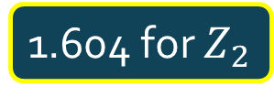
Finite-Size Scaling
Binder Cumulant
Ising Model
$$V=∞$$
1.604 for $Z_{2}$
smaller $V$
Sudden change of $B_{4}$ is smeared by the finite-size effect.
$B_{4}$ obtained for various $V$ has crossing at $t=0$.
At the crossing point, $B_{4}=1.604$ in $Z_{2}$ universality class.

Slide 29



Binder-Cumulant Analysis
Light-quark region
Heavy-quark region
Kuramashi, Nakamura, Ohno, Takeda, ’20
Cuteri , Philipsen , Schön, Sciarra, ’21
$$N_{t}=12, LT<2.7$$
$$N_{t}=10, LT≤6$$
Statistically-significant deviation of the crossing point from the 3d-Ising value.
Large non-singular contribution?

Slide 30

Numerical Simulation
Kiyohara, MK, Ejiri, Kanaya, PRD, 2021
Coarse lattice: $N_{t}=4$
But large spatial volume:
$LT=N_{s} / N_{t}≤12$
Hopping-param. (~$1$/$m_{q}$) expansion
Monte-Calro with LO action
High statistical analysis
Simulation params.

Slide 31




Binder-Cumulant Analysis
Kiyohara, MK, Ejiri, Kanaya, PRD, 2021
Z2
$$LT≥9$$
$$LT≥8$$
$B_{4}$ and $ν$ are consistent with $Z_{2}$ universality class only when $LT≥9$ data are used for the analysis.

Slide 32
HIC vs LAT: Pros & Cons
HIC
Real
Dynamical
LAT
Virtual
Thermal
necessary
in physics
simulating
unphysical
world
need
space-time
models
ideal environment;
unable to simulate
real-time evolution
input
motivate
finite density
Accessible
beam-energy
scan
Difficult
due to
sign problem

Slide 33

Remaining Challenges in LAT
Transport coefficient
  shear/bulk viscosity
  conductivity
Particles’ properties: dissociation, mass shift, etc.
  charmonia, light hadrons
  quarks and gluons
Finite density
  Taylor expansion, imaginary $μ_{B}$
  Complex Langevin, Thimble, etc.
Static quantities
  yet higher order cumulants, screening masses
  scaling behavior around $T_{c}$ & CP, etc.

Slide 34
Final Remarks
Relativistic HIC and lattice simulations are useful tools for exploring hot and dense medium. Their complementary use is essential.
The cumulants measured by the event-by-event analysis in HIC should be interpreted carefully.
Steady progress in revealing Columbia plot in LAT.
Further exchange of ideas between LAT and HIC communities is indispensable for revealing the QCD phase structure!

Slide 35




Critical Points
Water
Ising Model
gas
Critical
Point
Temperature
1st tr.
liquid
Critical
Point
1st tr.
solid
pressure
These CPs belong to the same universality class ($Z_{2}$).
Common critical exponents.
ex.

Slide 36



Beam-Energy Scan
LHC
temperature
RHIC
beam energy scan
future facilities
ex. J-PARC @ Tokai
baryon chemical potential

Slide 37
Beam-Energy Scan
RHIC-BES
Phase I
2010~2015
Phase II
2019~2021
GSI-FAIR,
NICA-MPD
2026~?
J-PARC-HI
2028~??
LHC
temperature
RHIC
beam energy scan
future facilities
ex. J-PARC @ Tokai
baryon chemical potential

Slide 38

Lattice QCD Numerical Simulations
Hadron Spectroscopy
PACS-CS,
PRD79 (’09)
Thermodynamics
Unique tool to perform
quantitative analyses of
non-perturbative QCD aspects

Slide 39
Beam-Energy Scan
RHIC-BES
Phase I
2010~2015
Phase II
2019~2021
GSI-FAIR,
NICA-MPD
2026~?
J-PARC-HI
2028~??
LHC
temperature
RHIC
beam energy scan
Lattice QCD
future facilities
ex. J-PARC @ Tokai
baryon chemical potential

Slide 40



Event-by-event Fluctuations
STAR, PRL105 (2010)
Detector
Cumulants

