Slide 1

Phase Structure of
Hot and Dense QCD and its Experimental Search
Masakiyo Kitazawa
(Osaka U.)
GPPU Seminar, Tohoku University, 2022/6/22, (Tohoku U.)

Slide 2
Contents
Introduction to Hot & Dense QCD
  phase structure of QCD
  Relativistic heavy-ion collisions
  Beam-Energy Scan
Search for QCD-CP: Fluctuations
Search for CSC: Precursor of CSC
40min
25min
15min

Slide 3
Advertising
A book “Quark matter at extreme conditions: Phase transitions in the world of elementary particles”
will come soon (end of August)!
Intro. to hot and dense QCD
Relativistic heavy-ion collisions
BCS theory
Phase diagram in NJL model
Linear response, collective modes
Color superconductivity
Numerical codes in Python
Codes at:
https://github.com/MasakiyoK/Saizensen

Slide 4
Contents
Introduction to Hot & Dense QCD
  phase structure of QCD
  Relativistic heavy-ion collisions
  Beam-Energy Scan
Search for QCD-CP: Fluctuations
Search for CSC: Precursor of CSC

Slide 5

Quantum ChromoDynamics
Building blocks of matter
nucleus
nucleon
quark

Slide 6

Quantum ChromoDynamics
Building blocks of matter
nucleus
nucleon
quark
Quantum chromodynamics (QCD)
=Fundamental theory of strong interaction
gluons
quarks
gluons

Slide 7

Confinement of Quarks
If one wants to pick up a quark from a nucleon…
A meson is formed via $\overline{q}q$ pair production.
Basic degrees of freedom around us
Baryons
Hadrons
Mesons

Slide 8
Quark-Gluon Plasma (QGP)
vacuum
baryon
meson

Slide 9
Quark-Gluon Plasma (QGP)
temperature
vacuum
baryon
meson

Slide 10


Quark-Gluon Plasma (QGP)
temperature
vacuum
baryon
meson
quark-gluon plasma
Early Universe

Slide 11
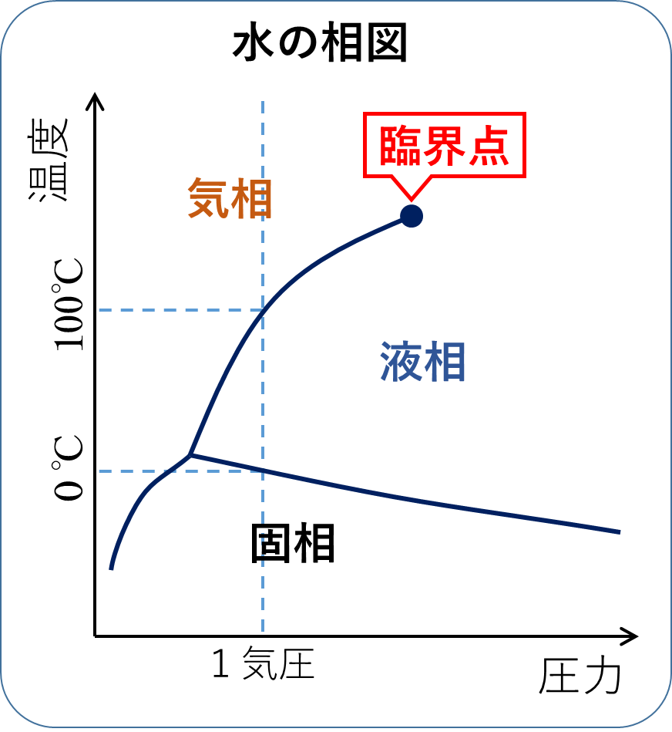




QCD Phase Diagram
Temperature
Quark-Gluon Plasma
Critical
Point
Hadron
Phase
1st tr.
Color SC
Chemical Potential

Slide 12
QCD Phase Diagram
Temperature
Quark-Gluon Plasma
Critical
Point
Another CP?
MK+ (2002)
Hadron
Phase
1st tr.
Color SC
Chemical Potential

Slide 13


QCD Phase Diagram
Early
Universe
Temperature
Quark-Gluon Plasma
Critical
Point
Another CP?
MK+ (2002)
Hadron
Phase
1st tr.
Color SC
Compact
Stars
Chemical Potential

Slide 14
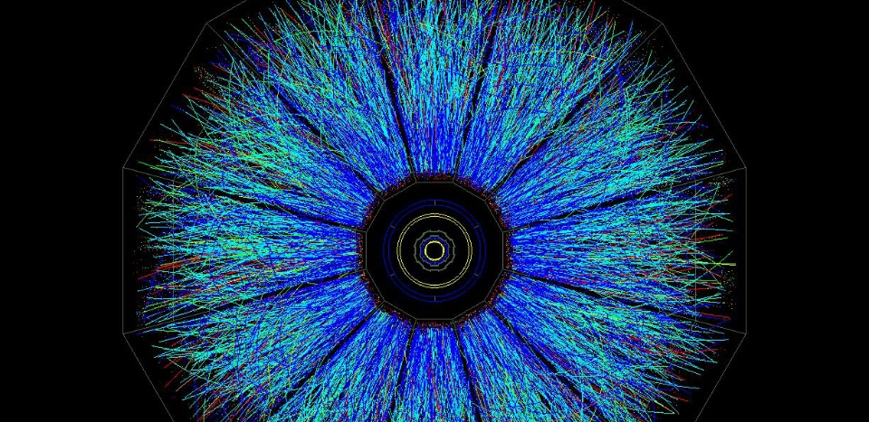
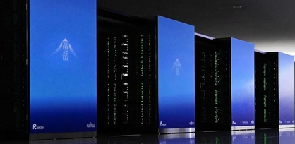
Two Experimental Tools
Real Experiment
Virtual Experiment
Relativistic Heavy-Ion Collisions
Lattice QCD
Numerical Simulations
Colliding two heavy nuclei in accelerators
RHIC (USA), LHC (EU), etc.
First-principle simulations
on supercomputers

Slide 15

Lattice QCD Numerical Simulations
Hadron Spectroscopy
PACS-CS,
PRD79 (’09)
Thermodynamics
Unique tool to perform
quantitative analyses of
non-perturbative QCD aspects

Slide 16
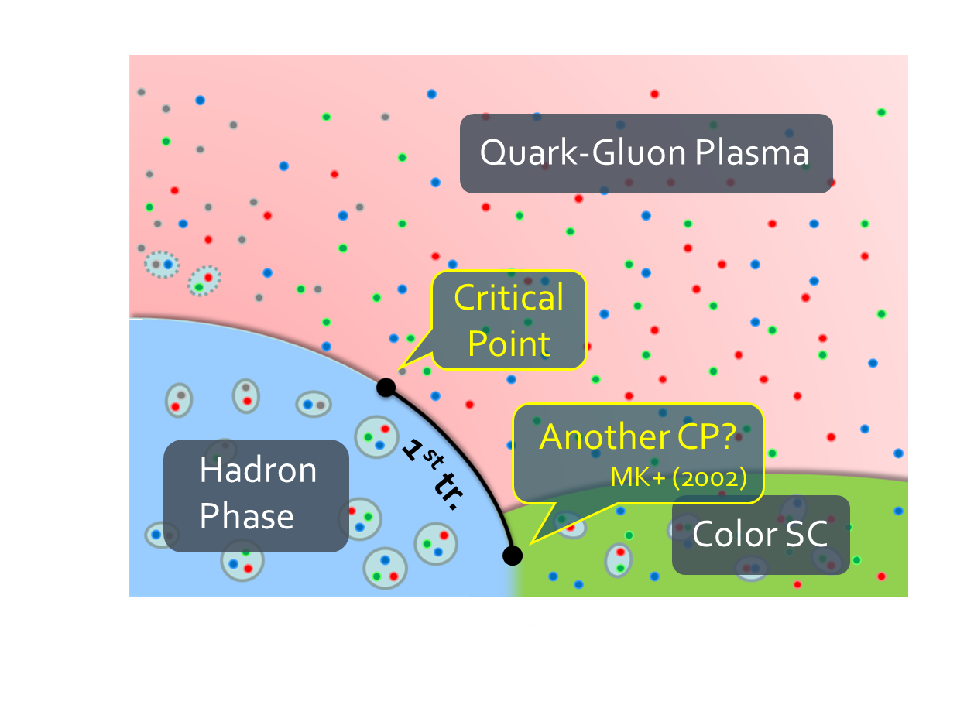


Sign Problem
(Complex-Phase Problem)
Lattice simulations are available only at $μ=0$.
Lattice QCD
The conventional lattice algorithm (importance sampling) is applicable only to real and positive action.
QCD’s action becomes complex at $μ≠0$.

Slide 17




QCD Thermodynamics
No phase boundary
➔Crossover
High $T$:
approach to Stefan-Boltzmann limit
Budapest-Wuppertal ’14,
HotQCD ’14
Low $T$:
consistent w/ hadron resonance gas model
Sudden increase
around $T≃160$MeV
$1$eV $≃{10}^{4}$K
$1$MeV $≃{10}^{10}$K
$100$MeV $≃1$兆K

Slide 18



Stefan-Boltzmann Limit
SB limit = Free gas of massless quarks & gluons

Slide 19
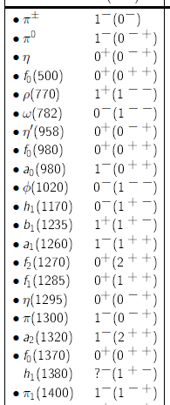



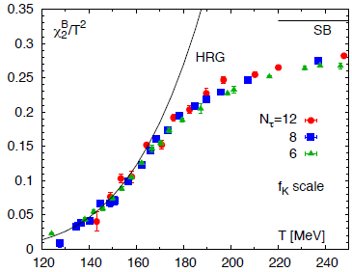

Hadron Resonance Gas (HRG) Model
Particle data group
= Free gas composed of all known hadrons
HRG reproduces QCD thermodynamics for $T<160$MeV quite well

Slide 20


HRG Model 2
List of hadrons: Bollweg+, PRD104, 7 (’21)
code: https://github.com/MasakiyoK/Saizensen, Fig. 3-1

Slide 21


Relativistic Heavy-Ion Collisions
LHC – Large Hadron Collider

Slide 22
Relativistic Heavy-Ion Collisions
Proton-proton
Heavy Ion Collisions
proton
proton
Elementary processes
new particle search
properties of particles
Thermal Medium
hot & dense medium
phase transitions
LHC – Large Hadron Collider

Slide 23
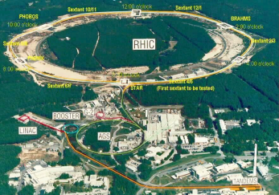
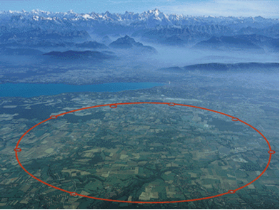

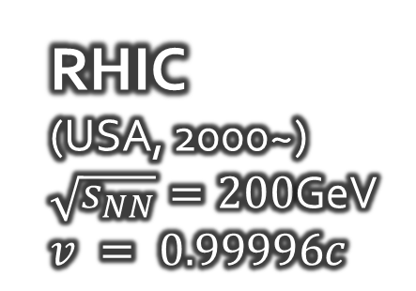
Relativistic Heavy-Ion Collisions
Collide 2 heavy nuclei
Physics
Hot & dense medium
Early Universe
Quark-gluon plasma
QCD phase structre
RHIC
(USA, 2000~)
$\sqrt{s_{NN}}=200$GeV
$v = 0.99996c$
LHC
(CHE/FR, 2009~)
$\sqrt{s_{NN}}=5.5$TeV
$v=0.999999c$

Slide 24


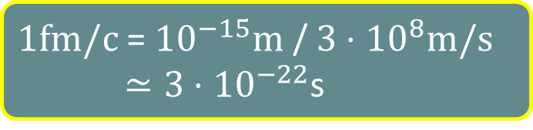


Relativistic Heavy-Ion Collisions
Formation of QGP
$$t\sim 0.6 fm/c$$
Hadronize
$$t≃5 fm/c$$
Freezeout
$$t=10\sim 30 fm/c$$
$1fm/c$ = ${10}^{−15}m$ / $3⋅{10}^{8}m/s$
$≃3⋅{10}^{−22}$s

Slide 25
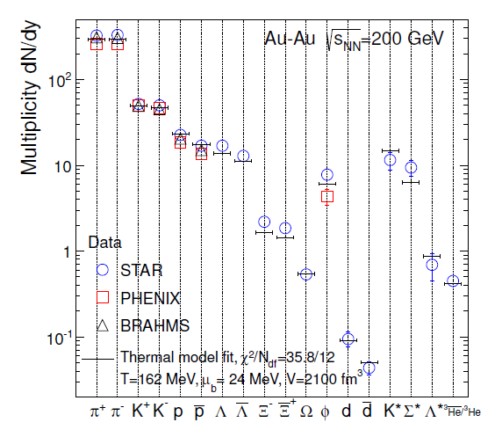
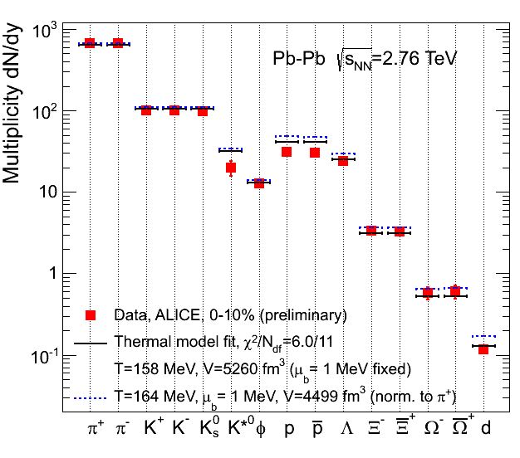


Chemical Freezeout
Fit the number of particles observed experimentally by 3 parameters: $T, μ_{B}, V$
Fit works quite well!!
Chemical equilibration
$T_{chem}=150\sim 160$MeV

Slide 26


Pseudo-Critical Temperature obtained on the lattice
HotQCD, PLB795, 15 (2019)
Susceptibility:
From peak of susceptibilities
$T_{c}^{∗}=156.5(1.5)$ MeV

Slide 27
Beam-Energy Dependence

Slide 28



Chemical Freezeout
Chemical Freezeout $T, μ$
STAR,2012
Nuclear density $ρ_{0}$

Slide 29
Beam-Energy Dependence
High energy
Low energy
Nuclear transparency
Baryon stopping
net-baryon #: small
net-baryon #: large

Slide 30
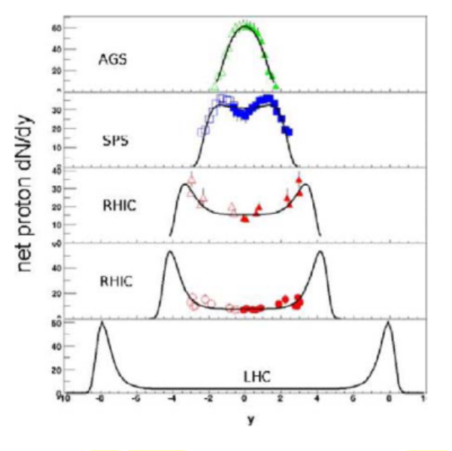






Baryon Stopping
stopping
Baryon stopping
Net proton number （N_{p}ーN$\overline{p}$）
penetrate
Penetration
rapidity
beam axis

Slide 31



Maximum Density
Time evolution in T-ρ plane by JAM
A. Ohnishi, 2002
Maximum density 5~10ρ₀ @ E/A~20GeV
Large event-by-event fluctuations?

Slide 32
Beam-Energy Scan
LHC
temperature
RHIC
beam energy scan
future facilities
ex. J-PARC @ Tokai
baryon chemical potential

Slide 33
Beam-Energy Scan
RHIC-BES
Phase I
2010~2015
Phase II
2019~2021
GSI-FAIR
2026~?
J-PARC-HI
2028~??
LHC
temperature
RHIC
beam energy scan
future facilities
ex. J-PARC @ Tokai
baryon chemical potential

Slide 34
Beam-Energy Scan
RHIC-BES
Phase I
2010~2015
Phase II
2019~2021
GSI-FAIR
2026~?
J-PARC-HI
2028~??
LHC
temperature
RHIC
beam energy scan
Lattice QCD
future facilities
ex. J-PARC @ Tokai
baryon chemical potential

Slide 35




Brief History of Relativistic HIC
AGS
-1996
SPS
1994-2000
RHIC
2000-
LHC
2010-
~2010
High Energy Frontier

Slide 36
Brief History of Relativistic HIC
AGS
-1996
SPS
1994-2000
RHIC
2000-
LHC
2010-
RHIC-BES
2010-
~2010
High Energy Frontier
NICA
2010~
Lower Energy
FAIR
Interaction rate
FAIR, J-PARC-HI: ~10⁷ Hz
AGS, SPS: ~10² Hz
J-PARC-HI

Slide 37
Collision Rate
J-PARC-HI
J-PARC-HI:
High-luminosity x Fixed target
→World highest rate～10⁸Hz
5-order higher than AGS,SPS
SPS
AGS
AGS, SPS
1 year
J-PARC-HI
5 min.
＝
High-statistical exp.
various event selections
higher order correlations
search for rare events
Galatyuk, NPA982,163 (2019)

Slide 38
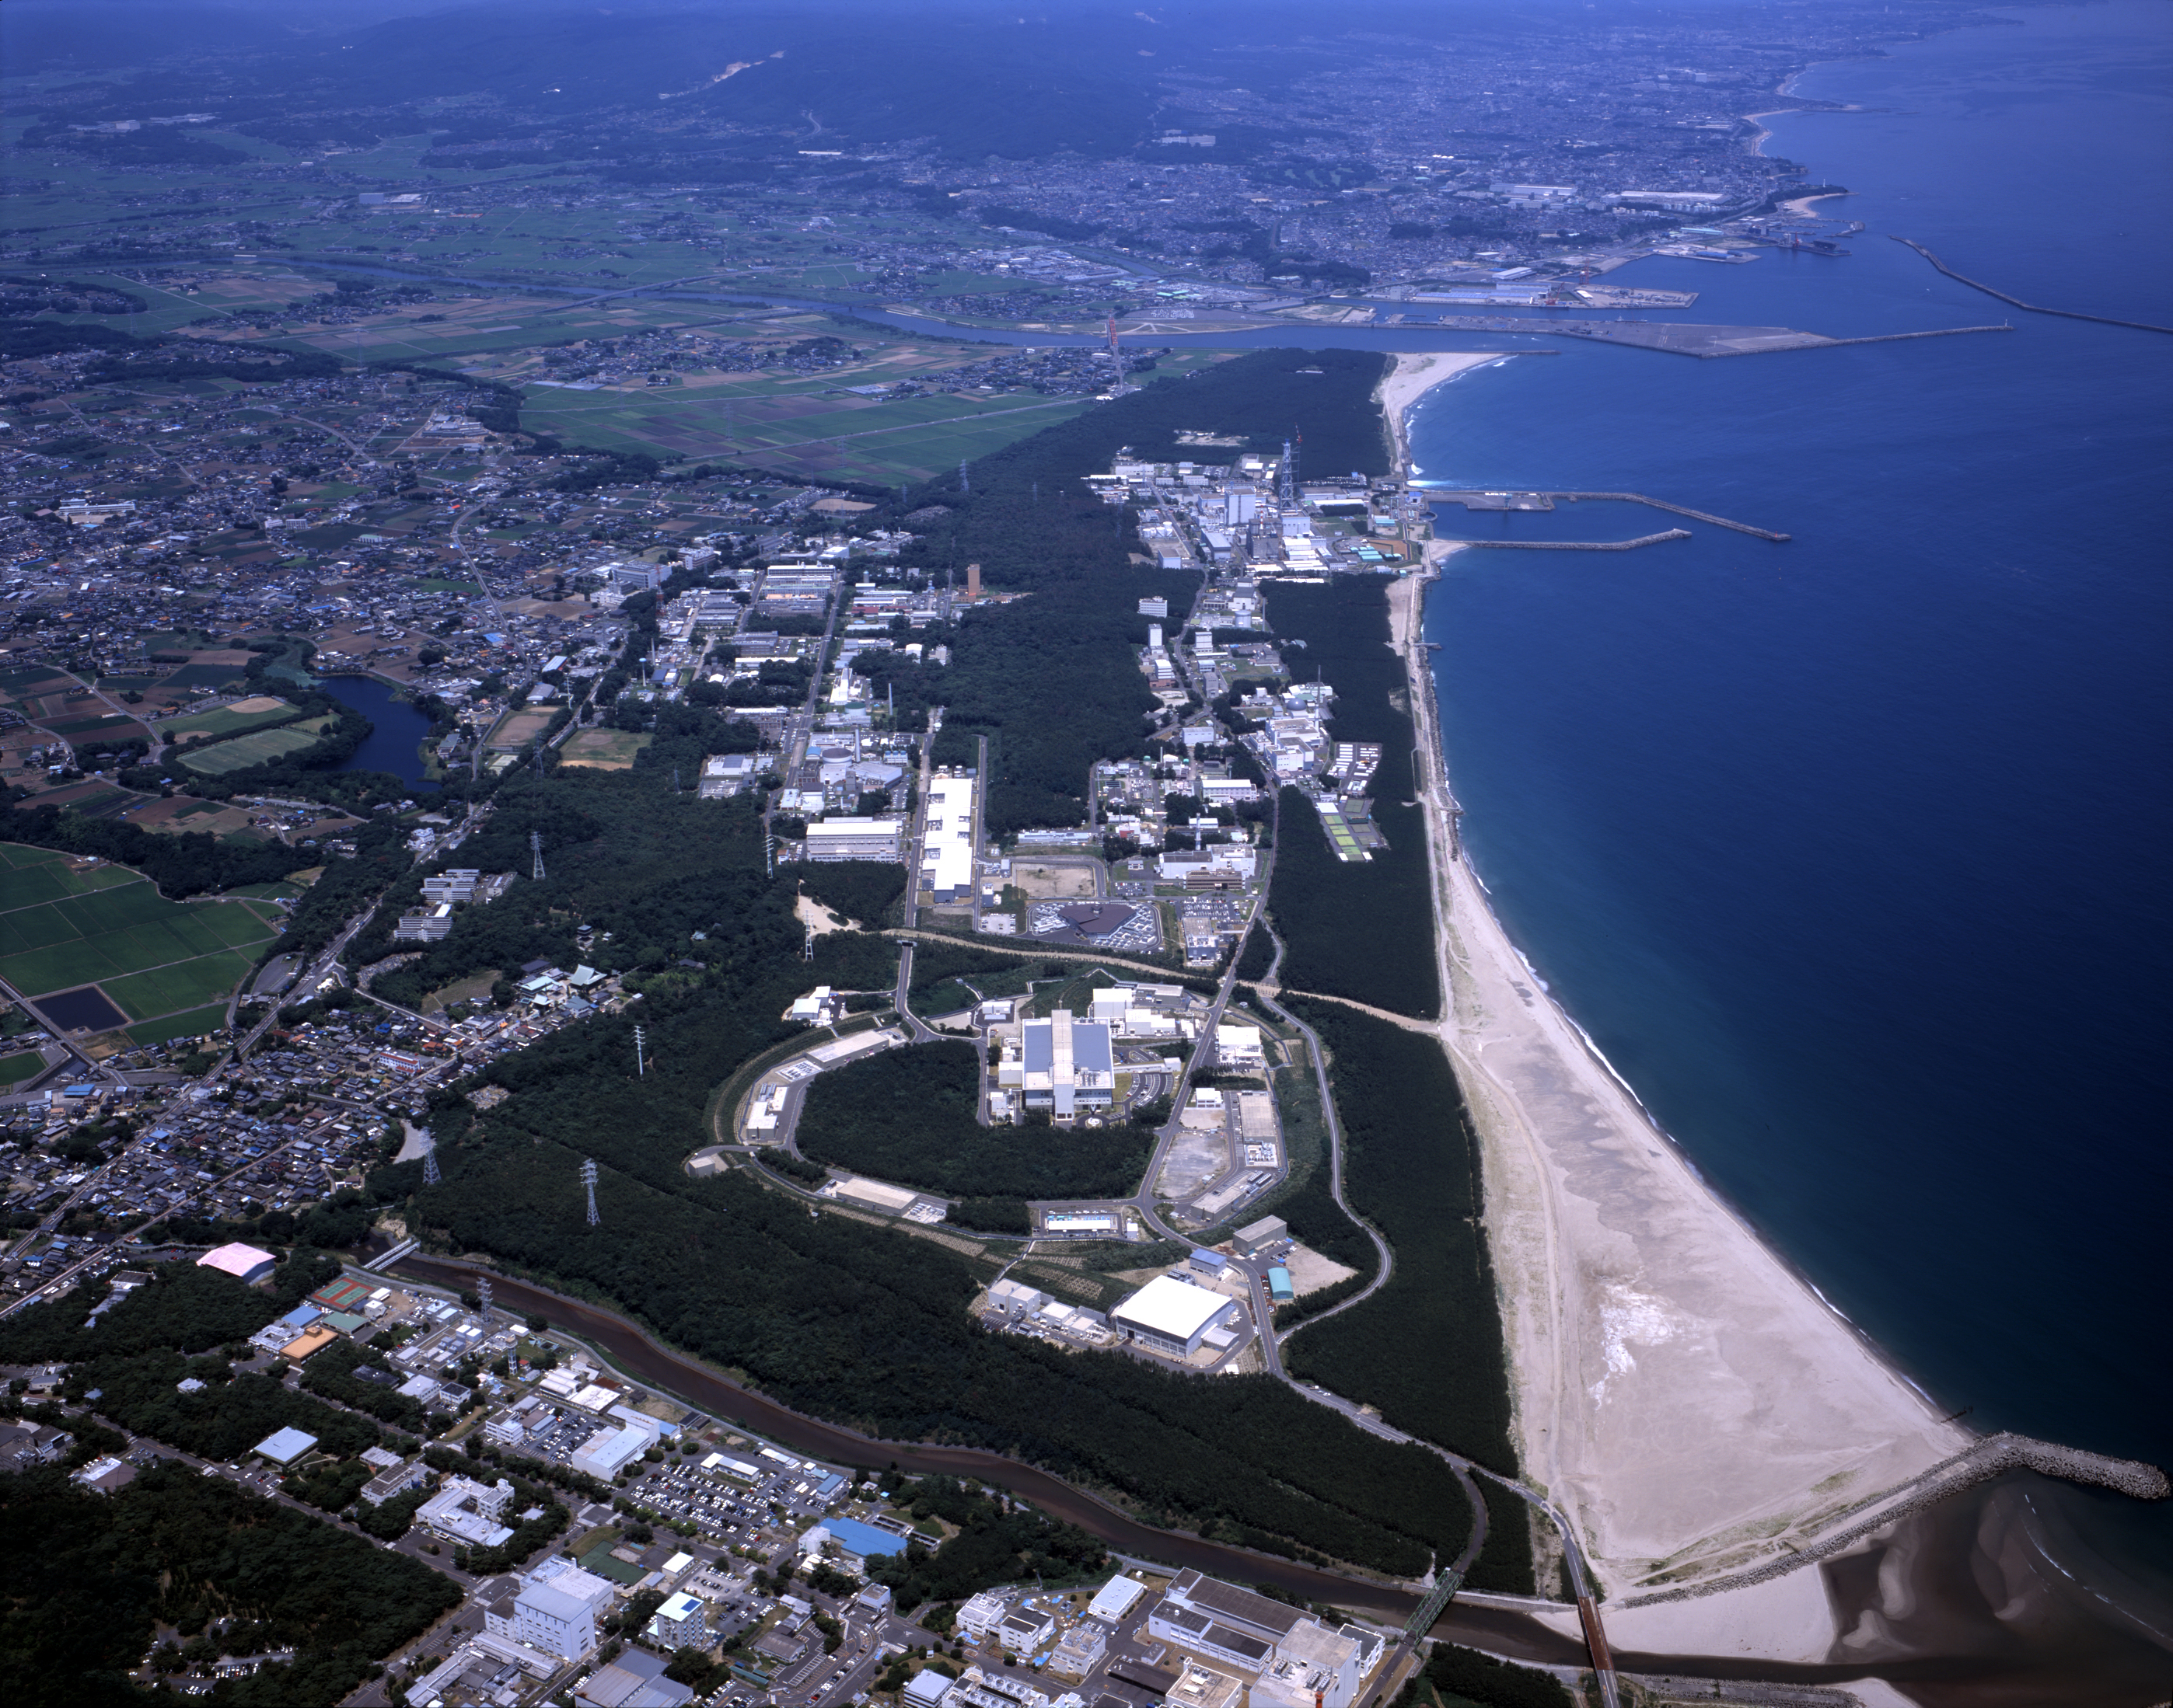
J-PARC-HI
J-PARC Heavy-Ion Program
Heavy-ion collision experiments
using accelerators in J-PARC (RCS/MR)
World highest intensity / Low cost
HI Injector
reliable
high intensity
RCS & MR
E_{lab} ~11→19 AGeV
√s_{NN}~4.9→6.2 GeV
Collision rate: ~10⁸Hz
2028~?

Slide 39
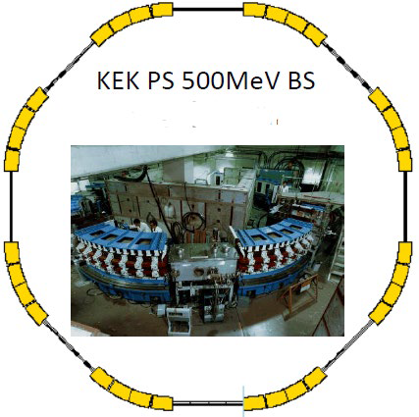


J-PARC-HI: Staging Plan
Phase-I (~2026)
SC HI Linac
KEK PS booster $\sim {10}^{8}$Hz
E16 spectrometer (upgrade)
Thermal dileptons
Phase-II (~2032)
Phase-II
New spectrometer
New booster $\sim {10}^{11}$Hz
New spectrometer
Fluctuations
Correlations
Phase-I
E16 (upgraded)

Slide 40
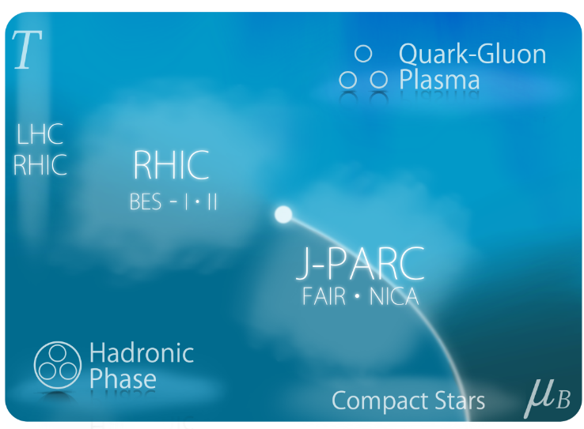
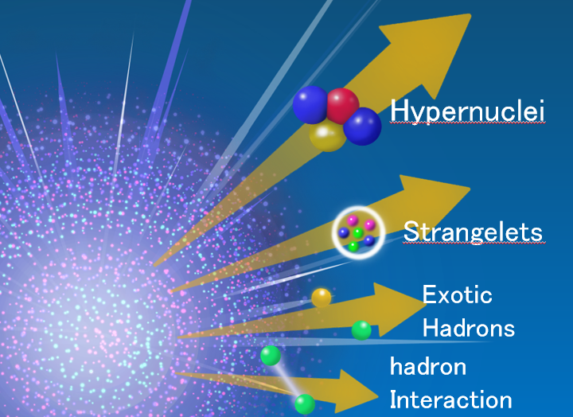
2 Main Goals
Exploring Dense Medium
QCD phase diagram
1st order phase transition
equation of state
Rare-event Factory
hyper nuclei
exotic hadrons
hadron interaction

Slide 41
Collapse of Vacuum
Our vacuum is filled with the quark condensate.
quark
anti-quark

Slide 42
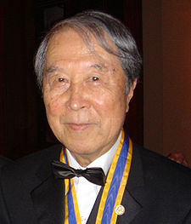
Collapse of Vacuum
Our vacuum is filled with the quark condensate.
quark
anti-quark
Spontaneous breaking of chiral symmetry (Nambu)

Slide 43
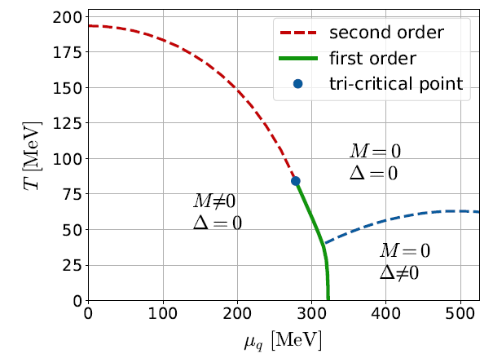
Collapse of Vacuum
Matter modifies the vacuum.
Restoration of chiral symmetry

Slide 44
Search for Rare Events
Exotic
Hadrons
High density
High luminosity
High strange yield
Hypernuclei
Strangelets
Rare-event
Factory
hadron
Interaction
creation
properties
interaction

Slide 45
Contents
Introduction to Hot & Dense QCD
  phase structure of QCD
  Relativistic heavy-ion collisions
  Beam-Energy Scan
Search for QCD-CP: Fluctuations
Search for CSC: Precursor of CSC
Reviews: Asakawa, MK, PPNP (’16); Bluhm, MK+, NPA 1003 (’20)
MK, Esumi, Nonaka, JPS journal, 2021/8

Slide 46
Beam-Energy Scan
LHC
temperature
RHIC
beam energy scan
future facilities
ex. J-PARC @ Tokai
baryon chemical potential

Slide 47



Fluctuations
Observables in equilibrium are fluctuating!
variance
V

Slide 48


Event-by-event Fluctuations
Review: Asakawa, MK, PPNP 90 (2016)
STAR, PRL105 (2010)
Detector
Cumulants

Slide 49




Cumulants
Cumulants
skewness
kurtosis
average
variance
NOTE
Gauss distribution:
Poisson distribution:
Review: Asakawa, MK, PPNP 90 (2016)

Slide 50




A Coin Game
Bet 25 Euro
You get head coins of
A. 50 x 1 Euro
B. 25 x 2 Euro
Same expectation value.

Slide 51
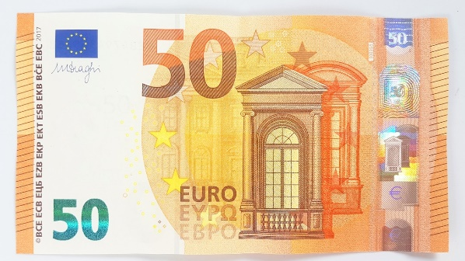
A Coin Game
Bet 25 Euro
You get head coins of
A. 50 x 1 Euro
B. 25 x 2 Euro
C. 1 x 50 Euro
Same expectation value.
But, different fluctuations!

Slide 52
The noise is the signal.
R. Landauer
1998

Slide 53


Fluctuations in QCD Phase Diagram
QCD Critical point
Onset of QGP
Fluctuations increase
Fluctuations decrease
Asakawa, Heinz, Muller, 2000;
Jeon, Koch, 2000
Stephanov, Rajagopal, Shuryak, 1998; 1999

Slide 54



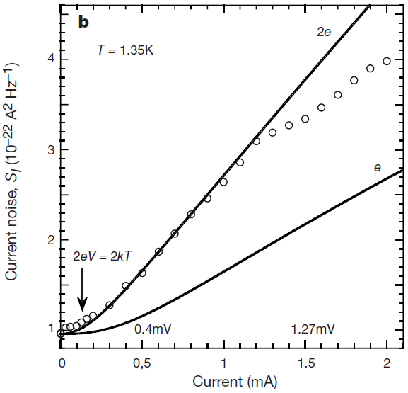


Shot Noise (電流雑音 )
e*
charge of quasi-particles
Super-
conductivity
Quantum Hall
Effect
doubled!
Jehl+, Nature 405,50 (2000)
Saminadayar+, PRL79,2526 (1997)
Higher orders:
3rd order: ex. Beenakker+, PRL90,176802(2003)
up to 5th order: Gustavsson+, Surf.Sci.Rep.64,191(2009)

Slide 55





Higher Order Cumulants
A. 50 x 1 Euro
B. 25 x 2 Euro
δ€²
δ€²
δ€³
δ€³
€⁴
€⁴
Asakawa, MK,
PPNP 90, 299
(2016)

Slide 56
Non-Gaussian Fluctuations
Onset of QGP
QCD Critical Point
Fluctuations decrease
Fluctuations increase
Ejiri, Karsch, Redlich, 2006
Stephanov, 2009
More amplified for higher order cumulants

Slide 57



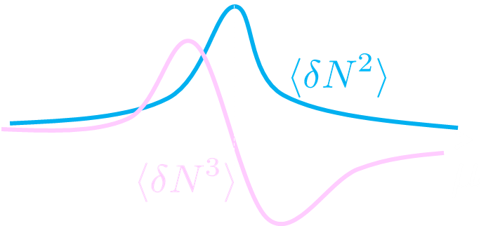


Sign Change of Cumulant
Asakawa, Ejiri, MK, PRL ’09
Geometric interpretation on the signs
Fluctuations ${\left\langle N_{B}^{2}\right\rangle }_{c}$ diverge at the QCD-CP.
Themodynamic Relation
Sign of ${\left\langle N_{B}^{3}\right\rangle }_{c}$ can distinguish near and away sides!

Slide 58

Impact of Negative Cumulants
Asakawa, Ejiri, MK, PRL ’09
Once negative ${\left\langle N_{B}^{3}\right\rangle }_{c}$ is established, it is evidences that
(1) χ_{B} has a peak structure in the QCD phase diagram.
(2) Hot matter beyond the peak is created in the collisions.
No dependence on any specific models.
Just the sign! No normalization (such as by N_{ch}).

Slide 59


Proton Number Cumulants
suppression?
non-monotonic
STAR, 2001.06419
Nonzero and non-Poissonian cumulants are experimentally established.

Slide 60




Cumulants of Conserved Charges
=Observable on the Lattice
Fluctuation-Response Relations
Thermal
Fluctuation
Susceptibility
Volume dependence canceled out in ratios
Ejiri, Karsch, Redlich, ’05
useful for comparison
w/ HIC
under magnetic field:
Ding+, 2104.06843
HotQCD, PRD101 (2020)

Slide 61
Issues to be Resolved
Experiments measure proton number cumulants, while lattice calculates baryon’s.
Experiments measure the final state of the dynamical evolution, while the lattice measures an equilibrium state.
And, other issues:
  Volume fluctuation
  Efficiency correction / imperfect acceptance
  Measurement in momentum space
  Resonance decays, Jets, …
More problematic for higher order cumulants!
See, Asakawa, MK, Mueller, PRC 101 (2020)

Slide 62





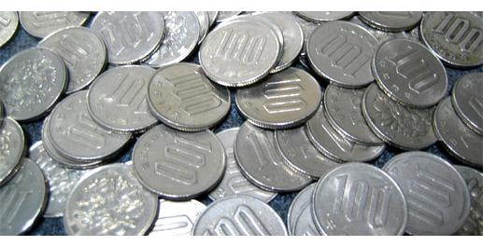
Slot Machine Analogy
= +
P (N)
N
P (N)
N

Slide 63
Slot Machine Analogy
Fixed # of coins
Constant probabilities
N
N
N
N

Slide 64
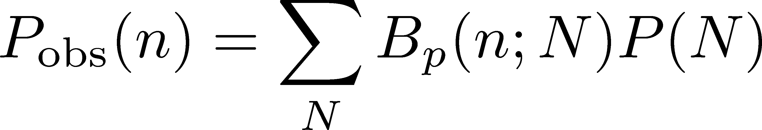
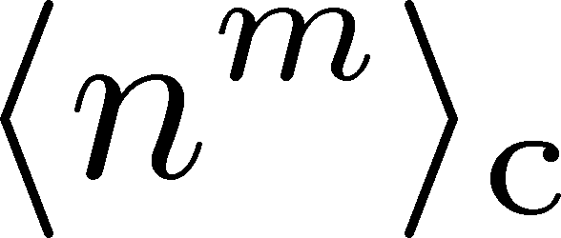
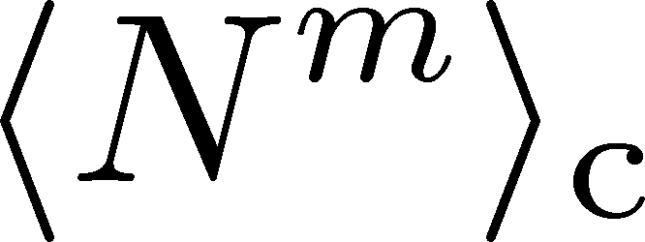
The Binomial Model
MK, Asakawa, 2012; 2012
Bzdak, Koch, 2012
When efficiency for individual particles are independent
dist. func. of
observed particle #
binmial
dist. func.
dist. func. of
original particle #
The cumulants connected with each other
Caveat: Effects of nonvanishing correlations: Holtzman+ 2016

Slide 65


Proton vs Baryon Cumulants
MK, Asakawa, 2012; 2012
${\left\langle N_{p}^{m}\right\rangle }_{c}≠{\left\langle N_{B}^{m}\right\rangle }_{c}$
${\left\langle N_{B}^{m}\right\rangle }_{c}$can be obtained from the distribution of $N_{p}$ thanks to the isospin randomization.
Information of baryon # cumulants are more suppressed in higher order proton # cumulants!

Slide 66
Diffusion of Non-Gaussian Fluc.
chem. f.o.
kinetic f.o.
hadronize
time
We want to see fluctuations around phase transition
But, fluctuations are modified
due to diffusion before observation

Slide 67







Rapidity Window dependence as a Result of Diffusion
MK+ (2014); MK (2015)
Parameters
(rough estimate)
Higher order cumulants can behave non-monotonically.
Δη dependence encodes history of time evolution.

Slide 68

Rapidity Window dependence as a Result of Diffusion
MK+ (2014); MK (2015)
Parameters
STAR 2015
(rough estimate)
Higher order cumulants can behave non-monotonically.
Δη dependence encodes history of time evolution.

Slide 69
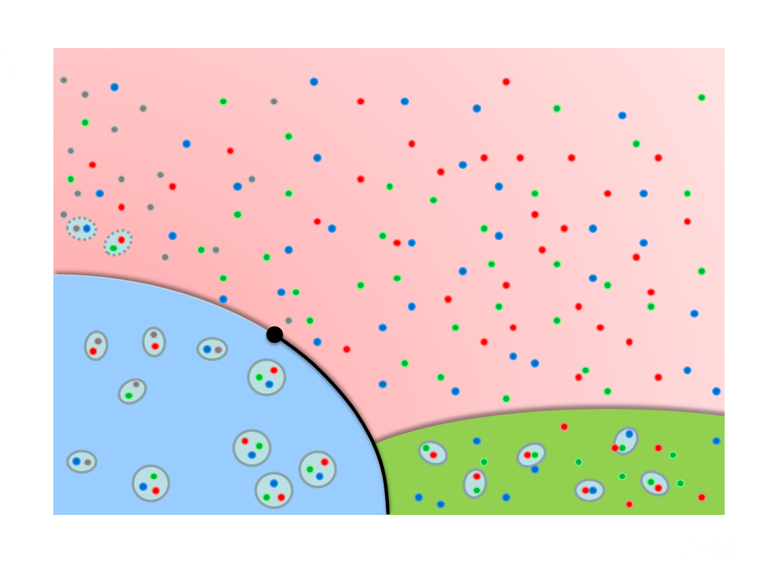
Time Evolution of Cumulants
initial
fluctuations
Critical slowing down around CP
diffusion of fluctuations
Proper understanding of the time evolution of fluctuations is indispensable.

Slide 70


Rapidity Window Dependence around QCD-CP in Stochastic Models
2nd order cumulant
higher order cumulants
analytic solution
numerical implementation
sakaida, Asakawa, Fujii, MK, 2018
Pihan+, 2205.12834
Non-monotonic $Δy$ dependence can emerge reflecting the dynamical evolution.

Slide 71
Contents
Introduction to Hot & Dense QCD
  phase structure of QCD
  Relativistic heavy-ion collisions
  Beam-Energy Scan
Search for QCD-CP: Fluctuations
Search for CSC: Precursor of CSC
Nishimura, MK, Kunihiro, arXiv:2201.01963

Slide 72
Search for CSC Phase Transition
using dilepton production rates
Nishimura, MK, Kunihiro, arXiv:2201.01963

Slide 73
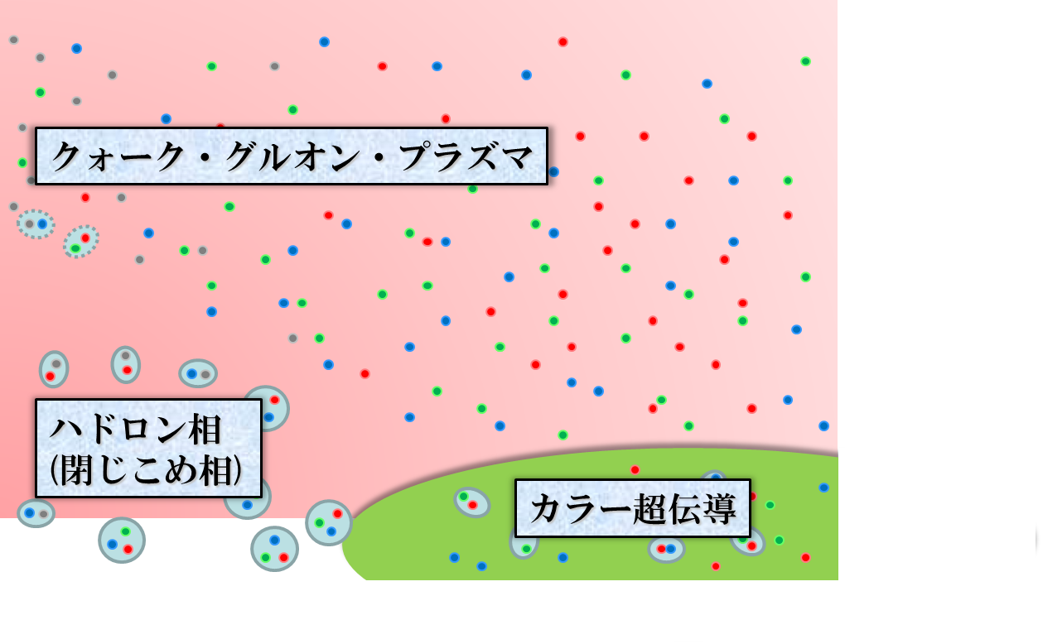

Color Superconductivity
Temperature
Quark-Gluon Plasma
ＱＣＤ Critical Point
Measurement of
CSC in HIC?
Hadronic
Phase
Color SC
Baryon chemical
potential

Slide 74
Color Superconductivity
Cooper Instability
Fermi particles ＋ attractive interaction @ Fermi surface
➔Superconductivity at sufficiently low T
Dense Quark Matter
Quarks = fermions
Attractive int. by gluon exchange
➔Cold quark matter is a superconducting state
1998~1999
Possible large diquark gap (Son,’99; …)
Various phases: 2SC, CFL, etc. (Alford+, ’99; …)

Slide 75
Variety of Color SC
Various Cooper Pairs
anti-symmetric （Pauli principle）
attractive int. in color anti-symm. channel in 1-gluon exchange
Scalar Cooper pairs
➔anti-symm. in flavor channel
Δ_{ud}
u
d
Δ_{us}
s
Δ_{ds}
Various Color SC States
Δ_{ud}=Δ_{us}=Δ_{ds} >0 | CFL | Alford, et al. ‘98
Δ_{ud}>0, Δ_{us}=Δ_{ds} =0 | 2SC | Bailin, Love ‘84
Δ_{ud}>0, Δ_{us}>0, Δ_{ds} =0 | uSC | Ruster, et al. ‘03
Δ_{ud}>0, Δ_{ds}>0, Δ_{us} =0 | dSC | Matsuura, et al., ‘04

Slide 76
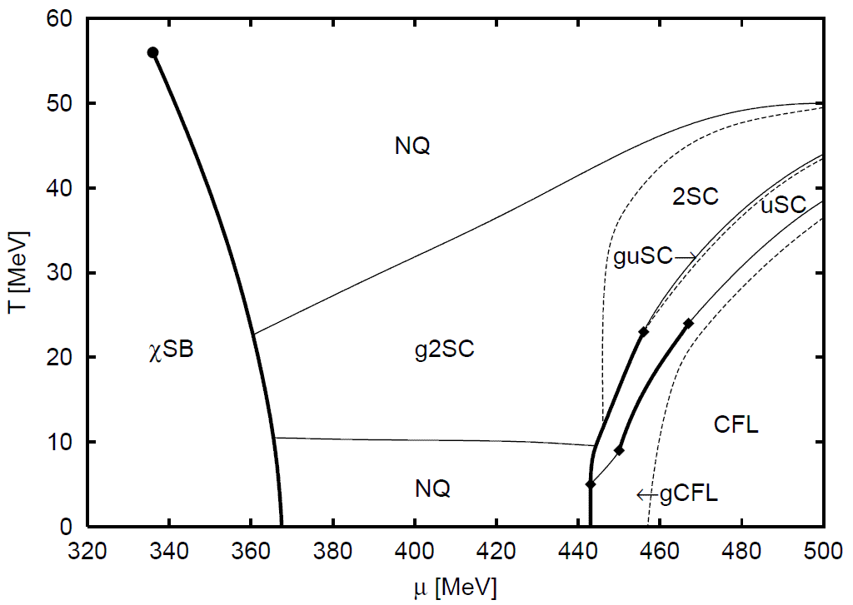
Example of Phase Structure
Ruster+ (2005)
T
μ

Slide 77
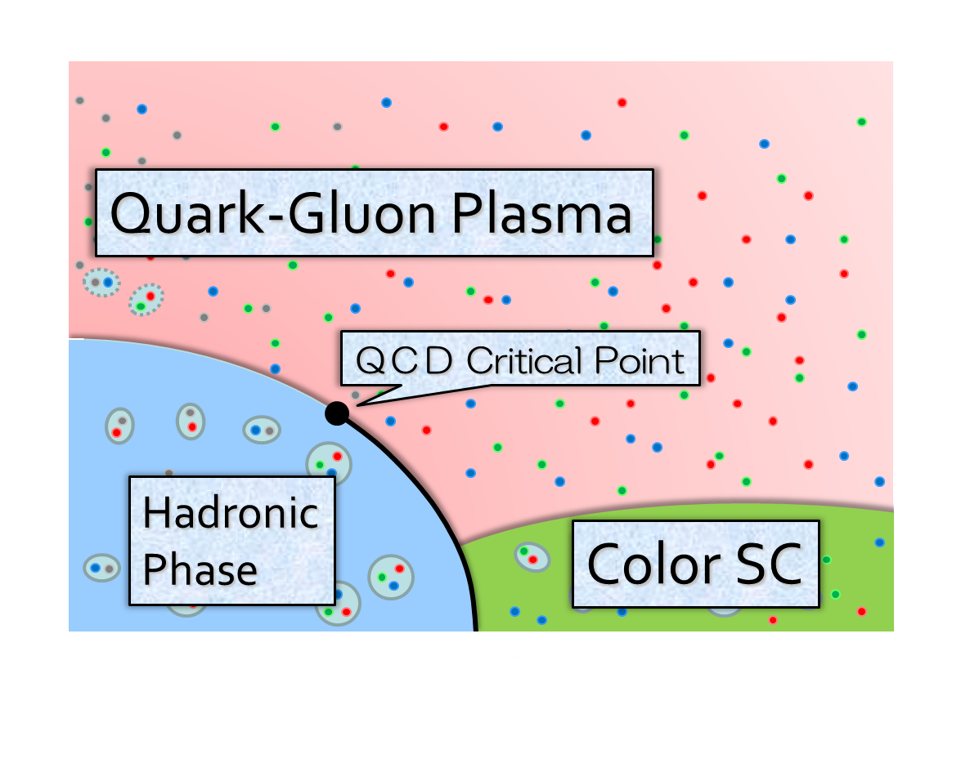
Observing CSC in HIC?
Difficulties
1)
2)
Creation of CSC itself would be impossible.
CSC would be realized only in the early stage.
Solution
1)
2)
Focus on precursor of CSC
Use dilepton production
precursor
Nishimura, MK, Kunihiro, 2201.01963

Slide 78



Precursory Phenomena
= anomalous behavior of observables near but above T_{c}
Electric conductivity in metals
Landau’s Free Energy
Skopal,
Tinkham
1975
T>T_{c}
fluctuation
T<T_{c}
Precursor of CSC
Density of States
Specific Heat
Pseudogap = Depression in the density of states
Specific heat
etc.
MK, Koide, Kunihiro, Nemoto, ’03, ’05

Slide 79


Dilepton Production
Production rate of virtual photons
Once virtual photons are produced, they almost penetrate the hot medium.
Rate of the primordial medium is accessible.
Real photons:
$$ω=p$$
Virtual photons:
$$ω≠p$$

Slide 80
Multi-Messenger Observation
gravitational waves
electromagnetic waves
time scale：10⁻¹s
leptons,
photons
hadronic observables
time scale：10⁻²²s

Slide 81
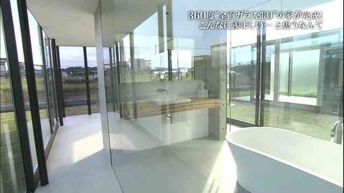

Dilepton Production 2
γ
e⁺
e⁻
Pros:
Once produced, they arrive at the detector directly
Initial state can be observable
Cons:
generation at all stages
superposition of various signals

Slide 82



Model
NJL model
(massless 2-flavor)
diquark interaction
Phase Diagram in MFA
$G_{C}$: free parameter
Order of CSC phase transition
Matsuura+(’04), Giannakis+(’04)
Noronha+(’06), Fejos, Yamamoto(’19)

Slide 83





Diquark Mode
Dynamical Structure
Factor
Diquark Propagator (T-matrix)
in random-phase approximaion
$$+$$
$$+ ∙∙∙$$
Massless at T=T_{c} as a soft mode of CSC transition
Strength in the space-like region
MK, Koide, Kunihiro, Nemoto, ’01,’05

Slide 84





Photon Self-Energy
Dilepton Production Rate
Terms included in $Π^{μν}$
Aslamasov-Larkin
Maki-Thompson, Density of states
= diquark propagator
common in metallic superconductors (conductivity)
time-dependent GL approx. for diquark field
gauge-invariant construction
Nishimura, MK, Kunihiro, 2201.01963

Slide 85



Dilepton Production Rates
Red: fluctuation contribution
Blue: free quarks
Nishimura, MK, Kunihiro,
2201.01963
Diquark fluctuations give rise to anomalous enhancement in the low energy-momentum region for $T<1.5T_{c}$.

Slide 86


Invariant-Mass Spectrum
Fixed Temperature
This point
enhancement at low M
Strong enhancement at low invariant mass, though the range of $M$ is narrower than the previous results.
Observable in the HIC?
Nishimura, MK, Kunihiro, 2201.01963

Slide 87
Summary
Exploring dense medium in relativistic heavy-ion collisions is a hot topic in this field. The beam-energy scan is ongoing, and many new experiments will start in the near future!
Among them, search for
  QCD critical point using fluctuation observables
  color superconductivity using dileptons
are especially interesting and important.
Heavy-ion collisions at J-PARC will play important roles in pursuing these subjects.

Slide 88






Critical Points
Water
Ising Model
gas
Critical
Point
Temperature
1st tr.
liquid
Critical
Point
1st tr.
solid
pressure
These CPs belong to the same universality class ($Z_{2}$).
Common critical exponents.
ex.

Slide 89



Maximum Density Scan?
Large event-by-event fluctuations even with fixed centrality.
“Maximum density” dependence
may be studied experimentally.
average transverse energy
non-monotonic
behavior
as evidence of 1st. tr?
Baryon-rich events
Beam-energy scan
(no event selection)
faster
increase
Baryon-rich
events

Slide 90
Strangeness Factory
Particle yields having strangeness have maximum at J-PARC energy

Slide 91
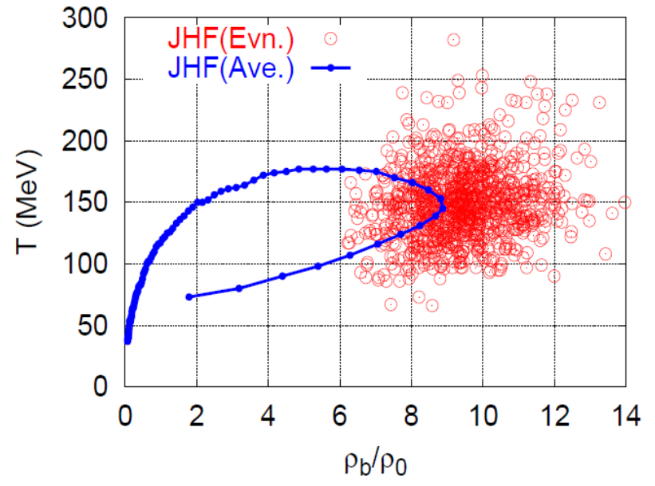
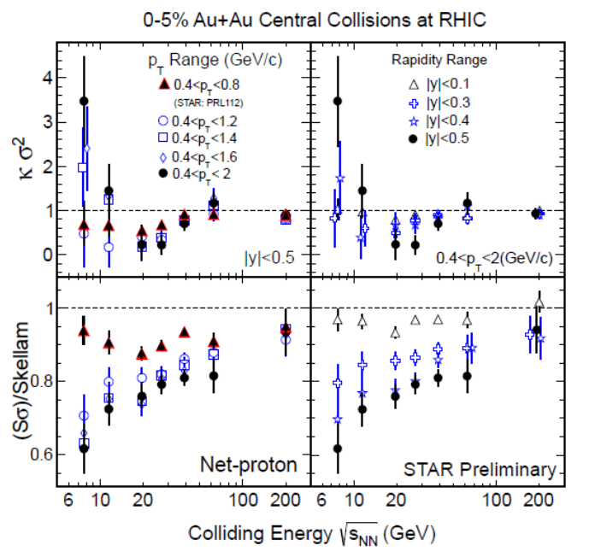
Various Observables
Flow
Dilepton / photon
Fluctuations, higher-order cumulants
Ξ, Ω, …
Sophisticated event selections
Various correlations

