Slide 1

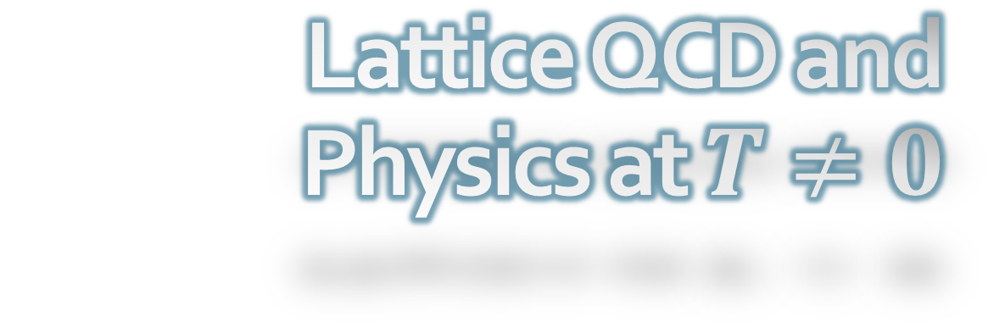
Lattice QCD and
Physics at $T≠0$
Nuclear Physics School (NPS2022), Busan, Korea, 2022/June/28
Masakiyo Kitazawa
(Osaka U.)

Slide 2

Contents
Why is Lattice so Difficult?
  Lattice field theory
  Observables
  Monte-Carlo simulations
  Nonzero temperature
  Dynamics
QCD at $T≠0$
  Equation of state
  QCD critical points & Columbia plot
  Gradient flow & energy-momentum tensor

Slide 3

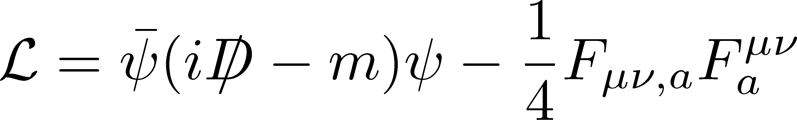

QCD
Fundamental Theory of Strong Interaction
$ψ$: quark field
$A_{μ}^{a}$: gluon field
Degrees of freedom
gluons
Properties
Asymptotic freedom
  ➔Energy-scale dependent coupling constant
  ➔Violation of perturbation at low E scale
Quark confinement
Chiral symmetry breaking

Slide 4
Lattice QCD numerical simulations are powerful tools
to explore non-perturbative phenomena of QCD.
Yes, but it is not so useful…

Slide 5
Establishments
Hadron Spectroscopy
Thermodynamics
PACS-CS,
PRD79 (’09)
Budapest-Wuppertal; HotQCD, 2014

Slide 6




QCD Phase Diagram
Temperature
Quark-Gluon Plasma
Critical
Point
Hadron
Phase
1st tr.
Color SC
Chemical Potential

Slide 7
QCD Phase Diagram
Temperature
Quark-Gluon Plasma
Critical
Point
Another CP?
MK+ (2002)
Hadron
Phase
1st tr.
Color SC
Chemical Potential

Slide 8


QCD Phase Diagram
Early
Universe
Temperature
Quark-Gluon Plasma
Critical
Point
Another CP?
MK+ (2002)
Hadron
Phase
1st tr.
Color SC
Compact
Stars
Chemical Potential

Slide 9
QCD Phase Diagram
Temperature
Quark-Gluon Plasma
Lattice QCD
Critical
Point
Another CP?
MK+ (2002)
Hadron
Phase
1st tr.
Color SC
Chemical Potential

Slide 10
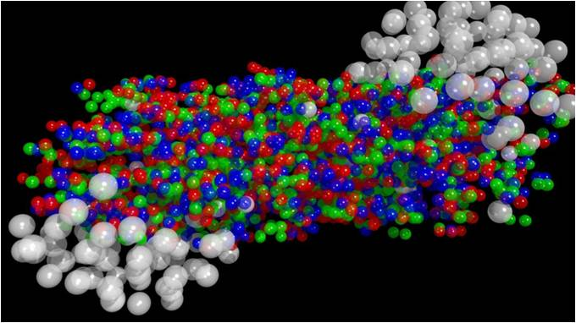
Reproducing HIC on the lattice?
Not possible with various fundamental reasons
Real-time simulations will be impossible forever

Slide 11
Nuclear Structure on the Lattice?
Nucleus
Nucleon
(Hadrons)
Difficult to treat.
Even a reliable measurement of deuteron mass has not been achieved.
Masses have been measured.
Other properties, such as charge distribution, are still difficult to measure.

Slide 12
Contents
Why is Lattice so Difficult?
  Lattice field theory
  Observables
  Monte-Carlo simulations
  Nonzero temperature
  Dynamics
QCD at $T≠0$
  Equation of state
  QCD critical points & Columbia plot
  Gradient flow & energy-momentum tensor

Slide 13





Lattice Simulations
Diffusion eq.:

Slide 14

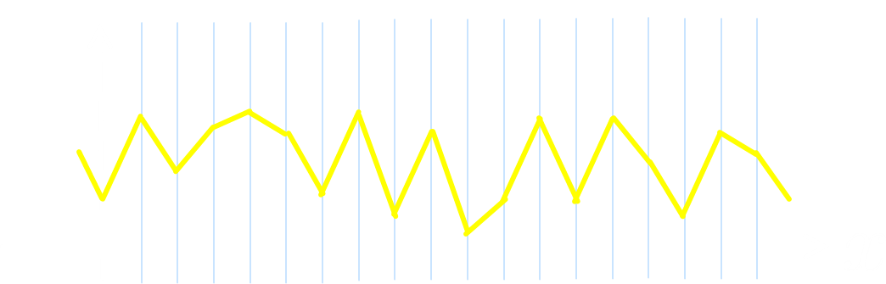

QCD is a Quantum Theory
Time evolution can be simulated,
but the eigenvalue problem would be better.

Slide 15

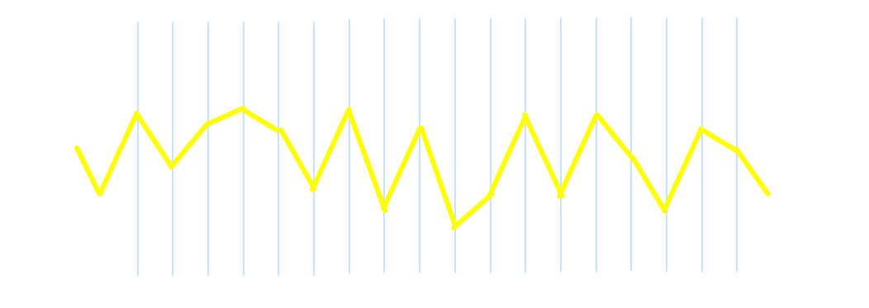
QCD is a Quantum Field Theory
Quantum Field Theory
φ(x) at every space-time points are arguments of wave func.
Spin ½ system:
QFT:

Slide 16

Physical States
Functional of ψ
So many d.o.f
Numerical simulation of time evolution
is too difficult to handle!

Slide 17




Initial Conditions
Initial conditions having physical meaning?
Vacuum
1-particle state
2-particle state
Vacuum state: unknown
Creation operators: unknown

Slide 18







Path Integral
Classical mechanics:
Principle of least action
Trajectory that minimize the action $S$ is realized as a classical path between $x_{1}$ and $x_{2}$.

Slide 19




Path Integral
Quantum mechanics:
Path integral
Transition amplitude $⟨x_{1},t_{1}|x_{2},t_{2}⟩$ is given by the sum of all trajectories with the weight $e^{iS}$.
Note: QM states are labeled only by the coordinate $x$.

Slide 20




Path Integral in QFT
Transition amplitude between two states can be calculated as
Lattice field theory is constructed
by the space-time discretization
①What are physical states?
②How to carry out path integral numerically?
Problems:

Slide 21


Problems
① Quantum states
QM:
: Not very useful…
QFT: We don’t know meaningful quantum states
？
② Numerical Integration
The phase oscillates rapidly.
➔Difficult to handle in numerical integration

Slide 22





Solution: Wick Rotation
($t→τ=−it$)
Minkowski → Euclid spacetime
Do not think
like this!
Integrand becomes real ➔ Numerically feasible

Slide 23










Solution: Wick Rotation
($t→τ=−it$)
Vacuum expectation value
Take the limit:
vacuum state
Expectation values w.r.t. $|0⟩$ can be evaluated!
Note: periodic BC is also possible.

Slide 24




Calculating Operators
Lattice Simulations can calculate
vacuum expectation values and correlation funcs.
These are almost everything
that lattice simulations can do.

Slide 25

Plane-Wave Solution of QCD?
Q.
Are states having translational symmetry (such as plane waves) of QCD analyzed in lower dimensional simulations?
Then, such a simulation will reduce numerical costs drastically.
A.
No. Gauge configurations are not translationally symmetric.

Slide 26

General Comments
Another advantage of lattice FT: removal of ultraviolet divergence thanks to finite d.o.f. on the lattice.
Lattice provides us with a non-perturbative construction of the QFT.
Continuum extrapolation ($a→0$ limit) must be taken at the end.
Numerical simulations were not the original purpose of introducing lattice gauge theory by K. Wilson.

Slide 27

Summary so far
A real-time simulation of QFT is quite difficult.
Ignorance of physical states is one of the reasons.
Lattice FT in Euclidean spacetime enables
  Stable numerical integral.
  ⬅ real integrand of path integral.
  Calculation of vacuum expectation values.
Lattice calculates vacuum expectation values (correlation functions / Green functions).
Physical information are extracted from them.

Slide 28
Contents
Why is Lattice so Difficult?
  Lattice field theory
  Observables
  Monte-Carlo simulations
  Nonzero temperature
  Dynamics
QCD at $T≠0$
  Equation of state
  QCD critical points & Columbia plot
  Gradient flow & energy-momentum tensor

Slide 29












Expectation Value of Physical States
Pion creation operator:
$1π$ state:
Mass
Charge density
Energy density

Slide 30
No Operators of Hadrons!!
We cannot represent hadrons in terms of quark and gluon fields.
We don’t know their operators in QCD.
Constructing operators of observables is also nontrivial.
Ex. energy-momentum tensor
➔cannot be defined as Noether current
(Recent progress: gradient flow mothod)

Slide 31







How to Create Hadrons on the Lattice?
Use an operator having the same quantum number as poins; ex.:
limit:
Evaluation of the lowest energy eigenvalue

Slide 32

Correlation Functions: Example
Figs from C.B. Lang
http://physik.uni-graz.at/~cbl/teaching/lgtped_c.pdf
Effective-mass Plot
Mass of hadrons are obtained
from the plateau of effective mass

Slide 33
Caveats
Successful analysis only for the lowest-energy state.
More sophisticated treatment is required for
  Excited states.
  Systems with small energy gaps: ex. multi-hadron states, etc.
The “plateau” region should be determined carefully.
energy level
PACS-CS,
PRD79 (’09)
HAL-QCD Collab. 2016

Slide 34






Charge Distribution inside Hadrons?
Charge distribution & radius?
×The hadron state is not
the eigenstate of coordinate $x$.
A hadron at position $x$
cannot be created on the lattice.
○form factor:

Slide 35
Contents
Why is Lattice so Difficult?
  Lattice field theory
  Observables
  Monte-Carlo simulations
  Nonzero temperature
  Dynamics
QCD at $T≠0$
  Equation of state
  QCD critical points & Columbia plot
  Gradient flow & energy-momentum tensor

Slide 36

DoF of Path Integral
(integration variable)＝
(spacetime points)×(dof of fields)
Multiple Integral
in Ultra-high Dimensions!!

Slide 37


Monte-Carlo Integral
Monte-Carlo Integral
Evaluate integrand randomly in the integral space
➔Take the average
integral space

Slide 38





Importance Sampling
Metropolis Method
If only a part of integral space contribute strongly to the integral:
:weight func.
integral space
Generate the sampling points
with the probability $G(x)$

Slide 39




Importance Sampling
Metropolis Method
If only a part of integral space contribute strongly to the integral:
:weight func.
Acceptance/rejection of integrand
accept!
accept with the probability
integral space

Slide 40

Path Integral in QFT
“Hot spot”: Extremely narrow
Acceptance hardly occurs
with the random sampling
An algorithm that “moves” only around
the hot spot is necessary
integral space
Hybrid Monte-Carlo method
(heat-bath method for pure YM)

Slide 41

Problem in Lattice QCD 1
Each step of the HMC need
a matrix inversion of
Larger numerical cost when the difference
of the min/max eigenvalues are larger.
integral space
Larger numerical cost for smaller quark masses.

Slide 42


Problem in Lattice QCD 2
Importance sampling is applicable only
when the action $S$ is real and positive.
Complex action cannot be handled.
“Sign Problem”
(complex-phase problem)
integral space
Real-time simulation
Nonzero density ($μ≠0$)

Slide 43



Sign Problem at $μ≠0$
Quark action becomes complex when $μ≠0$.
Exceptions
Solutions
pure imaginary $μ$
$μ_{u}=−μ_{d}$
SU(2)_{c}
Reweighting, Taylor expansion
Complex Langevin method
Lifshitz thimble method
…

Slide 44










Reweighting
: Action depends on a parameter $s$
Monte-Carlo simulation at $s=s_{1}$
Measurement at $s=s_{2}$
Measurement at $s=s_{2}$ from the Monte Carlo simulation at $s=s_{1}$.
Effective when “hot spots” overlaps well

Slide 45




Lattice Spacing $a$
QCD with zero quark masses
$g$ is the only parameter. No dimensionful parameters.
Physical scale arises from quantum effects.
Relation b/w $g$ and the lattice spacing $a$ must be determined
through the measurement of physical observables.

Slide 46
Contents
Why is Lattice so Difficult?
  Lattice field theory
  Observables
  Monte-Carlo simulations
  Nonzero temperature
  Dynamics
QCD at $T≠0$
  Equation of state
  QCD critical points & Columbia plot
  Gradient flow & energy-momentum tensor

Slide 47

Quantum Statistical Mechanics
The most important formulae in QSM
: density matrix
: partition function

Slide 48







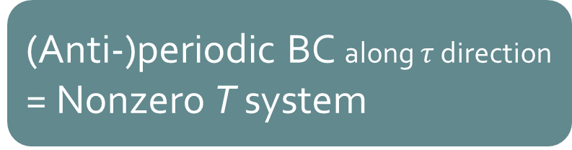
QFT @ Nonzero $T$
(Anti-)periodic BC along $τ$ direction
= Nonzero T system
Thermodynamics
Energy density:
Pressure:
Suzuki,2013; FloｗQCD, 2014

Slide 49








Thermodynamics
Thermodynamic Relations
$ε$ and $p$ are obtained from $T, V$ derivatives of $\ln{Z}$.
Derivative w.r.t. lattice spacing $a$ with fixed $N_{s}^{3}×N_{t}$
➔ Simultaneous variations of $V$ and $1/T$.

Slide 50



Integral Method
SU(3) YM
Boyd+ 1996
QCD Thermodynamics

Slide 51


Thermodynamics of SU(3) YM
Integral method
  Most conventional / established
  Use themodynamic relations
  Boyd+ 1995; Borsanyi, 2012
Gradient-flow method
  Take expectation values of EMT
  FlowQCD, 2014, 2016
Moving-frame method
  Giusti, Pepe, 2014~
Non-equilibrium method
  Use Jarzynski’s equality Caselle+, 2016;2018
Differential method
  Shirogane+(WHOT-QCD), 2016~

Slide 52
SU(3) Thermodynamics: Comparison
Iritani, MK, Suzuki, Takaura, 2019
□: 2-loop
△: Flow2016
Boyd+:1996 / Borsanyi+: 2012
All results agree well.
But, the results of integral method has a discrepancy.
(Older result looks better…)

Slide 53
Contents
Why is Lattice so Difficult?
  Lattice field theory
  Observables
  Monte-Carlo simulations
  Nonzero temperature
  Dynamics
QCD at $T≠0$
  Equation of state
  QCD critical points & Columbia plot
  Gradient flow & energy-momentum tensor

Slide 54

Analytic Continuation
Lattice: imaginary time
Dynamics: real time
Real-time info. have to be extracted from
the correlation funcs. in imaginary time.

Slide 55


Spectral Function
r (w,p)
slope at the origin
peaks
quasi-particle excitation
width ~ decay rate
→ transport coefficients
Kubo formulae
shear viscosity : T₁₂
bulk viscosity : T_{mm}
electric conductivity : J_{ii}

Slide 56



Analytic Continuation
Lattice: imaginary time
Dynamics: real time
discrete and noisy
continuous

Slide 57
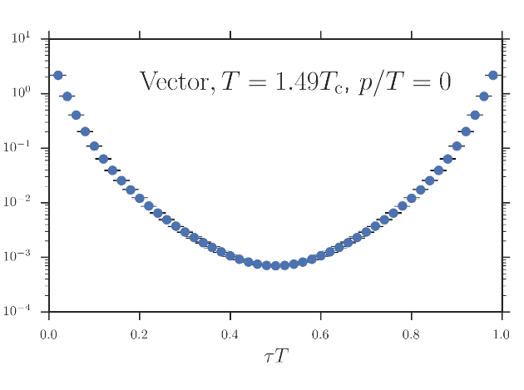



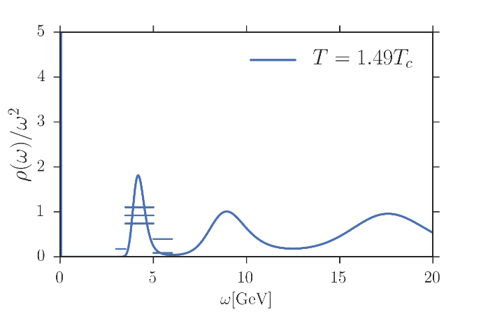
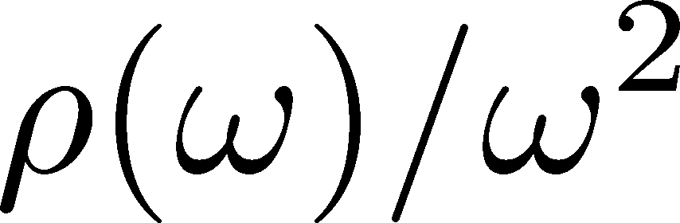
Maximum Entropy Method
Asakawa, Nakahara
Hatsuda, 2001
Lattice data
“ill-posed problem”
Spectral Function

Slide 58
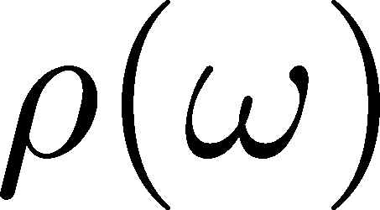
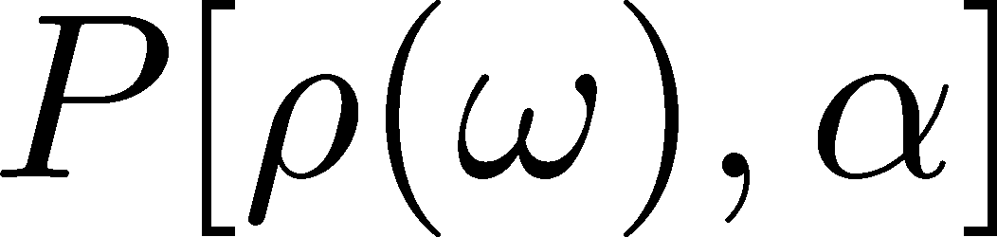

Maximum Entropy Method
Asakawa, Nakahara
Hatsuda, 2001
Lattice data
Bayes
theorem
Prior probability
Probability
of
Shannon-Jaynes entropy
default model
Spectral Function

Slide 59
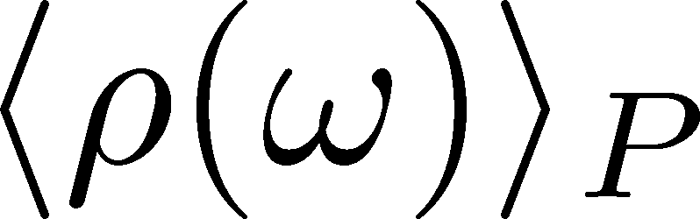

Maximum Entropy Method
Asakawa, Nakahara
Hatsuda, 2001
Lattice data
Bayes
theorem
Prior probability
Probability
of
Shannon-Jaynes entropy
default model
Spectral Function
expectation value
Output of MEM is jus an expectation value.
Error analysis is necessary!!!

Slide 60
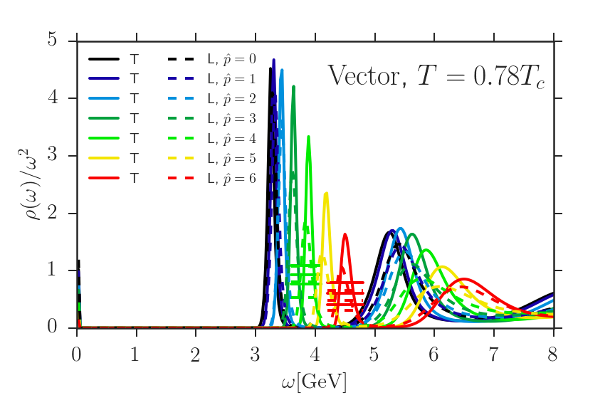
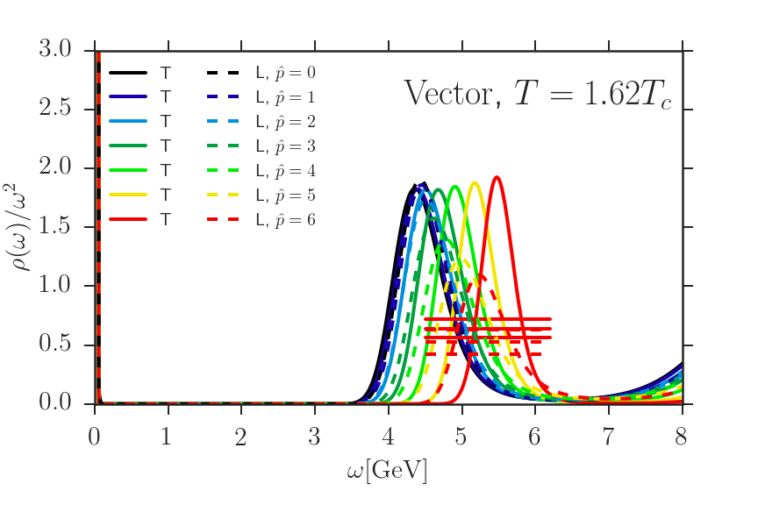

Charmonium SPC
Ikeda, Asakawa, MK
PRD 2017
Spectral function of J/ψ
Transverse/longitudinal decomposed
Mass enhancement in medium?

Slide 61
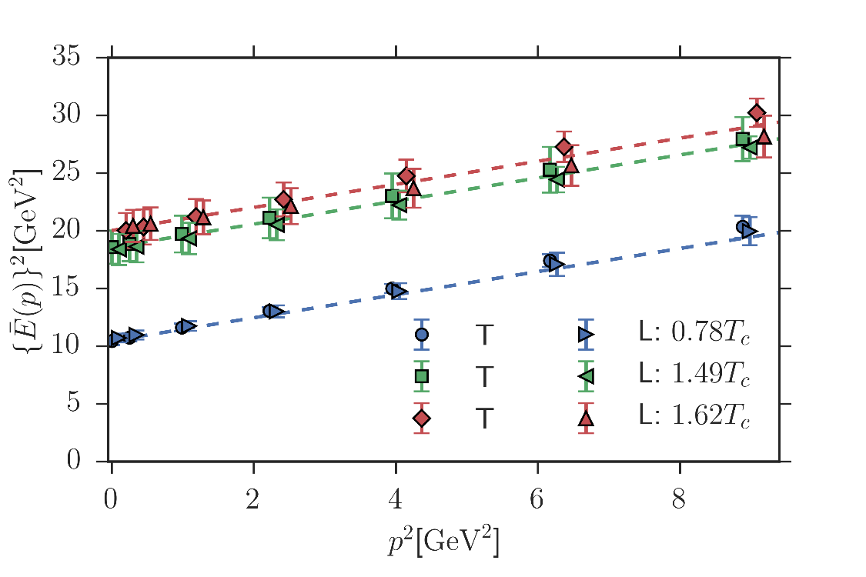

Dispersion Relation of Charmonia
Ikeda, Asakawa, MK
PRD 2017
Disp. Rel. in vacuum
Large mass enhancement at nonzero T.
Disp. Rel. of J/ψ is unchanged from the vacuum one.

Slide 62
Contents
Why is Lattice so Difficult?
  Lattice field theory
  Observables
  Monte-Carlo simulations
  Nonzero temperature
  Dynamics
QCD at $T≠0$
  Equation of state
  QCD critical points & Columbia plot
  Gradient flow & energy-momentum tensor

Slide 63
QCD Phase Diagram
Early
Universe
Temperature
Quark-Gluon Plasma
Critical
Point
Another CP?
MK+ (2002)
Hadron
Phase
1st tr.
Color SC
Compact
Stars
Chemical Potential

Slide 64


Beam-Energy Scan
LHC
temperature
RHIC
beam energy scan
future facilities
ex. J-PARC @ Tokai
baryon chemical potential

Slide 65
Beam-Energy Scan
RHIC-BES
Phase I
2010~2015
Phase II
2019~2021
GSI-FAIR
2026~?
J-PARC-HI
2028~??
LHC
temperature
RHIC
beam energy scan
Lattice QCD
future facilities
ex. J-PARC @ Tokai
baryon chemical potential

Slide 66
Contents
Why is Lattice so Difficult?
  Lattice field theory
  Observables
  Monte-Carlo simulations
  Nonzero temperature
  Dynamics
QCD at $T≠0$
  Equation of state
  QCD critical points & Columbia plot
  Gradient flow & energy-momentum tensor

Slide 67




QCD Thermodynamics
No phase boundary
➔Crossover
High $T$:
approach to Stefan-Boltzmann limit
Budapest-Wuppertal ’14,
HotQCD ’14
Low $T$:
consistent w/ hadron resonance gas model
Sudden increase
around $T≃160$MeV
$1$eV $≃{10}^{4}$K
$1$MeV $≃{10}^{10}$K
$100$MeV $≃1$兆K

Slide 68



Stefan-Boltzmann Limit
SB limit = Free gas of massless quarks & gluons

Slide 69
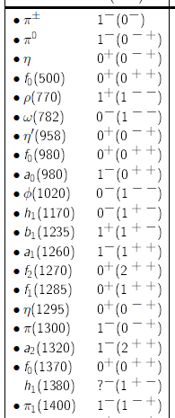



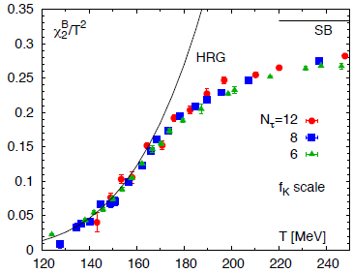

Hadron Resonance Gas (HRG) Model
Particle data group
= Free gas composed of all known hadrons
HRG reproduces QCD thermodynamics for $T<160$MeV quite well

Slide 70


HRG Model 2: Exercise in Phthon3
sample codes: https://www.dropbox.com/sh/t0jgef5khp5cb7h/AABiBSFtP8j
code: https://github.com/MasakiyoK/Saizensen/Chap3/
List of hadrons: Bollweg+, PRD104, 7 (’21) https://arxiv.org/abs/2107.10011

Slide 71
Advertising
A book “Quark matter at extreme conditions: Phase transitions in the world of elementary particles”
will come soon (end of August)!
Intro. to hot and dense QCD
Relativistic heavy-ion collisions
BCS theory
Phase diagram in NJL model
Linear response, collective modes
Color superconductivity
Numerical codes in Python
Codes at:
https://github.com/MasakiyoK/Saizensen

Slide 72



Thermal Fluctuations
Observables in equilibrium are fluctuating!
variance
V
Enhancement & sign change of higher order cumulants will be used for the signal of the QCD critical point.
Stephanov, ’09; Asakawa, Ejiri, MK, ’09

Slide 73




Cumulants
Cumulants
skewness
kurtosis
average
variance
NOTE
Gauss distribution:
Poisson distribution:
Review: Asakawa, MK, PPNP 90 (2016) Sec. 2

Slide 74




Cumulants of Conserved Charges
=Observable on the Lattice
Fluctuation-Response Relations
Thermal
Fluctuation
Susceptibility
Volume dependence canceled out in ratios
Ejiri, Karsch, Redlich, ’05
useful for comparison
w/ HIC
Review: Asakawa, MK, PPNP 90 (2016)
HotQCD, PRD101 (2020)

Slide 75


Proton Number Cumulants in HIC
suppression?
non-monotonic
STAR, PRC 2020 [2001.06419]
Nonzero and non-Poissonian cumulants are experimentally established.

Slide 76
Contents
Why is Lattice so Difficult?
  Lattice field theory
  Observables
  Monte-Carlo simulations
  Nonzero temperature
  Dynamics
QCD at $T≠0$
  Equation of state
  QCD critical points & Columbia plot
  Gradient flow & energy-momentum tensor

Slide 77





Critical Points
Water
Ising Model
gas
Critical
Point
Temperature
1st tr.
liquid
Critical
Point
1st tr.
solid
pressure
These CPs belong to the same universality class ($Z_{2}$).
Common critical exponents.
ex.

Slide 78
QCD Phase Diagram
Early
Universe
Temperature
Quark-Gluon Plasma
Critical
Point
Another CP?
MK+ (2002)
Hadron
Phase
1st tr.
Color SC
Compact
Stars
Chemical Potential

Slide 79

Columbia Plot
= order of phase tr. at $μ=0$
massless
2-flavor
pure gauge
s quark mass
massless
3-flavor
u,d (degenerate) quark mass
Various orders of phase transition with variation of $m_{q}$.

Slide 80








Varying Quark Masses
Columbia plot
Phase Diagram
= order of phase tr. at $μ=0$
on the $T−m_{q}$ plane
Critical
Points
1st tr.
1st tr.

Slide 81






Cumulants around Critical Point
Ising Model
$P(M)$: probability distr.
$V(M)$: effective potential
$M$ : order parameter
${\left\langle N^{4}\right\rangle }_{c}$ changes discontinuously at the CP.

Slide 82





Finite-Volume Effects
Binder Cumulant
Ising Model
$$V=∞$$
Sudden change of $B_{4}$ at the CP is smeared by finite $V$ effect.
$B_{4}$ obtained for various $V$ has crossing at $t=0$.
At the crossing point, $B_{4}=1.604$ in $Z_{2}$ universality class.

Slide 83

Finite-Volume Effects
Binder Cumulant
Ising Model
$$V=∞$$
smaller $V$
Sudden change of $B_{4}$ at the CP is smeared by finite $V$ effect.
$B_{4}$ obtained for various $V$ has crossing at $t=0$.
At the crossing point, $B_{4}=1.604$ in $Z_{2}$ universality class.

Slide 84



Binder-Cumulant Analysis
Light-quark region
Heavy-quark region
Kuramashi, Nakamura, Ohno, Takeda, ’20
Cuteri , Philipsen , Schön, Sciarra, ’21
$$N_{t}=12, LT<2.7$$
$$N_{t}=10, LT≤6$$
Statistically-significant deviation of the crossing point from the 3d-Ising value.
Too large finite-V effects?

Slide 85
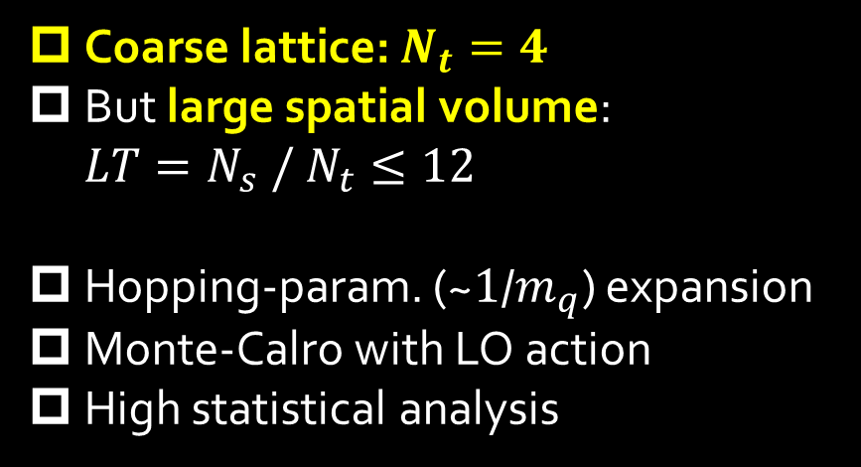
Numerical Simulation
Coarse lattice: $N_{t}=4$
But large spatial volume: $LT=N_{s} / N_{t}≤12$
Hopping-param. (~$1$/$m_{q}$) expansion
Monte-Calro with LO action
High statistical analysis
Simulation params.

Slide 86




Binder-Cumulant Analysis
Z2
$$LT≥9$$
$$LT≥8$$
$B_{4}$ and $ν$ are consistent with Z2 universality class only when $LT≥9$ data are used for the analysis.

Slide 87
Further Check of Finite-V Scaling
Effective potential at the CP
Scaling of order parameter
Z2 scaling is well established

Slide 88
Contents
Why is Lattice so Difficult?
  Lattice field theory
  Observables
  Monte-Carlo simulations
  Nonzero temperature
  Dynamics
QCD at $T≠0$
  Equation of state
  QCD critical points & Columbia plot
  Gradient flow & energy-momentum tensor

Slide 89




Energy-Momentum Tensor
energy
momentum
pressure
stress
All components are important physical observables!

Slide 90
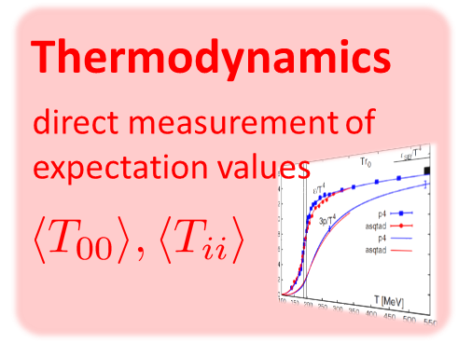
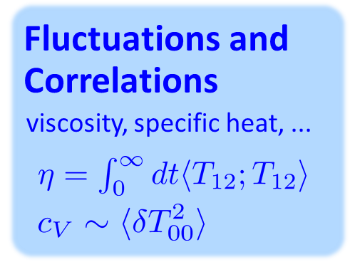
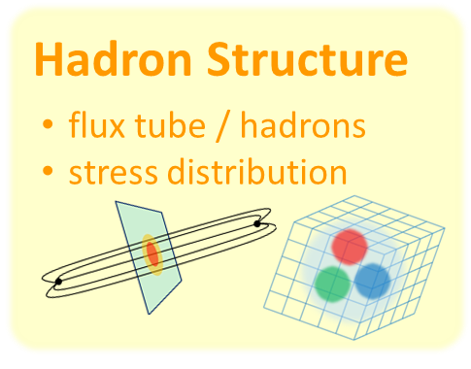
EMT with Gradient Flow
“SFtE Method”
New measurement of the renormalized EMT on the lattice.
Suzuki 2013; FlowQCD 2014~; WHOT-QCD 2017~

Slide 91




Yang-Mills Gradient Flow
Luscher 2010
Narayanan, Neuberger, 2006
Luscher, Weiss, 2011
t: “flow time”
dim:[length²]
leading
diffusion equation in 4-dim space
diffusion distance
“continuous” cooling/smearing
No UV divergence at t>0

Slide 92
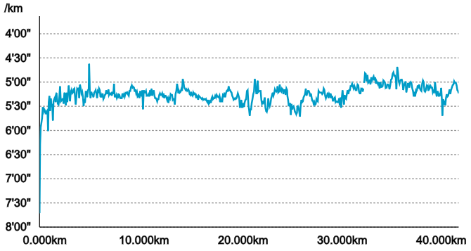
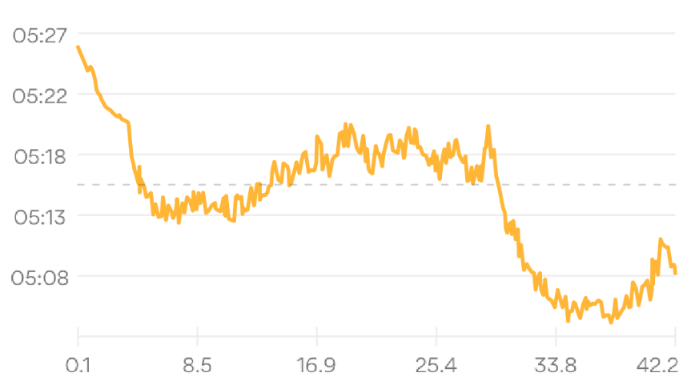


Gradient Flow = Smearing
Original Data
RunKeeper
Sasayama Marathon
2019/3/3 (Sun.)
record: 3:42.45

Slide 93

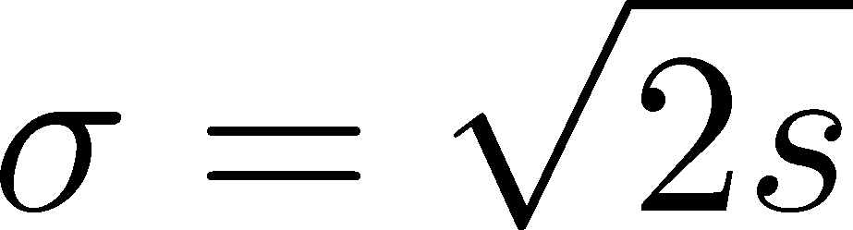



Gradient Flow = Smearing
Original Data
RunKeeper
Gaussian
①
②
Gradient Flow

Slide 94





Small Flow-Time Expansion
Luescher, Weisz, 2011
Suzuki, 2013
an operator at t>0
remormalized operators
of original theory
original 4-dim theory
t→0 limit

Slide 95


Constructing EMT 1
Suzuki, 2013
Gauge-invariant dimension 4 operators

Slide 96

Constructing EMT
Suzuki, 2013
vacuum subtr.
Remormalized EMT
Perturbative coefficient:
Suzuki (2013); Makino, Suzuki (2014); Harlander+ (2018); Iritani, MK, Suzuki, Takaura (2019)

Slide 97
Higher Order Coefficient: ε+p
NLO (1-loop)
N²LO (2-loop)
Iritani, MK, Suzuki, Takaura, PTEP 2019
t dependence becomes milder with higher order coeff.
Better t→0 extrapolation
Systematic error: μ₀ or μ_{d}, uncertaintyof Λ (±3%), fit range
Extrapolation func: linear, higher order term in c₁ (~g⁶)

Slide 98



Double Extrapolation t→0, a→0
O(t) terms in SFTE
lattice discretization
Continuum extrapolation
strong
discretization
effect
Small t extrapolation

Slide 99
Higher Order Coefficient: ε+p
NLO (1-loop)
N²LO (2-loop)
Range2
Range2
Range1
Range1
Range3
Range3
Iritani, MK, Suzuki, Takaura, PTEP 2019
t dependence becomes milder with higher order coeff.
Better t→0 extrapolation
Systematic error: μ₀ or μ_{d}, uncertaintyof Λ (±3%), fit range
Extrapolation func: linear, higher order term in c₁ (~g⁶)

Slide 100
Effect of Higher-Order Coeffs.
Iritani, MK, Suzuki, Takaura, 2019
□: 2-loop
△: Flow2016
Systematic error: μ₀ or μ_{d}, Λ, t→0 function, fit range
More stable extrapolation with higher order c₁ & c₂
(pure gauge)

Slide 101
Energy-Momentum Tensor
energy
momentum
pressure
stress
Spatial components of EMT: Stress Tensor

Slide 102
Stress = Force per Unit Area

Slide 103


Stress = Force per Unit Area
Pressure
S

Slide 104




Stress = Force per Unit Area
Pressure
Generally, F and n are not parallel
v
fluid
S
F
S
elastic body
S
In thermal medium
Stress Tensor
Landau
Lifshitz

Slide 105


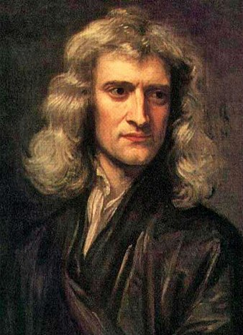




Force
Action-at-a-distance
Newton
1687
Local interaction
Faraday
1839

Slide 106




Maxwell Stress
(in Maxwell Theory)
Maxwell
E
pulling
Parallel to field: Pulling
Vertical to field: Pushing
pushing

Slide 107



Maxwell Stress
(in Maxwell Theory)
length:
pulling
pushing
Definite physical meaning
Distortion of field, line of the field
Propagation of the force as local interaction

Slide 108
Quark-Anti-quark system
Formation of the flux tube → confinement
Previous Studies on Flux Tube
Potential
Action density
Color-electric field
so many studies…
Cea+ (2012)
Cardoso+ (2013)

Slide 109
Stress Tensor in QQ System
ー
Yanagihara+, 1803.05656
PLB, in press
Lattice simulation
SU(3) Yang-Mills
a=0.029 fm
R=0.69 fm
t/a²=2.0
pulling
pushing
Definite physical meaning
Distortion of field, line of the field
Propagation of the force as local interaction
Manifestly gauge invariant

Slide 110
SU(3) YM vs Maxwell
SU(3) Yang-Mills
(quantum)
Maxwell
(classical)
Propagation of the force is clearly different
in YM and Maxwell theories!

Slide 111


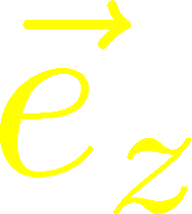






Stress Distribution on Mid-Plane
From rotational symm. & parity
EMT is diagonalized
in Cylindrical Coordinates
Degeneracy
in Maxwell theory

Slide 112


Mid-Plane
Separation
Continuum
Extrapolated!
In Maxwell theory
Degeneracy:
Separation:
Nonzero trace anomaly

Slide 113
Mid-Plane
Separation
Continuum
Extrapolated!
Degeneracy:
Separation:
Nonzero trace anomaly

Slide 114


Force
Force from Potential
Force from Stress

Slide 115
Force
Force from Potential
Force from Stress
Newton
1687
Faraday
1839

Slide 116
Force
Force from Potential
Force from Stress
Good Agreement!
Newton
1687
Faraday
1839

Slide 117
Summary
Lattice QCD numerical simulations are unique tools to investigate non-perturbative aspects of QCD.
Observables that can be measured on the lattice are strictly limited due to our ignorance of physical states and Euclidean formulation.
There still are many things that can be obtained from there.
More studies based on novel ideas are awaited!

Slide 118



Data & Physics
Gauge Configuration
128⁴
Textbook
Peskin-Schroeder

