Slide 1
Critical Points in Hot and Dense QCD
Masakiyo Kitazawa
(Osaka U.→YITP, Kyoto)
The 15th Asia Pacific Physics Conference, 2022/8/25, online (Korea)

Slide 2






Critical Points
Water
Ising Model
gas
Critical
Point
Temperature
1st tr.
liquid
Critical
Point
1st tr.
solid
pressure
The CP is a singular point.
Divergence of thermodynamic quantities.
These CPs belong to the same universality class ($Z_{2}$).
Common critical exponents. Ex.

Slide 3





QCD Phase Diagram
Temperature
Quark-Gluon Plasma
Critical
Point
$$Z_{2}$$
Hadron
Phase
1st tr.
Color SC
Chemical Potential

Slide 4
QCD Phase Diagram
Temperature
Quark-Gluon Plasma
Critical
Point
Another CP?
MK+ (2002)
Hadron
Phase
1st tr.
Color SC
Chemical Potential

Slide 5


QCD Phase Diagram
Early
Universe
Temperature
Quark-Gluon Plasma
Critical
Point
Another CP?
MK+ (2002)
Hadron
Phase
1st tr.
Color SC
Compact
Stars
Chemical Potential

Slide 6





Varying Quark Masses
Columbia plot
Example
= order of phase tr. at $μ_{q}=0$
Phase diagram in heavy-quark region
1st tr.
Critical
Point
Various orders of phase transition with variation of $m_{q}$.

Slide 7
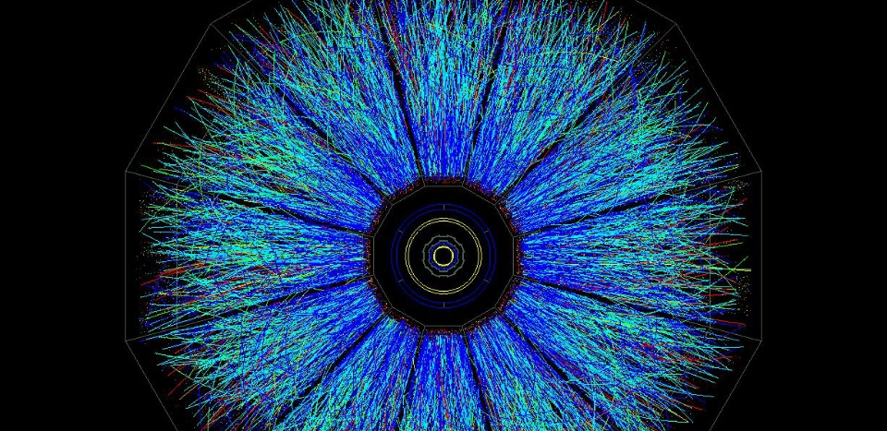
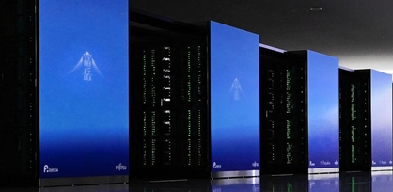
Two Experimental Tools
Real Experiment
Virtual Experiment
Relativistic Heavy-Ion Collisions
Lattice QCD
Numerical Simulations
Colliding two heavy nuclei in accelerators
RHIC (USA), LHC (EU), etc.
First-principle simulations
on supercomputers

Slide 8

Lattice QCD Numerical Simulations
Hadron Spectroscopy
PACS-CS,
PRD79 (’09)
Thermodynamics
Unique tool to perform
quantitative analyses of
non-perturbative QCD aspects

Slide 9


Relativistic Heavy-Ion Collisions
LHC – Large Hadron Collider

Slide 10
Relativistic Heavy-Ion Collisions
Proton-proton
Heavy Ion Collisions
proton
proton
Elementary processes
new particle search
properties of particles
Thermal Medium
hot & dense medium
phase transitions
LHC – Large Hadron Collider

Slide 11

Beam-Energy Scan
LHC
temperature
RHIC
beam energy scan
future facilities
ex. J-PARC @ Tokai
baryon chemical potential

Slide 12
Beam-Energy Scan
RHIC-BES
Phase I
2010~2015
Phase II
2019~2021
GSI-FAIR
2026~?
J-PARC-HI
2028~??
LHC
temperature
RHIC
beam energy scan
future facilities
ex. J-PARC @ Tokai
baryon chemical potential

Slide 13
Beam-Energy Scan
RHIC-BES
Phase I
2010~2015
Phase II
2019~2021
GSI-FAIR
2026~?
J-PARC-HI
2028~??
LHC
temperature
RHIC
beam energy scan
Lattice QCD
future facilities
ex. J-PARC @ Tokai
baryon chemical potential

Slide 14
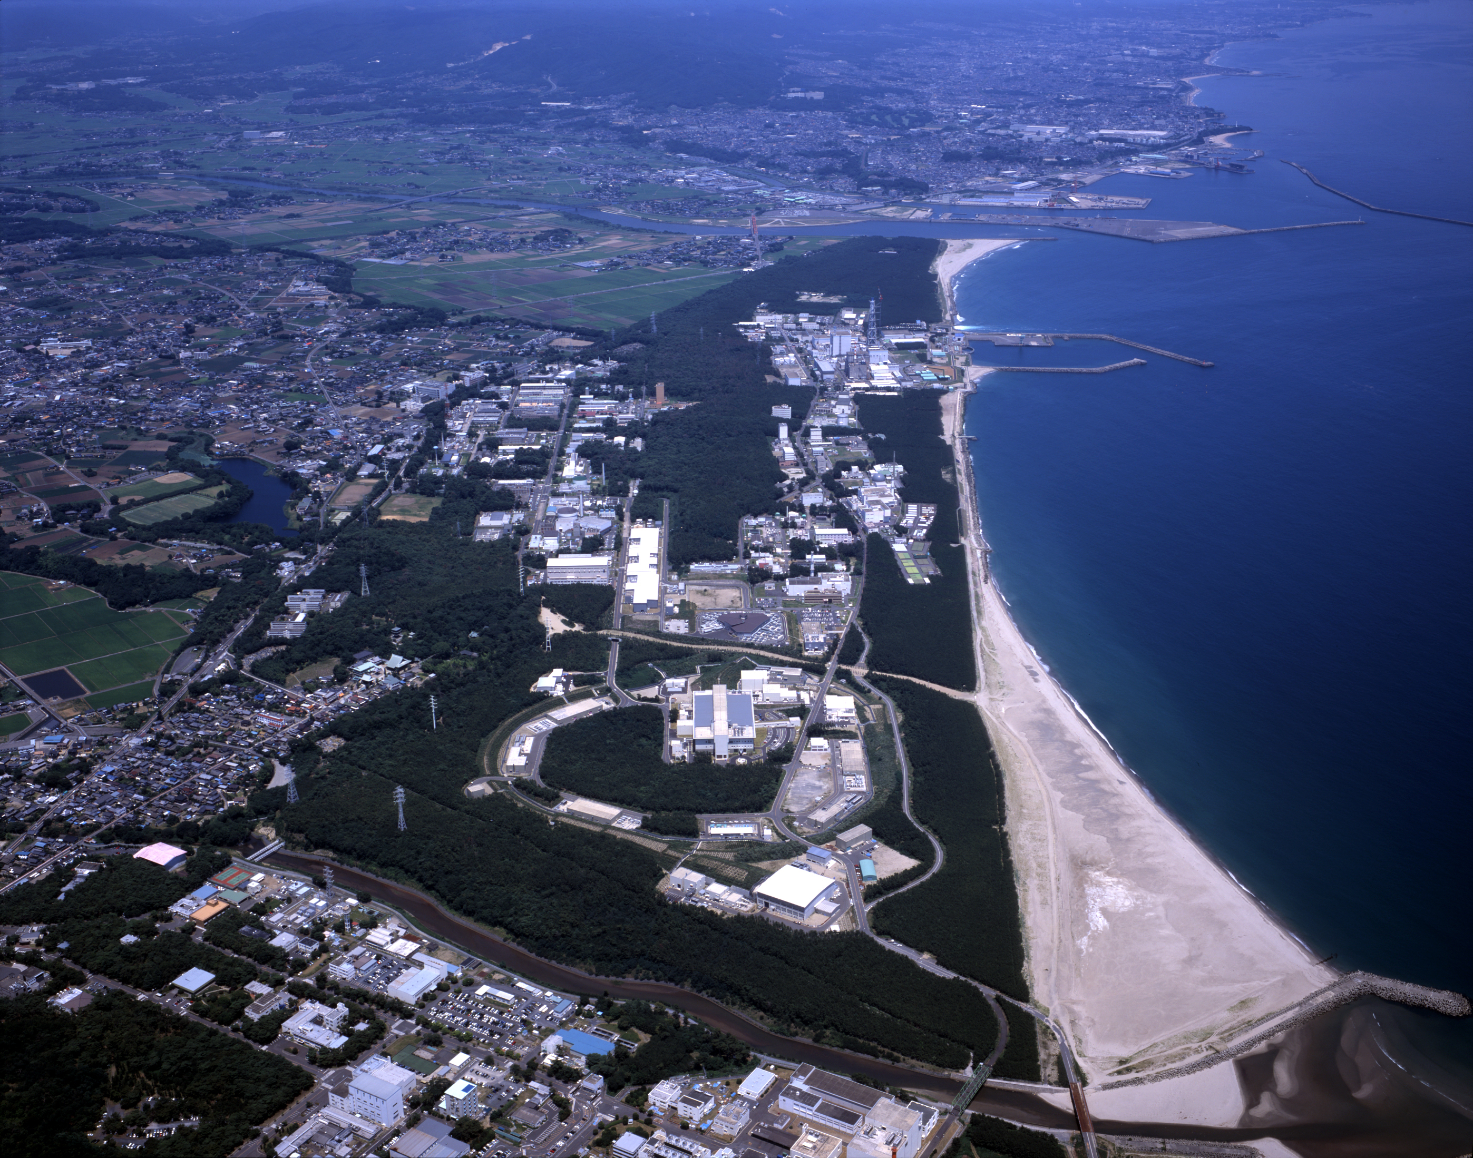
J-PARC-HI
J-PARC Heavy-Ion Program
Heavy-ion collision experiments
using accelerators in J-PARC (RCS/MR)
World highest intensity / Low cost
HI Injector
reliable
high intensity
RCS & MR
E_{lab} ~11→19 AGeV
√s_{NN}~4.9→6.2 GeV
Collision rate: ~10⁸Hz
2028~?

Slide 15
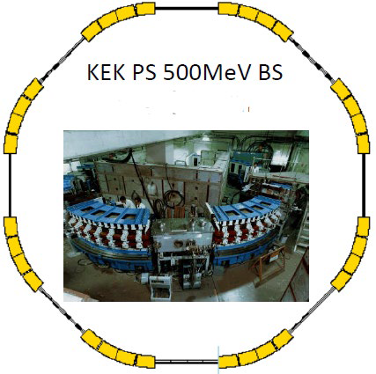


J-PARC-HI: Staging Plan
Phase-I (~2026)
SC HI Linac
KEK PS booster $\sim {10}^{8}$Hz
E16 spectrometer (upgrade)
Thermal dileptons
Phase-II (~2032)
Phase-II
New spectrometer
New booster $\sim {10}^{11}$Hz
New spectrometer
Fluctuations
Correlations
Phase-I
E16 (upgraded)

Slide 16
HIC vs LAT: Pros & Cons
HIC
Real
Dynamical
LAT
Virtual
Thermal
necessary
in physics
simulating
unphysical
world
need
space-time
models
ideal environment;
unable to simulate
real-time evolution
input
motivate

Slide 17
HIC vs LAT: Pros & Cons
HIC
Real
Dynamical
LAT
Virtual
Thermal
necessary
in physics
simulating
unphysical
world
need
space-time
models
ideal environment;
unable to simulate
real-time evolution
input
motivate
finite density
Accessible
beam-energy
scan
Difficult
due to
sign problem

Slide 18
Fluctuations &
Distribution Functions

Slide 19



Fluctuations
Observables in equilibrium are fluctuating!
variance
V

Slide 20




Cumulants
Binder Cumulant
Cumulants
skewness
kurtosis
average
variance
NOTE
Gauss distribution:
Poisson distribution:
Review: Asakawa, MK, PPNP 90 (2016)

Slide 21



Cumulants around Critical Point
Ising Model
$P(M)$: probability distr.
$V(M)$: effective potential
$M$ : order parameter
1st tr.
Sign of ${\left\langle N^{3}\right\rangle }_{c}$ is flipped at the CP.

Slide 22



Cumulants around Critical Point
Ising Model
$P(M)$: probability distr.
$V(M)$: effective potential
$M$ : order parameter
1st tr.
Sign of ${\left\langle N^{3}\right\rangle }_{c}$ is flipped at the CP.

Slide 23


Cumulants around Critical Point
Ising Model
$P(M)$: probability distr.
$V(M)$: effective potential
$M$ : order parameter
${\left\langle N^{4}\right\rangle }_{c}$ changes discontinuously at the CP.

Slide 24
Experimental Search for QCD Critical Point
Reviews:
Asakawa, MK, PPNP (’16)
Bluhm, MK+, NPA 1003 (’20)
MK, Esumi, Nonaka, JPS journal, 2021/8

Slide 25
Beam-Energy Scan
LHC
temperature
RHIC
beam energy scan
future facilities
ex. J-PARC @ Tokai
baryon chemical potential

Slide 26



Event-by-event Fluctuations
Review: Asakawa, MK, PPNP 90 (2016)
STAR, PRL105 (2010)
Detector
Cumulants

Slide 27
Cumulants around Critical Point
Ising Model
$P(M)$: probability distr.
$V(M)$: effective potential
$M$ : order parameter
1st tr.
Sign of ${\left\langle N^{3}\right\rangle }_{c}$ is flipped at the CP.

Slide 28



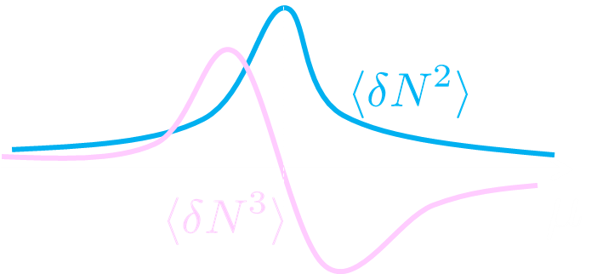


Sign Change of Cumulant
Asakawa, Ejiri, MK, PRL ’09
Geometric interpretation on the signs
Fluctuations ${\left\langle N_{B}^{2}\right\rangle }_{c}$ diverge at the QCD-CP.
Themodynamic Relation
Sign of ${\left\langle N_{B}^{3}\right\rangle }_{c}$ can distinguish near and away sides!

Slide 29

Impact of Negative Cumulants
Asakawa, Ejiri, MK, PRL ’09
Once negative ${\left\langle N_{B}^{3}\right\rangle }_{c}$ is established, it is evidences that
(1) χ_{B} has a peak structure in the QCD phase diagram.
(2) Hot matter beyond the peak is created in the collisions.
No dependence on any specific models.
Just the sign! No normalization (such as by N_{ch}).

Slide 30


Proton Number Cumulants
suppression?
non-monotonic
STAR, PRL126 (’21)
Nonzero and non-Poissonian cumulants are experimentally established.

Slide 31
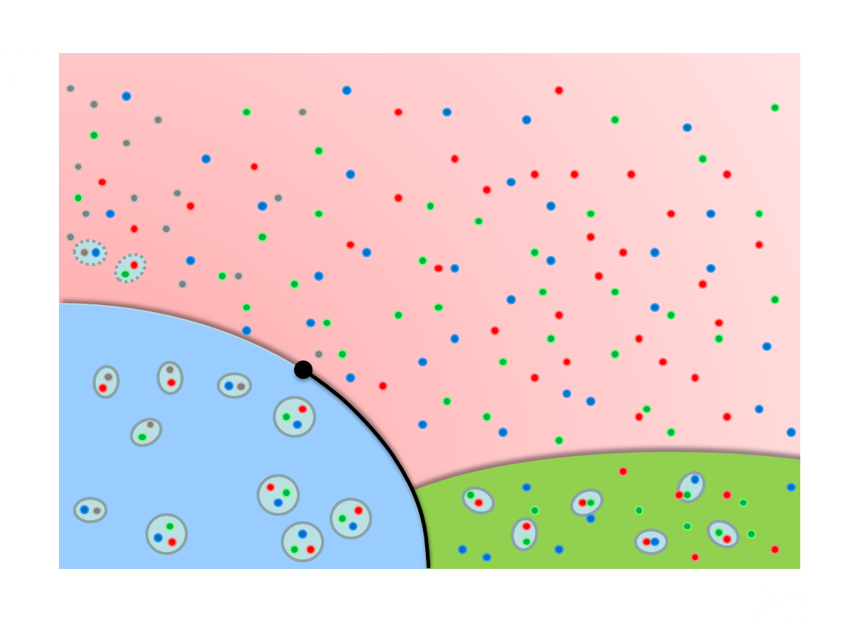
Time Evolution of Cumulants
initial
fluctuations
Critical slowing down around CP
diffusion of fluctuations
Proper understanding of the time evolution of fluctuations is indispensable.

Slide 32




Rapidity Window Dependence in Diffusion Models
Higher order cumulants
2nd order cumulant near CP
in diffusion master equation
in stochastic diffusion equation
MK+ (2014); MK (2015)
sakaida, Asakawa, Fujii, MK, 2018
Non-monotonic $Δy$ dependence can emerge reflecting the dynamical evolution.

Slide 33
Issues with Experimental Analysis
Detector-response correction
MK, Asakawa, 2012
MK, 2016
MK, Luo, 2017
Nonaka, MK, Esumi, 2017
Nonaka, MK, Esumi, 2018
Pileup correction
true
Nonaka, MK, Esumi, 2020
pileup
Acceptance correction
Nonaka, MK, Esumi, 2022

Slide 34
Lattice Simulation of
CP in Heavy-Quark Region
WHOT-QCD, Phys. Rev. D 101 (2020) 05450;
WHOT-QCD, PTEP 2021 (2021) 013B08;
Kiyohara, MK, Ejiri, Kanaya, Phys. Rev. D 104 (2021) 114509;
WHOT-QCD, PTEP 2022 (2022) 033B05
WHOT-QCD (Ashikawa, et al.), in progress

Slide 35


Varying Quark Masses
Columbia plot
Example
= order of phase tr. at $μ=0$
Phase diagram in heavy-quark region
1st tr.
Critical
Point
Various orders of phase transition with variation of $m_{q}$.

Slide 36
Cumulants around Critical Point
Ising Model
$P(M)$: probability distr.
$V(M)$: effective potential
$M$ : order parameter
${\left\langle N^{4}\right\rangle }_{c}$ changes discontinuously at the CP.

Slide 37





Finite-Volume Effects
Binder Cumulant
Ising Model
$$V=∞$$
Sudden change of $B_{4}$ at the CP is smeared by finite $V$ effect.
$B_{4}$ obtained for various $V$ has crossing at $t=0$.
At the crossing point, $B_{4}=1.604$ in $Z_{2}$ universality class.

Slide 38

Finite-Volume Effects
Binder Cumulant
Ising Model
$$V=∞$$
smaller $V$
Sudden change of $B_{4}$ at the CP is smeared by finite $V$ effect.
$B_{4}$ obtained for various $V$ has crossing at $t=0$.
At the crossing point, $B_{4}=1.604$ in $Z_{2}$ universality class.

Slide 39



Binder-Cumulant Analysis
Light-quark region
Heavy-quark region
Kuramashi, Nakamura, Ohno, Takeda, ’20
Cuteri , Philipsen , Schön, Sciarra, ’21
$$N_{t}=12, LT<2.7$$
$$N_{t}=10, LT≤6$$
Statistically-significant deviation of the crossing point from the 3d-Ising value.
Too large finite-V effects?

Slide 40
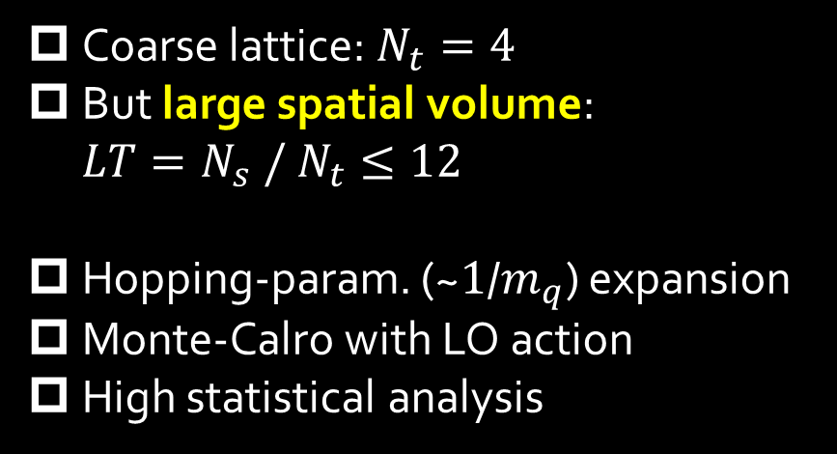
Numerical Simulation
Coarse lattice: $N_{t}=4$
But large spatial volume: $LT=N_{s} / N_{t}≤12$
Hopping-param. (~$1$/$m_{q}$) expansion
Monte-Calro with LO action
High statistical analysis
Simulation params.

Slide 41




Binder-Cumulant Analysis
Z2
$$LT≥9$$
$$LT≥8$$
$B_{4}$ and $ν$ are consistent with Z2 universality class only when $LT≥9$ data are used for the analysis.

Slide 42

Further Check of Finite-V Scaling
Effective potential at the CP
Scaling of order parameter
Z2 scaling is well established
Deviation from Z2 may come from “non-singular” part that are not negligible when $V$ is not large enough.

Slide 43





Lattice Spacing Dependence
New result for $N_{t}=6$(Ashikawa+, 2022)
preliminary
On the finer lattice, deviation from the finite-size scaling becomes larger with the same $V$.
Violation of the HPE → See, WHOT, PTEP2022, 033B05

Slide 44
Summary
Critical points appear many places in QCD at nonzero temperature.
Two experimental tools for the search for the CPs:
  Relativistic heavy-ion collisions
  Lattice QCD numerical simulations
Various studies are ongoing using both real and virtual experiments.

Slide 45

Quantum ChromoDynamics
Building blocks of matter
nucleus
nucleon
quark

Slide 46

Quantum ChromoDynamics
Building blocks of matter
nucleus
nucleon
quark
Quantum chromodynamics (QCD)
=Fundamental theory of strong interaction
gluons
quarks
gluons

Slide 47
Quark-Gluon Plasma (QGP)
vacuum
baryon
meson

Slide 48
Quark-Gluon Plasma (QGP)
temperature
vacuum
baryon
meson

Slide 49


Quark-Gluon Plasma (QGP)
temperature
vacuum
baryon
meson
quark-gluon plasma
Early Universe

