Slide 1
Energy-momentum tensor around the kink in 1+1d field theories
Hiroaki Ito, Masakiyo Kitazawa
in preparation
KEK Journal club, online, 2022/10/24

Slide 2
Main Conclusion

Slide 3
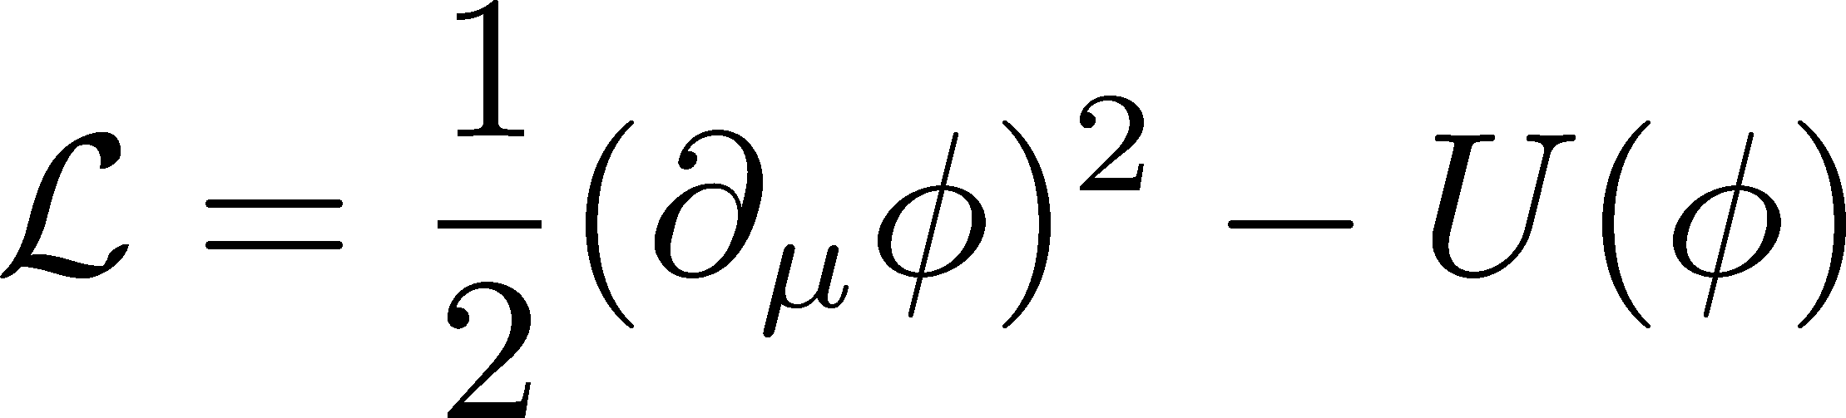
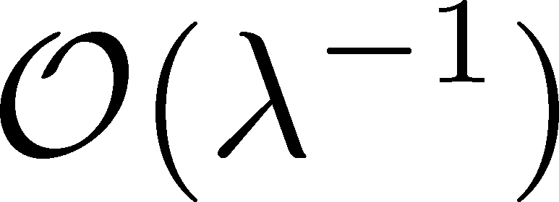

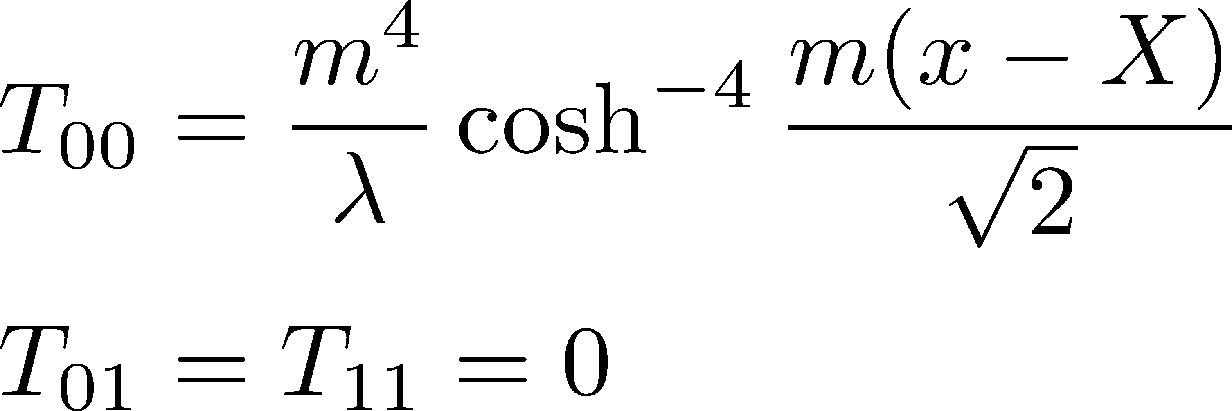
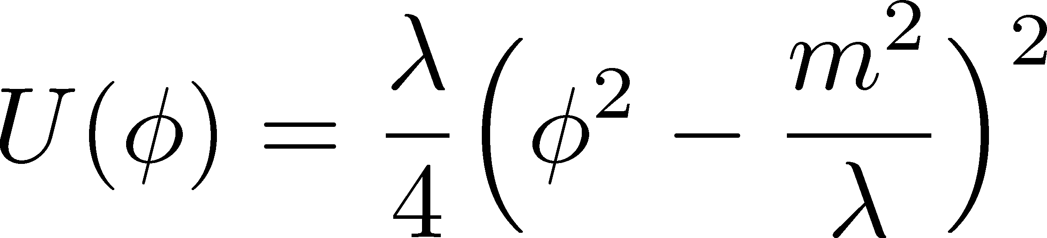

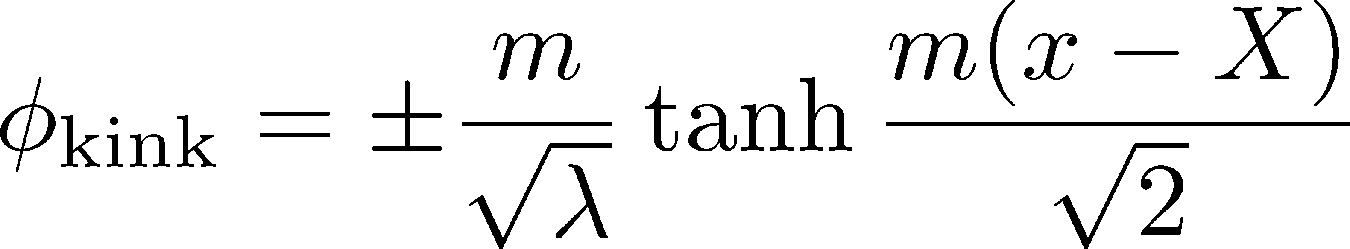
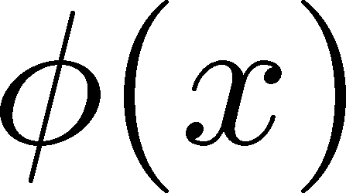



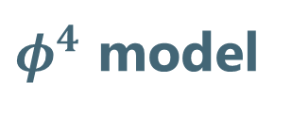
$φ^{4}$ Model & Kink
$φ^{4}$ model
Energy-Momentum Tensor
Classical
Kink (Soliton)
classical solution
stable
local

Slide 4
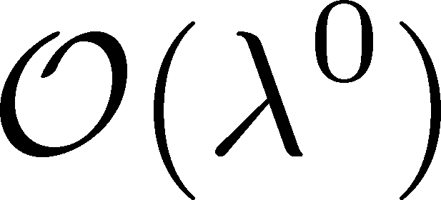
$φ^{4}$ Model & Kink
$φ^{4}$ model
Energy-Momentum Tensor
Classical
Kink (Soliton)
This study
Quantum correction at
finite result
satisfy conservation law
classical solution
stable
local
Previous Studies:
Total energy: Dashen+ (’74)
Energy density (?): Goldhaber+ (’03)

Slide 5
Motivations

Slide 6

Gravitational Form Factors &
EMT Distribution inside Hadrons
Pressure distribution inside hadrons
Proton
Pion
EMT → mechanical structure of hadrons.
Measurement will be refined at the EIC.
EMT distribution around local structures in QFT.
Kumano+, PRD 97, 014020 (’18)
Burket+, Nature 557, 396 (’18)

Slide 7
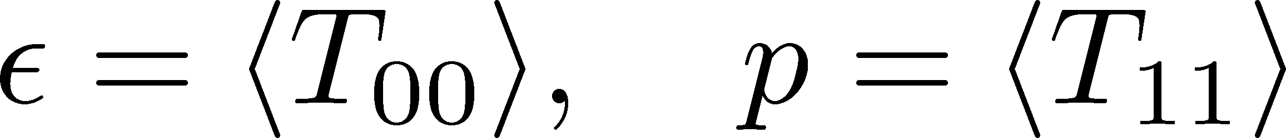
EMT on the Lattice QCD
Measurement of EMT on the lattice QCD simulations had been difficult.
  Violation of translational sym.
  Large statistical noise.
New method based on the gradient flow
SFtX (Small Flow-time eXpansion)
Numerical simulations show
  Valid definition of EMT.
  Suppression of statistical error.
Thermodynamics
Suzuki (’13)
□: SFtX
FlowQCD (’14~); WHOT-QCD (’15~)
Iritani, MK, Takaura, Suzuki (’19)

Slide 8

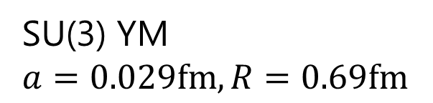
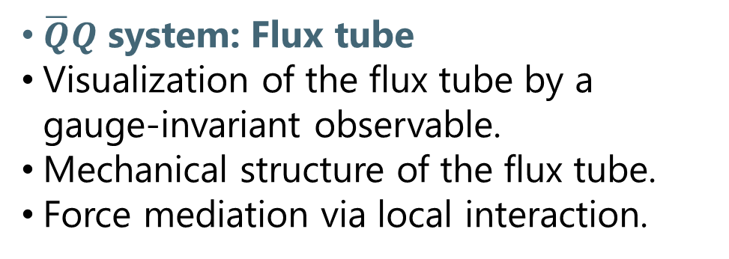
EMT Distribution in $\overline{Q}Q$ System
Eigenvectors of Stress Tensor
Yanagihara, MK+ (FlowQCD Col.), PLB (’19)
$\overline{Q}Q$ system: Flux tube
Visualization of the flux tube by a gauge-invariant observable.
Mechanical structure of the flux tube.
Force mediation via local interaction.
SU(3) YM
$a=0.029fm, R=0.69fm$
pulling
pushing

Slide 9
EMT Distribution in $\overline{Q}Q$ System
Eigenvectors of Stress Tensor
Yanagihara, MK+ (FlowQCD Col.), PLB (’19)
$\overline{Q}Q$ system: Flux tube
Visualization of the flux tube by a gauge-invariant observable.
Mechanical structure of the flux tube.
Force mediation via local interaction.
SU(3) YM
$a=0.029fm, R=0.69fm$
pulling
pushing

Slide 10
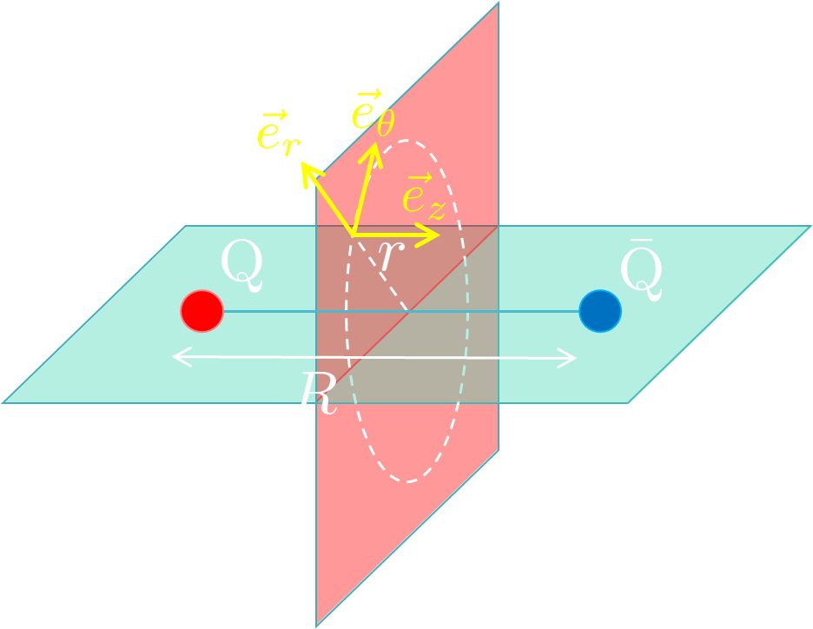
Flux Tube in Dual SC Model
Yanagihara, MK, PTEP (’19)
Dual Superconductor Picture
EMT on the Midplane
Nambu (’70); Nielsen, Olesen (’73);
t ‘Hooft (’81); …
Abelian-Higgs model
QCD vacuum
Flux tube
E/M dual of SC
Magnetic vortex
ex) Abelian-Higgs Model
Lattice
Classical solution in the AH model
Lattice EMT can be reproduced by the AH model qualitatively.
Quantitative reproduction is not possible.

Slide 11


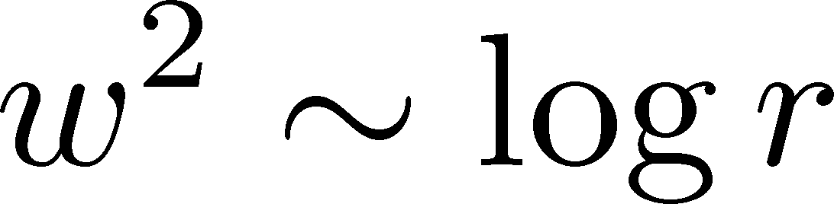
Quantum Effect on Flux Tube
Classical vortex is unstable against quantum fluctuations
Quantum effects give rise to
  Luscher term in potential Luscher (1981)
  Fattening of the tube Luscher, Munster, Weisz (1981)
Nielsen, Olesen (’73)
How does quantum vibration of the flux tube modify the EMT distribution?
Discrimination of “intrinsic” and “vibration” via EMT?

Slide 12
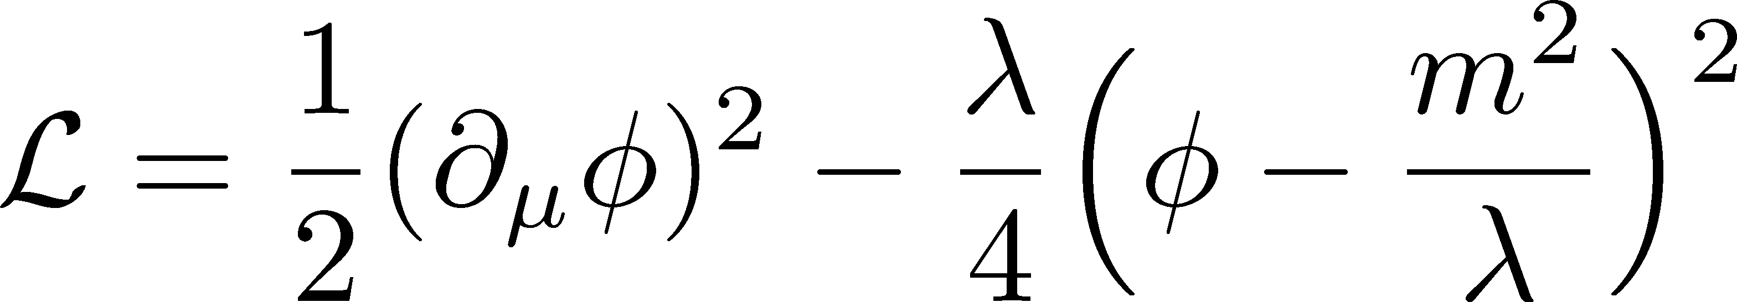
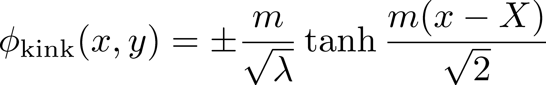

Quantum Effect in 2+1d $φ^{4}$ Model
The kink in 2+1d forms a stable surface at the classical level.
How do the quantum effects blur the surface?

Slide 13

Analysis of $φ^{4}$ Model

Slide 14
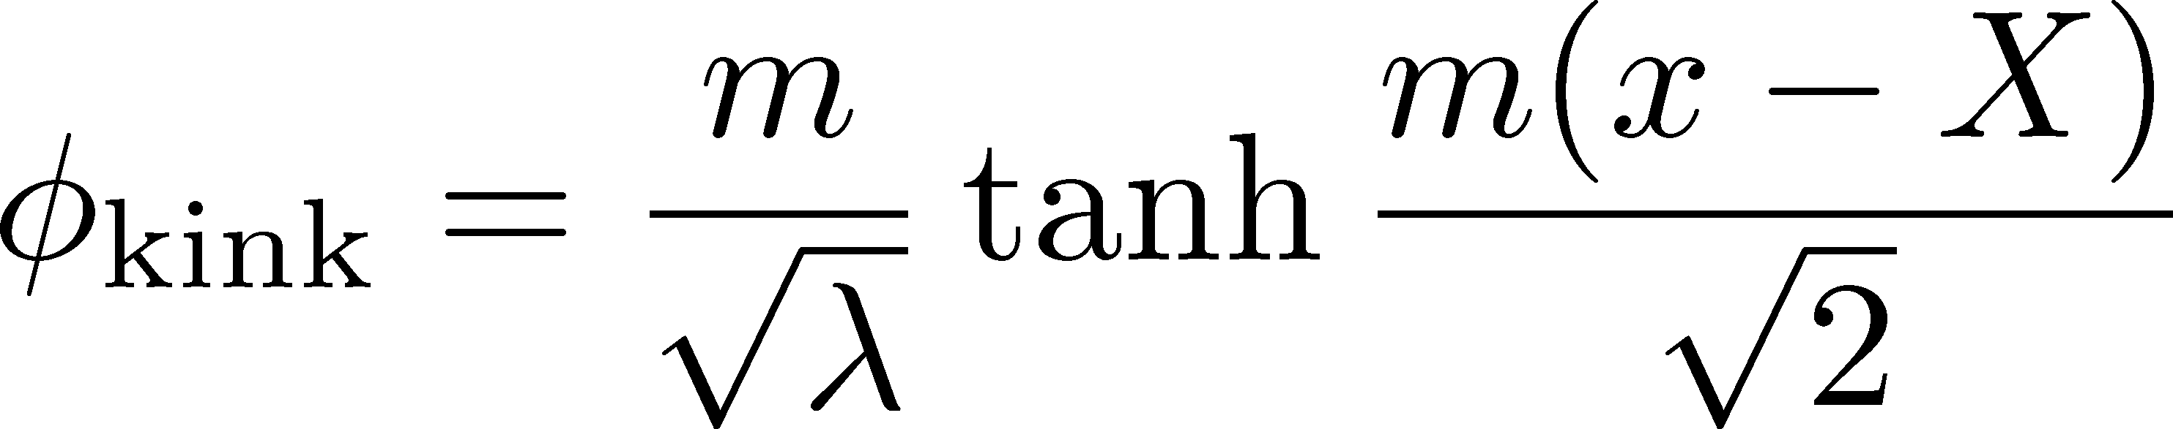
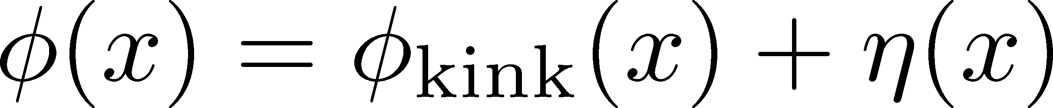
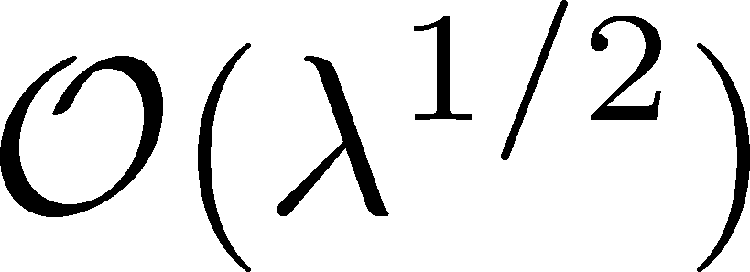
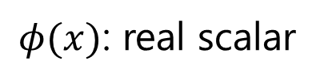
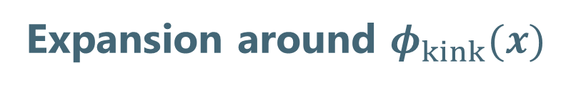

Fluctuations around the Kink
Model: $φ^{4}$ theory (1+1d)
Kink
$φ(x)$: real scalar
Expansion around $φ_{kink}(x)$
quadratic
diagonalize
First-order terms can be eliminated by the partial integral & EoM.

Slide 15
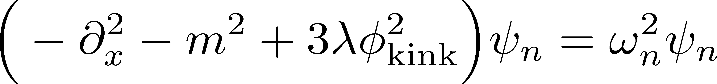

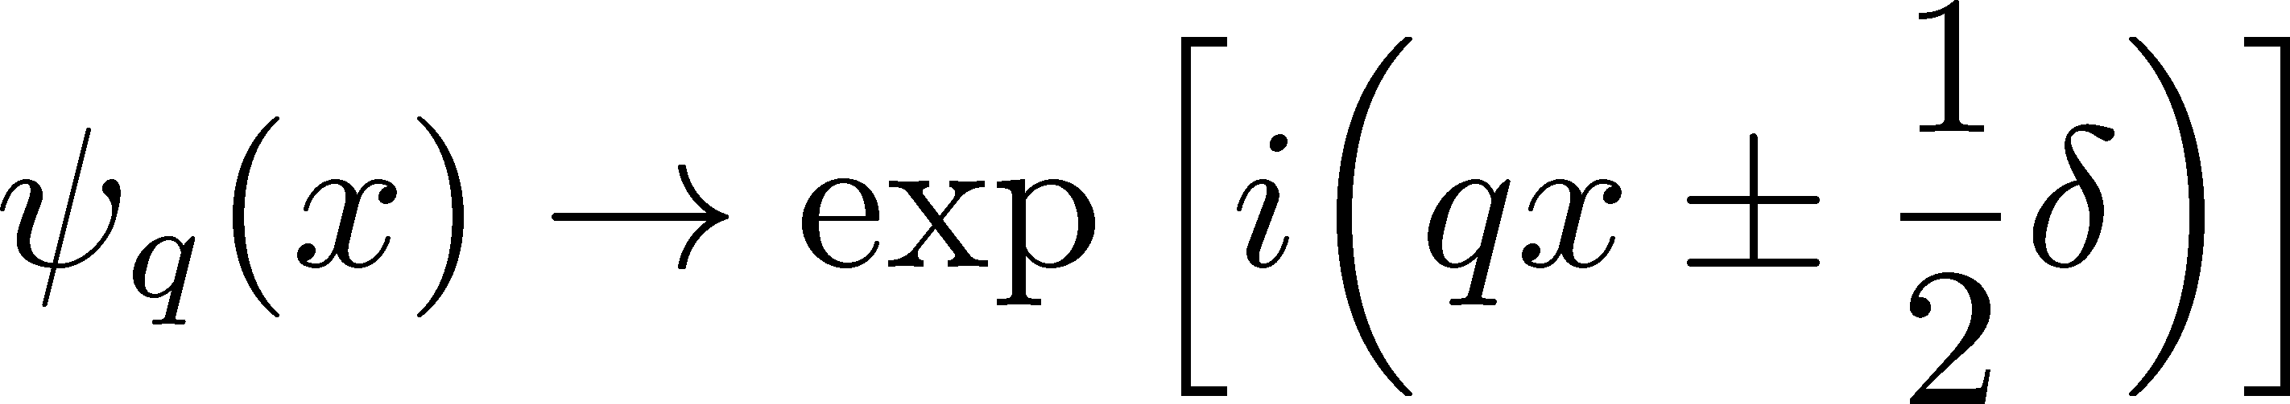
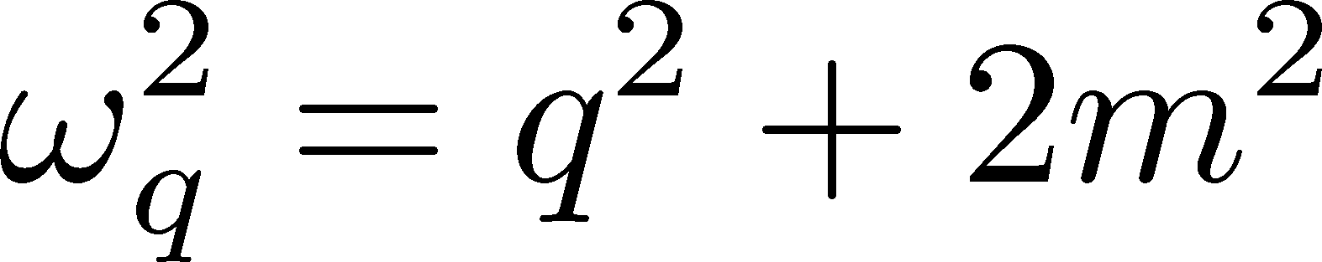
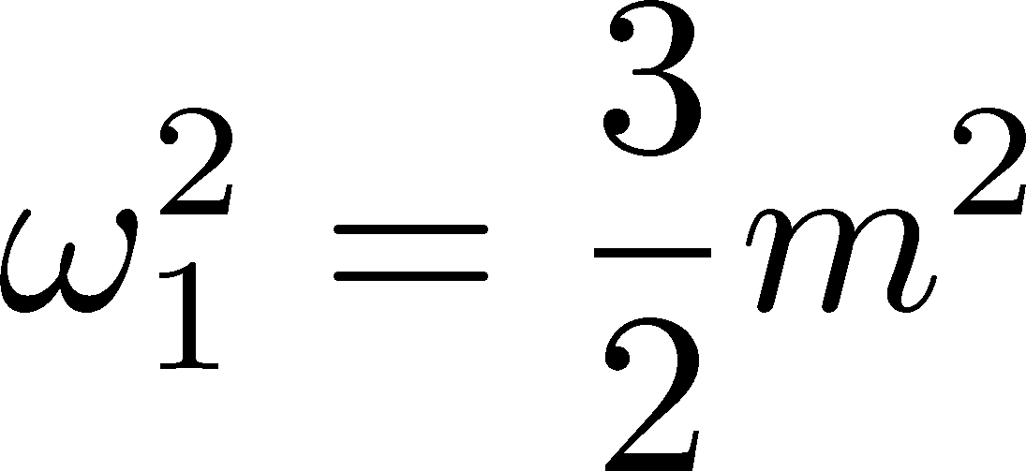
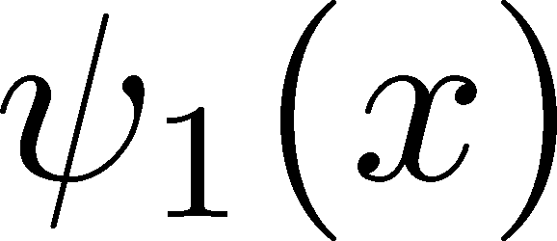
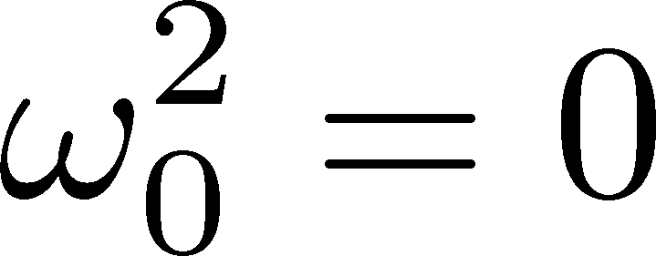
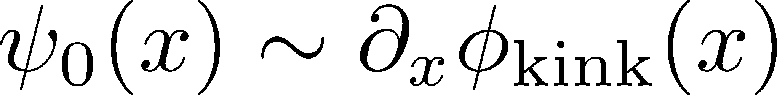
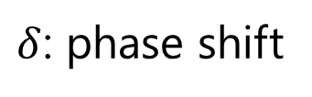
Diagonalization
ex)
Rajaraman,
“Solitons & Instantons”
Eigenvals
Eigenfuncs
$δ$: phase shift
scattering
states
: vibrational mode
bound states
: translational mode
(zero mode)

Slide 16
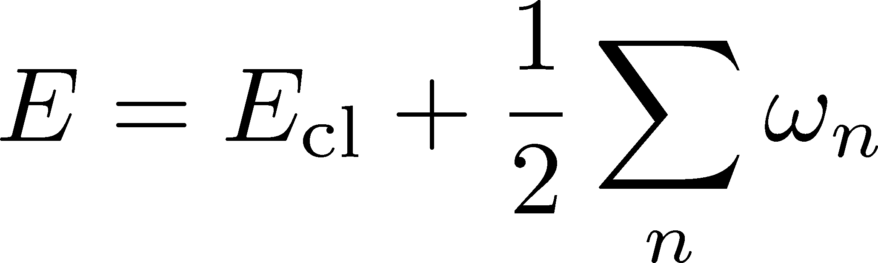


Total Energy at $O\left(λ^{0}\right)$ (Dashen+, ’74)
Total Energy
Sum of zero-point energy of all modes
Divergent
Two Steps to Remove the Divergence
1) Vacuum Subtraction
2) Mass Renormalization
mass counter term in vacuum sector

Slide 17
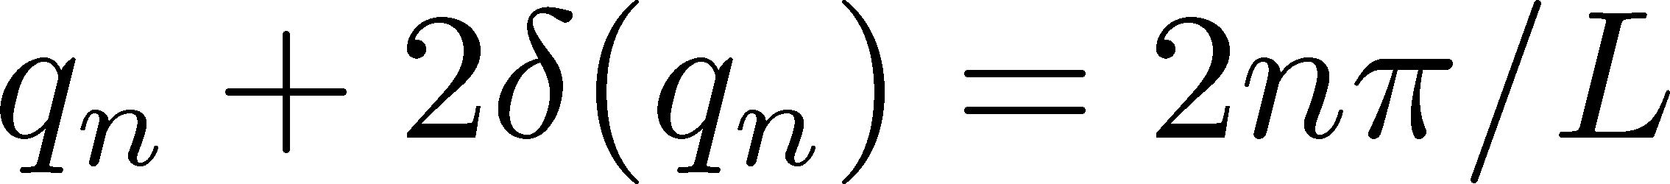
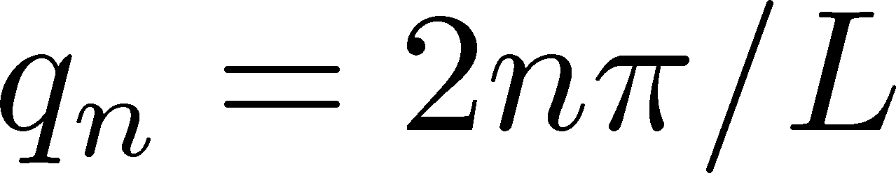
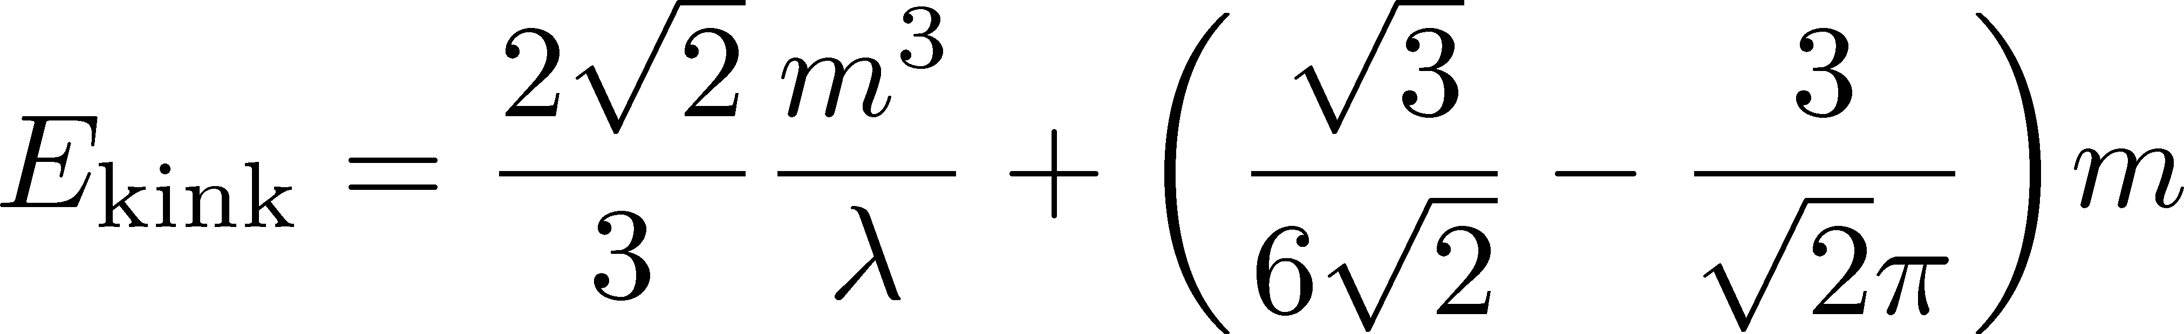

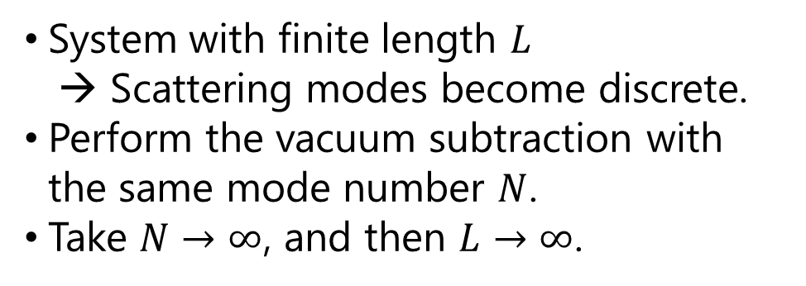
Vacuum Subtraction (Dashen+, ’74)
Rebhan and Nieuwenhuizen (’97)
Rajaraman, “solitons & instantons”
Mode Number Cutoff
System with finite length $L$
→ Scattering modes become discrete.
Perform the vacuum subtraction with the same mode number $N$.
Take $N→∞$, and then $L→∞$.
Spectra for periodic BC
Soliton
Vacuum
Scattering modes $ψ_{q}\left(x\right)$ satisfy
Soliton sector:
Vacuum sector:
continuum
bound
states

Slide 18
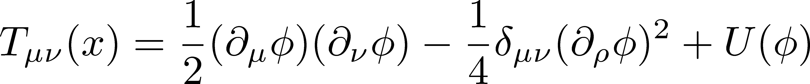
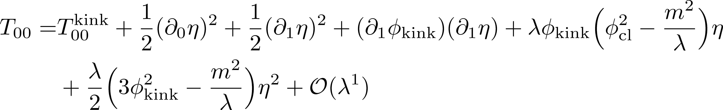
Energy Momentum Tensor
EMT as a Noether Current
Calculate expectation value of each term.
First-order terms do exist.
Zero mode gives rise to divergences in perturbative expansion.

Slide 19
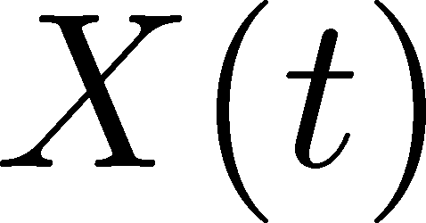
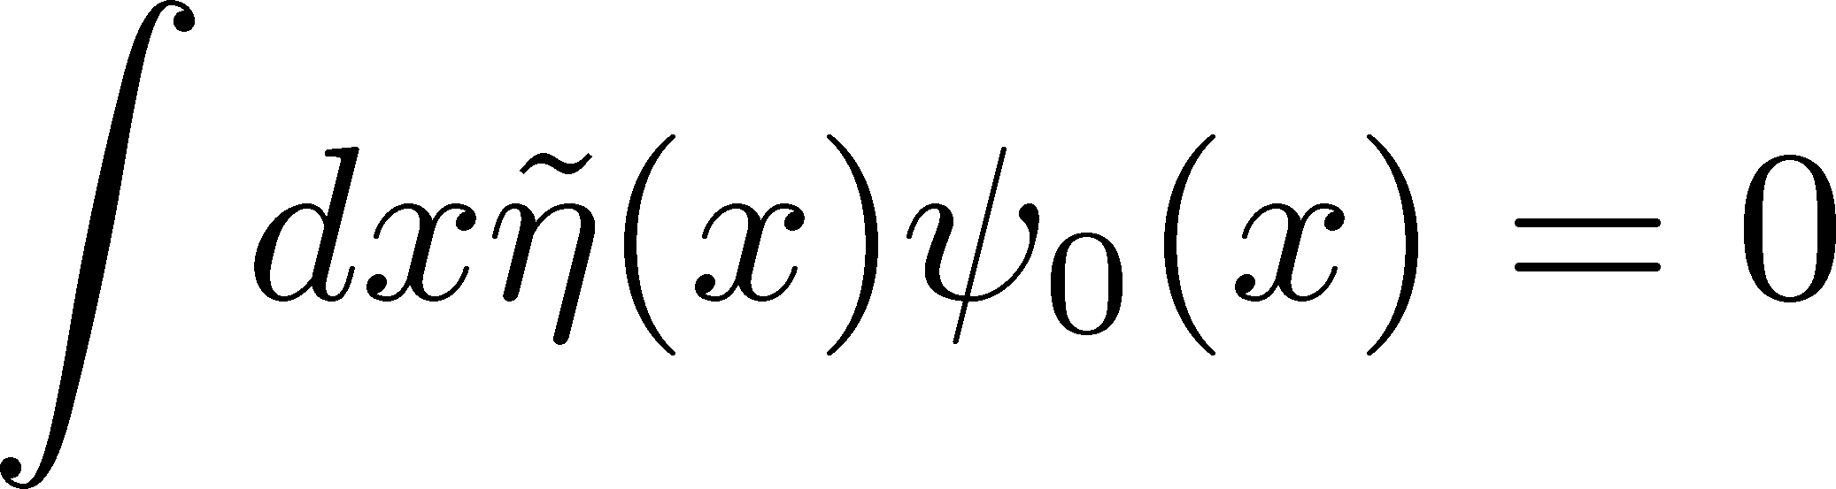
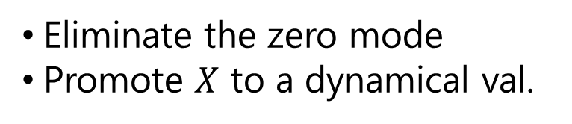
Collective Coordinate Method
Zero mode gives rise to IR divergence!
Gervais, Sakita ’74
Gervais, Jevicki, Sakita, ’75
Tomboulis, ’75; Christ, Lee, ‘75
CCM: Basic idea
zero mode = translational mode
Eliminate the zero mode
Promote $X$ to a dynamical val.
: dynamical
constraint:

Slide 20
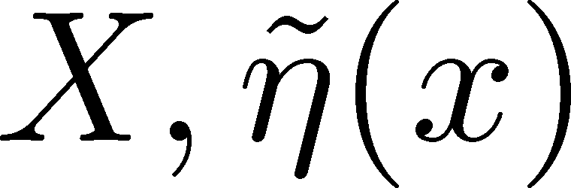
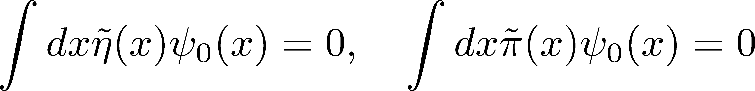
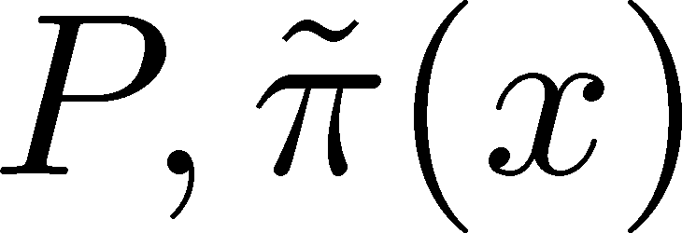
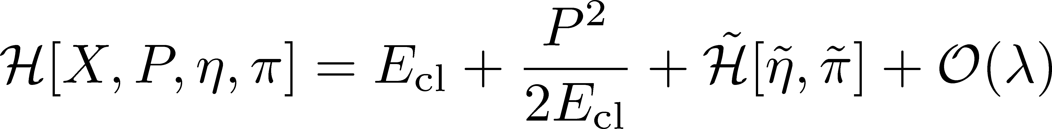
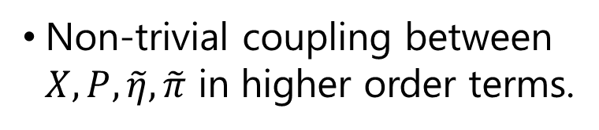
Collective Coordinate Method
Gervais, Sakita ’75
Gervais, Jevicki, Sakita, ’75
Tomboulis, ’75; Christ, Lee, ‘75
Dynamical variables:
Constraints:
Conjugate momenta:
New Hamiltonian
Non-trivial coupling between $X, P, \tilde{η}, \tilde{π}$ in higher order terms.
Hamiltonian in the center of mass frame

Slide 21

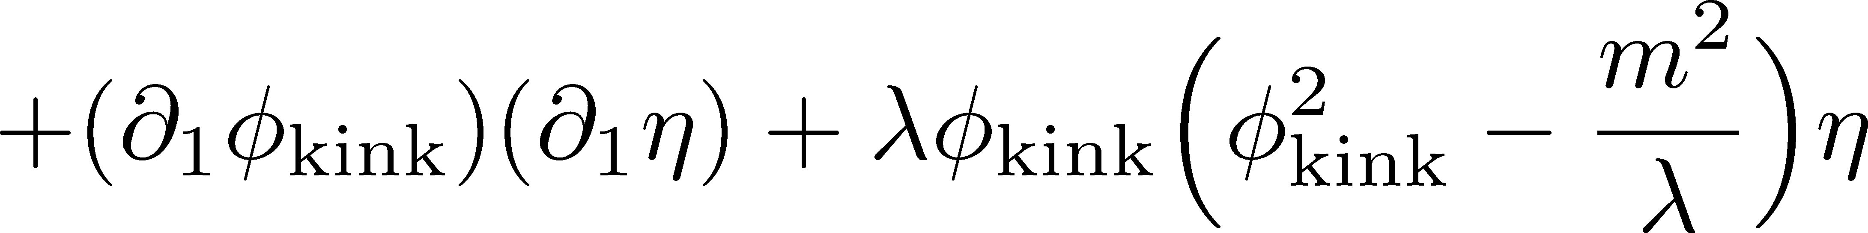
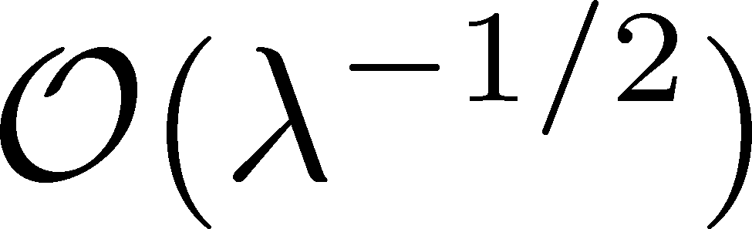
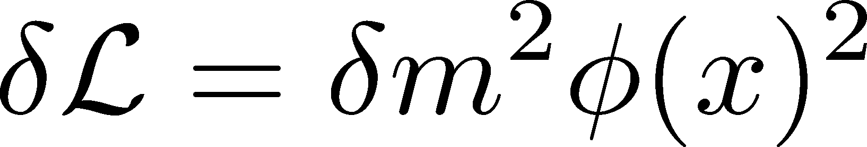
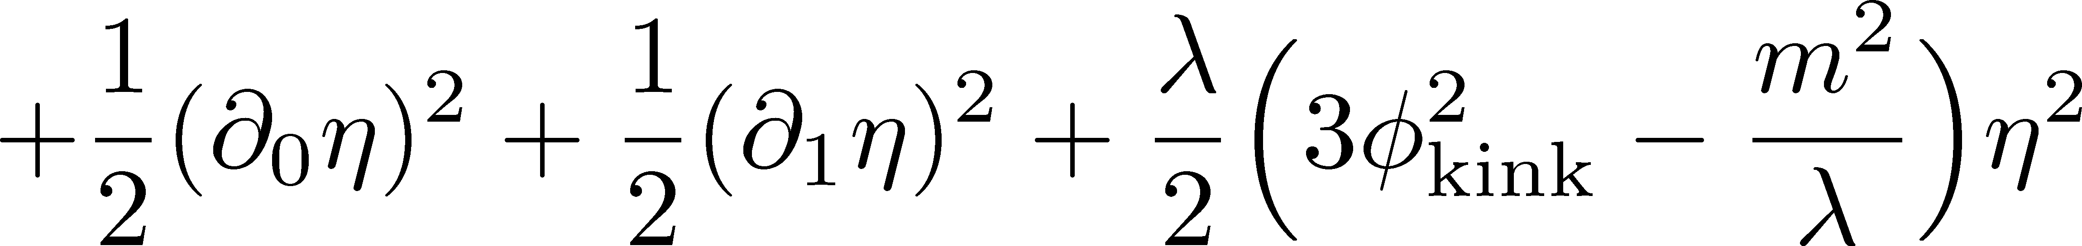
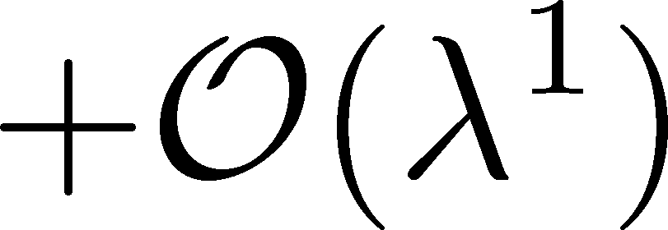
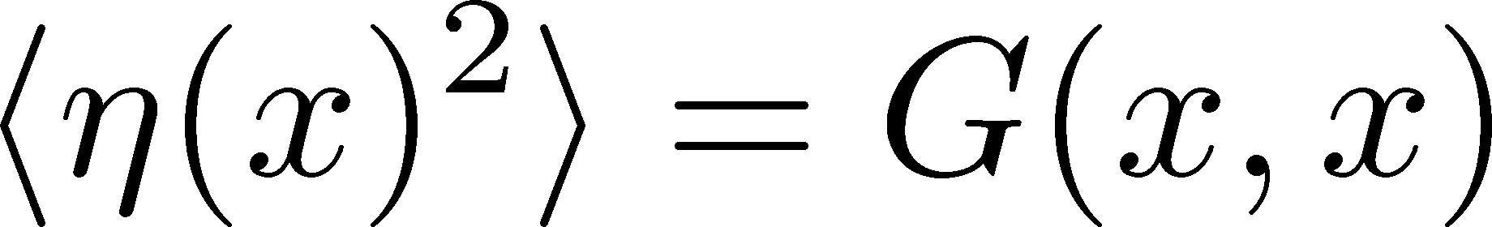
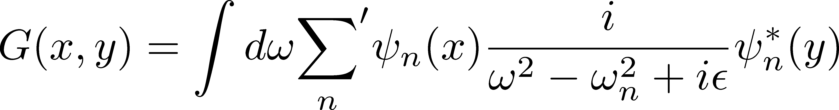


Expectation Values
Mass Counter Term
$O\left(λ^{0}\right)$ Terms
Green Function

Slide 22








Tadpole Diagram
analytically calculable
Note:
EoM
Anti-periodic BC $η\left(x+L\right)=−η\left(x\right)$ must be imposed.
Eigen eq.

Slide 23







Results
$T_{00}^{∞}$: finite & local function
$L$: spatial length
Note:
$T_{μν}\left(x\right)$ has a constant term $\sim 1/L$ that vanishes at $L→∞$.
$E=\int_{−L/2}^{L/2}{dx}T_{00}(x)$ reproduces Dashen+ (’74), but $∫dx T_{00}^{∞}(x)$ does not.
Is the result in Dashen+ the total energy of the soliton?
$T_{11}(x)$ does not have $x$ dependence. ➔ consistent with EM conservation

Slide 24











Another Scheme (Goldhaber+, ’03)
$$q$$
$$k$$
Local Mode Regularization
$$ρ_{Λ−ΔΛ}^{soliton}\left(x\right)=ρ_{Λ}^{vac}\left(x\right)$$
Infinite system
Subtraction with “local density of states” for each sector.
$$Λ$$
$$Λ−ΔΛ$$
$$ρ_{N}\left(x\right)≡\sum_{n=0}^{N}{{\left|η_{n}\left(x\right)\right|}^{2}}$$
$$ρ_{Λ}^{vac}\left(x\right)$$
$$ρ_{Λ−ΔΛ}^{soliton}\left(x\right)$$
Results in LMR
$E=\int_{−L/2}^{L/2}{dx}T_{00}^{LMR}(x)$ reproduces Dashen+ (’74).
$T_{11}(x)$ has $x$ dependence.
➔ violates EM conservation

Slide 25



Kink in Sine-Gordon Model
Ito, JPS meeting 2022fall
$$φ$$
vacuum
Spectra for periodic BC
Soliton
Vacuum
Same calculation is feasible.
Obtained EMT satisfies the momentum conservation.
continuum
Difference in the spectra:
SG model has only a bound state.
bound
state

Slide 26

Summary & Outlook
Calculation of EMT distribution around a kink at the one-loop order.
EMT distr. at the quantum level around a localized structure in QFT.
Our result satisfies the momentum conservation.
Conservation laws can be used for discriminating the correct scheme.
Future Studies
Interpretation of $\sim 1/L$term in the EMT.
Breather state in Sine-Gordon model.
Similar problem in 2+1dimensional systems → fattening of the surface

