Slide 1
Lattice study of the
Critical point in heavy-quark QCD
CPOD2022 (Critical Point and Onset of Deconfinement), Dec. 1, 2022
Masakiyo Kitazawa
(YITP, Kyoto)
with R. Ashikawa, S. Ejiri, K. Kanaya, H. Suzuki, N. Wakabayashi
Ashikawa+, in preparation
Wakabayashi+, PTEP 2022, 033B05 (2022) [2112.06340]
Kiyohara+, Phys. Rev. D104, 114509 (2021) [2108.00118]
Shirogane+, PTEP 2021, 013B08 (2021) [2011.10292]
Ejiri+, Phys. Rev. D101, 054505 (2020) [1912.10500]

Slide 2






Critical Points
Water
Ising Model
gas
Critical
Point
Temperature
1st tr.
liquid
Critical
Point
1st tr.
solid
pressure
CP: Second-order transition point.
Singularities in thermodynamic quantities.
These CPs belong to the same universality class ($Z_{2}$).
Common critical exponents. Ex.

Slide 3





QCD Phase Diagram
Temperature
Quark-Gluon Plasma
Critical
Point
$$Z_{2}$$
Hadron
Phase
1st tr.
Color SC
Chemical Potential

Slide 4
QCD Phase Diagram
Temperature
Quark-Gluon Plasma
Critical
Point
Another CP?
MK+ (2002)
Hadron
Phase
1st tr.
Color SC
Chemical Potential

Slide 5















Varying Quark Masses @ $μ_{q}=0$
Columbia plot
Example
= order of phase tr. at $μ_{q}=0$
Phase diagram
in $T−m_{q}$ plane
$$∞$$
?
$1$st
Critical
Point
physical
point
?
This study
1st tr.
strange-quark mass $m_{s}$
crossover
1st tr.
$1$st
$$0$$
light-quark mass $m_{u,d}$
$$∞$$
Various orders of phase transition with a variation of $m_{q}$.

Slide 6










Binder Cumulant $B_{4}$
Binder Cumulant
Ising Model
Kurtosis:
${\left\langle M^{4}\right\rangle }_{c, h=0}$ changes discontinuously at the CP.

Slide 7



Finite-Volume Effects
Binder Cumulant
Ising Model
$$V=∞$$
Discontinuity of $B_{4}$ at the CP is smeared on finite $V$.
$B_{4}$ obtained at various $V$ have crossing at $t=0$.

Slide 8



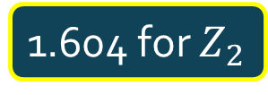
Finite-Volume Effects
Binder Cumulant
Ising Model
$$V=∞$$
1.604 for $Z_{2}$
smaller $V$
Z(2) CP
Discontinuity of $B_{4}$ at the CP is smeared on finite $V$.
$B_{4}$ obtained at various $V$ have crossing at $t=0$.

Slide 9

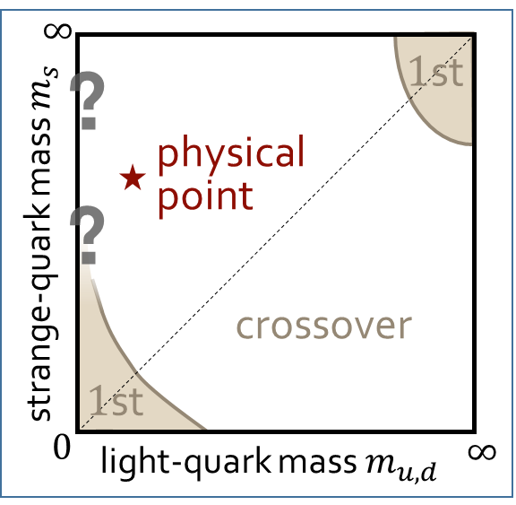



Lattice Studies of Binder-Cumulant
Light-quark region
Heavy-quark region
Kuramashi, Nakamura, Ohno, Takeda, ’20
Cuteri , Philipsen , Schön, Sciarra, ’21
$$N_{t}=12, LT<2.7$$
$$N_{t}=10, LT≤6 (10)$$
Statistically-significant deviation of the crossing point from the 3d-Ising value.
$V$ may not be large enough?

Slide 10


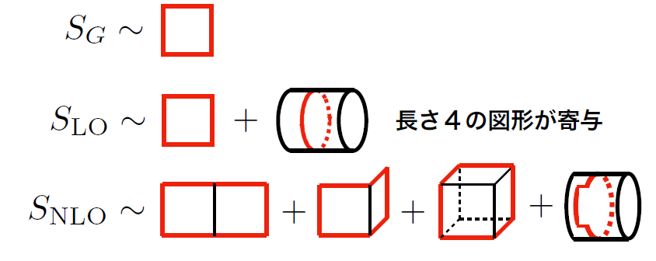


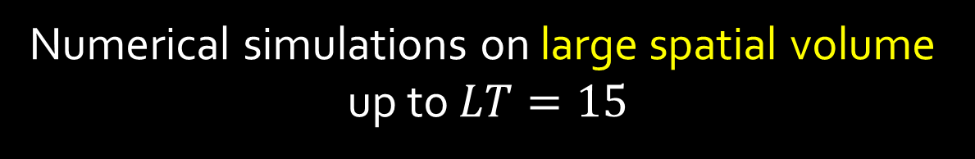

Our Strategy
Kiyohara+, PRD104 (2021); Ashikawa+, in prep.
Numerical simulations on large spatial volume
up to $LT=15$
To realize it:
CP in the heavy-quark region
Simulations on coarse lattices ($N_{t}=1/aT=4→6$)
Hopping parameter ($κ\sim 1/m_{q}$) expansion (HPE)
$tr[B_{n}]$is given by the closed trajectories of length $n$.
$$N_{t}=4$$

Slide 11


Hopping Parameter Expansion
Monte Carlo Simulation @ LO
heat bath & over relaxation with modified staple
Numerical cost is almost the same as the pure YM!
NLO by Reweighting
Overlapping problem is well suppressed due to the LO confs.
Realize high statistical analysis

Slide 12
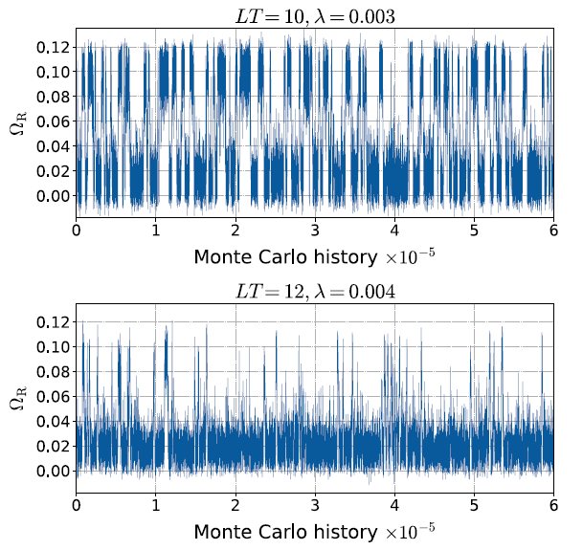

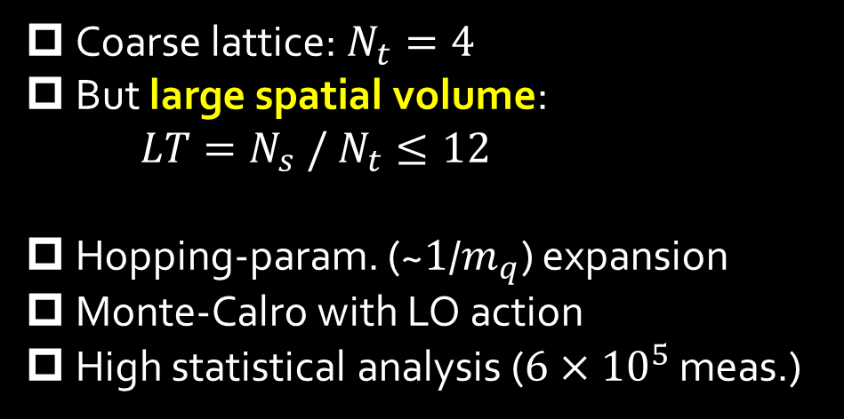
Numerical Simulation @ $N_{t}=4$
Kiyohara+, PRD104 (2021) 114509
Coarse lattice: $N_{t}=4$
But large spatial volume:
$LT=N_{s} / N_{t}≤12$
Hopping-param. (~$1$/$m_{q}$) expansion
Monte-Calro with LO action
High statistical analysis ($6×{10}^{5}$ meas.)
Simulation params.

Slide 13

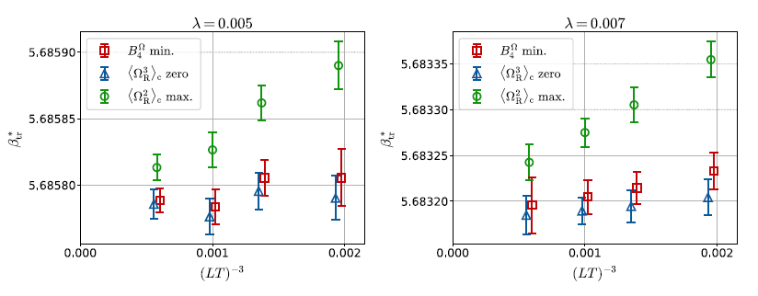

Transition Line
1st tr.
Critical
Point
Definitions of transition line
Maximum of $⟨Ω_{R}^{2}⟩$
Zero of $⟨Ω_{R}^{2}⟩$
Minimum of $B_{4}$
Ising Model

Slide 14


Binder-Cumulant Analysis
Fitting function
params: $b_{4}, c, λ_{c}, ν$

Slide 15




Binder-Cumulant Analysis
$$LT≥9$$
$$LT≥8$$
Z2
$B_{4}$ and $ν$ are consistent with Z2 universality class only when $LT≥9$ data are used for the analysis.

Slide 16




Scaling of Distribution Function
Effective Potential:
Result at
$Z_{2}$-FSS is well applied near the peaks
Scaling violation around the edges
lead to scaling violation of $B_{4}$

Slide 17
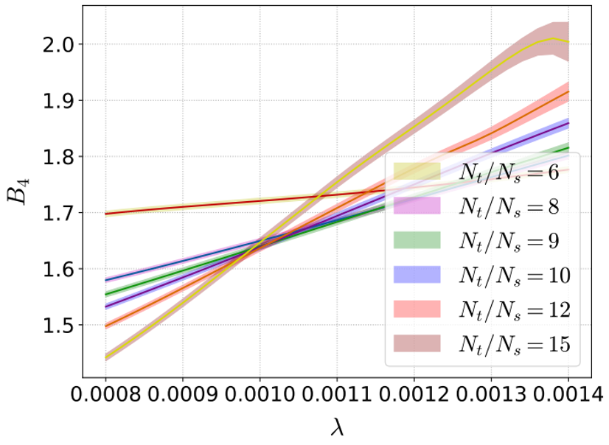
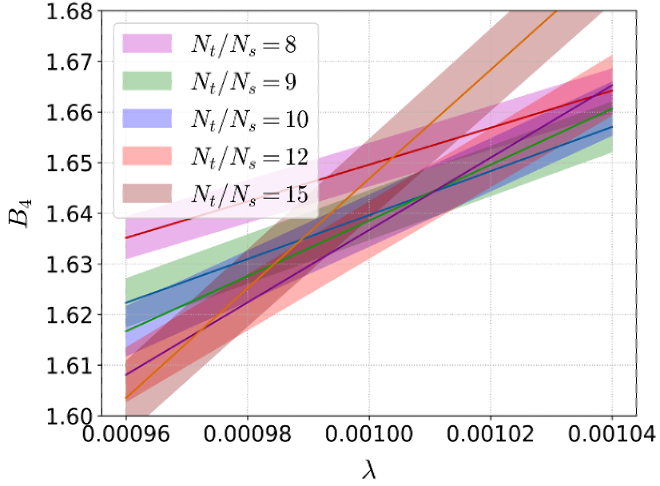




Numerical Simulation @ $N_{t}=6$
Ashikawa+, in prep.
preliminary
For $N_{t}=6$, deviation from the finite-size scaling is more significant with the same $V$.

Slide 18
Lattice Studies of Binder-Cumulant
Light-quark region
Heavy-quark region
Kuramashi, Nakamura, Ohno, Takeda, ’20
Cuteri , Philipsen , Schön, Sciarra, ’21
$$N_{t}=12, LT<2.7$$
$$N_{t}=10, LT≤6 (10)$$
Statistically-significant deviation of the crossing point from the 3d-Ising value.
$V$ may not be large enough?

Slide 19






Convergence of HPE
Wakabayashi+ (’22)
HPE for free lattice field (U=1)
=The worst convergence case
Wilson-loop-type
Polyakov-loop-type
$$N_{t}=4$$
$$N_{t}=6$$
$$N_{t}=4$$
$$N_{t}=6$$
$N_{t}=4$ $κ_{c}=0.0602\left(4\right)$ Kiyohara+,’21
$N_{t}=6$ $κ_{c}=0.0877\left(9\right)$ Cuteri+, ’21
NLO of HPE is reliable
for $N_{t}=6$.

Slide 20



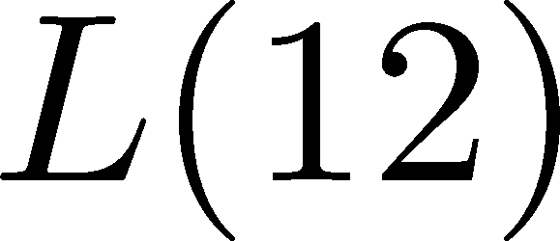



Effective Inclusion of
Higher-order Terms
Ejiri+ (’20)
Wakabayashi+ (’22)
Wilson-loop
Polyakov-loop
$L(n)$ are strongly correlated with each other.
Higher order terms: $L\left(n\right)≃c_{n}L(N_{t})$
incorporated by determining $c_{n}$.

Slide 21


Summary
CP in the light- & heavy-quark QCD can be investigated by the lattice QCD simulations.
The hopping-parameter expansion allows us to study the CP in the heavy-quark region quite efficiently.
  Our method: Monte-Carlo@LO + NLO by Reweighting
  Good convergence at the NLO for $N_{t}=4, 6$.
  Effective method will extend the applicability of the HPE further.
Confirmation of Z(2) scaling behavior.
But, large spatial volume is necessary.
Precise determination of $κ_{c}$
Future: $N_{t}=8, 10, ⋯$

Slide 22
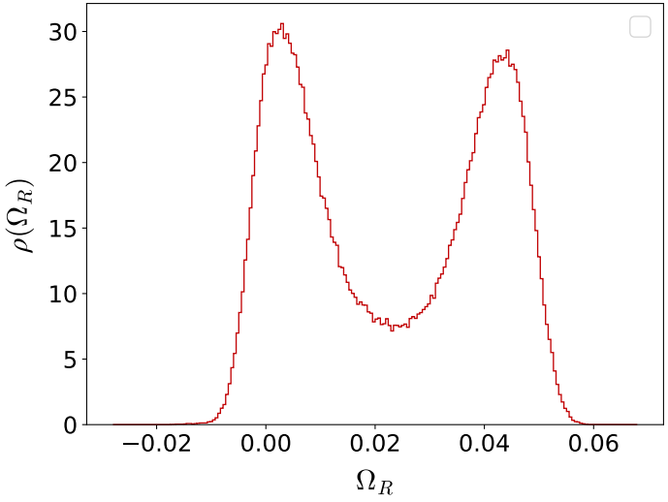
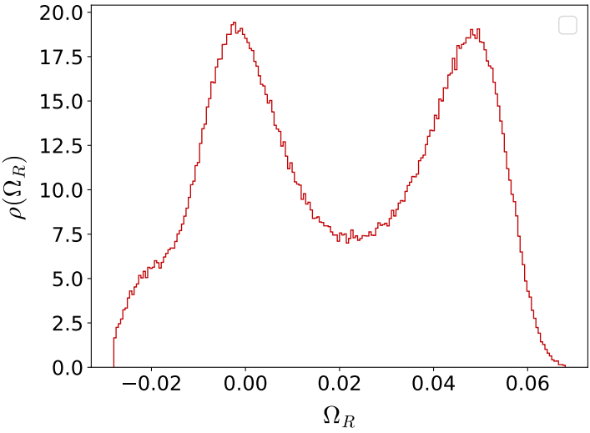


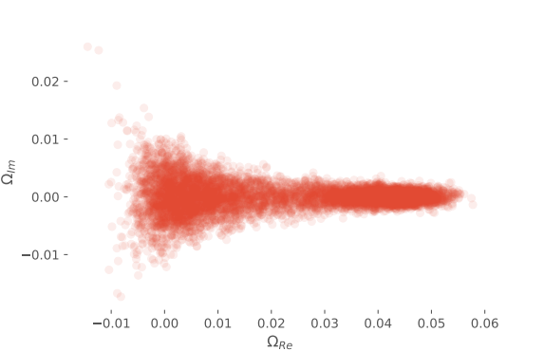
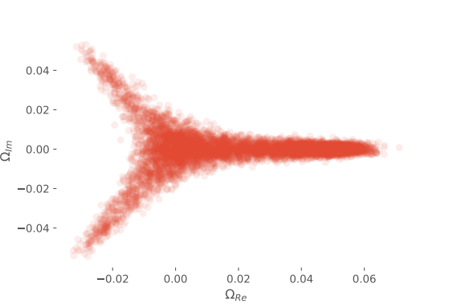
Violation of FSS & Remnant of Z(3)
Probability Distribution of Polyakov loop
bump
Real Part
Complex Plane

Slide 23

Scaling of Gap of Peaks
Polyakov-loop Distribution
Peak Position
Gap with scaling
$λ$ dep. of the gap agrees well with $Z_{2}$-FSS.

Slide 24






Mapping b/w Ising & QCD
Ising Model
QCD
1st tr.
1st tr.
1st tr.
Singular part:

Slide 25






Hopping Parameter Expansion 1
Wilson fermion
nonzero only for neighboring $(x,y)$
$tr[B_{n}]$is given by the closed trajectories of length $n$.
$$N_{t}=4$$

