Slide 1
Exploring
Strongly-Interacting Systems with Energy-Momentum Tensor
YITP Colloquium, YITP, Kyoto, 2023/01/10
Masakiyo Kitazawa
(YITP)
MK, Mogliacci, Kolbe, Horowitz, PRD99, 094507 (2019)
FlowQCD, PLB789, 210 (2019)
Yanagihara, MK, PTEP2019, 093B02 (2019)
FlowQCD, PRD102, 114522 (2020)
Suenaga, MK, 2210.09363
Ito, MK, to appear

Slide 2
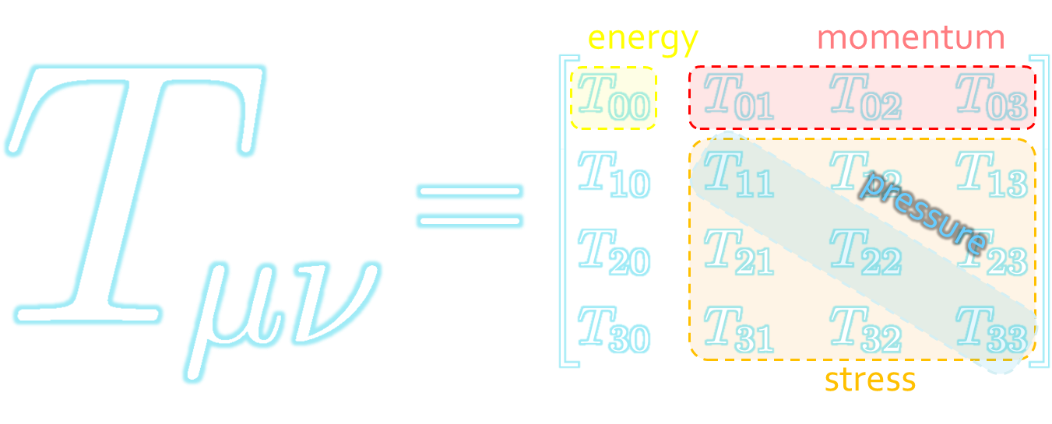



Energy-Momentum Tensor
The most fundamental quantity in physics.
All components are important observables.

Slide 3


Gravitational Form Factors
Pressure inside proton
(partially) accessible with hard exclusive processes
Mass distribution
Mechanical structure inside hadrons
D-term: the last global unknown
Mass decomposition
Burkert+, Nature 557, 396 (2018)
Polyakov(2003); Kumano, Song, Teryaev (2018); Ji (1995); Locre (2018); Hatta, Rajan, Tanaka (2018); …

Slide 4
Stress = Force per Unit Area

Slide 5


Stress = Force per Unit Area
Pressure
S

Slide 6
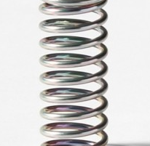



Stress = Force per Unit Area
Pressure
Generally, F and n are not parallel
v
fluid
S
F
S
elastic body
S
In thermal medium
Stress Tensor
Landau
Lifshitz

Slide 7


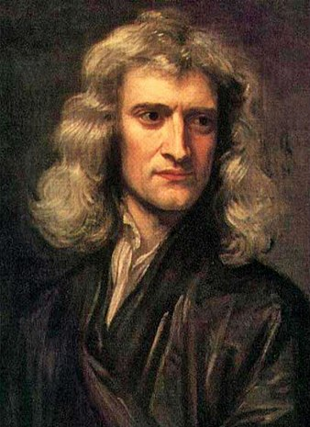


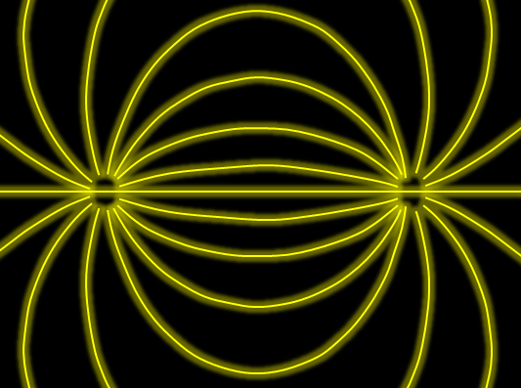

Force
Action-at-a-distance
Newton
1687
Local interaction
Faraday
1839

Slide 8




Maxwell Stress
(in Maxwell Theory)
Maxwell
E
pulling
Parallel to field: Pulling
Vertical to field: Pushing
pushing

Slide 9



Maxwell Stress
(in Maxwell Theory)
length:
pulling
pushing
Definite physical meaning
Distortion of field, line of the field
Propagation of the force as local interaction

Slide 10




: nontrivial observable
on the lattice
Definition of the operator is nontrivial
because of the explicit breaking of translational invariance
ex:
Measurement is extremely noisy
due to high dimensionality and etc.
Solved by the SFtX method
Suzuki (’13); FlowQCD(’14); …

Slide 11
Stress Tensor in QQ System
ー
FlowQCD, PLB (2019)
Lattice simulation
SU(3) Yang-Mills
a=0.029 fm
R=0.69 fm
t/a²=2.0
pulling
pushing
Flux-tube formation
Definite physical meaning
Distortion of field
Propagation of the force as local interaction

Slide 12
SU(3) YM vs Maxwell
SU(3) Yang-Mills
(quantum)
Maxwell
(classical)
Propagation of the force is clearly different
in YM and Maxwell theories!

Slide 13
Contents
1. SFtX: EMT through Gradient Flow
2. Casimir Effect & Pressure Anisotropy
MK, Mogliacci, Horowitz, Kolbe, PRD99, 094507 (2019)
Suenaga, MK, 2210.09363
3. Static-Quark Systems
FlowQCD, PLB789, 210 (2019)
Yanagihara, MK, PTEP2019, 093B02 (2019)
FlowQCD, PRD102, 114522 (2020)
4. Model Calculations of EMT
Yanagihara, MK, PTEP2019, 093B02 (2019)
Ito, MK, to appear

Slide 14





Yang-Mills Gradient Flow
Luscher 2010
Narayanan, Neuberger, 2006
Luscher, Weiss, 2011
t: “flow time”
dim:[length²]
leading
diffusion equation in 4-dim space
diffusion distance
“continuous” cooling/smearing
No UV divergence at $t>0$

Slide 15





Small Flow-Time Expansion
Luescher, Weisz, 2011
Suzuki, 2013
an operator at t>0
remormalized operators
of original theory
original 4-dim theory
t→0 limit

Slide 16


Constructing EMT
Suzuki, 2013
vacuum subtr.
Remormalized EMT
“SFtX method” (Small Flow time eXpansion)

Slide 17

Thermodynamics:
Iritani, MK, Suzuki, Takaura, 2019
□: SFtX
□: SFtX
Agreement with other methods within 1% level!
Smaller statistics thanks to smearing by the flow

Slide 18


2+1 QCD EoS from Gradient Flow
WHOT-QCD, PRD96 (2017); PRD102 (2020)
Agreement with integral method
Substantial suppression of statistical errors
m_{PS}/m_{V} ≈0.63
Physical mass: Kanaya+ (WHOT-QCD), 1910.13036

Slide 19
Contents
1. SFtX: EMT through Gradient Flow
2. Casimir Effect & Pressure Anisotropy
MK, Mogliacci, Horowitz, Kolbe, PRD99, 094507 (2019)
Suenaga, MK, 2210.09363
3. Static-Quark Systems
FlowQCD, PLB789, 210 (2019)
Yanagihara, MK, PTEP2019, 093B02 (2019)
FlowQCD, PRD102, 114522 (2020)
4. Model Calculations of EMT
Yanagihara, MK, PTEP2019, 093B02 (2019)
Ito, MK, to appear

Slide 20
Casimir Effect

Slide 21
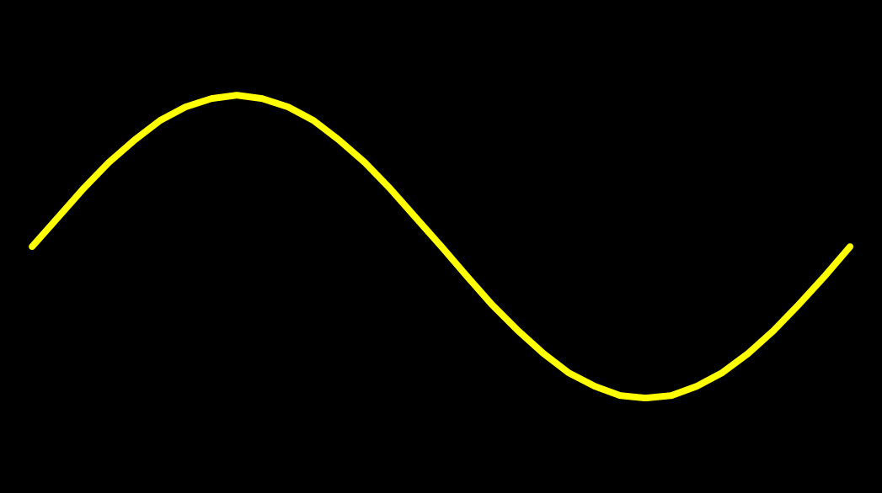
Casimir Effect
attractive force between two conductive plates

Slide 22





Casimir Effect
Brown, Maclay
1969

Slide 23



Casimir Effect
Brown, Maclay
1969

Slide 24

Casimir Effect
Brown, Maclay
1969
T

Slide 25

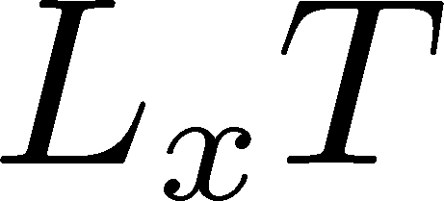

Pressure Anisotropy @ T≠0
MK, Mogliacci, Kolbe,
Horowitz, PRD (2019)
Free scalar field
L₂=L₃=∞
Periodic BC
Mogliacci+, 1807.07871

Slide 26
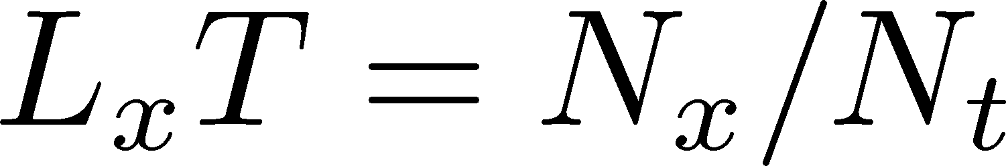
Pressure Anisotropy @ T≠0
MK, Mogliacci, Kolbe,
Horowitz, PRD (2019)
Free scalar field
L₂=L₃=∞
Periodic BC
Mogliacci+, 1807.07871
Lattice result
Periodic BC
Only t→0 limit
Error: stat.+sys.
Medium near T_{c} is remarkably insensitive to finite size!

Slide 27
Pressure Anisotropy @ T≠0
MK, Mogliacci, Kolbe,
Horowitz, PRD (2019)
Free scalar field
L₂=L₃=∞
Periodic BC
Mogliacci+, 1807.07871
Lattice result
Periodic BC
Only t→0 limit
Error: stat.+sys.
Medium near T_{c} is remarkably insensitive to finite size!

Slide 28
Energy densty / transverse P
Energy Density
Transverse Pressure P_{z}

Slide 29




Thermodynamics on the Lattice
Various Methods
Integral, differential, moving frame, non-equilibrium, …
rely on thermodynamic relations valid in V→∞
Not applicable to
anisotropic systems
We employ SFtX Method
Components of EMT are directly accessible!

Slide 30








Interpreting Response against BC
Suenaga, MK (’22)
Remnant of Confinement?
“Intermediate” Polyakov loop $P$ for $T\sim T_{c}$
Meisinger+ (’02)
Treat $P$ as a dynamical variable
Background const gauge field $A^{0}(x)$
Potential term to realize $\left\langle P\right\rangle =0$
Dumitru+ (’12)
Thermodynamics near $T_{c}$ is
well described.
Meisinger+ (’02); …
AdS/CFT
AdS soliton
N=4 SYM with $S^{1}$
confined phase
Horowitz, Myers (’98)
Myers (’99)
Balasubramanian, Kraus (’99)
Thanks to M. Natsuume

Slide 31







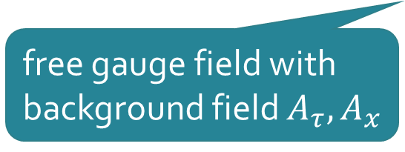
Extension to $T^{2}×R^{2}$
Two Polyakov loops
Suenaga, MK (’22)
temporal
treated as
dynamical vals.
$x$-direction
Free Energy
free gauge field with
background field $A_{τ}, A_{x}$
potential term: separable ansatz
: from Meisinger+(’02)

Slide 32



Phase Diagram on $L_{x}−L_{τ}$ Plane
Suenaga, MK (’22)
$N=2$
$N=3$

Slide 33



Thermodynamics
fixed $A_{0}, A_{1}$
model result
massless free theory
Anisotropic thermodynamics is strongly affected by $A_{0}, A_{1}$.
Our simple model is inconsistent with the lattice result.
Modification of the model will reproduce it.

Slide 34
Contents
1. SFtX: EMT through Gradient Flow
2. Casimir Effect & Pressure Anisotropy
MK, Mogliacci, Horowitz, Kolbe, PRD99, 094507 (2019)
Suenaga, MK, 2210.09363
3. Static-Quark Systems
FlowQCD, PLB789, 210 (2019)
Yanagihara, MK, PTEP2019, 093B02 (2019)
FlowQCD, PRD102, 114522 (2020)
4. Model Calculations of EMT
Yanagihara, MK, PTEP2019, 093B02 (2019)
Ito, MK, to appear

Slide 35
SU(3) YM vs Maxwell
SU(3) Yang-Mills
(quantum)
Maxwell
(classical)
Propagation of the force is clearly different
in YM and Maxwell theories!

Slide 36
Flux Tube
Quark confinement
Non-pert. dynamics
Linear potential
String theory
36

Slide 37
Flux Tube
Quark confinement
Non-pert. dynamics
Linear potential
String theory
Many Studies on Flux Tube
Potential
Color-electric field
Action density
so many studies…
Cea+ (2012)
Cardoso+ (2013)
37

Slide 38
Stress Tensor in QQ System
ー
FlowQCD, PLB (2019)
Lattice simulation
SU(3) Yang-Mills
a=0.029 fm
R=0.69 fm
t/a²=2.0
pulling
pushing
Flux-tube formation
Definite physical meaning
Distortion of field
Propagation of the force as local interaction

Slide 39


Lattice Setup
FlowQCD, PLB (2019)
SU(3) Yang-Mills (Quenched)
Wilson gauge action
Clover operator
EMT around Wilson Loop
APE smearing / multi-hit
fine lattices (a=0.029-0.06 fm)
continuum extrapolation
Simulation: bluegene/Q@KEK
R=0.92 fm
R=0.69 fm
R=0.46 fm

Slide 40
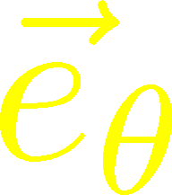
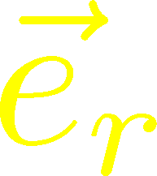
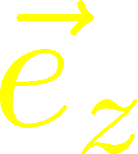






Stress Distribution on Mid-Plane
From rotational symm. & parity
EMT is diagonalized
in Cylindrical Coordinates
Degeneracy
in Maxwell theory

Slide 41


Mid-Plane
Separation
Continuum
Extrapolated!
In Maxwell theory
Degeneracy:
Separation:
Nonzero trace anomaly

Slide 42
Mid-Plane
Separation
Continuum
Extrapolated!
Degeneracy:
Separation:
Nonzero trace anomaly

Slide 43


Force
Force from Potential
Force from Stress

Slide 44
Force
Force from Potential
Force from Stress
Good Agreement!

Slide 45
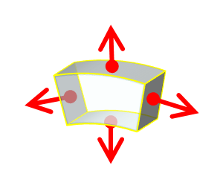



Momentum Conservation
Yanagihara, MK, PTEP2019
In cylindrical coordinates,
For infinitely-long tube
T_{rr} and T_{θθ} must separate!
T_{θθ} must change sign!

Slide 46
Momentum Conservation
Yanagihara, MK, PTEP2019
Lattice
Infinitely-long system
T_{rr} and T_{θθ}
degenerate!
T_{rr} and T_{θθ} must separate
T_{θθ} must change sign
Effect of boundaries is important
for the flux tube at R=0.92fm

Slide 47
Dual Superconductor Picture
Nambu, 1970
Nielsen, Olesen, 1973
t ‘Hooft, 1981
…
QCD Vacuum
Superconductor
Anti-
Monopole
Quark
Anti-quark
Monopole
Flux Tube
Magnetic Vortex
Dual (E⇔B)

Slide 48






Abelian-Higgs Model
Yanagihara, MK, 2019
Abelian-Higgs Model
GL parameter:
Infinitely long tube
type-I :
type-II :
Bogomol’nyi bound :
degeneracy
Luscher, 1981
momentum conservation

Slide 49




Stress Tensor in AH Model infinitely-long flux tube
Type-I
Type-II
No degeneracy bw T_{rr} & T_{θθ}
T_{θθ} changes sign
conservation law

Slide 50

Stress Tensor in AH Model infinitely-long flux tube
Type-I
Lattice
Inconsistent with
lattice result
No degeneracy bw T_{rr} & T_{θθ}
T_{θθ} changes sign

Slide 51

Flux Tube with Finite Length
Yanagihara, MK (2019)
Comparison: $T_{00}\left(0\right), T_{rr}(0)$
AH model can reproduce lattice results qualitatively by tuning parameters.
But, quantitatively all parameters are rejected.

Slide 52

Quantum Effects?
Classical vortex is unstable against quantum fluctuations
Quantum effects give rise to
  Luscher term in potential Luscher (1981)
  Fattening of the tube Luscher, Munster, Weisz (1981)
How do these effects modify EMT distribution?

Slide 53


Single Static-Quark System
$T<T_{c}$: Heavy-light meson
EMT distribution in the meson
$T>T_{c}$: Single charge
Screening
Running coupling
$T≈T_{c}$
Confinement transition
Q
This study:
$T>T_{c}$ in pure YM

Slide 54

Lattice Setup
SU(3) Yang-Mills (Quenched)
Wilson gauge action
Clover operator
Analysis above Tc
Simulation on a Z₃ minimum
EMT around a Polyakov loop
continuum extrapolation
Ω: Polyakov loop
FlowQCD, PRD 102, 114522 (2020)

Slide 55


Spherical Coordinates
EMT is diagonalized
in Spherical Coordinates
Maxwell theory

Slide 56
Stress Tensor Around a Quark
T=1.44T_{c}
Suppression at large distance
Separation of different channels
pulling
pushing

Slide 57




$r$ Dependence
Increase
Leading order perturbation
supress
Higher order terms:
M. Berwein, in progress
Increase at short $r$ / suppression at larger $r$
$T$ dependence is suppressed at $r<1/T$
Too noisy at large $r$ for extracting screening mass $m_{D}$

Slide 58



Channel Dependence
Separation b/w channels becomes clearer for smaller T
FlowQCD, PRD 102, 114522 (2020)

Slide 59

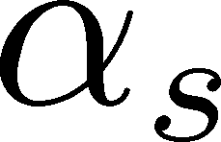


Running Coupling
Estimate of $α_{s}$
by the formula at the leading-order perturbation theory
channel dependent
Consistent with the estimate from $Q\overline{Q}$ potential
Kaczmarek, Karsch, Zantow, 2004

Slide 60
Contents
1. SFtX: EMT through Gradient Flow
2. Casimir Effect & Pressure Anisotropy
MK, Mogliacci, Horowitz, Kolbe, PRD99, 094507 (2019)
Suenaga, MK, 2210.09363
3. Static-Quark Systems
FlowQCD, PLB789, 210 (2019)
Yanagihara, MK, PTEP2019, 093B02 (2019)
FlowQCD, PRD102, 114522 (2020)
4. Model Calculations of EMT
Yanagihara, MK, PTEP2019, 093B02 (2019)
Ito, MK, to appear

Slide 61




EMT Distr. in Simple Systems
$φ^{4}$ Theory in 1+1d
Soliton (kink)
EMT
Classical
How do quantum effects modify this result?
Ito, MK, to appear
cf) total energy: Dashen+ (’74)

Slide 62

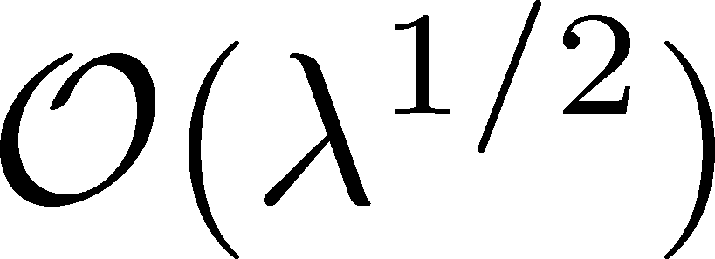
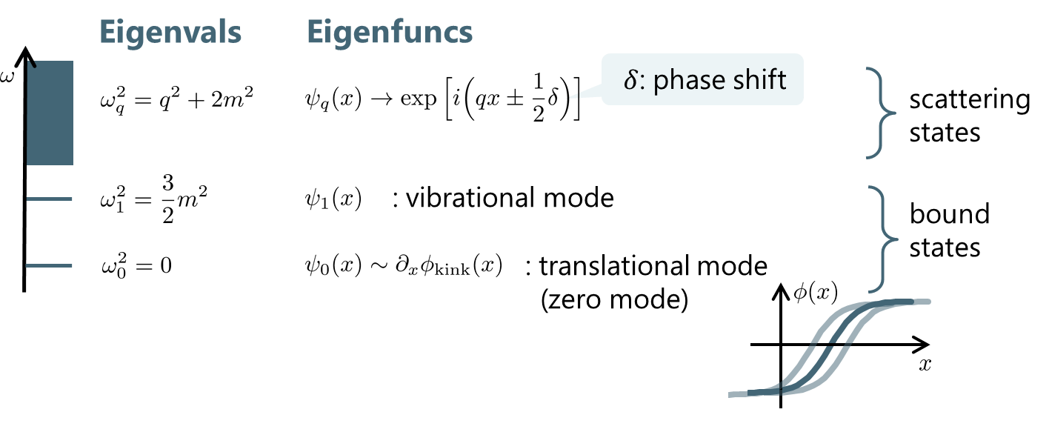
Fluctuation around the Kink
quadratic
diagonalize

Slide 63
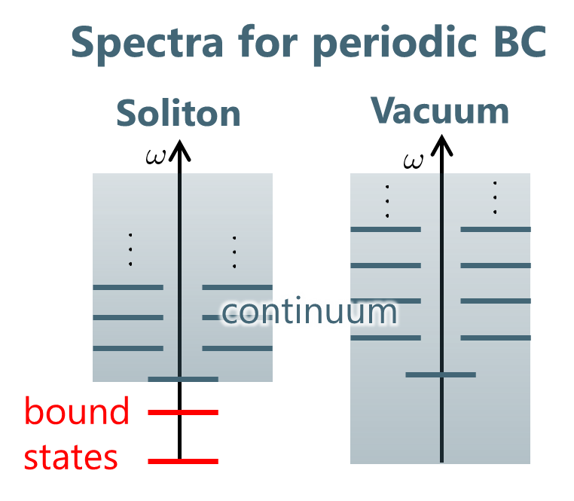
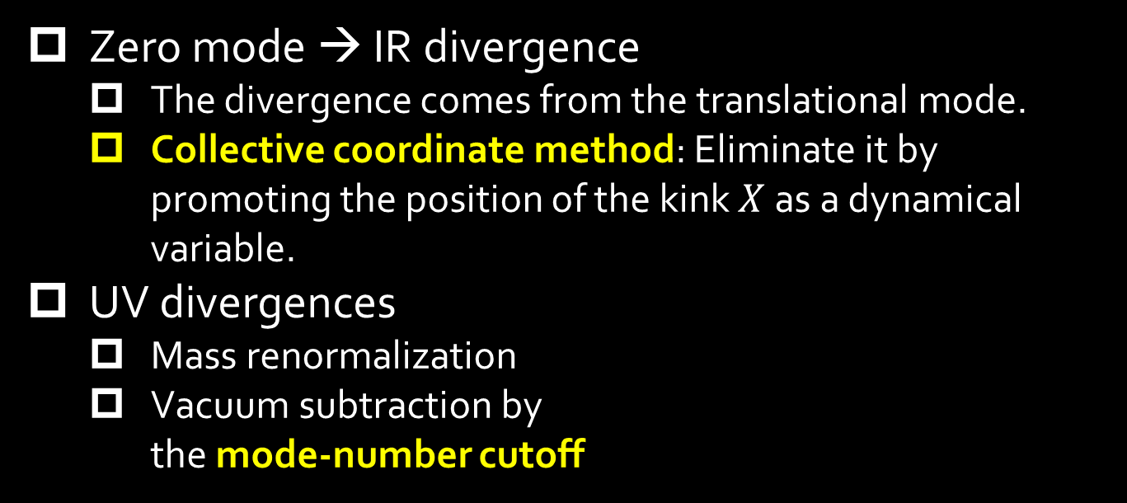

Removal of Divergences
Zero mode → IR divergence
  The divergence comes from the translational mode.
  Collective coordinate method: Eliminate it by promoting the position of the kink $X$ as a dynamical variable.
UV divergences
  Mass renormalization
  Vacuum subtraction by
    the mode-number cutoff
Gervais, Sakita ’74; Gervais, Jevicki, Sakita, ’75
Tomboulis, ’75; Christ, Lee, ‘75
1) Take the length of the system $L$ finite.
2) Subtract with the same mode numbers.
3) Take $L→∞$ limit.
Rebhan and Nieuwenhuizen (’97)
Rajaraman, “solitons & instantons”

Slide 64
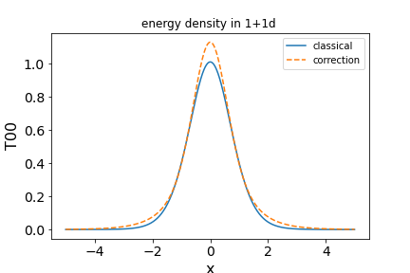

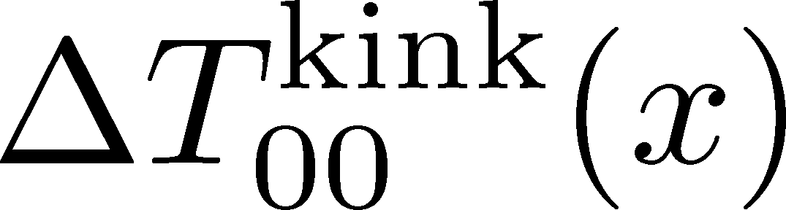
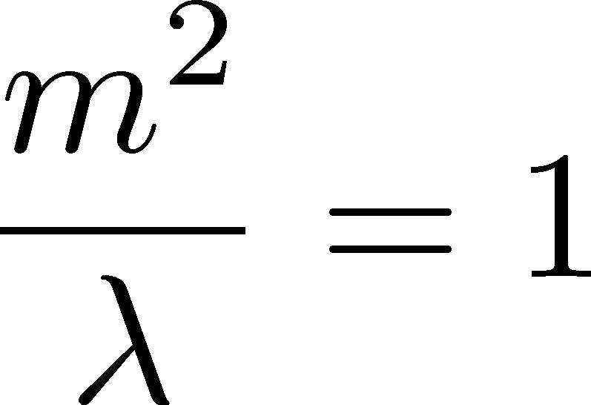



Results
$L$: spatial length
Note:
Constant term $\sim 1/L$ that vanishes at $L→∞$: potential term?
$E=\int_{−L/2}^{L/2}{dx}T_{00}(x)$ reproduces Dashen+.
$T_{11}(x)$ is $x$ independent. ➔ consistent with EM conservation

Slide 65
Summary
Now, EMT distribution in localized systems in QCD is accessible by the experimental and numerical analyses.
These information will enrich our understanding on the strongly-interacting systems.
Further lattice and experimental investigations, as well as theoretical studies are called for.
Future studies:
  Hadrons (GFF), single-Q in QCD / QQQ, QQ, etc. / T dependence / Solitons / GFF of nuclei / …

Slide 66
backup

Slide 67









Fermion Propagator
propagator of flow equation
Inverse propagator is needed
fermion field
t=0
gauge field

Slide 68
N_{f}=2+1 QCD Thermodynamics
Taniguchi+ (WHOT-QCD),
PRD96, 014509 (2017)
N_{f}=2+1 QCD, Iwasaki gauge + NP-clover
m_{PS}/m_{V} ≈0.63 / almost physical s quark mass
T=0: CP-PACS+JLQCD (ß=2.05, 28³x56, a≈0.07fm)
T>0: 32³xN_{t}, N_{t} = 4, 6, ... , 14, 16):
T≈174-697MeV
t→0 extrapolation only (No continuum limit)

Slide 69





Perturbative Coefficients
Suzuki, PTEP 2013, 083B03
Harlander+, 1808.09837
Iritani, MK, Suzuki, Takaura, PTEP 2019
LO
1-loop
2-loop
3-loop
×
Iritani, MK, Suzuki,
Takaura, 2019
zero
Suzuki (2013)
Harlander+(2018)
Choice of the scale of g²
Previous:
Improved:
Harlander+ (2018)

Slide 70
t Dependence
Iritani, MK, Suzuki, Takaura, PTEP 2019
Existence of “linear window” at intermediate t

Slide 71



Double Extrapolation t→0, a→0
O(t) terms in SFTE
lattice discretization
Continuum extrapolation
strong
discretization
effect
Small t extrapolation

Slide 72
Thermodynamics: ε+p & ε-3p
Range2
Range2
Range1
Range3
Range1
Range3
Iritani, MK, Suzuki, Takaura, PTEP 2019
Existence of “linear window” at intermediate t
Stable t→0 extrapolation
Systematic errors: fit range, uncertaintyof Λ (±3%), …

Slide 73



EMT on the Lattice: Conventional
Lattice EMT Operator
Caracciolo+, 1990
Determination of Zs are necessary.
Non-pert. Determination of Zs
Shifted-boundary method
Full QCD with fermions
Giusti, Pepe, 2014~; Borsanyi+, 2018
Brida, Giusti, Pepe, 2020

Slide 74


Higher T
High-T limit: massless free gluons
How does the anisotropy approach this limit?
Difficulties
Vacuum subtraction requires large-volume simulations.
Lattice spacing not available → c₁(t), c₂(t) are not determined.
Ratio of Traceless Parts
Neither vacuum subtr. nor Suzuki coeffs. necessary!

Slide 75
T
massless free
T/T_{c}≅8.1 (β=8.0) / T/T_{c}≅25 (β=9.0)
Ratio slowly approaches the asymptotic value.
But, large deviation still exists even at T/T_{c}~25.

