Slide 1
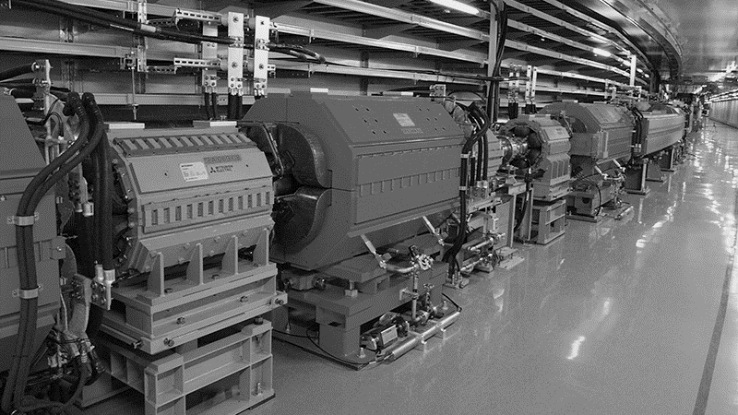
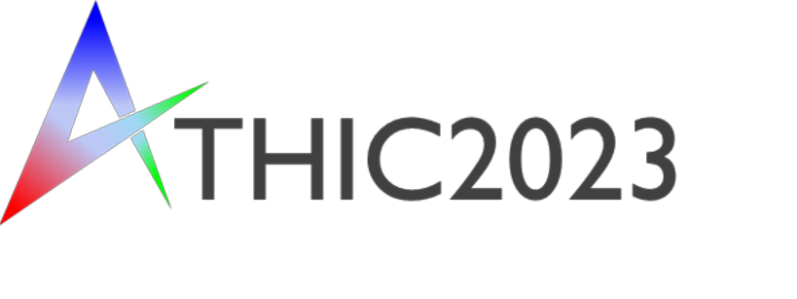
J-PARC-HI
J-PARC Heavy-Ion Project
Masakiyo Kitazawa
for J-PARC-HI Collaboration
ATHIC2023, Apr. 27, 2023, Hiroshima
Photo: J-PARC Main Ring

Slide 2
J-PARC
= Japan Proton Accelerator Research Complex

Slide 3
J-PARC
= Japan Proton Accelerator Research Complex
J-PARC
Kyoto
Hiroshima
Tokyo

Slide 4
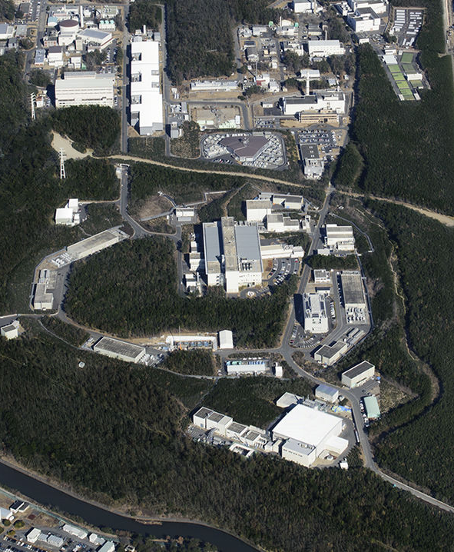
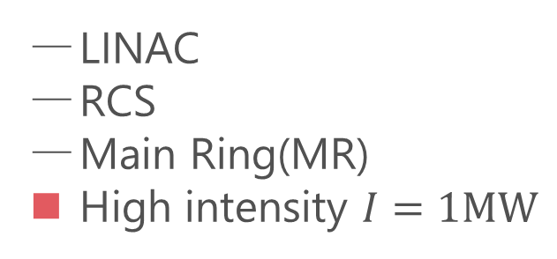
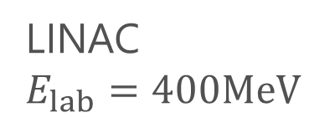

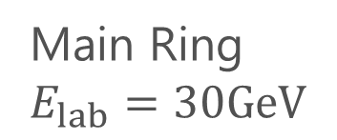
LINAC
$E_{lab}=400MeV$
Accelerators
LINAC
RCS
Main Ring(MR)
High intensity $I=1MW$
RCS
$E_{lab}=3GeV$
Purposes
Hadron/Nuclear physics
Neutrino physics
Material/Life science
Main Ring
$E_{lab}=30GeV$
Hadron hall

Slide 5
LINAC
$E_{lab}=400MeV$
Accelerators
LINAC
RCS
Main Ring(MR)
High intensity $I=1MW$
HI-injector
RCS
$E_{lab}=3GeV$
Purposes
Hadron/Nuclear physics
Neutrino physics
Material/Life science
Main Ring
$E_{lab}=30GeV$
J-PARC-HI
J-PARC Heavy Ion
High intensity
Hadron hall
Intermediate eneargy

Slide 6





History / Current Status of HIC
LHC
2010~
RHIC
2000~
SPS
Increasing Collision Energy
NA61/SHINE
~2000
RHIC-BES
AGS
FAIR-CBM
~1996
HADES

Slide 7
History / Current Status of HIC
LHC
J-PARC-HI
2010~
FAIR-CBM
Galatyuk, NPA982, 163
RHIC
NICA
2000~
HADES
NA61/SHINE
Beam-Energy
Scan
RHIC-BES-FXT
SPS
RHIC-BES
Increasing Collision Energy
NA61/SHINE
~2000
RHIC-BES
AGS
FAIR-CBM
~1996
HADES
2010~

Slide 8
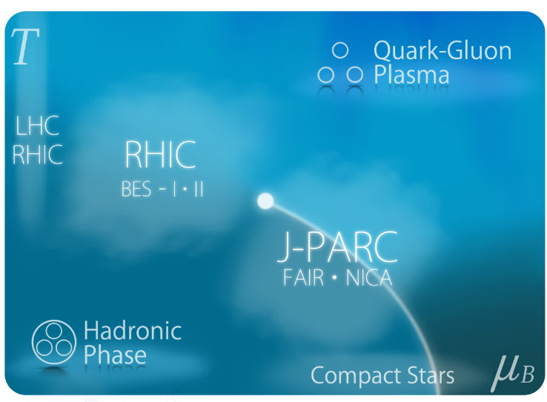
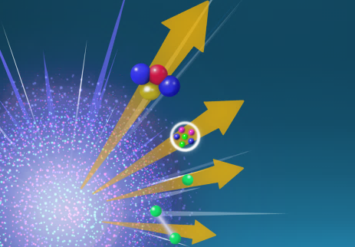
Physics Goals
Exploring
Extremely Dense Medium
Search for
Rare Hadronic/Hypernuclear
Events

Slide 9

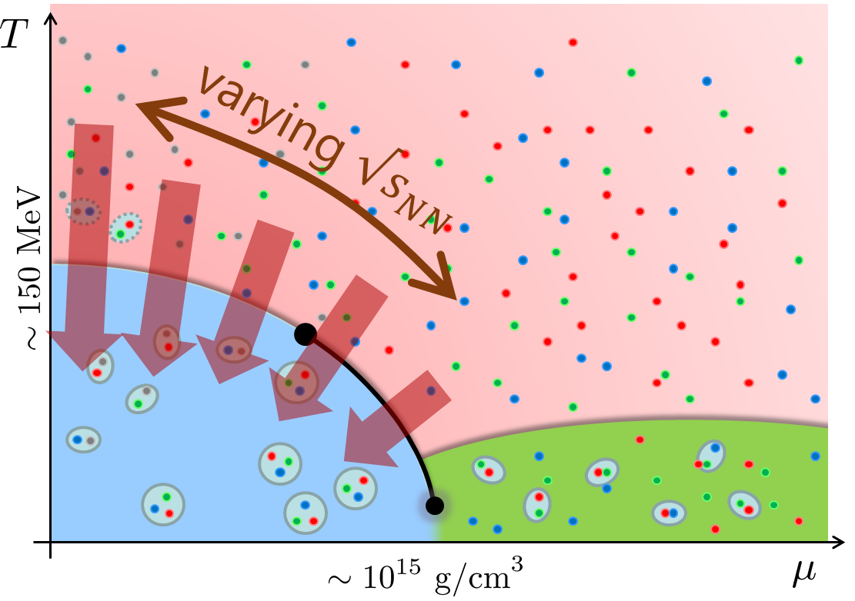
Beam-Energy Scan
STAR, 2012
High E
Low E
Baryon stopping

Slide 10
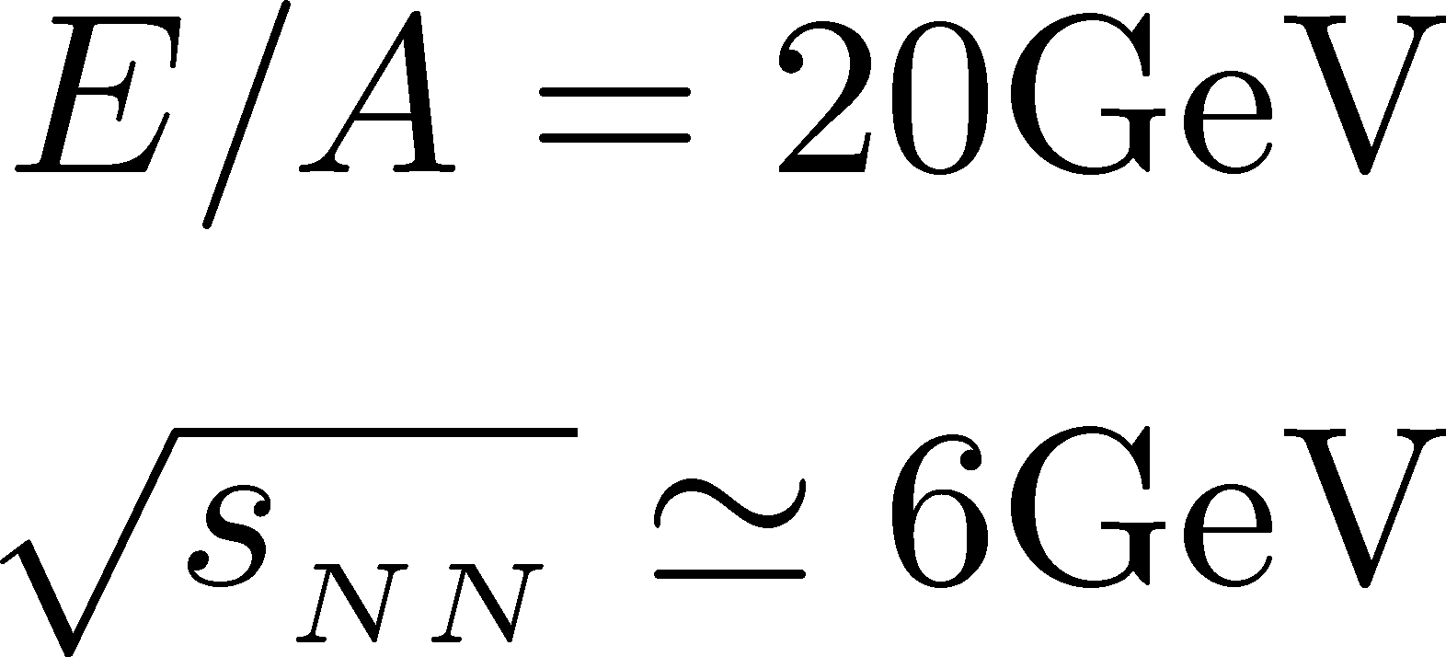


J-PARC-HI = Highest Baryon Density
Ohnishi, 2002

Slide 11

Exploring Dense Medium
Neutron stars
Equation of state
QCD critical point /
1st order transition /
Color superconductivity
Dilepton production rate
Event selection /
Higher correlations

Slide 12


Event-by-event Fluctuations
Conserved charge fluctuations
Higher-order cumulants
Signal of QCD CP
Experimental Result
STAR (2022)
Asakawa, Ejiri, MK (2009)
Stephanov (2011)

Slide 13
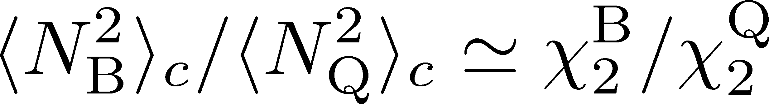
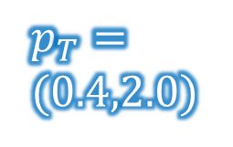


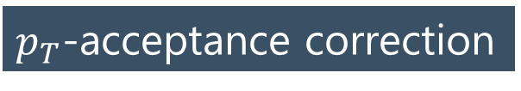


Baryon/Charge Cumulant Ratio
MK, Esumi, Nonaka, 2205.10030
STAR, $200$GeV
Lattice QCD＋HRG
$p_{T}$-acceptance correction
Yield
$p_{T}$ uncorrected
$p_{T}=$
$(0.4,2.0)$
$p_{T}$ corrected
$$p_{T}$$
Electric charge: 49%
Protons: 82%
Finite acceptance modifies the ratio strongly.
Wider acceptance is necessary.

Slide 14
Dilepton at Ultra-Low-Mass Region
Signal for color SC?
Anomalous dilepton production due to soft modes at phase boundary
Nishimura, MK,
Kunihiro
2302.03191
2201.01963
Competition with pion Dalitz
Momentum dependence

Slide 15
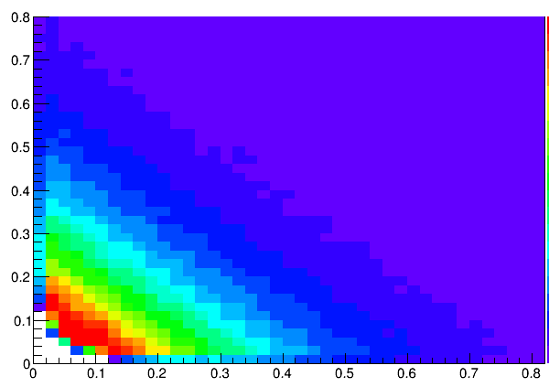
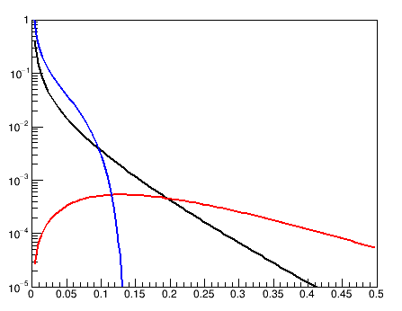
Dilepton at Ultra-Low-Mass Region
Signal for color SC?
Experiments
Anomalous dilepton production due to soft modes at phase boundary
e⁺ Mom
(GeV/c)
Analysis by
Y. Morino
dR/dM
(A.U)
e⁻ Mom (GeV/c)
Nishimura, MK,
Kunihiro
2302.03191
2201.01963
Dalitz
Free quark
diquark fluc
M(GeV/c²)
Competition with pion Dalitz
Momentum dependence
Study of experimental observability has just started!

Slide 16


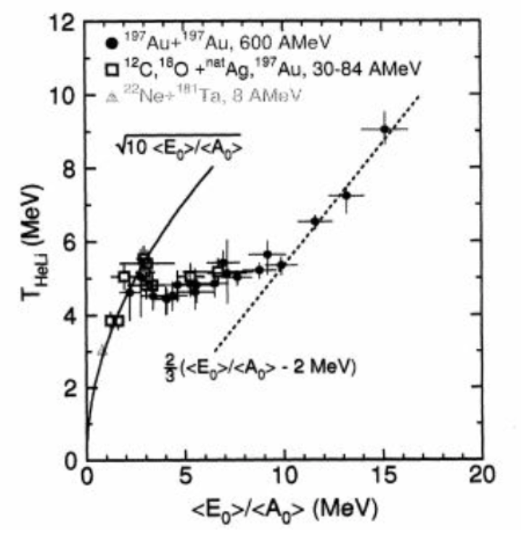

Event Selection
average transverse energy
Density Scan
Baryon-rich
events
Baryon-rich events
Pochodzalla+,
PRL 1995
Event selections via highest baryon/energy density will allow us a detailed study of QCD phase diagram.

Slide 17
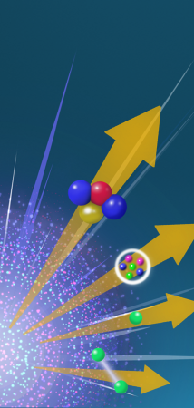
Hadron/Hypernuclear Physics
Hypernuclei
Correlation functions
→hadron interaction
STAR,2015
¹²C+¹²C at 15AGeV
(5T / 2.4m magnet)

Slide 18
J-PARC-HI
Future Plan

Slide 19
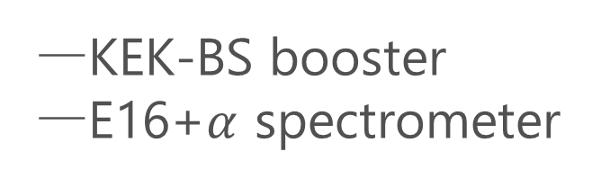
J-PARC-HI Staging Plan
Phase-II
Phase-I
KEK-BS booster
E16+$α$ spectrometer
Phase-I
Phase-II
NEW HI booster
NEW spectrometer

Slide 20
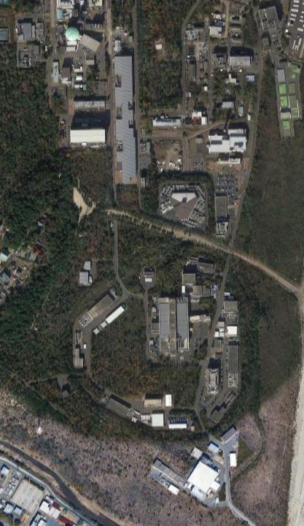
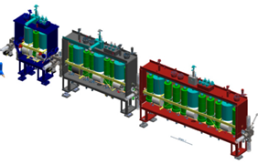
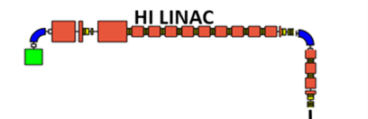
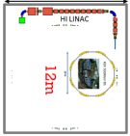
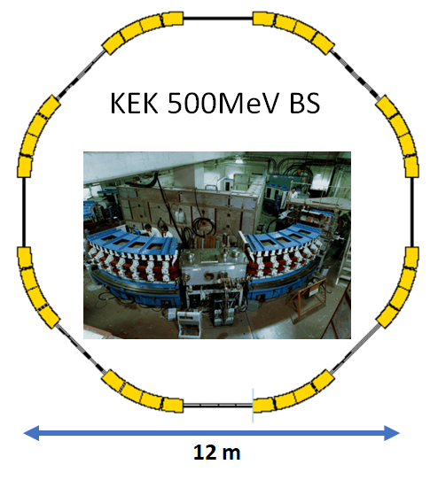


Staging of HI Booster
HI LINAC
Phase-I
LINAC
New
Building
RCS
60m
KEK 500MeV BS
REUSE
kept in working
condition
Main Ring

Slide 21
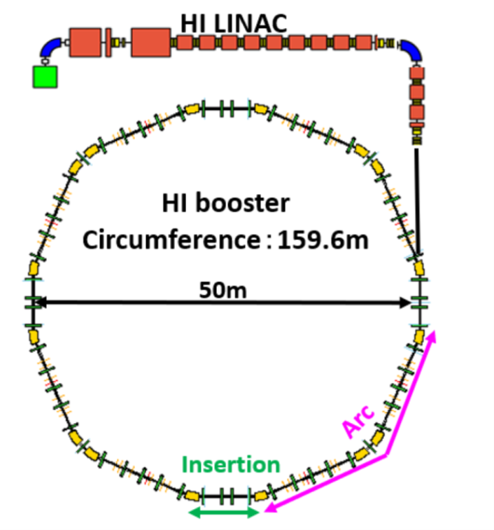

Staging of HI Booster
Phase-I
Phase-II
LINAC
New
Building
RCS
Completely NEW
HI booster
World highest intensity
60m
Main Ring
Interaction rate

Slide 22
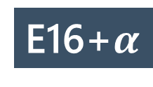
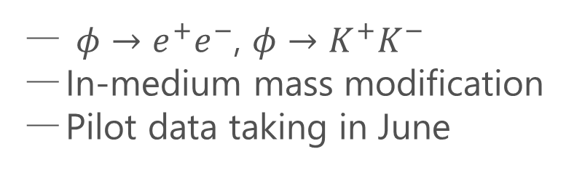
Detector
Phase-I
E16 Spectrometer
$φ→e^{+}e^{−}$, $φ→K^{+}K^{−}$
In-medium mass modification
Pilot data taking in June
UPGRADE
E16+$α$
Upgrade forward region for high-multiplicity counting
Hadron/lepton measurement
at wide acceptance

Slide 23
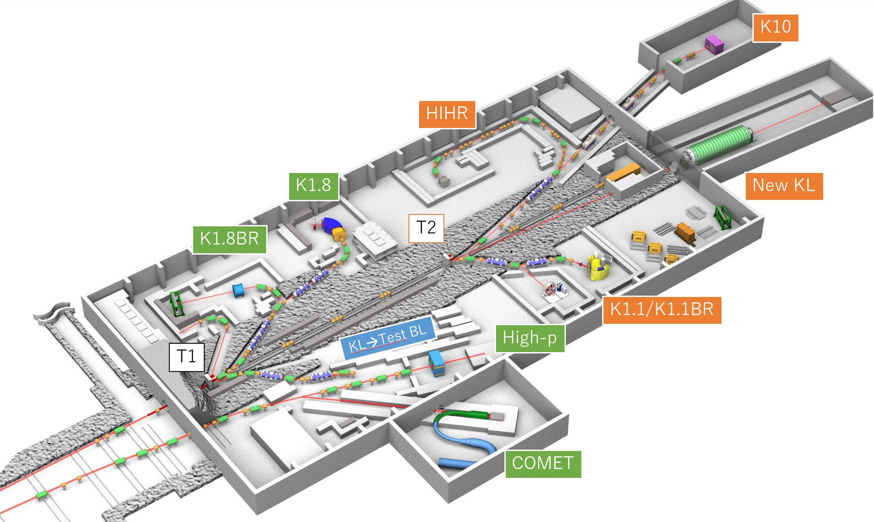
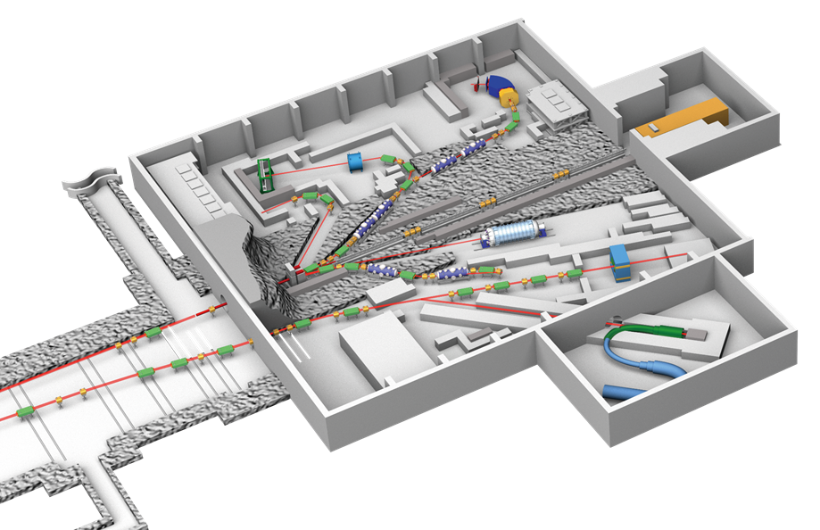
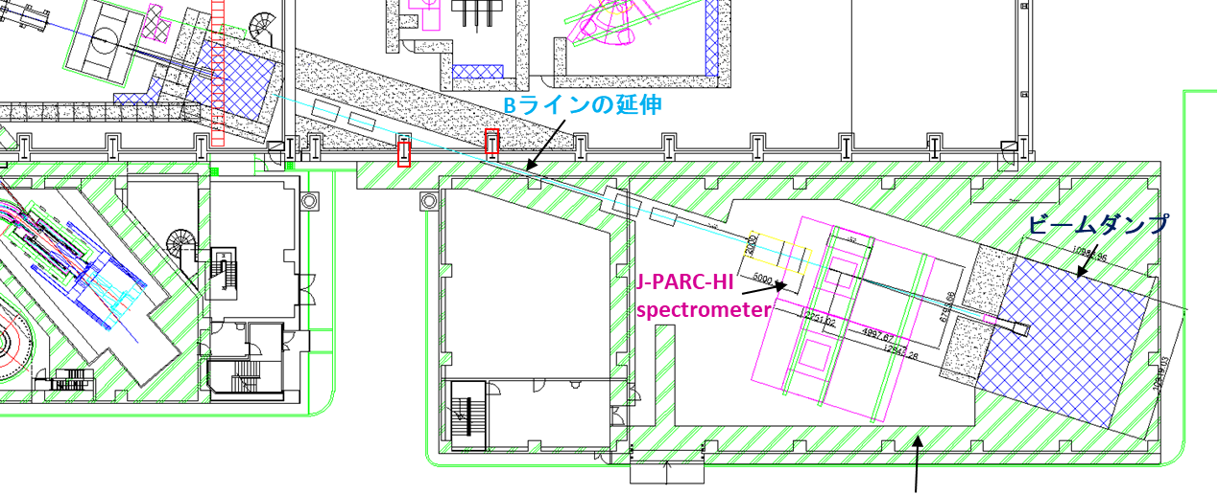
Hadron Hall Extension
Present
Extended
E16
J-PARC-HI
Spectrometer
Top priority at KEK-PIP2022
J-PARC-HI spectrometer will be installed in an annex
E16

Slide 24
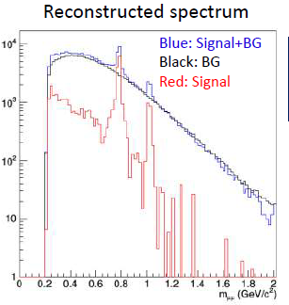
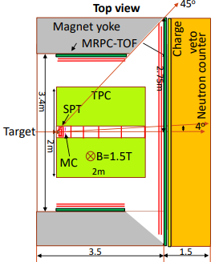
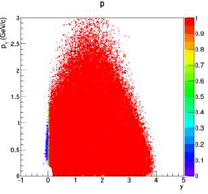
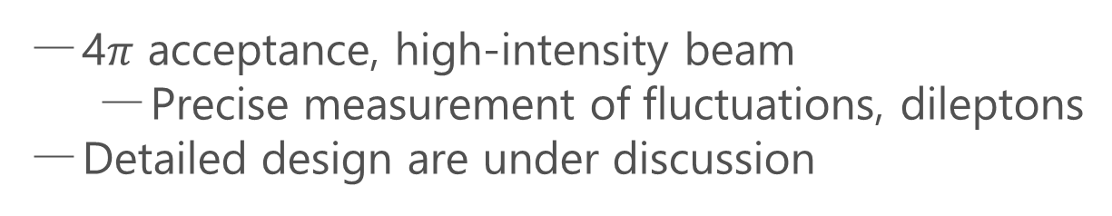
Detector
Phase-II
Dimuon Setup
4$π$ acceptance, high-intensity beam
  Precise measurement of fluctuations, dileptons
Detailed design are under discussion
Hadron calorimeter + hyper-nuclear measurement
acceptance
ALICE3-like dipole

Slide 25



Current Status of J-PARC-HI
Proposal (Phase-I)
submitted to
J-PARC PAC
Detailed design (HI acceleration, cost, schedule) started officially
Support from
nuclear physics community in Japan
J-PARC-HI is an official future project of J-PARC

Slide 26


Confucius
want
promptly
then
not
establish
Haste makes waste

Slide 27
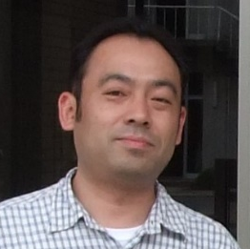
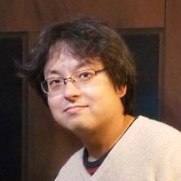
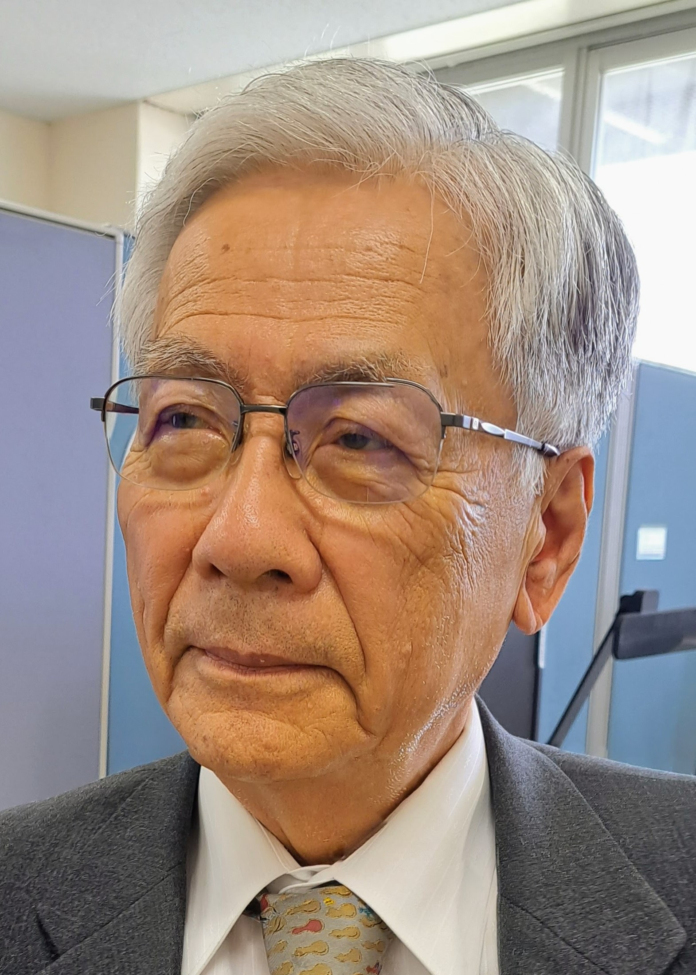
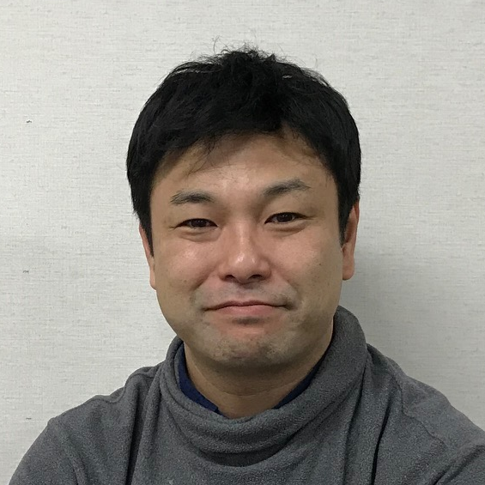
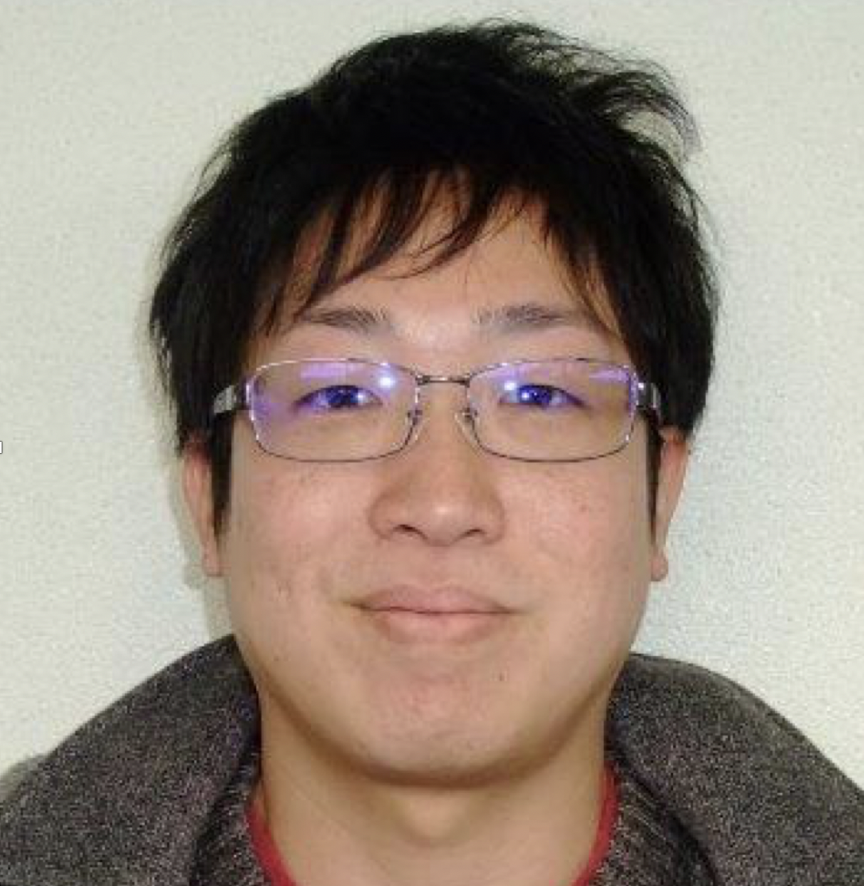
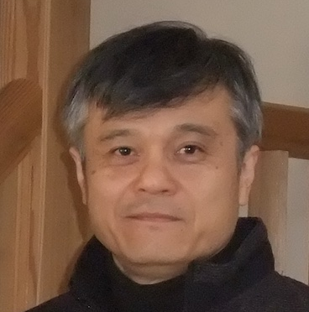
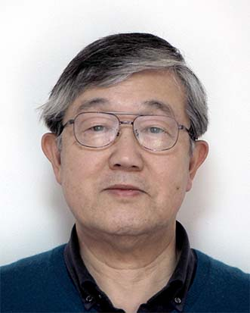
J-PARC-HI Collaboration
Hiroyuki Sako
Taku Gunji
Kazuya Aoki
Shoji Nagamiya
MK
Kyoichiro Ozawa
Yudai Ichilawa
ShinIchi Esumi
Kazuhiro Tanaka
and 138 members in total
Exp.: J. K. Ahn , K. Aoki, S. Ashikaga, O. Busch, M. Chiu, T. Chujo , P. Cirkovic , T. Csorgo , D. Devetak , G. David, M. Djordjevic,
S. Esumi , P. Garg, R. Guernane , T. Gunji , T. Hachiya , H. Hamagaki , S. Hasegawa, B. S. Hong, S. H. Hwang, Y. Ichikawa, T. Ichisawa , K. Imai, M. Inaba, M. Kaneta , H. Kato, B. C. E. J. Kim, X. Luo, Y. Miake , J. Milosevic, D. Mishra, Y. Morino, L. Nadjdjerdj , S. Nagamiya , T. Nakamura, M. Naruki , K. Nishio , T. Nonaka, M. Ogino, K. Oyama , K. Ozawa, T. R. Saito, A. Sakaguchi , T. Sakaguchi , S. Sakai, H. Sako, K. Sato, S. Sato, S. Sawada, K. Shigaki , S. Shimansky , M. Shimomura, M. Stojanovic , H. Sugimura, Y. Takeuchi, H. Tamura, K. H. Tanaka, Y. Tanaka, K. Tanida, N. Xu, S. Yokkaichi, I. K. Yoo
Theor.: Y. Akamatsu, M. Asakawa, K. Fukushima, H. Fujii , T. Hatsuda , M. Harada, T. Hirano, K. Itakura M. Kitazawa , T. Maruyama , K. Morita, K. Murase A. Nakamura, Y. Nara, C. Nonaka, A. Ohnishi, M. Oka
Acc.: E. Chishiro , H. Harada, Y. Hashimoto, N. Hayashi, K. Hirano, H. Hotchi , K. Ishii, T. Ito, M. Kinsho , R. Kitamura, A. Kovalenko, J. Kamiya , N. Kikuzawa , T. Kimura, Y. Kondo, H. Kuboki , Y. Kurimoto, Y. Liu S. Meigo , A. Miura, T. Miyao , T. Morishita , Y. Morita, K. Moriya, R. Muto, T. Nakanoya , K. Niki, H. Oguri , C. Ohmori , A. Okabe, M. Okamura, P. K. Saha , K. Sato, Y. Sato, T. Shibata, T. Shimokawa , K. Shindo , S. Shinozaki, M. Shirakata , Y. Shobuda , K. Suganuma , Y. Sugiyama, H. Takahashi, T. Takayanagi , F. Tamura, J. Tamura, N. Tani , M. Tomisawa , T. Toyama, Y. Watanabe, K. Yamamoto, M. Yamamoto, M. Yoshii, M. Yoshimoto

Slide 28

Summary
J-PARC-HI will
realize high-precision HI experiments to explore
  extremely dense QCD
  hadron/hypernuclear physics
be realized through the staging plan:
  Phase-I: Experiment exploiting existing equipment
  Phase-II: Full-spec experiment
Still many things to do
We need continuous support from community.
New challengers are welcome!

Slide 29
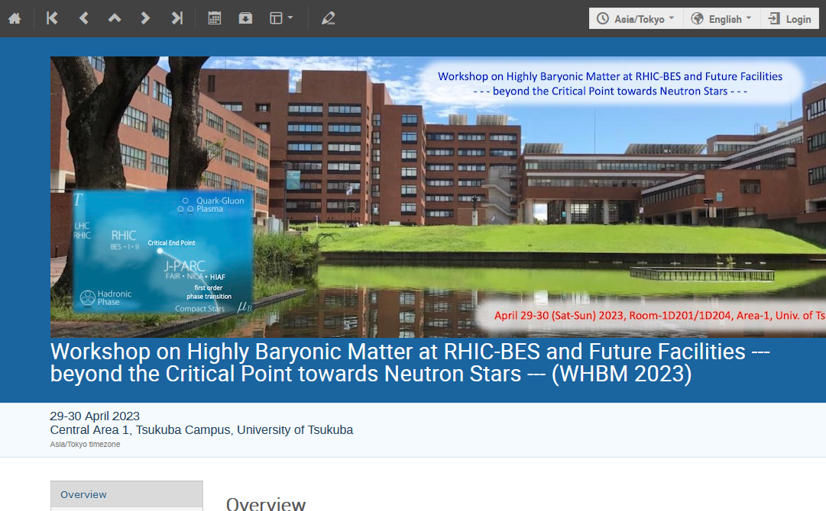
WHBM2023
This weekend
Registration still open

Slide 30
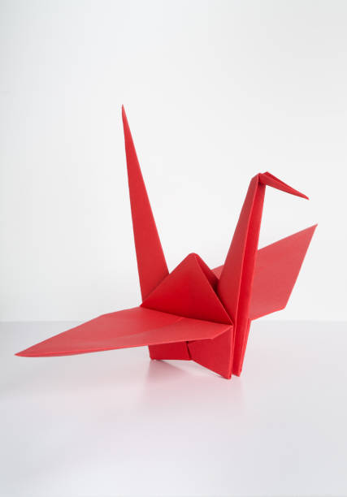
Many Thanks
for your attention
to J-PARC-HI Collaboration
for your continuous support
to ATHIC2023 Organizers

