Slide 1
Critical Point and Fluctuations
Workshop on Highly Baryonic Matter at RHIC-BES and Future Facilities (WHBM 2023), Tsukuba, 2023/04/30
Masakiyo Kitazawa (YITP, Kyoto)

Slide 2

Beam-Energy Scan
T
Quark-Gluon Plasma
150MeV
ＱＣＤ Critical Point
Hadron Phase
(confined)
Color SC
~10¹⁵g/cm³
μ

Slide 3
Beam-Energy Scan
T
Experiments
RHIC-BES
HADES
NA61/SHINE
FAIR
NICA
J-PARC-HI
…
LHC
Quark-Gluon Plasma
Beam Energy Scan
150MeV
ＱＣＤ Critical Point
Hadron Phase
(confined)
Color SC
~10¹⁵g/cm³
μ

Slide 4





History / Current Status of HIC
LHC
J-PARC-HI
2010~
FAIR-CBM
Galatyuk, NPA982, 163
RHIC
NICA
2000~
HADES
NA61/SHINE
Beam-Energy
Scan
RHIC-BES-FXT
SPS
RHIC-BES
Increasing Collision Energy
NA61/SHINE
~2000
RHIC-BES
AGS
FAIR-CBM
~1996
HADES
2010~

Slide 5
Three Topics
1 Event-by-event fluctuations of conserved charges
2 Dilepton production rate at ultra-low-mass region
as a signal of QCD phase transitions
3 Event selections
MK, Esumi, Nonaka, 2205.10030
Talk by Nishimura, yesterday; Nishimura, MK, Kunihiro, 2302.03191; 2201.01963

Slide 6
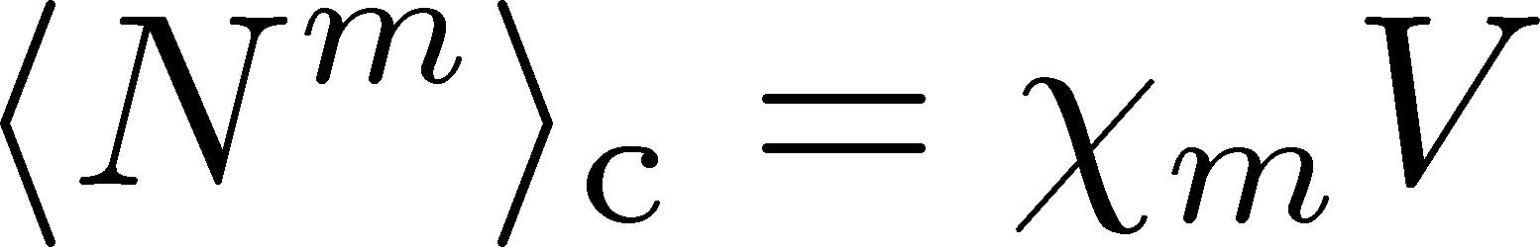
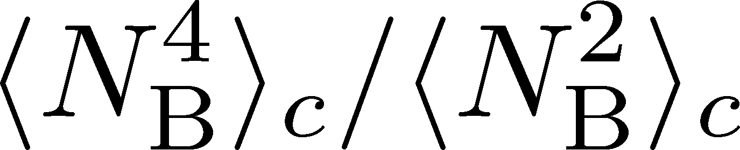


Fluctuations, Cumulants of Conserved Charges
Divergence and sign change at the QCD-CP. Stephanov,’09; Asakawa, Ejiri, MK,’09
Volume dependence is canceled out in ratio. Ejiri, Karsch, Redlich,’05
Direct comparison with lattice QCD simulations.
Slower diffusion.
HOT-QCD 2017
Asakawa, Ejiri, MK (2009)
Stephanov (2011)

Slide 7
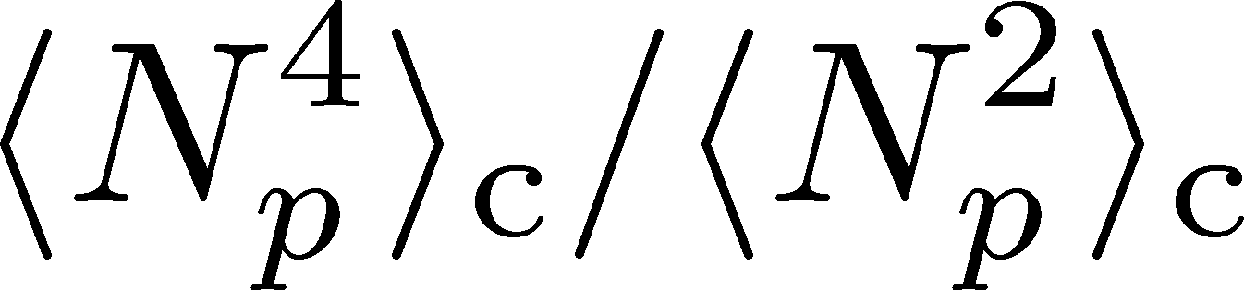
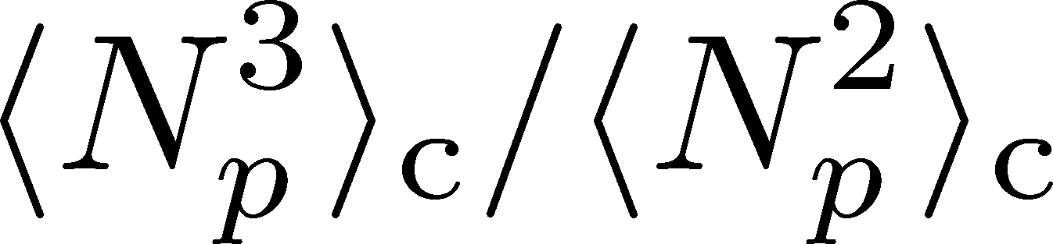
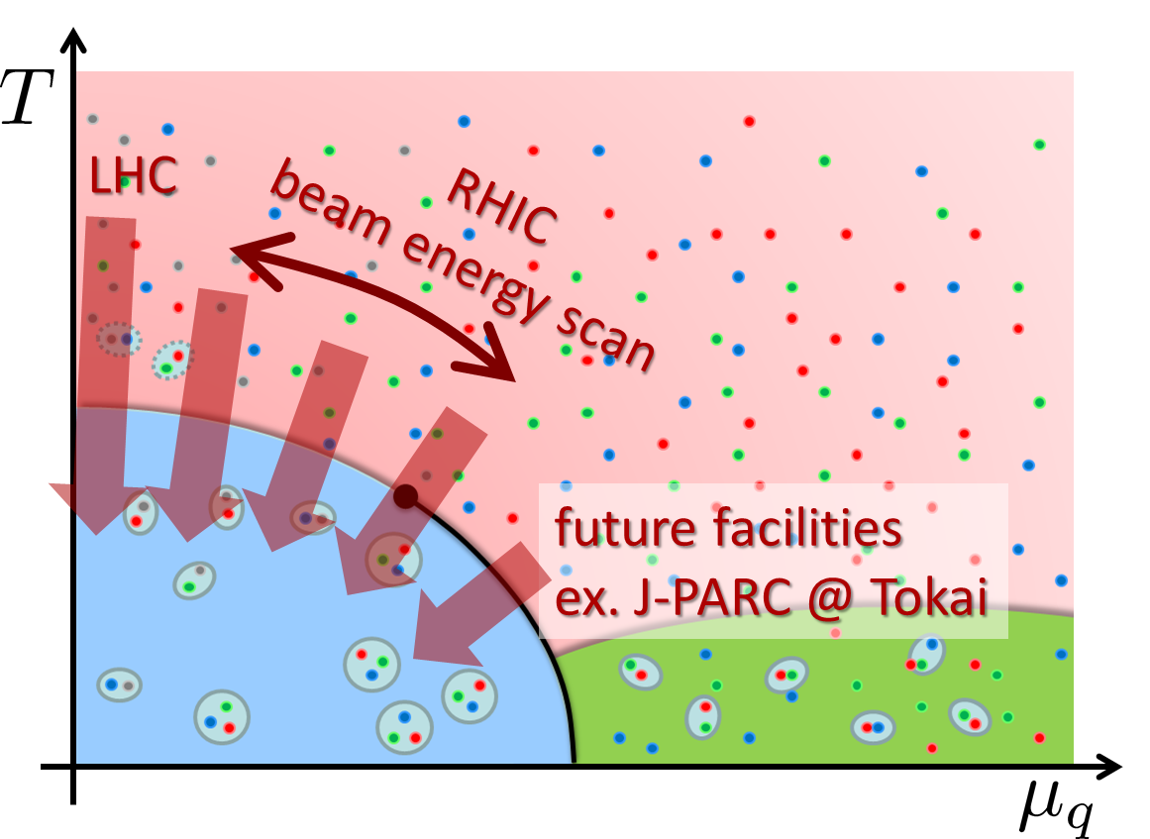
Experimental Results
Net-proton number cumulants
STAR, 2020 (2001.02852)
Non-Poisson and non-monotonic behaviors of the higher order cumulants.
Questions
When are these fluctuations generated?
Is the use of proton # cumulants as a proxy of baryon’s justified?

Slide 8
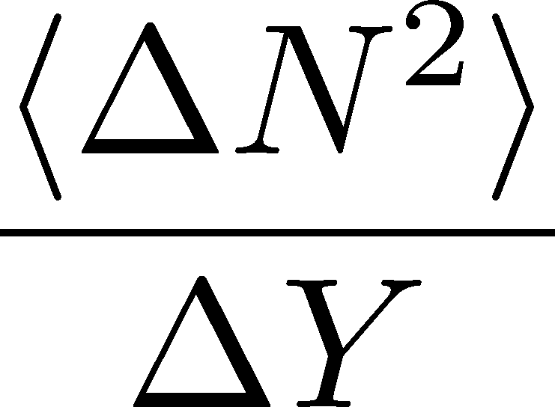



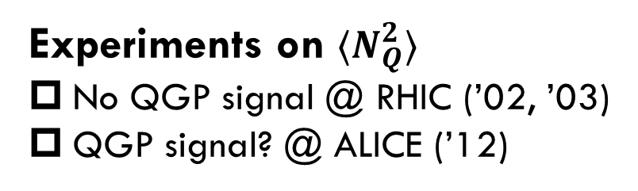
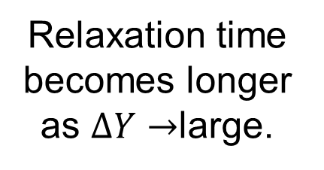
Evolution of Conserved-charge Fluctuations
Quark-Gluon Plasma
Fluctuations of CC are modified by the diffusion.
Hadronization
Relaxation time becomes longer as $ΔY→$large.
Freezeout
Experiments on $⟨N_{Q}^{2}⟩$
No QGP signal @ RHIC (’02, ’03)
QGP signal? @ ALICE (’12)
Asakawa, Heinz, Muller, 2000
Jeon, Koch, 2000; Shuryak, Stephanov, 2001

Slide 9


Nucleon’s Isospin as Two Sides of a Coin
a coin
N
p
n
Nucleons have
two isospin states.
Coins have two sides.
MK, Asakawa, 2012;2012

Slide 10



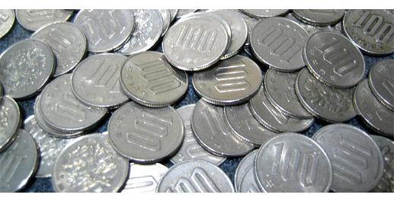
Slot Machine Analogy
Fixed # of coins
P (N)
P (N)
N
N
P (N)
P (N)
N
N

Slide 11


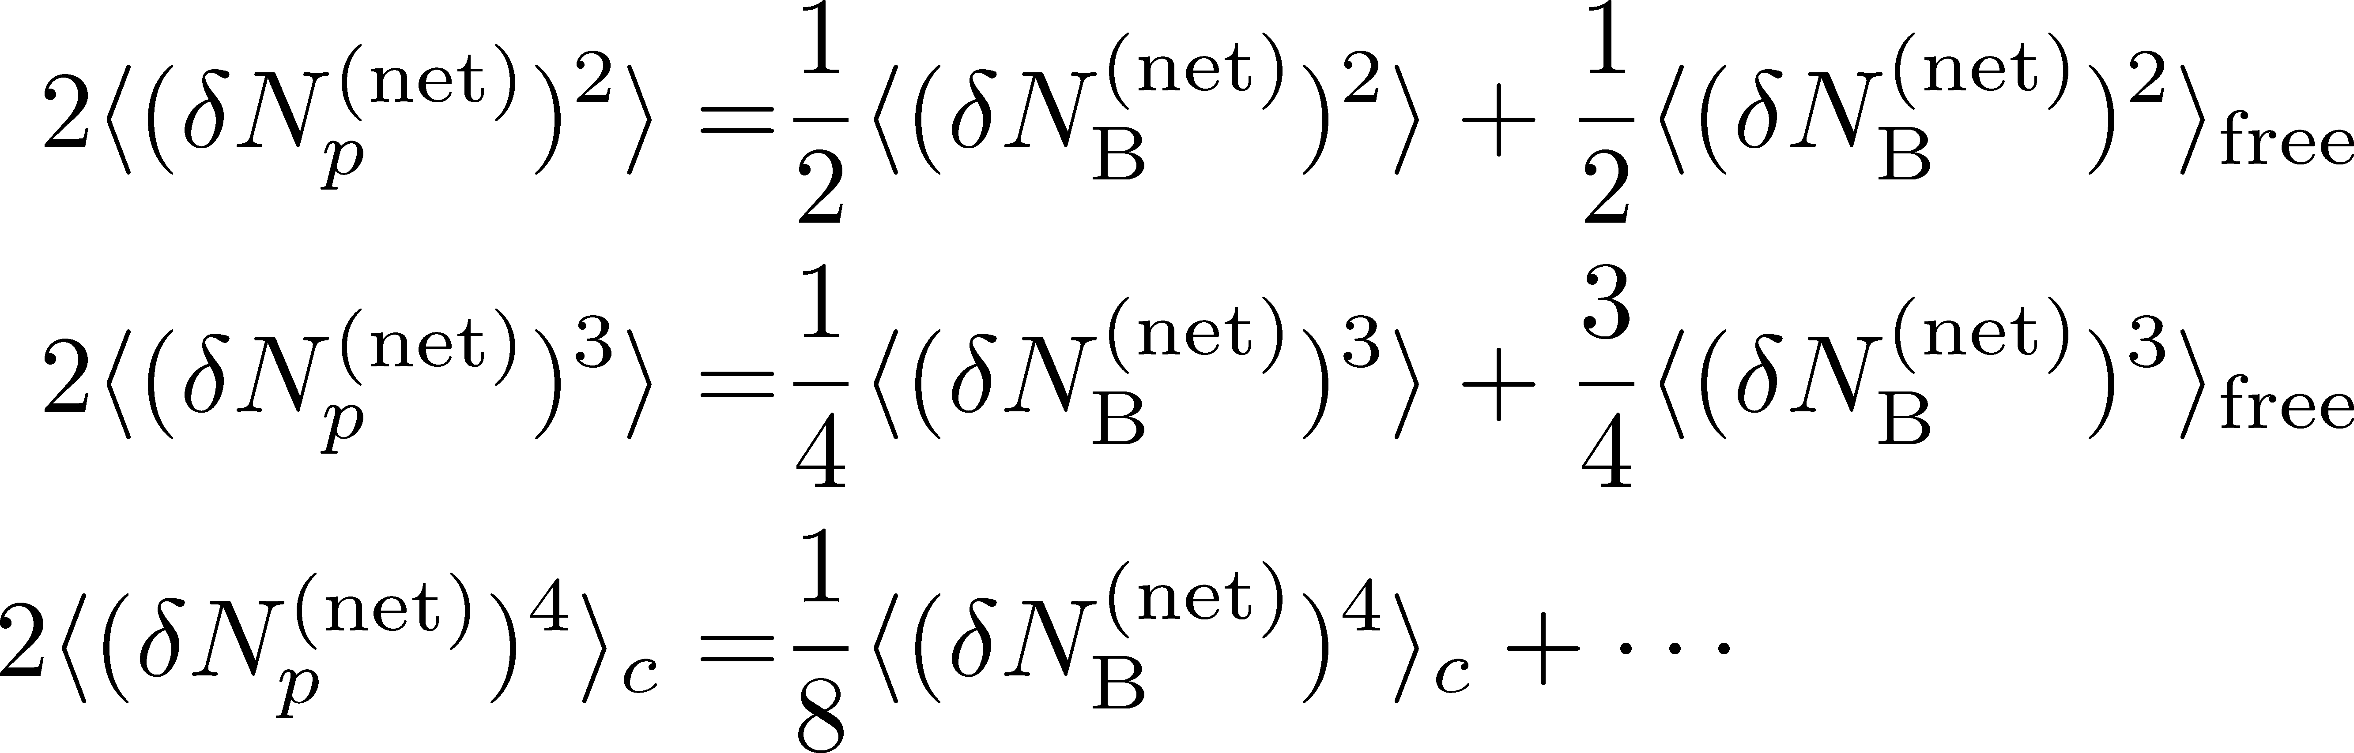
Reconstruction of Total Coin #
P (N )= P (N )B_{1/2}(N ;N )
= +
Example
genuine info.
Poisson noise
Note: Higher order cumulants are more fragile.
MK, Asakawa, 2012;2012

Slide 12

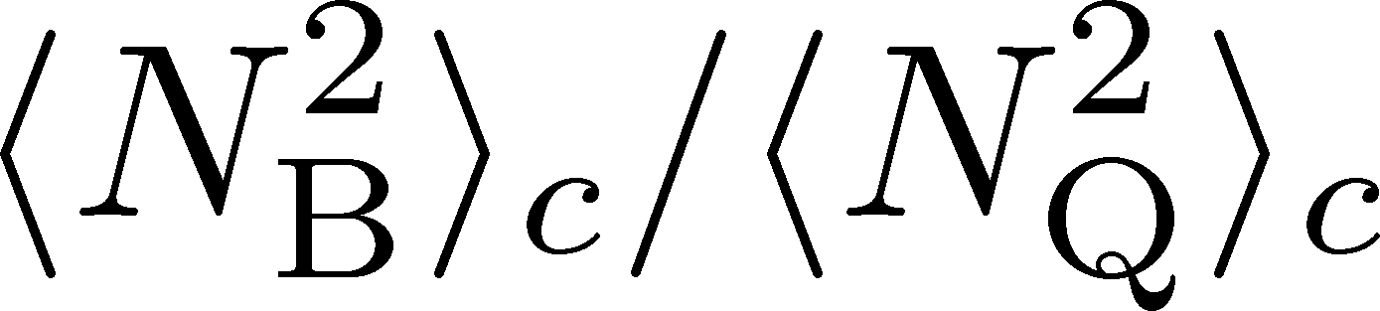
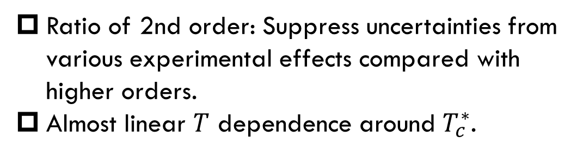
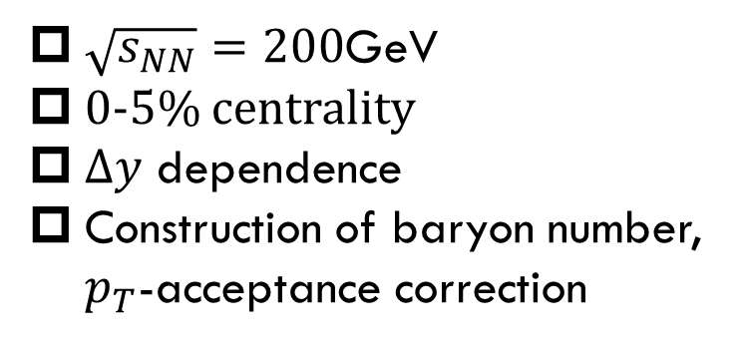
MK, Esumi, Nonaka, 2205.10030
$\sqrt{s_{NN}}=200$GeV
0-5% centrality
$Δy$ dependence
Construction of baryon number, $p_{T}$-acceptance correction
Ratio of 2nd order: Suppress uncertainties from various experimental effects compared with higher orders.
Almost linear $T$ dependence around $T_{c}^{∗}$.
Data from
HotQCD,
PRD104 (’21)
HOT-QCD 2017

Slide 13
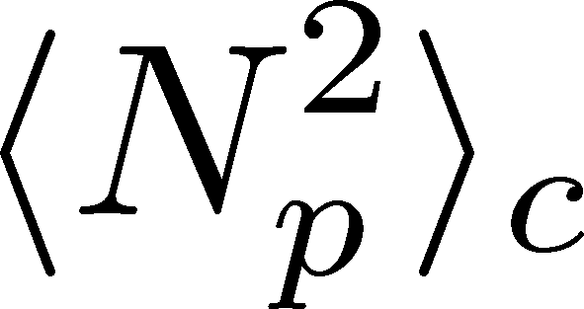
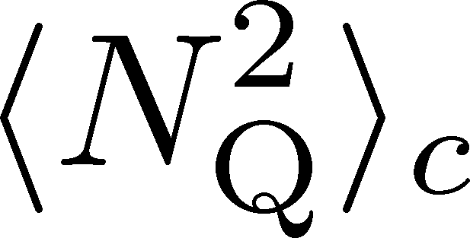
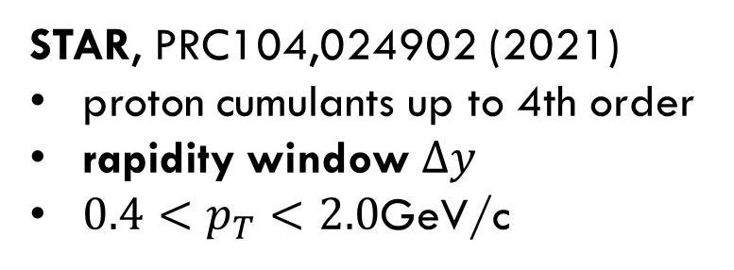
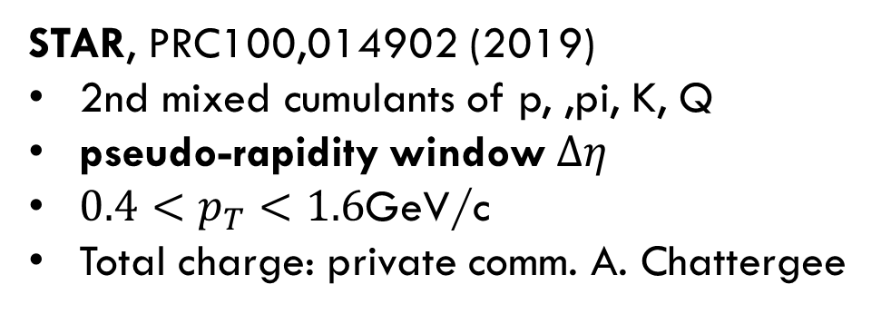
Experimental Data
$\sqrt{s_{NN}}=200$GeV
0-5% centrality
$Δy$ dependence
Construction of baryon number, $p_{T}$-acceptance correction
STAR, PRC104,024902 (2021)
proton cumulants up to 4th order
rapidity window $Δy$
$0.4<p_{T}<2.0$GeV/c
STAR, PRC100,014902 (2019)
2nd mixed cumulants of p, ,pi, K, Q
pseudo-rapidity window $Δη$
$0.4<p_{T}<1.6$GeV/c
Total charge: private comm. A. Chattergee
proton → baryon cumulants MK, Asakawa,’12;’12
Rapidity is better than pseudo-rapidity
Wider acceptance is more desirable.
Ohnishi, MK, Asakawa, ’16

Slide 14
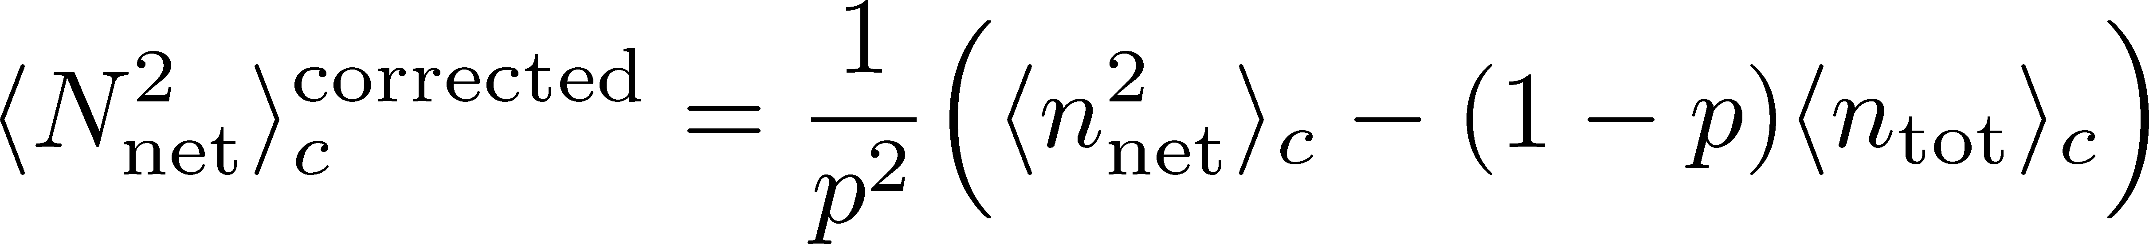



$pT$-Acceptance Correction
$p_{T}$ Acceptance
0.4<p_{T}<1.6 [GeV/c]
0.4<p_{T}<2.0 [GeV/c]
PRC100,014902(’19)
PRC104,024902(’21)
Particles in $p_{T}$ space
Electric charge: 49%
Protons: 82%
blast wave model @ √s_{NN}=200 GeV
Modification by $p_{T}$-cut should be corrected.
This study: Binomial distribution model.
MK, Asakawa, ’12, ’12

Slide 15
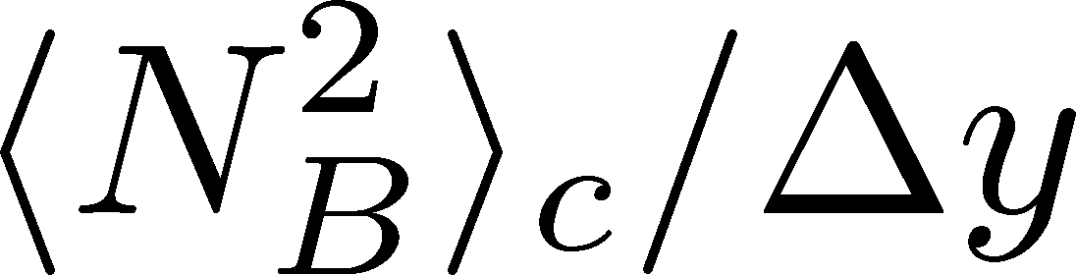
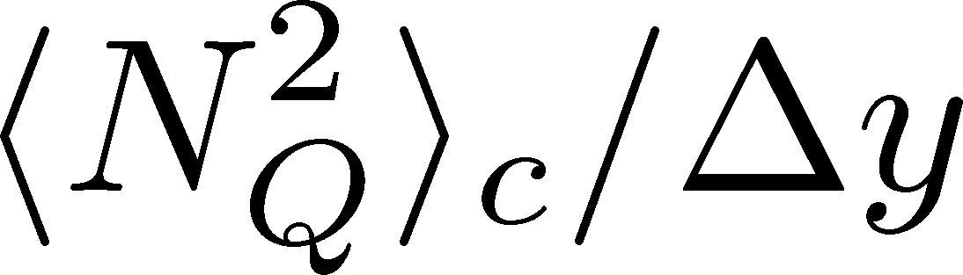

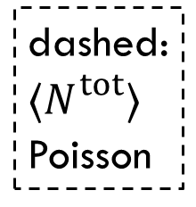
Cumulants: Proton→Baryon & Acceptance Correction
Data from STAR, ’19, ’21
corrected
dashed:
$⟨N_{}^{tot}⟩$
Poisson
suppress
corrected
uncorrected
uncorrected
$${\left\langle N_{p}^{2}\right\rangle }_{c}$$
Deviation from Poissonian is clarified by the acceptance correction.
MK, Asakawa, ’12, ’12

Slide 16
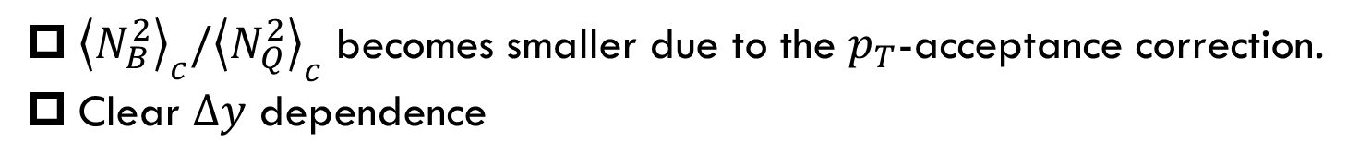

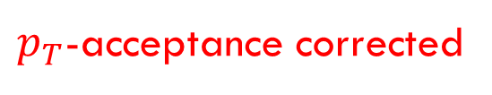
$p_{T}$-acceptance uncorrected
$p_{T}$-acceptance corrected
dashed:
Poisson
${\left\langle N_{B}^{2}\right\rangle }_{c}/{\left\langle N_{Q}^{2}\right\rangle }_{c}$ becomes smaller due to the $p_{T}$-acceptance correction.
Clear $Δy$ dependence
non-thermal effects behind fluctuations

Slide 17
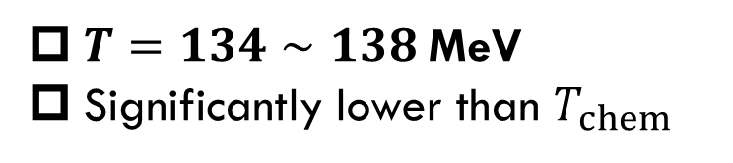
HIC vs HRG&LAT
From data @ STAR
HRG+Lattice
Data from
HotQCD, PRD104 (’21)
$T=134∼138$MeV
Significantly lower than $T_{chem}$
HRG: QMHRG2020
Bollweg+, PRD104, 7 (’21)
Volume dep. corrected
plot by MK

Slide 18
HIC vs HRG&LAT
From data @ STAR
HRG+Lattice
Data from
HotQCD, PRD104 (’21)
$T=134∼138$MeV
Significantly lower than $T_{chem}$
HRG: QMHRG2020
Bollweg+, PRD104, 7 (’21)
Volume dep. corrected
plot by MK

Slide 19
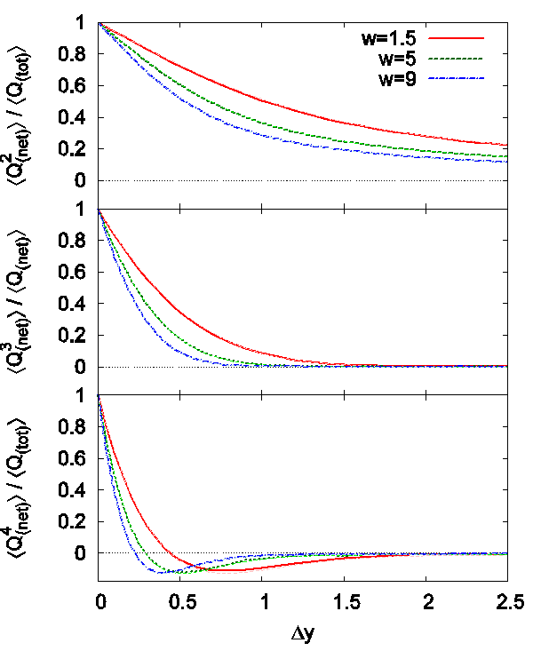

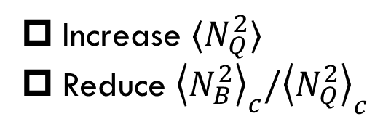

Effect of Diffusion and Rapidity Conversion
Ohnishi, MK, Asakawa, PRC (‘16)
Blurring due to diffusion & rapidity conversion ($Y→y$)
Stronger modification in Q than B
Resonance Decays
About 30% charged particles come from RD
Enhancement of charged particles
Increase $⟨N_{Q}^{2}⟩$
Reduce ${\left\langle N_{B}^{2}\right\rangle }_{c}/{\left\langle N_{Q}^{2}\right\rangle }_{c}$
These effects will be more important for higher order cumulants!

Slide 20
Three Topics
1 Event-by-event fluctuations of conserved charges
2 Dilepton production rate at ultra-low-mass region
as a signal of QCD phase transitions
3 Event selections
MK, Esumi, Nonaka, 2205.10030
Talk by Nishimura, yesterday; Nishimura, MK, Kunihiro, 2302.03191; 2201.01963

Slide 21
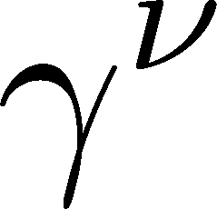
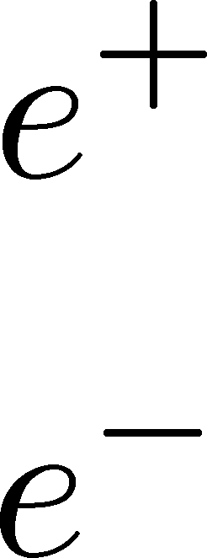
Purpose
T
Explore
color superconductivity
Nishimura+, PTEP2022, 093D02 (’22)
QCD critical point
Nishimura+, PTEP2023, in press
in heavy-ion collisions
using
dilepton production rate
Quark-Gluon Plasma
150MeV
ＱＣＤ Critical Point
2
1
Hadron Phase
(confined)
Color SC
~10¹⁵g/cm³
μ

Slide 22
Observing CSC in HIC
Difficulties
  CSC would not be created if Tc is not high enough.
  Even if created, its lifetime would be short.
  Since CSC is created in the early stage, its signal would be blurred during the evolution in later stage.
Ohnishi, 2002
Strategy in the present study:
  Focus on precursory phenomena of CSC
  Use dilepton production as an observable

Slide 23
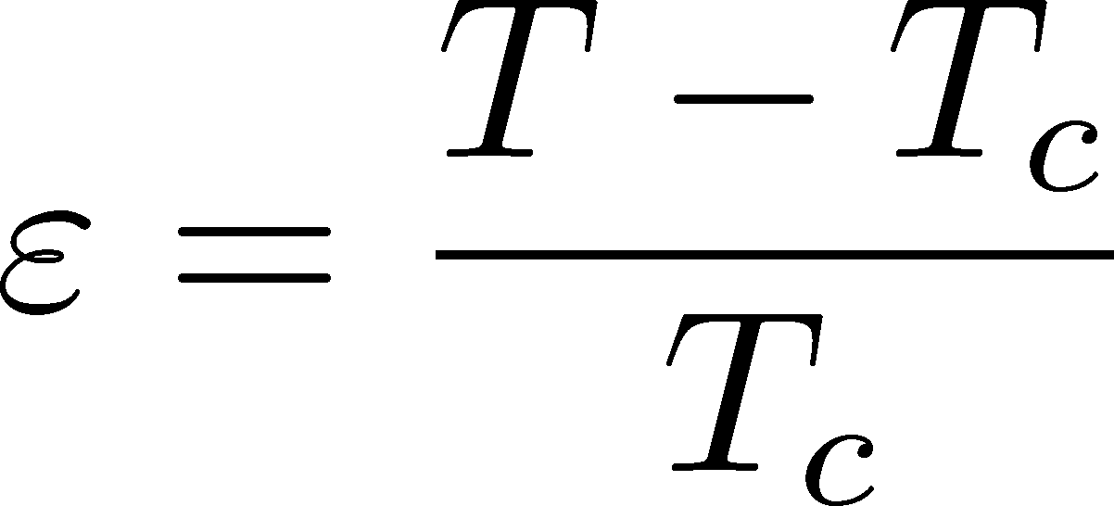


Precursor of CSC
Anomalous behavior of observables near but above Tc of SC
electric conductivity
magnetic susceptibility
pseudogap
Electric conductivity
Skopal, Tinkham(‘75)
Enhanced pair fluctuations is one of the origins of precursory phenomena.
More significant phenomena in strongly-coupled systems.
T>Tc
Landau’s free energy
T<Tc

Slide 24
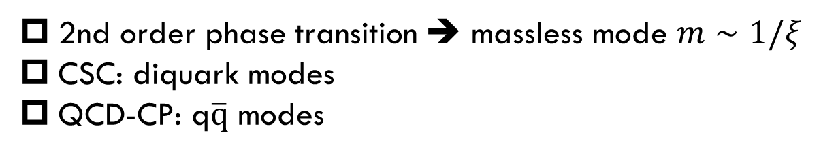
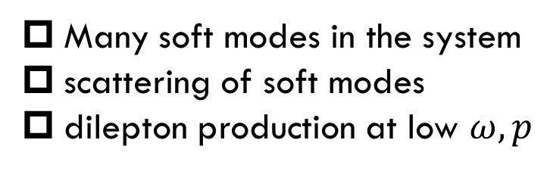
Dilepton Production from Soft Modes
Soft Mode
2nd order phase transition ➔ massless mode $m∼1/ξ$
CSC: diquark modes
QCD-CP: q$\overline{q}$ modes
Dilepton Production
Many soft modes in the system
scattering of soft modes
dilepton production at low $ω,p$

Slide 25
Dilepton Production from Diquark Soft Modes
Fixed Temperature
Strong enhancement at low invariant mass, though the range of M is narrower than the previous results.
Observable in the HIC?

Slide 26
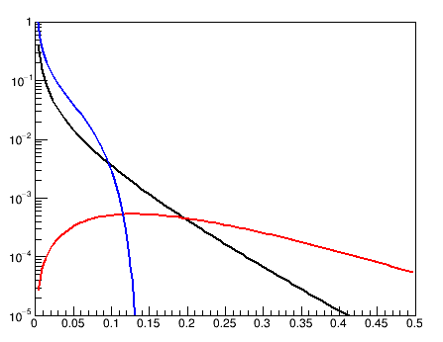
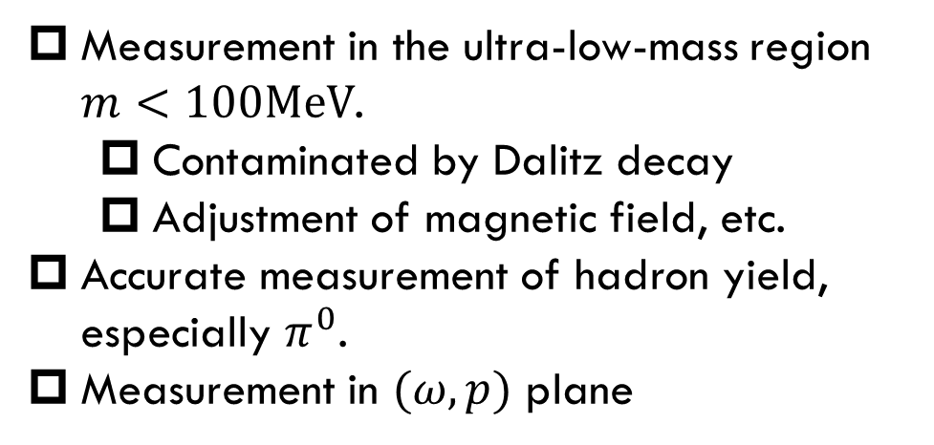
Challenges
Experimental
dR/dM
(A.U)
Dalitz
Free quark
diquark fluc
Measurement in the ultra-low-mass region $m<100MeV$.
  Contaminated by Dalitz decay
  Adjustment of magnetic field, etc.
Accurate measurement of hadron yield, especially $π^{0}$.
Measurement in $(ω,p)$ plane
Analysis by Y. Morino
M(GeV/c²)
Theoretical
Other production mechanisms in the ULMR
  pQCD, hadronic, lattice, etc.
  transport peak
Momentum dependence

Slide 27
Three Topics
1 Event-by-event fluctuations of conserved charges
2 Dilepton production rate at ultra-low-mass region
as a signal of QCD phase transitions
3 Event selections
MK, Esumi, Nonaka, 2205.10030
Talk by Nishimura, yesterday; Nishimura, MK, Kunihiro, 2302.03191; 2201.01963

Slide 28


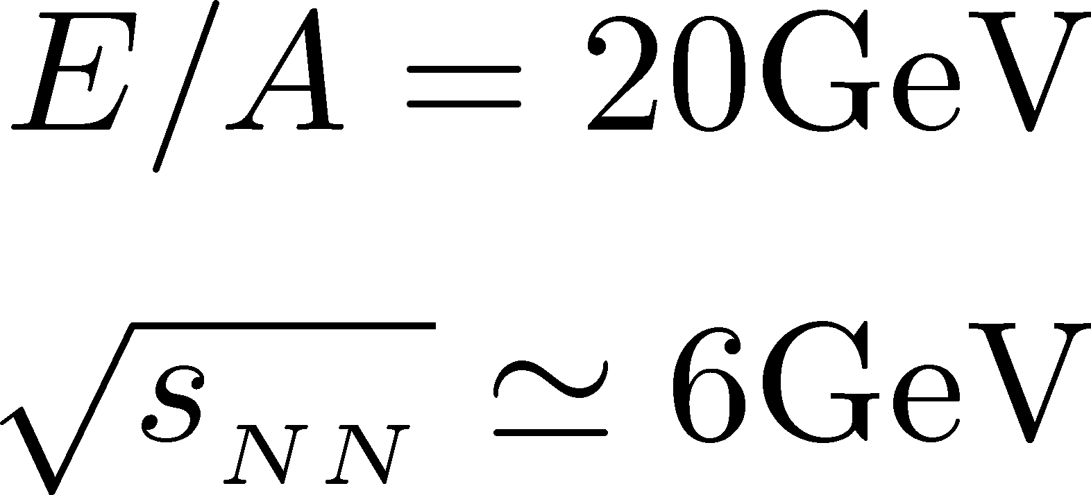

Sophisticated Event Selections
average transverse energy
Maximum baryon density has large event-by-event fluctuations
Ohnishi, 2002
Density Scan
Baryon-rich events
Baryon-rich
events
directed flow
Baryon-rich
events
Event selection in terms of maximum baryon density (or, correlation analysis) should be a useful tool.

Slide 29
Nuclear Liquid-Gas Phase Transition
Pochodzalla+, PRL, 75, 1040 (‘95)

Slide 30
Nuclear Liquid-Gas Phase Transition
Pochodzalla+, PRL, 75, 1040 (‘95)
Experiment:
Spectator
E/A=600MeV
measure all fragments
energy of the spectator
Similar analysis in relativistic HIC requires event-by-event total energy of the fireball.

Slide 31
Summary
Heavy-ion collisions will reveal phase transitions in dense QCD.
We discussed 3 observables/method:
  Event-by-event fluctuations of conserved charges
  Dilepton production at ultra-low-mass-region
  Event selection via baryon/energy density
In each method, further refinements are necessary.

