Slide 1
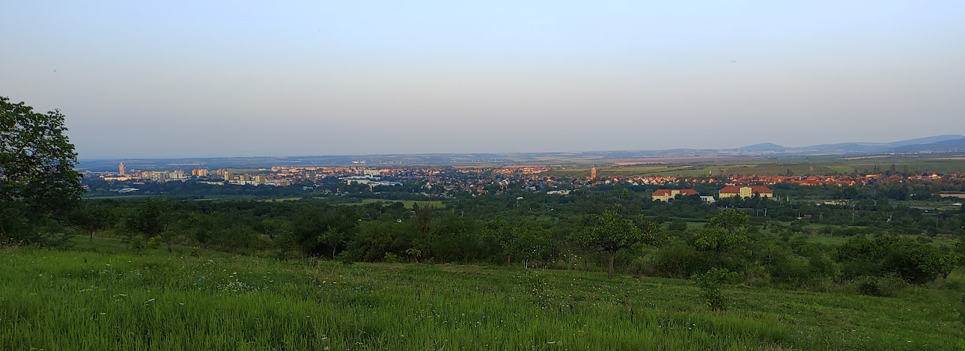
Exploring Strongly-Interacting Matter
in Heavy-ion Collisions
Masakiyo Kitazawa
(YITP, Kyoto)
ISMD 2023, Gyöngyös, Hungary, August. 22, 2023

Slide 2

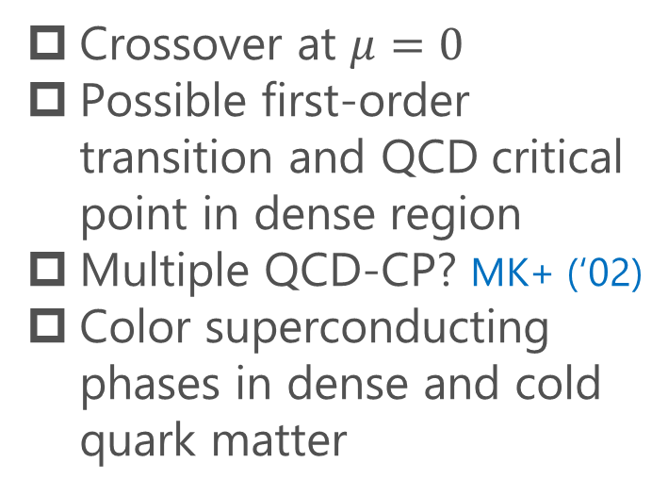
QCD Phase Diagram
T
Crossover at $μ=0$
Possible first-order transition and QCD critical point in dense region
Multiple QCD-CP? MK+ (‘02)
Color superconducting phases in dense and cold quark matter
Quark-Gluon Plasma
150MeV
ＱＣＤ Critical Point
Hadron Phase
(confined)
Color SC
~10¹⁵g/cm³
μ

Slide 3


QCD Phase Diagram
Early Universe
T
Crossover at $μ=0$
Possible first-order transition and QCD critical point in dense region
Multiple QCD-CP? MK+ (‘02)
Color superconducting phases in dense and cold quark matter
Quark-Gluon Plasma
150MeV
ＱＣＤ Critical Point
Hadron Phase
(confined)
Color SC
Compact
Stars
~10¹⁵g/cm³
μ

Slide 4

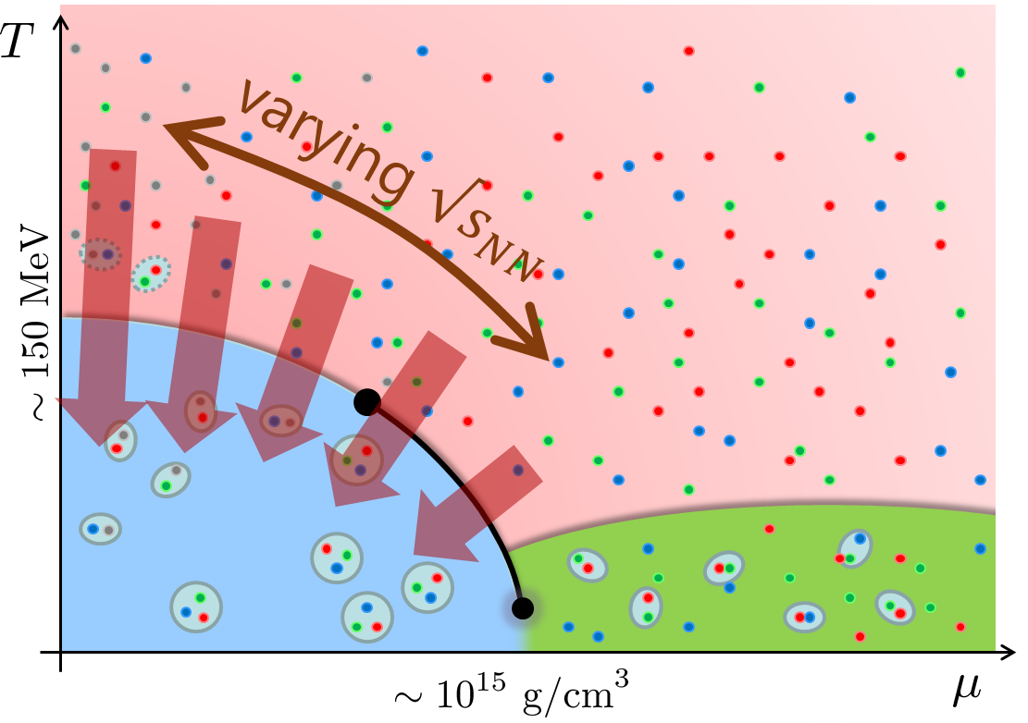
Beam-Energy Scan
STAR, 2012
High E
Low E
Baryon stopping

Slide 5
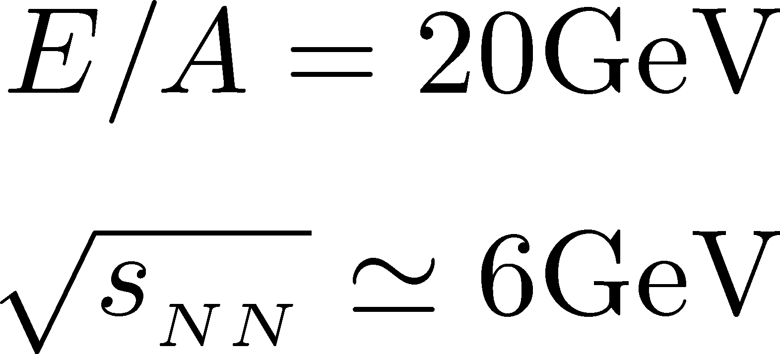


Highest Baryon Density
Ohnishi, 2002

Slide 6

Highest Baryon Density
Ohnishi, 2002
Akira Ohnishi
1964-2023
passed away silently
on May. 16, 2023

Slide 7





History / Current Status of HIC
LHC
2010~
RHIC
2000~
SPS
Increasing Collision Energy
~2000
AGS
~1996

Slide 8
History / Current Status of HIC
LHC
2010~
RHIC
2000~
SPS
Increasing Collision Energy
NA61/SHINE
~2000
RHIC-BES
AGS
FAIR-CBM
~1996
HADES

Slide 9
History / Current Status of HIC
LHC
2010~
FAIR-CBM
Galatyuk, NPA982, 163
RHIC
NICA
2000~
HADES
NA61/SHINE
Beam-Energy
Scan
RHIC-BES-FXT
SPS
RHIC-BES
Increasing Collision Energy
NA61/SHINE
~2000
RHIC-BES
AGS
FAIR-CBM
~1996
HADES
2010~

Slide 10
History / Current Status of HIC
LHC
J-PARC-HI
2010~
FAIR-CBM
Galatyuk, NPA982, 163
RHIC
NICA
2000~
HADES
NA61/SHINE
Beam-Energy
Scan
RHIC-BES-FXT
SPS
RHIC-BES
Increasing Collision Energy
NA61/SHINE
~2000
RHIC-BES
AGS
FAIR-CBM
~1996
HADES
2010~

Slide 11
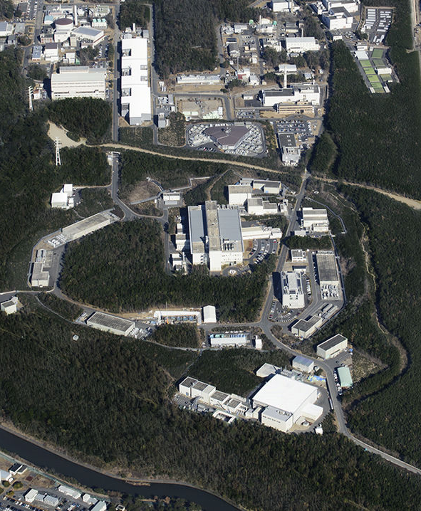
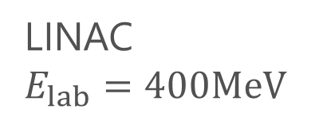
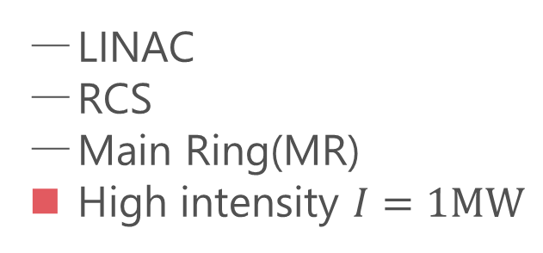

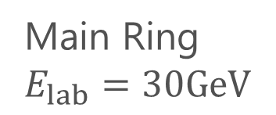
LINAC
$E_{lab}=400MeV$
J-PARC
Accelerators
LINAC
RCS
Main Ring(MR)
High intensity $I=1MW$
RCS
$E_{lab}=3GeV$
Purposes
Hadron/Nuclear physics
Neutrino physics
Material/Life science
Main Ring
$E_{lab}=30GeV$
proton
energy
Hadron hall

Slide 12
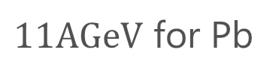
LINAC
$E_{lab}=400MeV$
J-PARC
HI-injector
Accelerators
LINAC
RCS
Main Ring(MR)
High intensity $I=1MW$
RCS
$E_{lab}=3GeV$
Purposes
Hadron/Nuclear physics
Neutrino physics
Material/Life science
Main Ring
$E_{lab}=30GeV$
$11AGeV$ for Pb
J-PARC-HI
proton
energy
J-PARC Heavy Ion Program
High intensity
Hadron hall
Intermediate energy

Slide 13
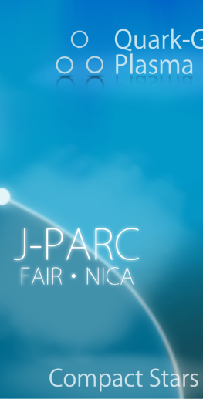
Exploring Dense Medium
Neutron stars
Equation of state
QCD critical point /
1st order transition /
Color superconductivity
Dilepton production rate
Event selection /
Higher correlations

Slide 14
Dilepton Production
as experimental observables of
Color Superconductivity & QCD-CP
Nishimura, MK, Kunihiro, PTEP2022, 093D02
Nishimura, MK, Kunihiro, PTEP2023, 053D01

Slide 15
Observing CSC in HIC
Difficulties
  CSC would not be created if Tc is not high enough.
  Even if created, its lifetime would be short.
  Since CSC is created in the early stage, its signal would be blurred during the evolution in later stage.
Strategy in the present study:
  Use dilepton production as an observable
  Focus on precursory phenomena of CSC
Ohnishi, 2002

Slide 16
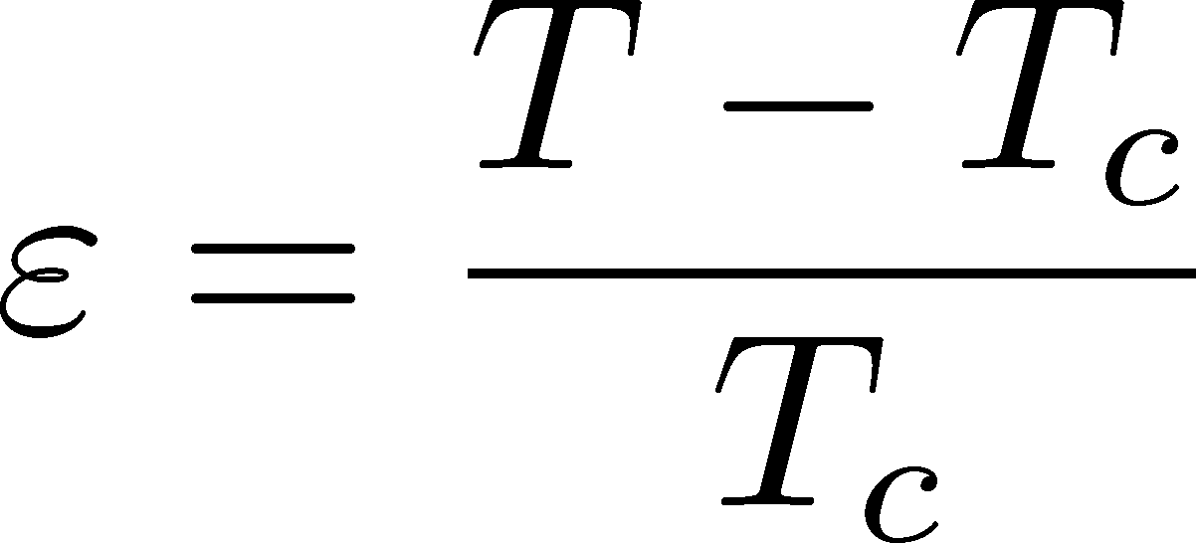


Precursor of CSC
Anomalous behavior of observables near but above Tc of SC
electric conductivity
magnetic susceptibility
pseudogap
Electric conductivity
Skopal, Tinkham(‘75)
Enhanced pair fluctuations is one of the origins of precursory phenomena.
More significant phenomena in strongly-coupled systems.
T>Tc
Landau’s free energy
T<Tc

Slide 17

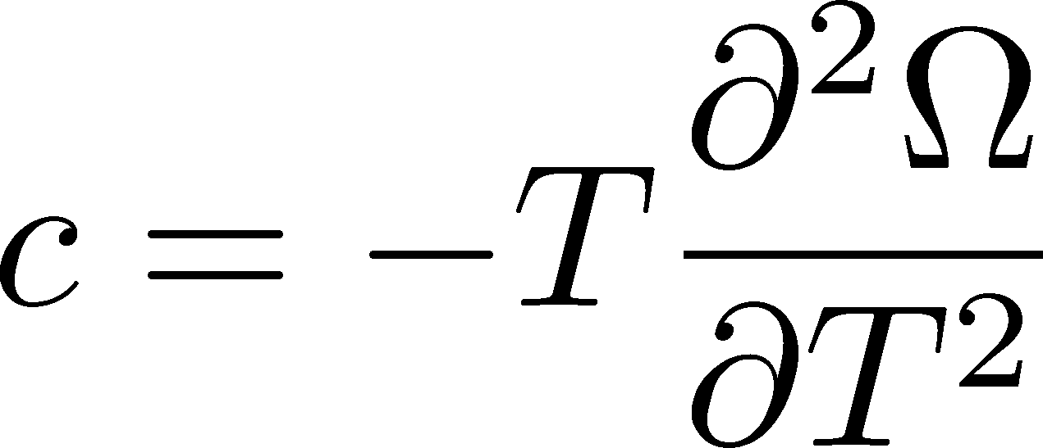
Precursor of Color Superconductivity
MK, Koide, Kunihiro, Nemoto, ’03, ‘05
Thermodynamic Potential
Pseudogap
Specific heat
density of states
Depression
in DoS above Tc

Slide 18
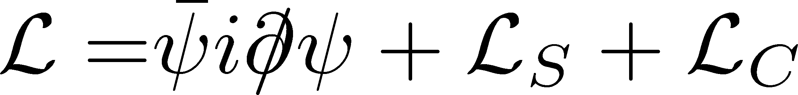
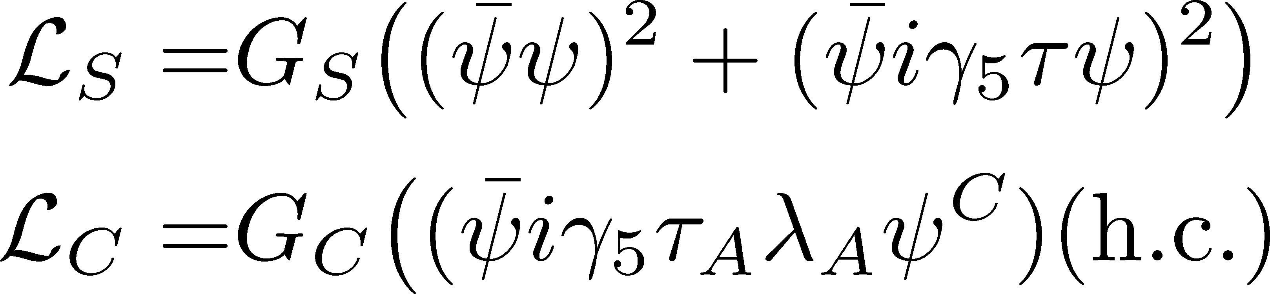
Model
NJL model (2-flavor)
Phase Diagram in MFA
diquark interaction
Parameters
Order of phase transition
  2nd in the MFA
  can be 1st due to gauge fluctuation
Matsuura+(’04), Giannakis+(’04)
Noronha+(’06), Fejos, Yamamoto(’19)

Slide 19
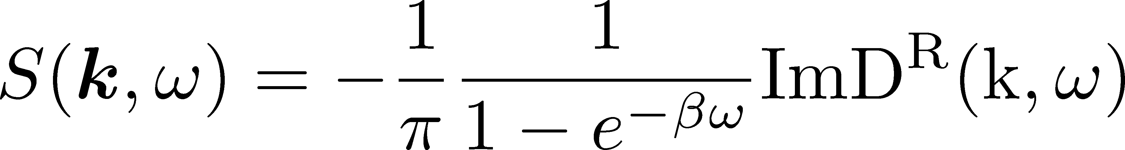

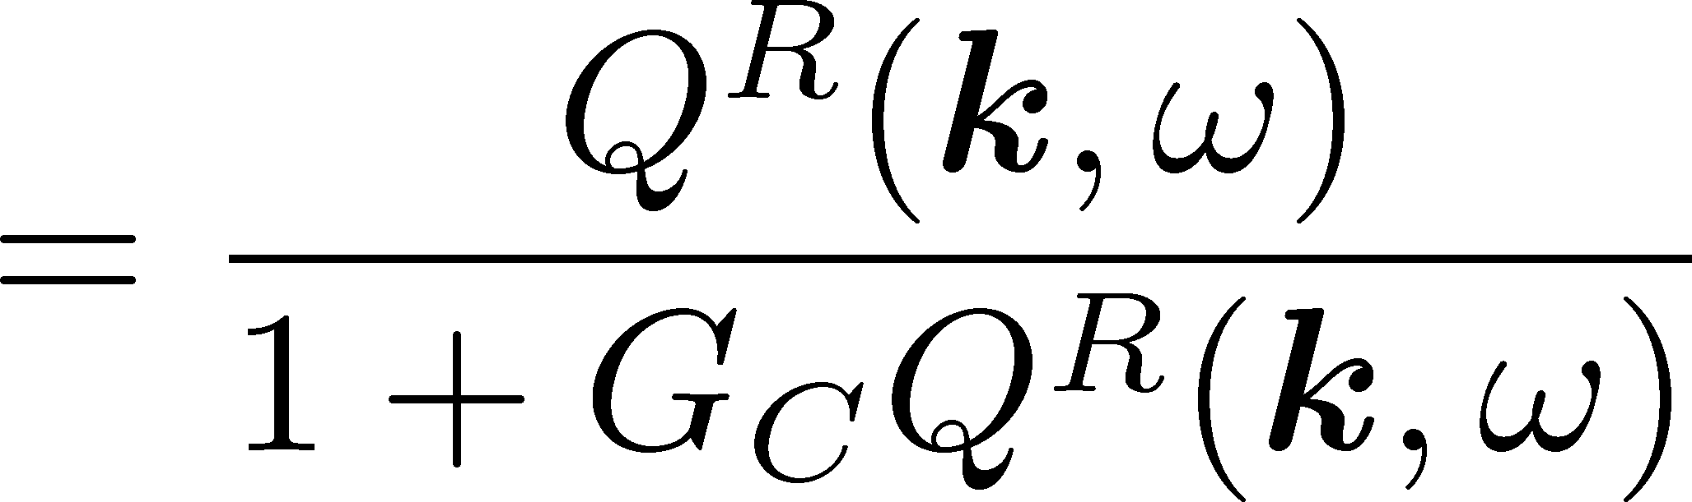




Di-quark Fluctuations
Diquark Propagator
Dynamical Structure Factor
Random Phase Approximaion
$$=$$
$$+$$
$$+ ∙∙∙$$
Diquark field becomes massless at T=Tc
Soft mode of CSC transition
Strength in the space-like region
MK, Koide, Kunihiro, Nemoto, ’01,’05

Slide 20

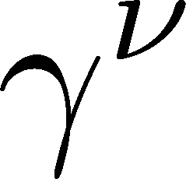
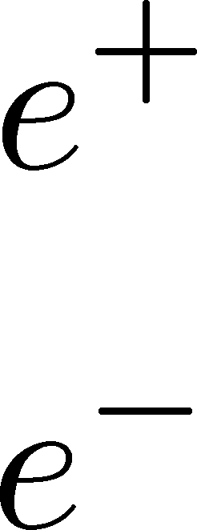
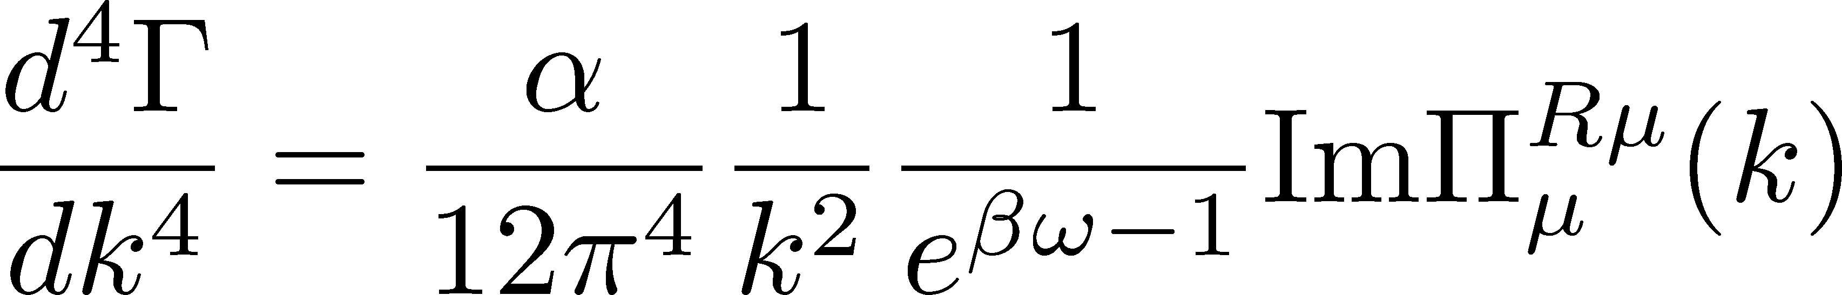
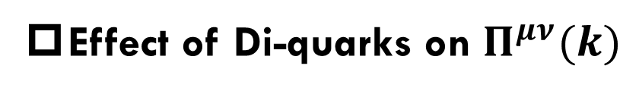
Photon Self-Energy: Precursor of CSC
Dilepton Production Rate
Effect of Di-quarks on $Π^{μν}(k)$
Aslamasov-Larkin term
Maki-Thompson term
DPR from CFL phase
Jaikumar, Rapp, Zahed (’02)
Well-known diagrams in metallic SC
for describing paraconductivity

Slide 21
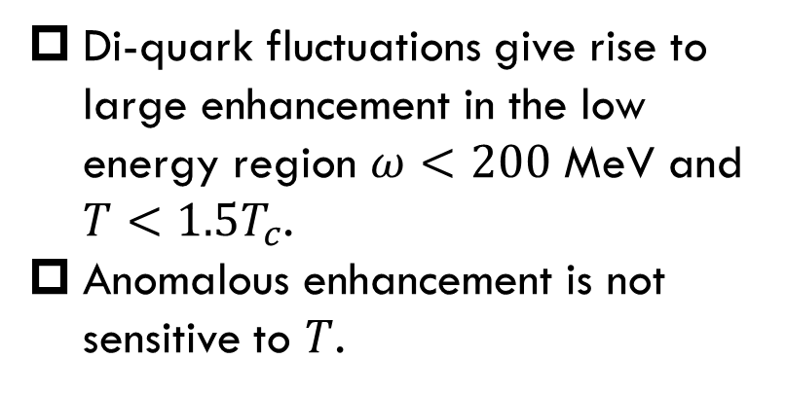
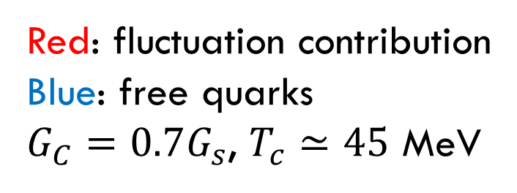
Production Rate at $k=0$
Nishimura, MK, Kunihiro (’22)
Red: fluctuation contribution
Blue: free quarks
$G_{C}=0.7G_{s}$, $T_{c}≃45$ MeV
enhancement
Di-quark fluctuations give rise to large enhancement in the low energy region $ω<200$ MeV and $T<1.5T_{c}$.
Anomalous enhancement is not sensitive to $T$.

Slide 22
Invariant-Mass Spectrum
Nishimura, MK, Kunihiro (’22)
Strong enhancement at low invariant mass.
Observable in the HIC?

Slide 23





Dileptons from QCD Critical Point
NJL model (2-flavor)
Parameters
Soft Mode of QCD-CP
= fluctuation of scalar ($\overline{q}q$) channel
Modification of dilepton production through
Random Phase Approximaion
$$=$$
$$+$$
$$+ ∙∙∙$$
+$⋯$
MT, DoS

Slide 24
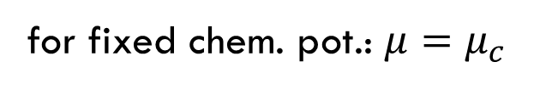

Dilepton production rate near QCD-CP
Invariant mass spectrum
Nishimura, MK, Kunihiro (’23)
for fixed chem. pot.: $μ=μ_{c}$
Enhancement at low $M_{ll}$ region near QCD-CP
Distinguishment from diquark soft mode may be difficult.

Slide 25
Summary
Exploring dense quark matter
is an interesting subject in heavy-ion collisions that are investigated actively all over the world.
J-PARC-HI will accelerate this research field.
Dilepton production at ultra-low mass region
can be used for experimental signals to detect
  onset of color-superconducting phase transition
  existence of QCD critical point

Slide 26
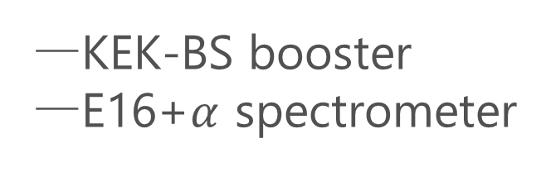
J-PARC-HI Staging Plan
Phase-II
Phase-I
KEK-BS booster
E16+$α$ spectrometer
Phase-I
Phase-II
NEW HI booster
NEW spectrometer

Slide 27

Gauge-Invariant Construction of $Π_{μν}(k)$
Insert two photon vertices in thermodynamic potential
Aslamasov-Larkin (AL)
Maki-Thompson (MT)
Density of States (DoS)
WT identity $k_{μ}Π^{μν}\left(k\right)=0$ is satisfied with AL, MT and DoS terms.

Slide 28
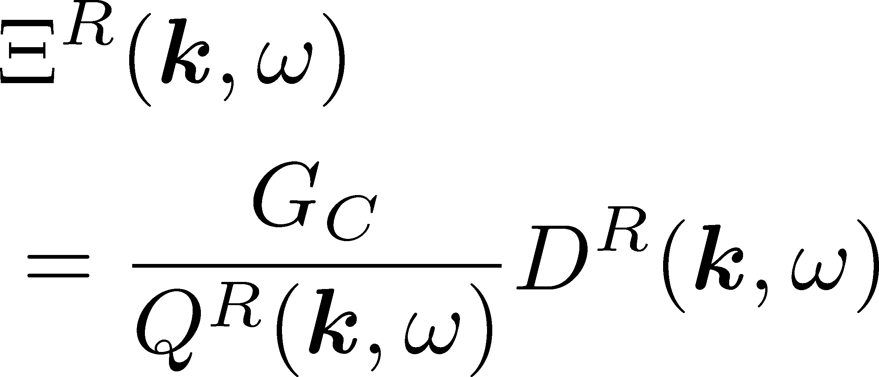
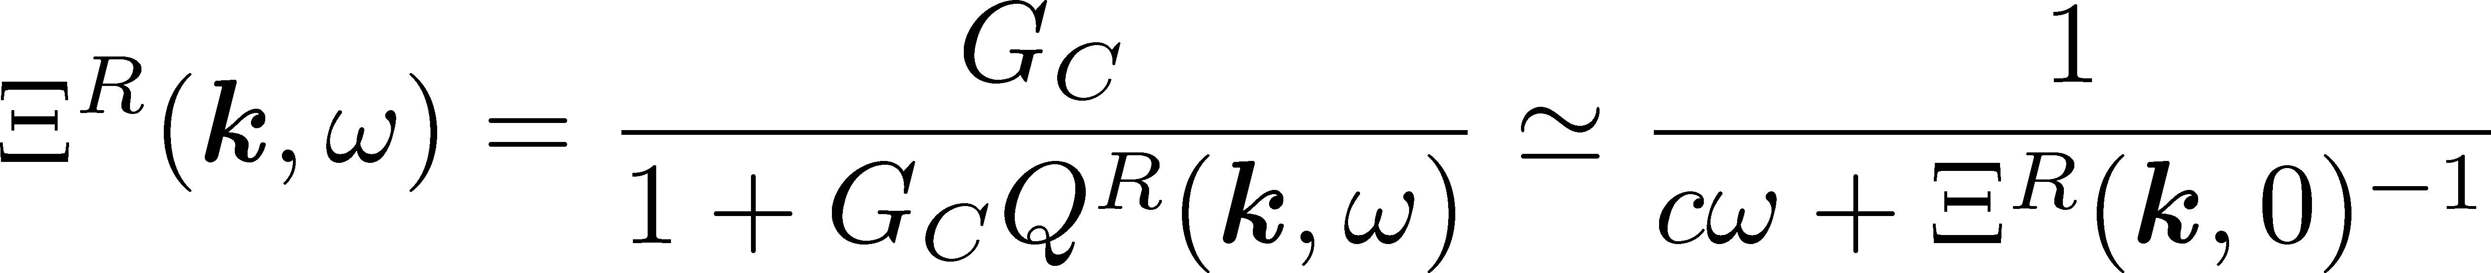
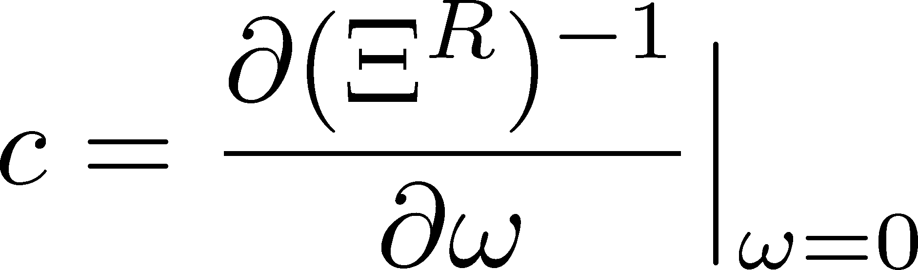
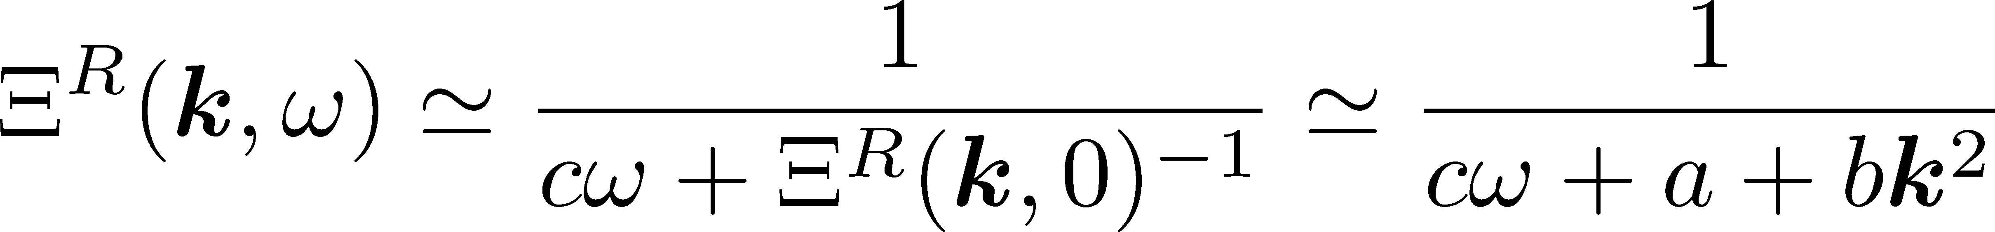
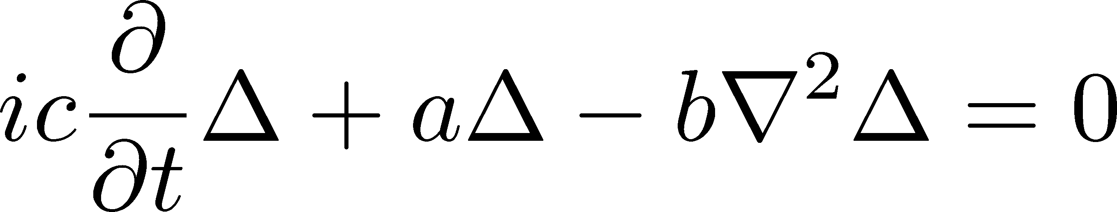
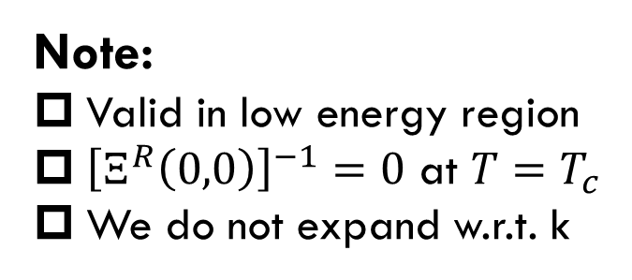
(Modified) Time-Dependent Ginzburg-Landau Approximation
TDGL approximation for T-matrix
Note:
Valid in low energy region
${\left[Ξ^{R}\left(0,0\right)\right]}^{−1}=0$ at $T=T_{c}$
We do not expand w.r.t. k
TDGL equation:

Slide 29



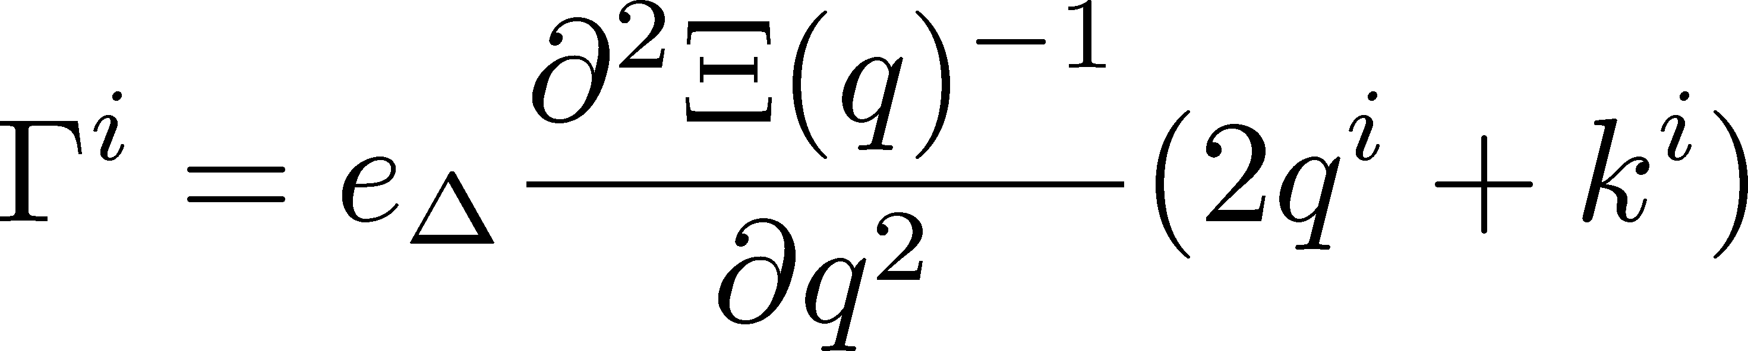
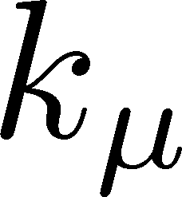

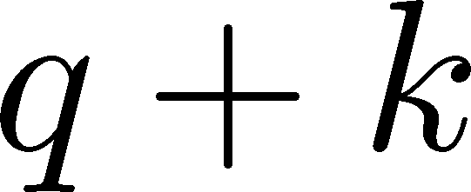





Vertices
Vertices must be determined to be consistent with the TDGL approx.
WT identity for AL vertex
At the lowest order in k
$$=$$
$$−$$
$e_{Δ}$: electric charge of diquarks
MT+DoS
Similar formula for MT+DoS vertex
$$=$$
$$−$$

Slide 30

Energy-Momentum Dependence
Nishimura, MK, Kunihiro (’22)
Red: fluctuation contribution
Blue: free quarks
$G_{C}=0.7G_{s}$, $T_{c}≃45$ MeV
Enhancement due to diquark fluctuations is more suppressed for larger k.

Slide 31
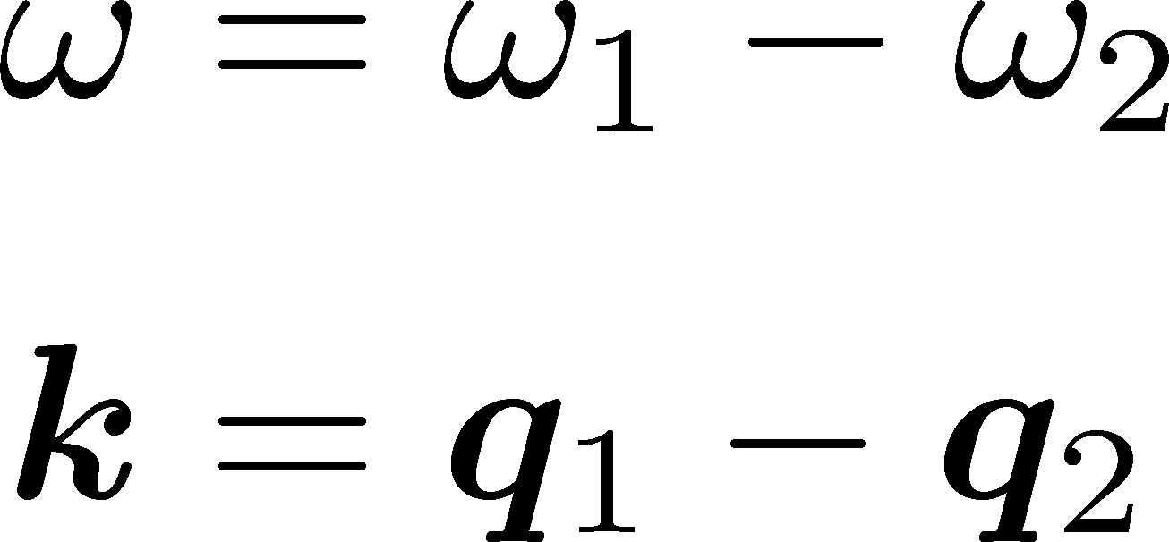
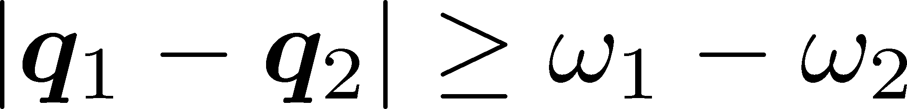
Production Mechanism of Virtual Photons
Production mechanism
scattering of diquarks
diquarks: space-like region
Production in the time-like region is possible.
C.f.) Scattering of free quarks produces virtual photons only in the space-like region.

Slide 32


Formulation
Diquark Fluctuations
AL term
+$⋯$
MT, DoS
Attach 2 photons
Scalar Fluctuations
AL term
+$⋯$
MT, DoS
Photon self-energy including the soft mode of QCD-CP can be constructed in a similar manner as before.

Slide 33


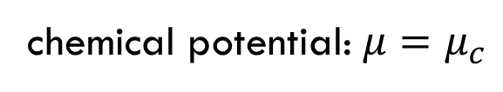
Dilepton production rate near QCD-CP
Nishimura, MK, Kunihiro (’23)
$ω−k$ plane
Invariant mass spectrum
chemical potential: $μ=μ_{c}$
Enhancement at low $ω, k, m_{ll}$ regions near QCD-CP
Distinguishment from diquark soft mode may be difficult.

Slide 34
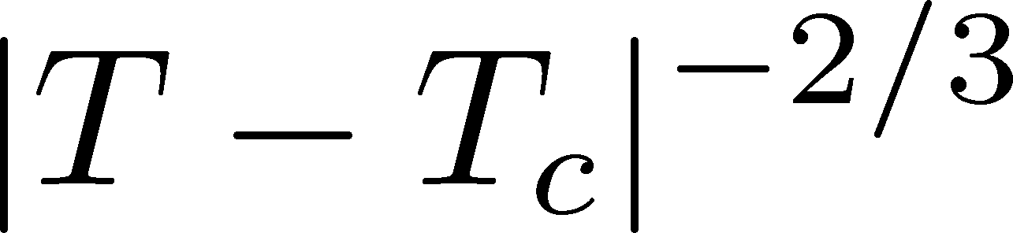
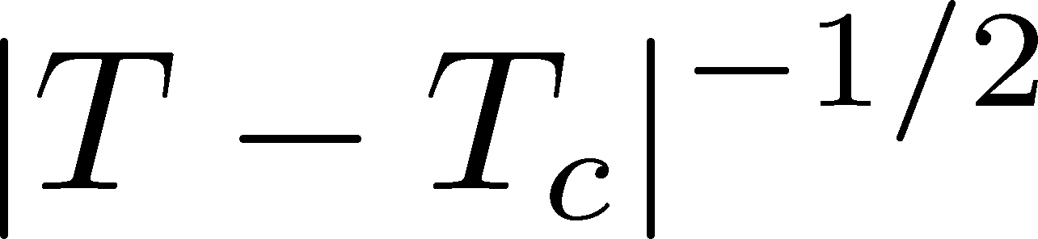
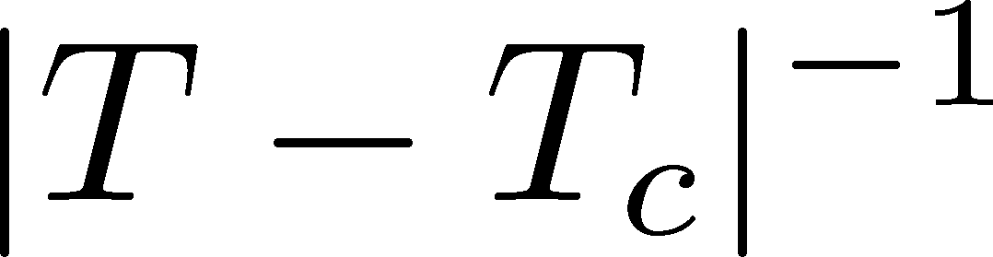


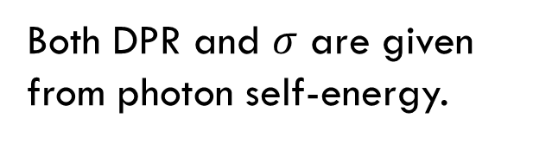
Electric Conductivity
Soft mode leads to enhancement of conductivity $σ$.
Note:
Both DPR and $σ$ are given from photon self-energy.
Critical Exponents
QCD-CP
CSC
Conductivity diverges with different critical exponents in QCD-CP & CSC.
Can they distinguishable in HIC??
$$σ$$
$$τ$$
Nishimura, MK, Kunihiro, in prep.

