Slide 1
Thermodynamics of
SU(3) Yang-Mills theory with boundary conditions
KEK Lunch Seminar, 2023/09/29, KEK
Masakiyo Kitazawa (YITP)
MK, Mogliacci, Kolbe, Horowitz, Phys. Rev. D99 (2019) 094507
Suenaga, MK, Phys. Rev. D107 (2023) 074502
D. Fujii, A. Iwanaka, D. Suenaga, MK, in prep.

Slide 2
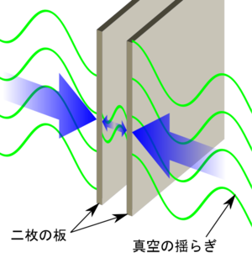
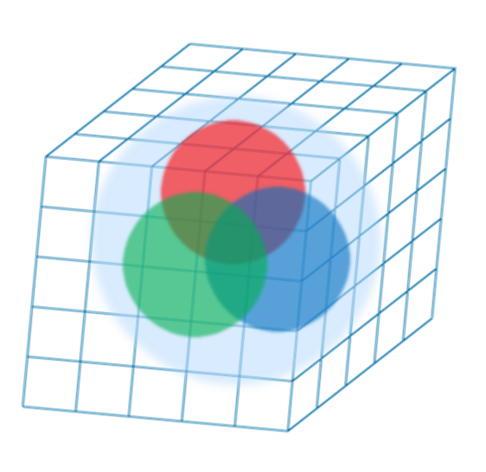


Boundary Conditions in QFT
Many motivations
Casimir effect
Relativistic heavy-ion collisions
Numerical simulations (ex. lattice QCD)
Matsubara formalism for thermal systems
from wikipedia

Slide 3




Matsubara Formalism
Thermal Field Theory
PBC for imaginary-time
for bosons

Slide 4






Matsubara Formalism
Thermal Field Theory
PBC along $x$ dir. at $T=0$
PBC for imaginary-time
for bosons

Slide 5




Purpose
Thermal SU(3) YM with PBC along $x$ direction
QFT on $T^{2}×R^{2}$
How does thermodynamics behave w.r.t. $T$ and $L_{x}$?
Thermal Casimir effect in a non-perturbative system
QCD phase diagram as a function of $L_{x}$
2 Polyakov loops will play important roles

Slide 6
Contents
1. Lattice study
MK+, Phys. Rev. D99 (2019) 094507
2. Model analyses
Suenaga, MK, Phys. Rev. D107 (2023) 074502
D. Fujii, A. Iwanaka, D. Suenaga, MK, in prep.

Slide 7
Casimir Effect

Slide 8
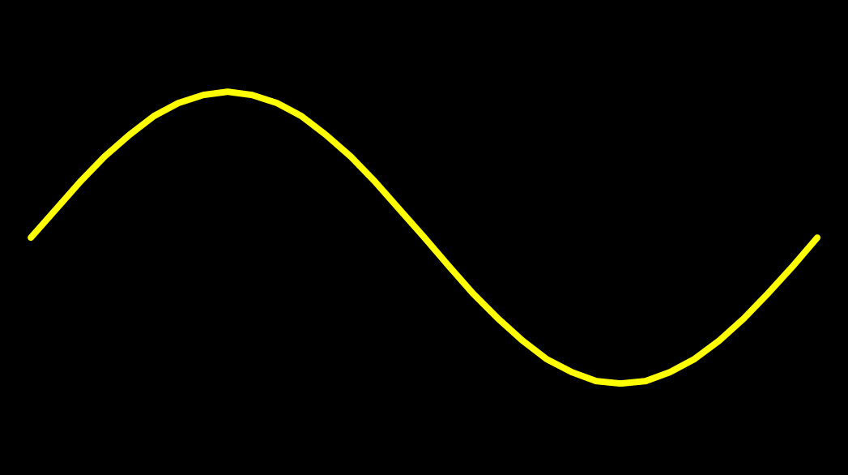
Casimir Effect
attractive force between two conductive plates

Slide 9





Casimir Effect
Brown, Maclay
1969

Slide 10



Casimir Effect
Brown, Maclay
1969

Slide 11
Casimir Effect
Brown, Maclay
1969
T

Slide 12

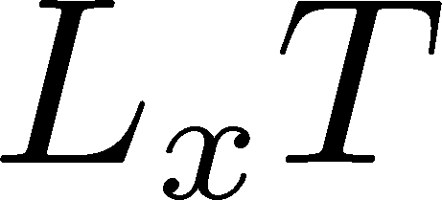


Pressure Anisotropy @ $T≠0$
MK, Mogliacci, Kolbe,
Horowitz, in prep.
Free scalar field
L₂=L₃=∞
Periodic BC
Mogliacci+, 1807.07871

Slide 13

Pressure Anisotropy @ $T≠0$
MK, Mogliacci, Kolbe,
Horowitz, in prep.
Free scalar field
L₂=L₃=∞
Periodic BC
Mogliacci+, 1807.07871
Lattice result
Periodic BC
Only t→0 limit
Error: stat.+sys.
Medium near T_{c} is remarkably insensitive to finite size!

Slide 14




Thermodynamics on the Lattice
Various Methods
Integral, differential, moving frame, non-equilibrium, …
rely on thermodynamic relations valid in V→∞
Not applicable to
anisotropic systems
We employ Gradient Flow Method
Components of EMT are directly accessible!

Slide 15




Yang-Mills Gradient Flow
Luscher 2010
Narayanan, Neuberger, 2006
Luscher, Weiss, 2011
t: “flow time”
dim:[length²]
leading
diffusion equation in 4-dim space
diffusion distance
“continuous” cooling/smearing
No UV divergence at t>0

Slide 16





Small Flow-Time Expansion
Luescher, Weisz, 2011
Suzuki, 2013
an operator at t>0
remormalized operators
of original theory
original 4-dim theory
t→0 limit

Slide 17


Constructing EMT
Suzuki, 2013
vacuum subtr.
Remormalized EMT
Perturbative coefficient:
Suzuki (2013); Makino, Suzuki (2014); Harlander+ (2018); Iritani, MK, Suzuki, Takaura (2019)

Slide 18
Thermodynamics
Iritani, MK, Suzuki, Takaura, 2019
□: 2-loop
△: Flow2016
Systematic error: μ₀ or μ_{d}, Λ, t→0 function, fit range
Good agreement between different methods
Our method can investigate finite systems with BCs

Slide 19

Numerical Setup
SU(3) YM theory
Wilson gauge action
N_{t} = 16, 12
N_{z}/N_{t}=6
2000~4000 confs.
Even N_{x}
No Continuum extrap.
Same Spatial volume
12x72²x12 ~ 16x96²x16
18x72²x12 ~ 24x96²x16
Simulations on
OCTOPUS/Reedbush

Slide 20
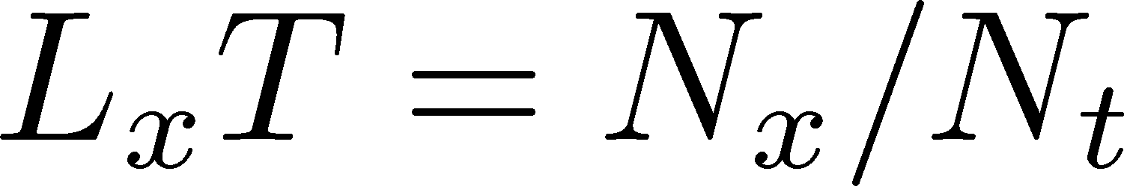
Pressure Anisotropy @ $T≠0$
MK, Mogliacci, Kolbe,
Horowitz, in prep.
Free scalar field
L₂=L₃=∞
Periodic BC
Mogliacci+, 1807.07871
Lattice result
Periodic BC
Only t→0 limit
Error: stat.+sys.
Medium near T_{c} is remarkably insensitive to finite size!

Slide 21
Pressure Anisotropy @ $T≠0$
MK, Mogliacci, Kolbe,
Horowitz, in prep.
Free scalar field
L₂=L₃=∞
Periodic BC
Mogliacci+, 1807.07871
Lattice result
Periodic BC
Only t→0 limit
Error: stat.+sys.
Medium near T_{c} is remarkably insensitive to finite size!

Slide 22
Higher T
High-T limit: massless free gluons
How does the anisotropy approach this limit?
Difficulties
Vacuum subtraction requires large-volume simulations.
Lattice spacing not available → c₁(t), c₂(t) are not determined.

Slide 23


Higher T
High-T limit: massless free gluons
How does the anisotropy approach this limit?
Difficulties
Vacuum subtraction requires large-volume simulations.
Lattice spacing not available → c₁(t), c₂(t) are not determined.
We study
No vacuum subtr. nor Suzuki coeffs. necessary!

Slide 24

T
massless free
$$T/Tc≅8.1 (b=8.0) / T/Tc≅25 (b=9.0)$$
Ratio approaches the asymptotic value for large $T$.
But, large deviation exists even at $T/Tc\sim 25$.
1st-order phase transition??

Slide 25
Contents
1. Lattice study
MK+, Phys. Rev. D99 (2019) 094507
2. Model analyses
Suenaga, MK, Phys. Rev. D107 (2023) 074502
D. Fujii, A. Iwanaka, D. Suenaga, MK, in prep.

Slide 26
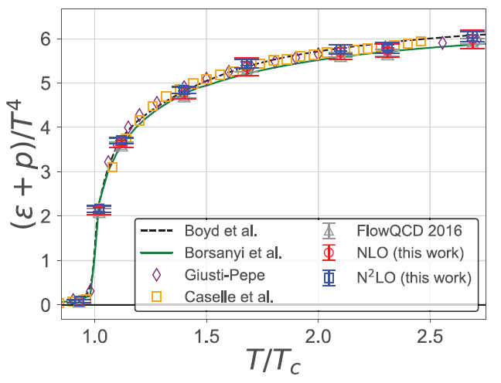
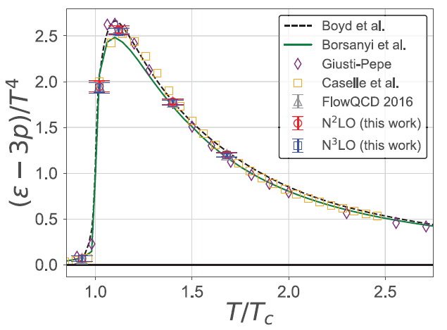
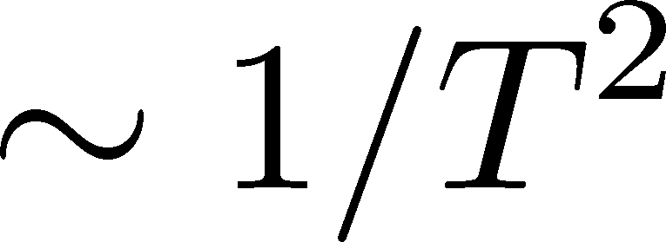


Thermodynamics of
SU(3) YM on $S^{1}×R^{3}$
Deconfinement phase transition = 1st-order PT
Stefen-Boltzmann limit for $T→∞$
How to describe these features quantitatively?

Slide 27




Polyakov-loop Effective Models
Meisinger+, PRD (2003)
General Idea
Introduce Polyakov loop $P$ through a constant background field $A_{0}$
Note:
: confinement / Z(3) symmetric
: deconfinement / Z(3) broken

Slide 28


Polyakov-loop Effective Models
Meisinger+, PRD (2003)
Free Energy
Perturbative term
Polyakov-loop potential
free energy of massless free gluons with a constant $A_{τ}$
Phenomenological free energy
that makes $P$ nontrivial
The value of $P$ is determined so as to minimize $F(T;P)$.

Slide 29





Meisinger+, PRD (2003)
Model A
gluon mass term at the leading order
employ this term as $F_{pot}$ with a parameter $m_{g}$
Model B
term inspired by the Haar measure
$R$: phenomenological parameter

Slide 30
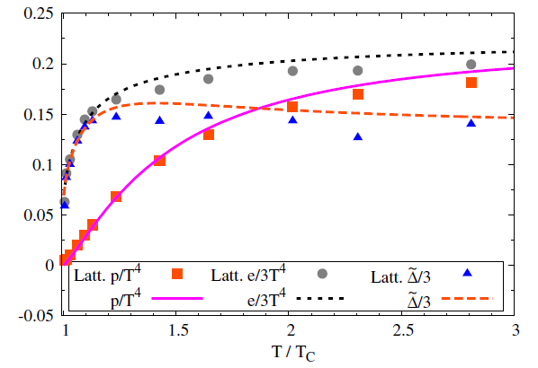

Results
Meisinger+, PRD (’03)
Dumitru+, PRD (’12)
Qualitative behavior of lattice thermodynamics near and above $T_{c}$ is well explained.

Slide 31







Extension to $T^{2}×R^{2}$
Suenaga, MK (’23); Fujii+, in prep.
2 Polyakov loops along $τ$ and $x$ directions
Diagonal ansatz:

Slide 32










Constraints on $F_{pot}$
$$S^{1}×R^{3}$$
Invariance w.r.t. exchange of $τ,x$ axes
$$S^{1}×R^{3}$$
Thermodynamics on $S^{1}×R^{3}$ must be reproduced at $L_{x}→∞$
must disappear faster

Slide 33
Separable Ansatz
Suenaga, MK (’23)
free gas
model result
Lattice result is not reproduced even qualitatively.

Slide 34
Phase Diagram

Slide 35




Introducing Cross Term
Fujii+, in prep.
Free Energy
cross term of $P_{τ}$ and $P_{x}$
: parameters in the model

Slide 36




Cross Term: coefficient

Slide 37

Result
Lattice results for ${T/T}_{c}>1.5$ are well reproduced.
No parameters to fit the results for $T/T_{c}=1.4, 1.12$.
Appearance of 1st-order PT?

Slide 38
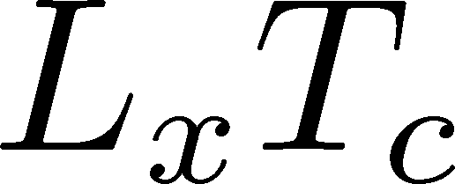
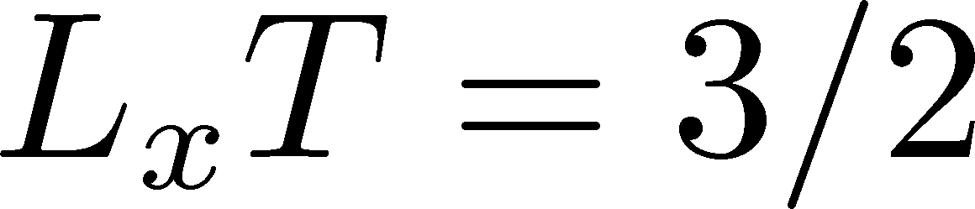
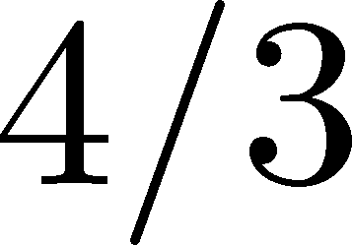
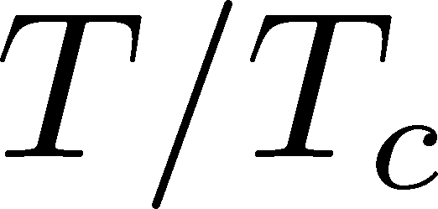
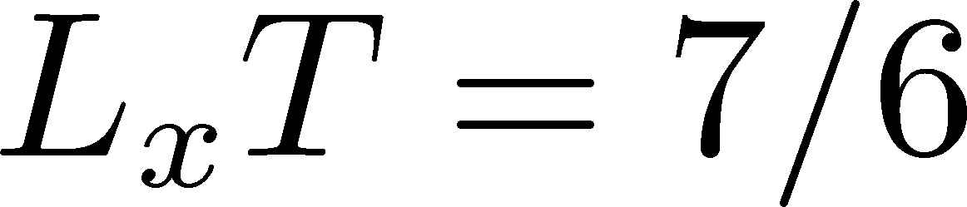
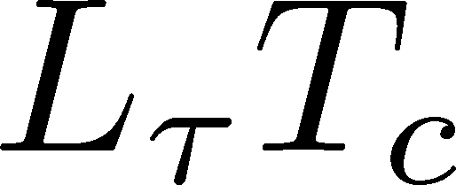
Phase Diagram
Appearance of a new 1st PT and critical points in the confined region
How do it affect lattice simulations?

Slide 39
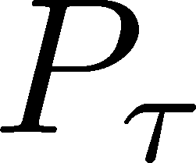
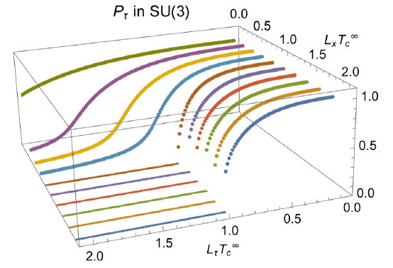

Polyakov Loops
without cross term
Suenaga, MK, ’23
Competition between $P_{τ}$ and $P_{x}$ leads to their sudden changes around $L_{τ}≃L_{x}$.

Slide 40
Thermodynamics

Slide 41
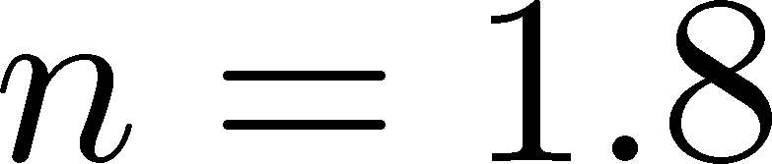
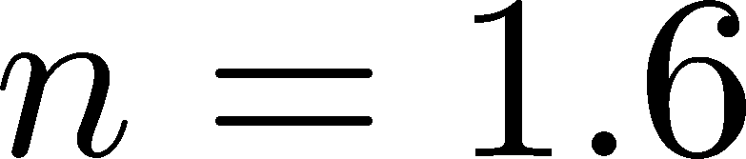
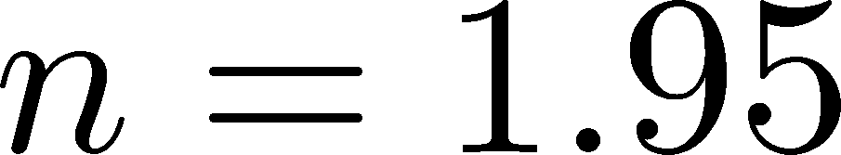

$n$ Dependence
The value of $n$ can be constrained by the high-T behavior.

Slide 42

Summary
Lattice thermodynamics in SU(3) YM with periodic BC have peculiar behaviors:
Medium at 1.4<T/T_{c}<2.1 is remarkably insensitive to the boundary.
Slow approach to the SB limit at small $L_{τ}, L_{x}$.
Our model with two Polyakov loops explains the lattice results for $T≥1.5T_{c}$ qualitatively:
Interplay b/w two Polyakov loops plays a crucial role.
Appearance of new 1st-PT & CP is predicted.
Future
More lattice results
Anti-periodic / Dirichlet BCs, BC for two directions, below T_{c}, …

Slide 43
backup

Slide 44



Extrapolations t→0, a→0
O(t) terms in SFTE
lattice discretization
FlowQCD2016
This Study
①Continuum
②Small t extrapol.
strong
discretization
effect
strong
discretization
effect

Slide 45
energy densty / transverse P
Energy Density
Transverse Pressure P_{z}

Slide 46





Gradient Flow Method
lattice regularized
gauge theory
Smeared world
by gradient flow
gradient flow
continuum theory
gradient flow
Measure on
the lattice
analytic relation
Take Extrapolation (t,a)→(0,0)
O(t) terms in SFTE
lattice discretization

Slide 47






Two Special Cases with PBC
In conformal (Σ_{μ}T_{μμ}=0)

Slide 48



EMT on the Lattice: Conventional
Lattice EMT Operator
Caracciolo+, 1990
Fit to thermodynamics: Z₃, Z₁
Shifted-boundary method: Z₆, Z₃
Giusti, Meyer, 2011; 2013;
Giusti, Pepe, 2014~; Borsanyi+, 2018
Multi-level algorithm
effective in reducing statistical error of correlator
Meyer, 2007;
Borsanyi, 2018;
Astrakhantsev+, 2018

Slide 49





Perturbative Coefficients
Suzuki, PTEP 2013, 083B03
Harlander+, 1808.09837
Iritani, MK, Suzuki, Takaura, PTEP 2019
LO
1-loop
2-loop
3-loop
×
Iritani, MK, Suzuki,
Takaura, 2019
zero
Suzuki (2013)
Harlander+(2018)
Choice of the scale of g²
Previous:
Improved:
Harlander+ (2018)

Slide 50
Higher Order Coefficient: ε+p
NLO (1-loop)
N²LO (2-loop)
Range2
Range2
Range1
Range1
Range3
Range3
Iritani, MK, Suzuki, Takaura, PTEP 2019
t dependence becomes milder with higher order coeff.
Better t→0 extrapolation
Systematic error: μ₀ or μ_{d}, uncertaintyof Λ (±3%), fit range
Extrapolation func: linear, higher order term in c₁ (~g⁶)

Slide 51

Small-t Extrapolation
Filled: N_{t}=16 / Open: N_{t}=12
Small-t extrapolation
Solid: N_{t}=16, Range-1
Dotted: N_{t}=16, Range-2,3
Dashed: N_{t}=12, Range-1
Stable small-t extrapolation
No N_{t} dependence within statistics for L_{x}T=1, 1.5

Slide 52
Small-t Extrapolation
Filled: N_{t}=16 / Open: N_{t}=12
Small-t extrapolation
Solid: N_{t}=16, Range-1
Dotted: N_{t}=16, Range-2,3
Dashed: N_{t}=12, Range-1
Stable small-t extrapolation
No N_{t} dependence within statistics for L_{x}T=1, 1.5

