Slide 1
J-PARC-HI: Theory
Masakiyo Kitazawa
(YITP, Kyoto)
Workshop on nuclear physics with heavy ion reaction and related topics, 2023/9/30, Tohoku University
ATHIC2023, Apr. 27, 2023, Hiroshima
Photo: J-PARC Main Ring

Slide 2
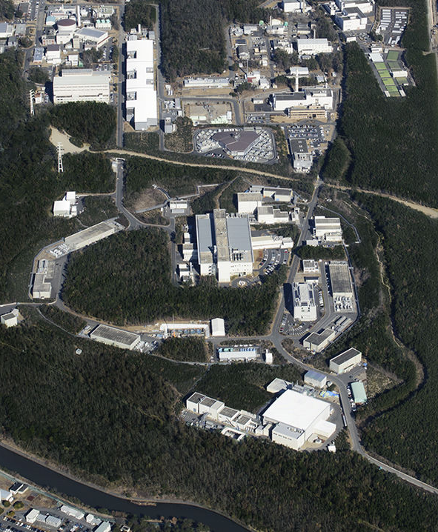
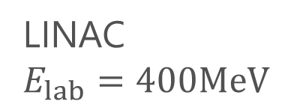
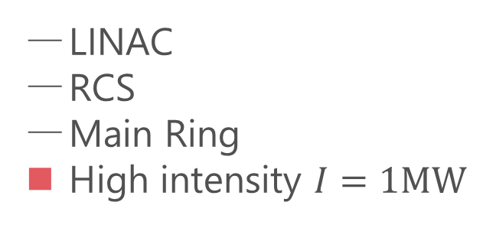

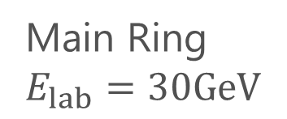
LINAC
$E_{lab}=400MeV$
Accelerators
LINAC
RCS
Main Ring
High intensity $I=1MW$
RCS
$E_{lab}=3GeV$
Purposes
Hadron/Nuclear physics
Neutrino physics
Material/Life science
Main Ring
$E_{lab}=30GeV$
Hadron hall

Slide 3
LINAC
$E_{lab}=400MeV$
Accelerators
LINAC
RCS
Main Ring
High intensity $I=1MW$
HI-injector
RCS
$E_{lab}=3GeV$
Purposes
Hadron/Nuclear physics
Neutrino physics
Material/Life science
Main Ring
$E_{lab}=30GeV$
J-PARC-HI
J-PARC Heavy Ion
High intensity
Hadron hall
Intermediate eneargy

Slide 4





History / Current Status of HIC
LHC
2010~
RHIC
2000~
SPS
Increasing Collision Energy
NA61/SHINE
~2000
RHIC-BES
AGS
FAIR-CBM
~1996
HADES

Slide 5
History / Current Status of HIC
LHC
J-PARC-HI
2010~
FAIR-CBM
Galatyuk, NPA982, 163
RHIC
NICA
2000~
HADES
NA61/SHINE
Beam-Energy
Scan
RHIC-BES-FXT
SPS
RHIC-BES
Increasing Collision Energy
NA61/SHINE
~2000
RHIC-BES
AGS
FAIR-CBM
~1996
HADES
2010~

Slide 6
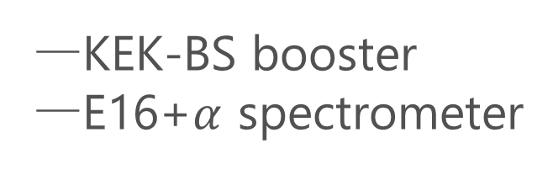
J-PARC-HI Staging Plan
Phase-II
Phase-I
KEK-BS booster
E16+$α$ spectrometer
Phase-I
Phase-II
NEW HI booster
NEW spectrometer

Slide 7
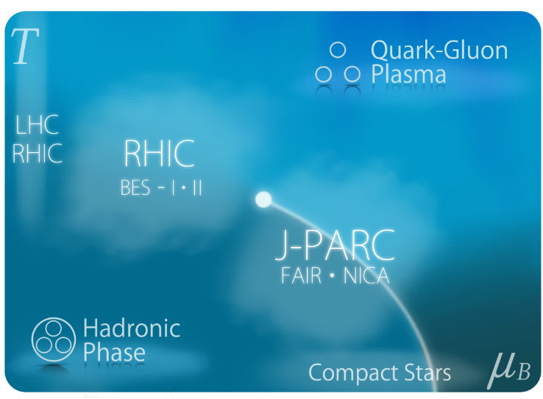

Physics Goals
Exploring
Extremely Dense Medium
Search for
Rare Hadronic/Hypernuclear
Events

Slide 8

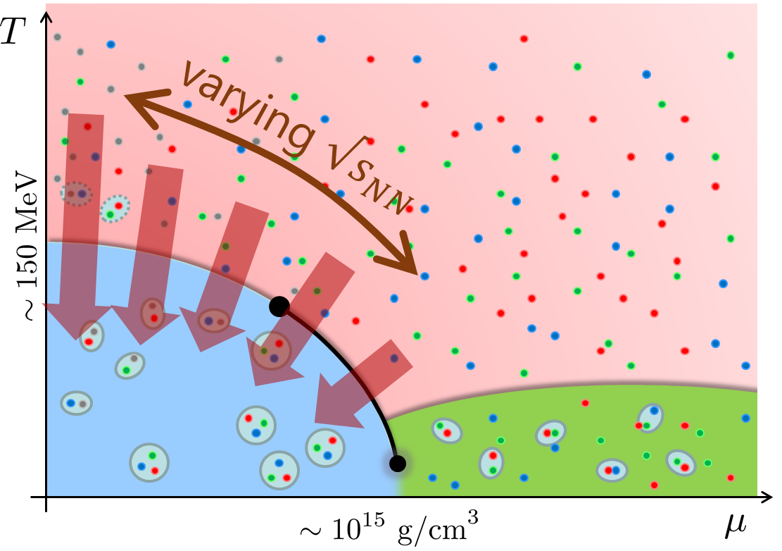
Beam-Energy Scan
STAR, 2012
High E
Low E
Baryon stopping

Slide 9
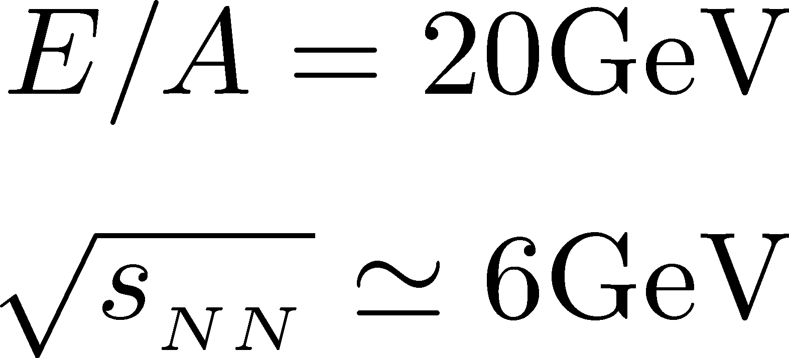


J-PARC-HI = Highest Baryon Density
Ohnishi, 2002

Slide 10

Exploring Dense Medium
Neutron stars
Equation of state
QCD critical point /
1st order transition /
Color superconductivity
Dilepton production rate
Event selection /
Higher correlations

Slide 11

Hadron/Hypernuclear Physics
Hypernuclei
Correlation functions
→hadron interaction
STAR,2015
¹²C+¹²C at 15AGeV
(5T / 2.4m magnet)

Slide 12
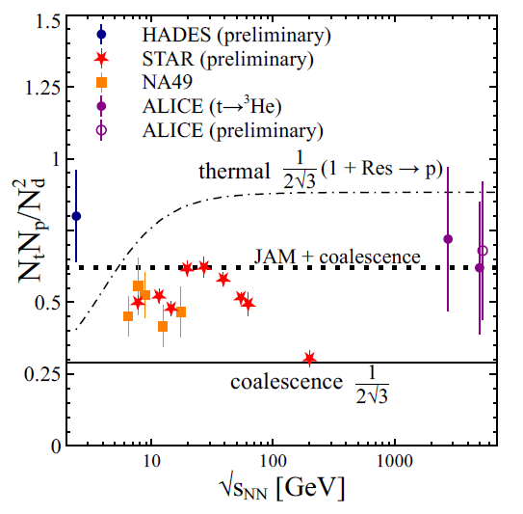
Production Mechanism
Light-nuclei production
as a signal of QCD critical point
Oliinychenko (’20)
baryon fluctuations
→ enhancement of light nuclei?
Sun+ (’18)

Slide 13
Production Mechanism
Light-nuclei production
Measurement of light/hyper-nuclei
as a signal of QCD critical point
from QM2023
Oliinychenko (’20)
baryon fluctuations
→ enhancement of light nuclei?
Precise data will lead us to a better understanding of production mechanism
Sun+ (’18)

Slide 14
Event-by-event Fluctuations
of Conserved Charges

Slide 15
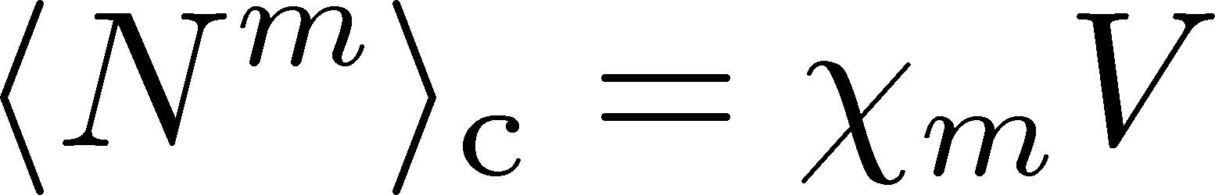
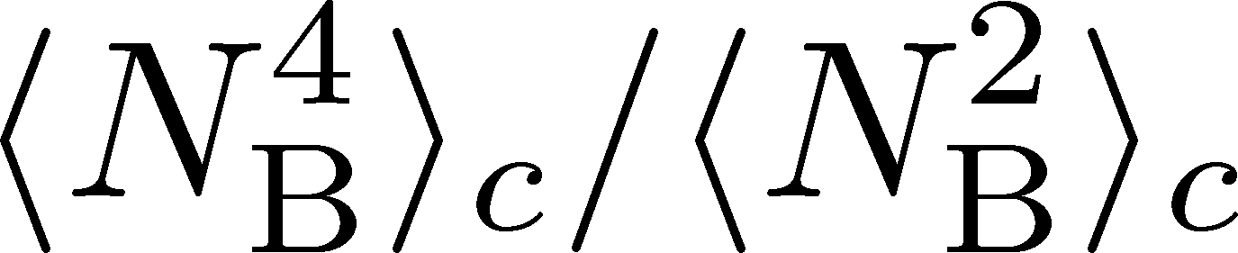


Fluctuations, Cumulants of Conserved Charges
Divergence and sign change at the QCD-CP. Stephanov,’09; Asakawa, Ejiri, MK,’09
Volume dependence is canceled out in ratio. Ejiri, Karsch, Redlich,’05
Direct comparison with lattice QCD simulations.
Slower diffusion.
HOT-QCD 2017
Asakawa, Ejiri, MK (2009)
Stephanov (2011)

Slide 16
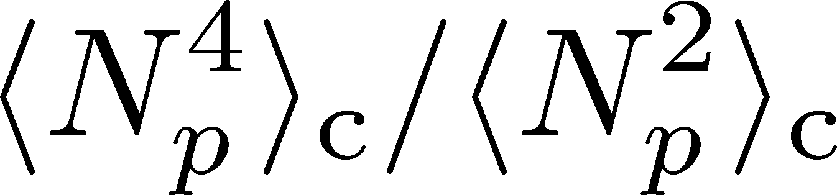
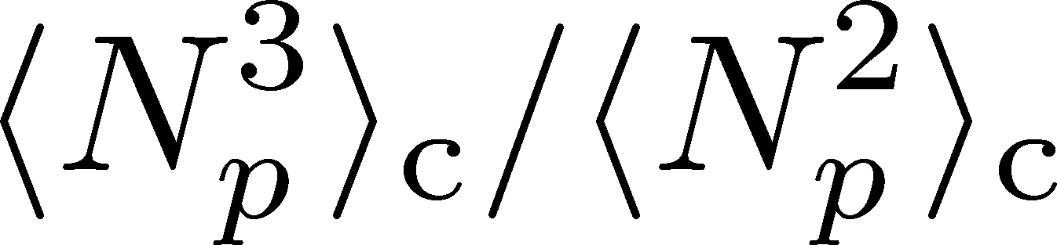
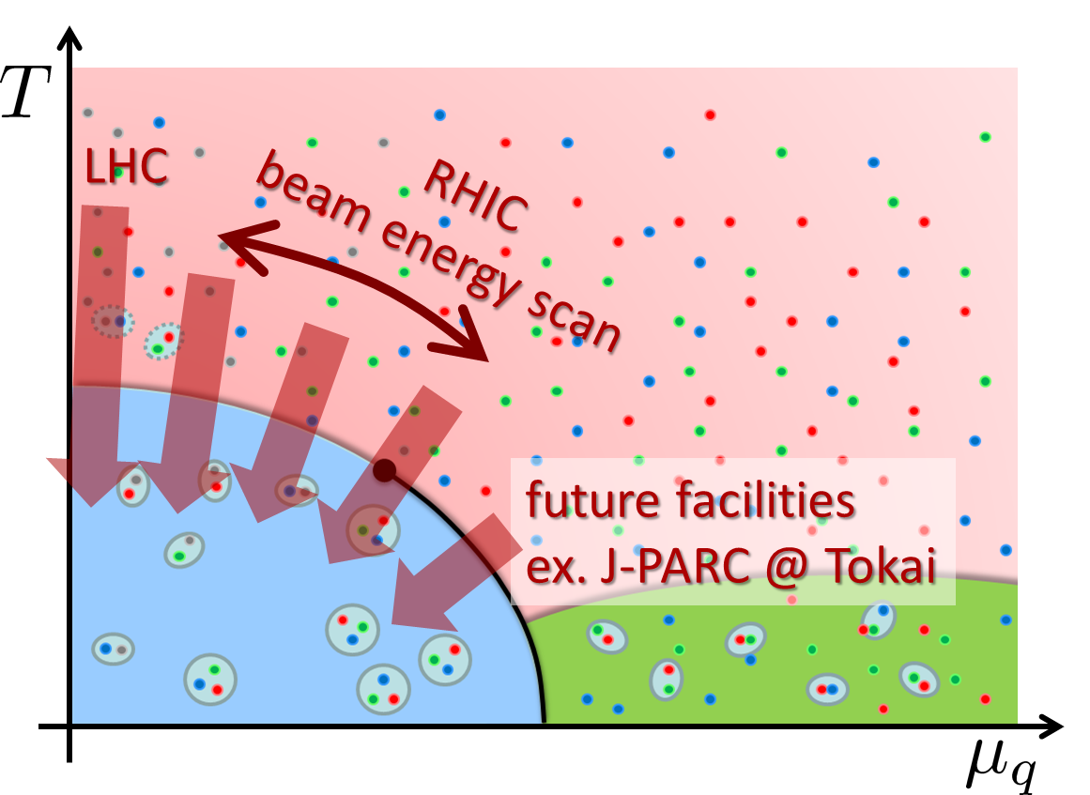
Experimental Results
Net-proton number cumulants
STAR, 2020 (2001.02852)
Non-Poisson and non-monotonic behaviors of the higher order cumulants.
Questions
When are these fluctuations generated?
Is the use of proton # cumulants as a proxy of baryon’s justified?

Slide 17
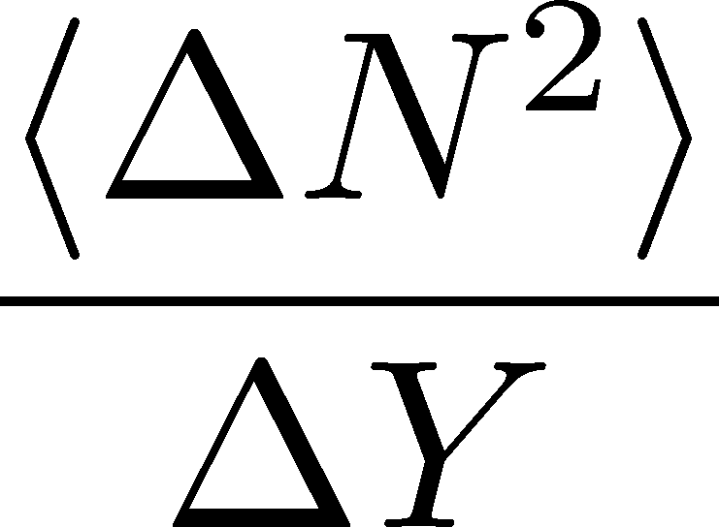

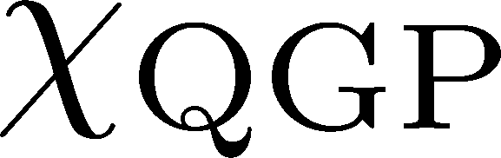

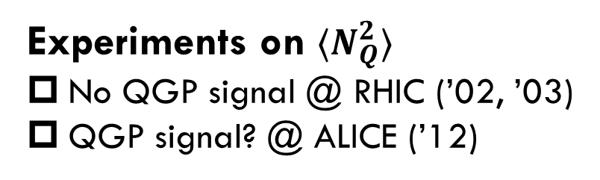
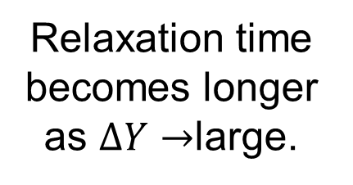
Evolution of Conserved-charge Fluctuations
Quark-Gluon Plasma
Fluctuations of CC are modified by the diffusion.
Hadronization
Relaxation time becomes longer as $ΔY→$large.
Freezeout
Experiments on $⟨N_{Q}^{2}⟩$
No QGP signal @ RHIC (’02, ’03)
QGP signal? @ ALICE (’12)
Asakawa, Heinz, Muller, 2000
Jeon, Koch, 2000; Shuryak, Stephanov, 2001

Slide 18

Electric-charge Fluctuations: Wider $Δη$
D-measure
CMS, QM2023
ALICE, PRL(’12)
D-measure
D ~ 3-4 Hadronic
D ~ 1-1.5 Quark

Slide 19

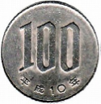
Nucleon’s Isospin as Two Sides of a Coin
a coin
N
p
n
Nucleons have
two isospin states.
Coins have two sides.
MK, Asakawa, 2012;2012

Slide 20



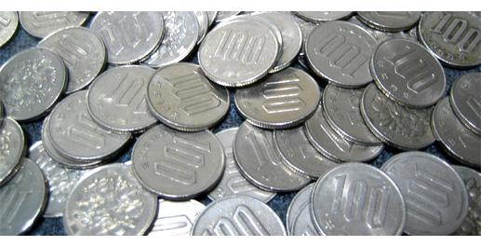
Slot Machine Analogy
Fixed # of coins
P (N)
P (N)
N
N
P (N)
P (N)
N
N

Slide 21


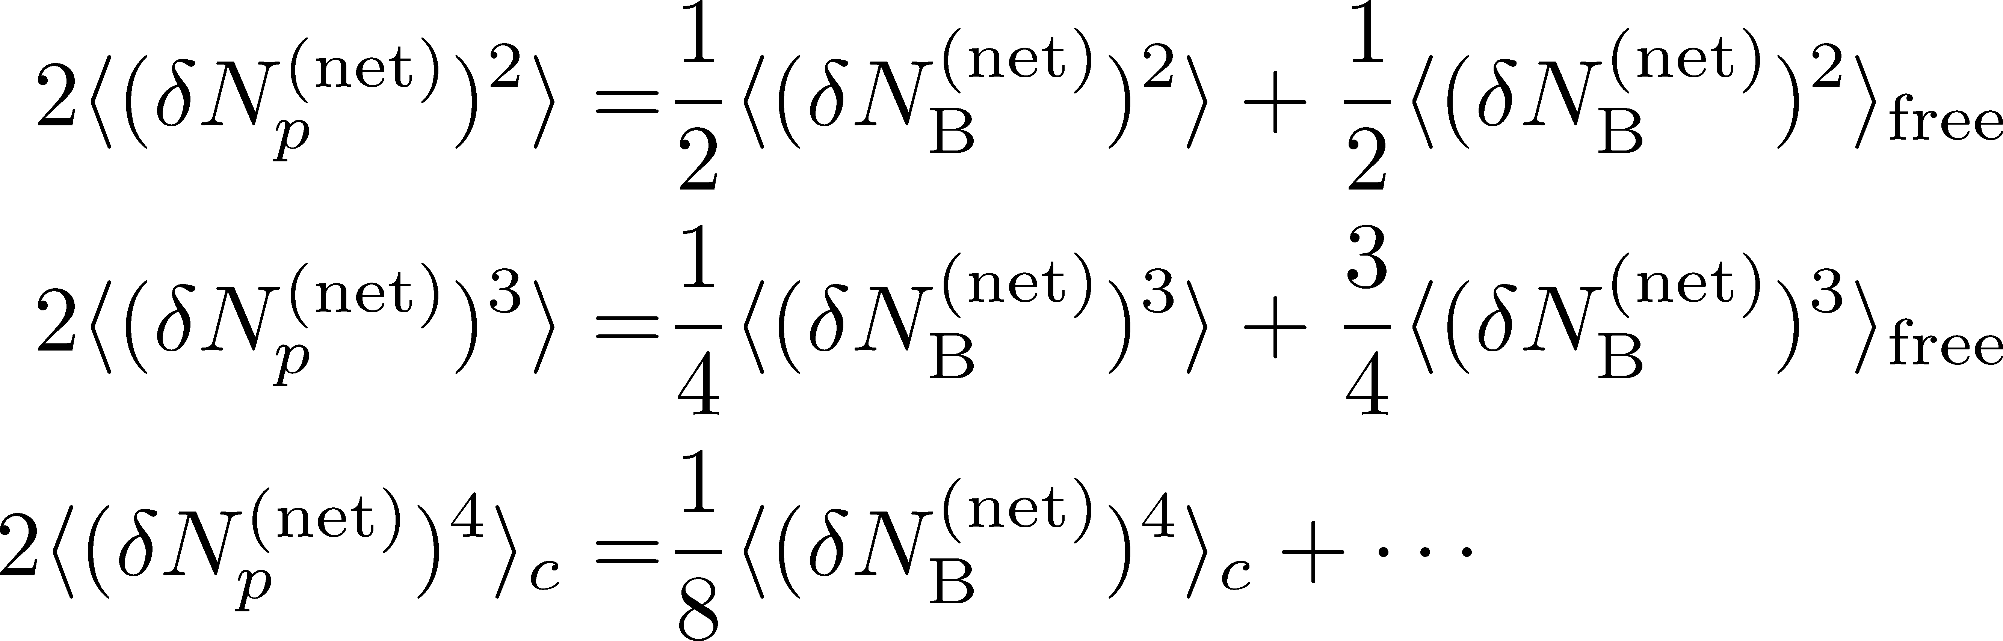
Reconstruction of Total Coin #
P (N )= P (N )B_{1/2}(N ;N )
= +
Example
genuine info.
Poisson noise
Note: Higher order cumulants are more fragile.
MK, Asakawa, 2012;2012

Slide 22

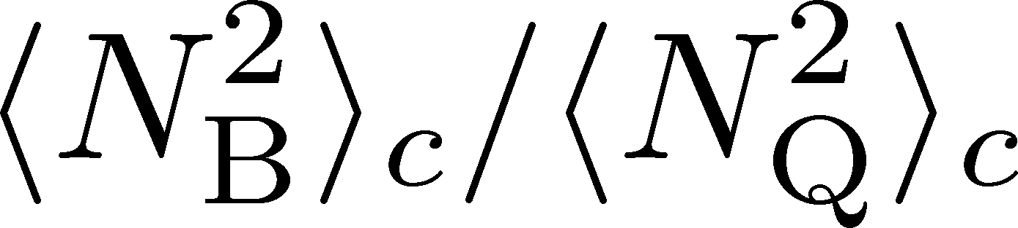
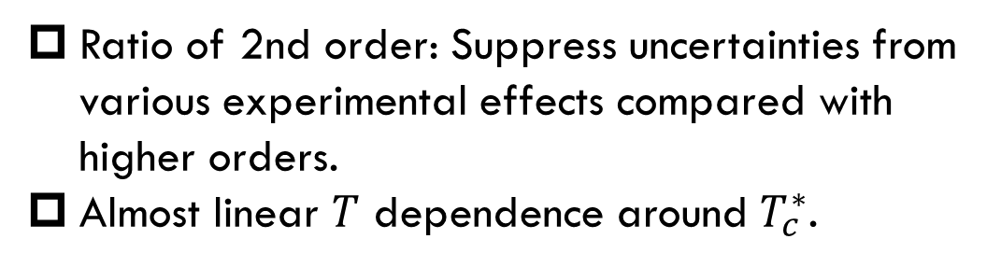
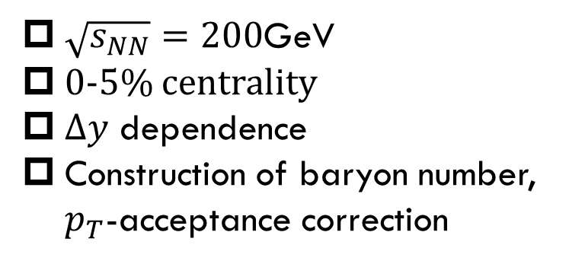
MK, Esumi, Nonaka, 2205.10030
$\sqrt{s_{NN}}=200$GeV
0-5% centrality
$Δy$ dependence
Construction of baryon number, $p_{T}$-acceptance correction
Ratio of 2nd order: Suppress uncertainties from various experimental effects compared with higher orders.
Almost linear $T$ dependence around $T_{c}^{∗}$.
Data from
HotQCD,
PRD104 (’21)
HOT-QCD 2017

Slide 23
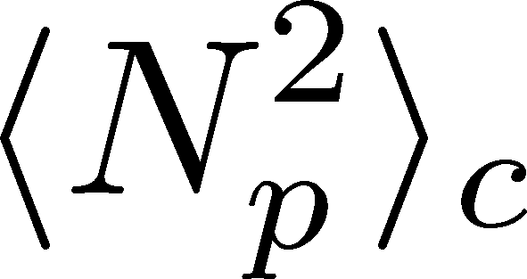
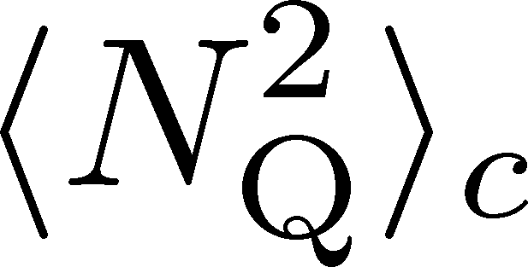
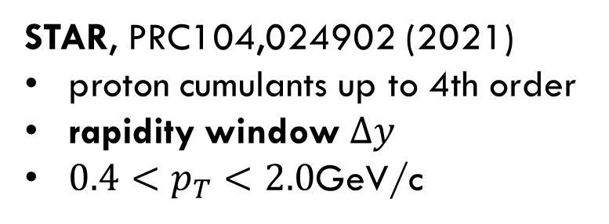
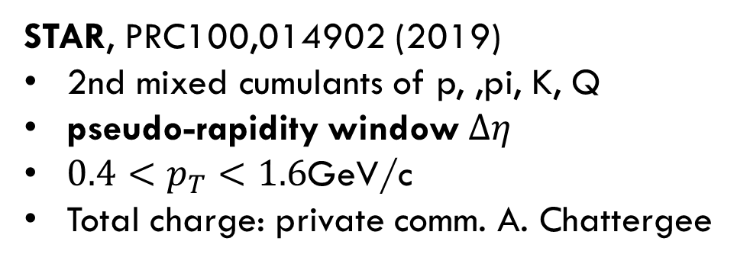
Experimental Data
$\sqrt{s_{NN}}=200$GeV
0-5% centrality
$Δy$ dependence
Construction of baryon number, $p_{T}$-acceptance correction
STAR, PRC104,024902 (2021)
proton cumulants up to 4th order
rapidity window $Δy$
$0.4<p_{T}<2.0$GeV/c
STAR, PRC100,014902 (2019)
2nd mixed cumulants of p, ,pi, K, Q
pseudo-rapidity window $Δη$
$0.4<p_{T}<1.6$GeV/c
Total charge: private comm. A. Chattergee
proton → baryon cumulants MK, Asakawa,’12;’12
Rapidity is better than pseudo-rapidity
Wider acceptance is more desirable.
Ohnishi, MK, Asakawa, ’16

Slide 24
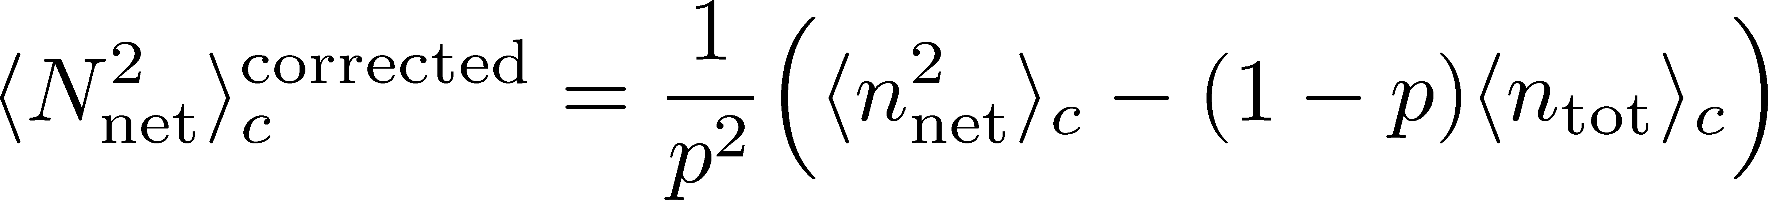
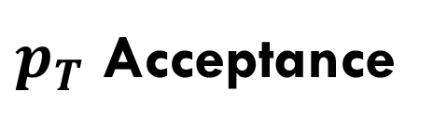


$pT$-Acceptance Correction
$p_{T}$ Acceptance
0.4<p_{T}<1.6 [GeV/c]
0.4<p_{T}<2.0 [GeV/c]
PRC100,014902(’19)
PRC104,024902(’21)
Particles in $p_{T}$ space
Electric charge: 49%
Protons: 82%
blast wave model @ √s_{NN}=200 GeV
Modification by $p_{T}$-cut should be corrected.
This study: Binomial distribution model.
MK, Asakawa, ’12, ’12

Slide 25
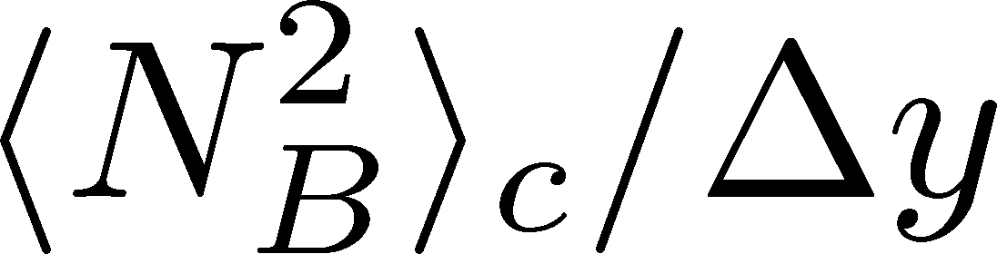
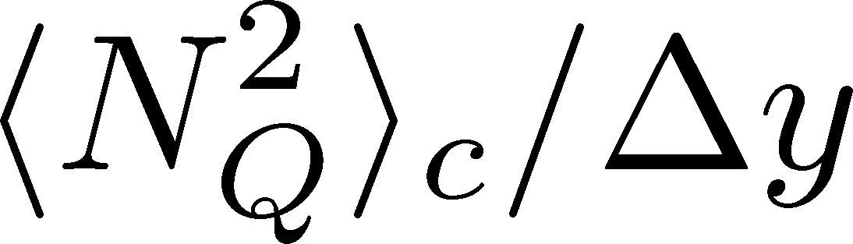

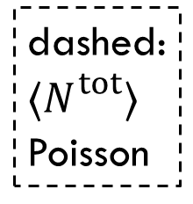
Cumulants: Proton→Baryon & Acceptance Correction
Data from STAR, ’19, ’21
corrected
dashed:
$⟨N_{}^{tot}⟩$
Poisson
suppress
corrected
uncorrected
uncorrected
$${\left\langle N_{p}^{2}\right\rangle }_{c}$$
Deviation from Poissonian is clarified by the acceptance correction.
MK, Asakawa, ’12, ’12

Slide 26
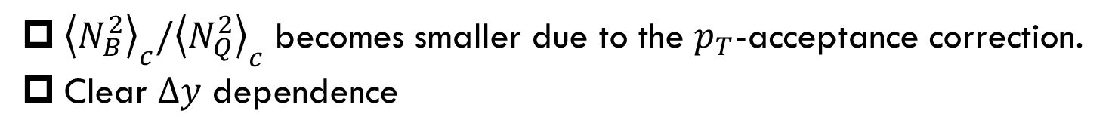

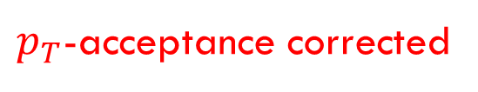
$p_{T}$-acceptance uncorrected
$p_{T}$-acceptance corrected
dashed:
Poisson
${\left\langle N_{B}^{2}\right\rangle }_{c}/{\left\langle N_{Q}^{2}\right\rangle }_{c}$ becomes smaller due to the $p_{T}$-acceptance correction.
Clear $Δy$ dependence
non-thermal effects behind fluctuations

Slide 27
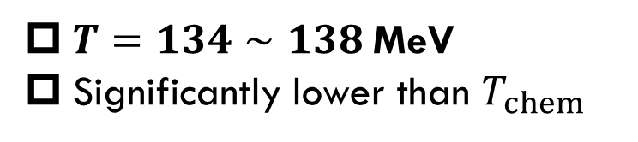
HIC vs HRG&LAT
From data @ STAR
HRG+Lattice
Data from
HotQCD, PRD104 (’21)
$T=134∼138$MeV
Significantly lower than $T_{chem}$
HRG: QMHRG2020
Bollweg+, PRD104, 7 (’21)
Volume dep. corrected
plot by MK

Slide 28
HIC vs HRG&LAT
From data @ STAR
HRG+Lattice
Data from
HotQCD, PRD104 (’21)
$T=134∼138$MeV
Significantly lower than $T_{chem}$
HRG: QMHRG2020
Bollweg+, PRD104, 7 (’21)
Volume dep. corrected
plot by MK

Slide 29
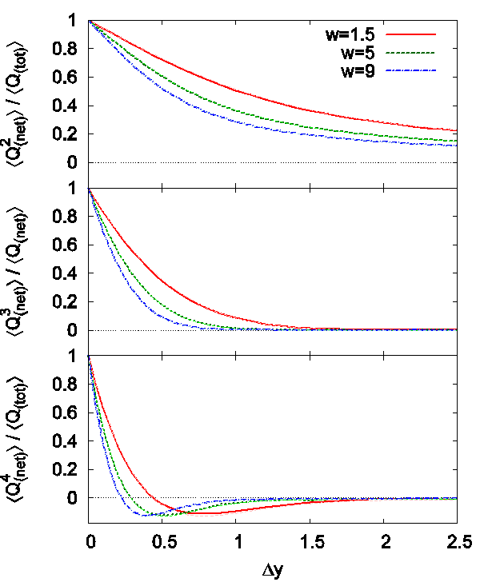

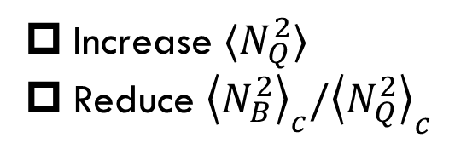

Effect of Diffusion and Rapidity Conversion
Ohnishi, MK, Asakawa, PRC (‘16)
Blurring due to diffusion & rapidity conversion ($Y→y$)
Stronger modification in Q than B
Resonance Decays
About 30% charged particles come from RD
Enhancement of charged particles
Increase $⟨N_{Q}^{2}⟩$
Reduce ${\left\langle N_{B}^{2}\right\rangle }_{c}/{\left\langle N_{Q}^{2}\right\rangle }_{c}$
These effects will be more important for higher order cumulants!

Slide 30
Dilepton Production
as experimental observables of
Color Superconductivity & QCD-CP
Nishimura, MK, Kunihiro, PTEP2022, 093D02
Nishimura, MK, Kunihiro, PTEP2023, 053D01

Slide 31
Observing CSC in HIC
Difficulties
  CSC would not be created if Tc is not high enough.
  Even if created, its lifetime would be short.
  Since CSC is created in the early stage, its signal would be blurred during the evolution in later stage.
Strategy in the present study:
  Use dilepton production as an observable
  Focus on precursory phenomena of CSC
Ohnishi, 2002

Slide 32
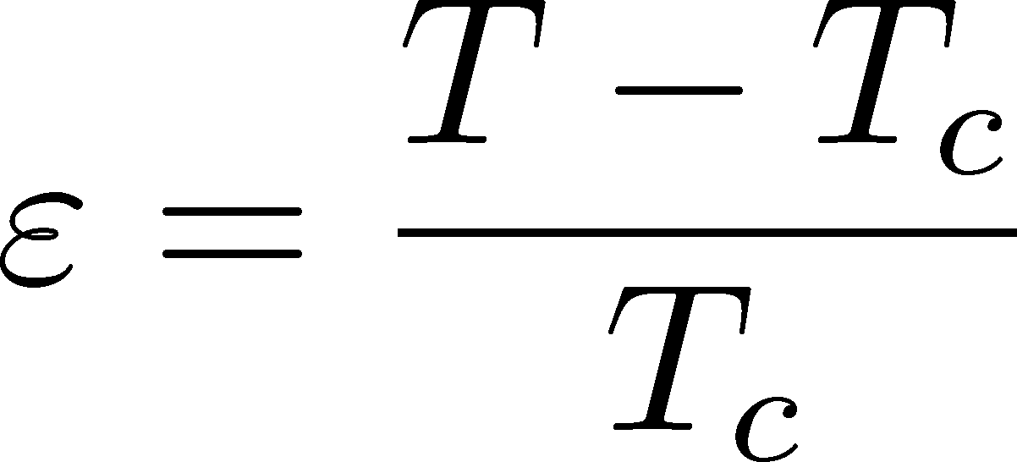


Precursor of CSC
Anomalous behavior of observables near but above Tc of SC
electric conductivity
magnetic susceptibility
pseudogap
Electric conductivity
Skopal, Tinkham(‘75)
Enhanced pair fluctuations is one of the origins of precursory phenomena.
More significant phenomena in strongly-coupled systems.
T>Tc
Landau’s free energy
T<Tc

Slide 33

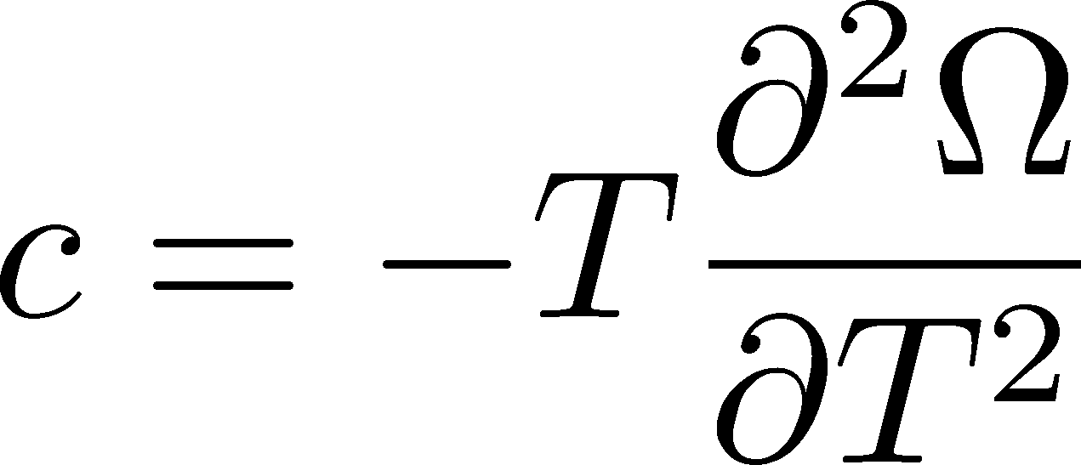
Precursor of Color Superconductivity
MK, Koide, Kunihiro, Nemoto, ’03, ‘05
Thermodynamic Potential
Pseudogap
Specific heat
density of states
Depression
in DoS above Tc

Slide 34
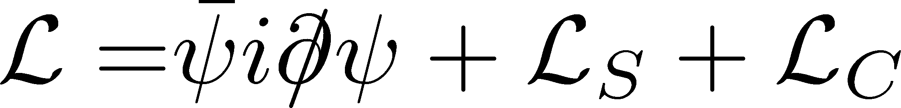
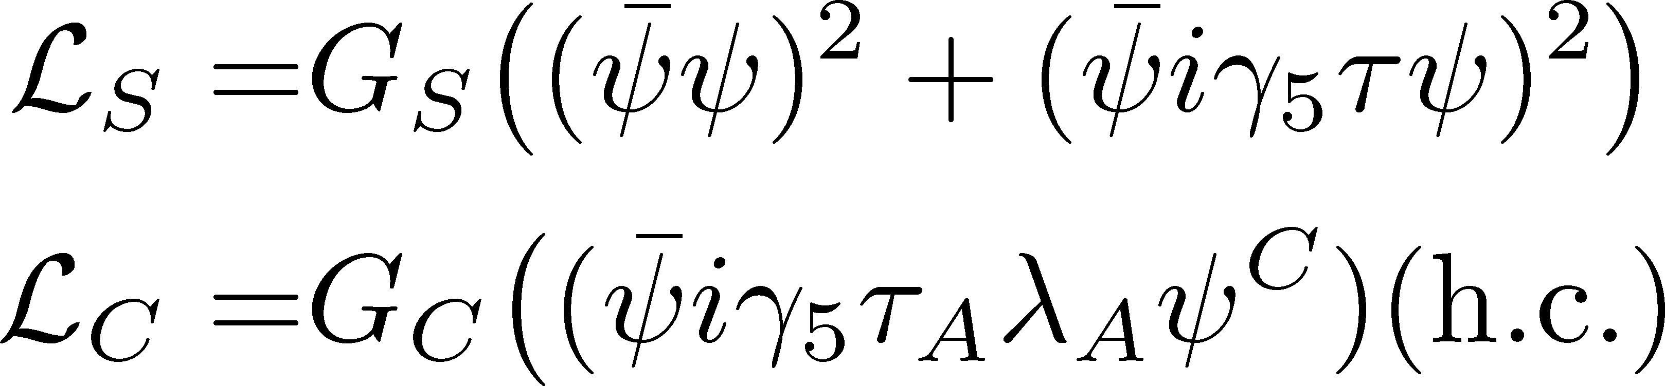
Model
NJL model (2-flavor)
Phase Diagram in MFA
diquark interaction
Parameters
Order of phase transition
  2nd in the MFA
  can be 1st due to gauge fluctuation
Matsuura+(’04), Giannakis+(’04)
Noronha+(’06), Fejos, Yamamoto(’19)

Slide 35
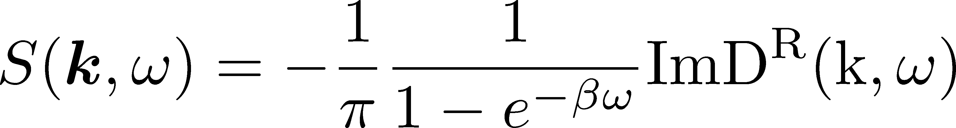

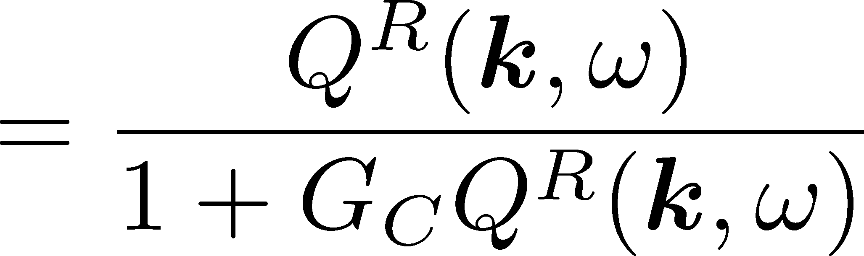




Di-quark Fluctuations
Diquark Propagator
Dynamical Structure Factor
Random Phase Approximaion
$$=$$
$$+$$
$$+ ∙∙∙$$
Diquark field becomes massless at T=Tc
Soft mode of CSC transition
Strength in the space-like region
MK, Koide, Kunihiro, Nemoto, ’01,’05

Slide 36

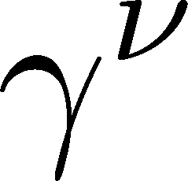
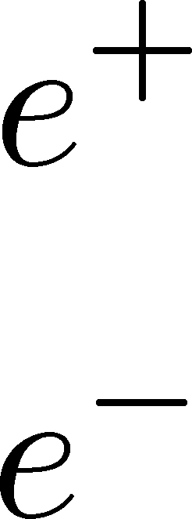
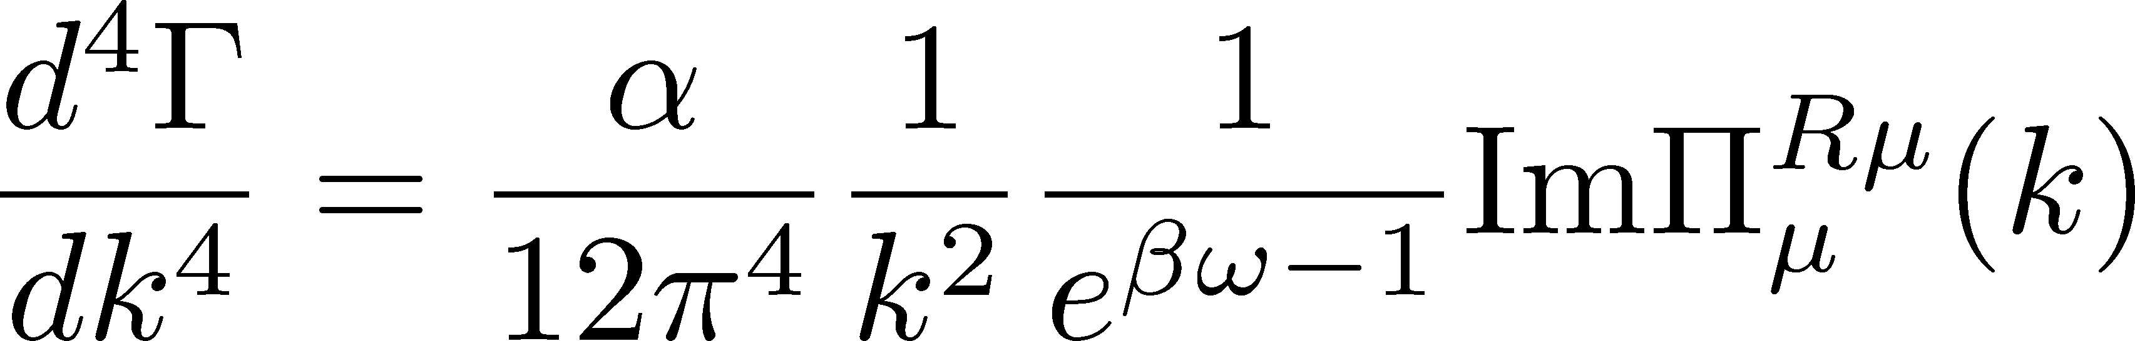
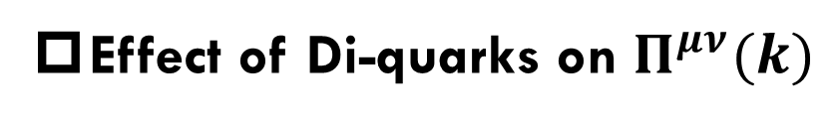
Photon Self-Energy: Precursor of CSC
Dilepton Production Rate
Effect of Di-quarks on $Π^{μν}(k)$
Aslamasov-Larkin term
Maki-Thompson term
DPR from CFL phase
Jaikumar, Rapp, Zahed (’02)
Well-known diagrams in metallic SC
for describing paraconductivity

Slide 37
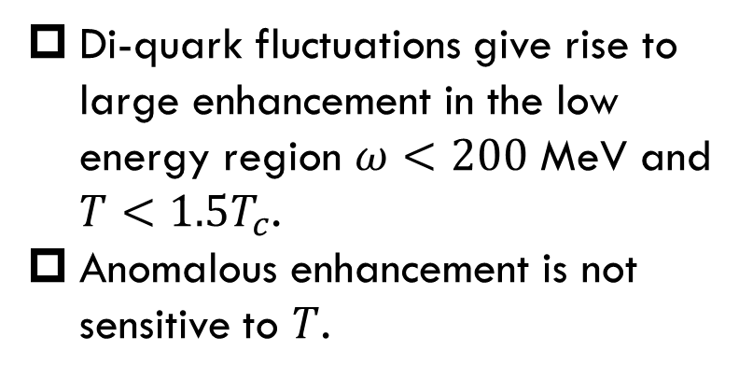

Production Rate at $k=0$
Nishimura, MK, Kunihiro (’22)
Red: fluctuation contribution
Blue: free quarks
$G_{C}=0.7G_{s}$, $T_{c}≃45$ MeV
enhancement
Di-quark fluctuations give rise to large enhancement in the low energy region $ω<200$ MeV and $T<1.5T_{c}$.
Anomalous enhancement is not sensitive to $T$.

Slide 38
Invariant-Mass Spectrum
Nishimura, MK, Kunihiro (’22)
Strong enhancement at low invariant mass.
Observable in the HIC?

Slide 39





Dileptons from QCD Critical Point
NJL model (2-flavor)
Parameters
Soft Mode of QCD-CP
= fluctuation of scalar ($\overline{q}q$) channel
Modification of dilepton production through
Random Phase Approximaion
$$=$$
$$+$$
$$+ ∙∙∙$$
+$⋯$
MT, DoS

Slide 40


Dilepton production rate near QCD-CP
Invariant mass spectrum
Nishimura, MK, Kunihiro (’23)
for fixed chem. pot.: $μ=μ_{c}$
Enhancement at low $M_{ll}$ region near QCD-CP
Distinguishment from diquark soft mode may be difficult.

Slide 41
Event Selection

Slide 42



Sophisticated Event Selections
average transverse energy
Maximum baryon density has large event-by-event fluctuations
Ohnishi, 2002
Density Scan
Baryon-rich events
Baryon-rich
events
directed flow
Baryon-rich
events
Event selection in terms of maximum baryon density (or, correlation analysis) should be a useful tool.

Slide 43
Nuclear Liquid-Gas Phase Transition
Pochodzalla+, PRL, 75, 1040 (‘95)

Slide 44
Nuclear Liquid-Gas Phase Transition
Pochodzalla+, PRL, 75, 1040 (‘95)
Experiment:
Spectator
E/A=600MeV
measure all fragments
energy of the spectator
Similar analysis in relativistic HIC requires event-by-event total energy of the fireball.

Slide 45
Summary
Beam-energy scan will reveal phase transitions in dense QCD.
J-PARC-HI will play an invaluable role in the future development.
Many interesting observables to reveal the QCD phase diagram:
  Event-by-event fluctuations of conserved charges
  Dilepton production at ultra-low-mass-region
  Event selection via baryon/energy density
  Light/hyper-nuclei production

Slide 46







J-PARC-HI Collaboration
Hiroyuki Sako
Taku Gunji
Kazuya Aoki
Shoji Nagamiya
MK
Kyoichiro Ozawa
Yudai Ichilawa
ShinIchi Esumi
Kazuhiro Tanaka
and 138 members in total
Exp.: J. K. Ahn , K. Aoki, S. Ashikaga, O. Busch, M. Chiu, T. Chujo , P. Cirkovic , T. Csorgo , D. Devetak , G. David, M. Djordjevic,
S. Esumi , P. Garg, R. Guernane , T. Gunji , T. Hachiya , H. Hamagaki , S. Hasegawa, B. S. Hong, S. H. Hwang, Y. Ichikawa, T. Ichisawa , K. Imai, M. Inaba, M. Kaneta , H. Kato, B. C. E. J. Kim, X. Luo, Y. Miake , J. Milosevic, D. Mishra, Y. Morino, L. Nadjdjerdj , S. Nagamiya , T. Nakamura, M. Naruki , K. Nishio , T. Nonaka, M. Ogino, K. Oyama , K. Ozawa, T. R. Saito, A. Sakaguchi , T. Sakaguchi , S. Sakai, H. Sako, K. Sato, S. Sato, S. Sawada, K. Shigaki , S. Shimansky , M. Shimomura, M. Stojanovic , H. Sugimura, Y. Takeuchi, H. Tamura, K. H. Tanaka, Y. Tanaka, K. Tanida, N. Xu, S. Yokkaichi, I. K. Yoo
Theor.: Y. Akamatsu, M. Asakawa, K. Fukushima, H. Fujii , T. Hatsuda , M. Harada, T. Hirano, K. Itakura M. Kitazawa , T. Maruyama , K. Morita, K. Murase A. Nakamura, Y. Nara, C. Nonaka, A. Ohnishi, M. Oka
Acc.: E. Chishiro , H. Harada, Y. Hashimoto, N. Hayashi, K. Hirano, H. Hotchi , K. Ishii, T. Ito, M. Kinsho , R. Kitamura, A. Kovalenko, J. Kamiya , N. Kikuzawa , T. Kimura, Y. Kondo, H. Kuboki , Y. Kurimoto, Y. Liu S. Meigo , A. Miura, T. Miyao , T. Morishita , Y. Morita, K. Moriya, R. Muto, T. Nakanoya , K. Niki, H. Oguri , C. Ohmori , A. Okabe, M. Okamura, P. K. Saha , K. Sato, Y. Sato, T. Shibata, T. Shimokawa , K. Shindo , S. Shinozaki, M. Shirakata , Y. Shobuda , K. Suganuma , Y. Sugiyama, H. Takahashi, T. Takayanagi , F. Tamura, J. Tamura, N. Tani , M. Tomisawa , T. Toyama, Y. Watanabe, K. Yamamoto, M. Yamamoto, M. Yoshii, M. Yoshimoto

Slide 47
J-PARC-HI
Future Plan

Slide 48
J-PARC-HI Staging Plan
Phase-II
Phase-I
KEK-BS booster
E16+$α$ spectrometer
Phase-I
Phase-II
NEW HI booster
NEW spectrometer

Slide 49







Staging of HI Booster
HI LINAC
Phase-I
LINAC
New
Building
RCS
60m
KEK 500MeV BS
REUSE
kept in working
condition
Main Ring

Slide 50


Staging of HI Booster
Phase-I
Phase-II
LINAC
New
Building
RCS
Completely NEW
HI booster
World highest intensity
60m
Main Ring
Interaction rate

Slide 51


Detector
Phase-I
E16 Spectrometer
$φ→e^{+}e^{−}$, $φ→K^{+}K^{−}$
In-medium mass modification
Pilot data taking in June
UPGRADE
E16+$α$
Upgrade forward region for high-multiplicity counting
Hadron/lepton measurement
at wide acceptance

Slide 52




Detector
Phase-II
Dimuon Setup
4$π$ acceptance, high-intensity beam
  Precise measurement of fluctuations, dileptons
Detailed design are under discussion
Hadron calorimeter + hyper-nuclear measurement
acceptance
ALICE3-like dipole

Slide 53



Hadron Hall Extension
Present
Extended
E16
J-PARC-HI
Spectrometer
Top priority at KEK-PIP2022
J-PARC-HI spectrometer will be installed in an annex
E16

