Slide 1
Some Topics on 2nd Order Fluctuations
EMMI Rapid Reaction Task Force
Fluctuations and Correlations of conserved charges in nuclear collisions – Challenges and Future Prospects,
GSI, Darmstadt, Germany, 7 Nov. 2023
Masakiyo Kitazawa (YITP, Kyoto)

Slide 2
Contents
1 Why Fluctuations?
2 D-measure
3 Baryon/Charge cumulant ratio at second order
MK, in progress for progress
MK, Esumi, Nonaka, 2205.10030

Slide 3

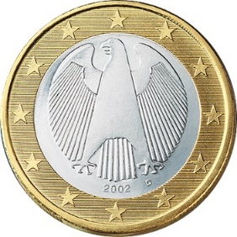
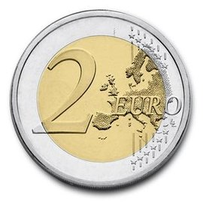

A Coin Game
Bet 25 Euro
You get head coins of
A. 50 x 1 Euro
B. 25 x 2 Euro
Same expectation value.

Slide 4
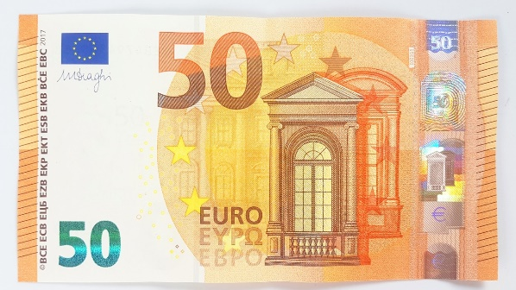
A Coin Game
Bet 25 Euro
You get head coins of
A. 50 x 1 Euro
B. 25 x 2 Euro
C. 1 x 50 Euro
Same expectation value.
But, different fluctuation.

Slide 5
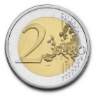

Fluctuations in HIC @ 2nd Order
Search for QCD CP
Onset of QGP
Fluctuation
increases
Fluctuation
decreases
Asakawa, Heinz, Muller, 2000;
Jeon, Koch, 2000
Stephanov, Rajagopal, Shuryak, 1998; 1999

Slide 6
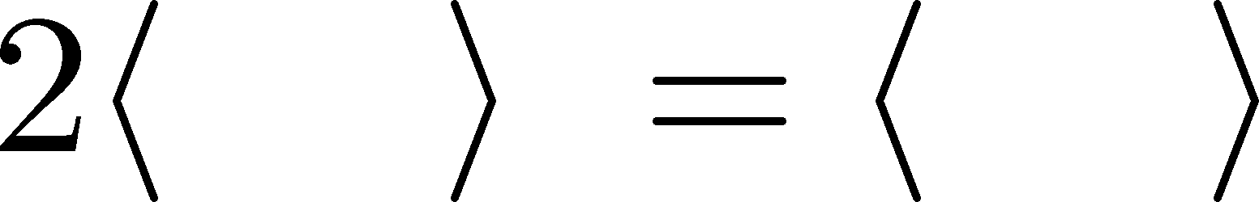

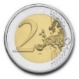
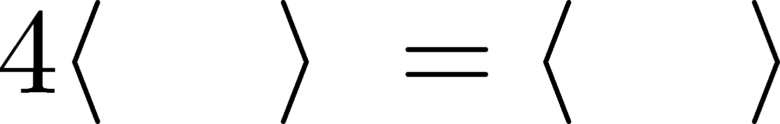
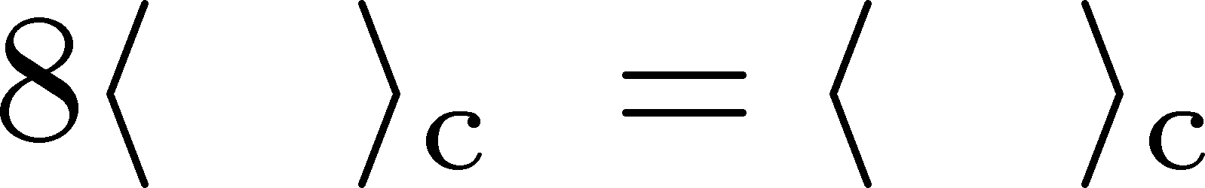
Higher Order Cumulants
A. 50 x 1 Euro
B. 25 x 2 Euro
δ€²
δ€²
δ€³
δ€³
€⁴
€⁴
Asakawa, MK,
PPNP 90, 299
(2016)

Slide 7
Non-Gaussian Fluctuations
Onset of QGP
Search for QCD CP
Fluctuation
decreases
Fluctuation
increases
Ejiri, Karsch, Redlich, 2006
Stephanov, 2009

Slide 8

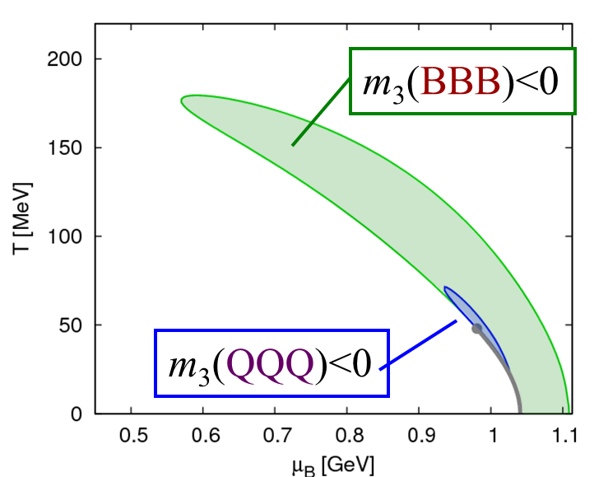

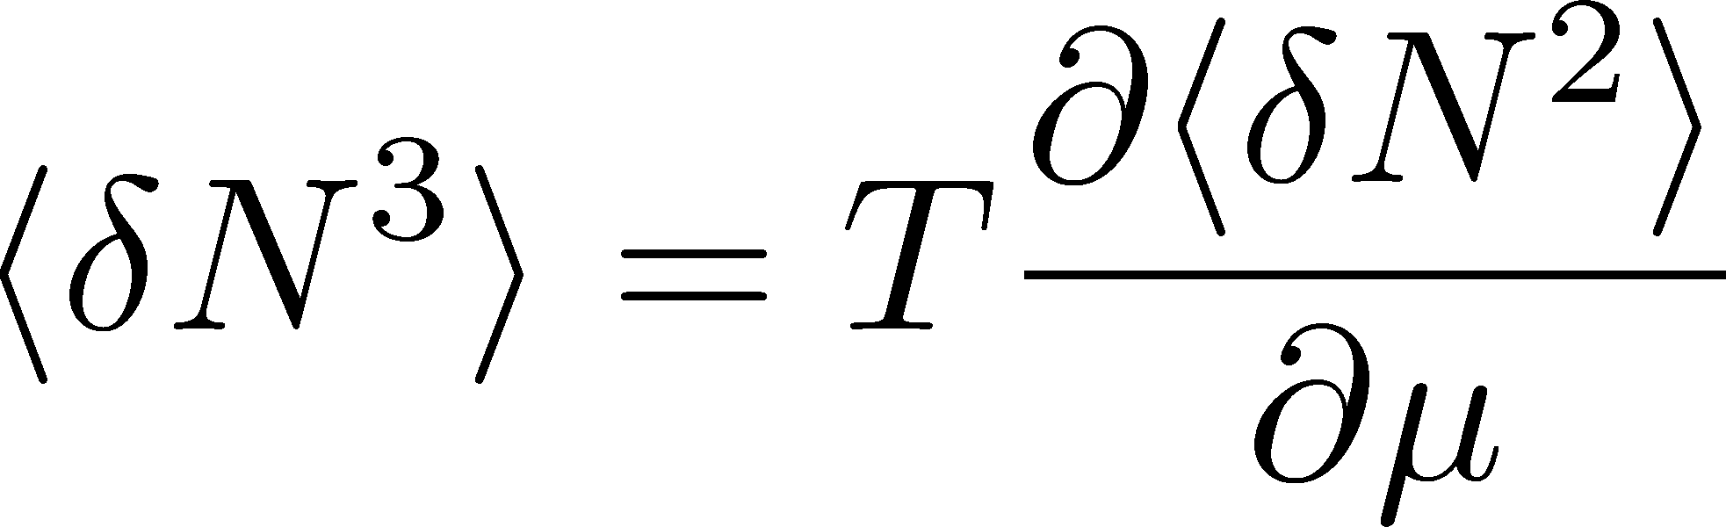

Sign of Higher Order Cumulants
Geometric Interpretation
Asakawa, Ejiri, MK, 2009
Asakawa, Ejiri, MK, 2009
Stephanov, 2011;
Friman, Karsch, Redlich, Skokov, 2011; …

Slide 9
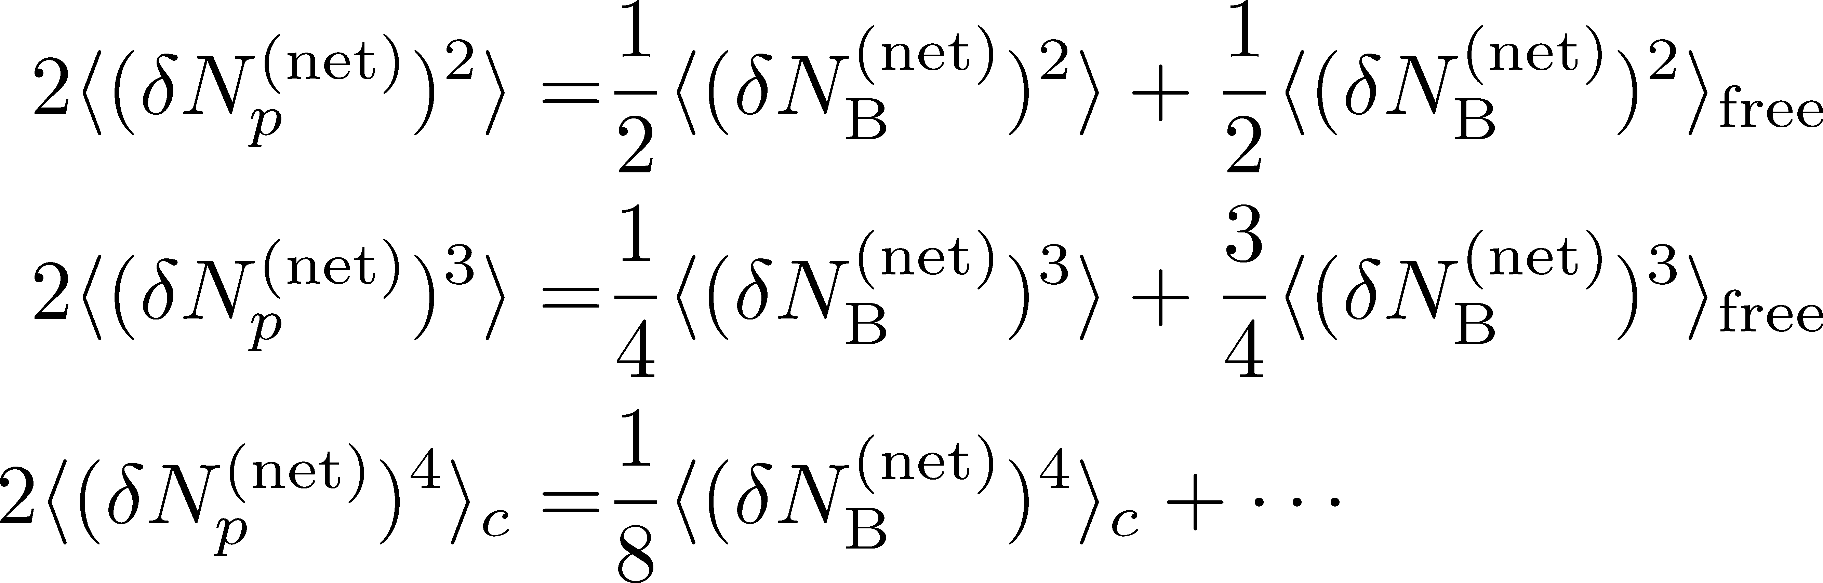
Fragile Higher Order Cumulants
Ex.: Relation b/w baryon & proton # cumulants
(with approximations)
MK, Asakawa, 2012
genuine info.
Poisson noise
Higher orders are more seriously affected by efficiency loss.
Volume fluctuations are another source of the modification.

Slide 10
Contents
1 Why Fluctuations?
2 D-measure
3 Baryon/Charge cumulant ratio at second order
MK, in progress for progress
MK, Esumi, Nonaka, 2205.10030

Slide 11
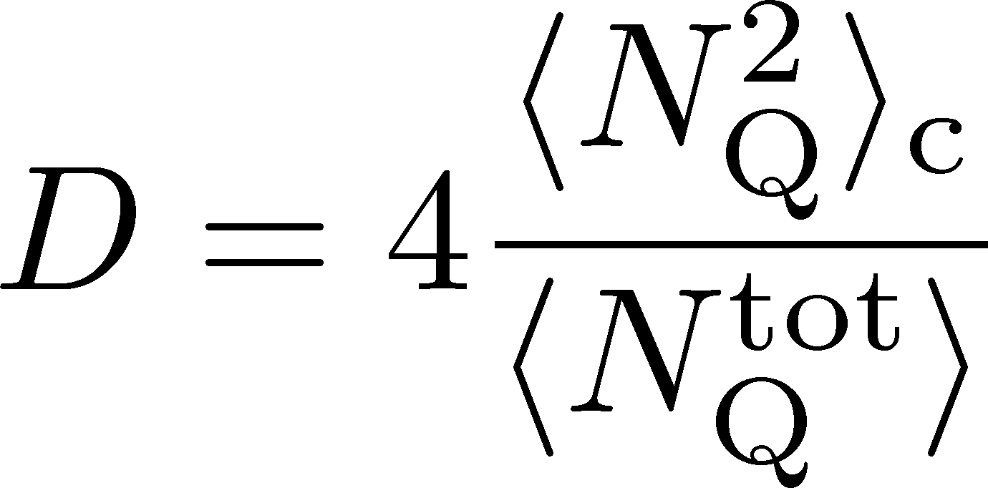



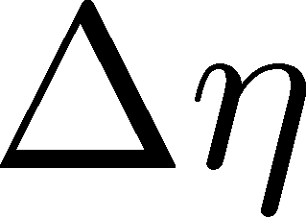
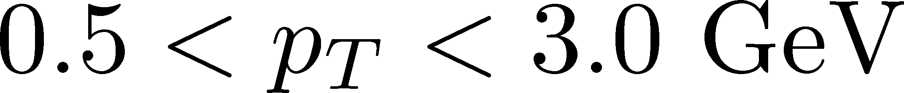
D-Measure = Net-charge Fluctuations
CMS (Tuo, QM2023)
D-measure
ALICE, PRL2013
Hadron gas
QGP
Jeon, Koch, 2000

Slide 12

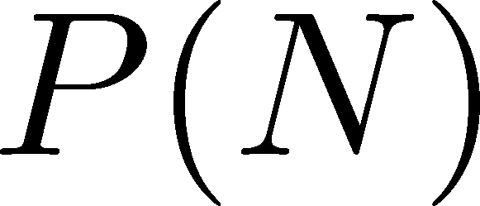




Diffusion of Fluctuations
Detector
Hadronic
Distributions in ΔY and
Δy are different due to
“thermal blurring”.
Ohnishi, MK, Asakawa, PRC(2016)
QGP
Fluctuations in ΔY continue
to change until kinetic f.o.

Slide 13


(non-interacting) Brownian Particle Model
Initial condition (uniform)
cumulants:
random
walk
diffusion master equation: MK+, PLB(2014)
probabilistic argument: Ohnishi+, PRC(2016)

Slide 14
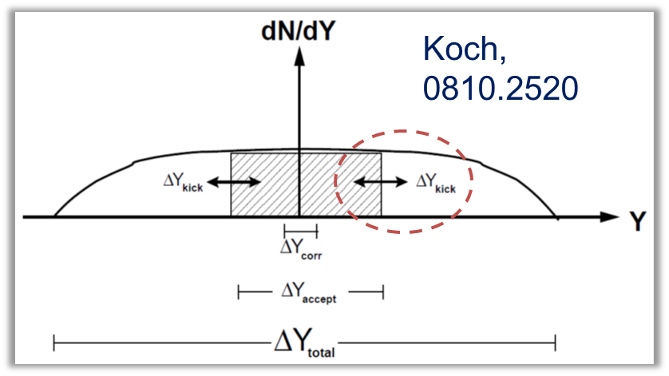

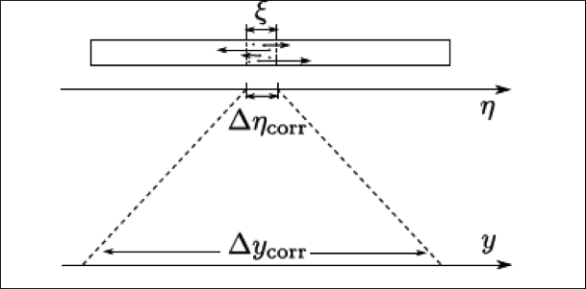
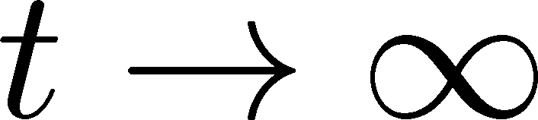
(non-interacting) Brownian Particle Model
Initial condition (uniform)
cumulants:
diffusion
distance
random
walk
Springer+
2014
Study ΔY dependence
Poisson distribution
diffusion master equation: MK+, PLB(2014)
probabilistic argument: Ohnishi+, PRC(2016)

Slide 15
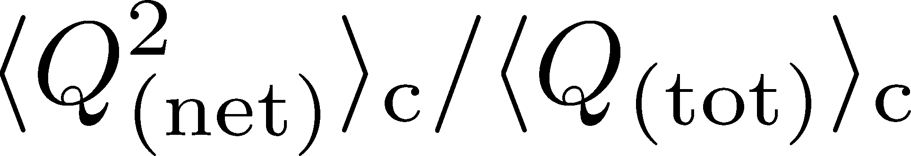


Global Charge Conservation
Conserved charges in the total system do no fluctuate!
1
0

Slide 16
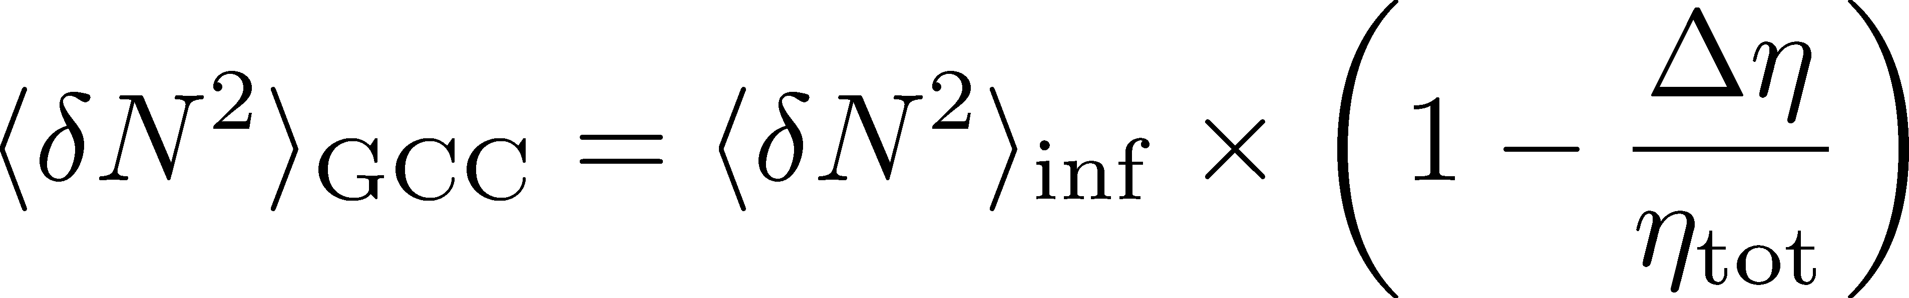
Global Charge Conservation
Conserved charges in the total system do no fluctuate!
1
0
GCC Effect without local correlations

Slide 17
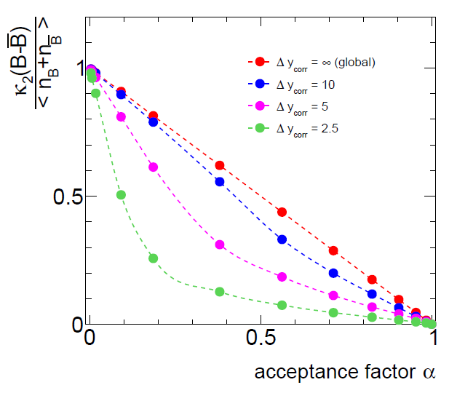
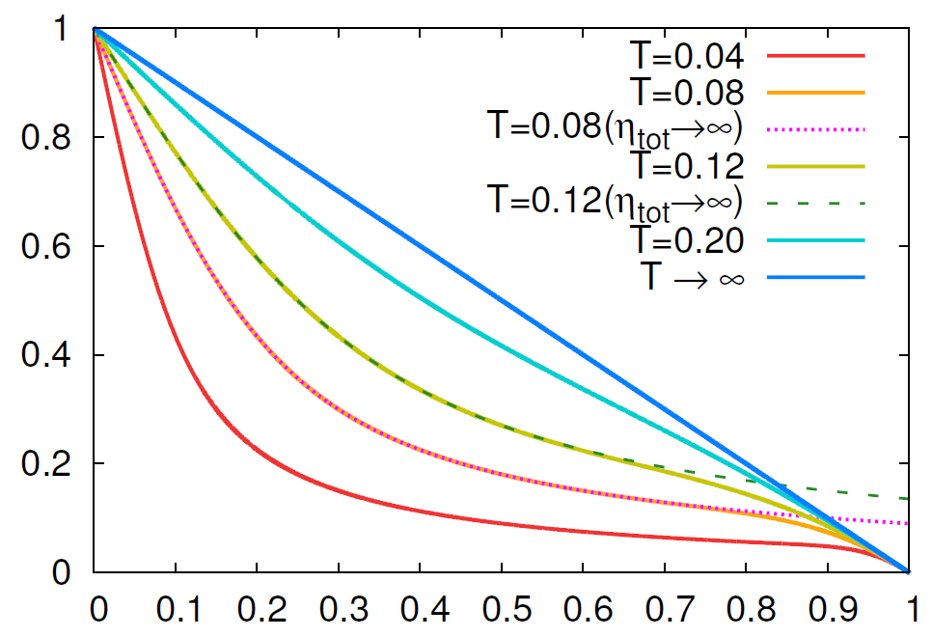
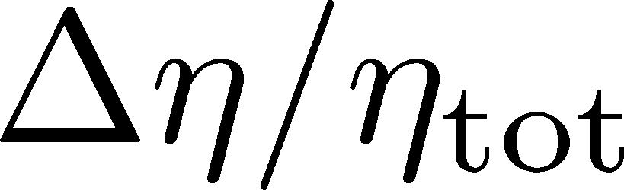
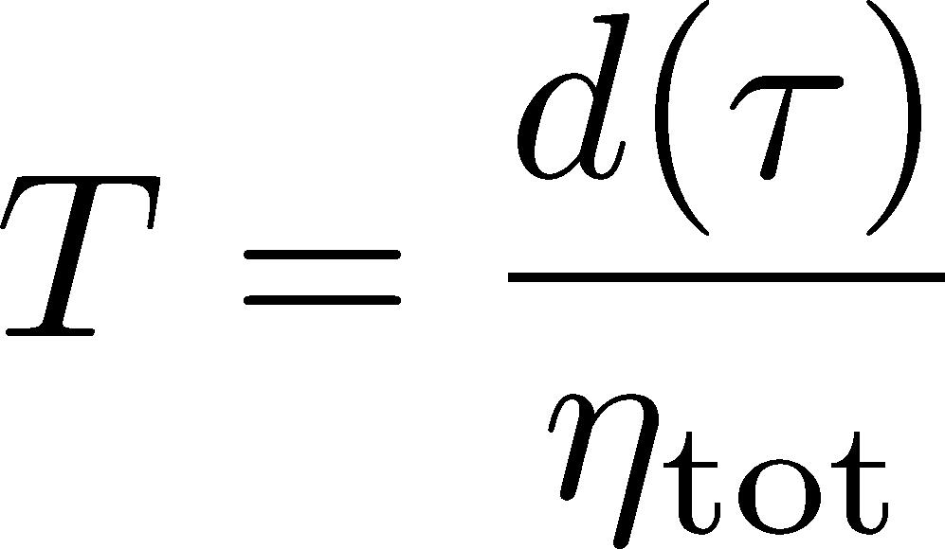
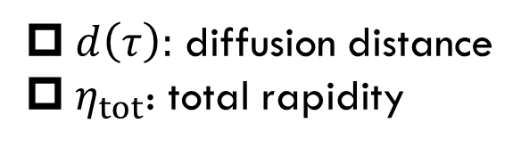
Diffusion in Finite Volume
Result of the diffusion model in finite volume
Sakaida, Asakawa, MK, PRC, 2014
$d\left(τ\right):$ diffusion distance
$η_{tot}$: total rapidity
effect of
GCC
PBM, Rustamov, Stachel
1907.03032

Slide 18
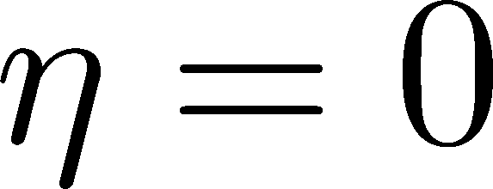


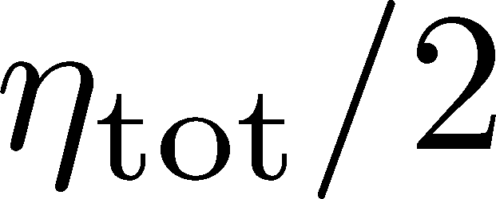
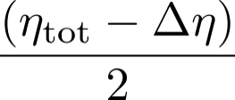
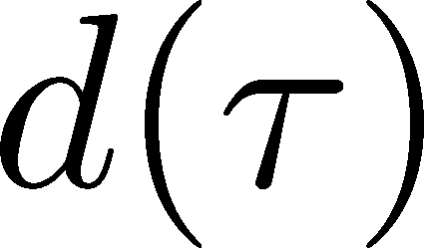
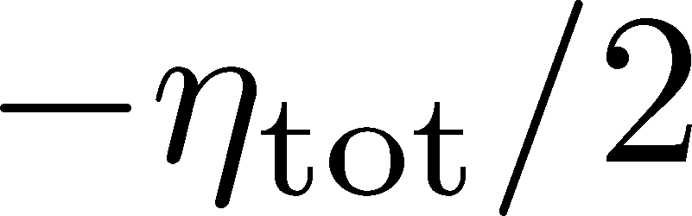
Diffusion in Finite Volume
Result of the diffusion model in finite volume
Sakaida, Asakawa, MK, PRC, 2014
Physical Interpretation
effect of
GCC
Time Passes…
: Averaged Diffusion Distance
: Total Length of Matter

Slide 19
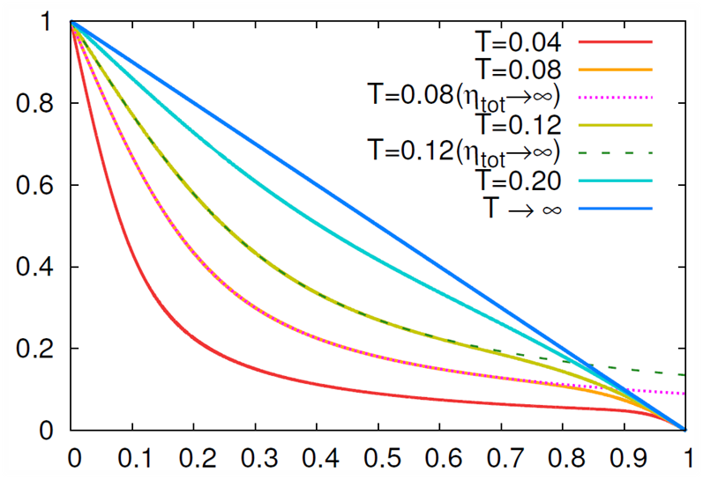
Comparison with CMS Result
MK, in progress for preparation
effect of
GCC
CMS result is well described by a simple diffusion model in finite volume.
Effects of the global charge conservation do not affect the results for $Δη<5$.

Slide 20

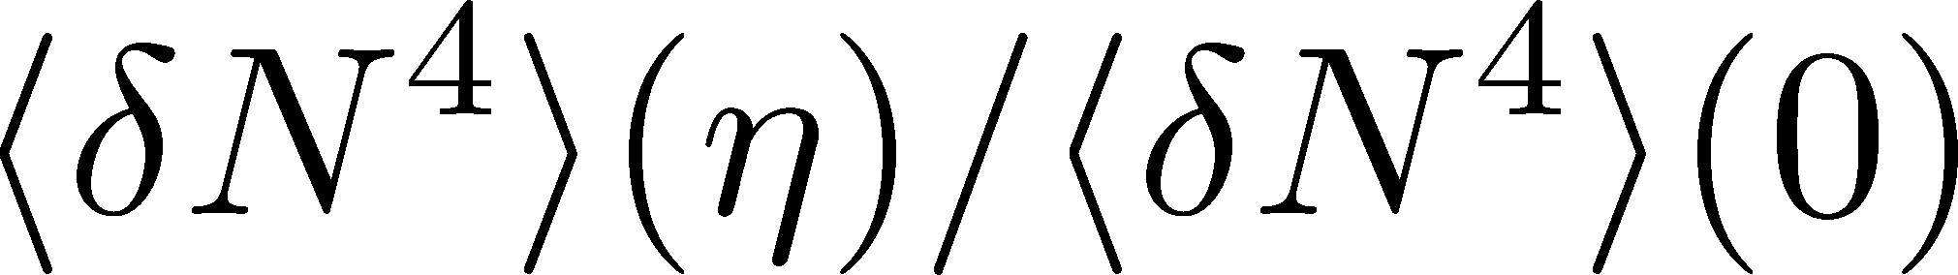
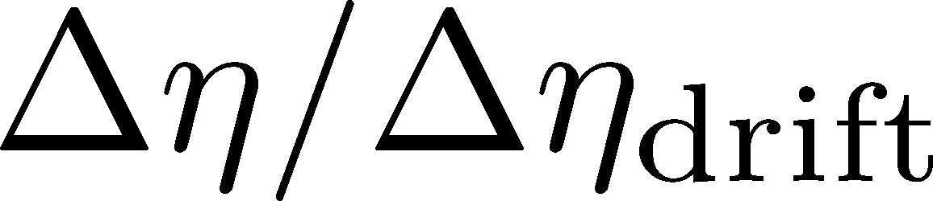
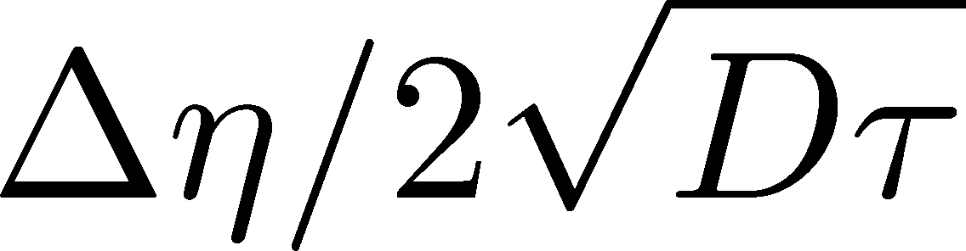

Higher Order Cumulants in the Diffusion Model
Predictions for higher order cumulants
MK+ (2014); MK (2015)
Higher order cumulants can have various non-monotonic $Δη$ dependence reflecting the initial condition.
Their experimental measurement gives us insights into it!

Slide 21
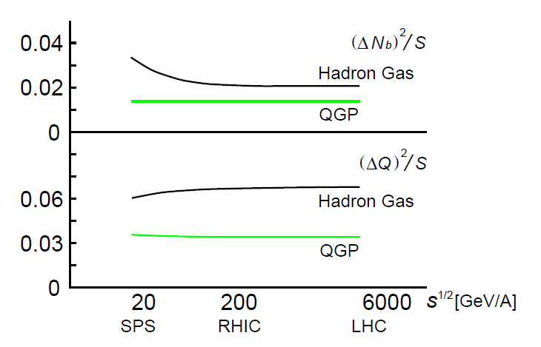
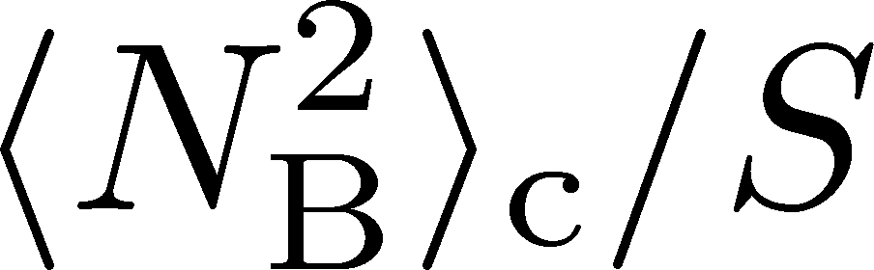
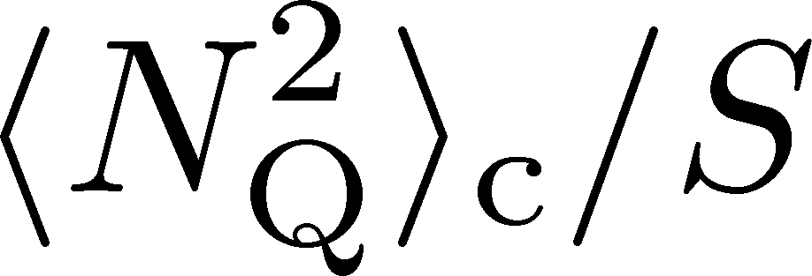
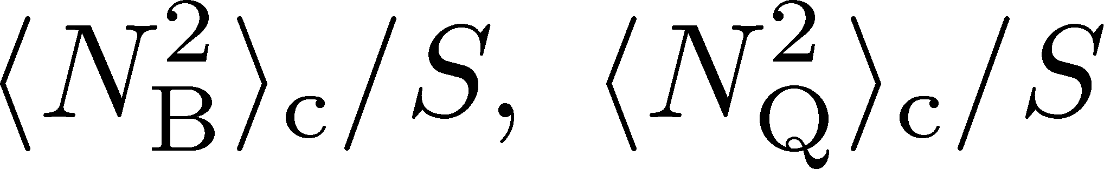

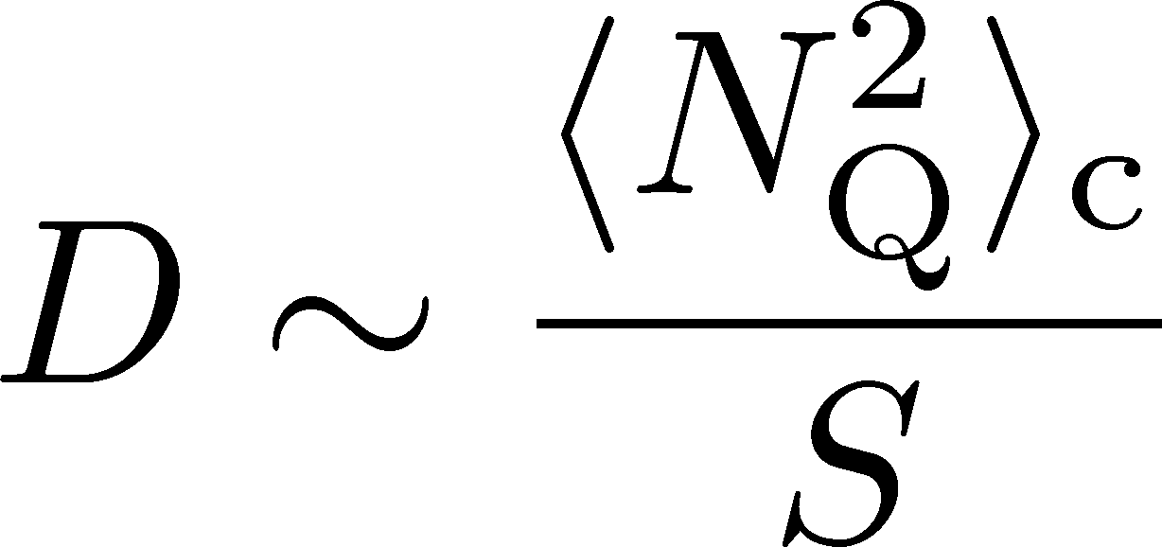
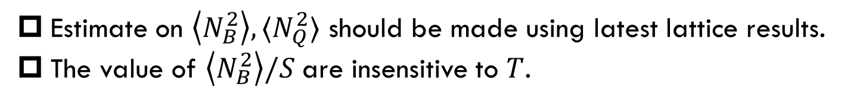
Revisiting Estimates of D-measure
D-measure
Prediction in 2000
Asakawa, Heinz, Mueller (’00)
From Recent Lattice Data
Hadron gas
QGP
Jeon, Koch, 2000
Bazavov+ (’12); Bazavov+ (’14)
Estimate on $\left\langle N_{B}^{2}\right\rangle , ⟨N_{Q}^{2}⟩$ should be made using latest lattice results.
The value of $\left\langle N_{B}^{2}\right\rangle /S$are insensitive to $T$.

Slide 22
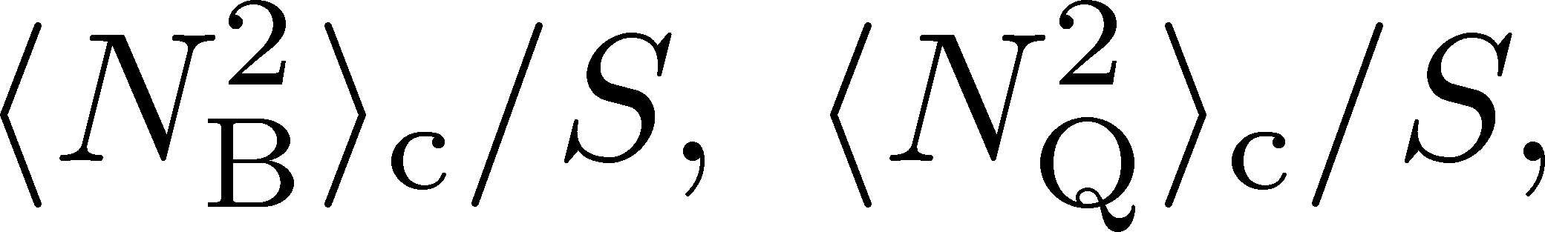

Net-Proton Fluctuations @ ALICE
Net proton fluctuation
From Recent Lattice Data
Bazavov+ (’12); Bazavov+ (’14)
ALICE, PLB (2023)
Weak $T$ dependence of $\left\langle N_{B}^{2}\right\rangle /S$ may explain the ALICE data on the proton fluctuation.

Slide 23
Contents
1 Why Fluctuations?
2 D-measure
3 Baryon/Charge cumulant ratio at second order
MK, in progress for progress
MK, Esumi, Nonaka, 2205.10030

Slide 24

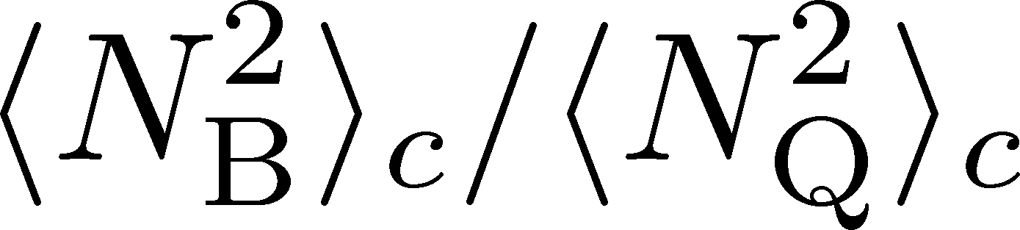
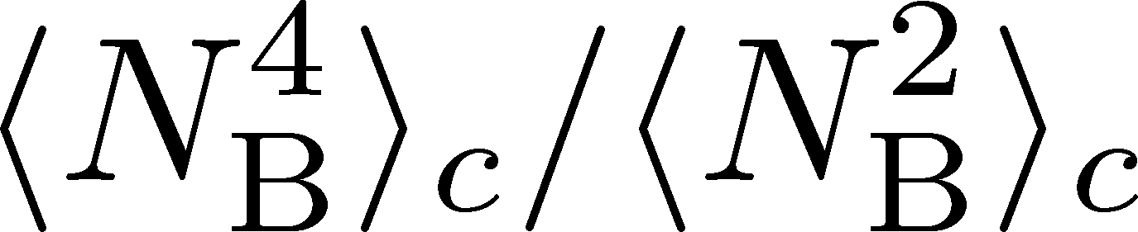
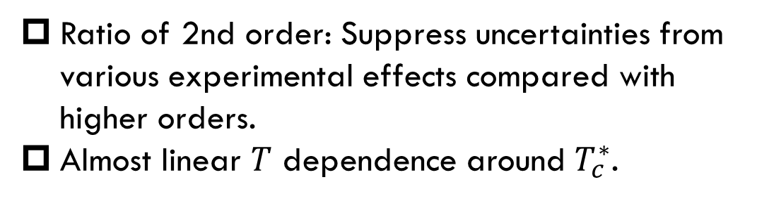
MK, Esumi, Nonaka, 2205.10030
Ratio of 2nd order: Suppress uncertainties from various experimental effects compared with higher orders.
Almost linear $T$ dependence around $T_{c}^{∗}$.
Data from
HotQCD,
PRD104 (’21)
HOT-QCD 2017

Slide 25
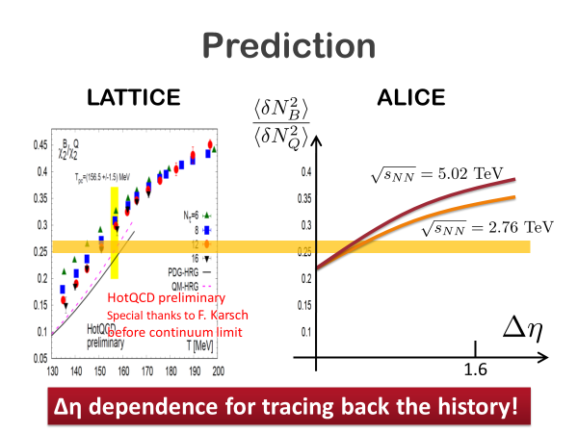
From my Slide for RRTF2019

Slide 26
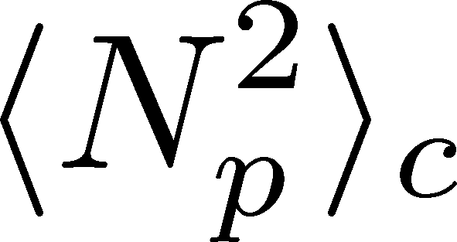
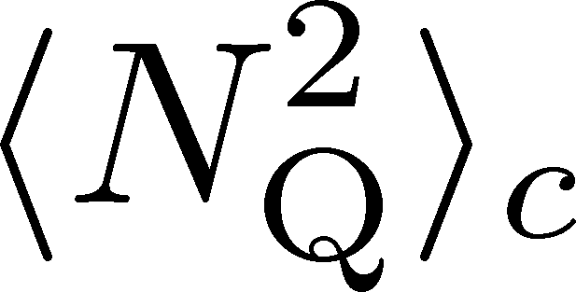
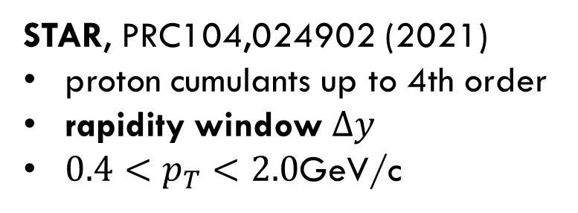
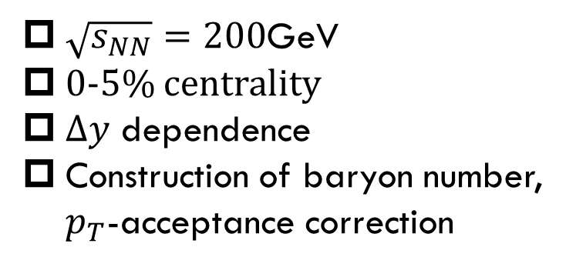
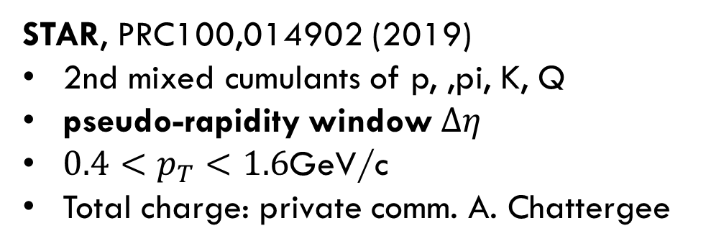
Experimental Data
$\sqrt{s_{NN}}=200$GeV
0-5% centrality
$Δy$ dependence
Construction of baryon number, $p_{T}$-acceptance correction
STAR, PRC104,024902 (2021)
proton cumulants up to 4th order
rapidity window $Δy$
$0.4<p_{T}<2.0$GeV/c
STAR, PRC100,014902 (2019)
2nd mixed cumulants of p, ,pi, K, Q
pseudo-rapidity window $Δη$
$0.4<p_{T}<1.6$GeV/c
Total charge: private comm. A. Chattergee
proton → baryon cumulants MK, Asakawa,’12;’12
Rapidity is better than pseudo-rapidity
Wider acceptance is more desirable.
Ohnishi, MK, Asakawa, ’16

Slide 27




$pT$-Acceptance Correction
$p_{T}$ Acceptance
0.4<p_{T}<1.6 [GeV/c]
0.4<p_{T}<2.0 [GeV/c]
PRC100,014902(’19)
PRC104,024902(’21)
Particles in $p_{T}$ space
Electric charge: 49%
Protons: 82%
blast wave model @ √s_{NN}=200 GeV
Modification by $p_{T}$-cut should be corrected.
This study: Binomial distribution model.
MK, Asakawa, ’12, ’12

Slide 28




Cumulants: Proton→Baryon & Acceptance Correction
Data from STAR, ’19, ’21
corrected
dashed:
$⟨N_{}^{tot}⟩$
Poisson
suppress
corrected
uncorrected
uncorrected
$${\left\langle N_{p}^{2}\right\rangle }_{c}$$
Deviation from Poissonian is clarified by the acceptance correction.
MK, Asakawa, ’12, ’12

Slide 29



$p_{T}$-acceptance uncorrected
$p_{T}$-acceptance corrected
dashed:
Poisson
${\left\langle N_{B}^{2}\right\rangle }_{c}/{\left\langle N_{Q}^{2}\right\rangle }_{c}$ becomes smaller due to the $p_{T}$-acceptance correction.
Clear $Δy$ dependence
non-thermal effects behind fluctuations

Slide 30

HIC vs HRG&LAT
From data @ STAR
HRG+Lattice
Data from
HotQCD, PRD104 (’21)
$T=134∼138$MeV
Significantly lower than $T_{chem}$
HRG: QMHRG2020
Bollweg+, PRD104, 7 (’21)
Volume dep. corrected
plot by MK

Slide 31
HIC vs HRG&LAT
From data @ STAR
HRG+Lattice
Data from
HotQCD, PRD104 (’21)
$T=134∼138$MeV
Significantly lower than $T_{chem}$
HRG: QMHRG2020
Bollweg+, PRD104, 7 (’21)
Volume dep. corrected
plot by MK

Slide 32




Effect of Diffusion and Rapidity Conversion
Ohnishi, MK, Asakawa, PRC (‘16)
Blurring due to diffusion & rapidity conversion ($Y→y$)
Stronger modification in Q than B
Resonance Decays
About 30% charged particles come from RD
Enhancement of charged particles
Increase $⟨N_{Q}^{2}⟩$
Reduce ${\left\langle N_{B}^{2}\right\rangle }_{c}/{\left\langle N_{Q}^{2}\right\rangle }_{c}$
These effects will be more important for higher order cumulants!

Slide 33
From my Slide for RRTF2019
1.0

Slide 34

Summary
$Δη$ dependence of fluctuations encodes the information of its evolution.
New CMS result looks consistent with a simple diffusion picture.
Temperature extracted from baryon/charge ratio is significantly lower than the one at chemical freezeout.
p_{T} acceptance correction is essential to extract correct cumulants.
Further experimental analysis on various cumulants with wider $Δy$ and $p_{T}$ are awaited!

Slide 35



Resonance Decays
Neutral Particles
Decay into charged particles
The larger Δη, the slower diffusion.

Slide 36





Evolution of Conserved-charge Fluctuations
Quark-Gluon Plasma
Fluctuations of CC are modified by the diffusion.
Hadronization
Relaxation time becomes longer as $ΔY→$large.
Freezeout
Experiments on $⟨N_{Q}^{2}⟩$
No QGP signal @ RHIC (’02, ’03)
QGP signal? @ ALICE (’12)
Asakawa, Heinz, Muller, 2000
Jeon, Koch, 2000; Shuryak, Stephanov, 2001

Slide 37


Nucleon’s Isospin as Two Sides of a Coin
a coin
N
p
n
Nucleons have
two isospin states.
Coins have two sides.
MK, Asakawa, 2012;2012

Slide 38




Slot Machine Analogy
Fixed # of coins
P (N)
P (N)
N
N
P (N)
P (N)
N
N

Slide 39


Reconstruction of Total Coin #
P (N )= P (N )B_{1/2}(N ;N )
= +
Example
genuine info.
Poisson noise
Note: Higher order cumulants are more fragile.
MK, Asakawa, 2012;2012

Slide 40
Difficulties of Low-Energy Collisions
Large contribution from global charge conservation
Violation of Bjorken picture
detector
Careful treatment is required to interpret fluctuations at low beam energies!

