Slide 1
Machine Learning
Topological Sector of
Yang-Mills Theory
Large-scale lattice QCD simulation and application of machine learning, Univ. of Tsukuba, 2023/11/25
Masakiyo Kitazawa (YITP, Kyoto)
Matsumoto, MK, Kohno, PTEP2021, 023D01
MK, Kohno, in preparation

Slide 2
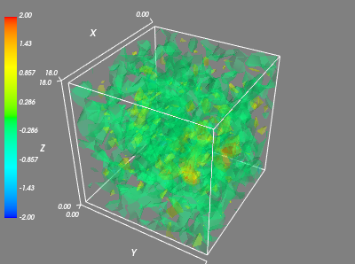
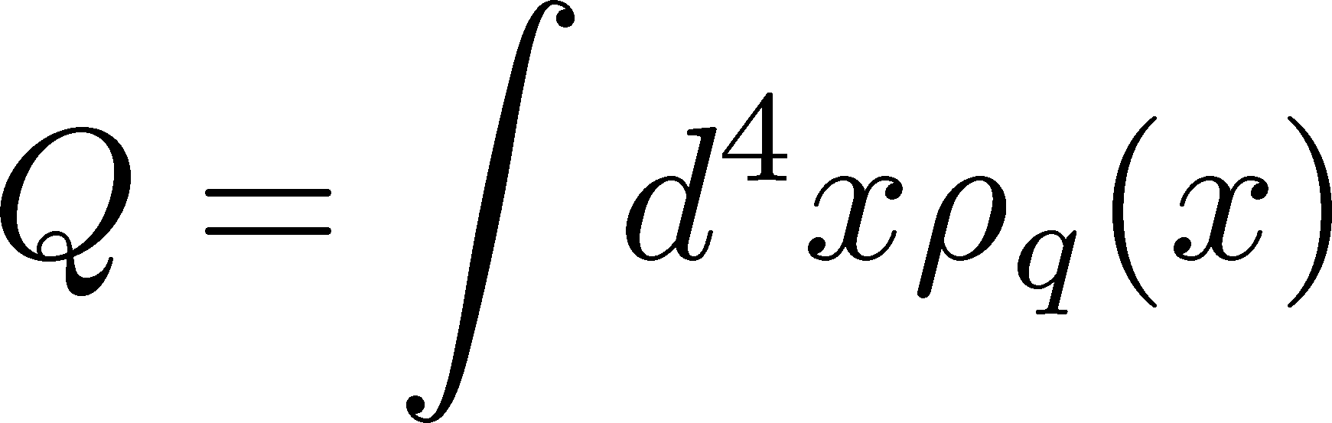
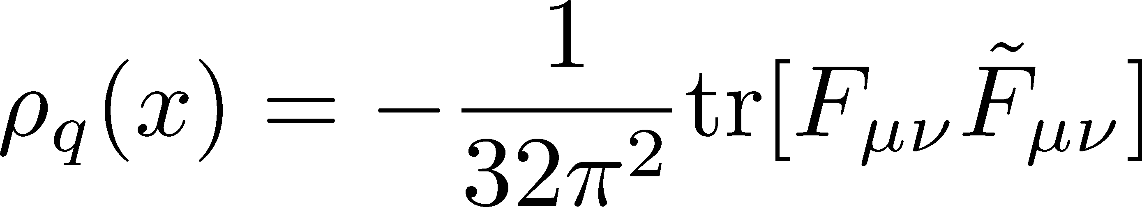
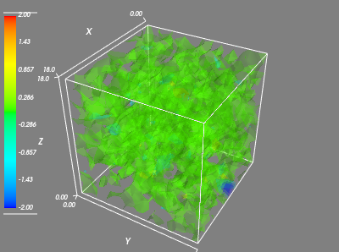
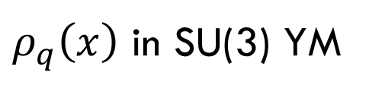
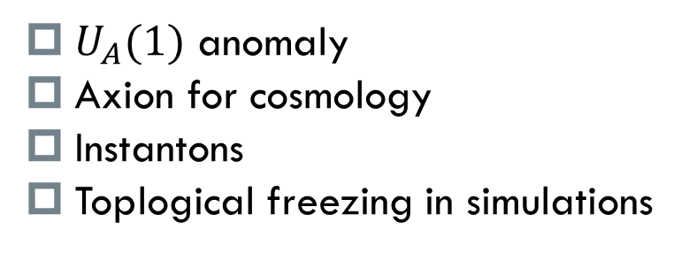
Topological Charge in YM Theory
$ρ_{q}\left(x\right)$ in SU(3) YM
Topological Charge
：integer
Motivations & Applications
$U_{A}(1)$ anomaly
Axion for cosmology
Instantons
Toplogical freezing in simulations

Slide 3
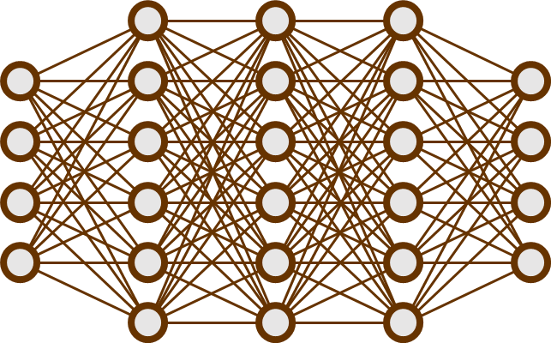
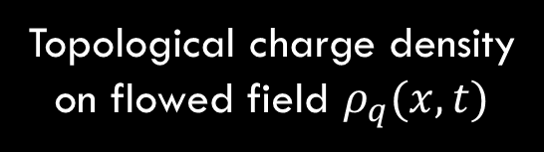

Machine Learning for measuring $Q$
Matsumoto, MK, Kohno, PTEP2021
Input
Output
Q
Convolutional
NN
Topological
charge
Observable on gauge conf.
Topological charge density
on flowed field $ρ_{q}(x,t)$
$Q$ @ $t/a^{2}=4$
Faster analysis of Q
Recognizing objects in high-dim. space
Aim:

Slide 4
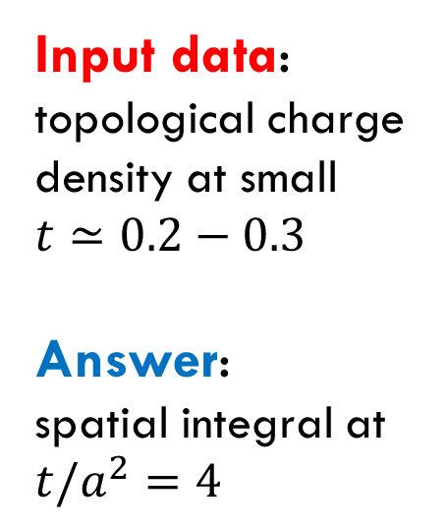
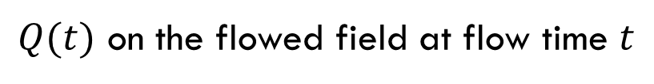
Input/Output Data
Matsumoto, MK, Kohno, PTEP2021
$Q(t)$ on the flowed field at flow time $t$
Input data:
topological charge density at small $t≃0.2−0.3$
Answer:
spatial integral at $t/a^{2}=4$

Slide 5
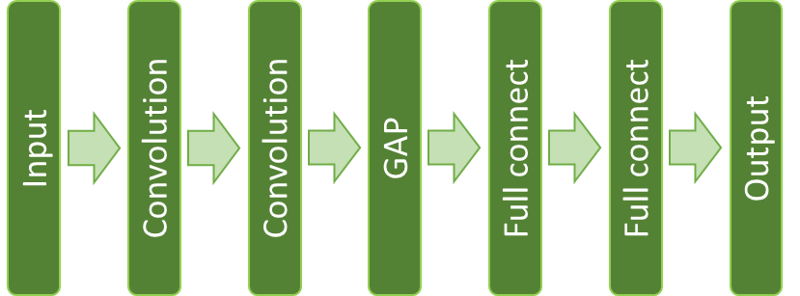
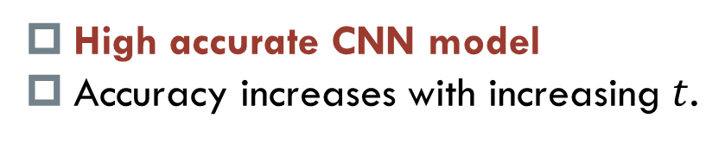
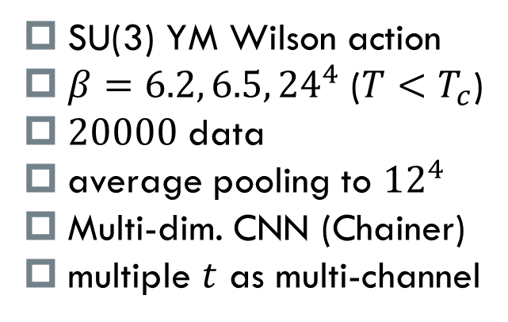
Setup/Result
Matsumoto, MK, Kohno, PTEP2021
Setup
SU(3) YM Wilson action
$β=6.2, 6.5, {24}^{4}$ ($T<T_{c}$)
$20000$ data
average pooling to ${12}^{4}$
Multi-dim. CNN (Chainer)
multiple $t$ as multi-channel
Result
High accurate CNN model
Accuracy increases with increasing $t$.

Slide 6
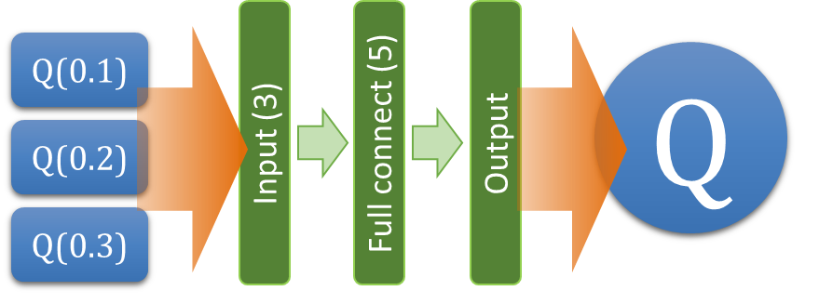
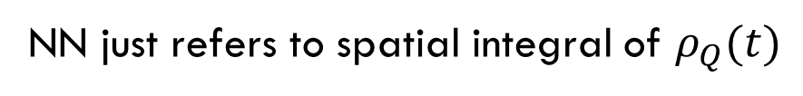
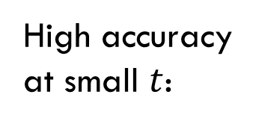
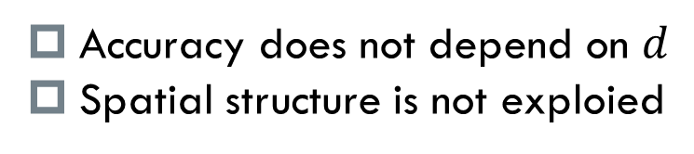
Result
Matsumoto, MK, Kohno, PTEP2021
Dimensional Reduction
NN without spatial coordinates
High accuracy
at small $t$:
Accuracy does not depend on $d$
Spatial structure is not exploied
NN just refers to spatial integral of $ρ_{Q}(t)$
Can NN recognize local structure?

Slide 7
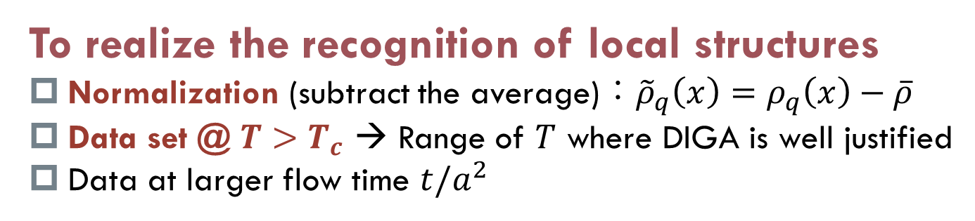
Strategy for 2nd Trial
MK, Kohno, in preparation
To realize the recognition of local structures
Normalization (subtract the average)：${\tilde{ρ}}_{q}\left(x\right)=ρ_{q}\left(x\right)−\overline{ρ}$
Data set @ $T>T_{c}$ → Range of $T$ where DIGA is well justified
Data at larger flow time $t/a^{2}$
Purpose
Recognition of local structure in higher-dimensional space
Direct confirmation of instantons
Further applications in numerical studies

Slide 8
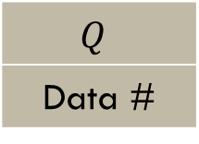
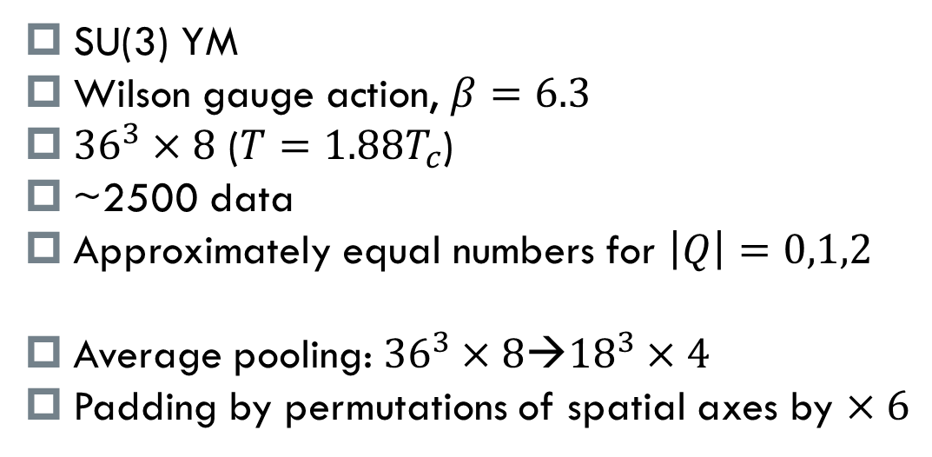
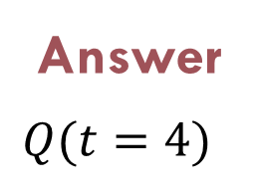
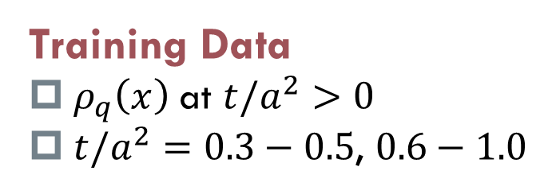
Setup
MK, Kohno, in preparation
SU(3) YM
Wilson gauge action, $β=6.3$
${36}^{3}×8$ ($T=1.88T_{c}$)
~2500 data
Approximately equal numbers for $\left|Q\right|=0,1,2$
Average pooling: ${36}^{3}×8$→${18}^{3}×4$
Padding by permutations of spatial axes by $×6$
$$Q$$
Data #
-3 | -2 | -1 | 0 | 1 | 2 | 3 | total
23 | 436 | 512 | 493 | 534 | 448 | 15 | 2461
Training Data
$ρ_{q}\left(x\right)$ at $t/a^{2}>0$
${t/a}^{2}=0.3−0.5$, $0.6−1.0$
Answer
$Q(t=4)$
CNN

Slide 9
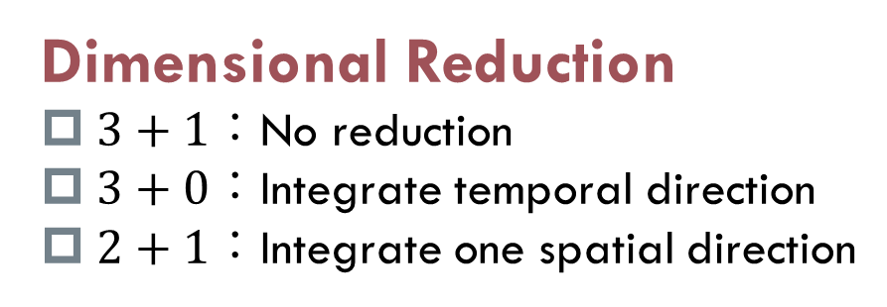
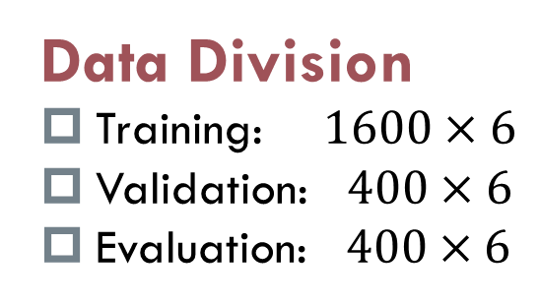
CNN Models & Training
MK, Kohno, in preparation
Dimensional Reduction
$3+1：$No reduction
$3+0$：Integrate temporal direction
$2+1$：Integrate one spatial direction
NN Structure
Layer | In ch | Out ch | Filter | Out size | Activation
conv1 | 1,2,3 | 4 | 3^4 | 4x4x18^3 | sigmoid
conv2 | 4 | 8 | 3^4 | 8x4x18^3 | sigmoid
conv3 | 8 | 16 | 3^4 | 16x4x18^3 | sigmoid
GAP | - | - | 4x18^3 | 16x1 | -
full connect | - | - | 16x1 | 1 | -
Data Division
Training: $1600×6$
Validation: $400×6$
Evaluation: $400×6$
4d CNN
Setting/Parameters
Optimizer | Adam
Learning rate | 0.001
Batchsize | 16
Loss function | MSE
N_train | 9600
N_val | 1200
N_eval | 1800
N_epoch | 1500
Data are divided randomly into training/validation/evalation
Perform the training 7 times for each setting

Slide 10

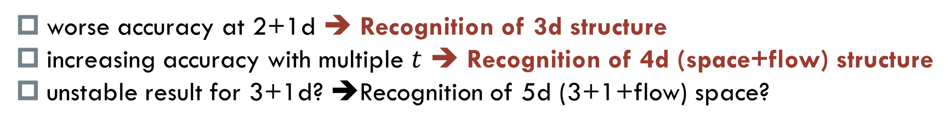
Result: Accuracy
$$t/a^{2}≤0.5$$
Training for 7 times
Big markers: Average and variance of top 5 results
Small points: accuracy of each training
Origin of errors
  training data
  procedure of training
ch number
worse accuracy at 2+1d ➔ Recognition of 3d structure
increasing accuracy with multiple $t$ ➔ Recognition of 4d (space+flow) structure
unstable result for 3+1d? ➔Recognition of 5d (3+1+flow) space?

Slide 11
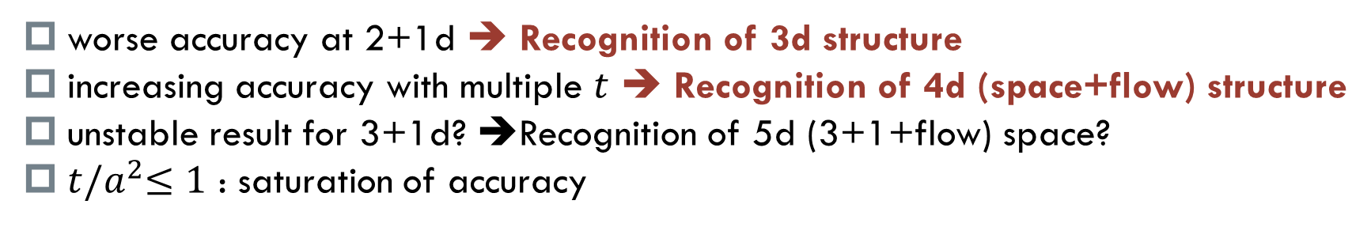

Result: Accuracy
$$t/a^{2}≤0.5$$
$$t/a^{2}≤1.0$$
ch number
worse accuracy at 2+1d ➔ Recognition of 3d structure
increasing accuracy with multiple $t$ ➔ Recognition of 4d (space+flow) structure
unstable result for 3+1d? ➔Recognition of 5d (3+1+flow) space?
$t{/a}^{2}≤1$ : saturation of accuracy

Slide 12
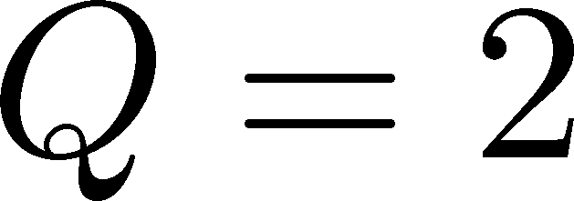
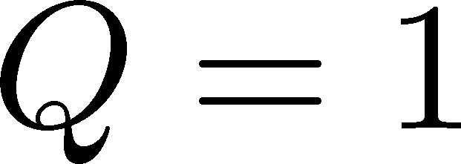
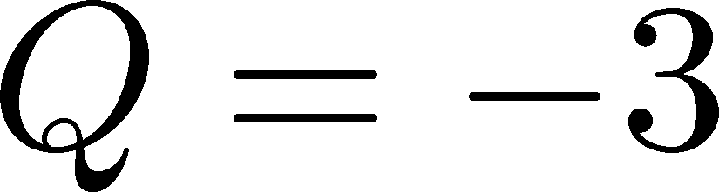
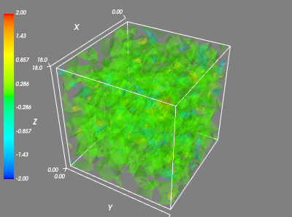
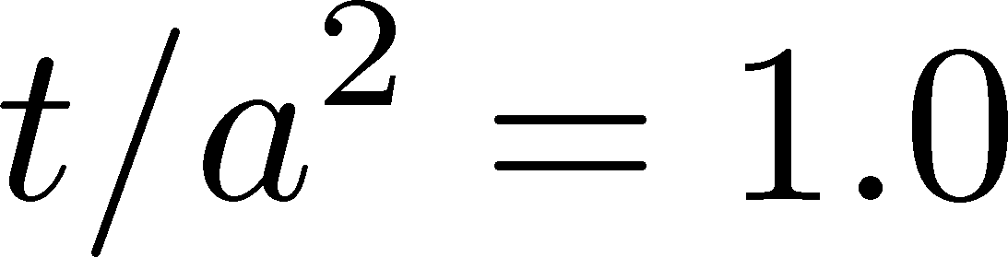
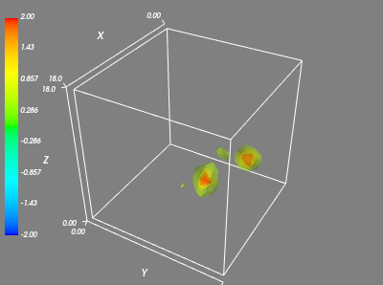
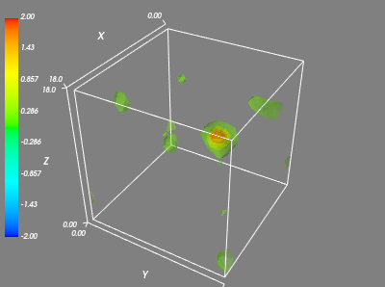
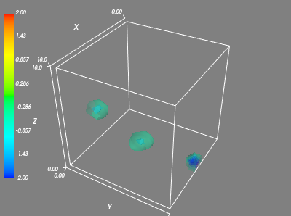
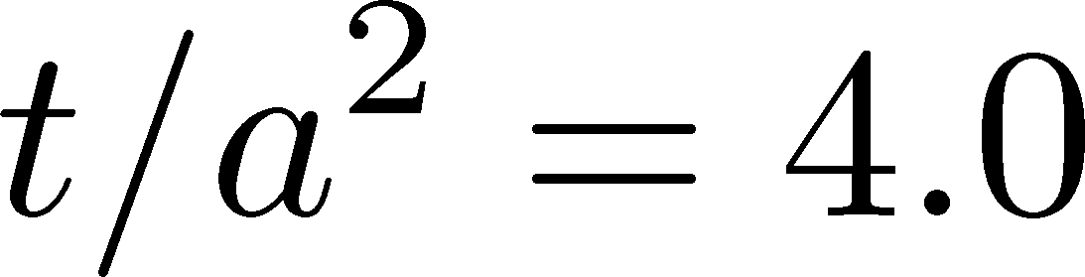
Topological Charge Density

Slide 13
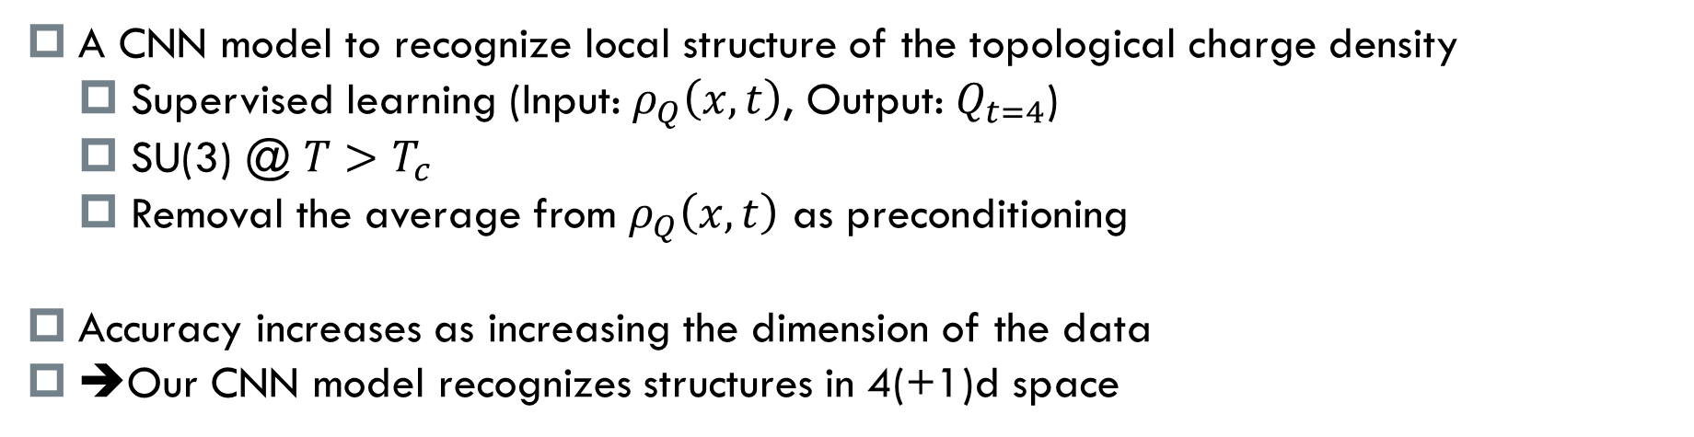
Summary
A CNN model to recognize local structure of the topological charge density
  Supervised learning (Input: $ρ_{Q}\left(x,t\right)$, Output: $Q_{t=4}$)
  SU(3) @ $T>T_{c}$
  Removal the average from $ρ_{Q}\left(x,t\right)$ as preconditioning
Accuracy increases as increasing the dimension of the data
➔Our CNN model recognizes structures in 4(+1)d space
Future
Detailed structure of localized objects: location, size, form, etc.
Training of vacuum configurations
  understanding of vacuum structure of YM theory
Other numerical applications

