Slide 1
Theoretical Study of
QCD Phase Diagram at High Baryon Density
Masakiyo Kitazawa
(YITP, Kyoto)
6th Joint Meeting of the APS Division of Nuclear Physics and the Physical Society of Japan,
Nov. 27, 2023, Waikoloa, Hawaii, USA
ATHIC2023, Apr. 27, 2023, Hiroshima
Photo: J-PARC Main Ring

Slide 2

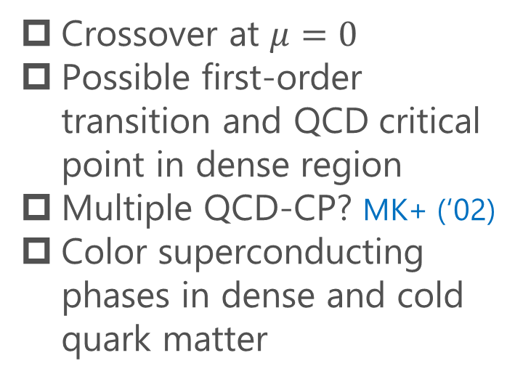
QCD Phase Diagram
T
Crossover at $μ=0$
Possible first-order transition and QCD critical point in dense region
Multiple QCD-CP? MK+ (‘02)
Color superconducting phases in dense and cold quark matter
Quark-Gluon Plasma
150MeV
ＱＣＤ Critical Point
Hadron Phase
(confined)
Color SC
~10¹⁵g/cm³
μ

Slide 3


QCD Phase Diagram
Early Universe
T
Crossover at $μ=0$
Possible first-order transition and QCD critical point in dense region
Multiple QCD-CP? MK+ (‘02)
Color superconducting phases in dense and cold quark matter
Quark-Gluon Plasma
150MeV
ＱＣＤ Critical Point
Hadron Phase
(confined)
Color SC
Compact
Stars
~10¹⁵g/cm³
μ

Slide 4

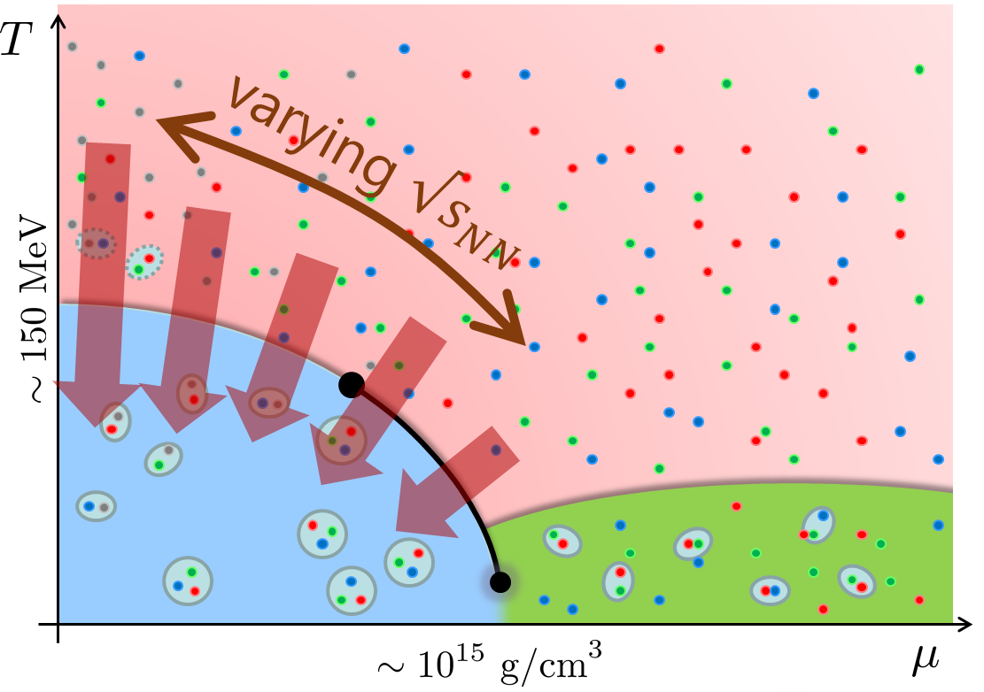
Beam-Energy Scan
STAR, 2012
High E
Low E
Baryon stopping

Slide 5
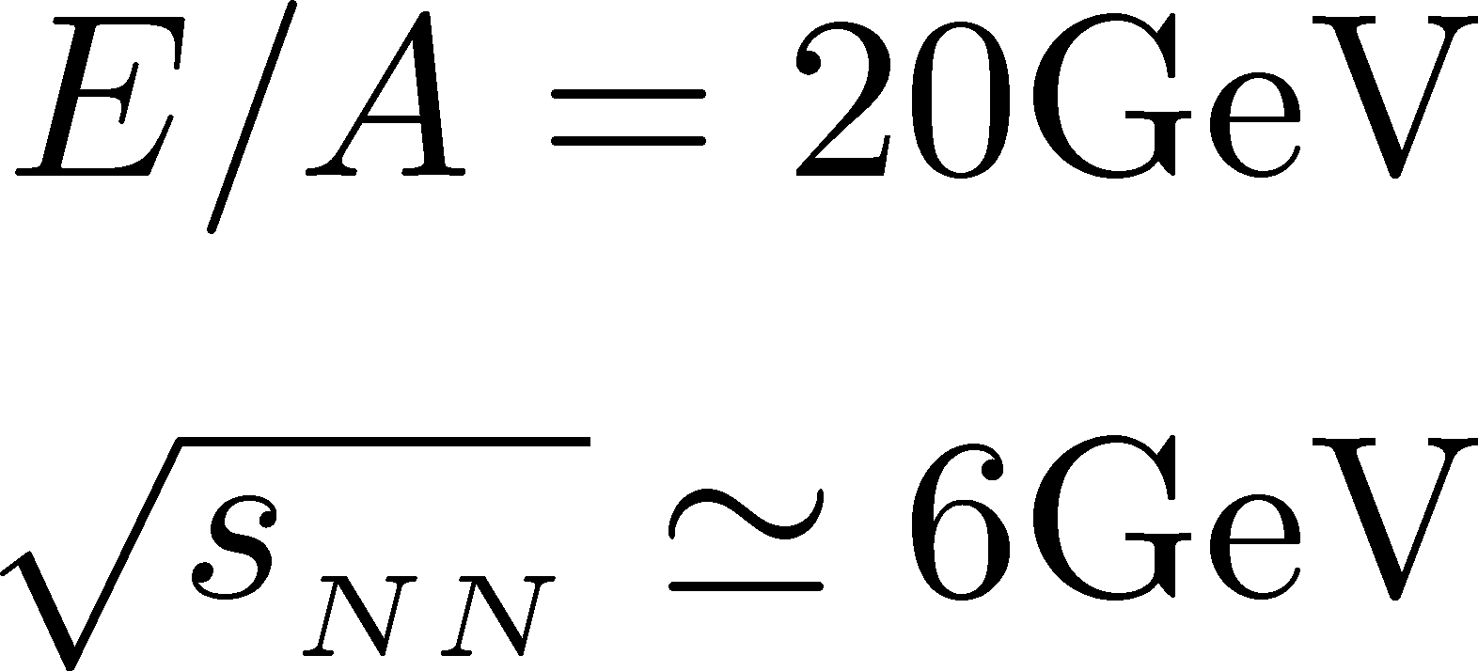


Highest Baryon Density
Ohnishi, 2002

Slide 6

Highest Baryon Density
Ohnishi, 2002
Akira Ohnishi
1964-2023
passed away silently
on May. 16, 2023

Slide 7





History / Current Status of HIC
LHC
2010~
RHIC
2000~
SPS
Increasing Collision Energy
~2000
AGS
~1996

Slide 8
History / Current Status of HIC
LHC
2010~
RHIC
2000~
SPS
Increasing Collision Energy
NA61/SHINE
~2000
RHIC-BES
AGS
FAIR-CBM
~1996
HADES

Slide 9
History / Current Status of HIC
LHC
2010~
FAIR-CBM
Galatyuk, NPA982, 163
RHIC
NICA
2000~
HADES
NA61/SHINE
Beam-Energy
Scan
RHIC-BES-FXT
SPS
RHIC-BES
Increasing Collision Energy
NA61/SHINE
~2000
RHIC-BES
AGS
FAIR-CBM
~1996
HADES
2010~

Slide 10
History / Current Status of HIC
LHC
J-PARC-HI
2010~
FAIR-CBM
Galatyuk, NPA982, 163
RHIC
NICA
2000~
HADES
NA61/SHINE
Beam-Energy
Scan
RHIC-BES-FXT
SPS
RHIC-BES
Increasing Collision Energy
NA61/SHINE
~2000
RHIC-BES
AGS
FAIR-CBM
~1996
HADES
2010~

Slide 11
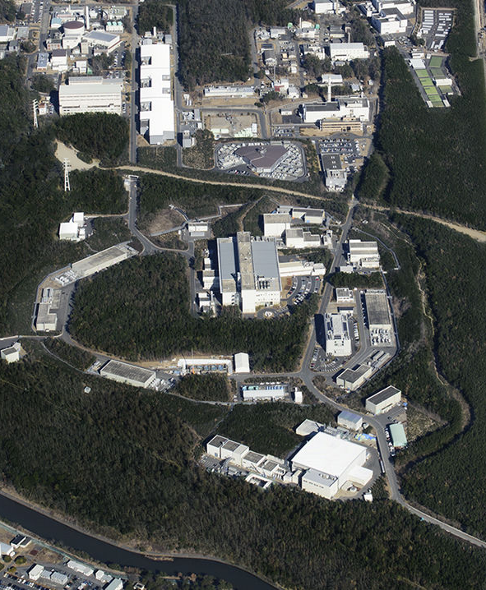
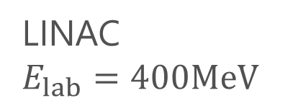
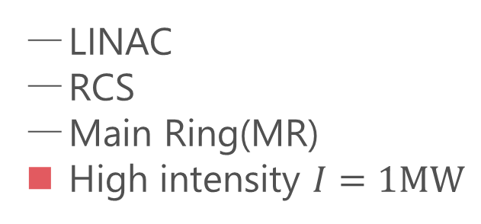

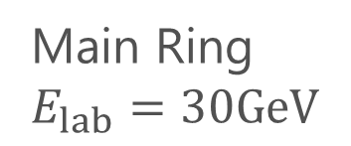
LINAC
$E_{lab}=400MeV$
J-PARC
Accelerators
LINAC
RCS
Main Ring(MR)
High intensity $I=1MW$
RCS
$E_{lab}=3GeV$
Purposes
Hadron/Nuclear physics
Neutrino physics
Material/Life science
Main Ring
$E_{lab}=30GeV$
proton
energy
Hadron hall

Slide 12
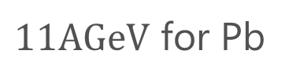
LINAC
$E_{lab}=400MeV$
J-PARC
HI-injector
Accelerators
LINAC
RCS
Main Ring(MR)
High intensity $I=1MW$
RCS
$E_{lab}=3GeV$
Purposes
Hadron/Nuclear physics
Neutrino physics
Material/Life science
Main Ring
$E_{lab}=30GeV$
$11AGeV$ for Pb
J-PARC-HI
proton
energy
J-PARC Heavy Ion Program
High intensity
Hadron hall
Intermediate energy

Slide 13
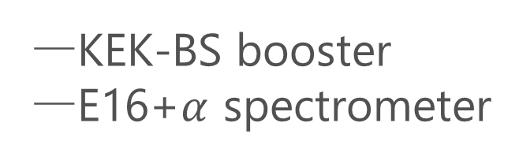
J-PARC-HI Staging Plan
Phase-II
Phase-I
KEK-BS booster
E16+$α$ spectrometer
Phase-I
Phase-II
NEW HI booster
NEW spectrometer

Slide 14
Event-by-event Fluctuations
of Conserved Charges

Slide 15


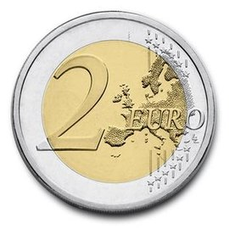

A Coin Game
Bet 25 Euro
You get head coins of
A. 50 x 1 Euro
B. 25 x 2 Euro
Same expectation value.

Slide 16
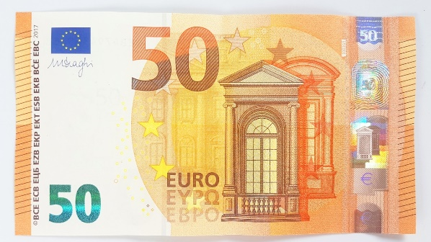
A Coin Game
Bet 25 Euro
You get head coins of
A. 50 x 1 Euro
B. 25 x 2 Euro
C. 1 x 50 Euro
Same expectation value.
But, different fluctuations.

Slide 17


Fluctuations in HIC @ 2nd Order
Search for QCD CP
Onset of QGP
Fluctuation
increases
Fluctuation
decreases
Asakawa, Heinz, Muller, 2000;
Jeon, Koch, 2000
Stephanov, Rajagopal, Shuryak, 1998; 1999

Slide 18
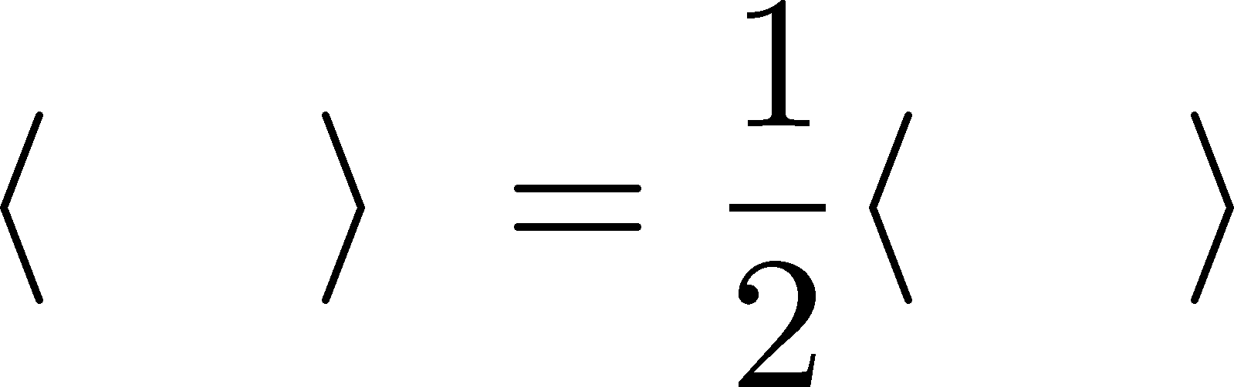


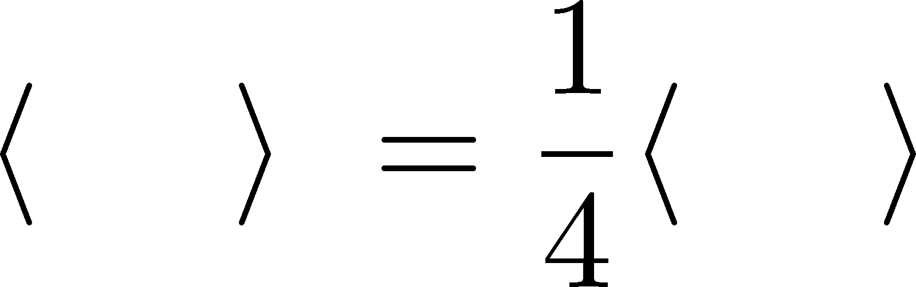
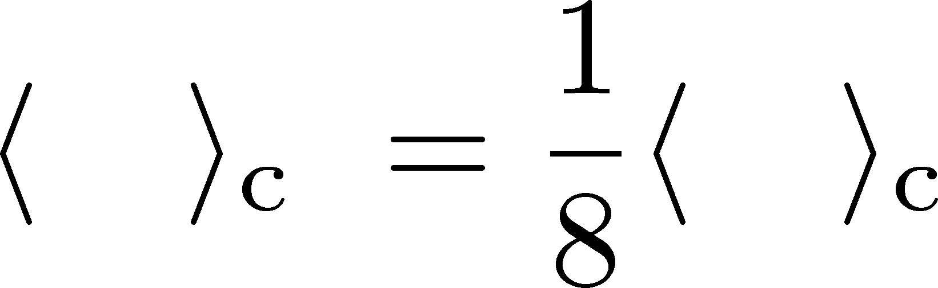
Higher Order Cumulants
A. 50 x 1 Euro
δ€²
δ€²
δ€³
δ€³
B. 25 x 2 Euro
€⁴
€⁴
Asakawa, MK, PPNP 90, 299 (2016)

Slide 19
Non-Gaussian Fluctuations in HIC
Onset of QGP
Search for QCD CP
Fluctuation
decreases
Fluctuation
increases
Ejiri, Karsch, Redlich, 2006
Stephanov, 2009

Slide 20

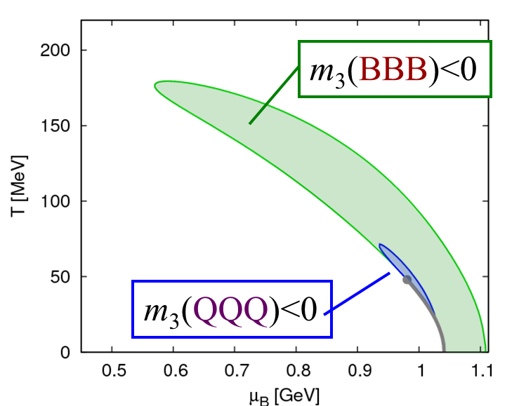

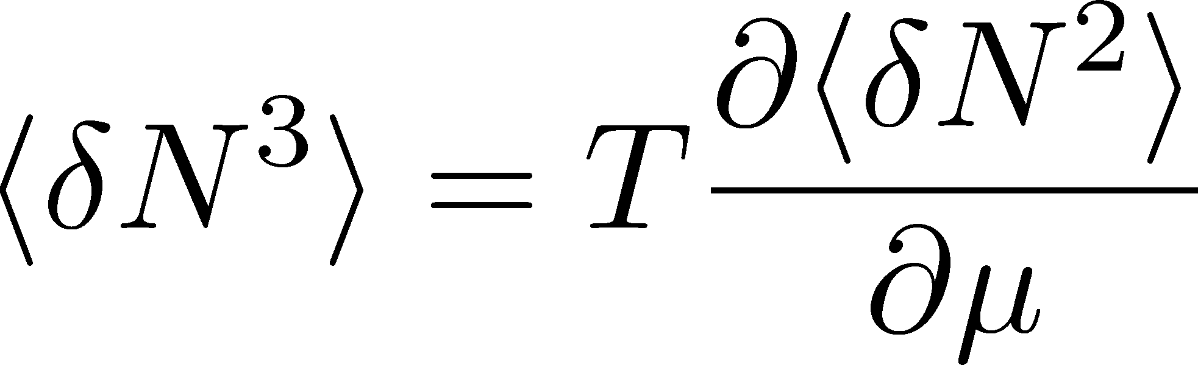

Sign of Higher Order Cumulants
Geometric Interpretation
Asakawa, Ejiri, MK, 2009
Asakawa, Ejiri, MK, 2009
Stephanov, 2011;
Friman, Karsch, Redlich, Skokov, 2011; …

Slide 21
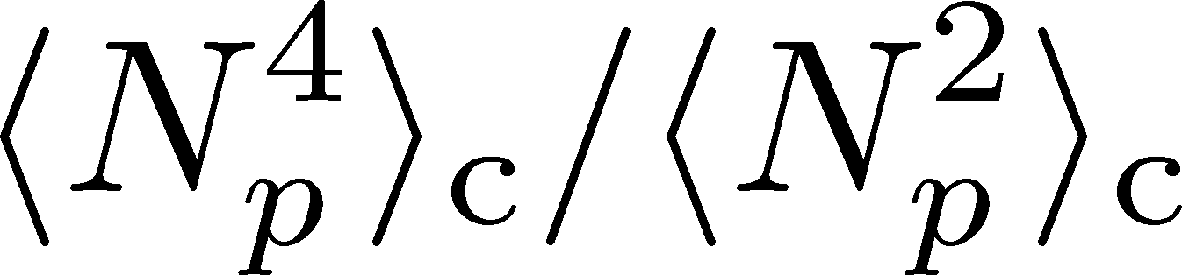
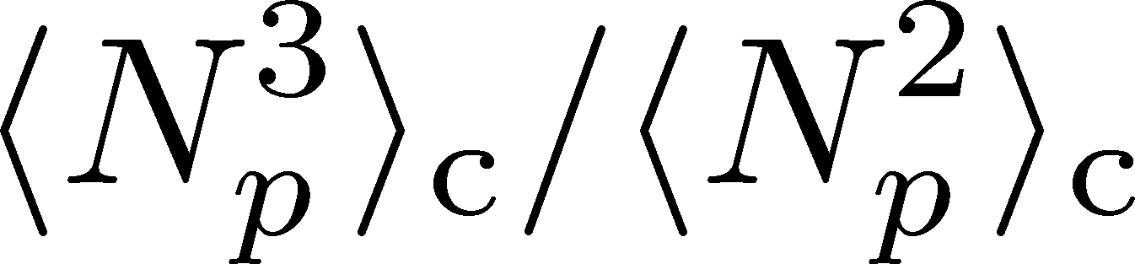
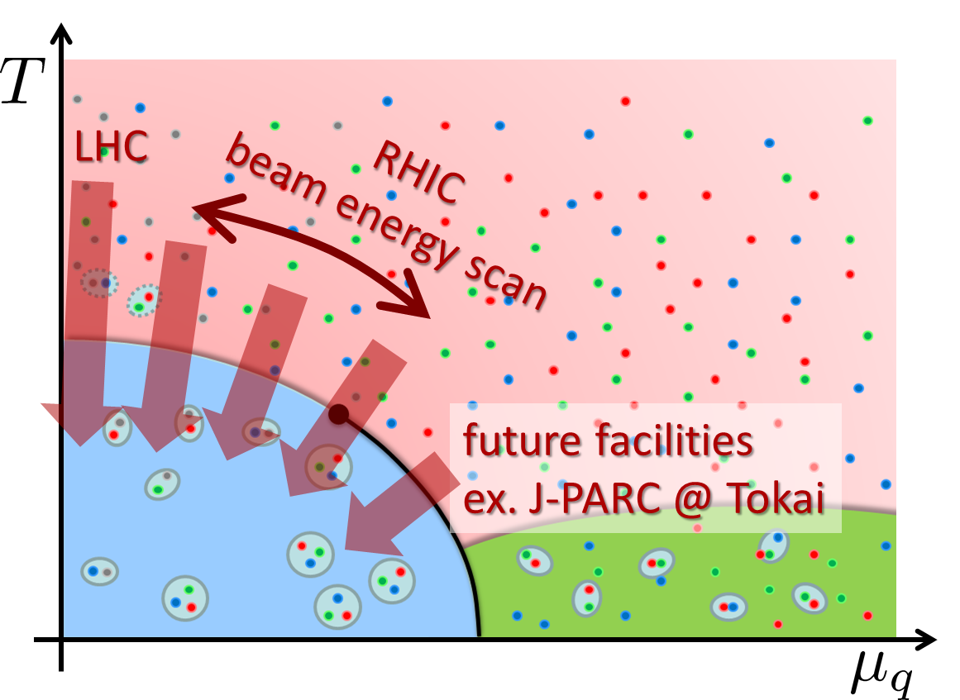
Experimental Results
Net-proton number cumulants
STAR, 2020 (2001.02852)
Non-Poisson and non-monotonic behaviors of the higher order cumulants.
Questions
When are these fluctuations generated?
Is the use of proton # cumulants as a proxy of baryon’s justified?

Slide 22

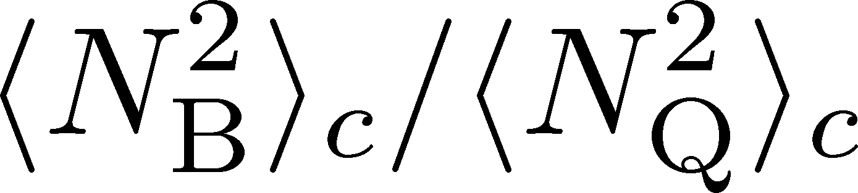
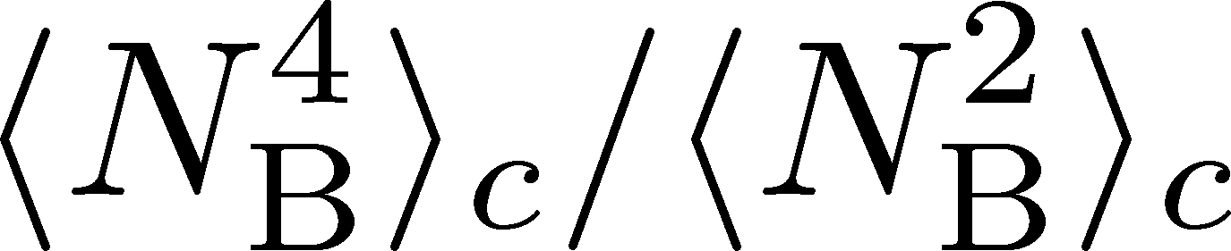
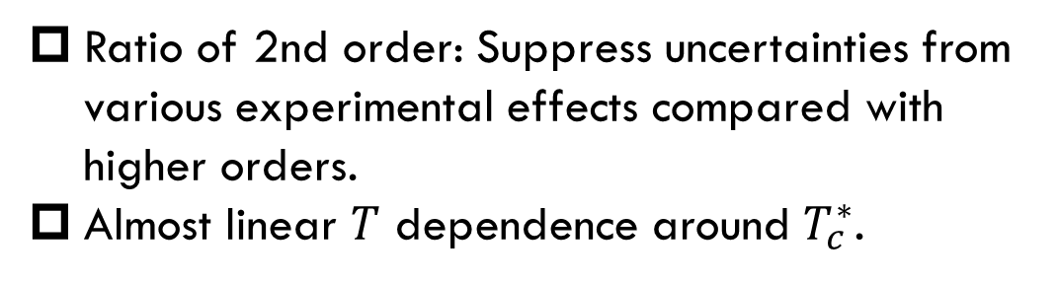
MK, Esumi, Nonaka, 2205.10030
Ratio of 2nd order: Suppress uncertainties from various experimental effects compared with higher orders.
Almost linear $T$ dependence around $T_{c}^{∗}$.
Data from
HotQCD,
PRD104 (’21)
HOT-QCD 2017

Slide 23
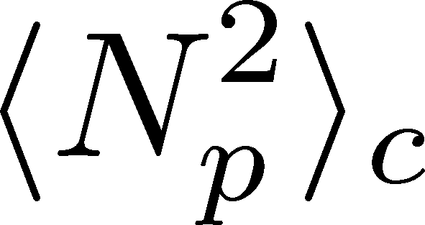
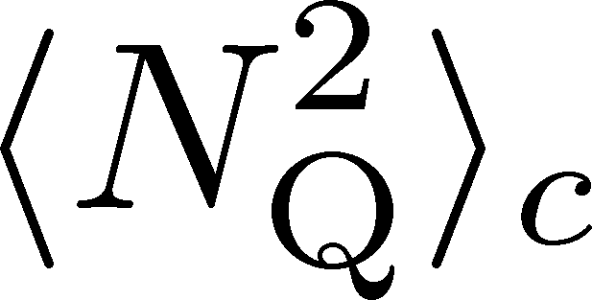
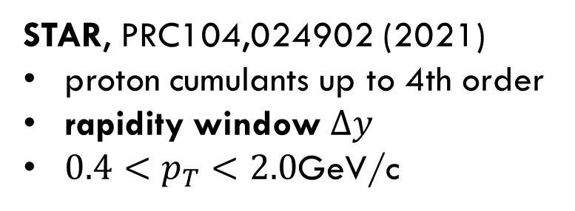
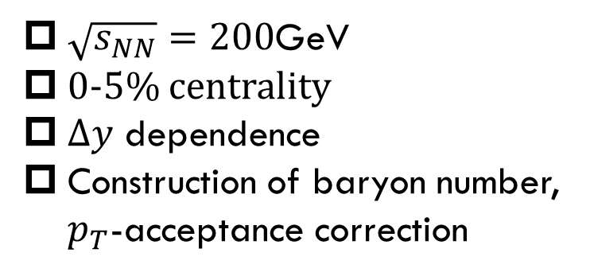
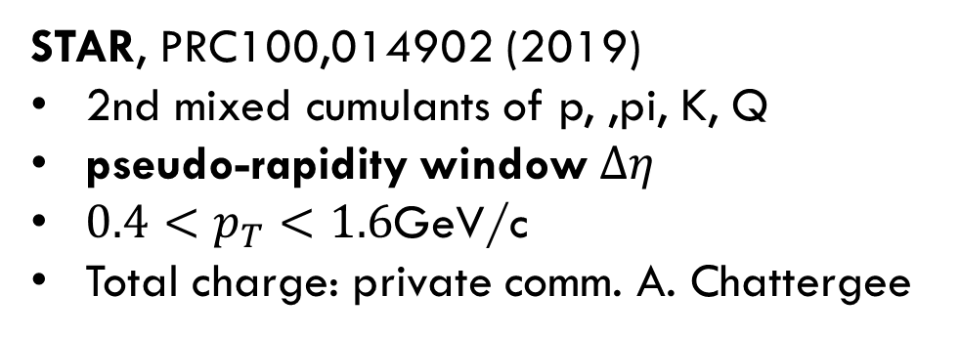
Experimental Data
MK, Esumi, Nonaka, 2205.10030
$\sqrt{s_{NN}}=200$GeV
0-5% centrality
$Δy$ dependence
Construction of baryon number, $p_{T}$-acceptance correction
STAR, PRC104,024902 (2021)
proton cumulants up to 4th order
rapidity window $Δy$
$0.4<p_{T}<2.0$GeV/c
STAR, PRC100,014902 (2019)
2nd mixed cumulants of p, ,pi, K, Q
pseudo-rapidity window $Δη$
$0.4<p_{T}<1.6$GeV/c
Total charge: private comm. A. Chattergee
proton → baryon cumulants MK, Asakawa,’12;’12
Rapidity is better than pseudo-rapidity
Wider acceptance is more desirable.
Ohnishi, MK, Asakawa, ’16

Slide 24
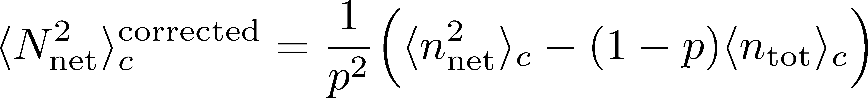
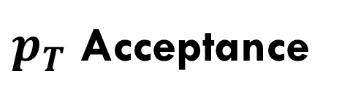


$pT$-Acceptance Correction
MK, Esumi, Nonaka, 2205.10030
$p_{T}$ Acceptance
0.4<p_{T}<1.6 [GeV/c]
0.4<p_{T}<2.0 [GeV/c]
PRC100,014902(’19)
PRC104,024902(’21)
Particles in $p_{T}$ space
Electric charge: 49%
Protons: 82%
blast wave model @ √s_{NN}=200 GeV
Modification by $p_{T}$-cut should be corrected.
This study: Binomial distribution model.
MK, Asakawa, ’12, ’12
correction in HRG: Alba+’14; ’15; …

Slide 25
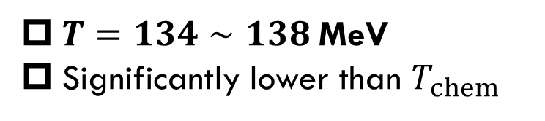
HIC vs HRG&LAT
MK, Esumi, Nonaka, 2205.10030
From data @ STAR
HRG+Lattice
Data from
HotQCD, PRD104 (’21)
$T=134∼138$MeV
Significantly lower than $T_{chem}$
HRG: QMHRG2020
Bollweg+, PRD104, 7 (’21)
Volume dep. corrected
plot by MK

Slide 26
HIC vs HRG&LAT
MK, Esumi, Nonaka, 2205.10030
From data @ STAR
HRG+Lattice
Data from
HotQCD, PRD104 (’21)
$T=134∼138$MeV
Significantly lower than $T_{chem}$
HRG: QMHRG2020
Bollweg+, PRD104, 7 (’21)
Volume dep. corrected
plot by MK

Slide 27
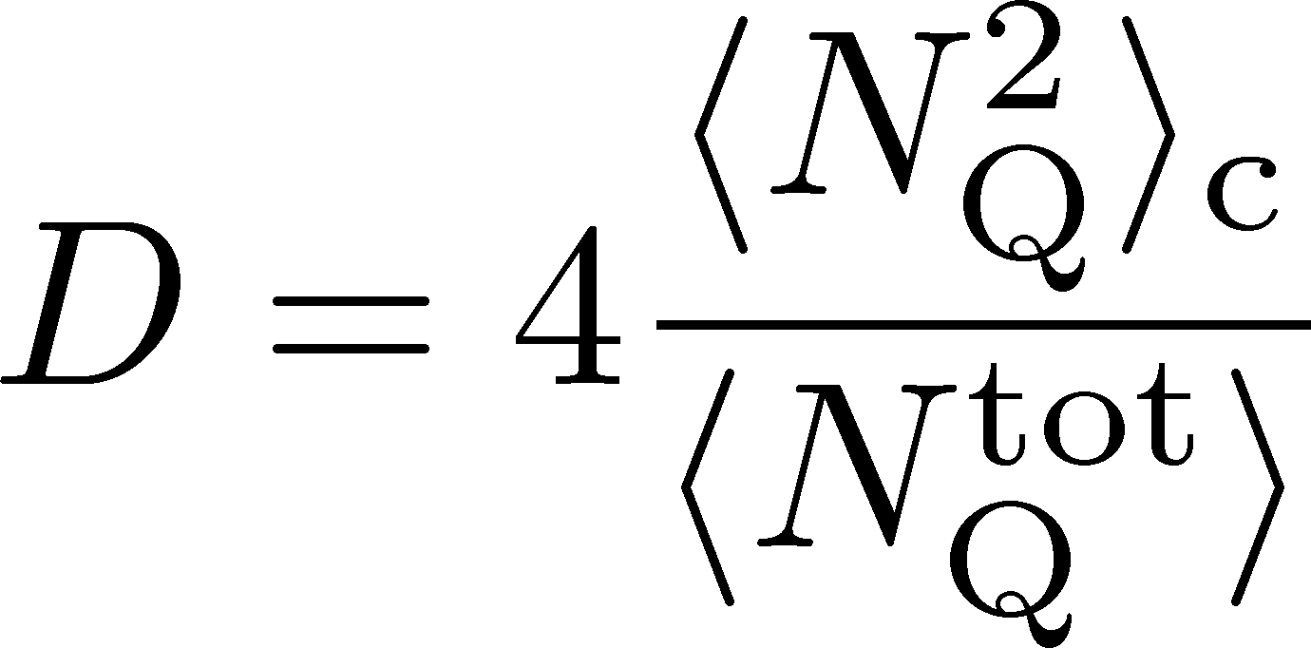





D-Measure = Net-charge Fluctuations
CMS (Tuo, QM2023)
D-measure
ALICE, PRL2013
Hadron gas
QGP
Jeon, Koch, 2000

Slide 28
D-Measure = Net-charge Fluctuations
CMS (Tuo, QM2023)
D-measure
ALICE, PRL2013
Hadron gas
QGP
Jeon, Koch, 2000

Slide 29
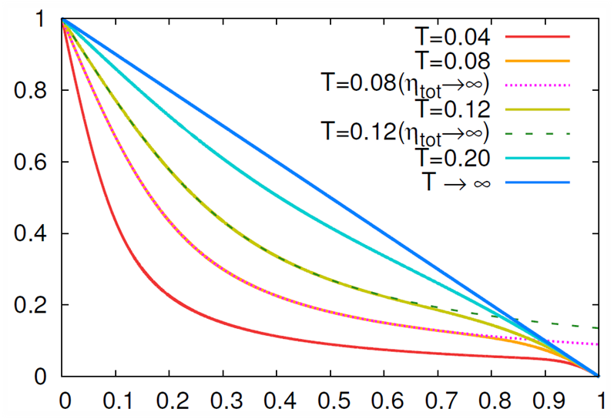
Comparison with a Diffusion Model in Finite Volume
Diffusion model in finite volume
MK, in progress
Sakaida, Asakawa, MK, PRC, 2014
CMS
QuarkMatter2023
Sakaida, Asakawa, MK, PRC ’14
effect of
GCC
CMS result is well described by a simple diffusion model in finite volume.
Effects of the global charge conservation do not affect the results for $Δη<5$.

Slide 30
Dilepton Production
as experimental observables of
Color Superconductivity & QCD-CP
Nishimura, MK, Kunihiro, PTEP2022, 093D02; PTEP2023, 053D01; in prep

Slide 31
Observing CSC in HIC
Difficulties
  CSC would not be created if Tc is not high enough.
  Even if created, its lifetime would be short.
  Since CSC is created in the early stage, its signal would be blurred during the evolution in later stage.
Strategy in our study:
  Focus on precursory phenomena of CSC
  Use dilepton production as an observable
Ohnishi, 2002

Slide 32
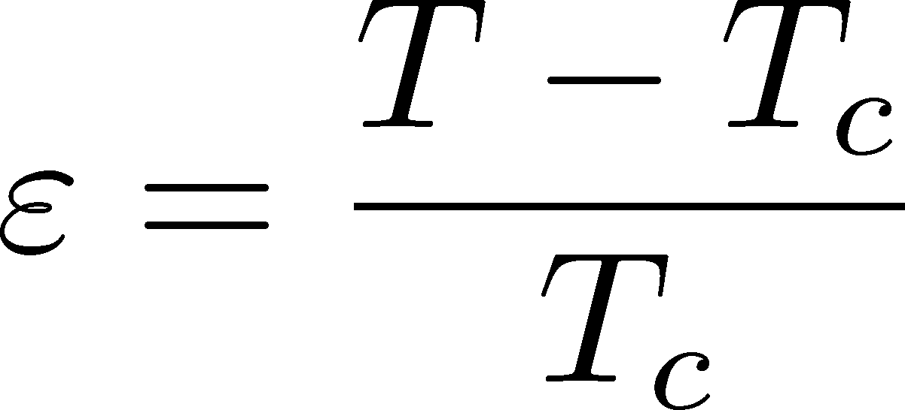


Precursor of CSC
Anomalous behavior of observables near but above Tc of SC
electric conductivity
magnetic susceptibility
pseudogap
Electric conductivity
Skopal, Tinkham(‘75)
Enhanced pair fluctuations is one of the origins of precursory phenomena.
More significant phenomena in strongly-coupled systems.
T>Tc
Landau’s free energy
T<Tc

Slide 33

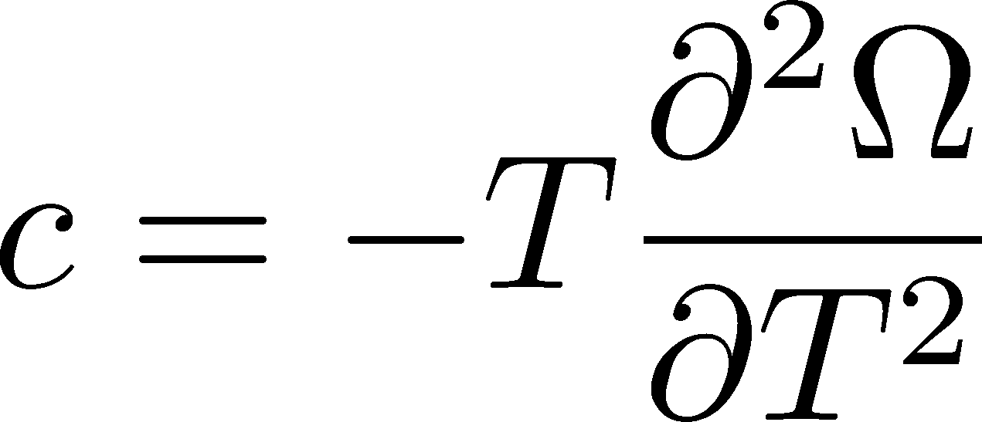
Precursor of Color Superconductivity
MK, Koide, Kunihiro, Nemoto, ’03, ‘05
Thermodynamic Potential
Pseudogap
Specific heat
density of states
Depression
in DoS above Tc

Slide 34
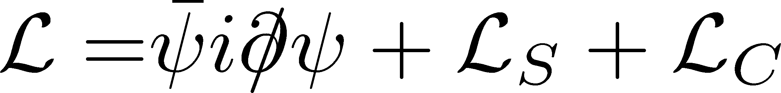
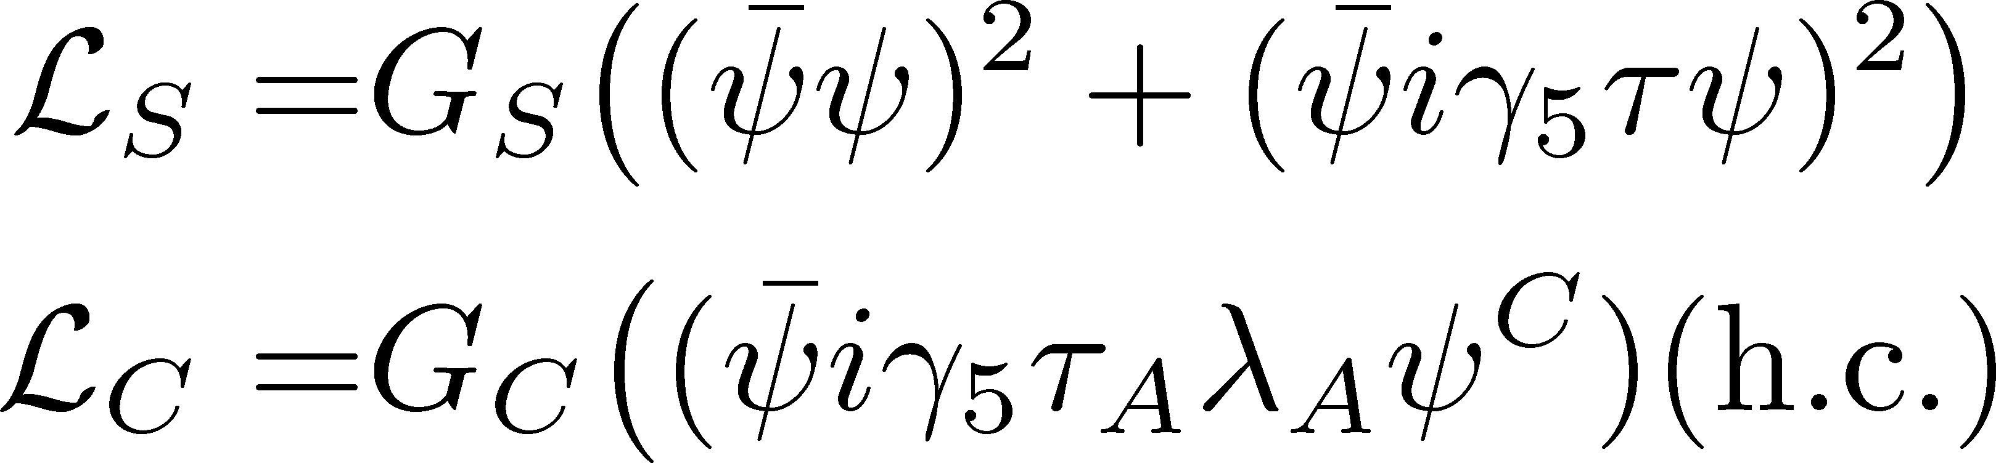
Model
NJL model (2-flavor)
Phase Diagram in MFA
diquark interaction
Parameters
Order of phase transition
  2nd in the MFA
  can be 1st due to gauge fluctuation
Matsuura+(’04), Giannakis+(’04)
Noronha+(’06), Fejos, Yamamoto(’19)

Slide 35
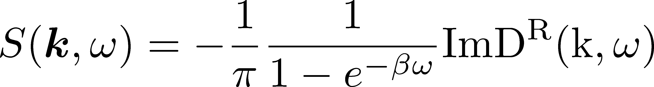

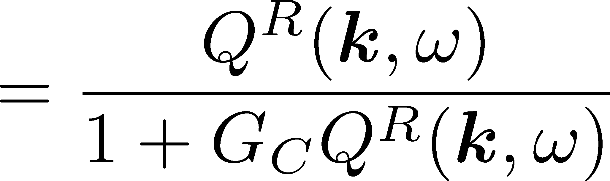




Di-quark Fluctuations
Diquark Propagator
Dynamical Structure Factor
Random Phase Approximaion
$$=$$
$$+$$
$$+ ∙∙∙$$
Diquark field becomes massless at T=Tc
Soft mode of CSC transition
Strength in the space-like region
MK, Koide, Kunihiro, Nemoto, ’01,’05

Slide 36

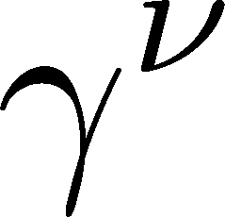
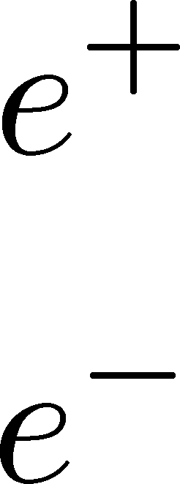
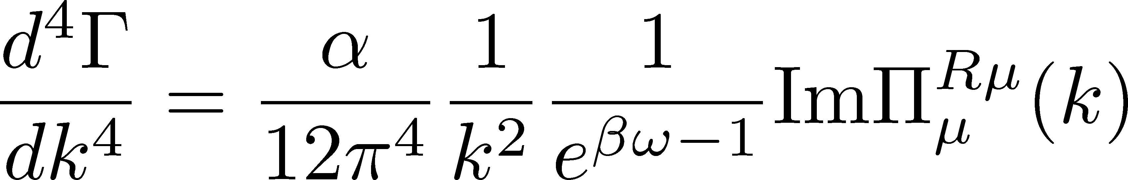
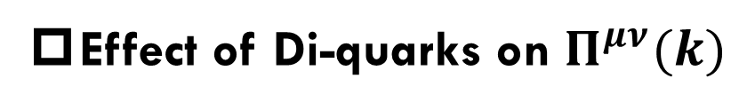
Photon Self-Energy: Precursor of CSC
Dilepton Production Rate
Effect of Di-quarks on $Π^{μν}(k)$
Aslamasov-Larkin term
Maki-Thompson term
DPR from CFL phase
Jaikumar, Rapp, Zahed (’02)
Well-known diagrams in metallic SC
for describing paraconductivity

Slide 37
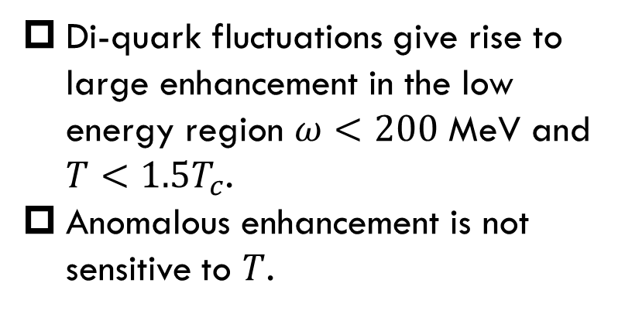
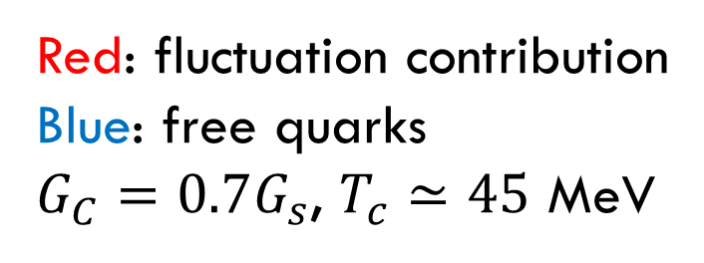
Production Rate at $k=0$
Nishimura, MK, Kunihiro (’22)
Red: fluctuation contribution
Blue: free quarks
$G_{C}=0.7G_{s}$, $T_{c}≃45$ MeV
enhancement
Di-quark fluctuations give rise to large enhancement in the low energy region $ω<200$ MeV and $T<1.5T_{c}$.
Anomalous enhancement is not sensitive to $T$.

Slide 38
Invariant-Mass Spectrum
Nishimura, MK, Kunihiro (’22)
Strong enhancement at low invariant mass.
Observable in the HIC?

Slide 39




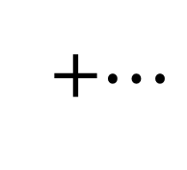
Dileptons from QCD Critical Point
NJL model (2-flavor)
Parameters
Soft Mode of QCD-CP
= fluctuation of scalar ($\overline{q}q$) channel
Modification of dilepton production through
Random Phase Approximaion
$$=$$
$$+$$
$$+ ∙∙∙$$
+$⋯$
MT, DoS

Slide 40
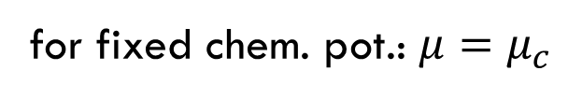

Dilepton production rate near QCD-CP
Invariant mass spectrum
Nishimura, MK, Kunihiro (’23)
for fixed chem. pot.: $μ=μ_{c}$
Enhancement at low $M_{ll}$ region near QCD-CP
Distinguishment from diquark soft mode may be difficult.

Slide 41
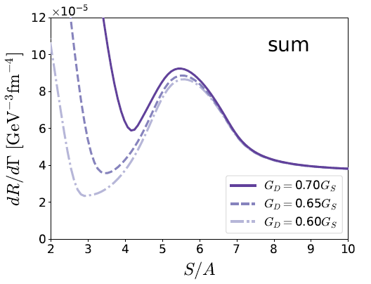
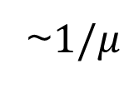


Dilepton Yields: Beam-Energy Scan
Nishimura, Nara, Steinheimer, arXiv:2311.14135
Dilepton yields
$≃$ integrated rate along isentropic lines
Dilepton Yields $50<M<100$ MeV
from 2SC
Isentropic lines in NJL model
peak from
QCD-CP
~$1/μ$

Slide 42
Summary
A rich phase structure exists in dense QCD.
  QCD critical point, color superconductivity, etc.
The beam-energy scan will reveal it.
Many interesting observables to explore the QCD phase diagram:
  Event-by-event fluctuations of conserved charges
  Dilepton production at ultra-low-mass-region
  …

Slide 43
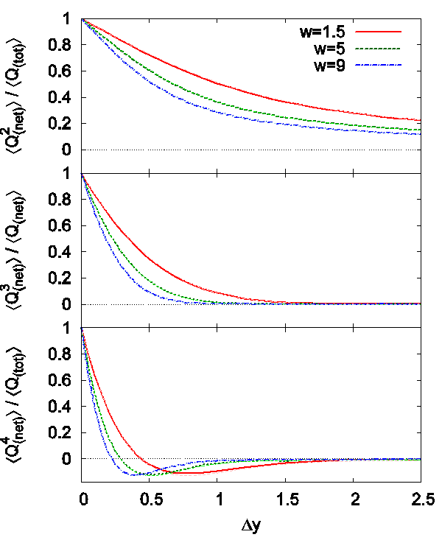



Effect of Diffusion and Rapidity Conversion
Ohnishi, MK, Asakawa, PRC (‘16)
Blurring due to diffusion & rapidity conversion ($Y→y$)
Stronger modification in Q than B
Resonance Decays
About 30% charged particles come from RD
Enhancement of charged particles
Increase $⟨N_{Q}^{2}⟩$
Reduce ${\left\langle N_{B}^{2}\right\rangle }_{c}/{\left\langle N_{Q}^{2}\right\rangle }_{c}$
These effects will be more important for higher order cumulants!

Slide 44




Cumulants: Proton→Baryon & Acceptance Correction
Data from STAR, ’19, ’21
corrected
dashed:
$⟨N_{}^{tot}⟩$
Poisson
suppress
corrected
uncorrected
uncorrected
$${\left\langle N_{p}^{2}\right\rangle }_{c}$$
Deviation from Poissonian is clarified by the acceptance correction.
MK, Asakawa, ’12, ’12

Slide 45



$p_{T}$-acceptance uncorrected
$p_{T}$-acceptance corrected
dashed:
Poisson
${\left\langle N_{B}^{2}\right\rangle }_{c}/{\left\langle N_{Q}^{2}\right\rangle }_{c}$ becomes smaller due to the $p_{T}$-acceptance correction.
Clear $Δy$ dependence
non-thermal effects behind fluctuations

Slide 46






Evolution of Conserved-charge Fluctuations
Quark-Gluon Plasma
Fluctuations of CC are modified by the diffusion.
Hadronization
Relaxation time becomes longer as $ΔY→$large.
Freezeout
Experiments on $⟨N_{Q}^{2}⟩$
No QGP signal @ RHIC (’02, ’03)
QGP signal? @ ALICE (’12)
Asakawa, Heinz, Muller, 2000
Jeon, Koch, 2000; Shuryak, Stephanov, 2001

Slide 47

Exploring Dense Medium
Neutron stars
Equation of state
QCD critical point /
1st order transition /
Color superconductivity
Dilepton production rate
Event selection /
Higher correlations

Slide 48

Hadron/Hypernuclear Physics
Hypernuclei
Correlation functions
→hadron interaction
STAR,2015
¹²C+¹²C at 15AGeV
(5T / 2.4m magnet)

Slide 49

Production Mechanism
Light-nuclei production
Measurement of light/hyper-nuclei
as a signal of QCD critical point
from QM2023
Oliinychenko (’20)
baryon fluctuations
→ enhancement of light nuclei?
Precise data will lead us to a better understanding of production mechanism
Sun+ (’18)

