Slide 1
YITP-RIKEN iTHEMS International Molecule-type Workshop “Condensed Matter Physics of QCD 2024”, 2024/03/15, YITP, Kyoto
Lee-Yang Zeros
around critical point of heavy-quark QCD
Masakiyo Kitazawa
(YITP)
with
Tatsuya Wada, Shinji Ejiri, Kazuyuki Kanaya

Slide 2

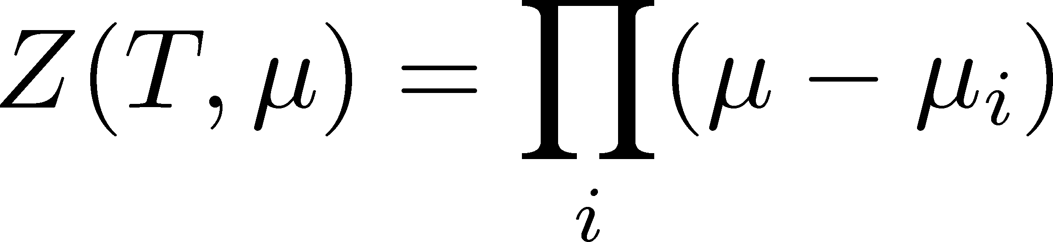




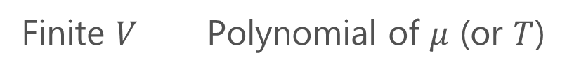
Lee-Yang Zero
Yang, Lee; Lee, Yang (’52)
Partition Function
Finite $V$ Polynomial of $μ$ (or $T$)
zeros on the complex plane
=Lee-Yang Zeros

Slide 3




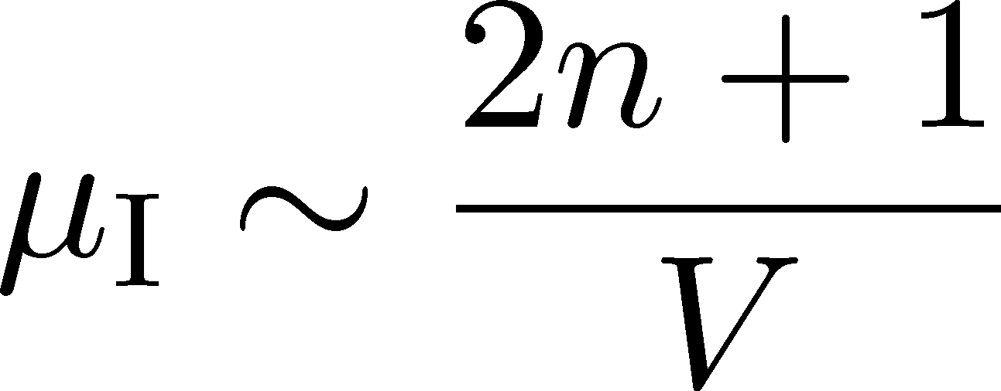
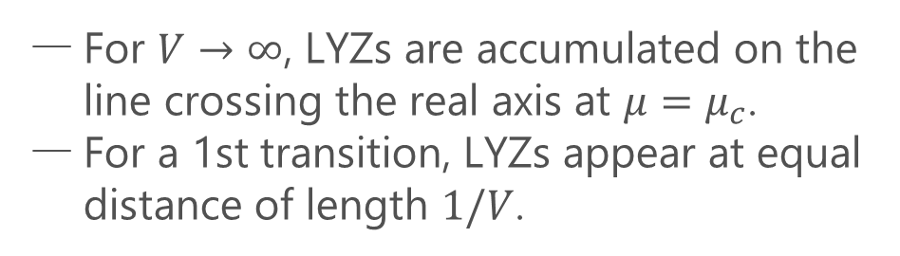
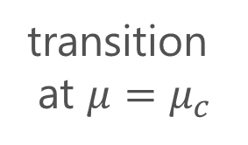
Lee-Yang Zero
Yang, Lee; Lee, Yang (’52)
Partition Function
Phase Transition & LYZ
Finite $V$ Polynomial of $μ$ (or $T$)
transition
at $μ=μ_{c}$
first order
transition
For $V→∞$, LYZs are accumulated on the line crossing the real axis at $μ=μ_{c}$.
For a 1st transition, LYZs appear at equal distance of length $1/V$.
zeros on the complex plane
=Lee-Yang Zeros

Slide 4



LY Zeros around a Critical Point
1st-transition
singularity on the real $h$ axis
Crossover
no singularity on the real axis

Slide 5
LY Zeros around a Critical Point
1st-transition
singularity on the real $h$ axis
Crossover
no singularity on the real axis

Slide 6
LY Zeros around a Critical Point
1st-transition
singularity on the real $h$ axis
Crossover
no singularity on the real axis
LY edge singularity
starting from the CP
Edge singularity is determined by the analytic property of the scaling function.

Slide 7
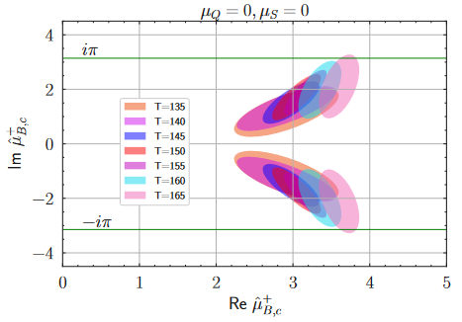
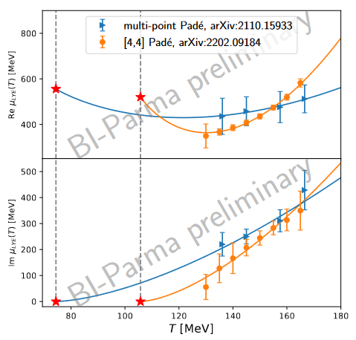

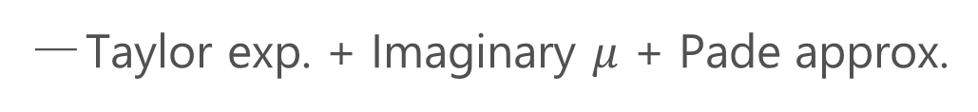
Recent Topics in LYZ
and LY edge singularity
HotQCD (’22)
Analytic Structure
Scaling functions, FRG, …
An, Mesterhazy, Stephanov (’16)
Johnson, Rennecke, Skokov (’23)
Karsch, Schmidt, Singh (‘23)
…
Locating QCD-CP at $μ≠0$ on the lattice?
Taylor exp. + Imaginary $μ$ + Pade approx.
HotQCD (’22)
D.A. Clarke, Lattice 2023
D.A. Clarke, Lattice 2023

Slide 8
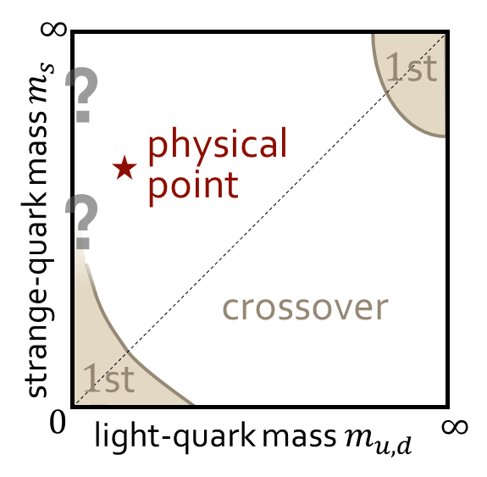
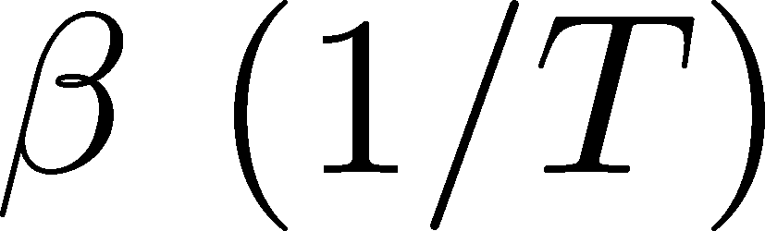
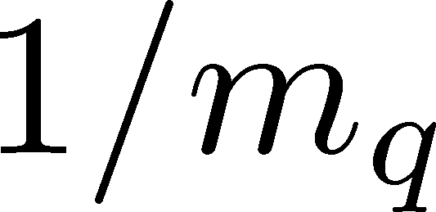

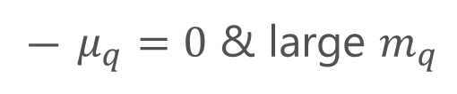
Present Study: Heavy-Quark QCD
Columbia Plot
Phase Diagram
This study
critical point
CP in heavy-quark QCD
We study the LYZ around the HQ-QCD-CP.
$μ_{q}=0$ & large $m_{q}$
Easy to handle in lattice simulations!

Slide 9
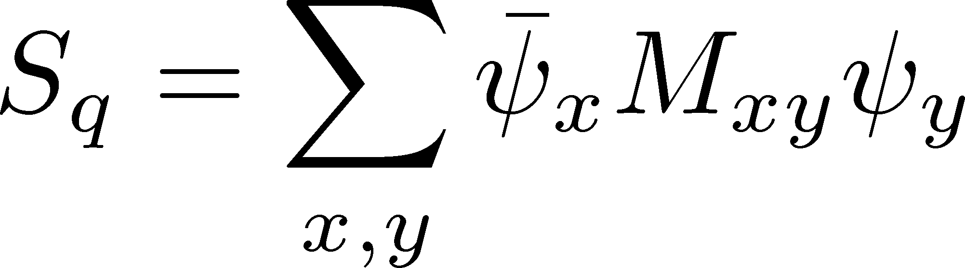
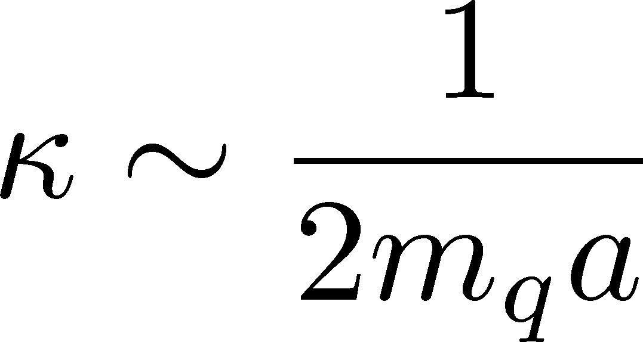
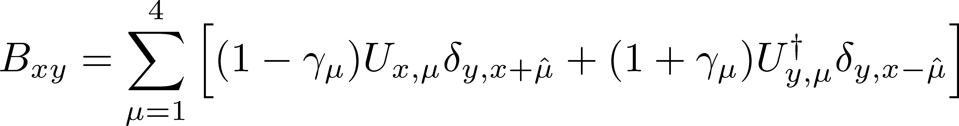
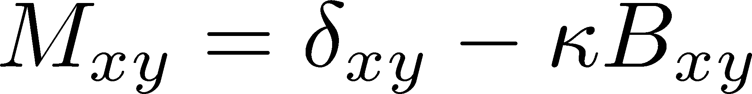
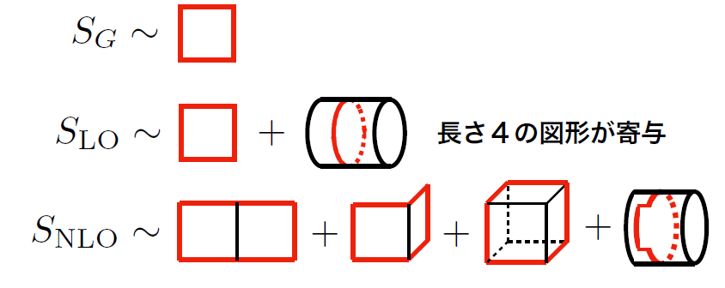
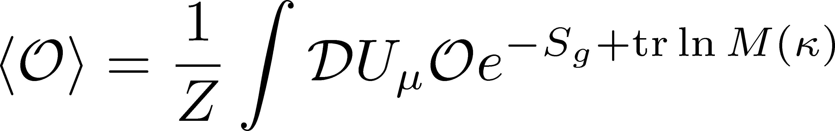
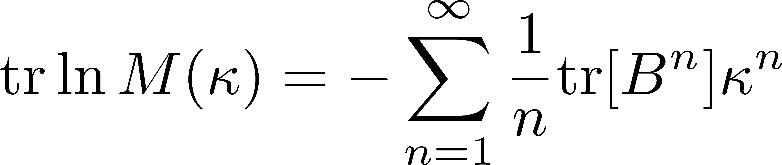


Hopping-Parameter Expansion (HPE)
~ $1/m_{q}$ expansion
Wilson Fermion
: hopping parameter
nonzero only for neighboring $(x,y)$
Hopping-Parameer Expansion
$n$th order terms in the HPE: closed trajectories of length $n$.

Slide 10
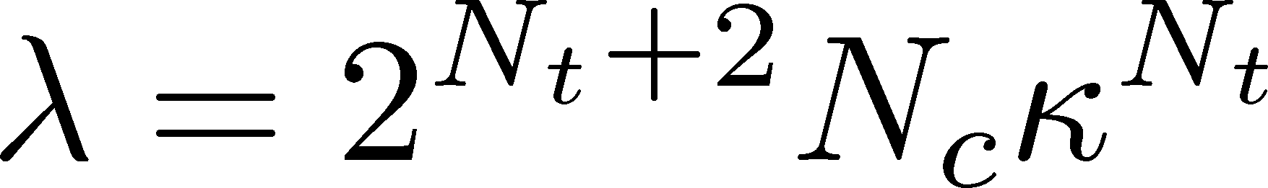

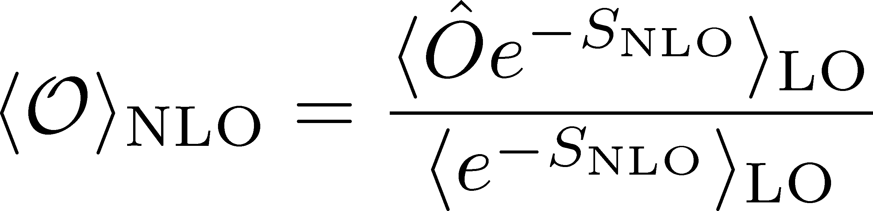
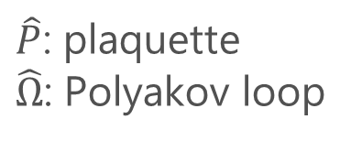
Higher-Order Terms in HPE
Monte Carlo Simulation @ LO
heat bath & over relaxation with modified staple
$\hat{P}$: plaquette
$\hat{Ω}$: Polyakov loop
Numerical cost is almost the same as the pure YM!
NLO by Reweighting
Overlapping problem is well suppressed due to the LO confs.
Realize high statistical analysis

Slide 11
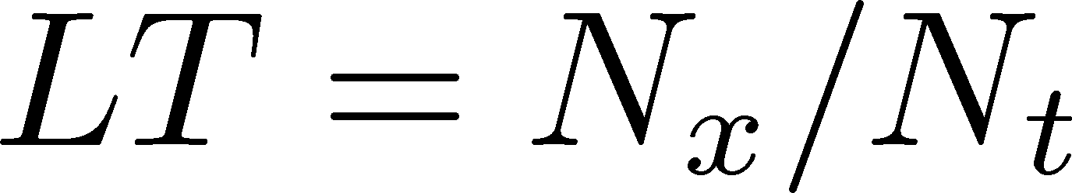
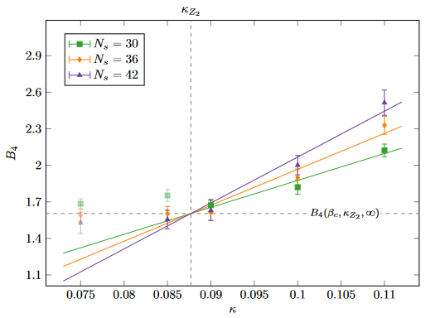



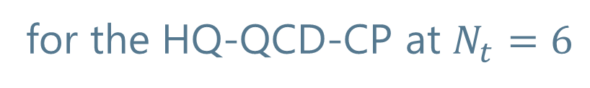

Binder Cumulant Analysis
for the HQ-QCD-CP at $N_{t}=6$
Our result (HPE-NLO)
w/ Dynamical Fermions
fit $LT=15−9$
fit $LT=15−10$
MK, Ashikawa, Ejiri, Kanaya, Lattice 2023
Cuteri , Philipsen , Schön, Sciarra, ’21
One order smaller statistical errors on more than twice larger $LT$!
Precise determination of the location of the CP

Slide 12

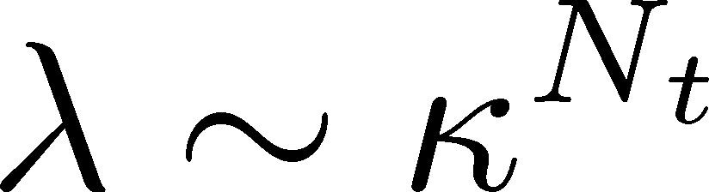
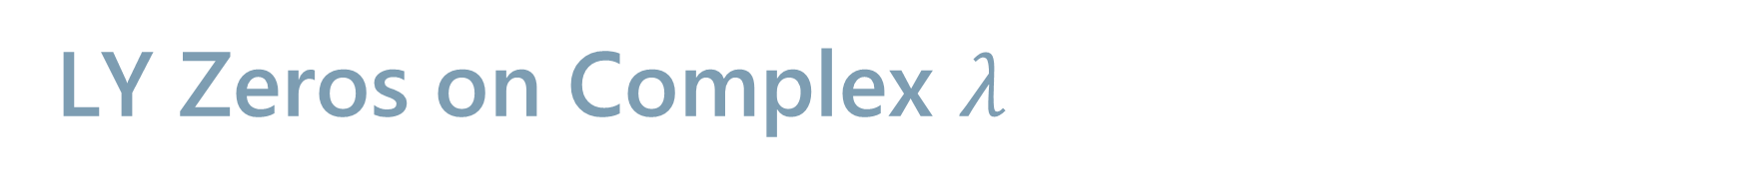
LY Zeros on Complex $λ$

Slide 13
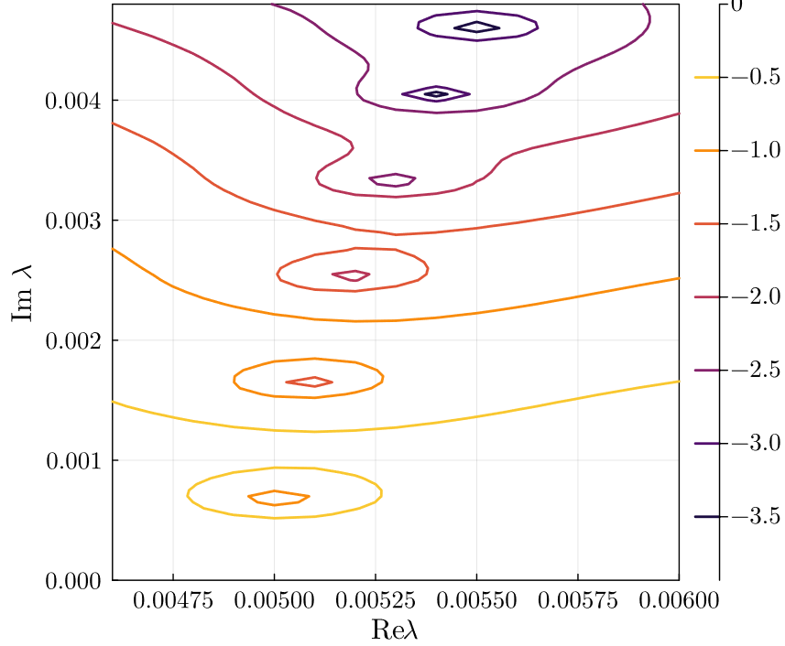
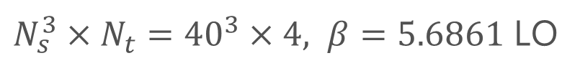
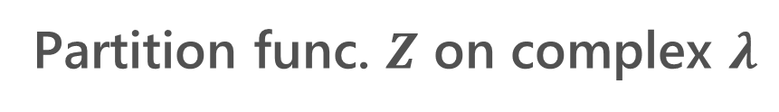
LY Zeros on Complex $λ$
Partition func. $Z$ on complex $λ$
$N_{s}^{3}×N_{t}={40}^{3}×4, β=5.6861$ LO
Good statistics to find many LYZ

Slide 14
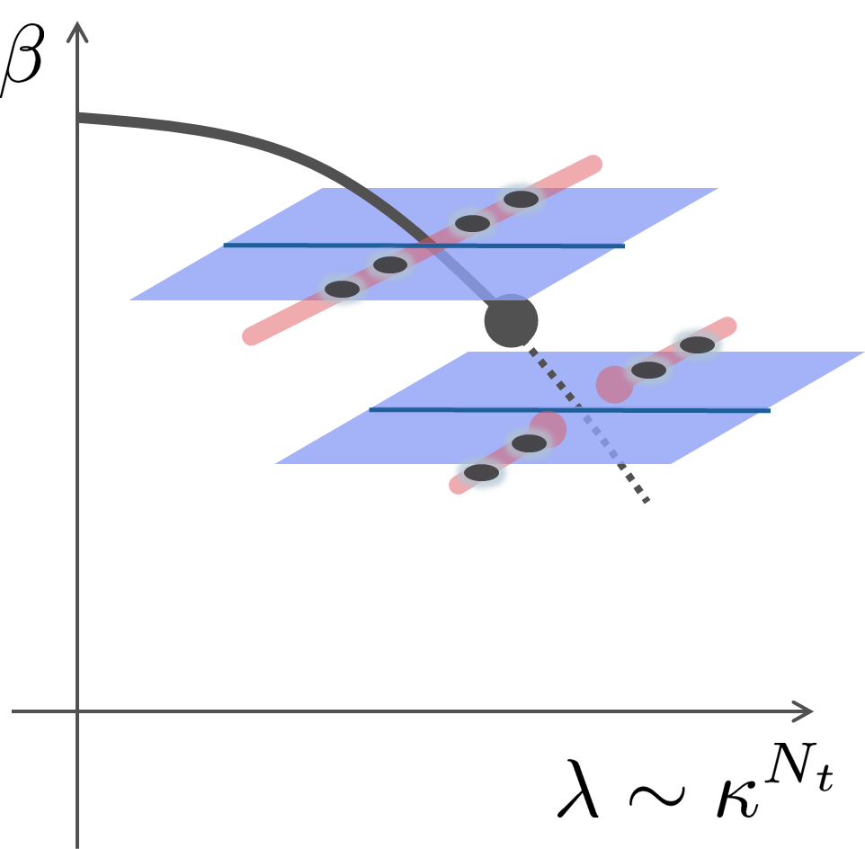
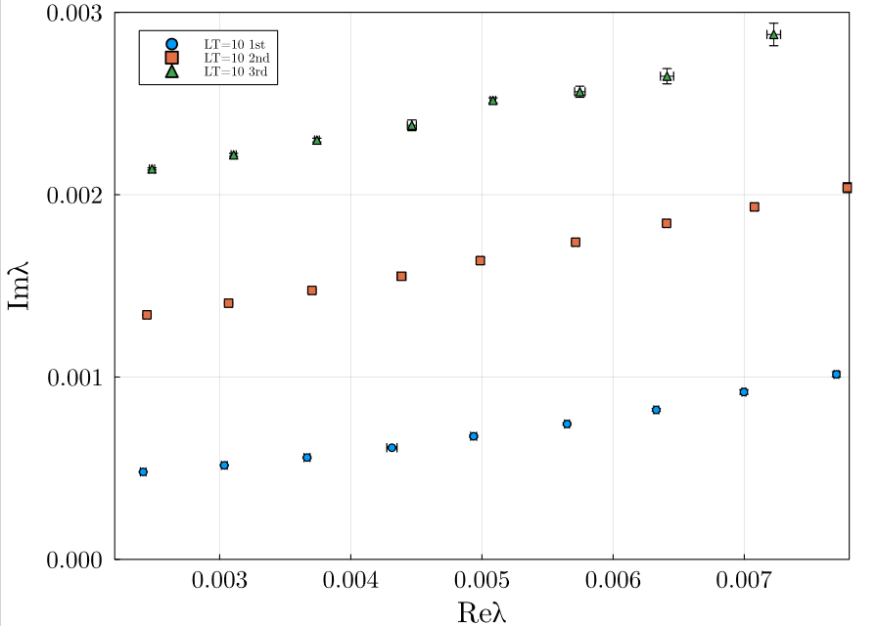
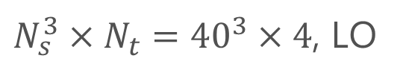
LY Zeros
$N_{s}^{3}×N_{t}={40}^{3}×4$, LO

Slide 15

LY Zeros
$N_{s}^{3}×N_{t}={40}^{3}×4$, LO
Quiz: Where is $λ_{c}$?
1st order
crossover
A
B
C

Slide 16
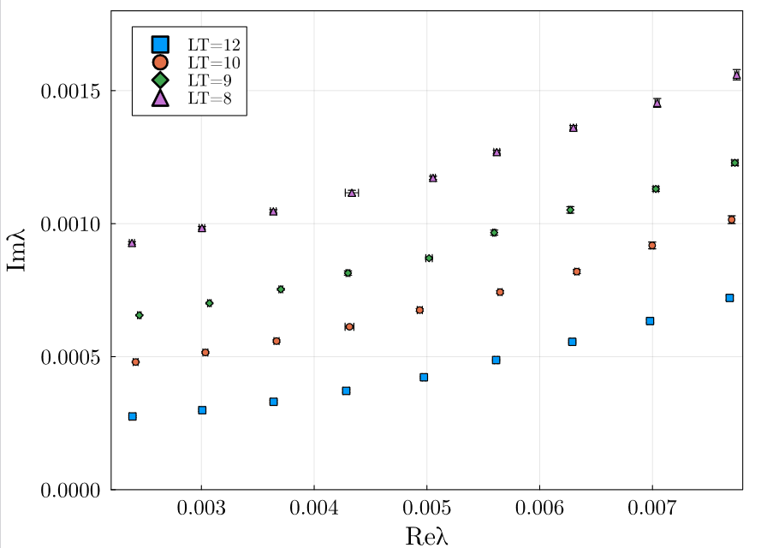
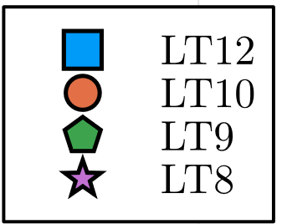

$LT$ Dependence of 1st LYZ
Quiz: Where is $λ_{c}$?
A
B
C

Slide 17
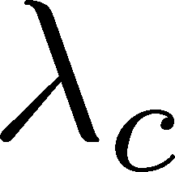
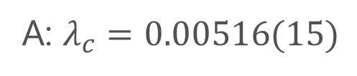
$LT$ Dependence of 1st LYZ
Quiz: Where is $λ_{c}$?
A: $λ_{c}=0.00516(15)$

Slide 18
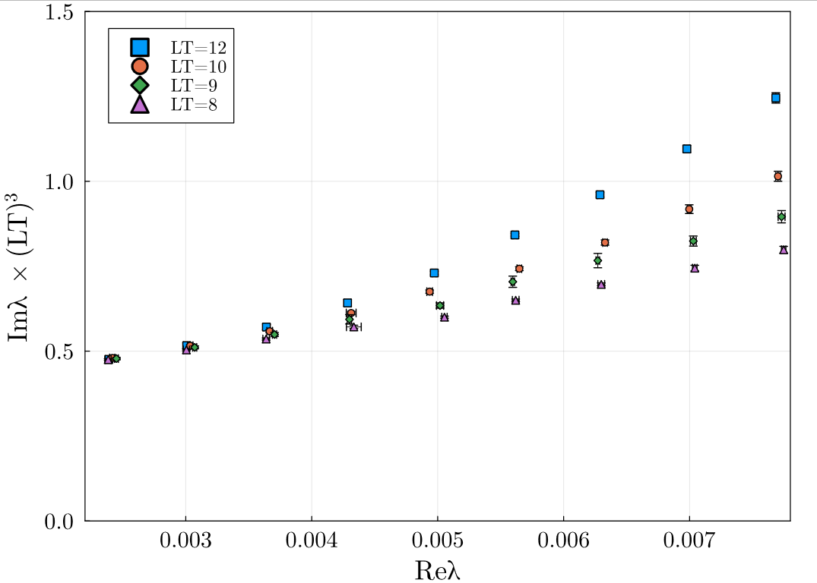
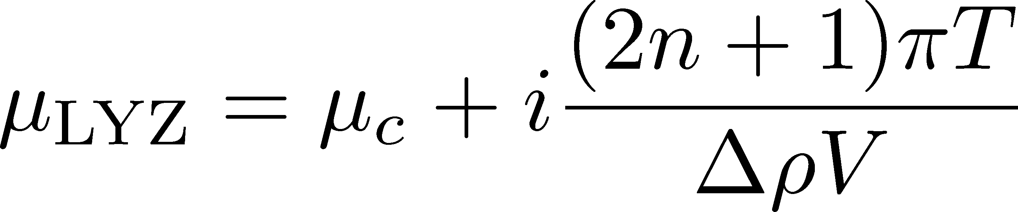
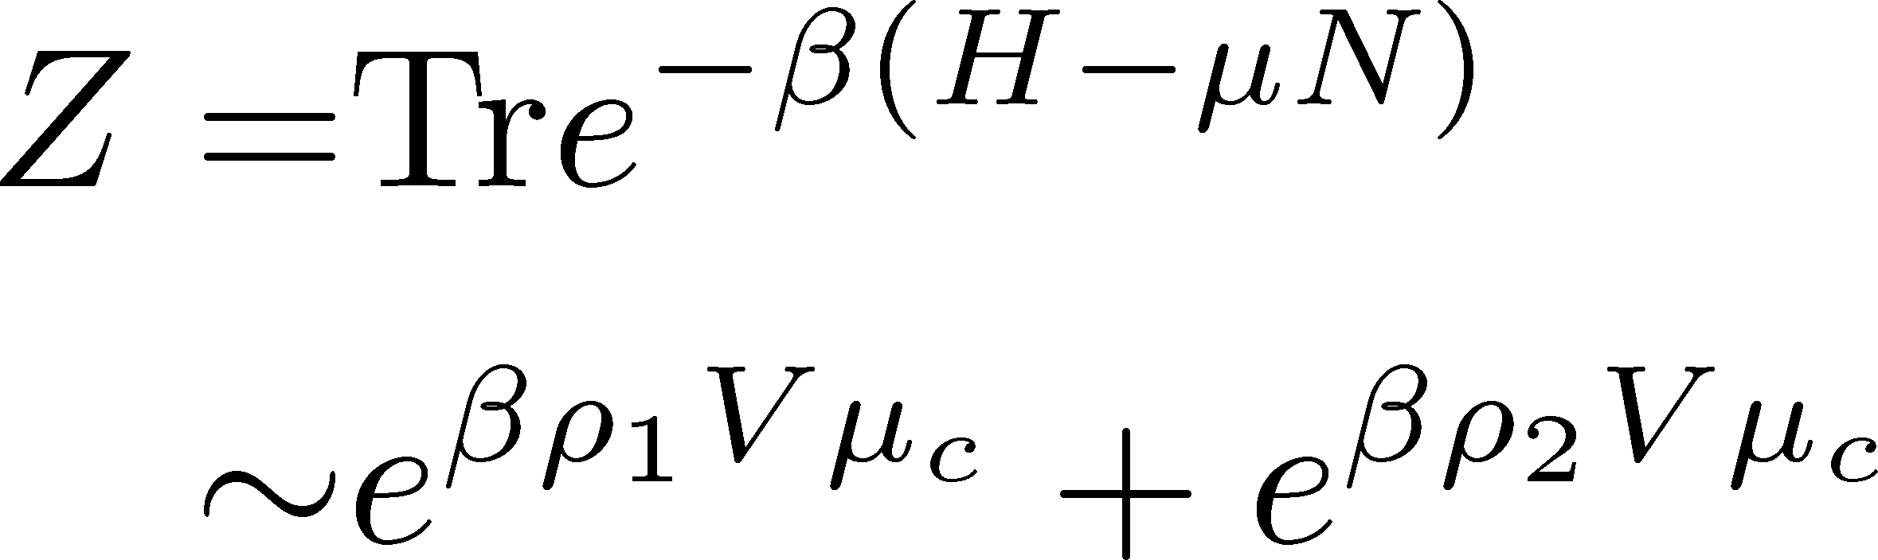
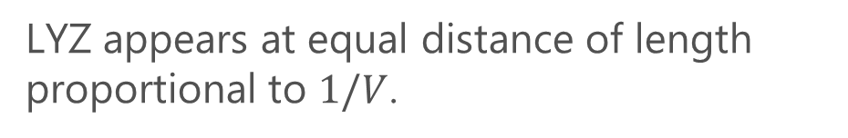
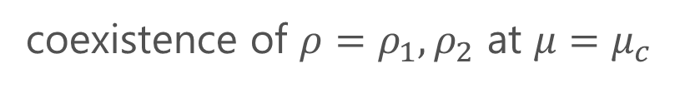
Scaling at the First-Order Side
1st Transition
coexistence of $ρ=ρ_{1}, ρ_{2}$ at $μ=μ_{c}$
LYZ appears at equal distance of length proportional to $1/V$.
Derivation:

Slide 19
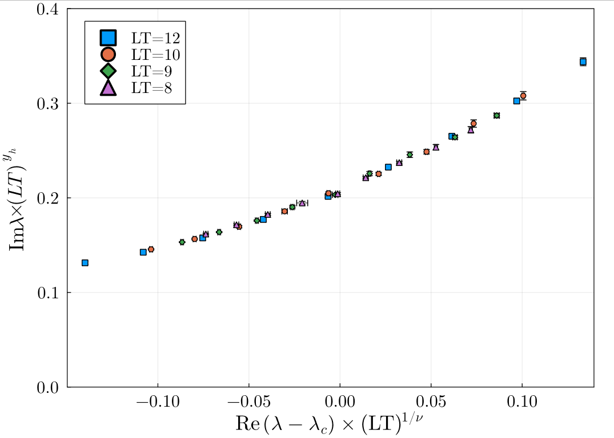
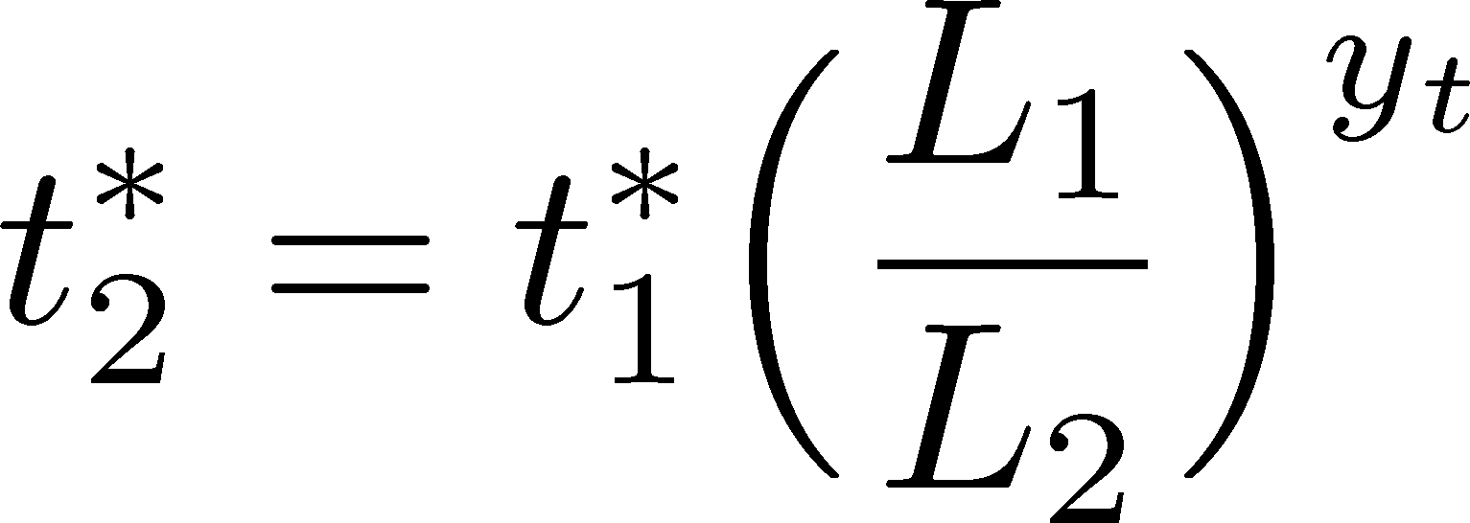
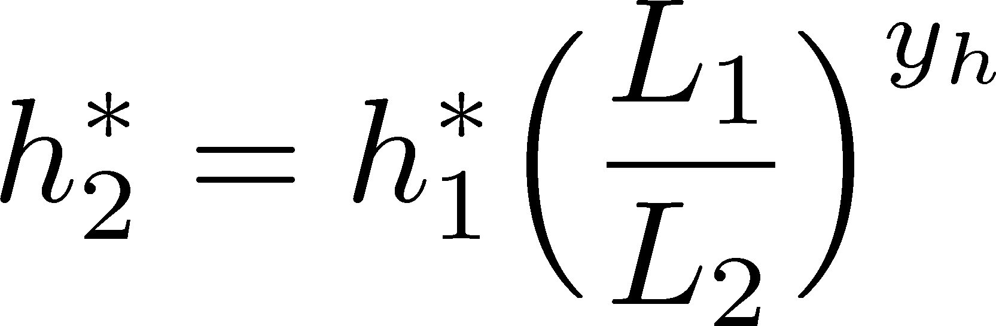
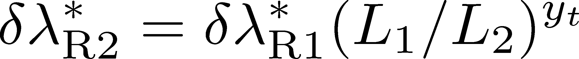
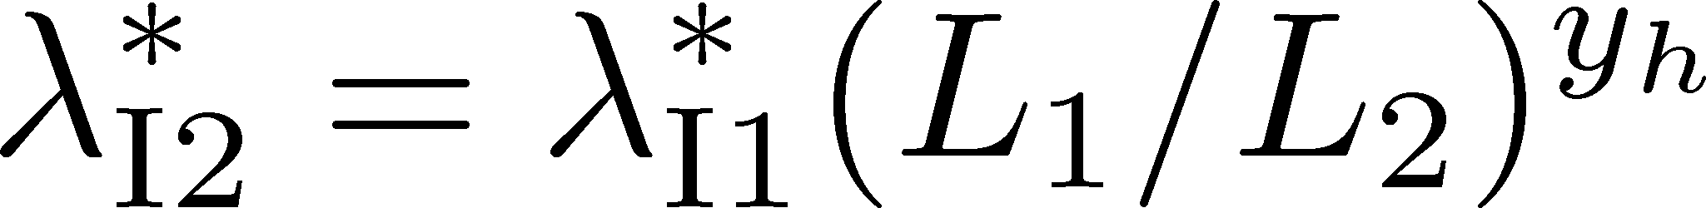
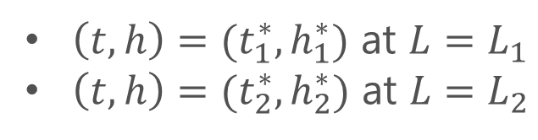
Finite-Size Scaling
LYZs
$\left(t,h\right)=(t_{1}^{∗},h_{1}^{∗})$ at $L=L_{1}$
$\left(t,h\right)=(t_{2}^{∗},h_{2}^{∗})$ at $L=L_{2}$
Stephanov, ’06

Slide 20
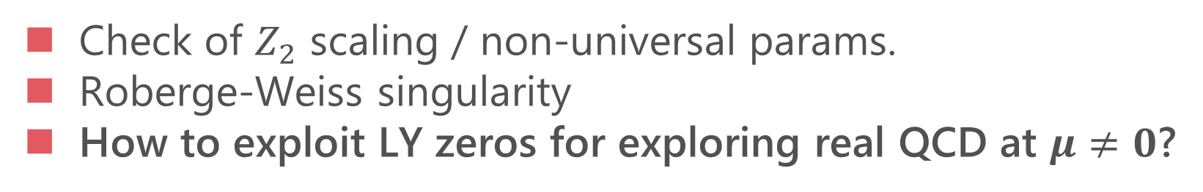
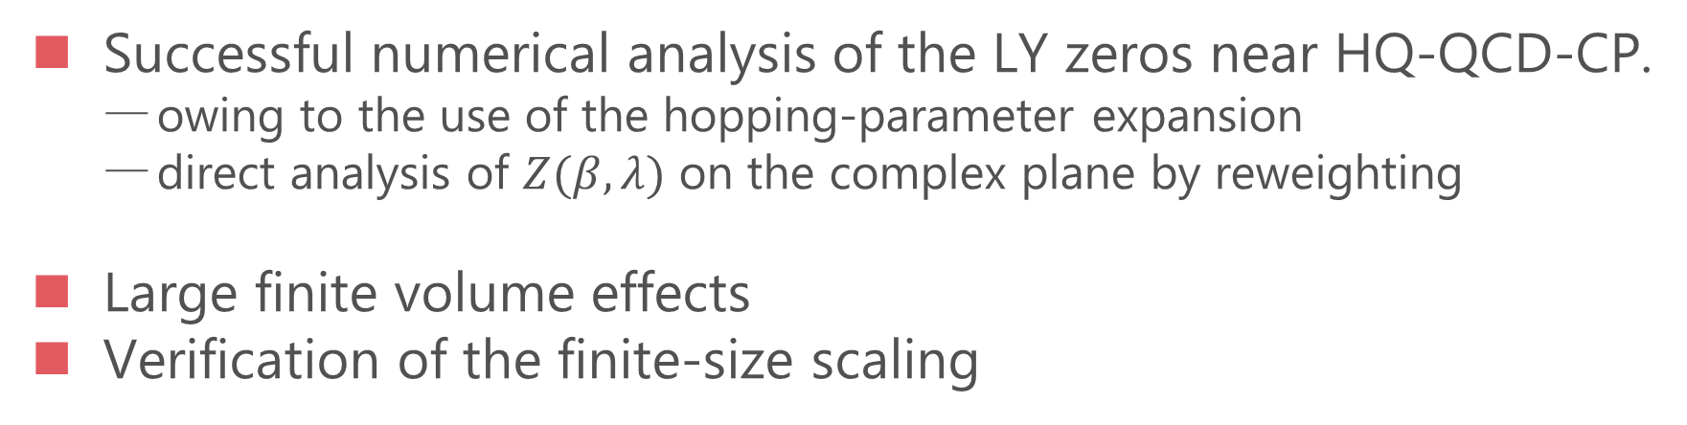
Summary & Outlook
Successful numerical analysis of the LY zeros near HQ-QCD-CP.
  owing to the use of the hopping-parameter expansion
  direct analysis of $Z(β,λ)$ on the complex plane by reweighting
Large finite volume effects
Verification of the finite-size scaling
Future
Check of $Z_{2}$ scaling / non-universal params.
Roberge-Weiss singularity
How to exploit LY zeros for exploring real QCD at $μ≠0$?

Slide 21
Backup

Slide 22


Ratio of 2nd/3rd LYZs to 1st
$$\frac{Imλ_{2}}{Imλ_{1}}, \frac{Imλ_{3}}{Imλ_{1}}$$

Slide 23







Numerical Setup
LO
NLO
NNLO$⋯$
Wilson type
Polyakov type
LO
NLO
NNLO+
Included in action of Monte-Carlo
reweighting
effective incorporation
Wakabayashi+ (’22)
Kiyohara+ (’21)

Slide 24





Convergence of HPE
Wakabayashi+ (’22)
HPE of free lattice field (U=1)
Wilson-loop-type
Polyakov-loop-type
$$N_{t}=4$$
$$N_{t}=6$$
$$N_{t}=4$$
$$N_{t}=6$$
$N_{t}=4$ $κ_{c}=0.0602\left(4\right)$ Kiyohara+,’21
$N_{t}=6$ $κ_{c}=0.0877\left(9\right)$ Cuteri+, ’21
NNLO and higher
Wakabayashi+ (’22)

Slide 25








Numerical Simulations
$N_{t}=4$
Kiyohara+, PRD104 (’21)
$N_{t}=6, 8$
Ashikawa+, in prep.
Coarse lattice: $N_{t}=4$, 6, 8
But large spatial volume:
$LT=N_{s} / N_{t}≤15$
High statistics ($\sim {10}^{6}$ measurements)
Hopping-param. (~$1$/$m_{q}$) expansion
Monte-Calro with LO action
4~6 simulation points for reweighting
Lattice size:
$$N_{t}=4$$
$LT=N_{x}/N_{t}=6,8,9,10,12$
$$N_{t}=6$$
$LT=N_{x}/N_{t}=6,7,8,9,10,12,15$
$$N_{t}=8$$
$LT=N_{x}/N_{t}=6,8,10,12$ (in prog.)

