Slide 1
The XVIth Quark Confinement and the Hadron Spectrum Conference, Cairns, 21 Aug. 2024
Lee-Yang Zeros
in Heavy-Quark QCD
Masakiyo Kitazawa
(YITP)
In collab. with Tatsuya Wada, Kazuyuki Kanaya

Slide 2
The XVIth Quark Confinement and the Hadron Spectrum Conference, Cairns, 21 Aug. 2024
Finite-Size Scaling of
Lee-Yang Zeros
(in Heavy-Quark QCD)
Masakiyo Kitazawa
(YITP)
In collab. with Tatsuya Wada, Kazuyuki Kanaya

Slide 3
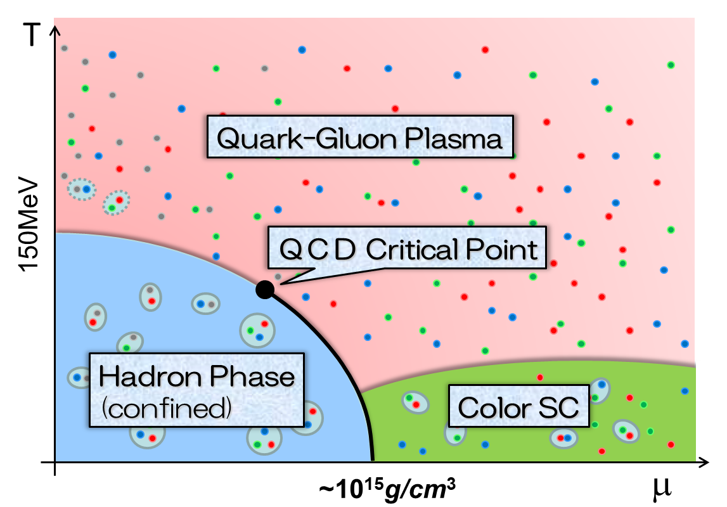
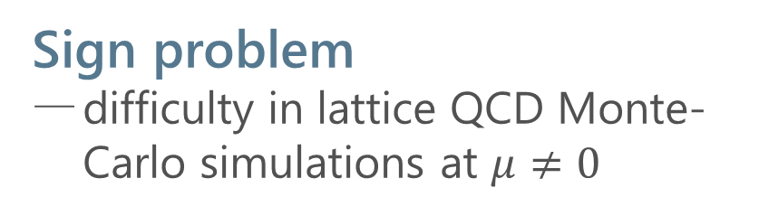
QCD Phase Diagram
Rich phase structure in QCD
QCD critical point(s)
color superconductivity
Sign problem
difficulty in lattice QCD Monte-Carlo simulations at $μ≠0$
Various approaches
Taylor expansion method
Imaginary chem. pot.
Complex Langevin
Lifschetz thimble
…

Slide 4
Lee-Yang-Zero Approach to QCD CP
arXiv:2405.10196 [hep-lat]
What are the Lee-Yang zeros?
Why they are so useful?

Slide 5

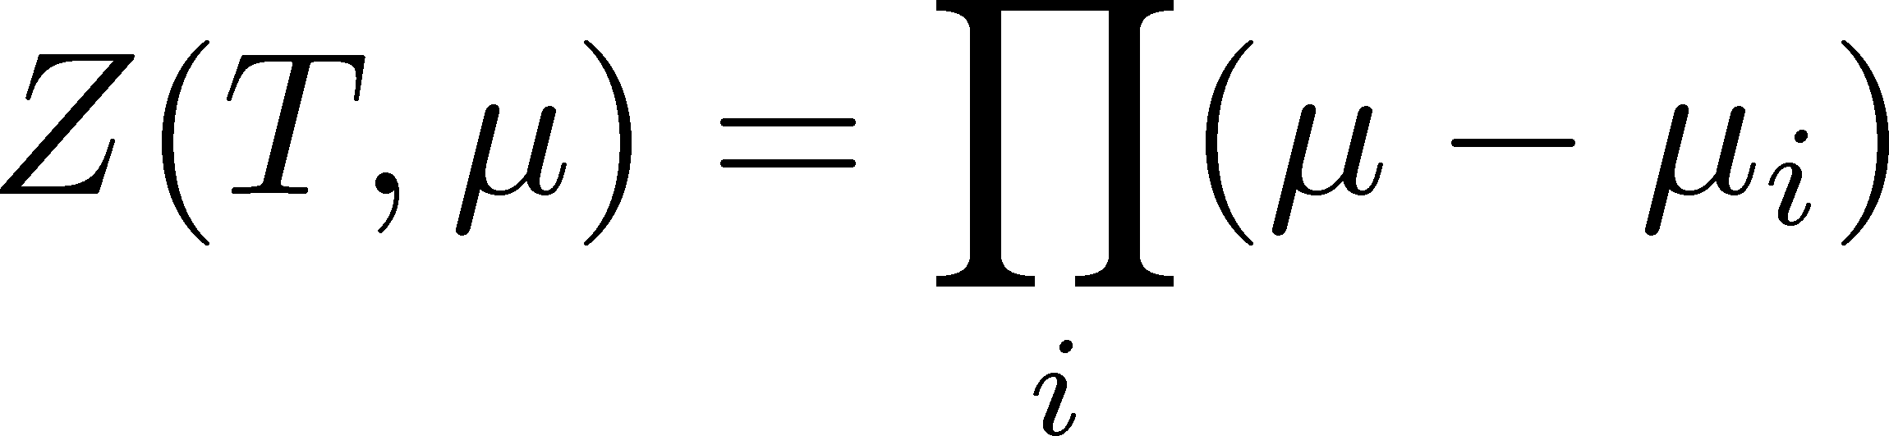




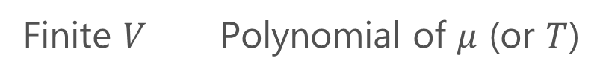
Lee-Yang Zeros
Yang, Lee; Lee, Yang (’52)
Partition Function
Finite $V$ Polynomial of $μ$ (or $T$)
zeros on the complex plane
=Lee-Yang Zeros

Slide 6


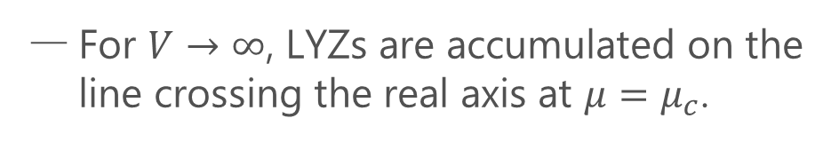

Lee-Yang Zero
Yang, Lee; Lee, Yang (’52)
Partition Function
Phase Transition & LYZ
Finite $V$ Polynomial of $μ$ (or $T$)
First-order transition
at $μ=μ_{c}$
For $V→∞$, LYZs are accumulated on the line crossing the real axis at $μ=μ_{c}$.
zeros on the complex plane
=Lee-Yang Zeros

Slide 7

Why should we care about the complex space
Photos from HP of this conference

Slide 8



Why should we care about the complex space
Photos from HP of this conference

Slide 9
Why should we care about the complex space
Let’s jump into the ocean of complex space!
I am a LYZ!
I am a LYZ!
I am a LYZ!
Let’s play with us!!
Photos from HP of this conference

Slide 10

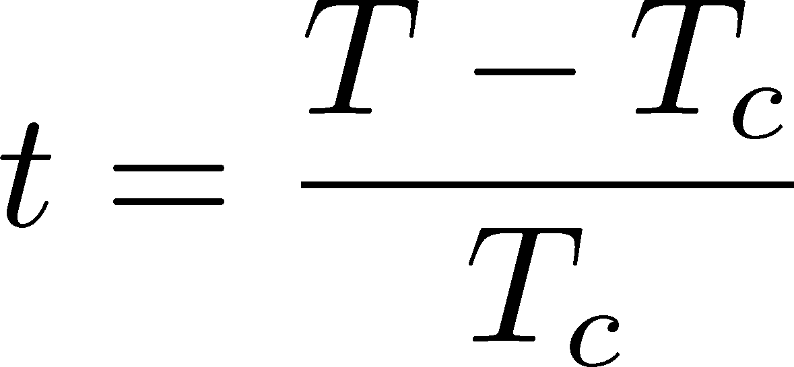

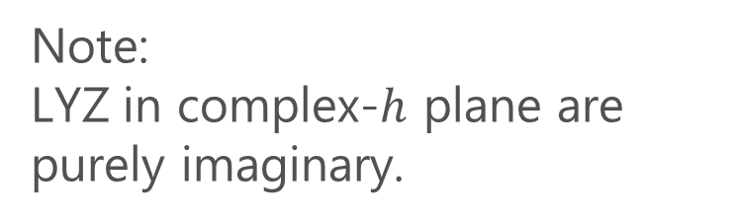

LYZ around a Critical Point in Ising Model
1st-transition
singularity on the real $h$ axis
Crossover
no singularity on the real axis
Note:
LYZ in complex-$h$ plane are purely imaginary.
Lee-Yang, 1952

Slide 11
LYZ around a Critical Point in Ising Model
1st-transition
singularity on the real $h$ axis
Crossover
no singularity on the real axis
Note:
LYZ in complex-$h$ plane are purely imaginary.
Lee-Yang, 1952

Slide 12

LYZ around a Critical Point in Ising Model
$$h_{I}\sim t^{y_{h}−y_{t}}$$
1st-transition
singularity on the real $h$ axis
Crossover
no singularity on the real axis
LY edge singularity
Starting from the CP
Its behavior is governed by the the scaling function.

Slide 13
LYZ around a Critical Point in Ising Model
$$h_{I}\sim t^{y_{h}−y_{t}}$$
1st-transition
singularity on the real $h$ axis
Crossover
no singularity on the real axis
LY edge singularity
Starting from the CP
Its behavior is governed by the the scaling function.

Slide 14

LYZ around a Critical Point in Ising Model
Ocean
$$h_{I}\sim t^{y_{h}−y_{t}}$$
1st-transition
singularity on the real $h$ axis
Crossover
Outer Reef
in between
=LYES
no singularity on the real axis
Corals of
LYZ
LY edge singularity
Starting from the CP
Its behavior is governed by the the scaling function.

Slide 15

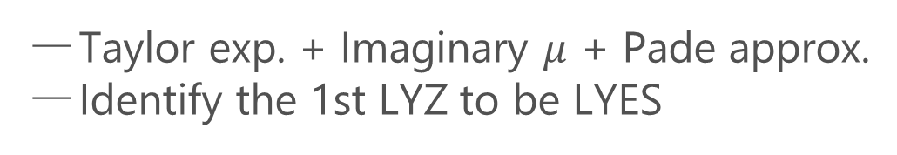
Recent Progress in LYZ/LYES and Lattice
Analytic Structure
Scaling functions, FRG, …
An, Mesterhazy, Stephanov (’16)
Johnson, Rennecke, Skokov (’23)
Karsch, Schmidt, Singh (‘23)
…
Locating QCD-CP at $μ≠0$ on the lattice?
Clarke+, arXiv:2405.10196
Taylor exp. + Imaginary $μ$ + Pade approx.
Identify the 1st LYZ to be LYES

Slide 16
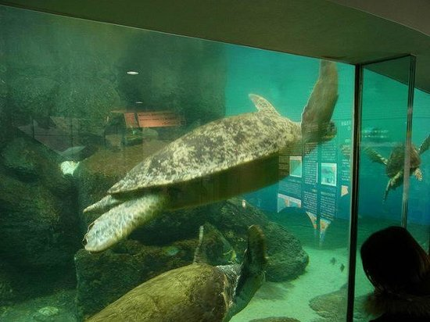
Our Motivations
Numerical simulations are performed on finite volume.
Thermodynamic Limit
Numarical Simulations
Discrepancy
healthy turtle
poor turtle
Purpose of this study:
Study finite-volume effects on the LYZ near CP.
Propose a new method to explore the CP via LYZ.

Slide 17


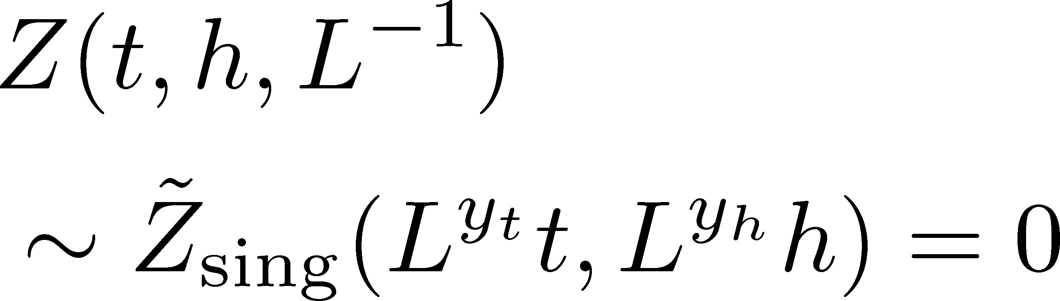
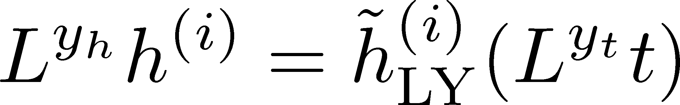
Finite-Size Scaling
Scaling Hypothesis
LYZ in the scaling region on finite volume

Slide 18
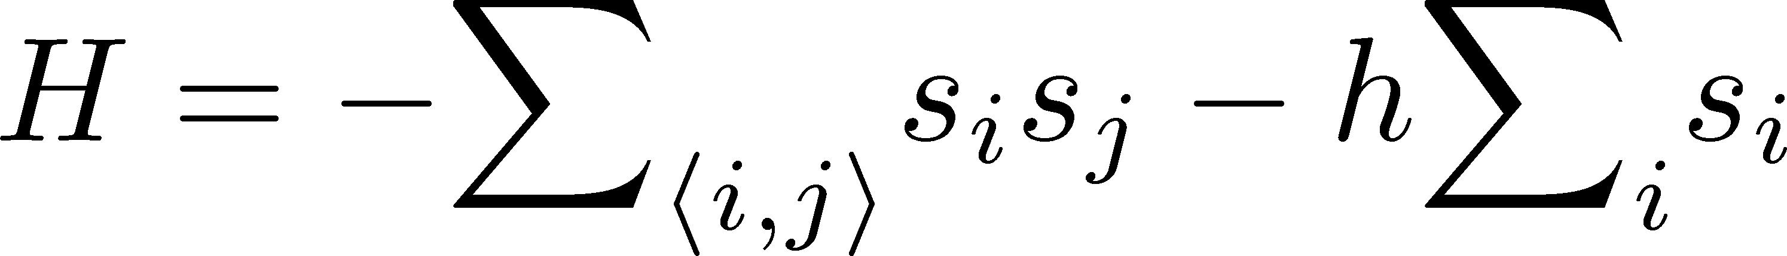
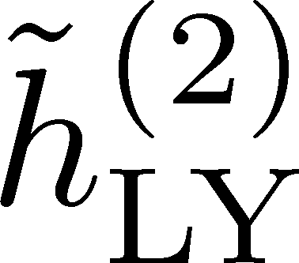

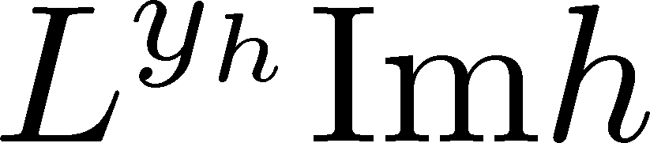
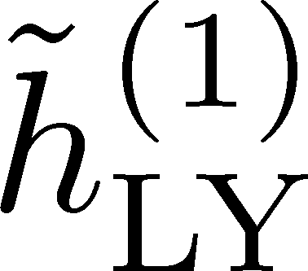
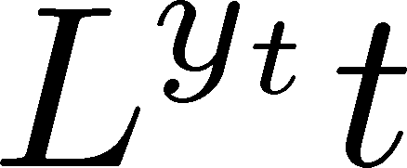

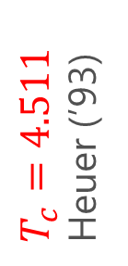
LYZ in 3d-Ising Model
Monte-Carlo + reweighting
1st & 2nd LYZ
Rescaled
rescale
$T_{c}=4.511$
Heuer (’93)
LYZ is away from the real axis at the CP on finite $L$.

Slide 19
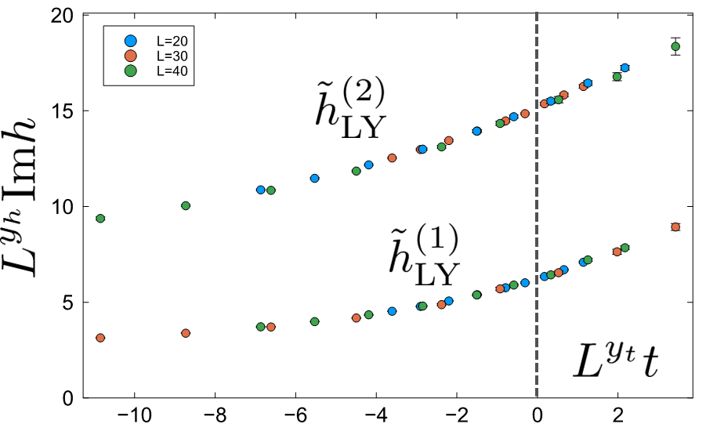


Where is QCD Critical Point?
Ising model
LYZ in QCD
Clarke+, arXiv:2405.10196
$T_{c}$around here??

Slide 20
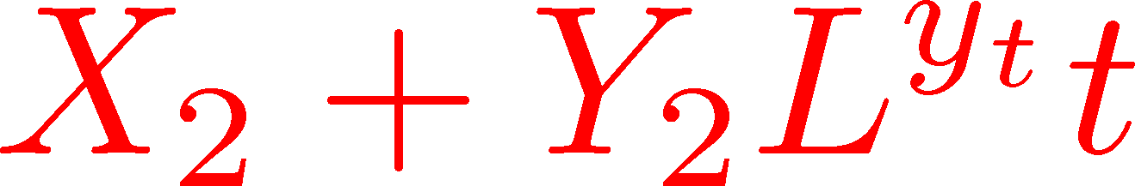
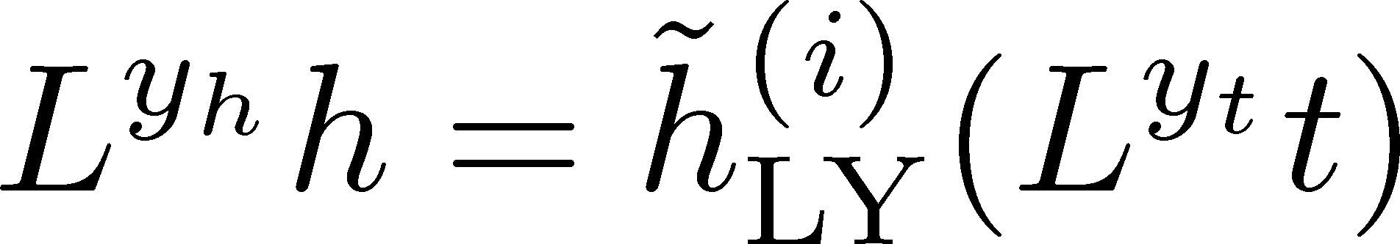
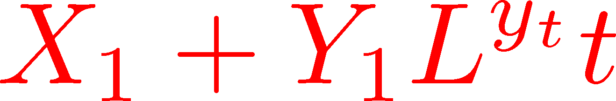
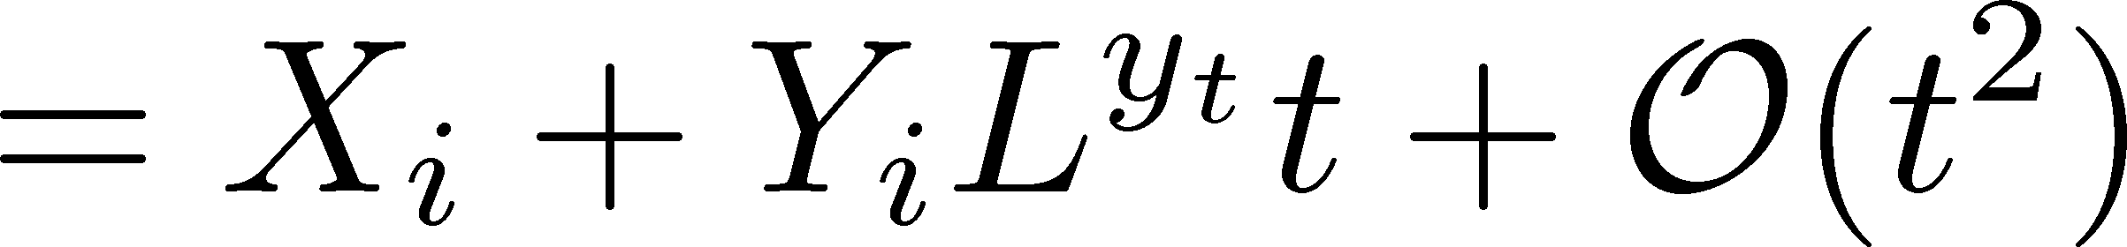
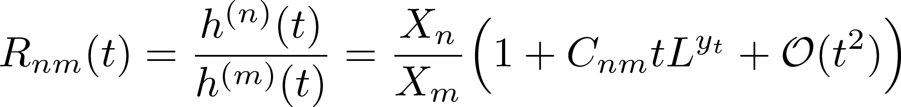
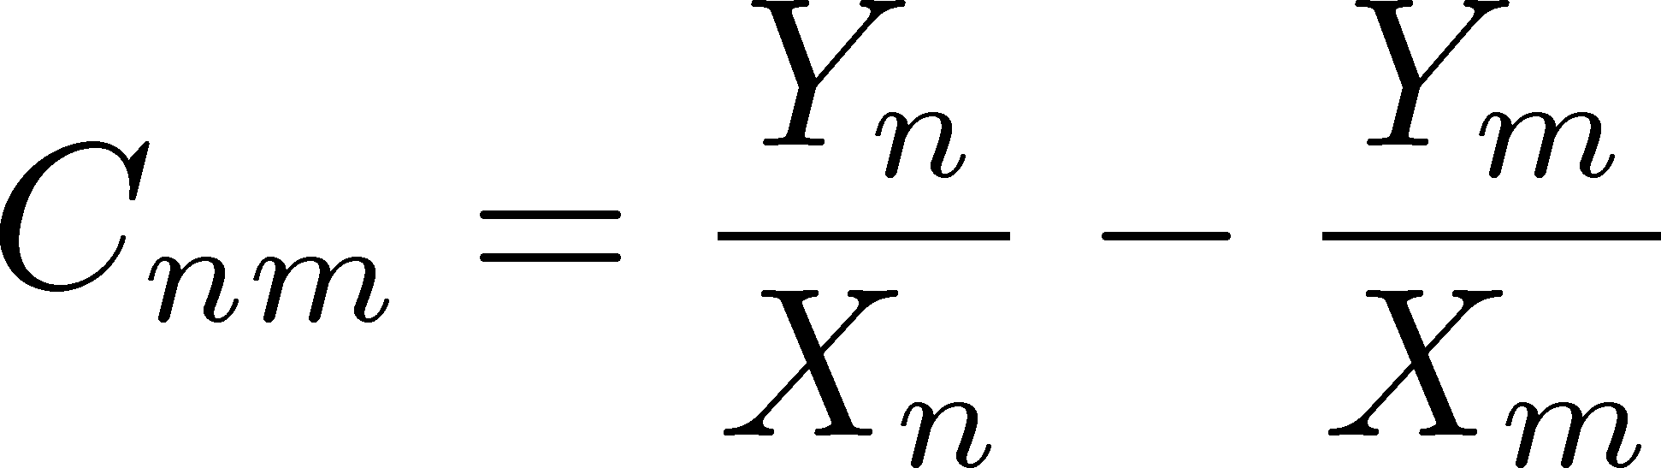

Linear Approximation & LYZ Ratio
Linear Approx. at $t=0$
Cooperate!
/
Take Ratio between $n$th/$m$th

Slide 21
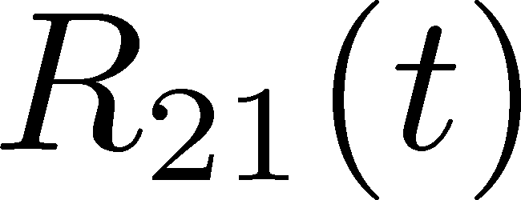

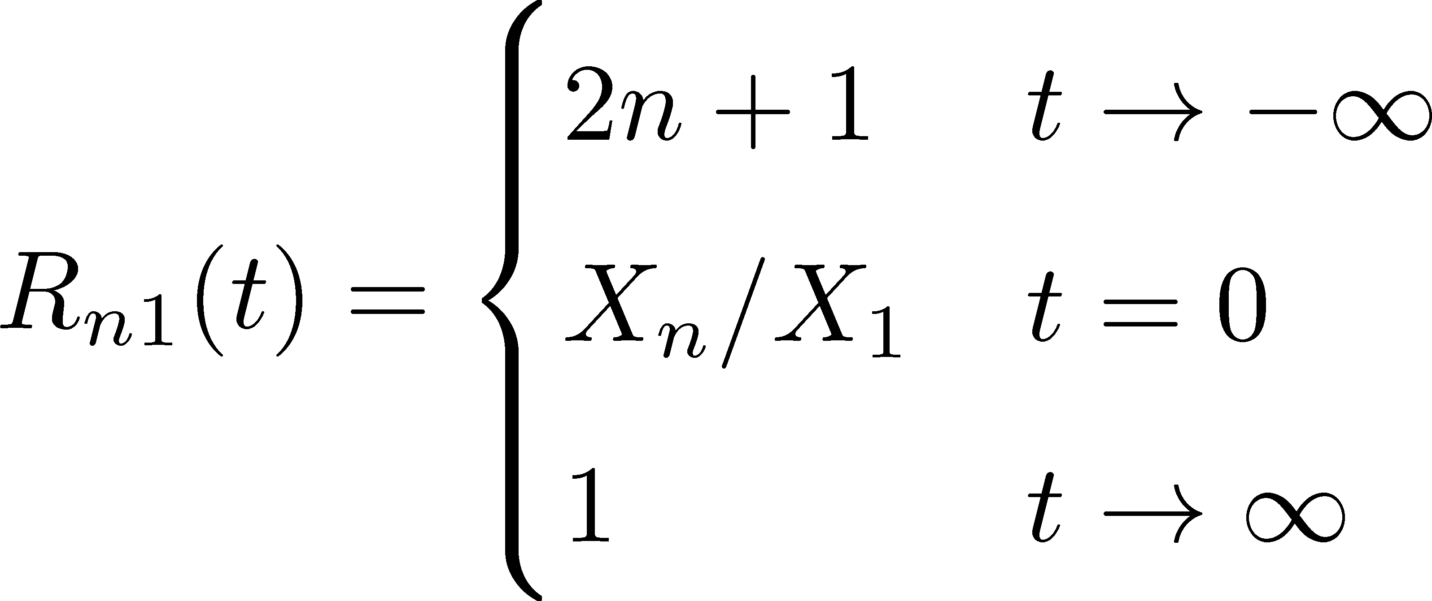
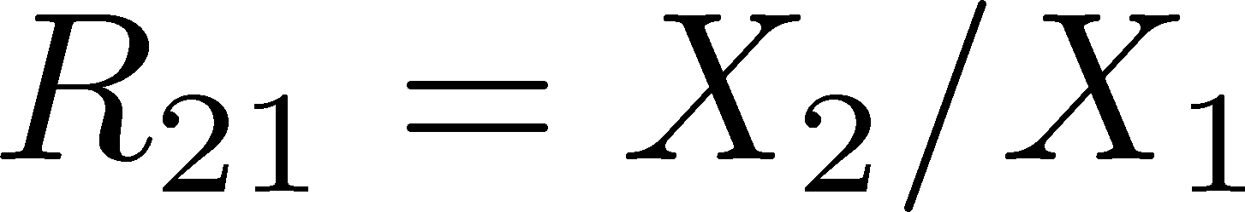


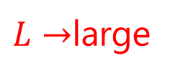
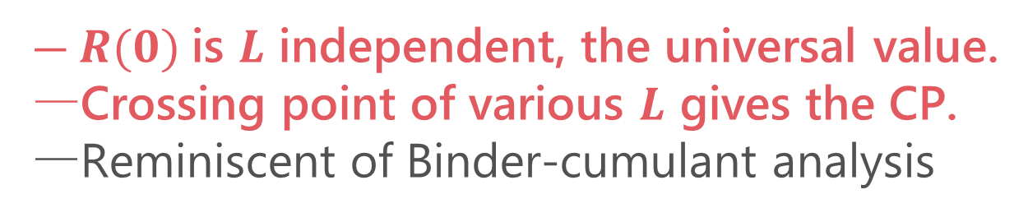
LYZ Ratio
(1st order)
crossing
$L→$large
(crossover)
$R(0)$is $L$ independent, the universal value.
Crossing point of various $L$ gives the CP.
Reminiscent of Binder-cumulant analysis

Slide 22
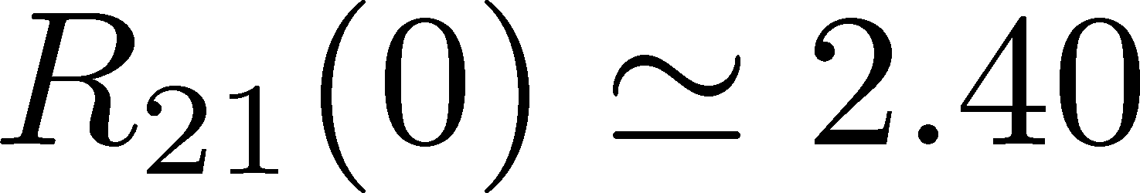
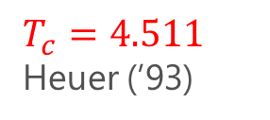
LYZ Ratio
Numerical Result in 3d-Ising
(1st order)
(crossover)
$T_{c}=4.511$
Heuer (’93)
$R(0)$is $L$ independent, the universal value.
Crossing point of various $L$ gives the CP.
Reminiscent of Binder-cumulant analysis
Cooperate!
/

Slide 23

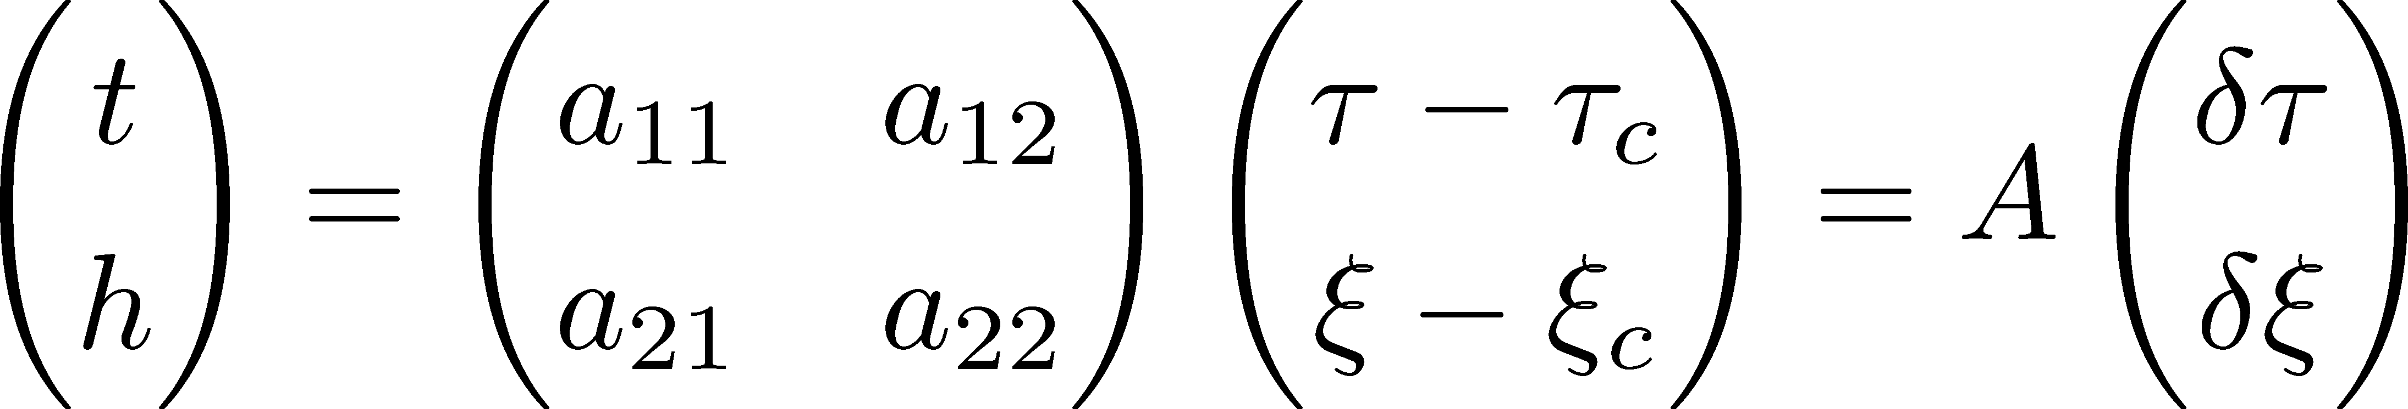

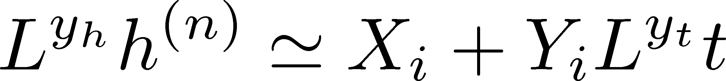
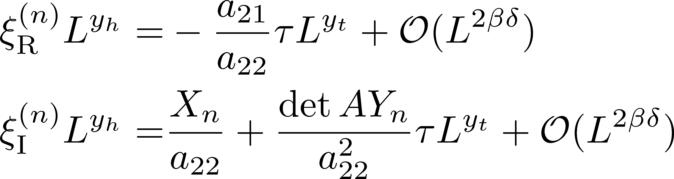
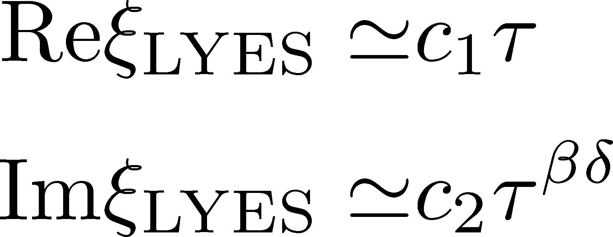


General CP
CP on a $τ−ξ$ plane
Search for LYZ on the complex $ξ$ plane
$$L→∞$$
LY Edge Singularity
generalization
Stephanov, 2006

Slide 24

LYZ Ratio for General CP
LYZ Ratio
nonzero for $a_{12}≠0$

Slide 25

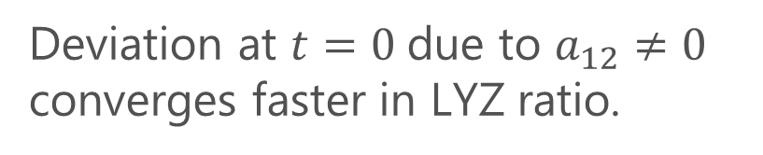
LYZ Ratio for General CP
LYZ Ratio
nonzero for $a_{12}≠0$
Binder cumulant
Jin+, PRD86, 2017
nonzero for $a_{12}≠0$
I am superior to Binder cumulant!
If you can find us.
Deviation at $t=0$due to $a_{12}≠0$ converges faster in LYZ ratio.

Slide 26
Numerical Analysis
3d Potts model
Heavy-quark QCD

Slide 27
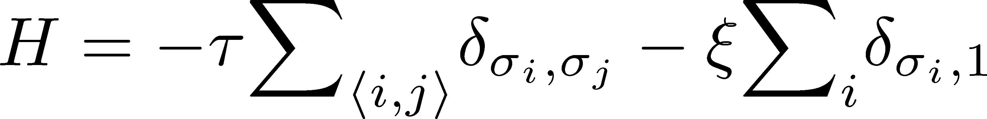
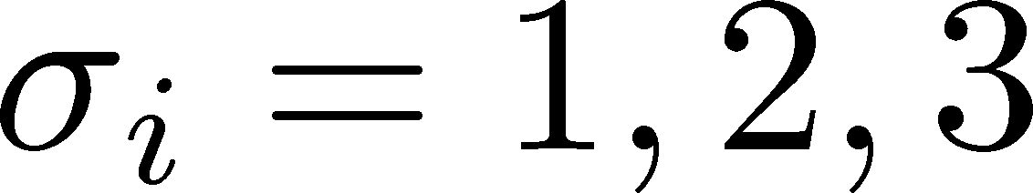
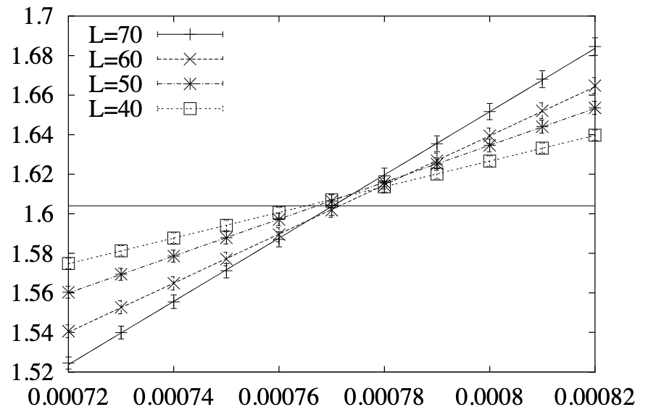
3d 3-State Potts Model
Monte-Carlo + reweighting
Phase Diagram
Binder-Cumulant Analysis
Z(2) CP
1st-order
Z(3)
Karsch, Stickan, 2000

Slide 28
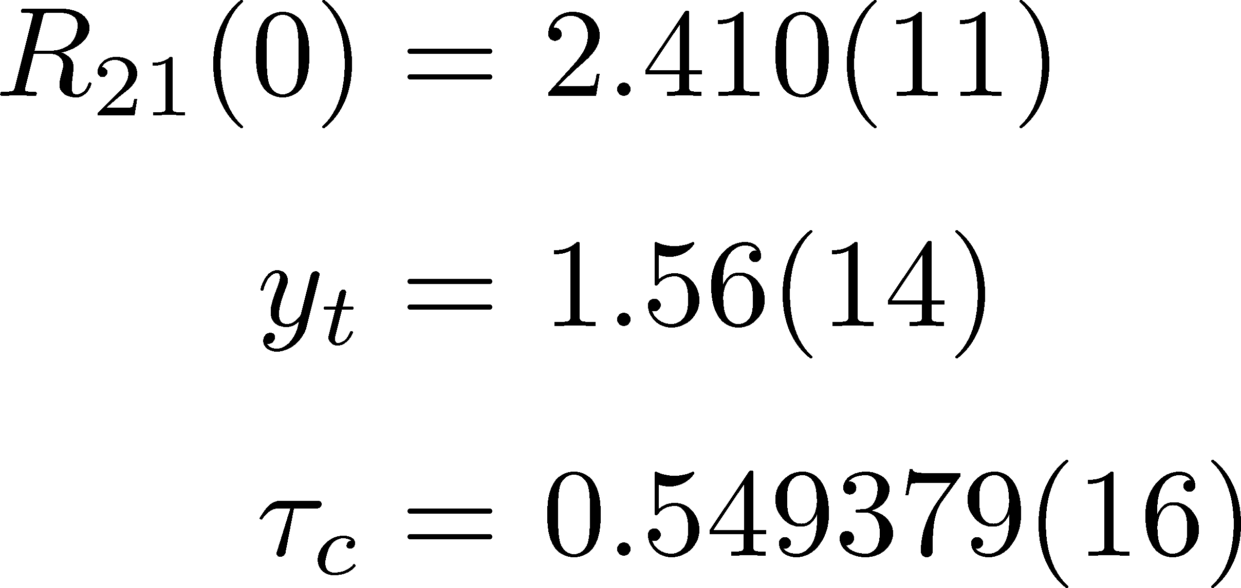
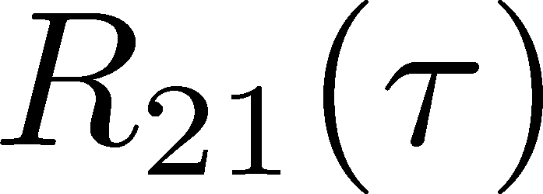
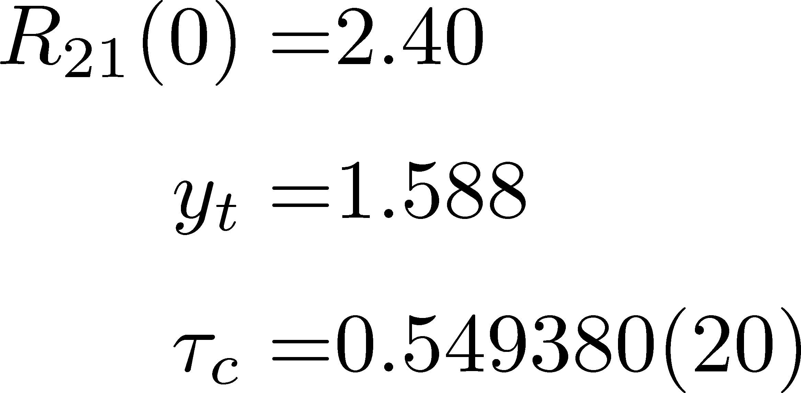

3d 3-State Potts Model: LYZ Ratio
Fit Results (to $L≥40$):
Consistent with
3d Ising
Karsch+, ‘00

Slide 29
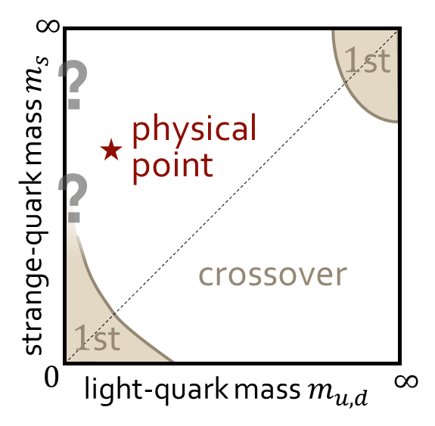

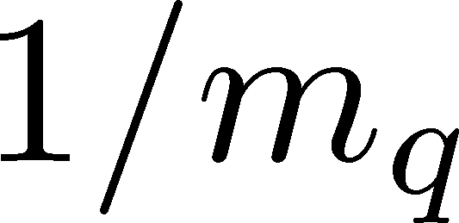
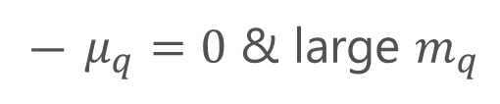
CP in Heavy-Quark QCD
Columbia Plot
Phase Diagram
This study
critical point
CP in heavy-quark QCD
We study the LYZ around the HQ-QCD-CP.
$μ_{q}=0$ & large $m_{q}$
Easy to handle in lattice simulations!

Slide 30
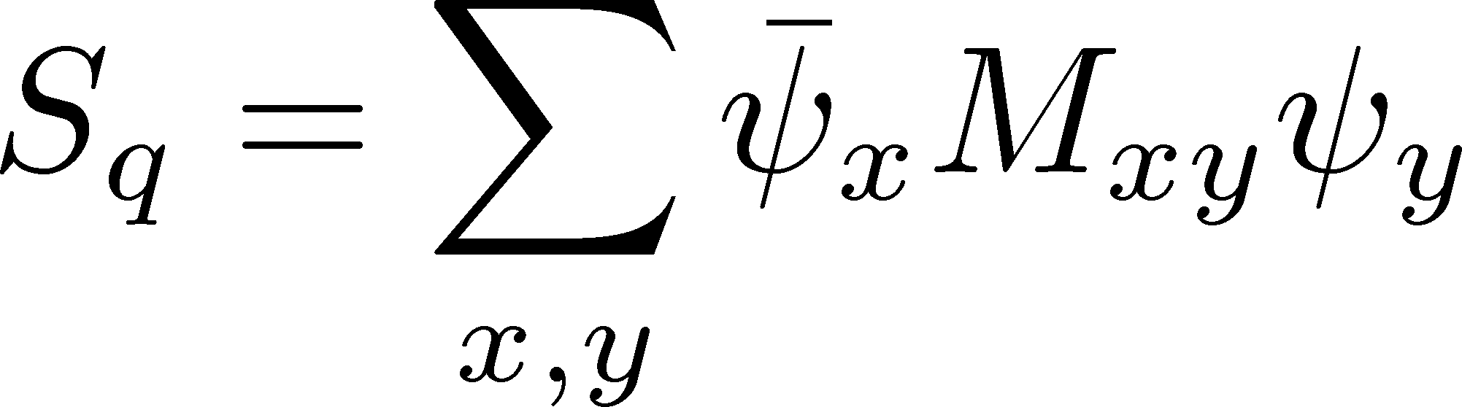
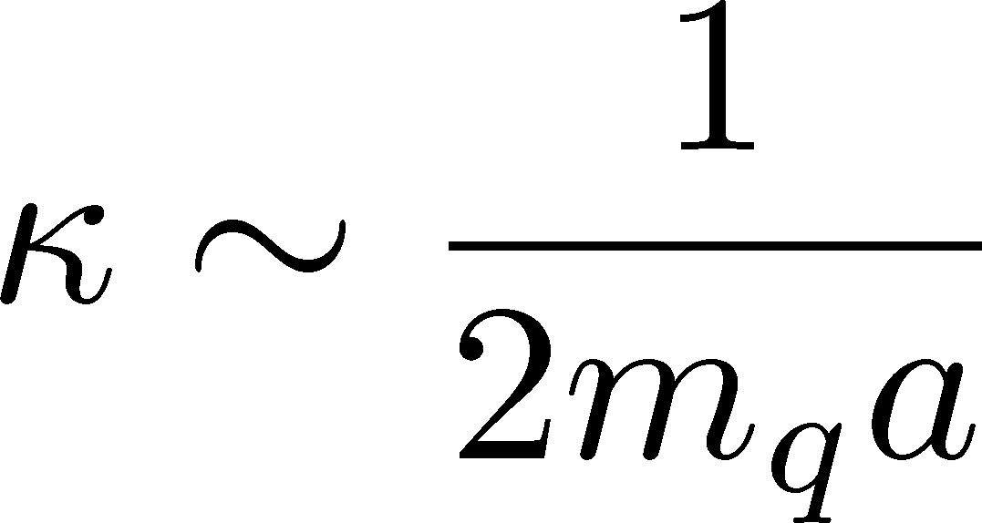
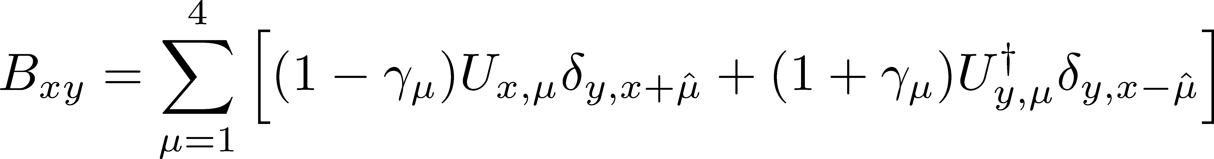
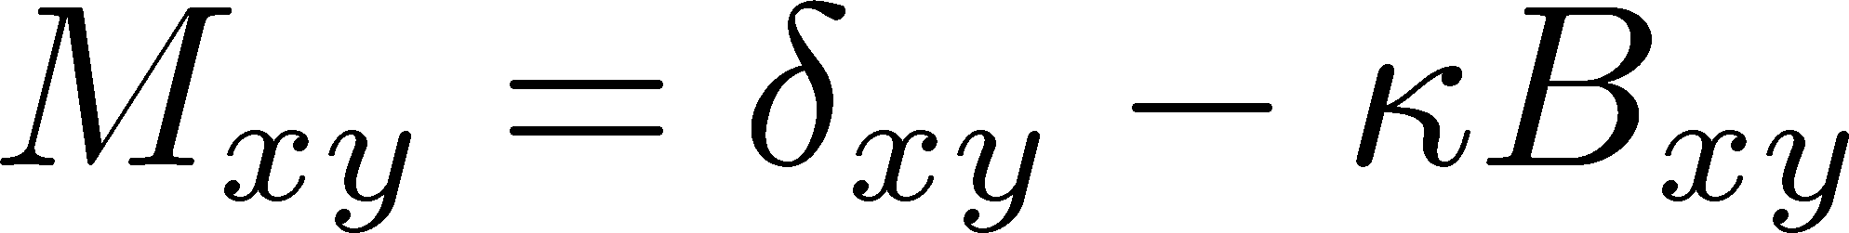
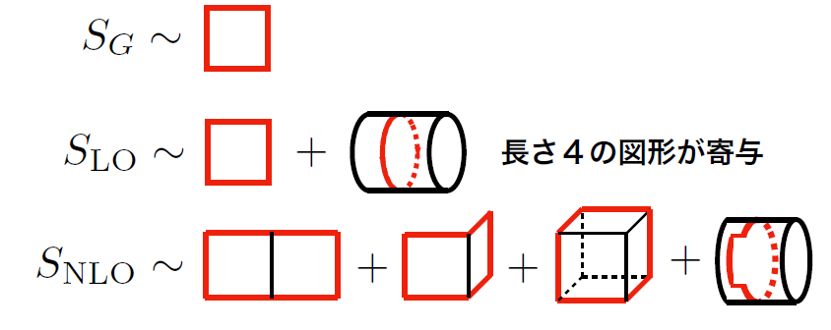




Hopping-Parameter Expansion (HPE)
~ $1/m_{q}$ expansion
Kiyohara, MK, Ejiri, Kanaya, PRD(’21)
Ashikawa, MK, Ejiri, Kanaya, arXiv:2407.09156
Wilson Fermion
: hopping parameter
nonzero only for neighboring $(x,y)$
Hopping-Parameer Expansion
$n$th order terms in the HPE: closed trajectories of length $n$.

Slide 31




Higher-Order Terms in HPE
Kiyohara, MK, Ejiri, Kanaya, PRD(’21)
Ashikawa, MK, Ejiri, Kanaya, arXiv:2407.09156
Monte Carlo Simulation @ LO
heat bath & over relaxation with modified staple
$\hat{P}$: plaquette
$\hat{Ω}$: Polyakov loop
Numerical cost is almost the same as the pure YM!
NLO by Reweighting
Overlapping problem is well suppressed due to the LO confs.
Realize high statistical analysis

Slide 32






Binder Cumulant Analysis
$N_{t}=4$: Kiyohara, MK, Ejiri, Kanaya, PRD, 2021
$N_{t}=6$: Ashikawa, MK, Ejiri, Kanaya, arXiv:2407.09156
w/ Dynamical Fermions
Cuteri , Philipsen , Schön, Sciarra, ’21
One order smaller statistical errors on more than twice larger $LT$!
Precise determination of the location of the CP

Slide 33


LYZ Ratio
$N_{t}=4,$ HPE-NLO
Conistent with the Binder-cumulant analysis $β_{c}=5.68578(22)$.

Slide 34
Summary
LYZ give us invaluable information of phase transitions.
Let’s jump into the complex ocean!
Numarical Simulations
Finite-size effects are non-negligible in typical numerical simulations.
We proposed a new method for locating a CP using LYZ on finite volume.
Verified in 3d-Potts & heavy-quark QCD.
Outlook: Can lattice QCD find the 2nd LYZ??

Slide 35
backup

Slide 36
QCD-CP and LYZ

Slide 37



Using LYZ for the QCD-CP Search
Taylor expansion
LYZ
LYZ
Imaginary chem. pot.
Use of Pade approximation

