Slide 1
日本物理学会第７９回年次大会 北海道大学 ２０２４年９月１９日 19aE315-13
臨界点近傍でのスケーリング関数の
埋め込みにおける
Lee-Yangゼロの活用
北沢正清
（京大基研）
和田辰也、金谷和至
Wada, MK, Kanaya, in preparation

Slide 2
日本物理学会第７９回年次大会 北海道大学 ２０２４年９月１９日 19aE315-13
このトークで伝えたいこと
Lee-Yangゼロを利用して
臨界点の位置を決める方法の提案
ビンダーキュムラン
ト法に似た方法です
北沢正清
（京大基研）
和田辰也、金谷和至
Wada, MK, Kanaya, in preparation

Slide 3
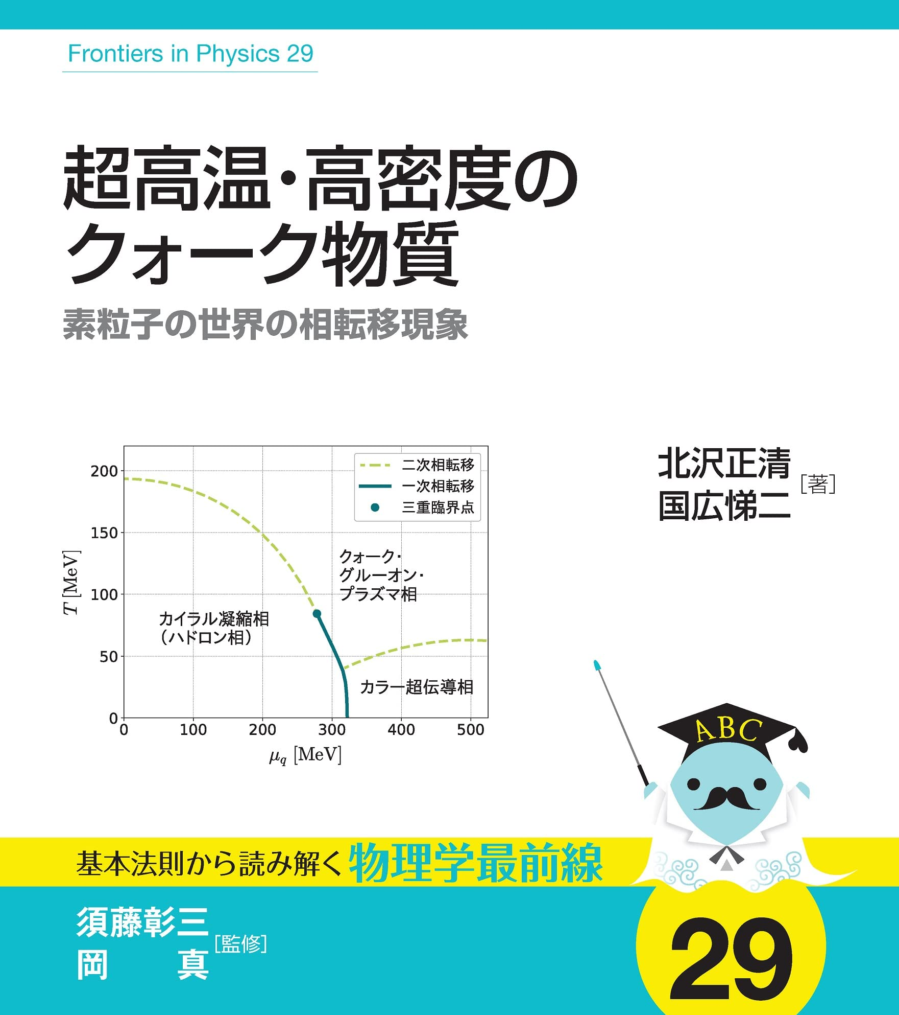
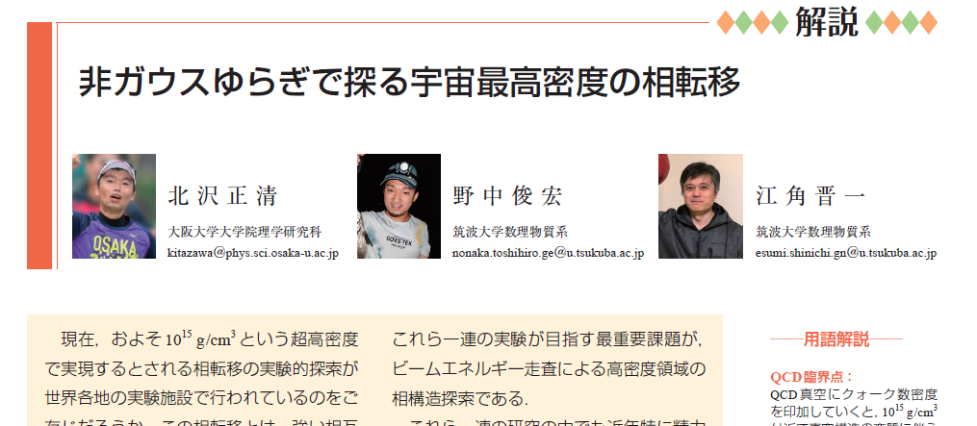

自己紹介
専門：原子核理論
有限温度・有限密度QCD
格子QCD数値解析など
物理学会誌2021年8月号

Slide 4
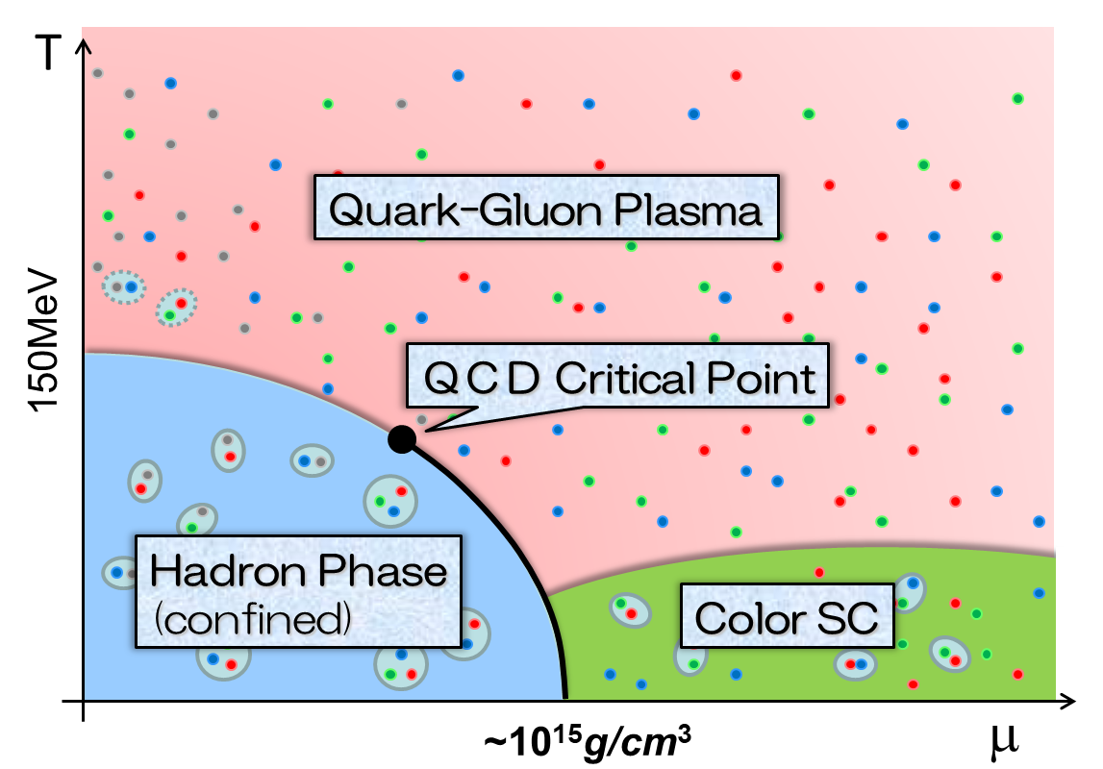
自己紹介
専門：原子核理論
有限温度・有限密度QCD
格子QCD数値解析など
格子QCD数値計算の有限密度系への適用は複素位相問題により困難
最近の進展
リーヤンゼロを利用して格子QCD数値計算で臨界点の位置決定に成功？
arXiv:2405.10196 [hep-lat]

Slide 5

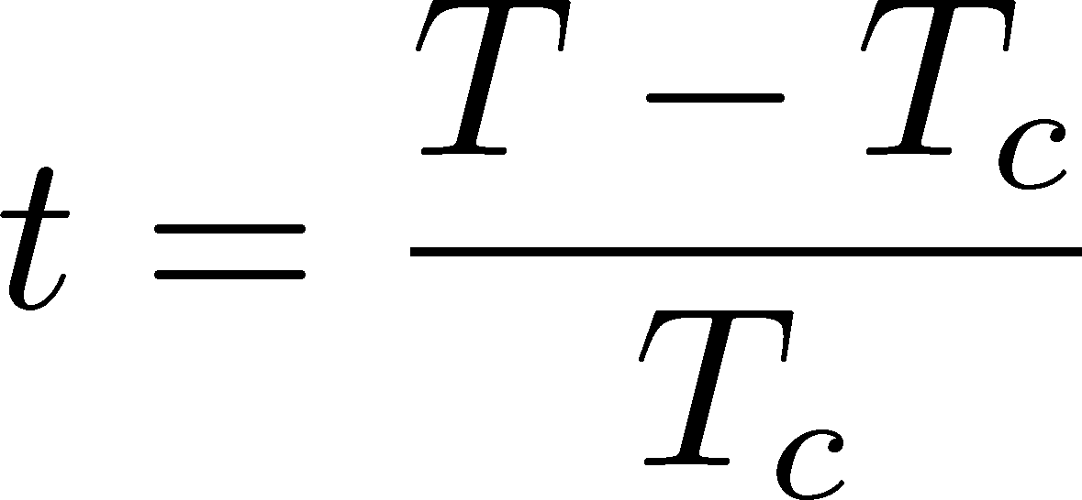



LYZ around Critical Point in Ising Model
1st-transition
singularity on the real $h$ axis
Crossover
no singularity on the real axis
Note:
LYZ in complex-$h$ plane are purely imaginary.
Lee-Yang, 1952

Slide 6
LYZ around Critical Point in Ising Model
1st-transition
singularity on the real $h$ axis
Crossover
no singularity on the real axis
Note:
LYZ in complex-$h$ plane are purely imaginary.
Lee-Yang, 1952

Slide 7


LYZ around Critical Point in Ising Model
$$h_{I}\sim t^{βδ}$$
1st-transition
singularity on the real $h$ axis
Crossover
no singularity on the real axis
LY edge singularity
Starting from the CP
Its behavior is governed by the the scaling function.
$$h_{I}\sim t^{βδ}$$

Slide 8
LYZ around Critical Point in Ising Model
$$h_{I}\sim t^{βδ}$$
1st-transition
singularity on the real $h$ axis
Crossover
no singularity on the real axis
LY edge singularity
Starting from the CP
Its behavior is governed by the the scaling function.
$$h_{I}\sim t^{βδ}$$

Slide 9


Recent Progress in LYZ/LYES and Lattice
Analytic Structure
Scaling functions, FRG, …
An, Mesterhazy, Stephanov (’16)
Johnson, Rennecke, Skokov (’23)
Karsch, Schmidt, Singh (‘23)
…
Locating QCD-CP at $μ≠0$ on the lattice?
Clarke+, arXiv:2405.10196
Taylor exp. + Imaginary $μ$ + Pade approx.
Identify the 1st LYZ to be LYES

Slide 10
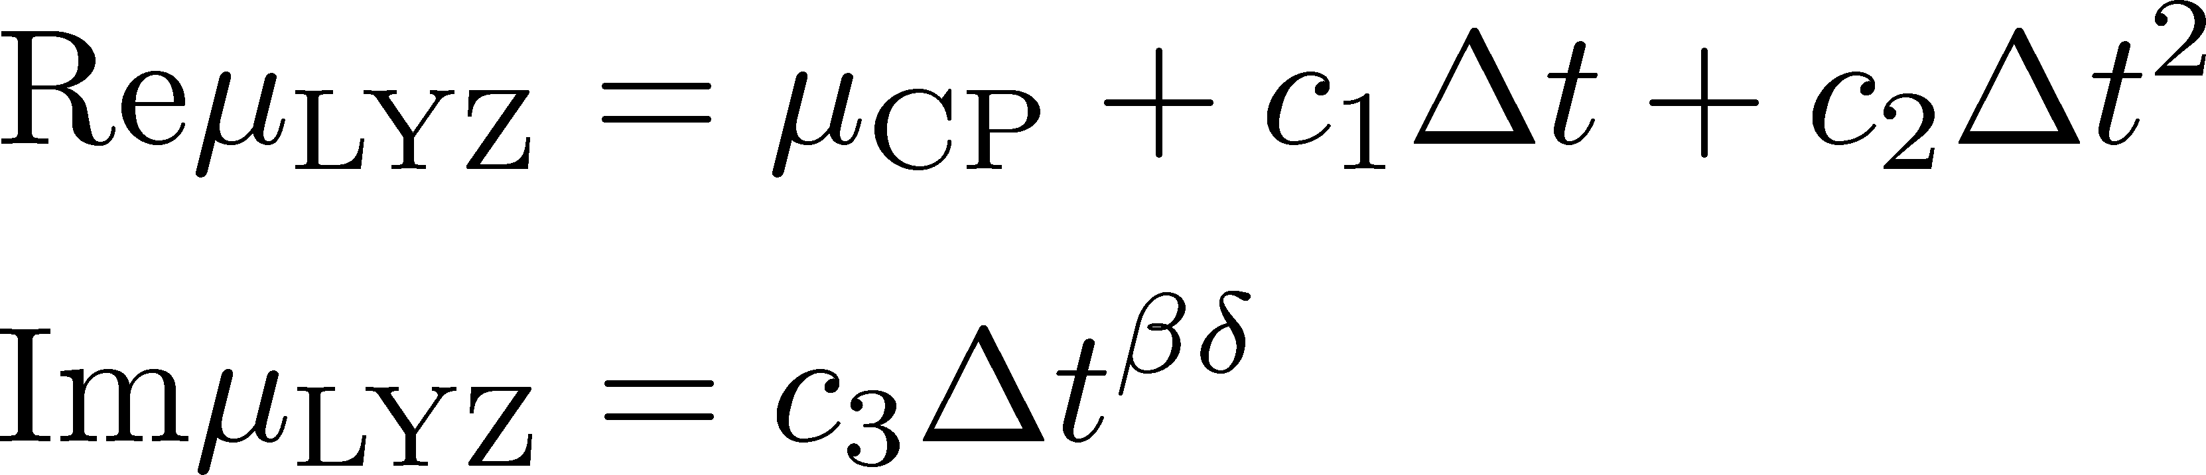

LYZによるQCD臨界点探索
1st LYZ = LY edge singuarity
を仮定して$Imμ_{LYZ}→0$へ外挿
有限サイズ効果は？
arXiv:2405.10196 [hep-lat]

Slide 11


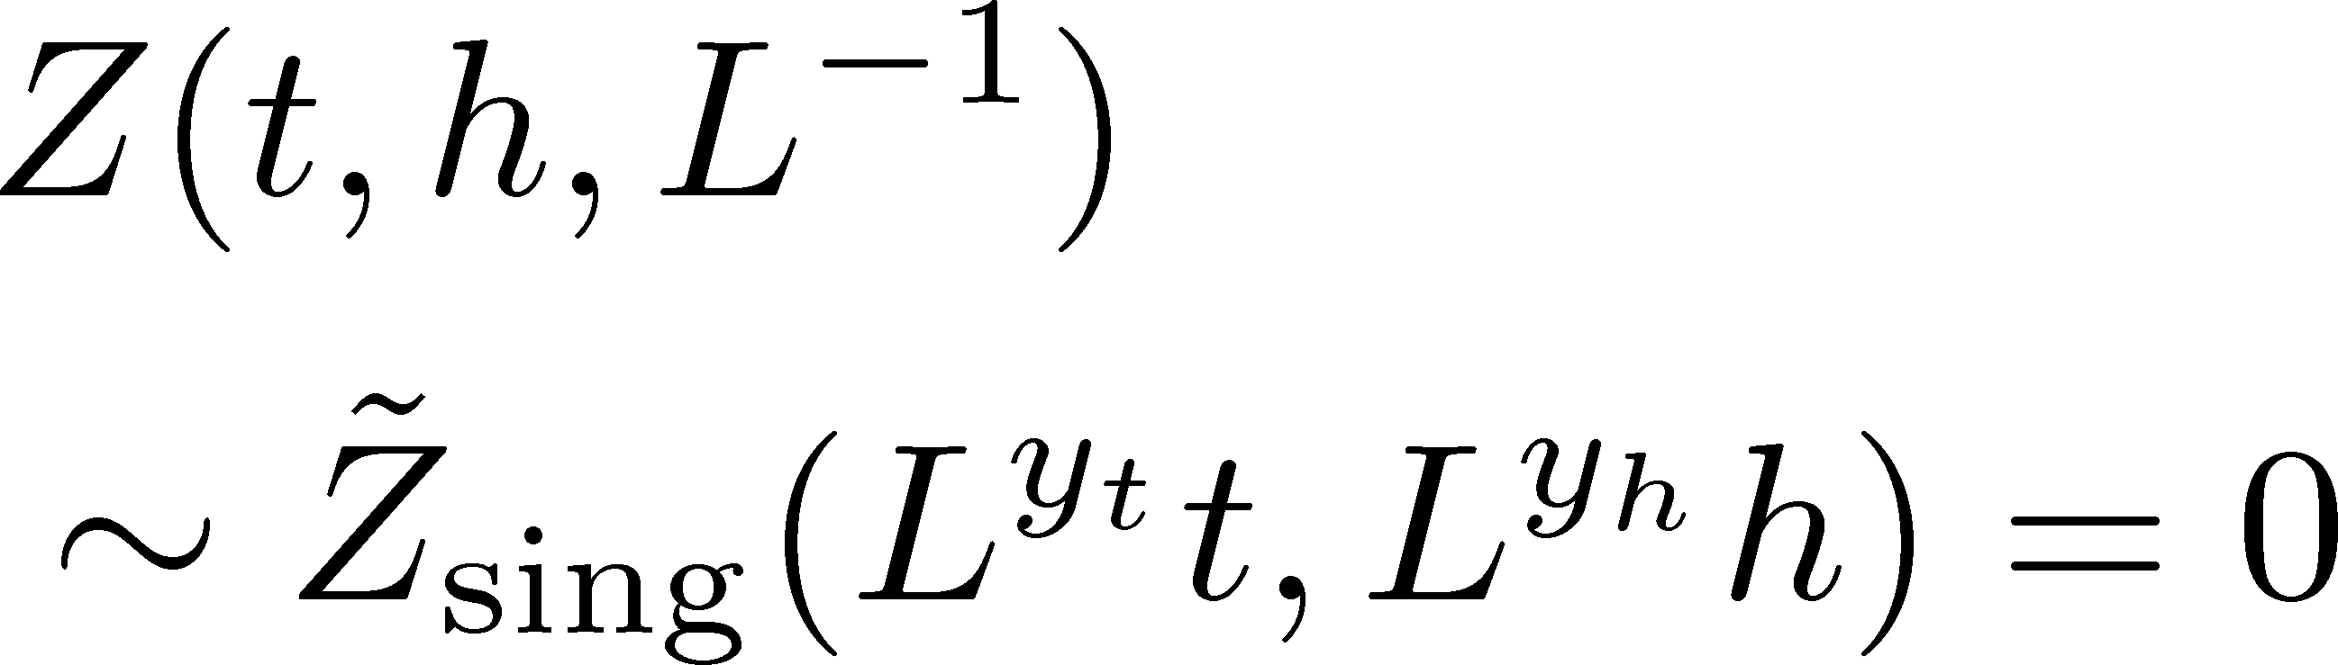
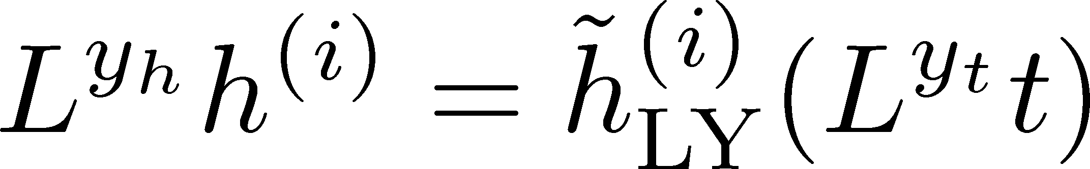
Finite-Size Scaling
Scaling Hypothesis
LYZ in the scaling region on finite volume

Slide 12
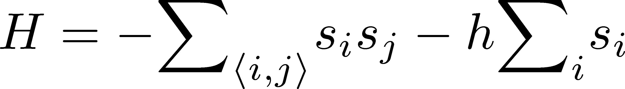
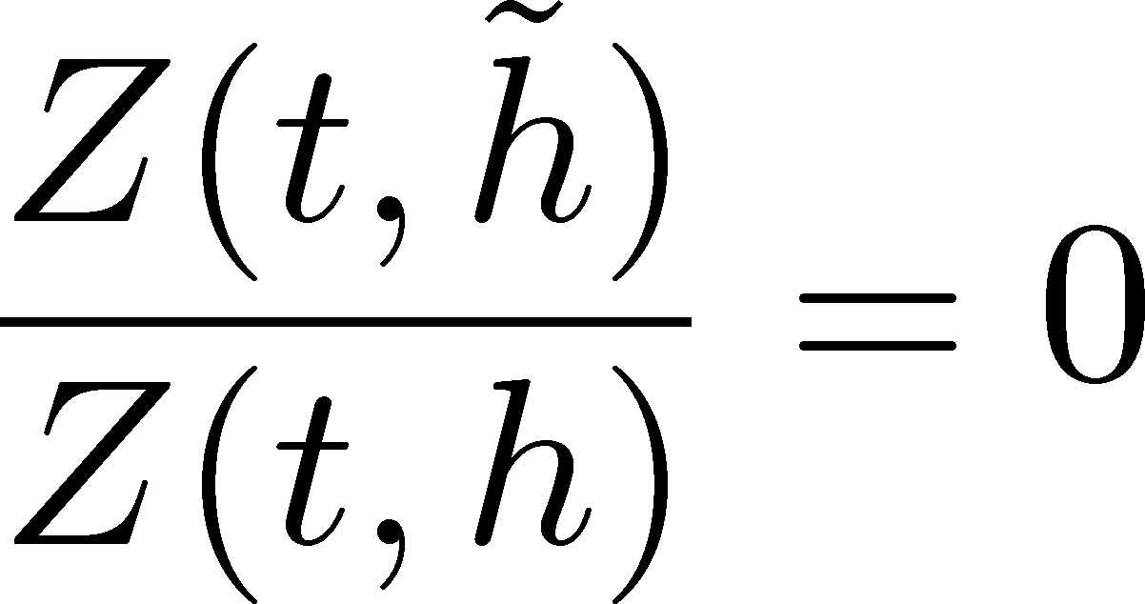
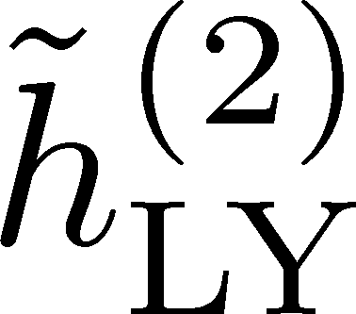

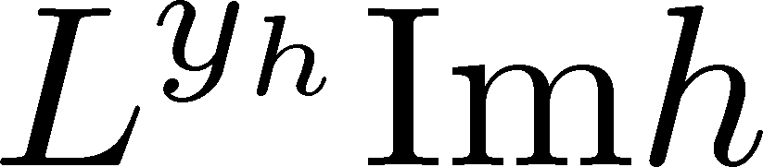
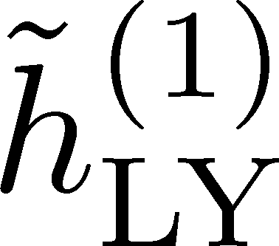
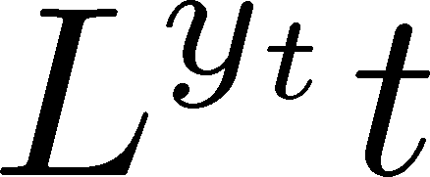

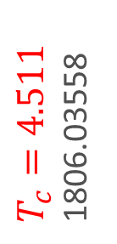
LYZ in 3d-Ising Model
LYZ
Monte-Carlo + reweighting
1st & 2nd LYZ
Rescaled
rescale
$T_{c}=4.511$
1806.03558
Preliminary
Preliminary

Slide 13
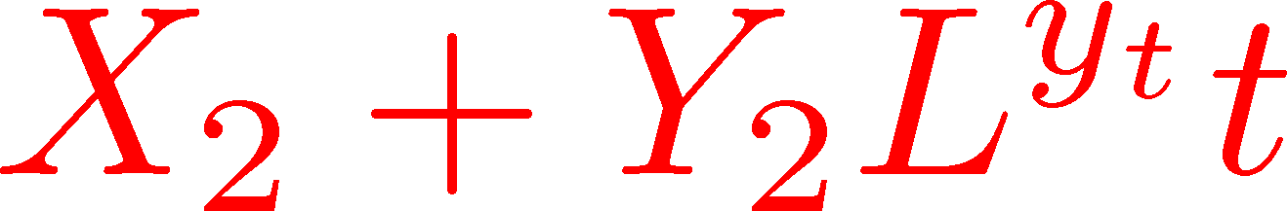
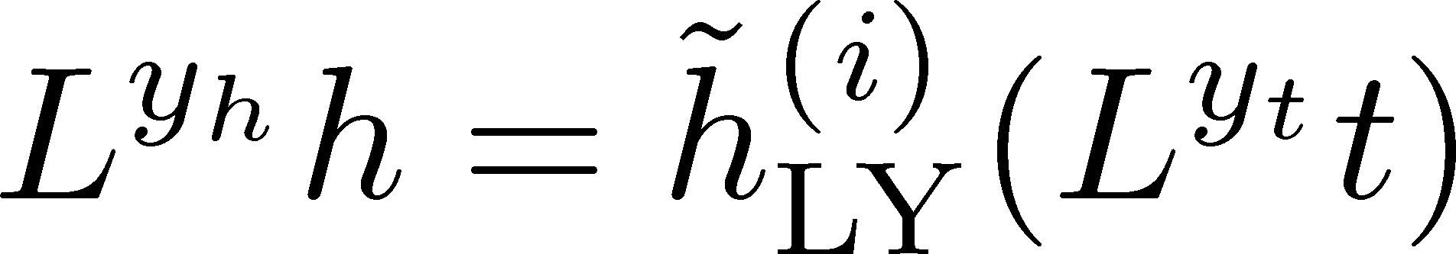

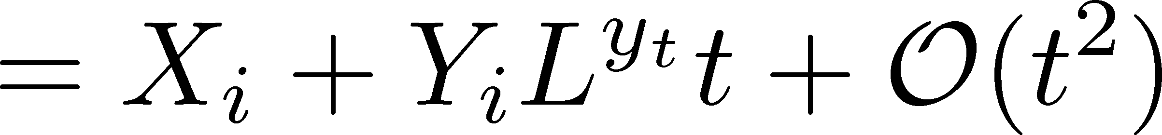
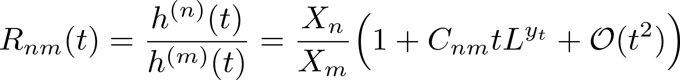
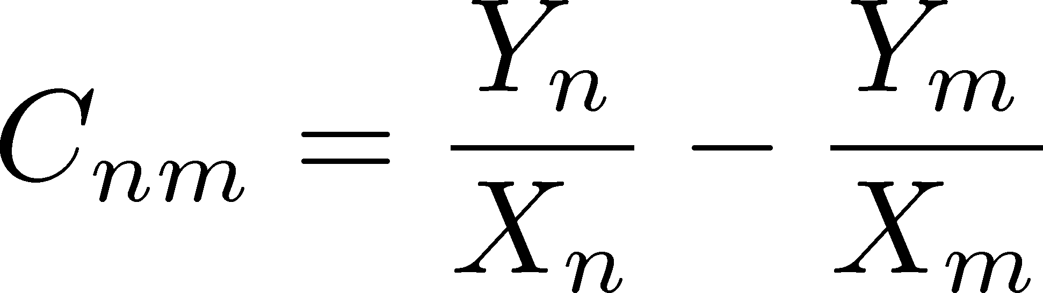

Linear Approximation & LYZ Ratio
Linear Approx. at $t=0$
Take Ratio between $n$th/$m$th

Slide 14
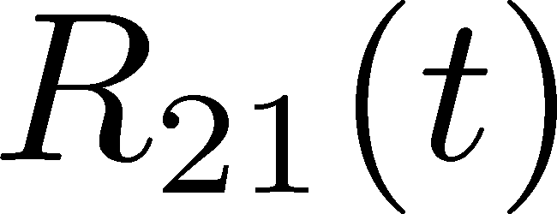

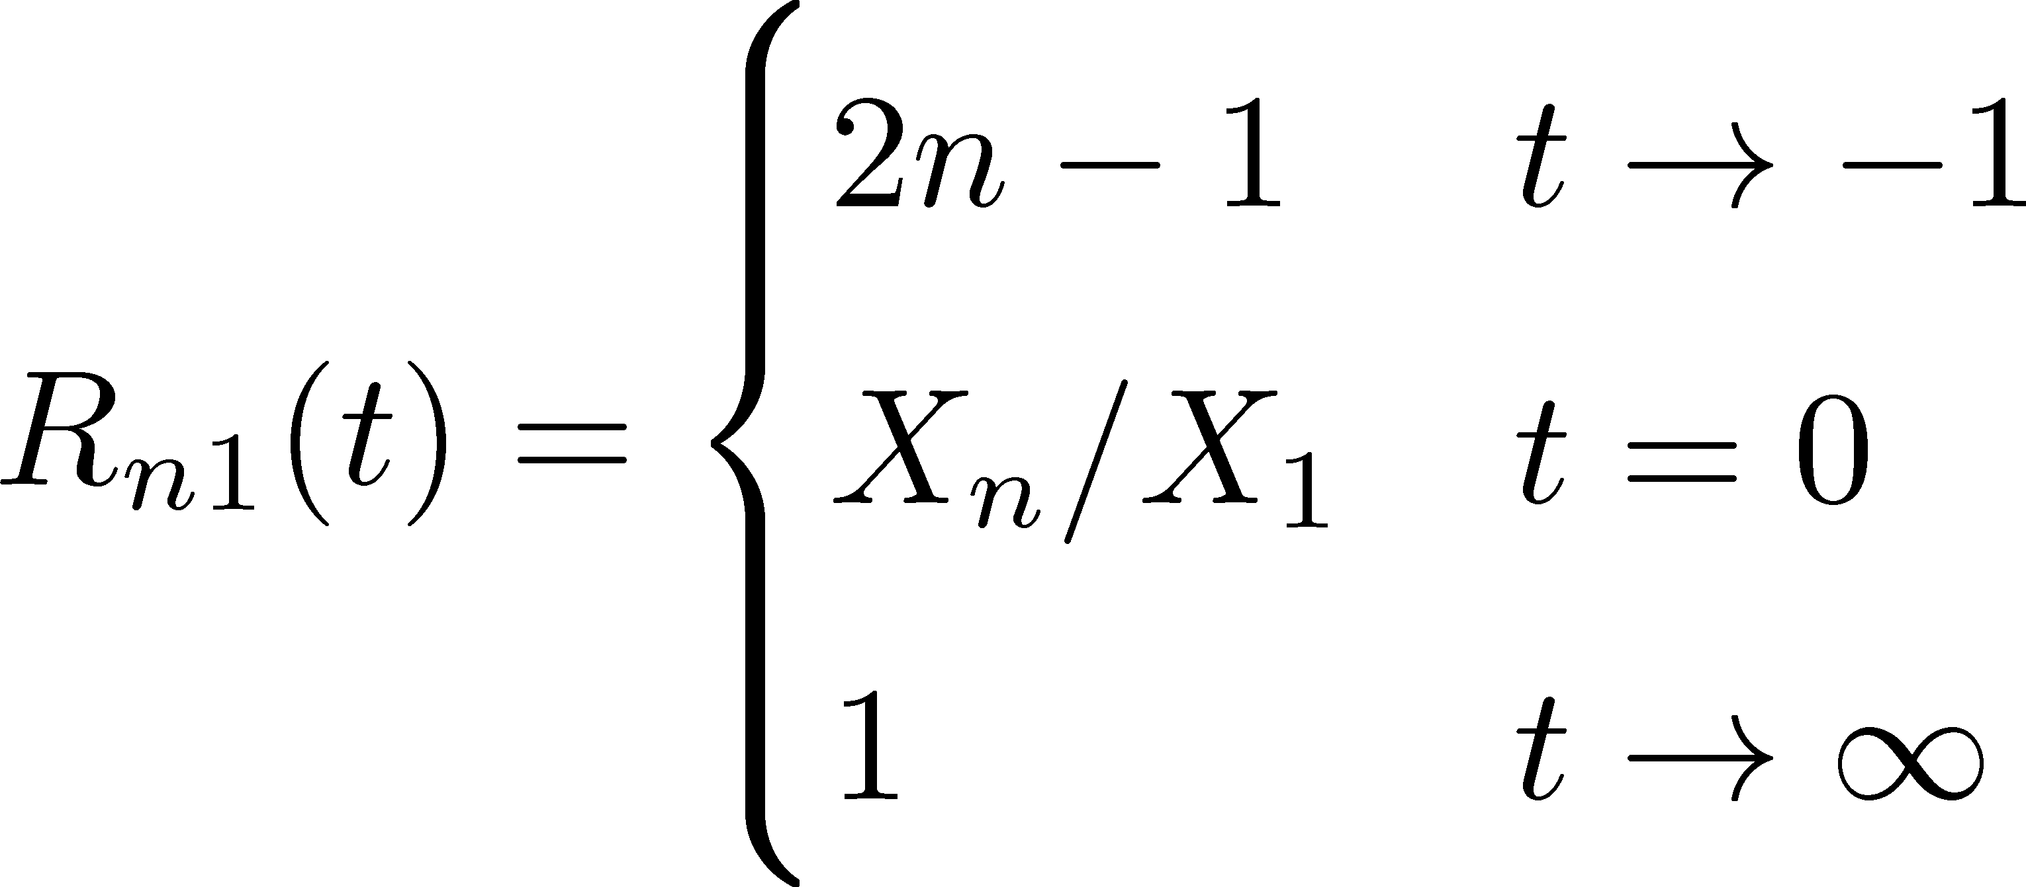
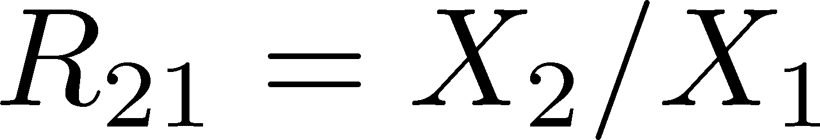


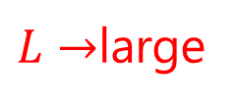
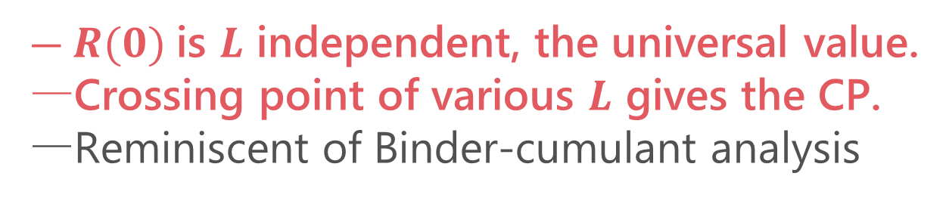
LYZ Ratio
(1st order)
crossing
$L→$large
(crossover)
$R(0)$is $L$ independent, the universal value.
Crossing point of various $L$ gives the CP.
Reminiscent of Binder-cumulant analysis

Slide 15
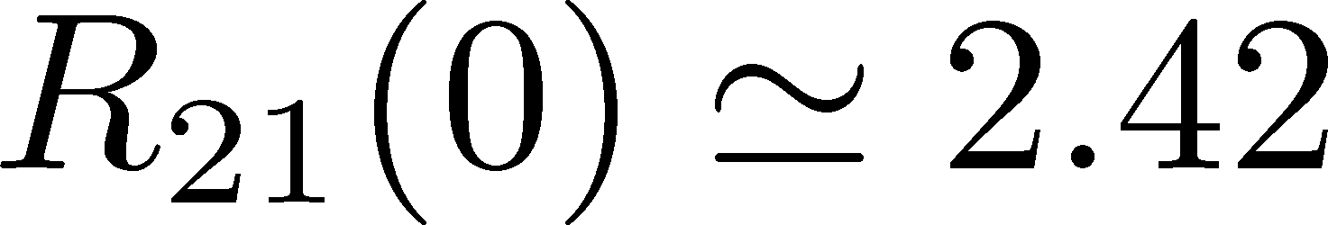
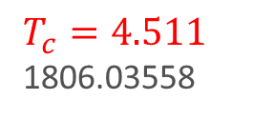
LYZ Ratio
Numerical Result in 3d-Ising
(1st order)
Preliminary
(crossover)
$T_{c}=4.511$
1806.03558
$R(0)$is $L$ independent, the universal value.
Crossing point of various $L$ gives the CP.
Reminiscent of Binder-cumulant analysis

Slide 16


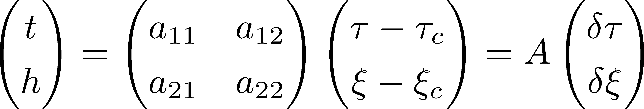

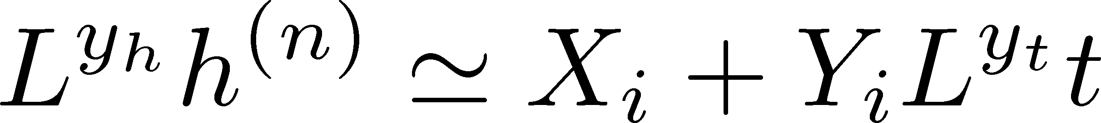

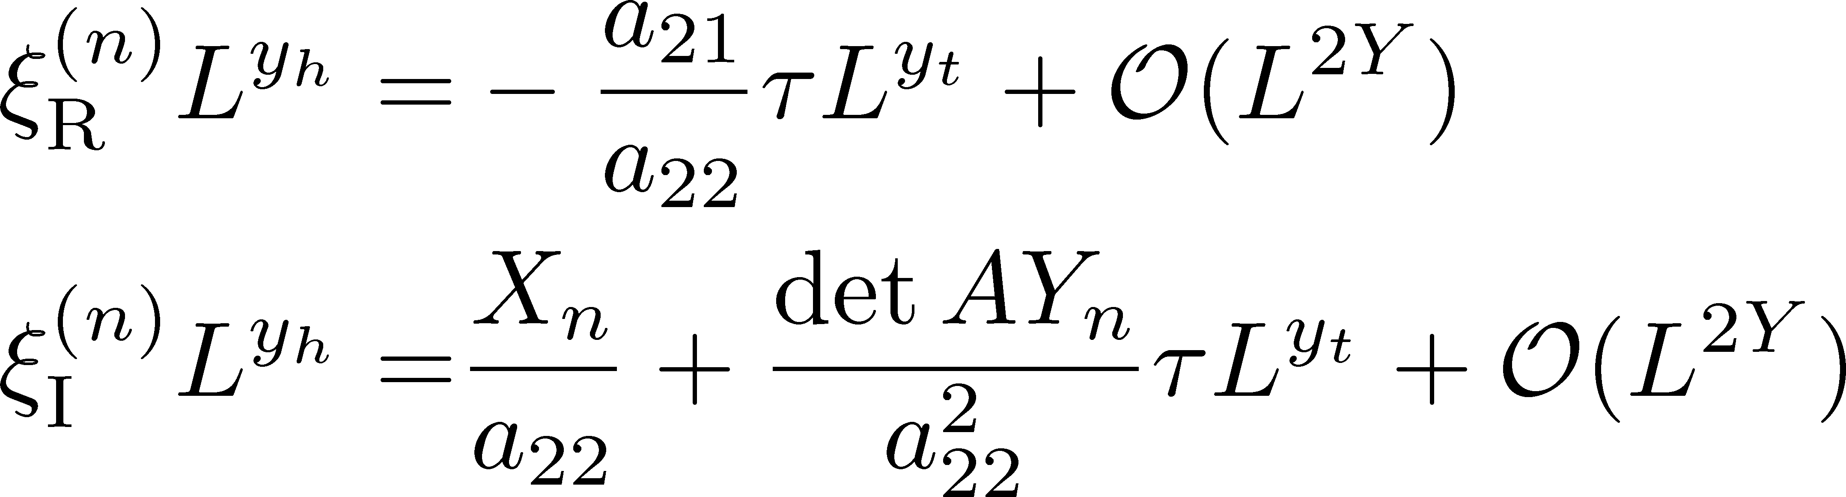
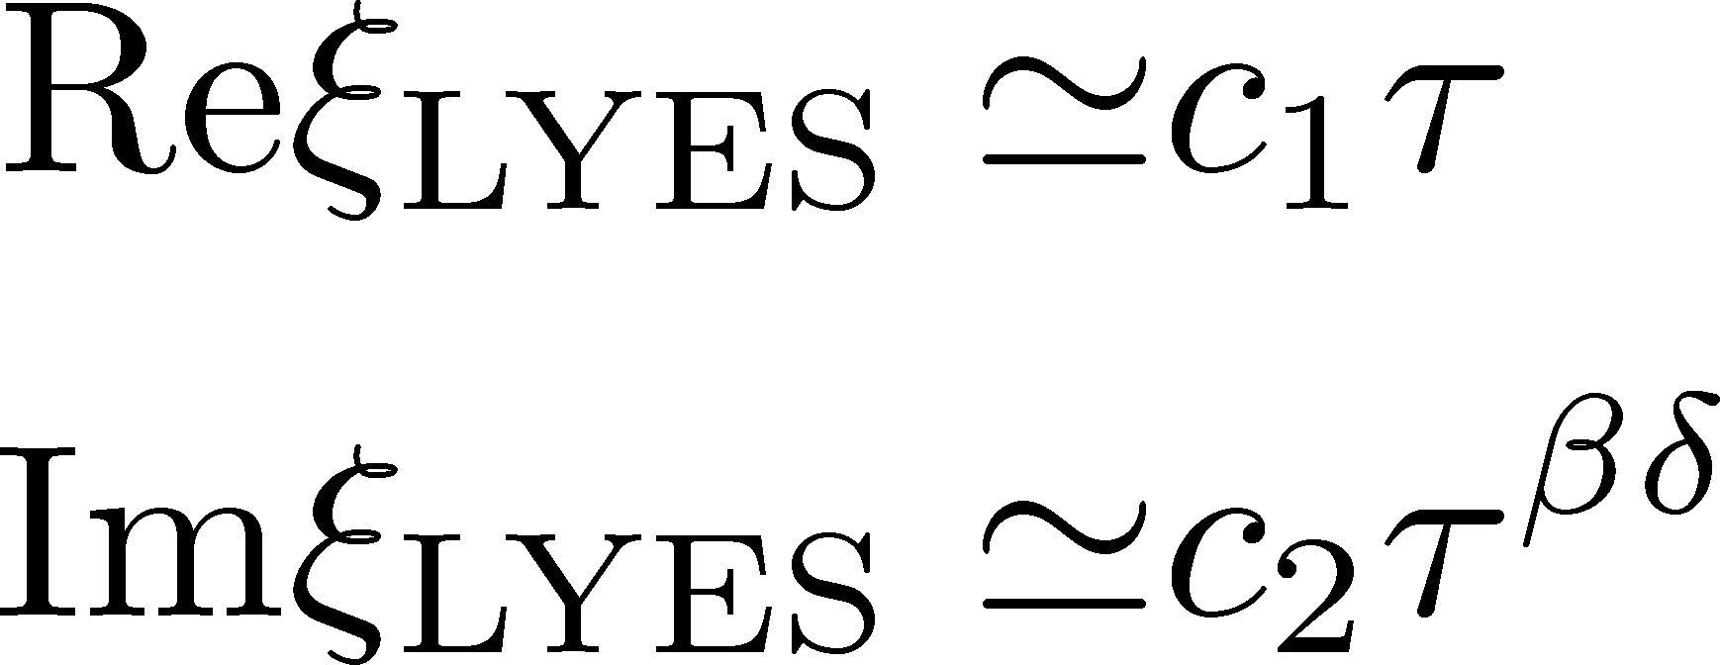


General CP
CP on a $τ−ξ$ plane
Search for LYZ on the complex $ξ$ plane
$$L→∞$$
LY Edge Singularity
generalization
Stephanov, 2006

Slide 17

LYZ Ratio for General CP
LYZ Ratio
nonzero for $a_{12}≠0$

Slide 18

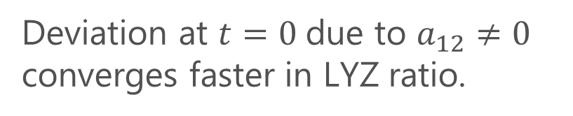
LYZ Ratio for General CP
LYZ Ratio
nonzero for $a_{12}≠0$
Binder cumulant
Jin+, PRD86, 2017
nonzero for $a_{12}≠0$
Deviation at $t=0$due to $a_{12}≠0$ converges faster in LYZ ratio.

Slide 19
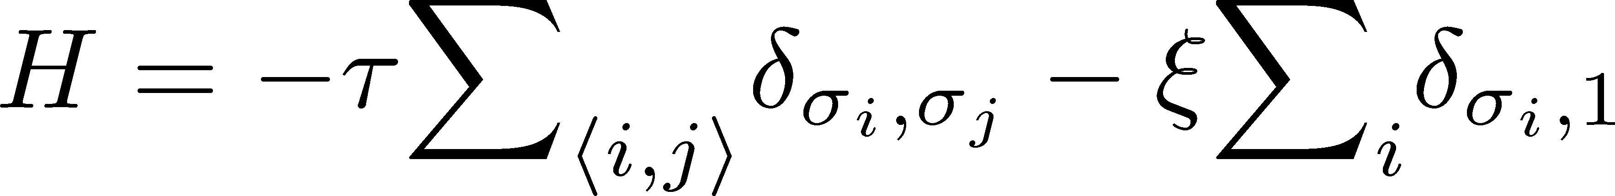
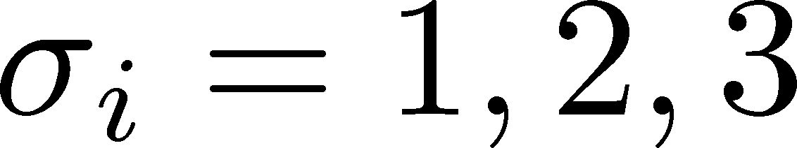
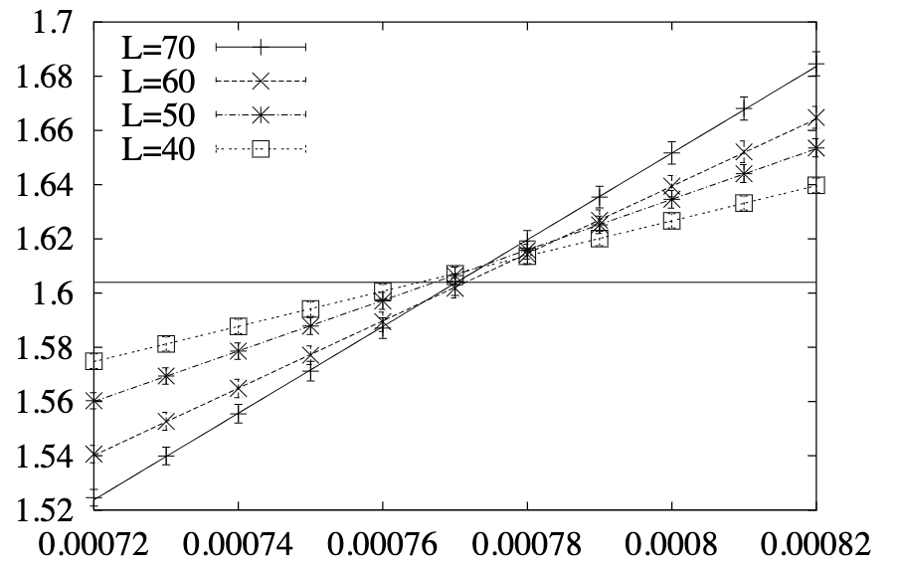
3d 3-State Potts Model
Monte-Carlo + reweighting
Phase Diagram
Binder-Cumulant Analysis
Z(2) CP
1st-order
Z(3)
Karsch, Stickan, 2000

Slide 20
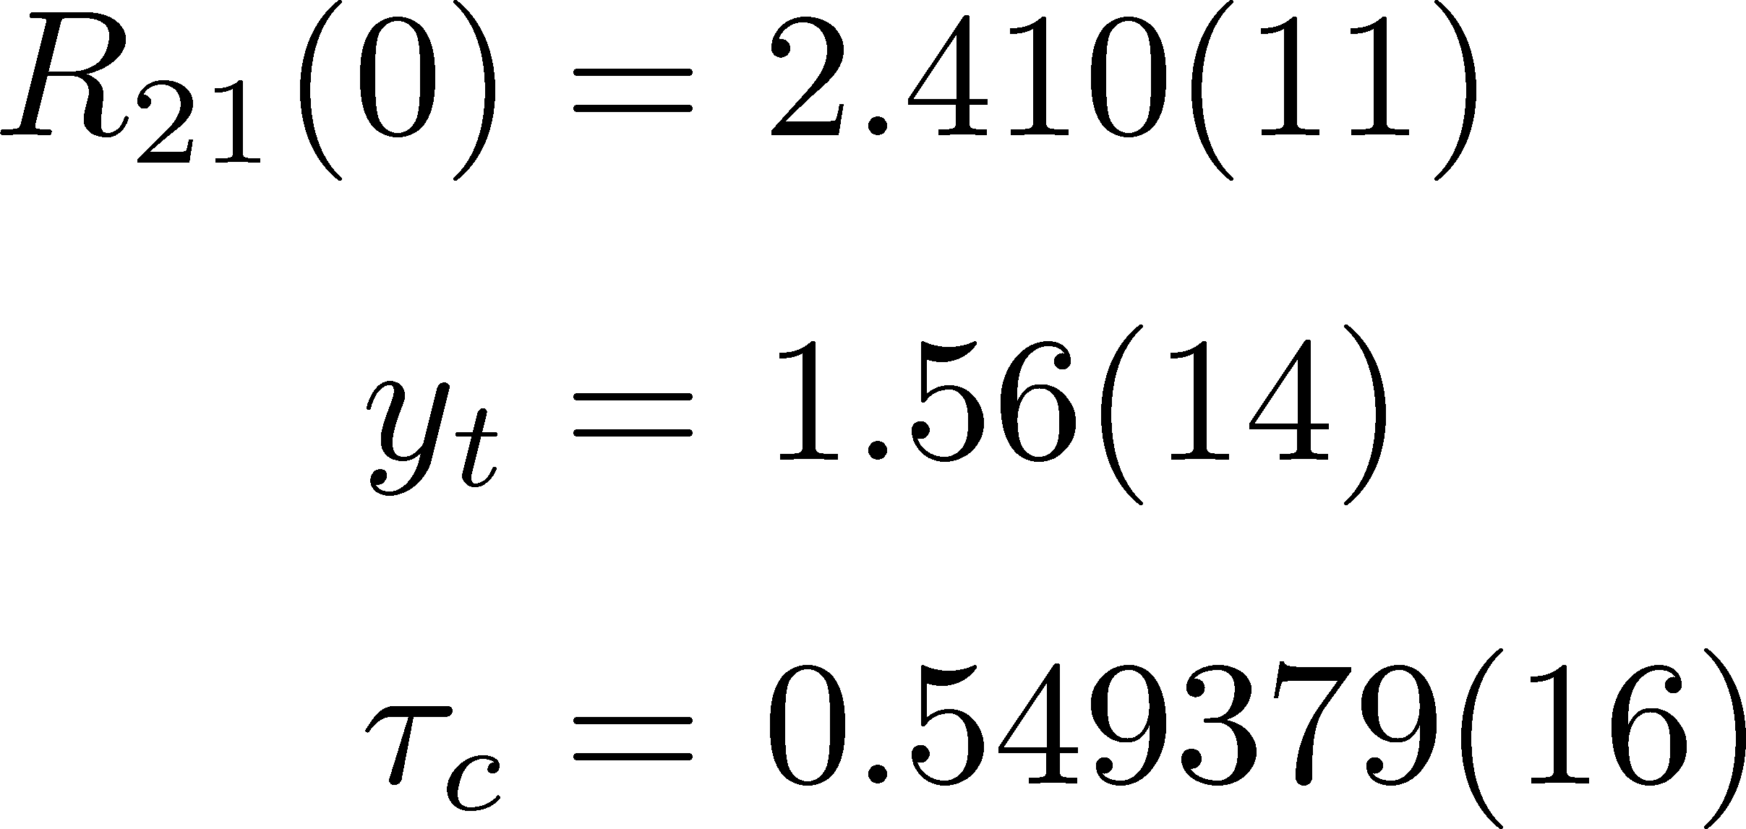
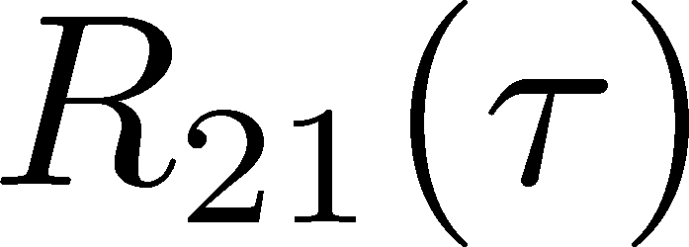
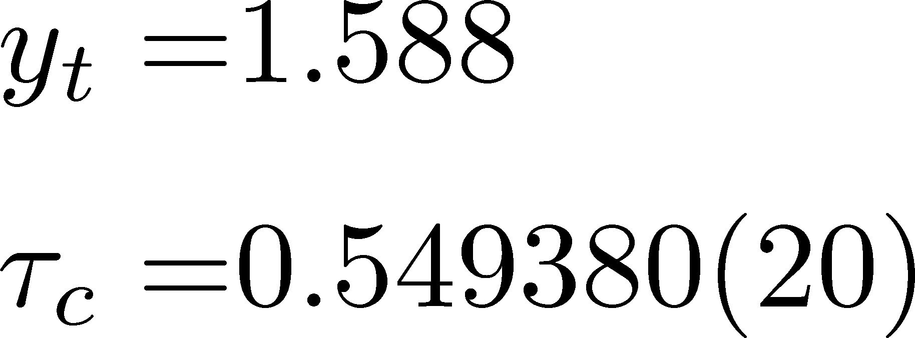

3d 3-State Potts Model: LYZ Ratio
Fit Results (to $L≥40$):
Consistent with
Preliminary
3d Ising
Karsch+, ‘00

Slide 21
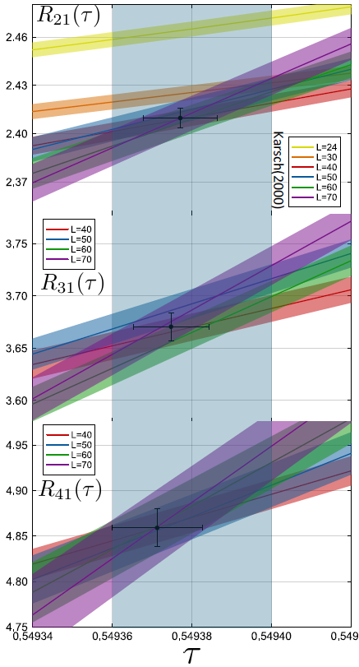
3d 3-State Potts Model: LYZ Ratio
Fit Results (to $L≥40$):
Consistent with
Preliminary
3d Ising
Karsch+, ‘00
42

Slide 22
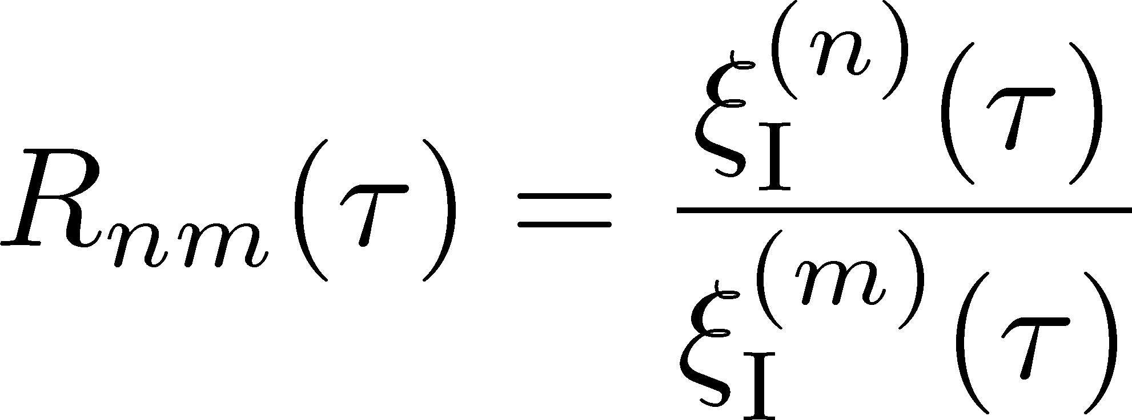

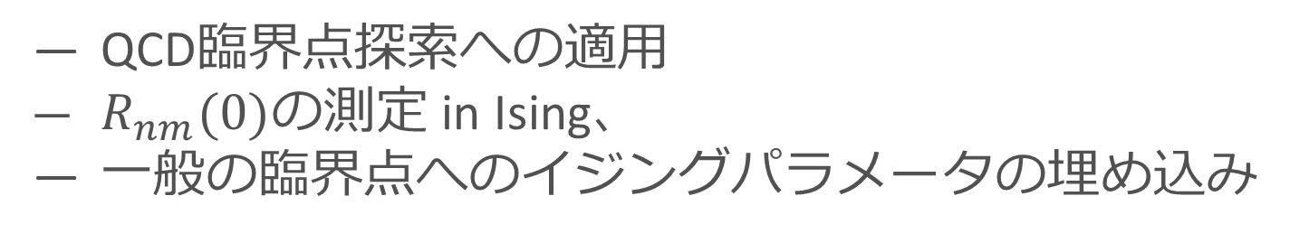
まとめ
リーヤンゼロの虚部の比
異なる体積で測定した$R_{nm}$は臨界点で交差
臨界点の位置決定に使える
一般のCPではビンダーキュムラントより有限体積効果を抑制
展望
QCD臨界点探索への適用
$R_{nm}(0)$の測定 in Ising、
一般の臨界点へのイジングパラメータの埋め込み

Slide 23
backup

Slide 24
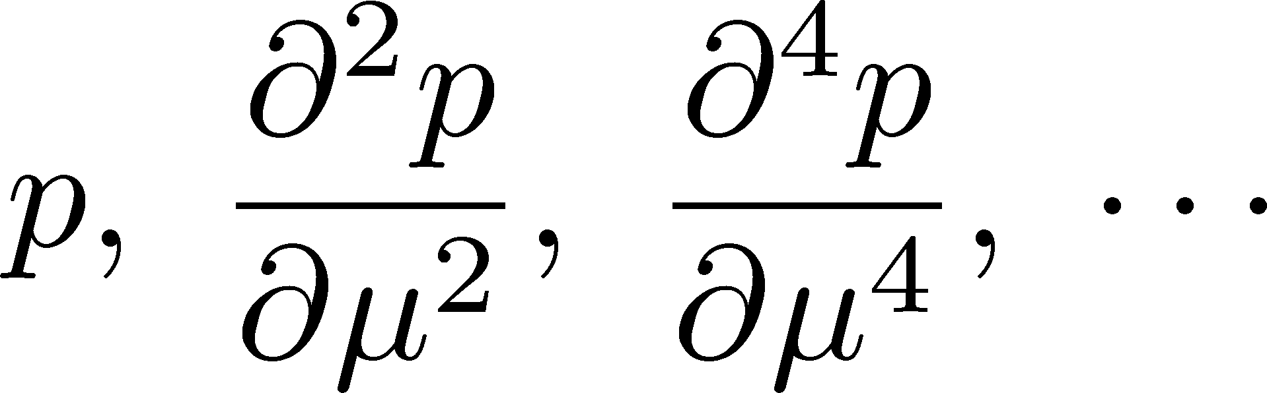




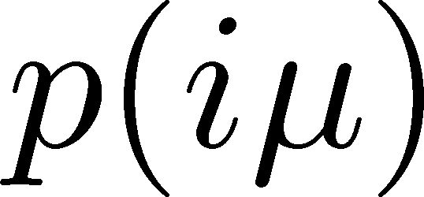
Using LYZ for the QCD-CP Search
Taylor expansion
LYZ
LYZ
Imaginary chem. pot.
Use of Pade approximation

Slide 25
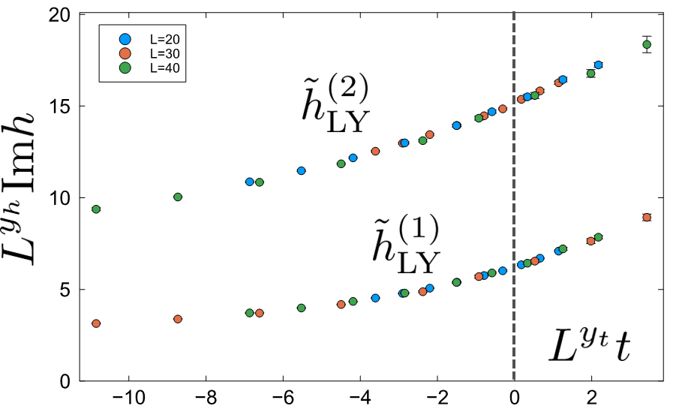



Where is QCD Critical Point?
Ising model
LYZ in QCD
Clarke+, arXiv:2405.10196
$T_{c}$around here??

Slide 26

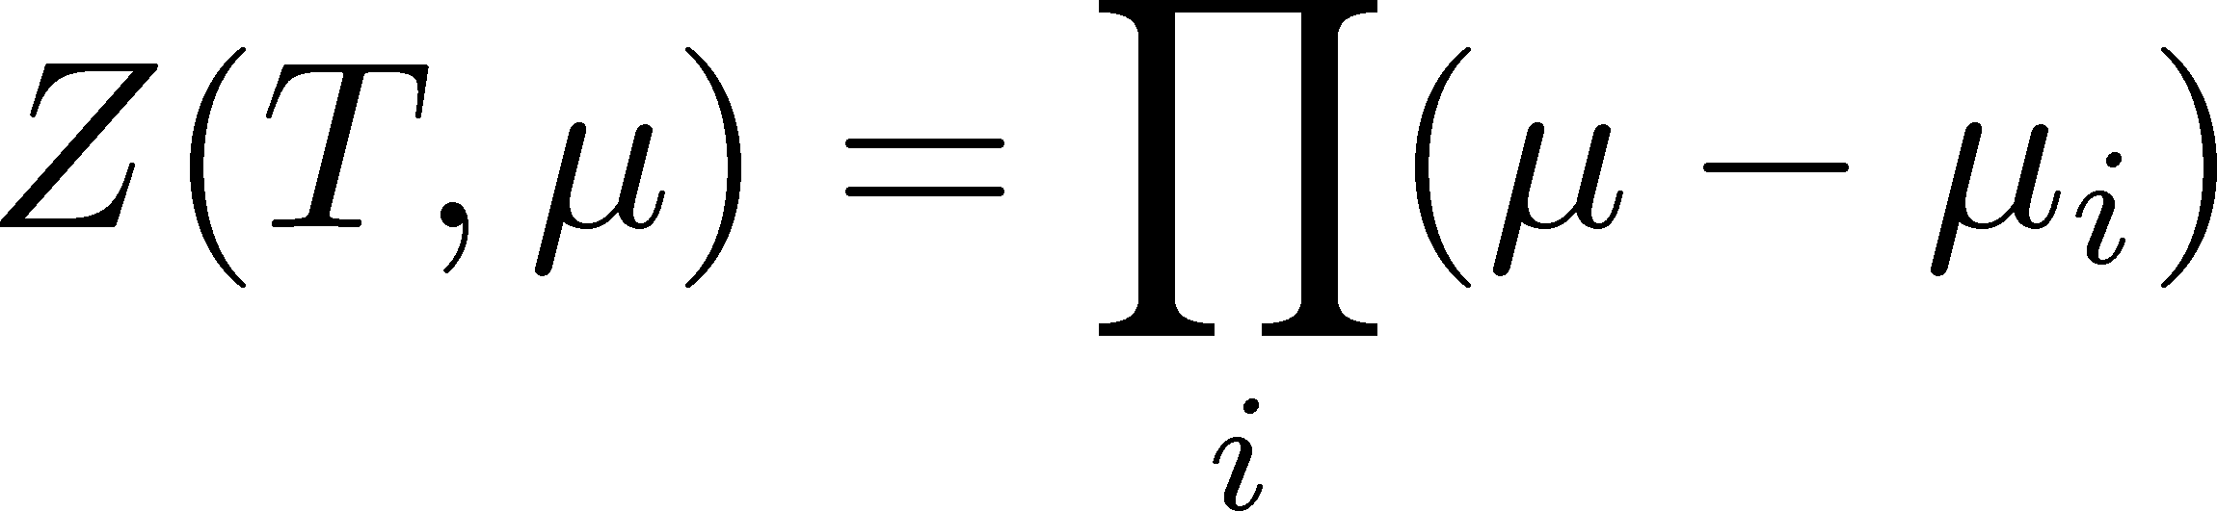



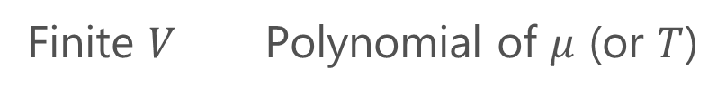


Lee-Yang Zero
Yang, Lee; Lee, Yang (’52)
Partition Function
Phase Transition & LYZ
Finite $V$ Polynomial of $μ$ (or $T$)
First-order transition
at $μ=μ_{c}$
For $V→∞$, LYZs are accumulated on the line crossing the real axis at $μ=μ_{c}$.
zeros on the complex plane
=Lee-Yang Zeros

