Slide 1
Physics of
J-PARC Heavy-Ion Project
The 4th J-PARC Symposium, Mito, Japan, 2024/10/15
Masakiyo Kitazawa
(YITP, Kyoto)
for J-PARC-HI Collaboration

Slide 2
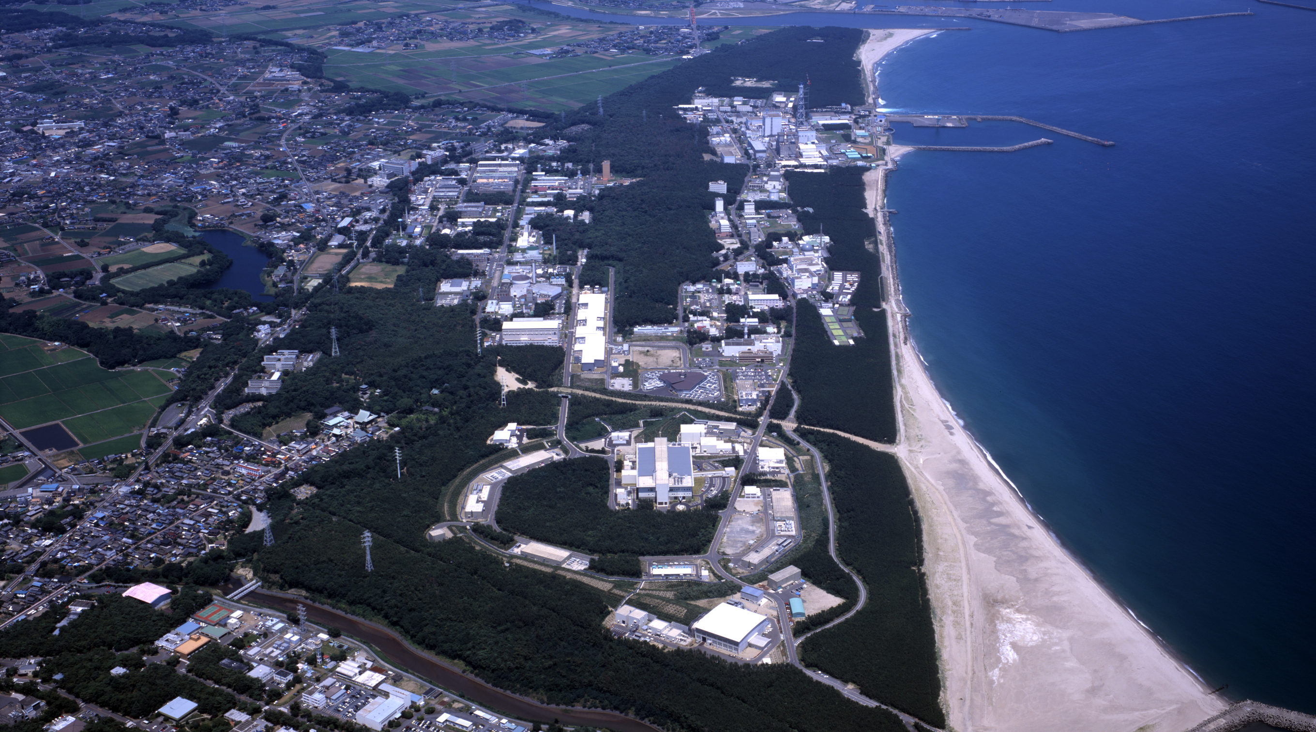
Imagine J-PARC 20 years from now!
New experiments with heavy-ion beams
will enrich the future of J-PARC.

Slide 3
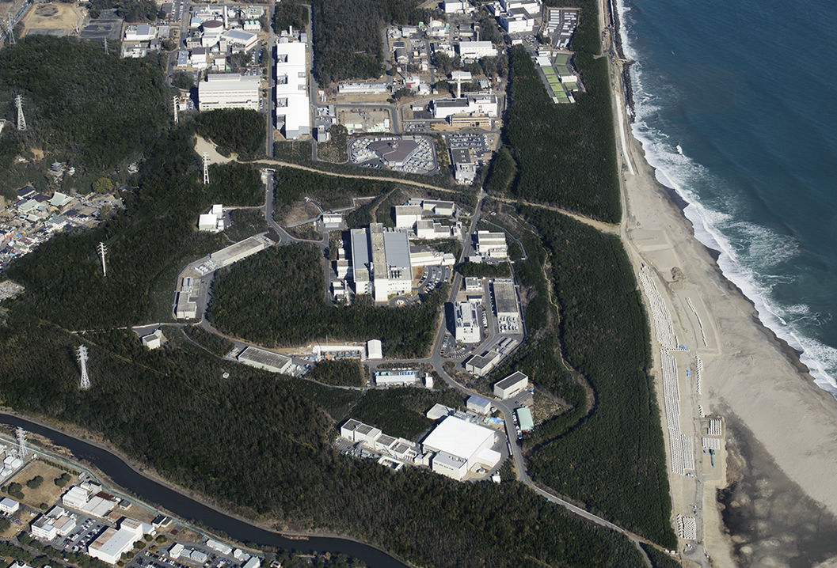



J-PARC-HI = J-PARC Heavy-Ion Project
LINAC
$E_{lab}=400MeV$
New HI injector + existing accelerators (RCS, MR)
Heavy-ion beams with world highest luminosity
Realize various new experiments at J-PARC
RCS
$E_{lab}=3GeV$
Main Ring
$E_{lab}=30GeV$
Hadron hall

Slide 4
J-PARC-HI = J-PARC Heavy-Ion Project
LINAC
$E_{lab}=400MeV$
New HI injector + existing accelerators (RCS, MR)
Heavy-ion beams with world highest luminosity
Realize various new experiments at J-PARC
HI
injector
RCS
$E_{lab}=3GeV$
Main Ring
$E_{lab}=30GeV$
Hadron hall

Slide 5
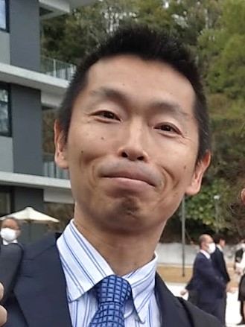
Who am I??
Masakiyo Kitazawa
Yukawa Institute for Theoretical Physics, Kyoto U.
Working with J-PARC-HI since 2014
Research Interests:
QCD in medium
Relativistic heavy-ion collisions
Lattice QCD Monte-Carlo simulations

Slide 6
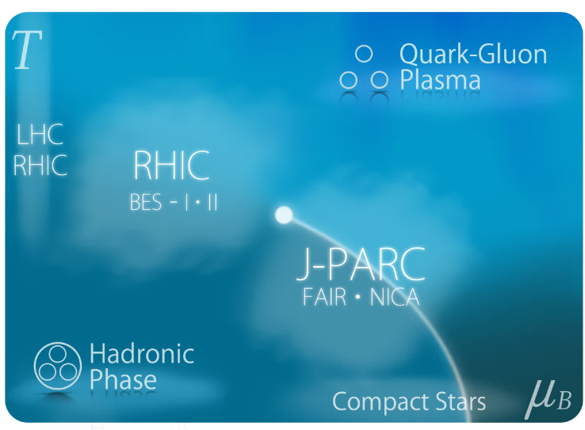
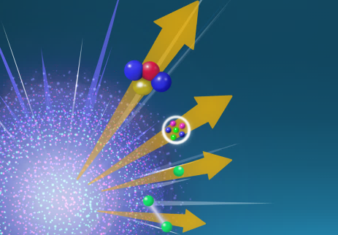
Relativistic HI Collisions at J-PARC:
Physics Goals
Exploring extremely dense medium
QCD phase transitions
Equation state for neutron stars
Hadron/hypernuclear physics
Hadron interaction/structure
Search for rare events
Hypernuclear physics

Slide 7
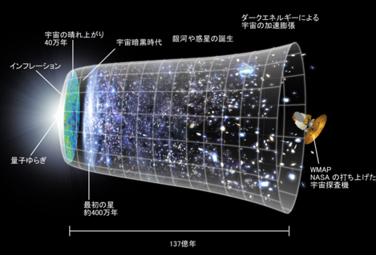

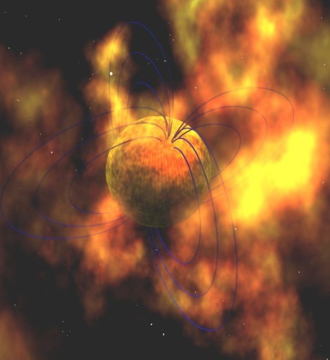
QCD Phase Diagram
Early Universe
T
Crossover at zero density
Possible first-order transition and QCD critical point in dense region
Multiple QCD-CP? MK+ (‘02)
Color superconducting phases in dense and cold quark matter
Quark-Gluon Plasma
150MeV
ＱＣＤ Critical Point
Hadron Phase
(confined)
Color SC
Compact
Stars
~10¹⁵g/cm³
μ

Slide 8
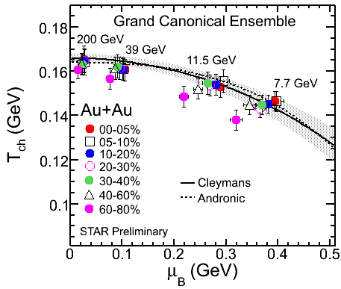
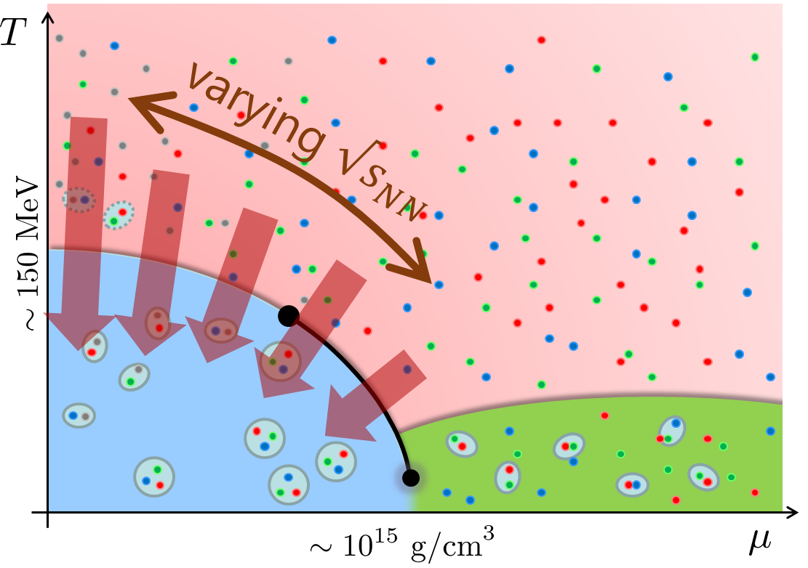
Beam-Energy Scan
STAR, 2012
High E
Low E
Baryon stopping

Slide 9





History / Current Status of HIC
LHC
2010~
RHIC
2000~
SPS
Increasing Collision Energy
NA61/SHINE
~2000
RHIC-BES
AGS
FAIR-CBM
~1996
HADES

Slide 10
History / Current Status of HIC
LHC
J-PARC-HI
2010~
FAIR-CBM
github.com/tgalatyuk/interaction_rate_facilities
RHIC
NICA
2000~
HADES
NA61/SHINE
Beam-Energy
Scan
RHIC-BES-FXT
SPS
RHIC-BES
Increasing Collision Energy
NA61/SHINE
~2000
RHIC-BES
AGS
FAIR-CBM
~1996
HADES
2010~

Slide 11
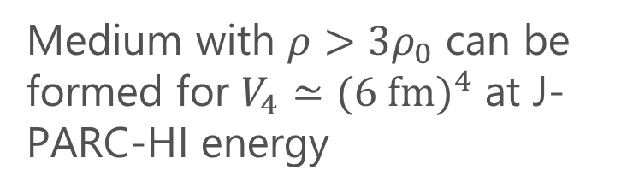
How High Density? Where is optimal $\sqrt{s_{NN}}$?
Four-volume of high-density region
Taya, Jinno, MK, Nara, 2409.07685
Medium with $ρ>3ρ_{0}$ can be formed for $V_{4}≃(6 f{m)}^{4}$ at J-PARC-HI energy
J-PARC-HI
(proton 30GeV)
(proton 50GeV)
The density is comparable with the cores of neutron stars
J-PARC-HI = experiments to create the highest baryon-density matter in the Universe
Collision energy

Slide 12

Exploring Dense Medium
Neutron stars
Equation of state
QCD critical point /
1st order transition /
Color superconductivity
Dilepton production rate
Event selection /
Higher correlations

Slide 13
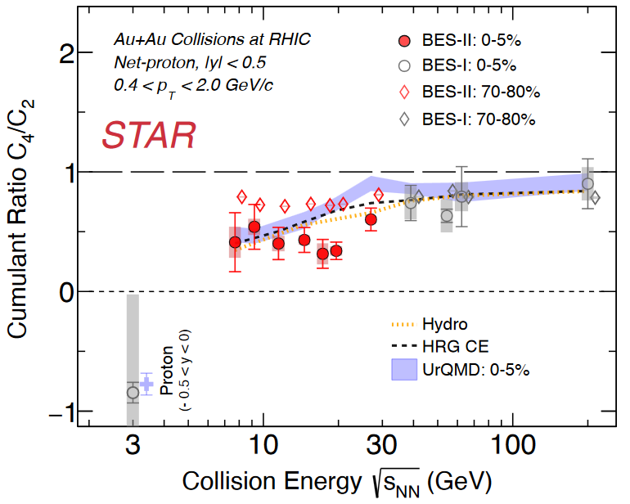
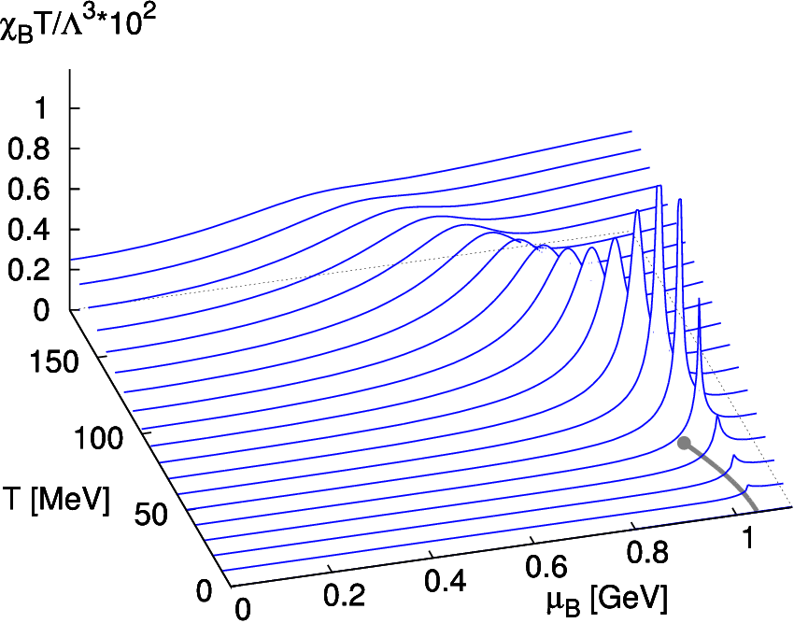
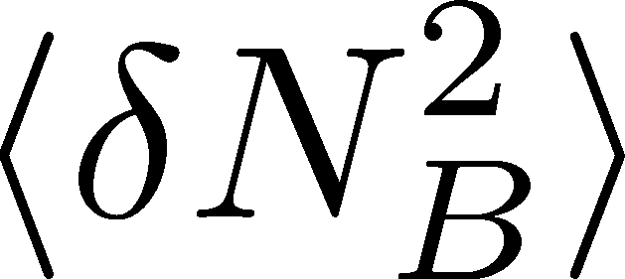
Event-by-event Fluctuations
Theoretical Predictions
on conserved charge fluctuations
Experimental Result
STAR (2024)
Higher-order cumulants
Signal of QCD CP
data
missing
Asakawa, Ejiri, MK (2009)
Stephanov (2011)

Slide 14
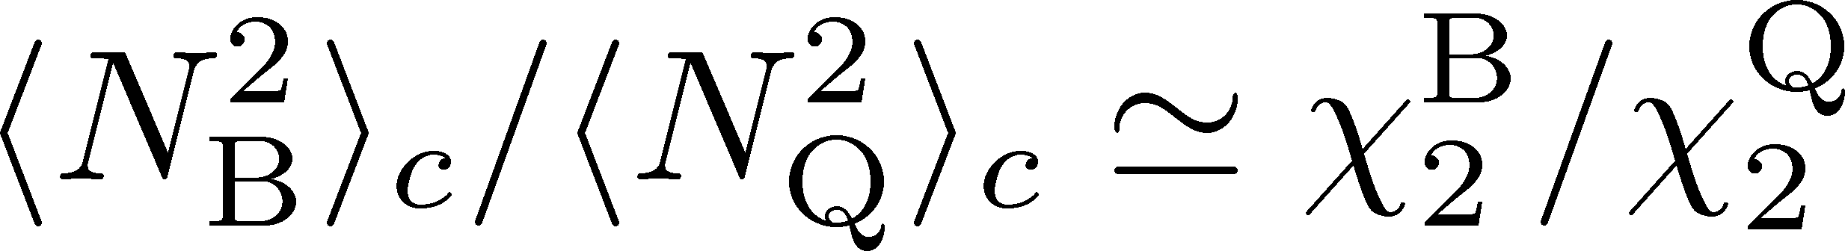
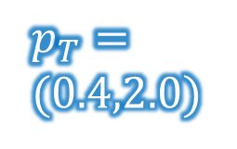





Baryon/Charge Cumulant Ratio
MK, Esumi, Nonaka, Nucl. Phys. A, 2023
STAR, $200$GeV
Lattice QCD＋HRG
$p_{T}$-acceptance correction
Yield
$p_{T}$ uncorrected
$p_{T}=$
$(0.4,2.0)$
$p_{T}$ corrected
$$p_{T}$$
Electric charge: 49%
Protons: 82%
Finite acceptance modifies the ratio strongly.
Wider acceptance/efficiency is desirable.

Slide 15
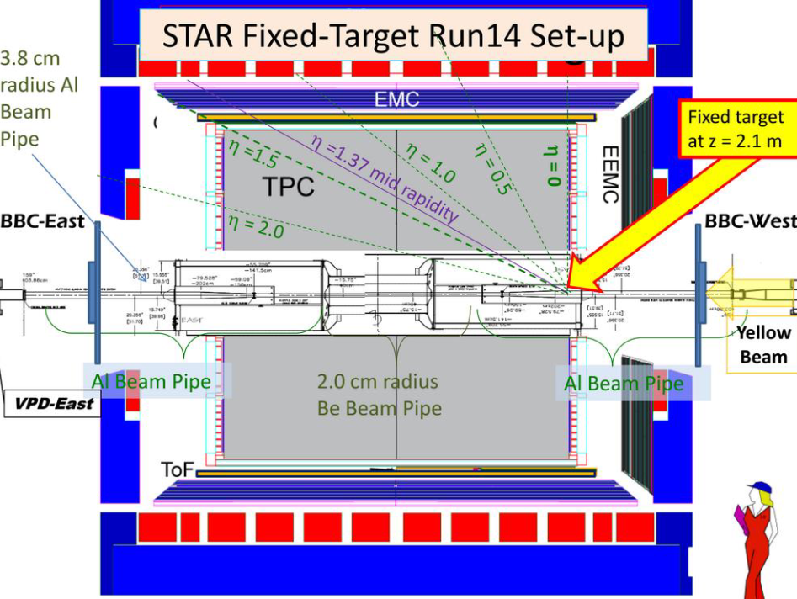


Acceptance of Detectors
STAR Fixed Target
FAIR (GSI)
$$3<\sqrt{s_{NN}}<7.7 GeV$$
$$2<\sqrt{s_{NN}}<5 GeV$$
target
from slide of D. Sebra
Each detector has individual acceptance and efficiency.
Checking detector-response correction is important.

Slide 16
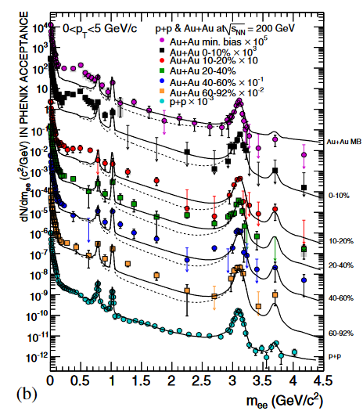
Dilepton Production Rate
Generated by the decay of virtual photons
Carry information of primordial medium
γ
e⁺
e⁻
Physics accessible with DPR
Medium temperature
Dispersion relations
Chiral mixing by chiral restoration
Signal of phase transitions
PHENIX, ‘10
Kim, Gubler, 2020
Sakai+, 2024

Slide 17
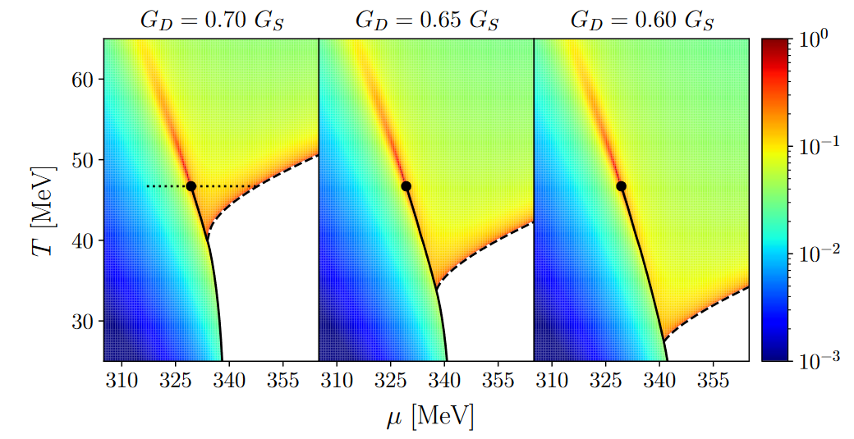
Dilepton at Ultra-Low-Mass Region
Signal for QCD-CP & Color SC
Nishimura, MK, Kunihiro, ‘22; ‘23; ‘24
Anomalous dilepton production due to soft modes at phase transitions
production
process:
Two “hot spots” on the 𝑇-𝜇 plane?

Slide 18



Event Selection
Density Scan?
Taya, Jinno, MK, Nara, 2409.07685
Baryon-rich events
large
e-v-e fluc
transverse energy
Event selections via highest baryon/energy density will allow us a detailed study of QCD phase diagram.
Baryon-rich
events

Slide 19
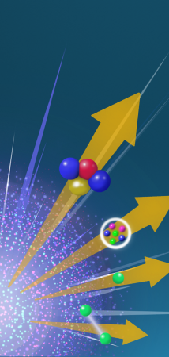
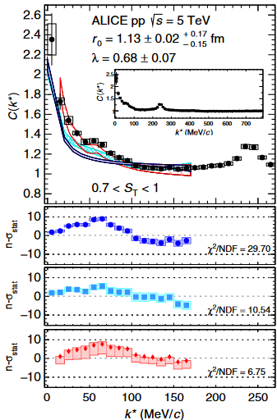
Hadron/Hypernuclear Physics
Hyodo (today)Mantovani Sarti (16th)
Hypernuclei
Correlation functions
→hadron interaction
ALICE,2020
¹²C+¹²C at 15AGeV
(5T / 2.4m magnet)

Slide 20

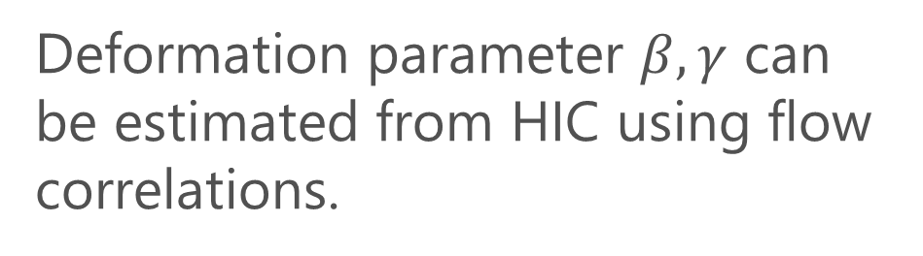
Shape of Nuclei
Deformation parameter $β, γ$ can be estimated from HIC using flow correlations.
$$γ$$
Beam
axis
ATLAS, PRC107 (’23)

Slide 21
J-PARC-HI
Future Plan

Slide 22
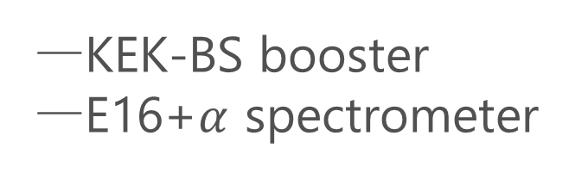
J-PARC-HI Staging Plan
Phase-II
Phase-I
KEK-BS booster
E16+$α$ spectrometer
Phase-I
Phase-II
NEW HI booster
NEW spectrometer

Slide 23
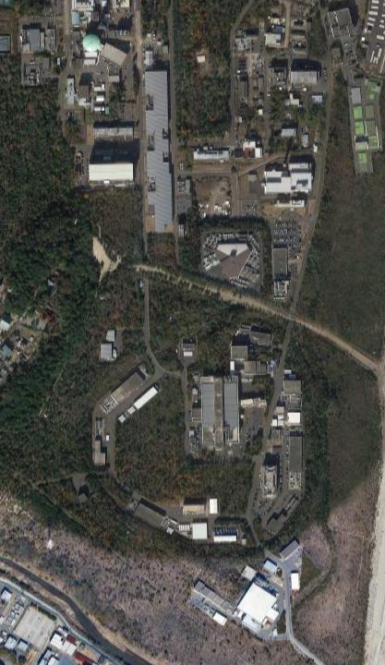
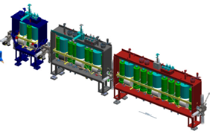
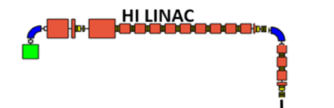
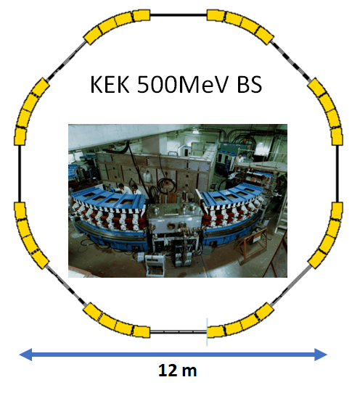
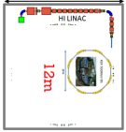


Staging of HI Booster
HI LINAC
Phase-I
LINAC
New
Building
RCS
60m
KEK 500MeV BS
REUSE
kept in working
condition
Main Ring

Slide 24
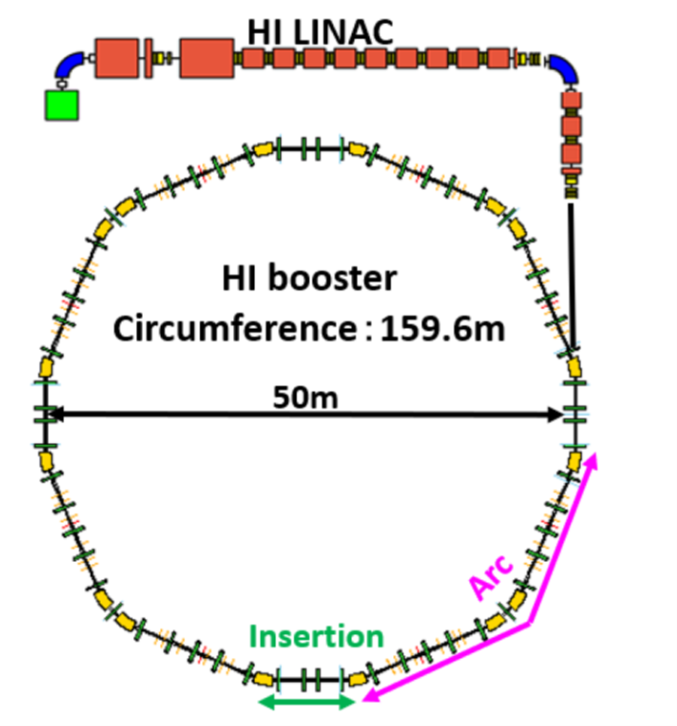

Staging of HI Booster
Phase-I
Phase-II
LINAC
New
Building
RCS
Completely NEW
HI booster
World highest intensity
60m
Main Ring
Interaction rate

Slide 25
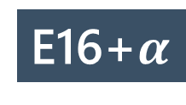
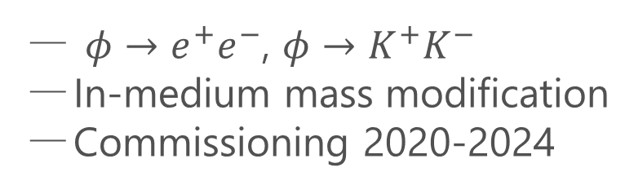
Detector
Phase-I
Morino (15th), Ozawa (Poster)
E16 Spectrometer
$φ→e^{+}e^{−}$, $φ→K^{+}K^{−}$
In-medium mass modification
Commissioning 2020-2024
UPGRADE
E16+$α$
Upgrade forward region for high-multiplicity counting
Hadron/lepton measurement
at wide acceptance

Slide 26
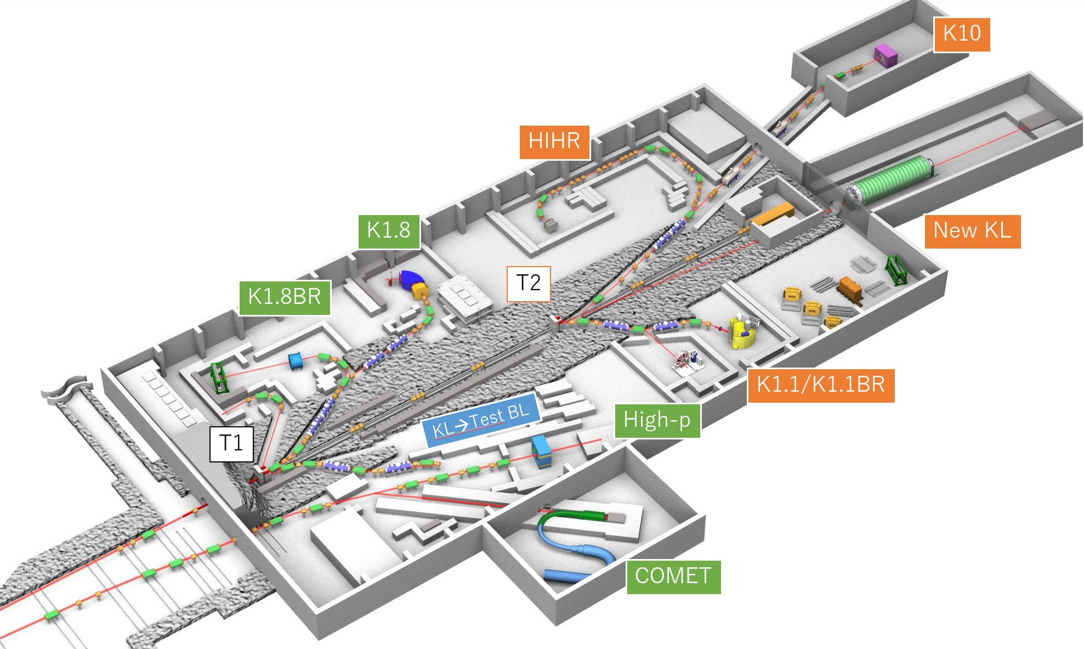
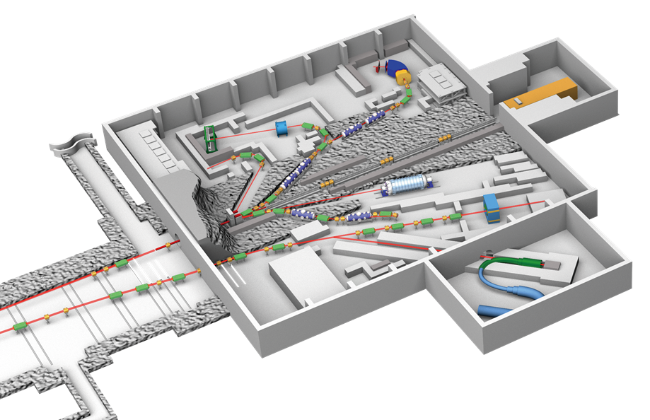
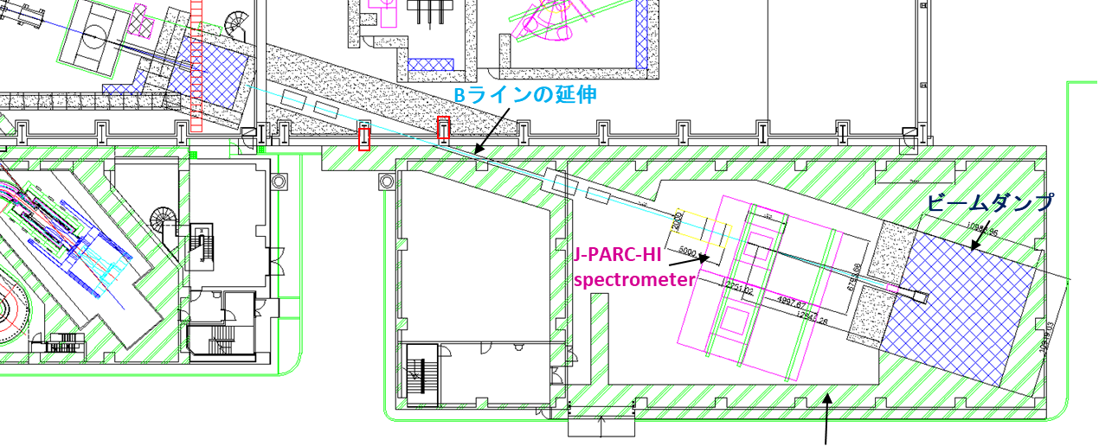
Detectors for Phase II
Present
Extended
E16
J-PARC-HI
Spectrometer
J-PARC-HI spectrometer will be installed in an annex
E16 will also be replaced
E16

Slide 27
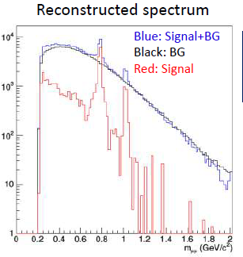
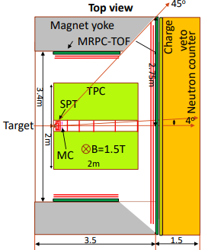
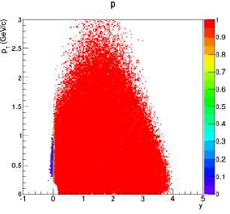
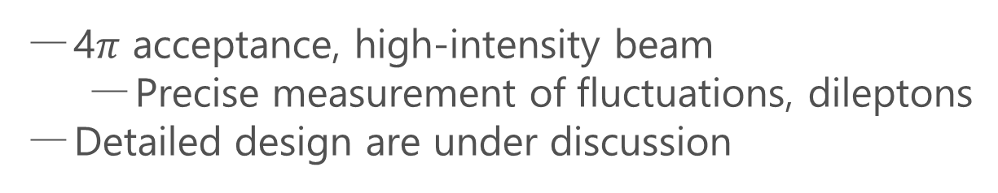
Hadron Spectrometer
Phase-II
Dimuon Setup
4$π$ acceptance, high-intensity beam
  Precise measurement of fluctuations, dileptons
Detailed design are under discussion
Hadron calorimeter
acceptance
ALICE3-like dipole

Slide 28
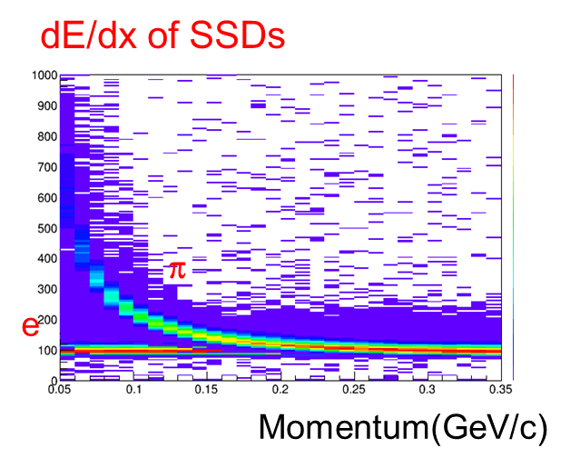
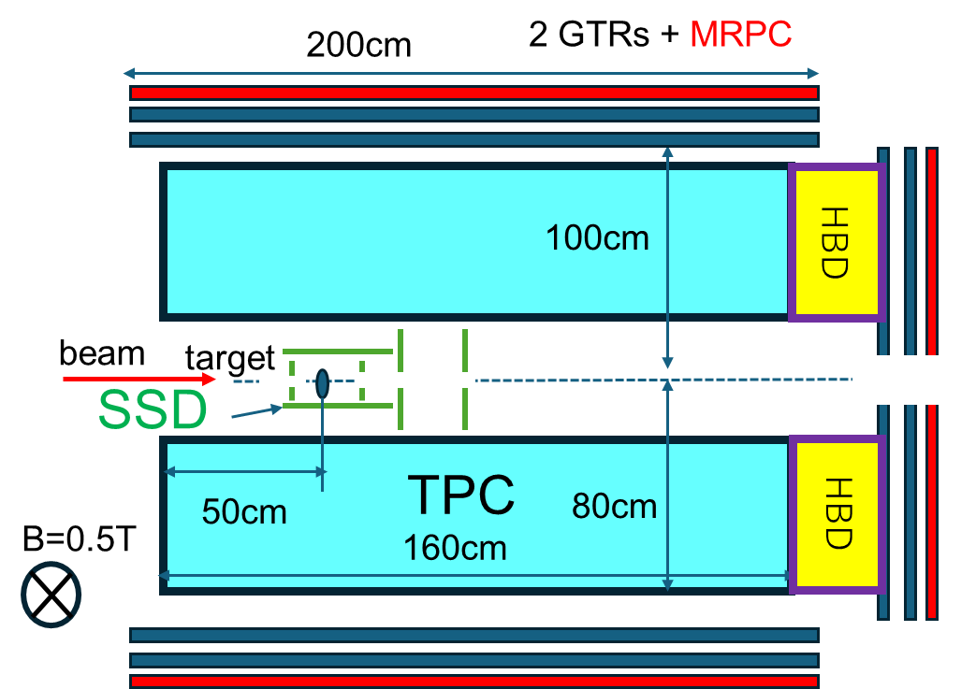
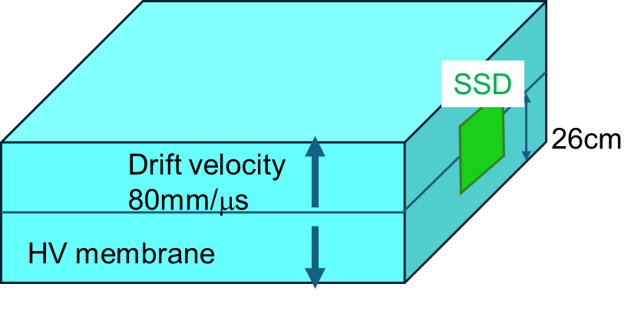
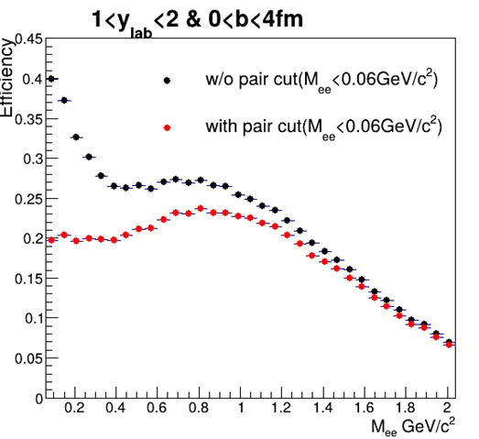
Dilelectron Measurements
Phase-II
Large acceptance measurement of dielectrons and hadrons
Efficiency
Precise measurement of low-mass dielectrons
search for QCD-CP & CSC phase transition

Slide 29
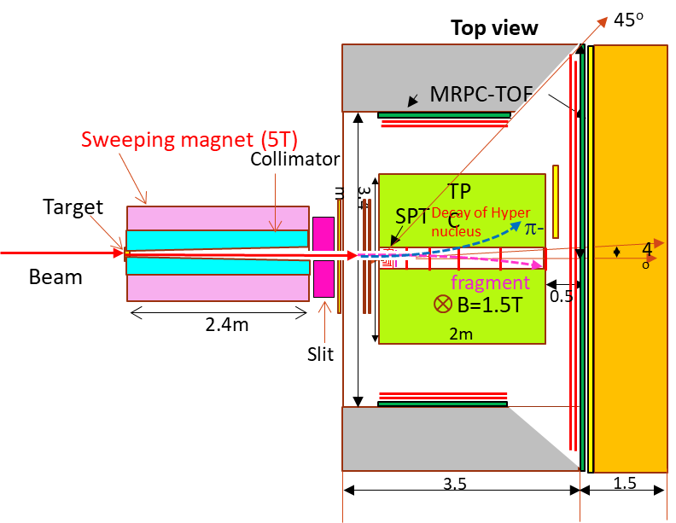
Hypernuclear Spectrometer
Phase-II
Closed geometry : Sweeping magnet and Collimator
Interaction Rate : ~100 MHz
Lifetime and Magnetic moment Search for new hypernuclei and strangelet

Slide 30
Imagine J-PARC 20 years from now!
New experiments with heavy-ion beams
will enrich the future of J-PARC.

Slide 31

Summary
J-PARC-HI will
realize high-precision HI experiments to explore
  extremely dense QCD
  hadron/hypernuclear physics, etc.
be realized through the staging plan:
  Phase-I: Experiment utilizing existing equipment
  Phase-II: Full-spec experiment with world highest rate
Still many things to do
We need continuous support from community.
New challengers are welcome!

Slide 32
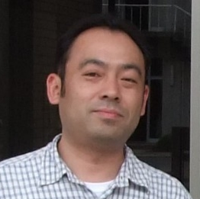
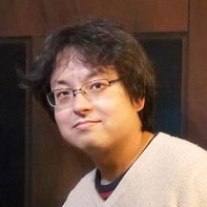
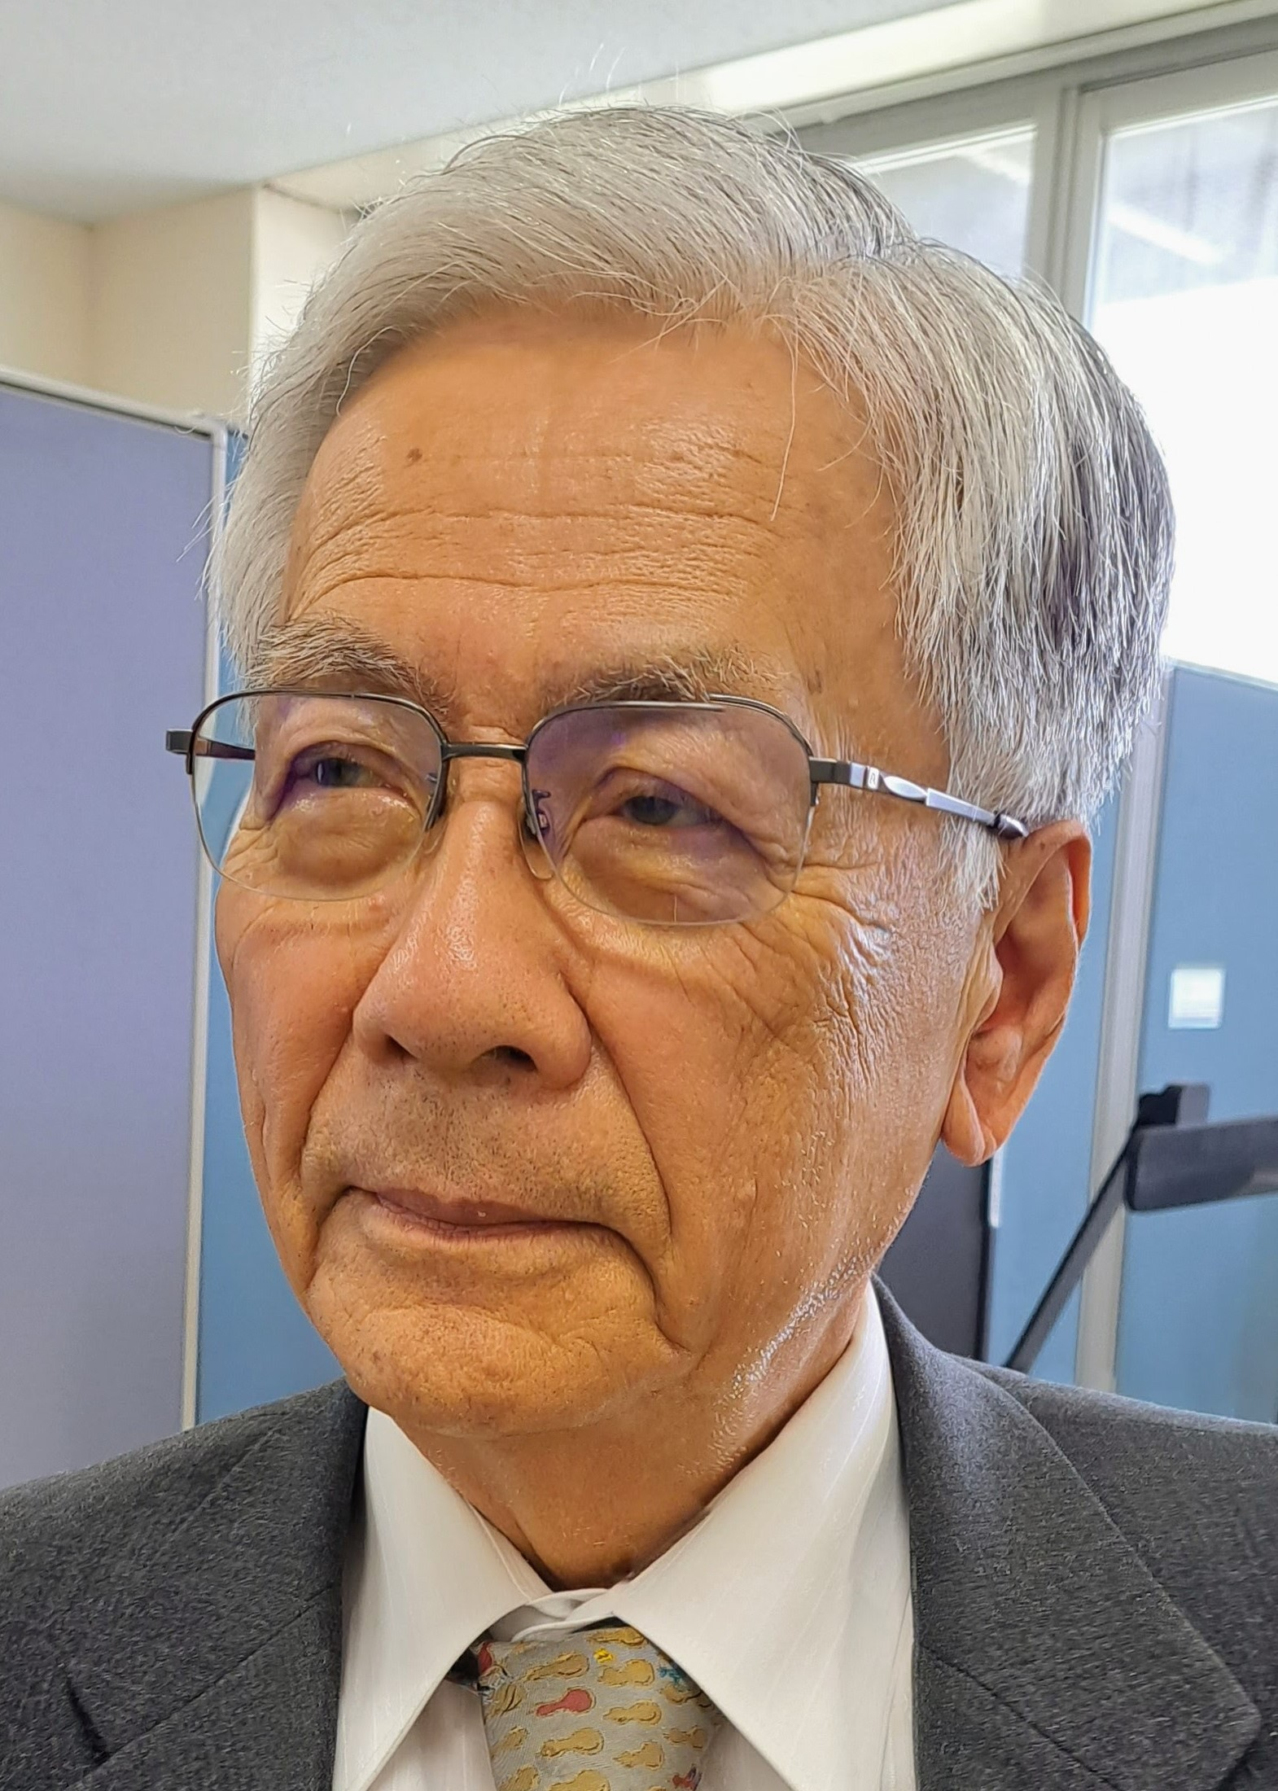
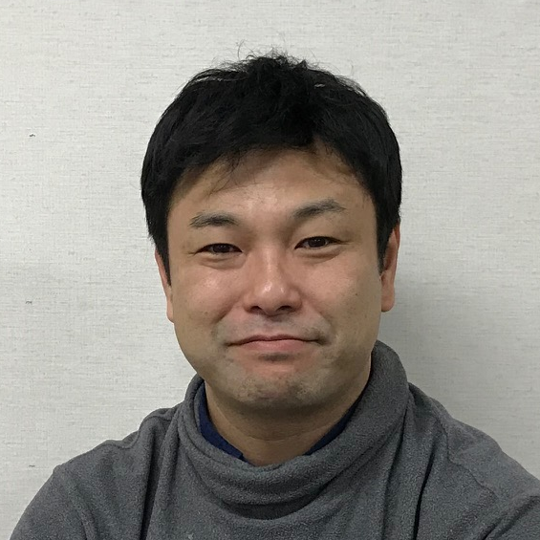
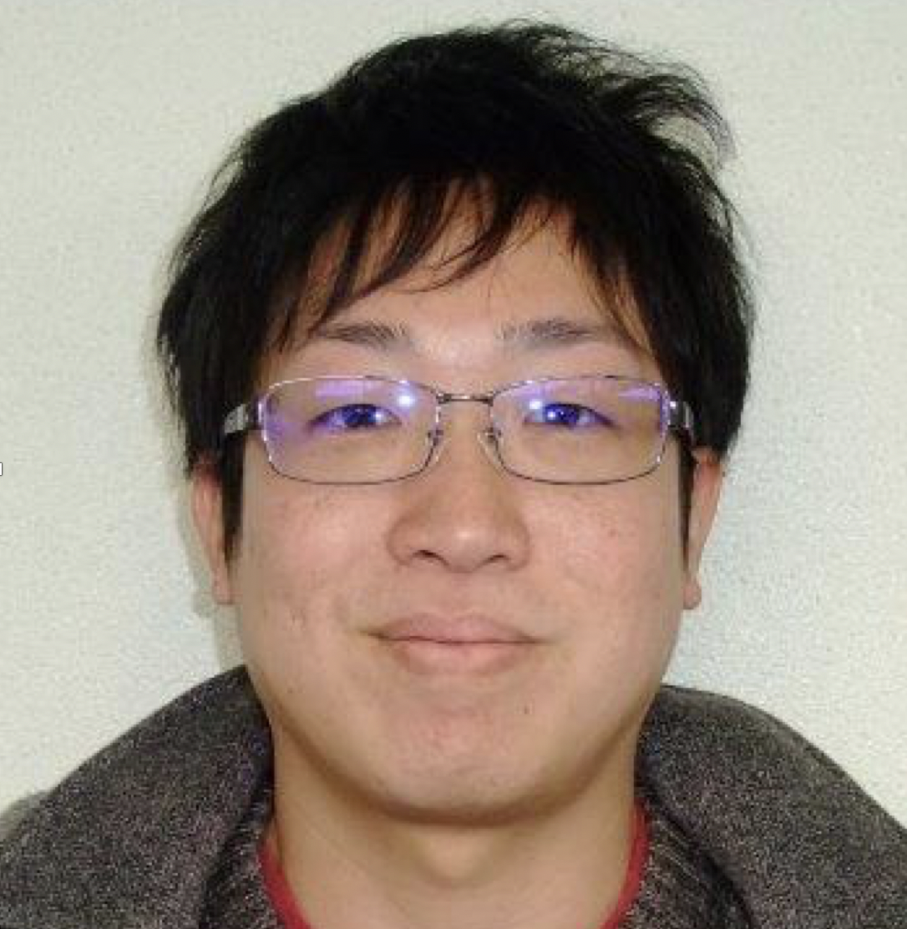


J-PARC-HI Collaboration
Hiroyuki Sako
Taku Gunji
Kazuya Aoki
Shoji Nagamiya
MK
Kyoichiro Ozawa
Yudai Ichilawa
ShinIchi Esumi
Kazuhiro Tanaka
and 138 members in total
Exp.: J. K. Ahn , K. Aoki, S. Ashikaga, O. Busch, M. Chiu, T. Chujo , P. Cirkovic , T. Csorgo , D. Devetak , G. David, M. Djordjevic,
S. Esumi , P. Garg, R. Guernane , T. Gunji , T. Hachiya , H. Hamagaki , S. Hasegawa, B. S. Hong, S. H. Hwang, Y. Ichikawa, T. Ichisawa , K. Imai, M. Inaba, M. Kaneta , H. Kato, B. C. E. J. Kim, X. Luo, Y. Miake , J. Milosevic, D. Mishra, Y. Morino, L. Nadjdjerdj , S. Nagamiya , T. Nakamura, M. Naruki , K. Nishio , T. Nonaka, M. Ogino, K. Oyama , K. Ozawa, T. R. Saito, A. Sakaguchi , T. Sakaguchi , S. Sakai, H. Sako, K. Sato, S. Sato, S. Sawada, K. Shigaki , S. Shimansky , M. Shimomura, M. Stojanovic , H. Sugimura, Y. Takeuchi, H. Tamura, K. H. Tanaka, Y. Tanaka, K. Tanida, N. Xu, S. Yokkaichi, I. K. Yoo
Theor.: Y. Akamatsu, M. Asakawa, K. Fukushima, H. Fujii , T. Hatsuda , M. Harada, T. Hirano, K. Itakura M. Kitazawa , T. Maruyama , K. Morita, K. Murase A. Nakamura, Y. Nara, C. Nonaka, A. Ohnishi, M. Oka
Acc.: E. Chishiro , H. Harada, Y. Hashimoto, N. Hayashi, K. Hirano, H. Hotchi , K. Ishii, T. Ito, M. Kinsho , R. Kitamura, A. Kovalenko, J. Kamiya , N. Kikuzawa , T. Kimura, Y. Kondo, H. Kuboki , Y. Kurimoto, Y. Liu S. Meigo , A. Miura, T. Miyao , T. Morishita , Y. Morita, K. Moriya, R. Muto, T. Nakanoya , K. Niki, H. Oguri , C. Ohmori , A. Okabe, M. Okamura, P. K. Saha , K. Sato, Y. Sato, T. Shibata, T. Shimokawa , K. Shindo , S. Shinozaki, M. Shirakata , Y. Shobuda , K. Suganuma , Y. Sugiyama, H. Takahashi, T. Takayanagi , F. Tamura, J. Tamura, N. Tani , M. Tomisawa , T. Toyama, Y. Watanabe, K. Yamamoto, M. Yamamoto, M. Yoshii, M. Yoshimoto

Slide 33




LINAC
$E_{lab}=400MeV$
Accelerators
LINAC
RCS
Main Ring(MR)
High intensity $I=1MW$
RCS
$E_{lab}=3GeV$
Purposes
Hadron/Nuclear physics
Neutrino physics
Material/Life science
Main Ring
$E_{lab}=30GeV$
Hadron hall

Slide 34



J-PARC-HI = J-PARC Heavy-Ion Project
proton beam
heavy-ion beam
$$E_{lab}=$$
$$0.4GeV$$
LINAC
3GeV RCS
$$3GeV$$
Main Ring
$$30GeV$$
Neutrino Exp. Facil.
HI Injector
Hadron
Hall
Low-E exp
MLF
New HI injector + existing synchrotrons (RCS, MR)
Supply heavy-ion beams with world highest luminosity
Realize various new experiments at J-PARC

