Slide 1

Japanese Gardens
Photo from: https://www.gankofood.co.jp/shop/detail/ya-nijyoen/

Slide 2

Japanese Gardens
project the great nature into limited space
Photo from: https://www.gankofood.co.jp/shop/detail/ya-nijyoen/

Slide 3


$$≃$$
numrical
simulations
Garden
Try to represent the real world in a limited space.
Various own techniques in numerical simulations
Luscher’s finite-volume method
finite-size scaling for phase transitions
Lee-Yang zeros
...
This study

Slide 4
HHIQCD2024, YITP, Kyoto, Oct. 30, 2024
Lee-Yang Zeros
for locating a critical point
Masakiyo Kitazawa
(YITP, Kyoto)
In collab. with Tatsuya Wada, Kazuyuki Kanaya
Special thanks to S. Ejiri
Wada, MK, Kanaya, arXiv:2410.19345 [hep-lat]

Slide 5
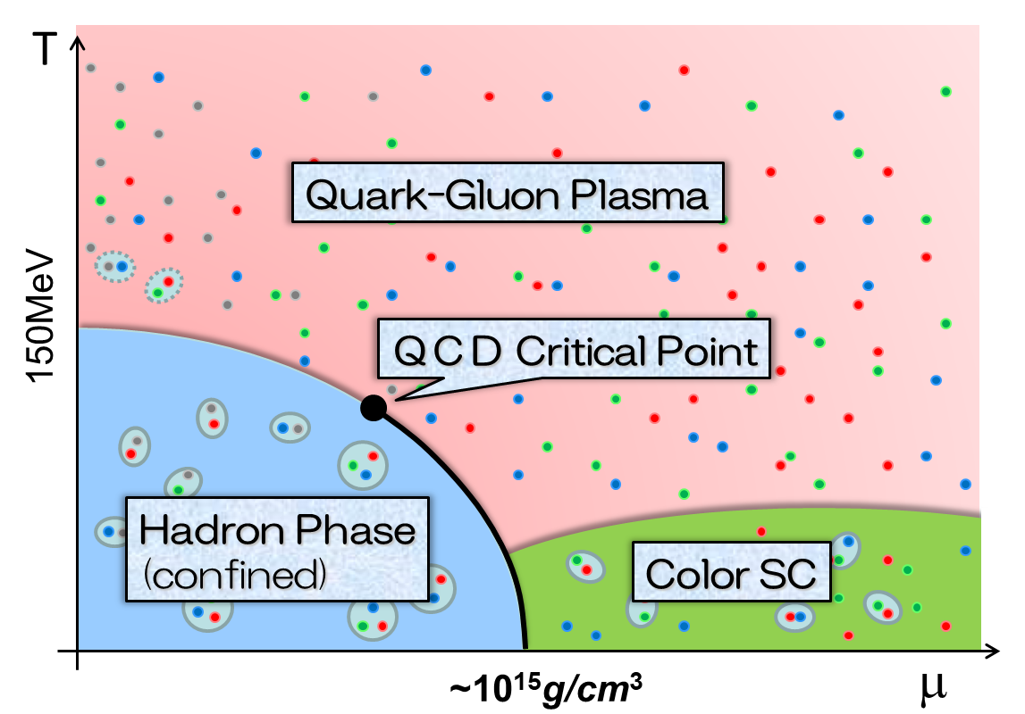
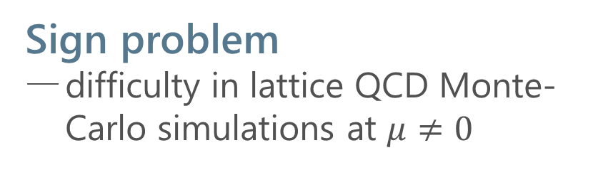
QCD Phase Diagram
Rich phase structure in QCD
QCD critical point(s)
color superconductivity
Sign problem
difficulty in lattice QCD Monte-Carlo simulations at $μ≠0$
Various approaches
Taylor expansion method
Imaginary chem. pot.
Complex Langevin
Lifschetz thimble
Lee-Yang edge singularity
…

Slide 6

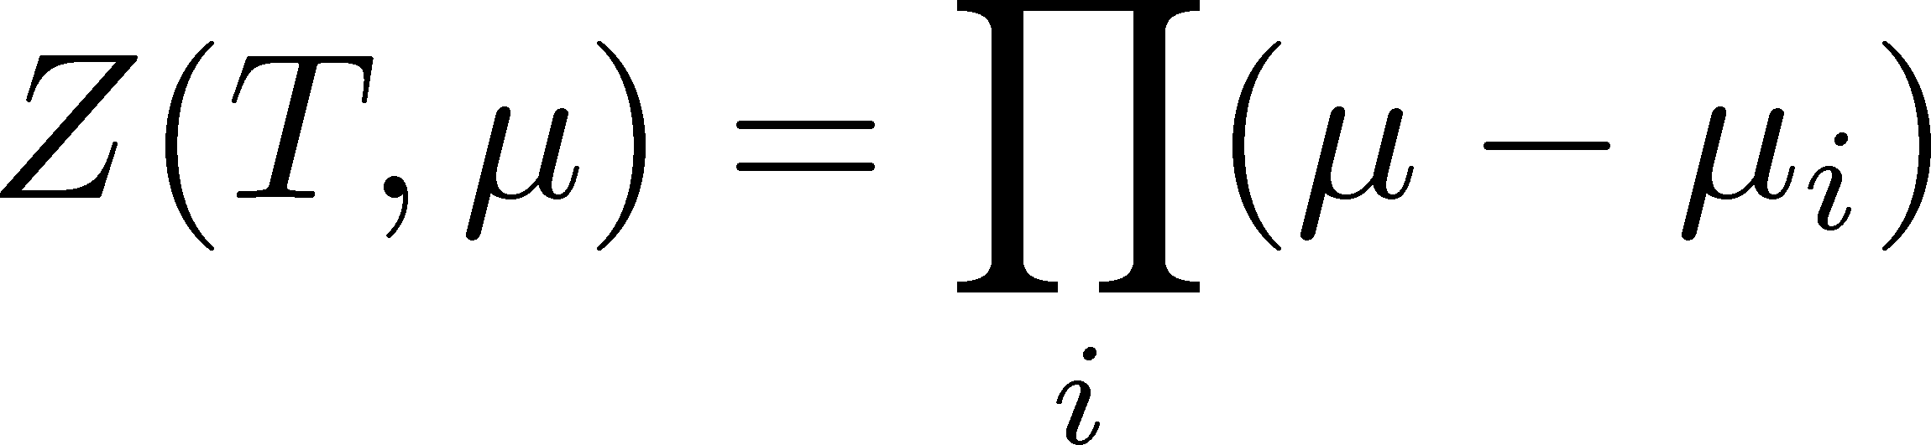




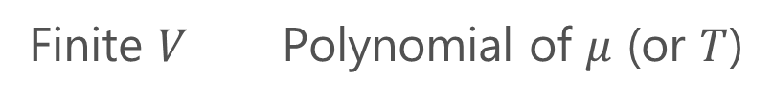
Lee-Yang Zeros
Yang, Lee; Lee, Yang (’52)
Partition Function
Finite $V$ Polynomial of $μ$ (or $T$)
zeros on the complex plane
=Lee-Yang Zeros

Slide 7


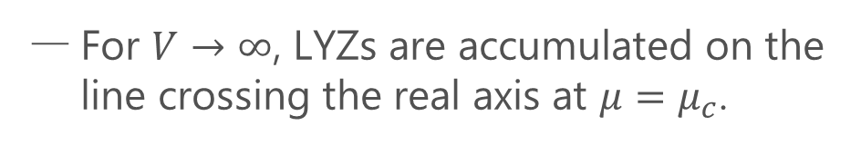

Lee-Yang Zeros
Yang, Lee; Lee, Yang (’52)
Partition Function
Phase Transition & LYZ
Finite $V$ Polynomial of $μ$ (or $T$)
First-order transition
at $μ=μ_{c}$
For $V→∞$, LYZs are accumulated on the line crossing the real axis at $μ=μ_{c}$.
zeros on the complex plane
=Lee-Yang Zeros

Slide 8

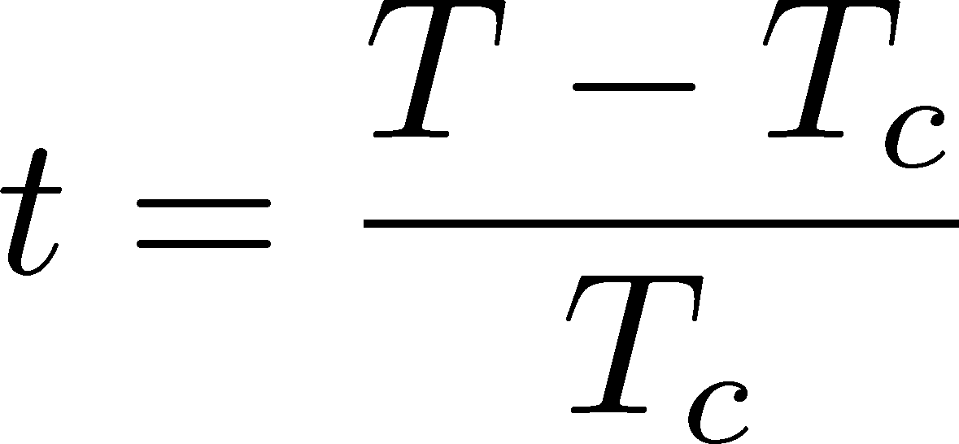

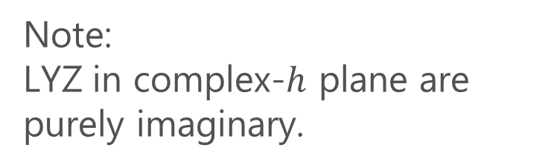

LYZ around a Critical Point in Ising Model
1st-transition
singularity on the real $h$ axis
Crossover
no singularity on the real axis
Note:
LYZ in complex-$h$ plane are purely imaginary.
Lee-Yang, 1952

Slide 9
LYZ around a Critical Point in Ising Model
1st-transition
singularity on the real $h$ axis
Crossover
no singularity on the real axis
Note:
LYZ in complex-$h$ plane are purely imaginary.
Lee-Yang, 1952

Slide 10


LYZ around a Critical Point in Ising Model
$$h_{I}\sim t^{βδ}$$
1st-transition
singularity on the real $h$ axis
Crossover
no singularity on the real axis
LY edge singularity
Starting from the CP
Its behavior is governed by the the scaling function.
$$h_{I}\sim t^{βδ}$$

Slide 11
LYZ around a Critical Point in Ising Model
$$h_{I}\sim t^{βδ}$$
1st-transition
singularity on the real $h$ axis
Crossover
no singularity on the real axis
LY edge singularity
Starting from the CP
Its behavior is governed by the the scaling function.
$$h_{I}\sim t^{βδ}$$

Slide 12

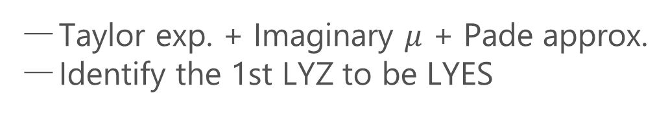
Recent Progress in LYZ/LYES and Lattice
Analytic Structure
Scaling functions, FRG, …
An, Mesterhazy, Stephanov (’16)
Johnson, Rennecke, Skokov (’23)
Karsch, Schmidt, Singh (‘23)
…
Locating QCD-CP at $μ≠0$ on the lattice?
Clarke+, arXiv:2405.10196
Alexander+ Lattice2024
Taylor exp. + Imaginary $μ$ + Pade approx.
Identify the 1st LYZ to be LYES

Slide 13

Purpose of This Study
$$h_{I}\sim t^{βδ}$$
On finite volume,
1st LYZ $≠$ LYES

Slide 14
Purpose of This Study
Understand finite-volume effects on LYZ
Exploit them for the CP searches

Slide 15


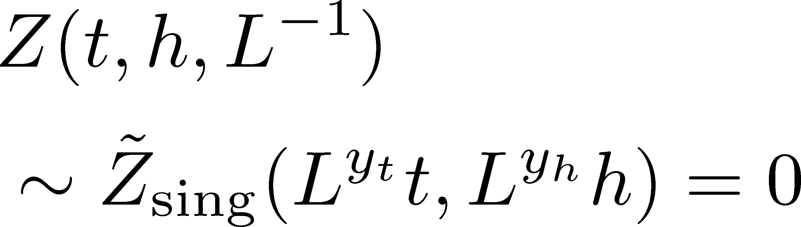
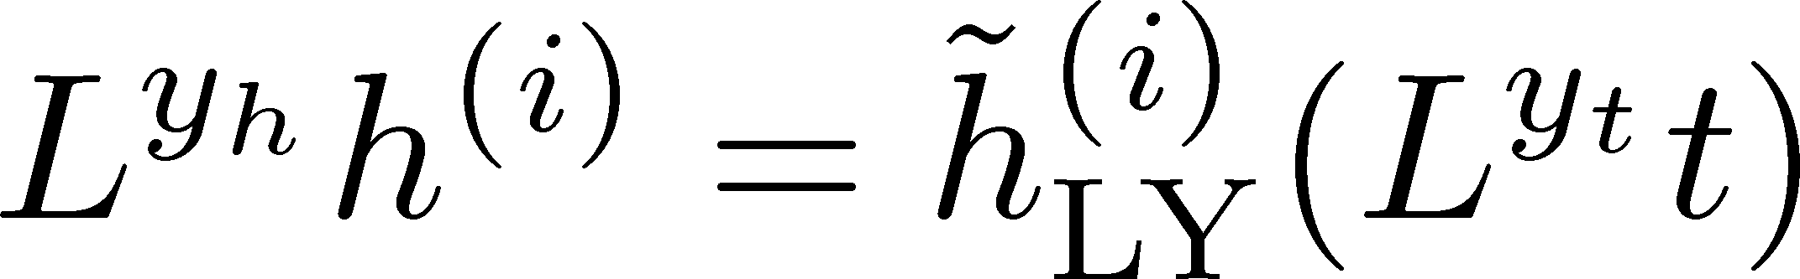
Finite-Size Scaling
Scaling Hypothesis
LYZ in the scaling region on finite volume

Slide 16
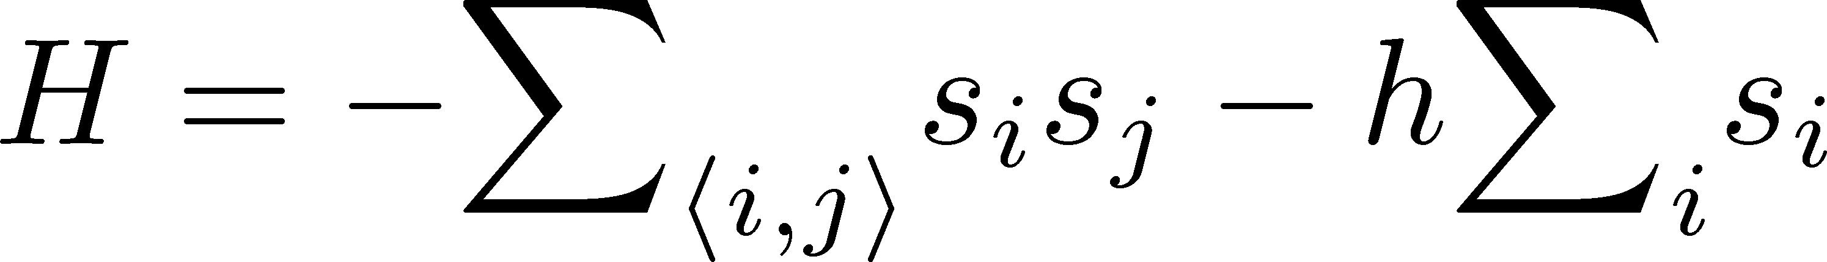
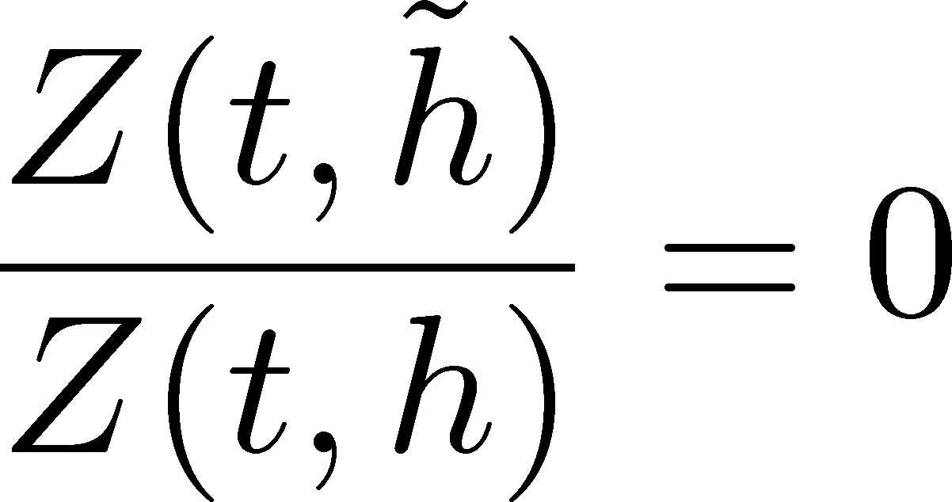
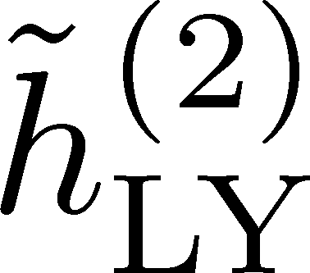

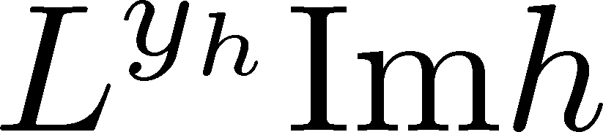
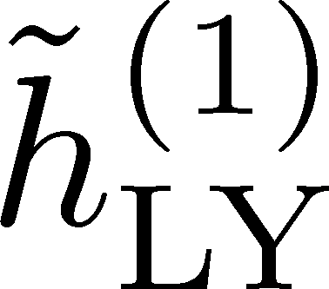
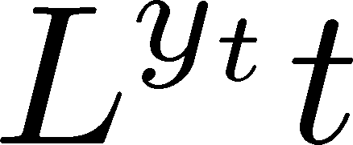

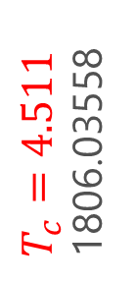
LYZ in 3d-Ising Model
LYZ
Monte-Carlo + reweighting
1st & 2nd LYZ
Rescaled
rescale
$T_{c}=4.511$
1806.03558
Preliminary
Preliminary
LYZ is away from the real axis at the CP on finite $L$.

Slide 17
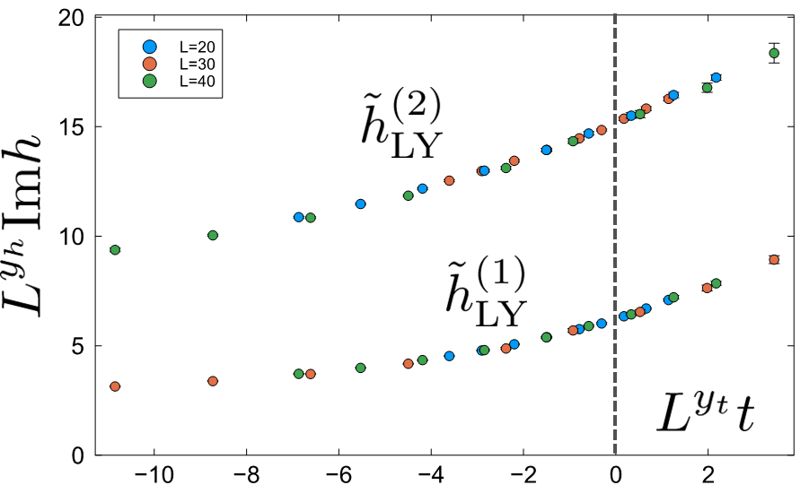

Where is QCD Critical Point?
Ising model
LYZ in QCD
Clarke+, arXiv:2405.10196
CP around here?

Slide 18
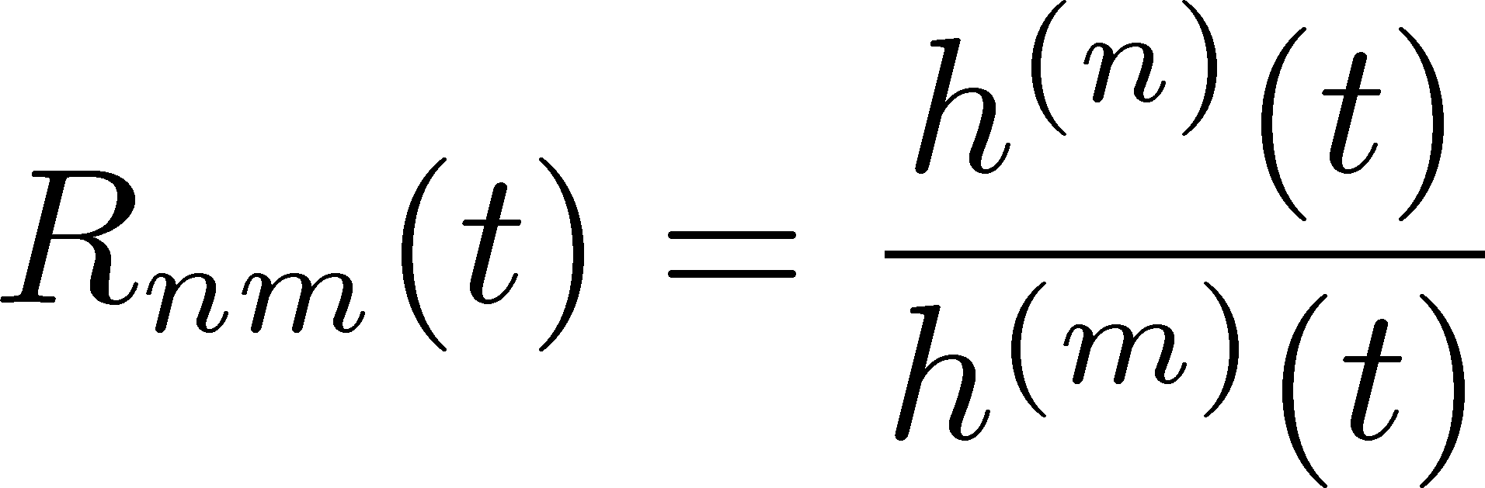
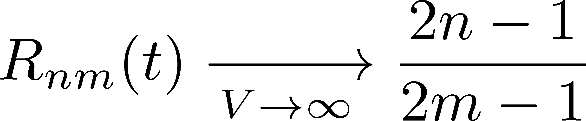
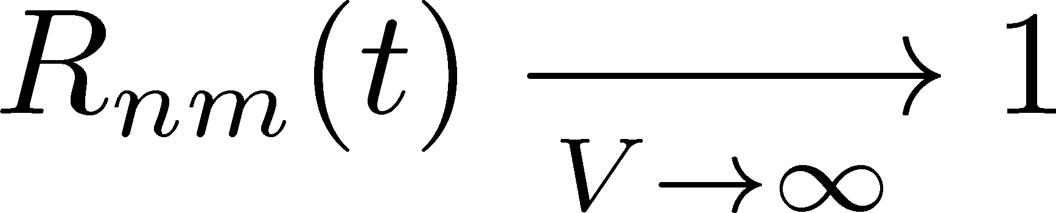
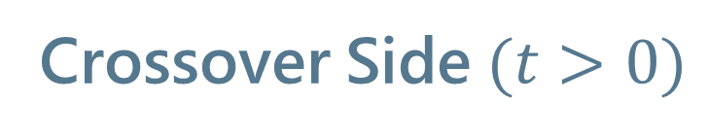
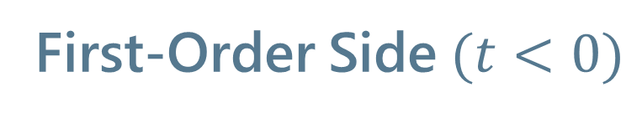
Lee-Yang Zero Ratios
First-Order Side$(t<0)$
Crossover Side$(t>0)$

Slide 19
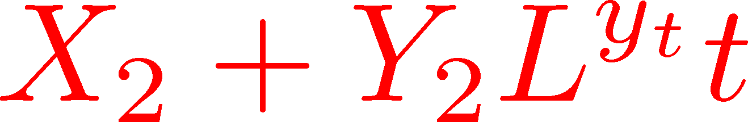
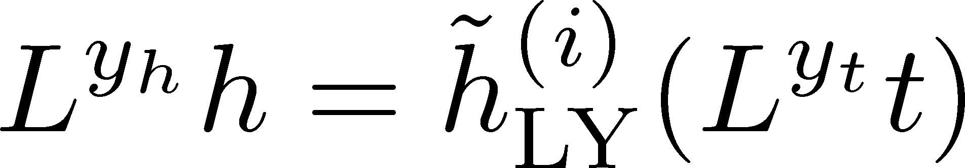
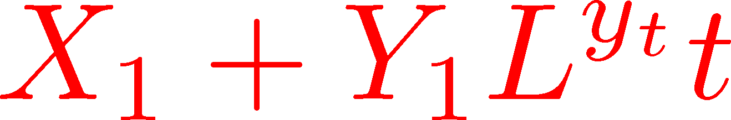
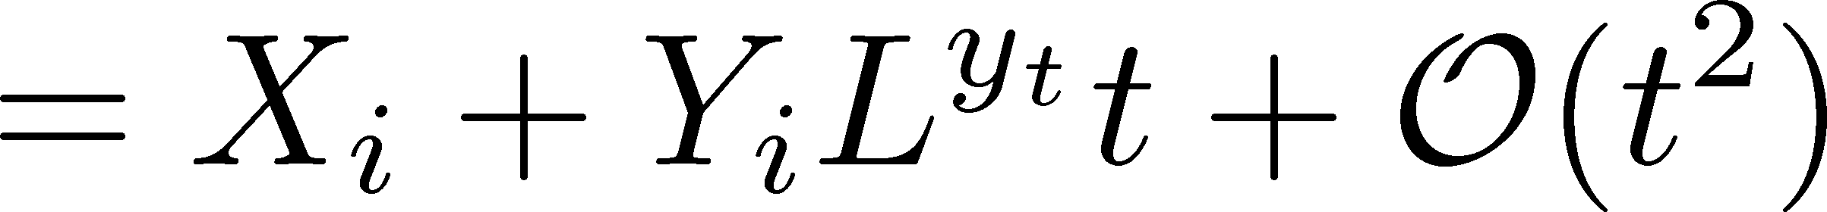
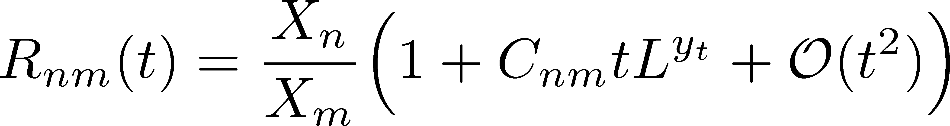
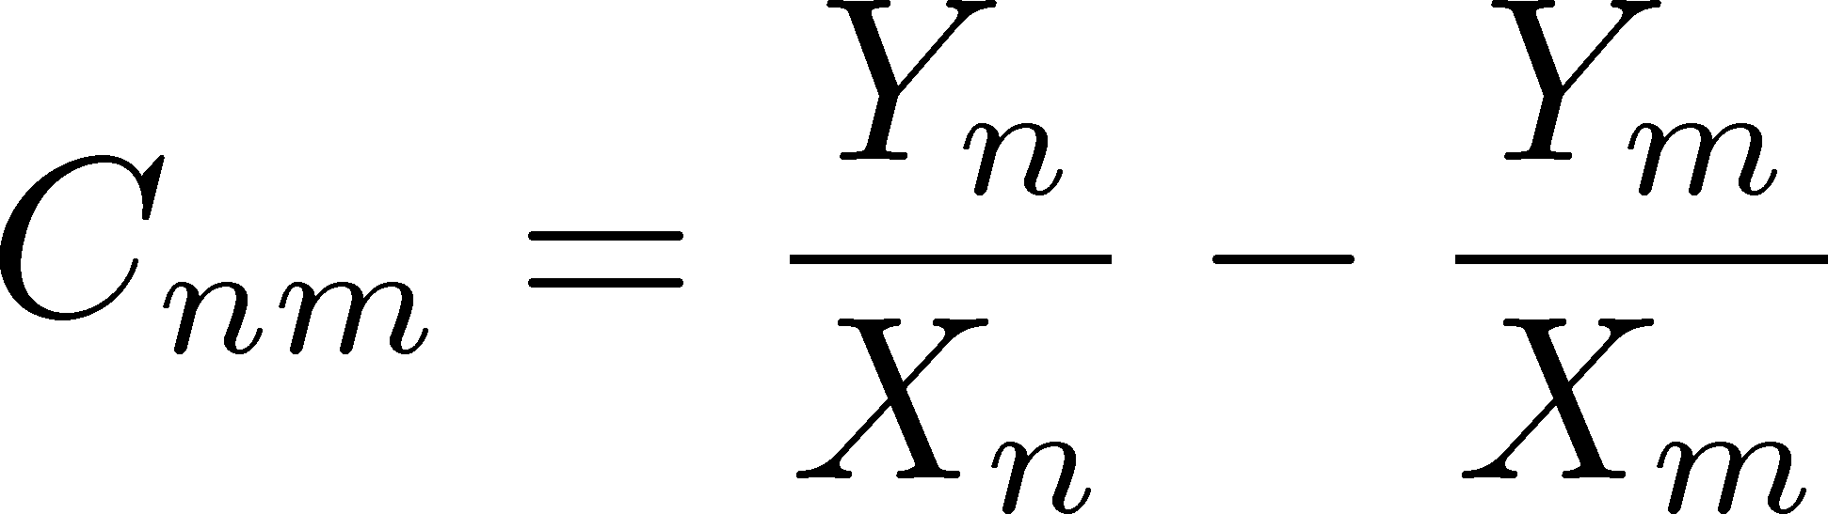

Lee-Yang Zero Ratios
Linear Approx. at $t=0$

Slide 20
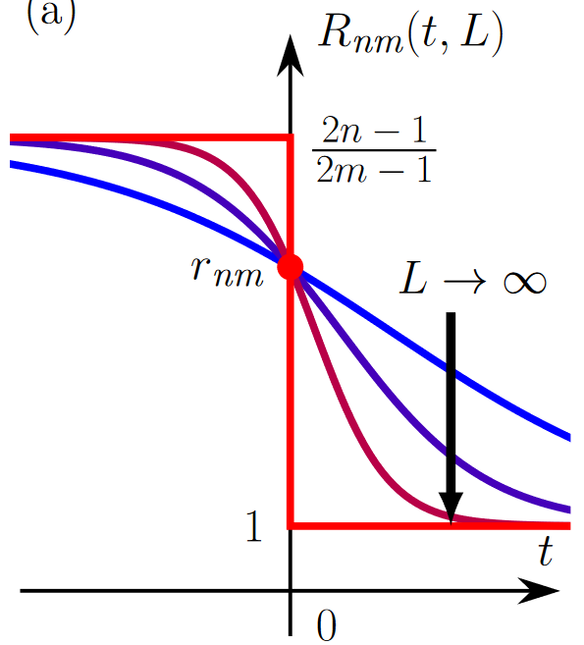
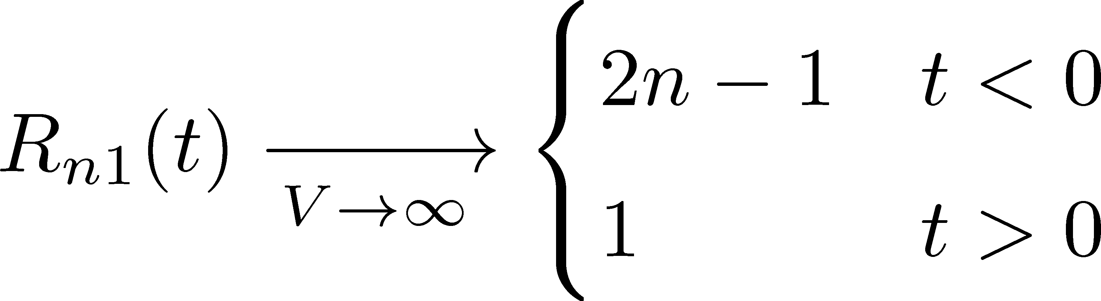
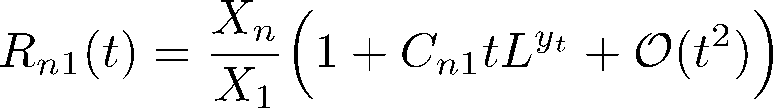
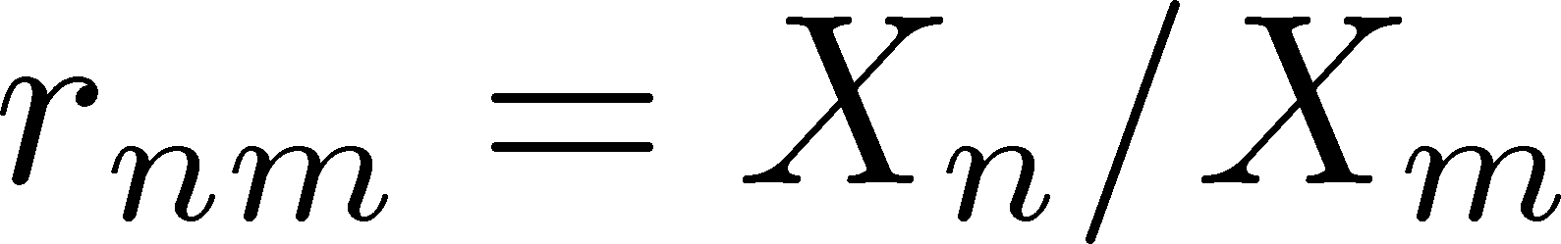
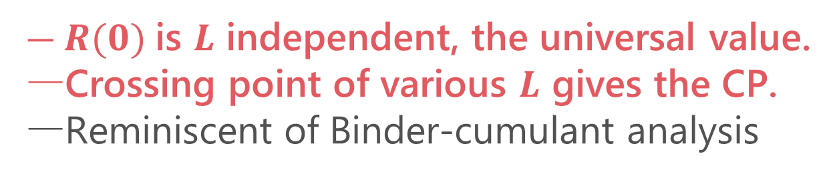
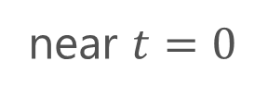
LYZ Ratios
Wada, MK, Kanaya, 2410.19345
(1st order)
(crossover)
crossing
near $t=0$
$R(0)$is $L$ independent, the universal value.
Crossing point of various $L$ gives the CP.
Reminiscent of Binder-cumulant analysis

Slide 21
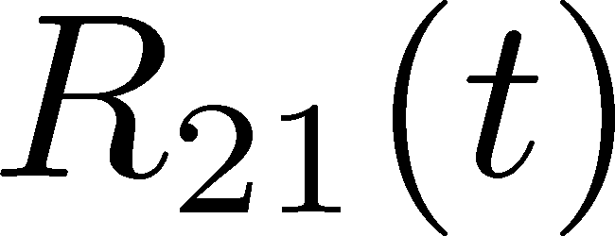
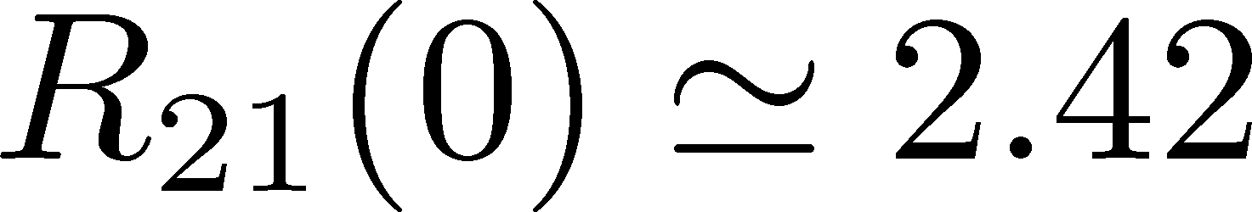
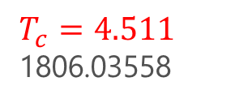
LYZ Ratios
Wada, MK, Kanaya, 2410.19345
Numerical Result in 3d-Ising
(1st order)
(crossover)
Preliminary
near $t=0$
$T_{c}=4.511$
1806.03558
$R(0)$is $L$ independent, the universal value.
Crossing point of various $L$ gives the CP.
Reminiscent of Binder-cumulant analysis

Slide 22


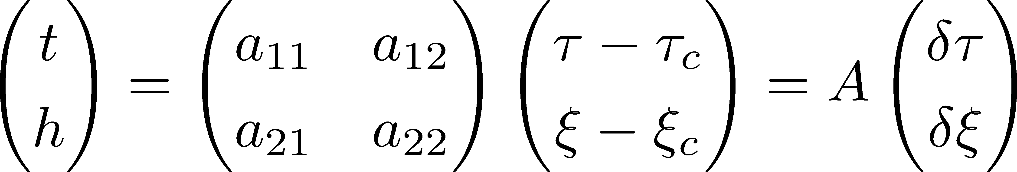

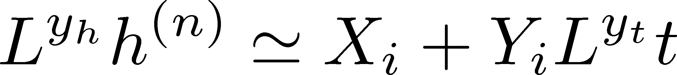


CP in a General System
CP on a $τ−ξ$ plane
LYZ on the complex $ξ$ plane

Slide 23
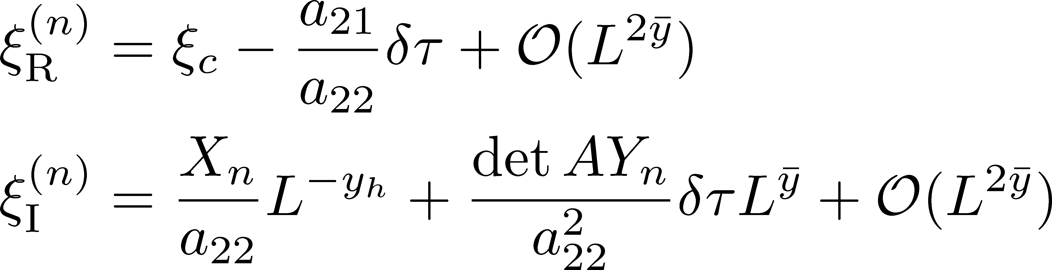
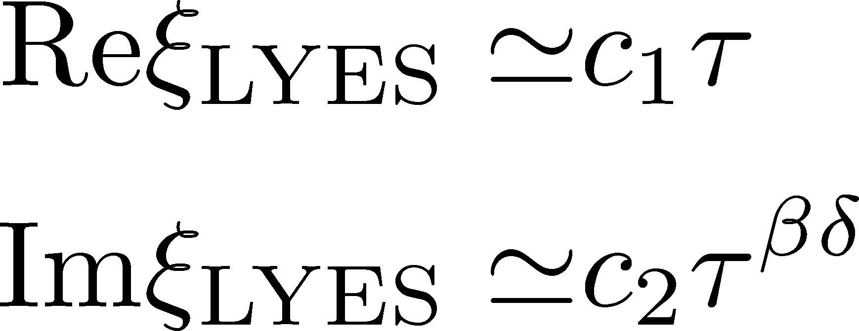

CP in a General System
CP on a $τ−ξ$ plane
LYZ on the complex $ξ$ plane
$$L→∞$$
LY Edge Singularity
generalization
Stephanov, 2006

Slide 24
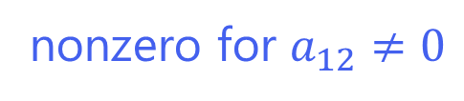
LYZ Ratios for General CP
LYZ Ratio
nonzero for $a_{12}≠0$

Slide 25
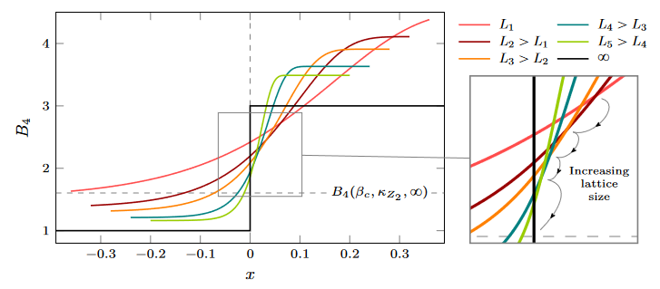

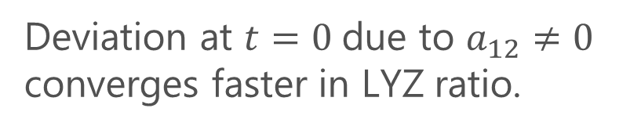
LYZ Ratios vs Binder Cumulant
LYZ Ratio
nonzero for $a_{12}≠0$
Binder cumulant
Jin+, PRD86, 2017
nonzero for $a_{12}≠0$
fig from
Cuteri+,
PRD (’21)
Deviation at $t=0$due to $a_{12}≠0$ converges faster in LYZ ratio.

Slide 26
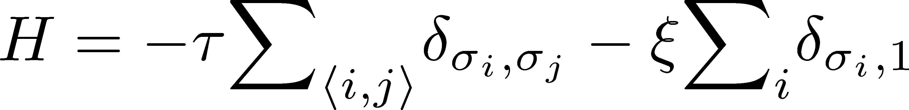
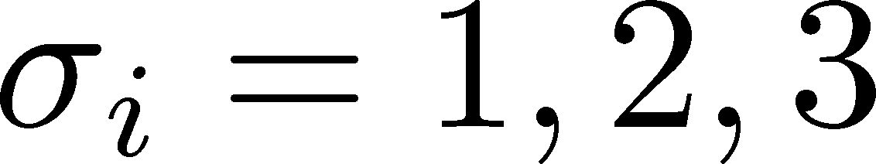




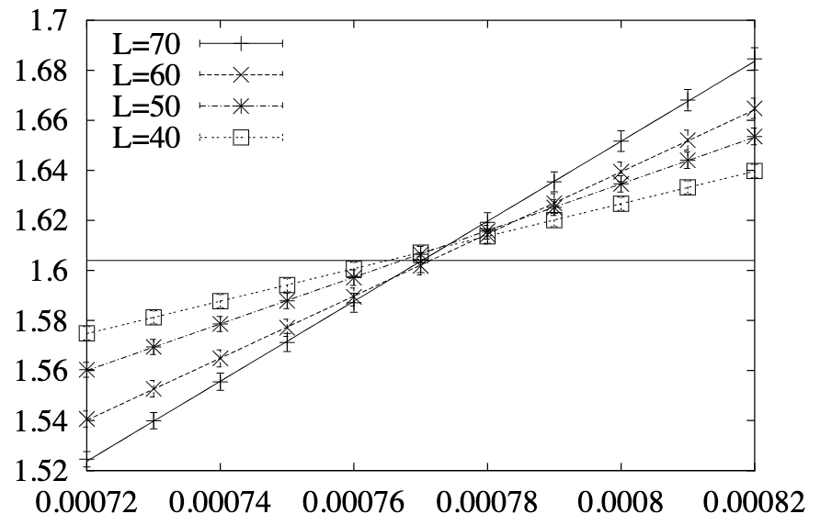
Numerical Analysis: 3d 3-State Potts Model
Monte-Carlo + reweighting
Phase Diagram
Binder-Cumulant Analysis
Z(2) CP
1st-order
Z(3)
Karsch, Stickan, 2000

Slide 27
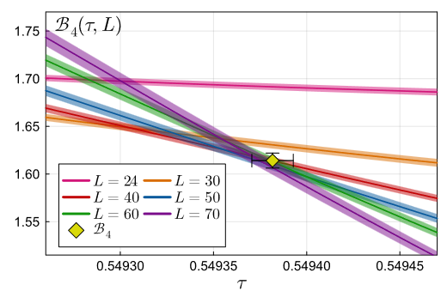
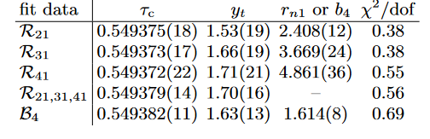

3d 3-State Potts Model: LYZ Ratio
LYZ Ratio (R₂₁)
Binder Cumulant
$R_{n1}$ and $B_{4}$ give the same value of $τ_{c}$ within statistics.

Slide 28



3d 3-State Potts Model: LYZ Ratio
LYZ Ratio (R₂₁)
Combined use of LYZ can improve statistics!

Slide 29


Summary
Lee-Yang-zero ratios
A new method to utilize the finite-size effects of Lee-Yang zeros for the CP searches.
Outlook
Determination of $r_{nm}$ in each universality class
More sophisticated utilization of $R_{nm}(t,L)$
Other quantities: $ξ_{c}$, mixing matrix $A$, etc.
Application to QCD-CP and other CPs
Question: Can lattice QCD find the 2nd LYZ??

Slide 30
Enjoy tomorrow’s banquet!!
Photo from: https://www.gankofood.co.jp/shop/detail/ya-nijyoen/

Slide 31
backup

Slide 32


QCD-CP Search with Lee-Yang Zeros
D. Clarke+
2405.10196 [hep-lat]
Imaginary chem. pot.
Lee-Yang zero
LYZ
See also, Alexander+ Lattice2024
analytic continuation via Pade approx.

Slide 33
QCD-CP and LYZ

