Slide 1
重イオン衝突実験を用いた
高密度核物質探索
2024年度第2回宇宙史研究センター構成員会議・成果報告会、2024/12/16、筑波大学
北沢正清
(京大基研)

Slide 2
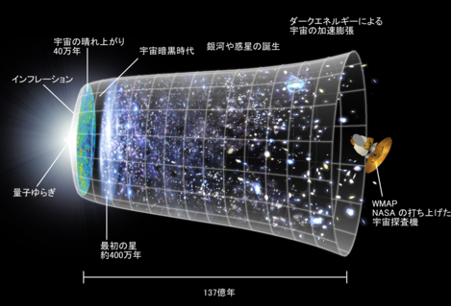

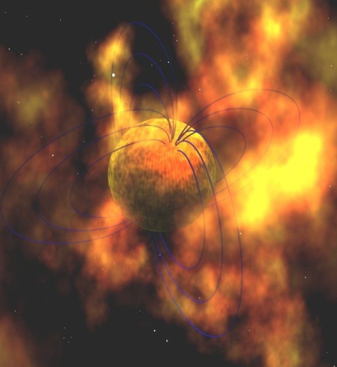
QCD Phase Diagram
Early Universe
T
Crossover at zero density
Possible first-order transition and QCD critical point in dense region
Multiple QCD-CP? MK+ (‘02)
Color superconducting phases in dense and cold quark matter
Quark-Gluon Plasma
150MeV
ＱＣＤ Critical Point
Hadron Phase
(confined)
Color SC
Compact
Stars
~10¹⁵g/cm³
μ

Slide 3
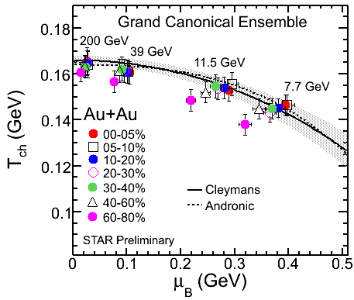
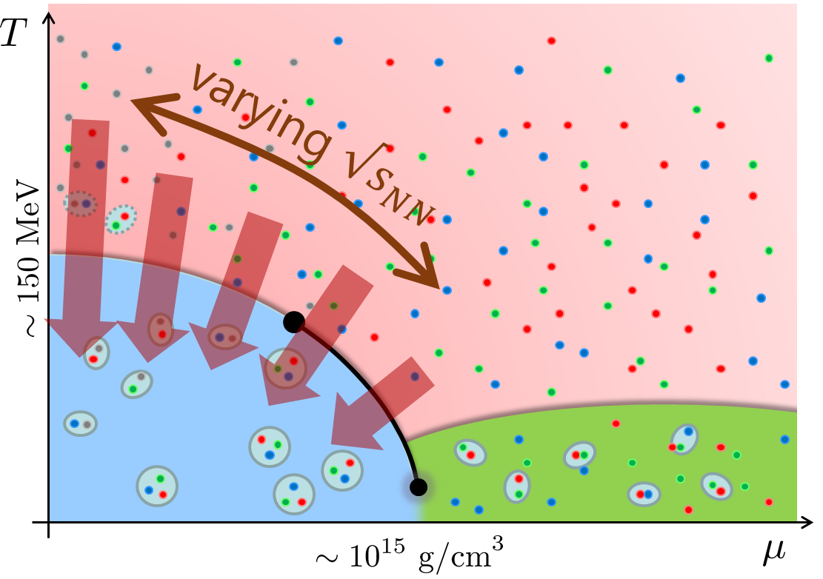
Beam-Energy Scan in HIC
STAR, 2012
High E
Low E
Baryon stopping

Slide 4





History / Current Status of HIC
LHC
2010~
RHIC
2000~
SPS
Increasing Collision Energy
NA61/SHINE
~2000
RHIC-BES
AGS
FAIR-CBM
~1996
HADES

Slide 5
History / Current Status of HIC
LHC
J-PARC-HI
2010~
FAIR-CBM
github.com/tgalatyuk/interaction_rate_facilities
RHIC
NICA
2000~
HADES
NA61/SHINE
Beam-Energy
Scan
RHIC-BES-FXT
SPS
RHIC-BES
Increasing Collision Energy
NA61/SHINE
~2000
RHIC-BES
AGS
FAIR-CBM
~1996
HADES
2010~

Slide 6
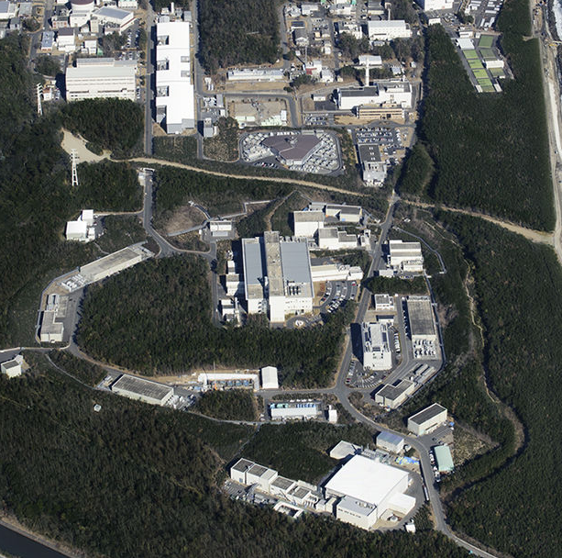



J-PARC-HI = J-PARC Heavy-Ion Project
LINAC
$E_{lab}=400MeV$
New HI injector + existing accelerators (RCS, MR)
Heavy-ion beams with world highest luminosity
Realize various new experiments at J-PARC
RCS
$E_{lab}=3GeV$
Main Ring
$E_{lab}=30GeV$
Hadron hall

Slide 7
J-PARC-HI = J-PARC Heavy-Ion Project
LINAC
$E_{lab}=400MeV$
New HI injector + existing accelerators (RCS, MR)
Heavy-ion beams with world highest luminosity
Realize various new experiments at J-PARC
HI
injector
RCS
$E_{lab}=3GeV$
Main Ring
$E_{lab}=30GeV$
Hadron hall

Slide 8
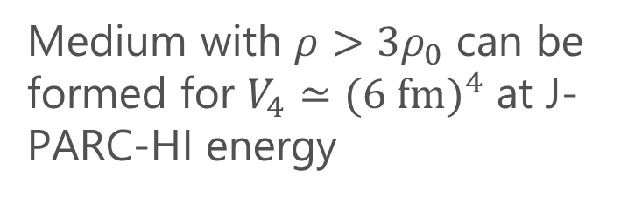
How High Density? Where is optimal $\sqrt{s_{NN}}$?
Four-volume of high-density region
Taya, Jinno, MK, Nara, 2409.07685
Medium with $ρ>3ρ_{0}$ can be formed for $V_{4}≃(6 f{m)}^{4}$ at J-PARC-HI energy
J-PARC-HI
(proton 30GeV)
(proton 50GeV)
The density is comparable with the cores of neutron stars
J-PARC-HI = experiments to create the highest baryon-density matter in the Universe
Collision energy

Slide 9
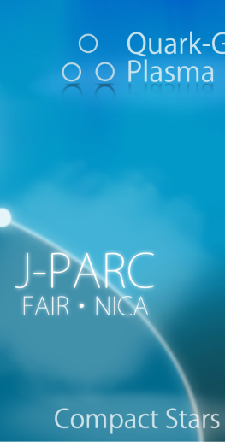
Exploring Dense Medium
Neutron stars
Equation of state
QCD critical point /
1st order transition /
Color superconductivity
Dilepton production rate
Event selection /
Higher correlations

Slide 10
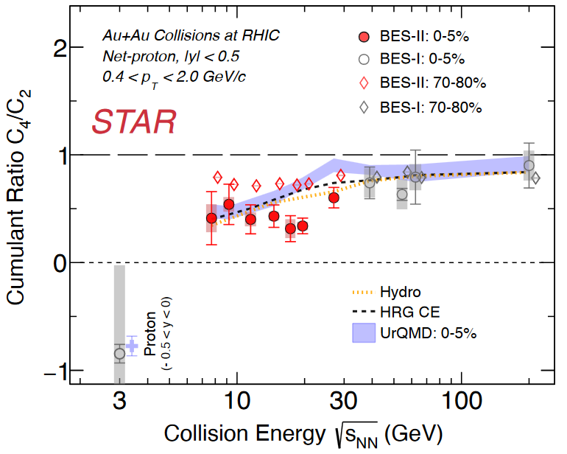
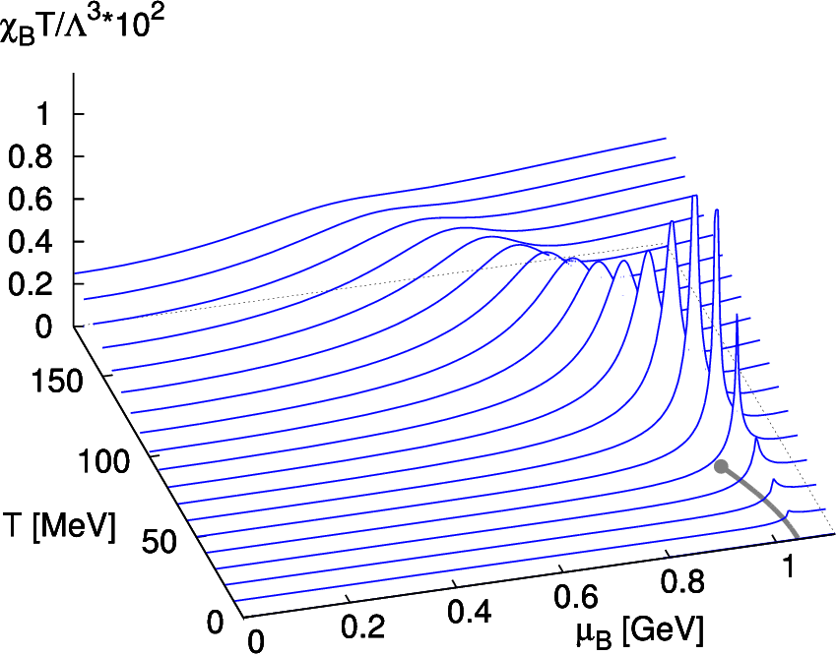
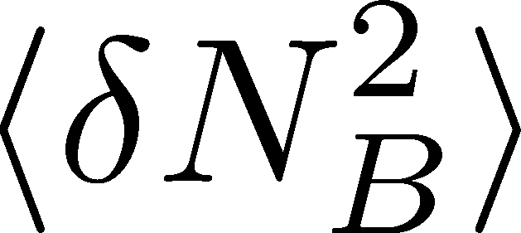
Event-by-event Fluctuations
Theoretical Predictions
on conserved charge fluctuations
Experimental Result
STAR (2024)
Higher-order cumulants
Signal of QCD CP
data
missing
Asakawa, Ejiri, MK (2009)
Stephanov (2011)

Slide 11

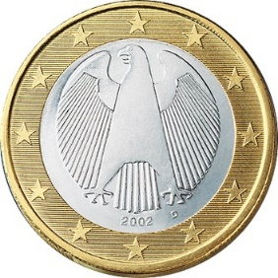
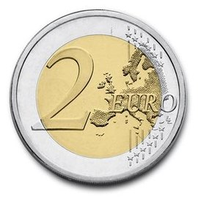

A Coin Game
Bet 25 Euro
You get head coins of
A. 50 x 1 Euro
B. 25 x 2 Euro
Same expectation value.

Slide 12
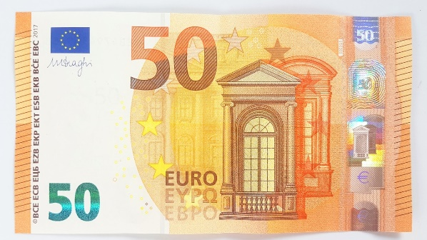
A Coin Game
Bet 25 Euro
You get head coins of
A. 50 x 1 Euro
B. 25 x 2 Euro
C. 1 x 50 Euro
Same expectation value.

Slide 13
Lattice & Exp. Cooperate
Lattice Data
Experimental Result
STAR (2024)
HOT-QCD 2017
Lattice-QCD Numerical Simulations:
equations of state, fluctuation, viscosity, …

Slide 14
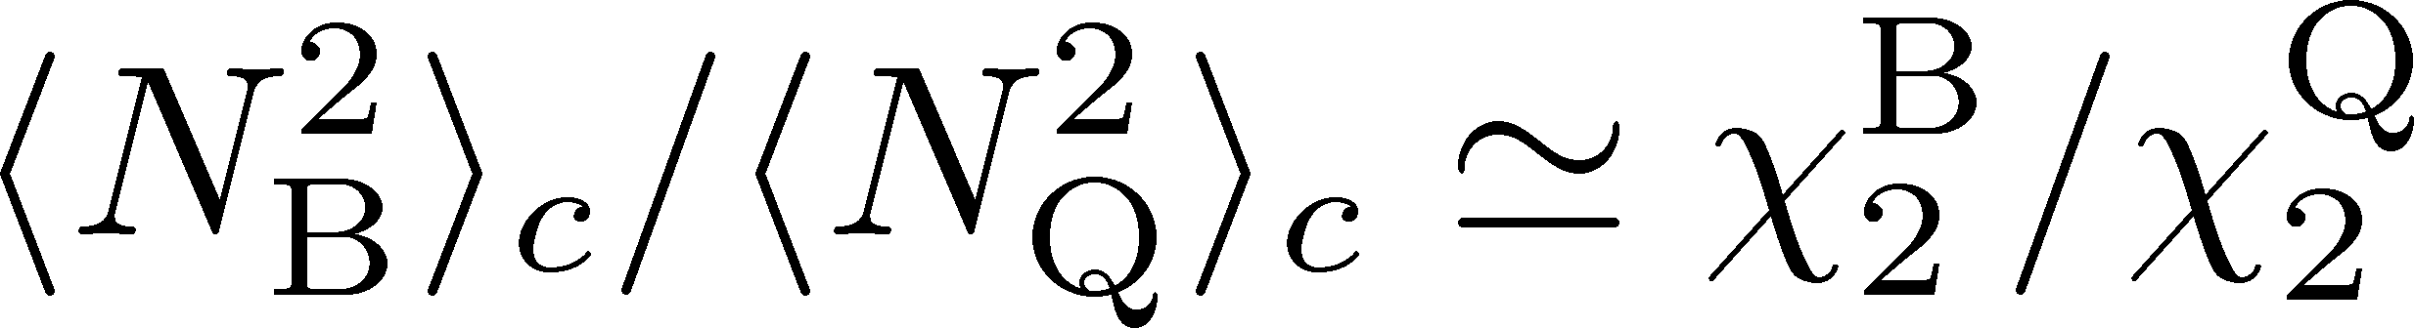
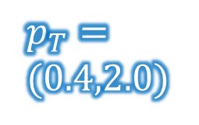





Baryon/Charge Cumulant Ratio
MK, Esumi, Nonaka, Nucl. Phys. A, 2023
STAR, $200$GeV
Lattice QCD＋HRG
$p_{T}$-acceptance correction
Yield
$p_{T}$ uncorrected
$p_{T}=$
$(0.4,2.0)$
$p_{T}$ corrected
$$p_{T}$$
Electric charge: 49%
Protons: 82%
Finite acceptance modifies the ratio strongly.
Wider acceptance/efficiency is desirable.

Slide 15
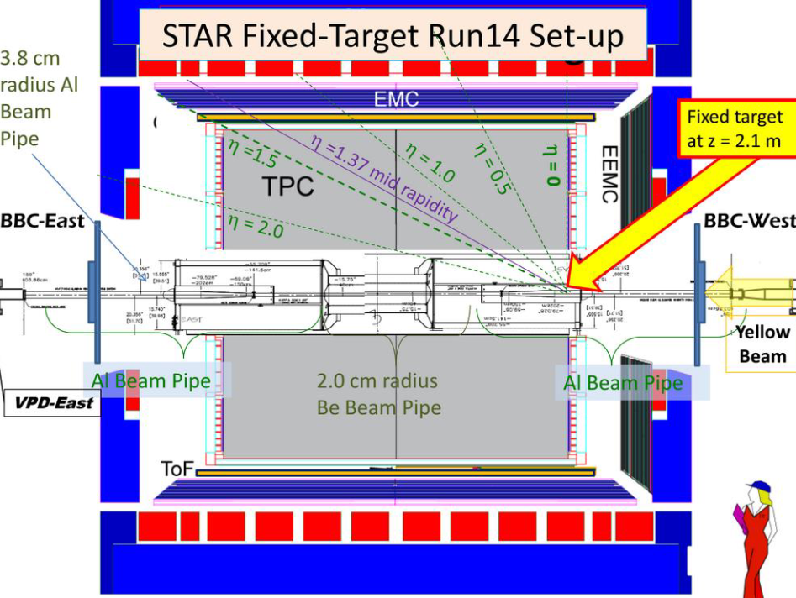


Acceptance of Detectors
STAR Fixed Target
FAIR (GSI)
$$3<\sqrt{s_{NN}}<7.7 GeV$$
$$2<\sqrt{s_{NN}}<5 GeV$$
target
from slide of D. Sebra
Each detector has individual acceptance and efficiency.
Checking detector-response correction is important.

Slide 16
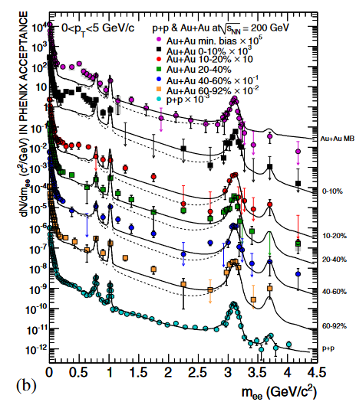
Dilepton Production Rate
Generated by the decay of virtual photons
Carry information of primordial medium
γ
e⁺
e⁻
Physics accessible with DPR
Medium temperature
Dispersion relations
Chiral mixing by chiral restoration
Signal of phase transitions
PHENIX, ‘10
Kim, Gubler, 2020
Sakai+, 2024

Slide 17
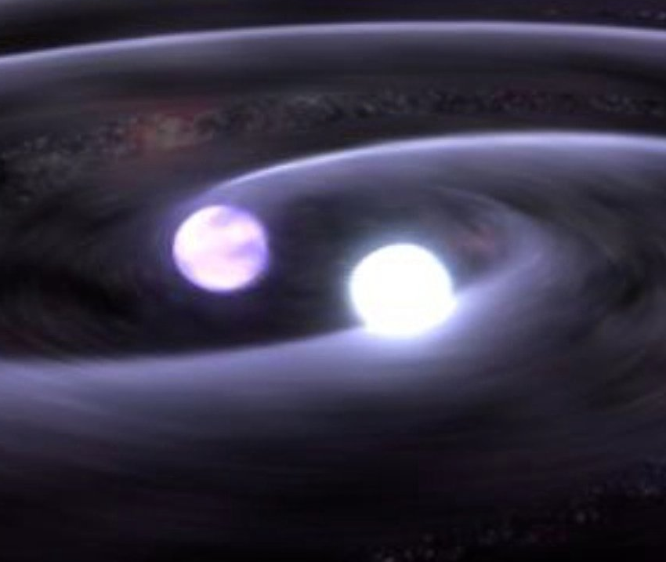
“Multi-Messenger” Observation
NS-NS merger
gravitational waves
electromagnetic waves
time scale：10⁻¹s
Relativistic HIC
leptons,
photons
hadronic observables
time scale：10⁻²²s

Slide 18
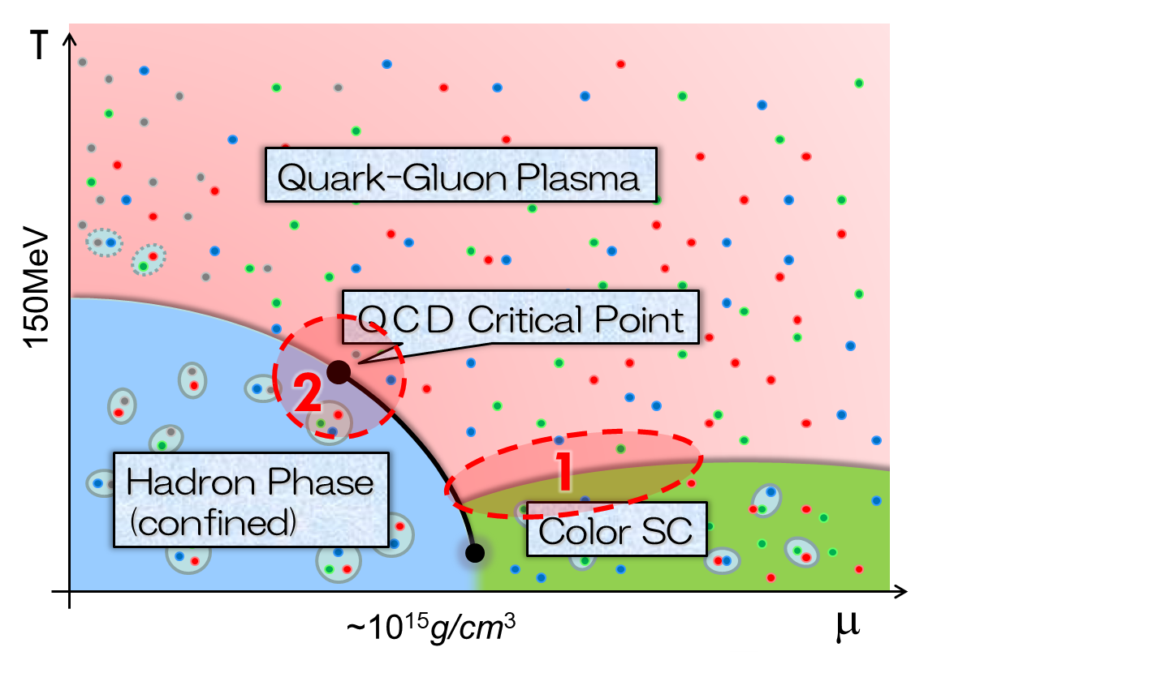


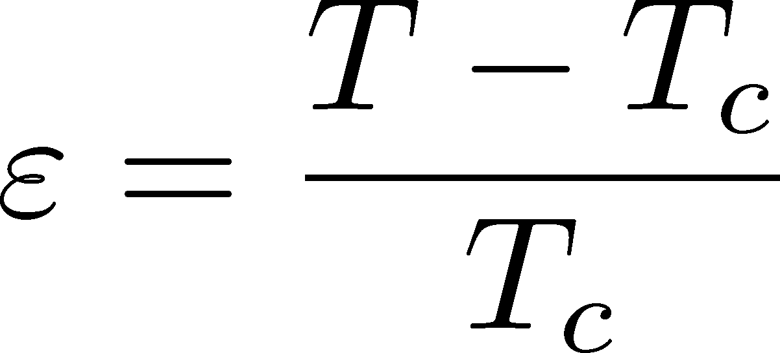
Dileptons and Phase Transitions
2nd-order phase transition
Formation of the soft modes
T>Tc
T<Tc
Anomalous phenomena
Electric
conductivity
Skopal, Tinkham(‘75)

Slide 19
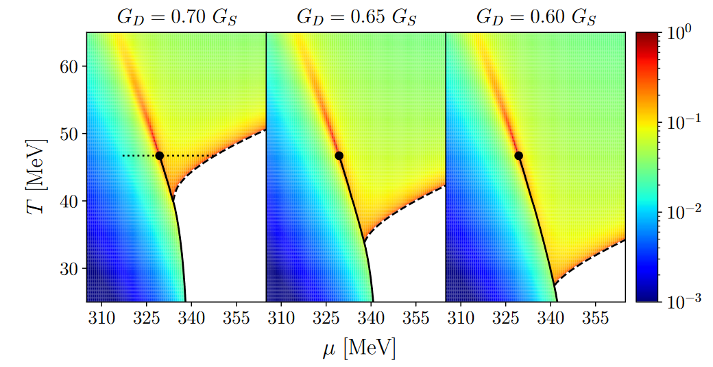
Dilepton at Ultra-Low-Mass Region
Signal for QCD-CP & Color SC
Nishimura, MK, Kunihiro, ‘22; ‘23; ‘24
Anomalous dilepton production due to soft modes at phase transitions
production
process:
Two “hot spots” on the 𝑇-𝜇 plane?

Slide 20

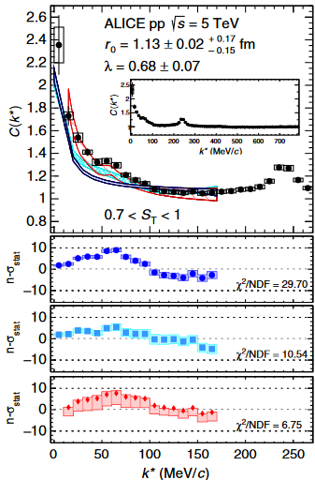
Hadron/Hypernuclear Physics
Hypernuclei
Correlation functions
→hadron interaction
ALICE,2020
¹²C+¹²C at 15AGeV
(5T / 2.4m magnet)

Slide 21
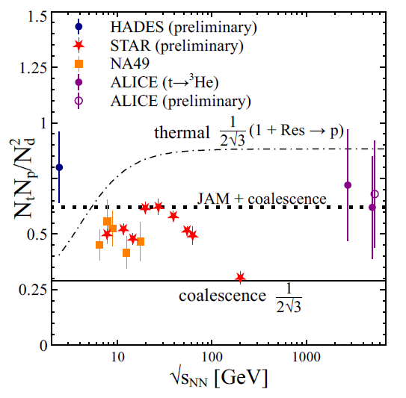
Light-/hyper-Nuclear Production
Measurement of light/hyper-nuclei
Light-nuclei production
as a signal of QCD critical point
from QM2023
Oliinychenko (’20)
baryon fluctuations
→ enhancement of light nuclei?
Precise data will lead us to a better understanding of production mechanism
Sun+ (’18)

Slide 22

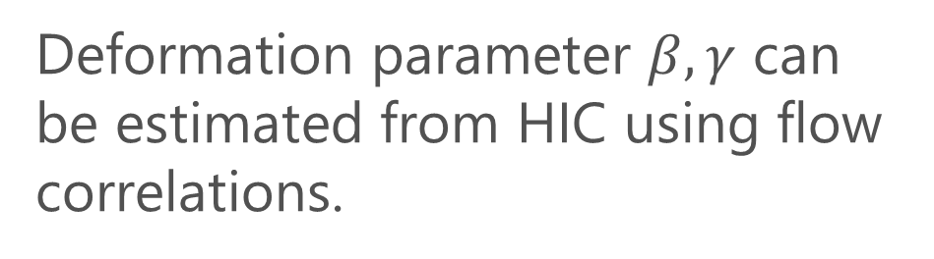
Shape of Nuclei
Deformation parameter $β, γ$ can be estimated from HIC using flow correlations.
$$γ$$
Beam
axis
ATLAS, PRC107 (’23)

Slide 23
J-PARC-HI
Future Plan

Slide 24
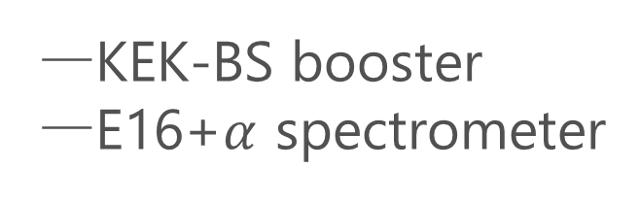
J-PARC-HI Staging Plan
Phase-II
Phase-I
KEK-BS booster
E16+$α$ spectrometer
Phase-I
Phase-II
NEW HI booster
NEW spectrometer

Slide 25
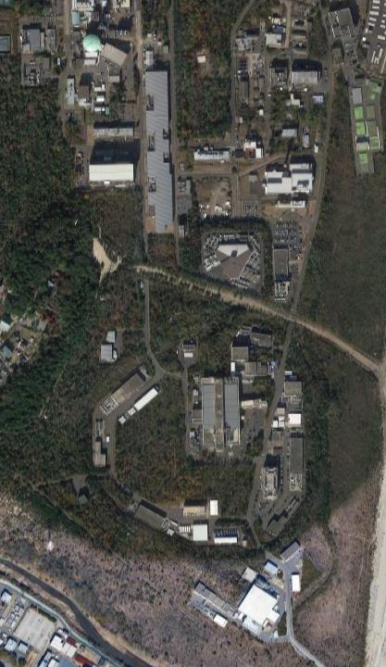
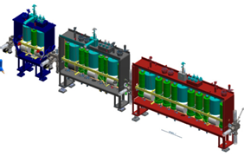
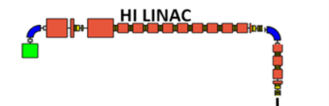
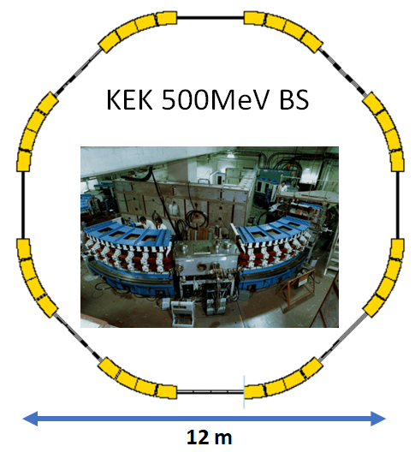
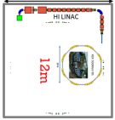


Staging of HI Booster
HI LINAC
Phase-I
LINAC
New
Building
RCS
60m
KEK 500MeV BS
REUSE
kept in working
condition
Main Ring

Slide 26
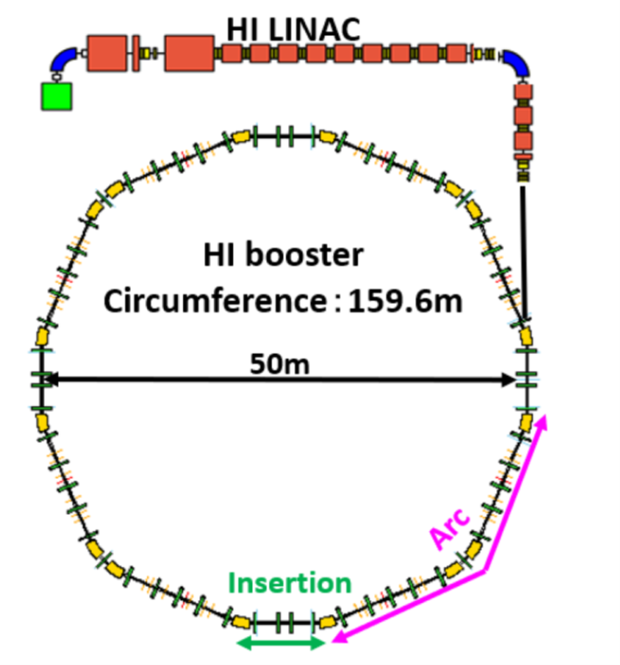

Staging of HI Booster
Phase-I
Phase-II
LINAC
New
Building
RCS
Completely NEW
HI booster
World highest intensity
60m
Main Ring
Interaction rate

Slide 27
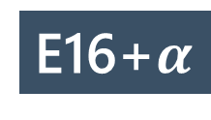
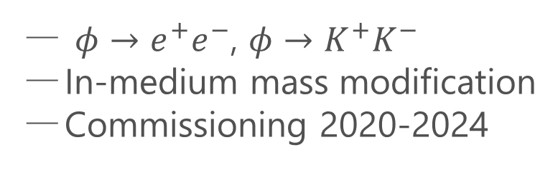
Detector
Phase-I
E16 Spectrometer
$φ→e^{+}e^{−}$, $φ→K^{+}K^{−}$
In-medium mass modification
Commissioning 2020-2024
UPGRADE
E16+$α$
Upgrade forward region for high-multiplicity counting
Hadron/lepton measurement
at wide acceptance

Slide 28
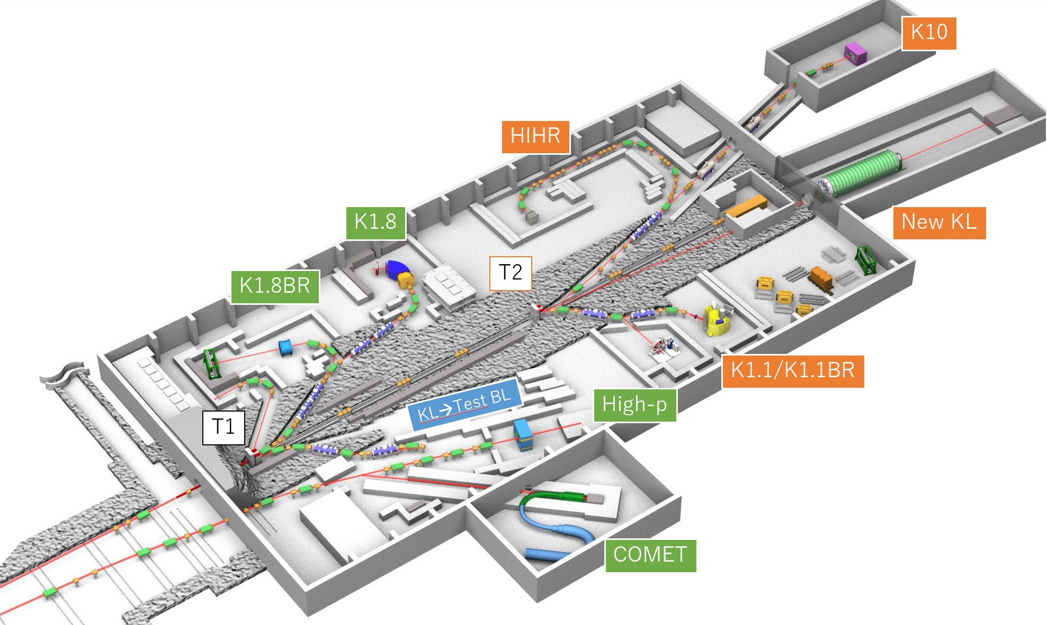
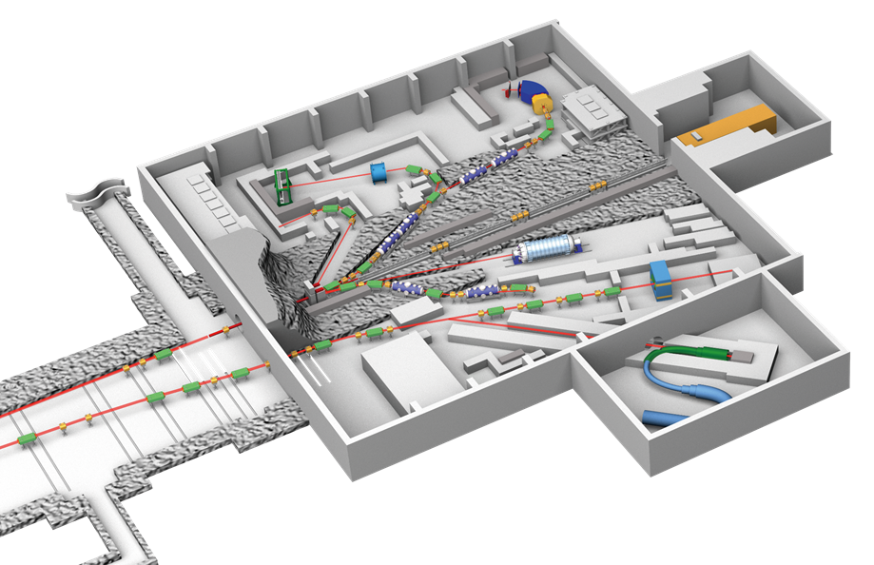
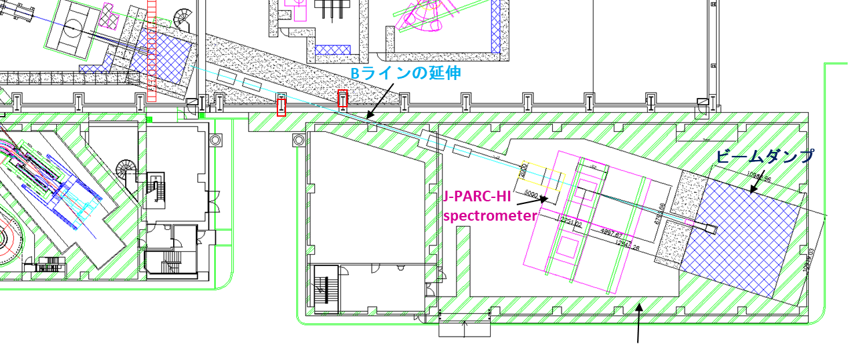
Detectors for Phase II
Present
Extended
E16
J-PARC-HI
Spectrometer
J-PARC-HI spectrometer will be installed in an annex
E16 will also be replaced
E16

Slide 29
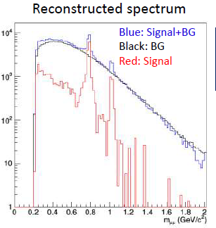
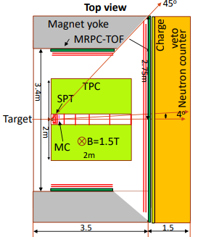
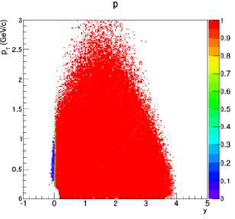
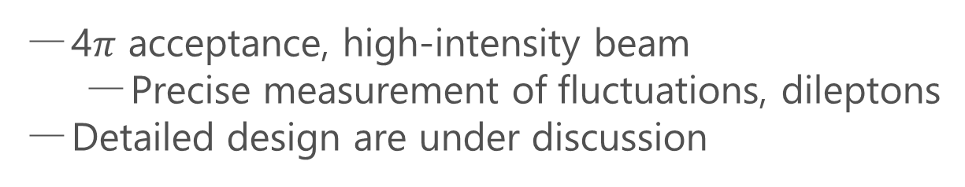
Hadron Spectrometer
Phase-II
Dimuon Setup
4$π$ acceptance, high-intensity beam
  Precise measurement of fluctuations, dileptons
Detailed design are under discussion
Hadron calorimeter
acceptance
ALICE3-like dipole

Slide 30
Summary
Relativistic HIC can investigate extremely hot/dense medium.
Density/temperature dependence of the produced medium can be studied by the beam-energy scan.
  Investigation of QCD phase diagram: QCD-CP, color-SC, etc.
Various observables
  fluctuations, dilepton production rate, light/hyper-nuclear production, …
Other applications: hadron interaction, nuclear shape, …
J-PARC-HI will pursue this realm further.
  world’s highest interaction rate
  best collision energy to study

Slide 31
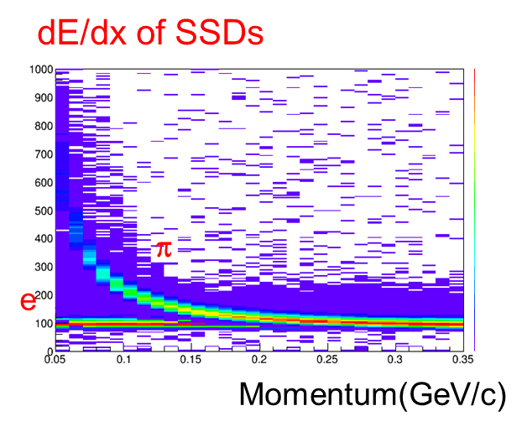
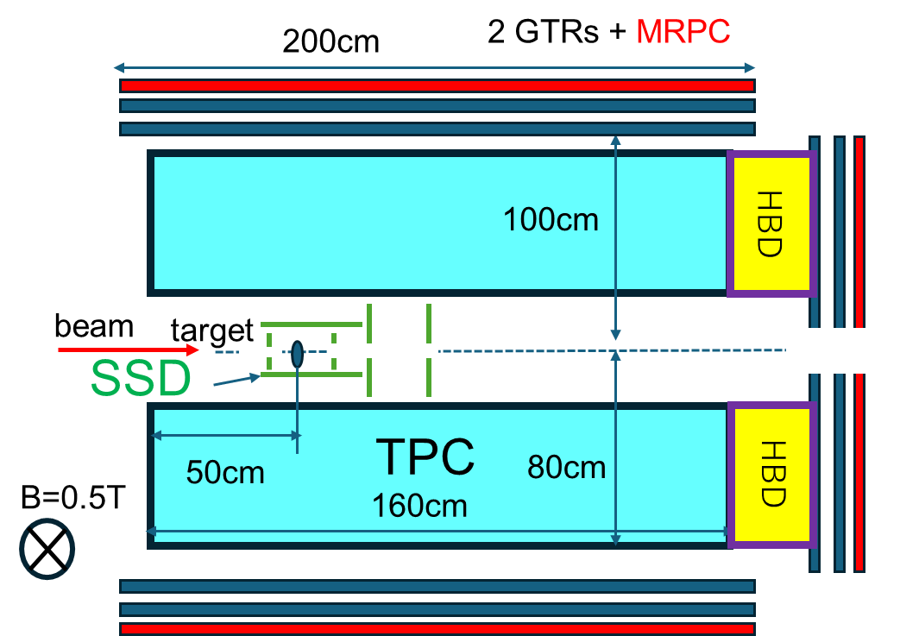
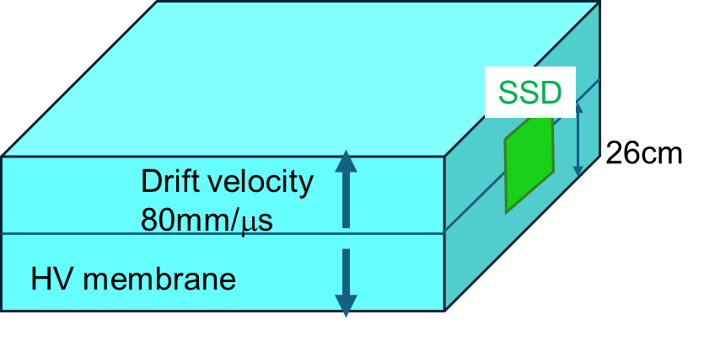
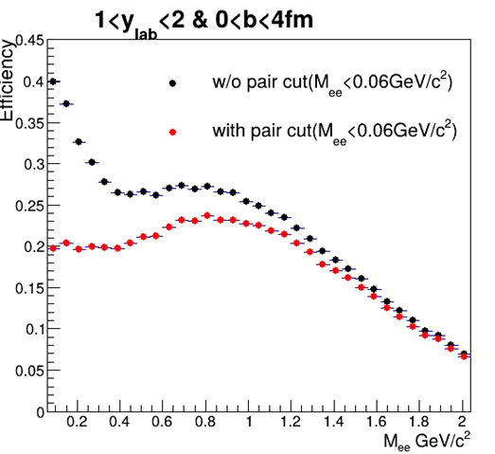
Dilelectron Measurements
Phase-II
Large acceptance measurement of dielectrons and hadrons
Efficiency
Precise measurement of low-mass dielectrons
search for QCD-CP & CSC phase transition

Slide 32
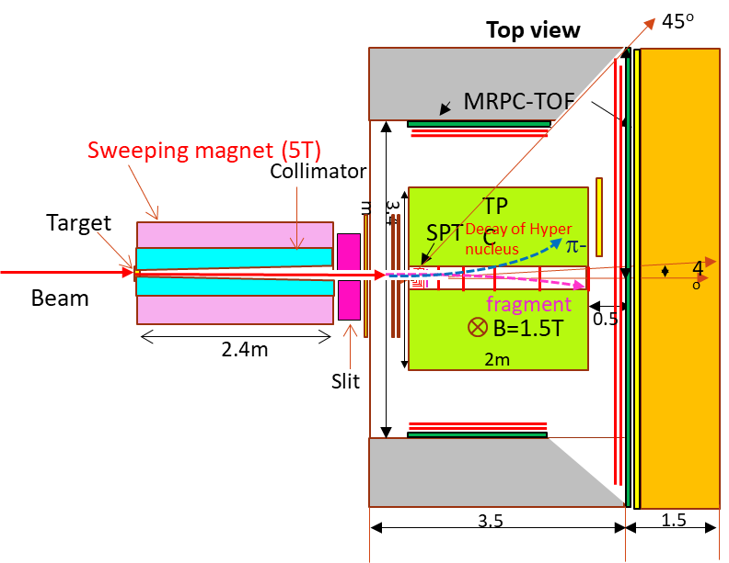
Hypernuclear Spectrometer
Phase-II
Closed geometry : Sweeping magnet and Collimator
Interaction Rate : ~100 MHz
Lifetime and Magnetic moment Search for new hypernuclei and strangelet

